Slide 1
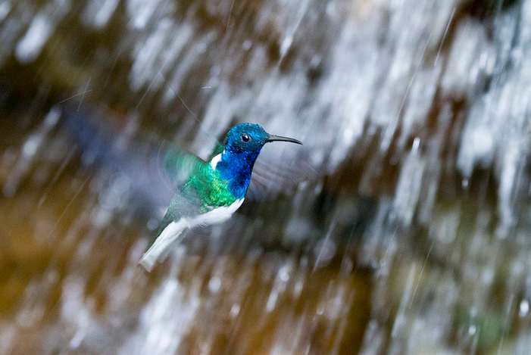

From Individual to Community:
The Learning Is in the Doing
Stephen Downes
March 19, 2016

Slide 2
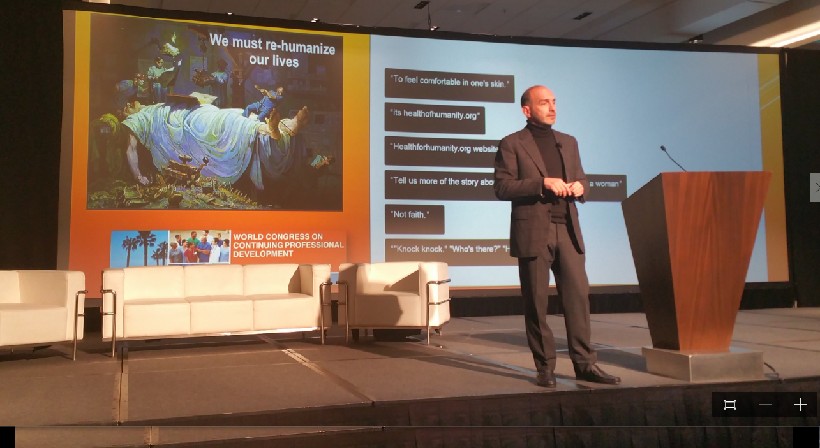
1. Learning is Personal
Alejandro Jadad, yesterday

Slide 3
Knowledge Translation
CIHR – “CIHR, knowledge translation (KT) is defined as a dynamic and iterative process that includes synthesis, dissemination, exchange and ethically-sound application of knowledge to improve the health of Canadians.”
CIHR, http://www.cihr-irsc.gc.ca/e/39033.html
Campbell Collaboration - knowledge base for decisions
http://www.campbellcollaboration.org

Slide 4
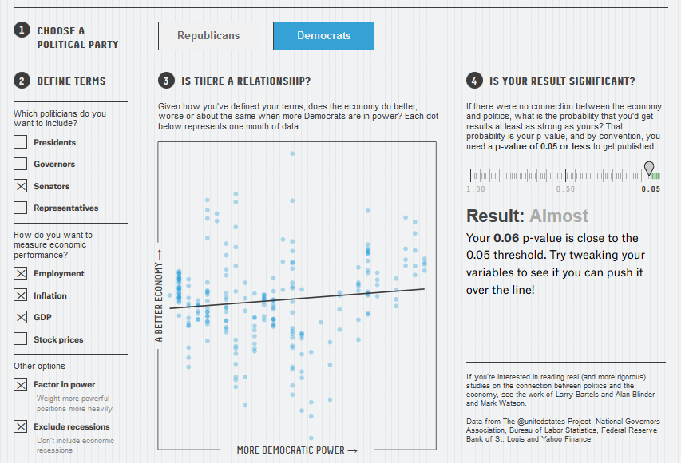
Reasonable Doubts
The crisis can't be wished away, nor can the basic lack of reproducibility be whitewashed.
http://www.downes.ca/post/65131
http://fivethirtyeight.com/features/science-isnt-broken/#part2

Slide 5
Criticisms…
“research should move beyond a narrow focus on the ‘know–do gap’ to cover a richer agenda…”
  situation-specific practical wisdom (phronesis)
  tacit knowledge shared among practitioners (‘mindlines’)
  complex links between power and knowledge; and
  macro-level knowledge partnerships
Greenhalgh and Weiringa, http://jrs.sagepub.com/content/104/12/501.full

Slide 6
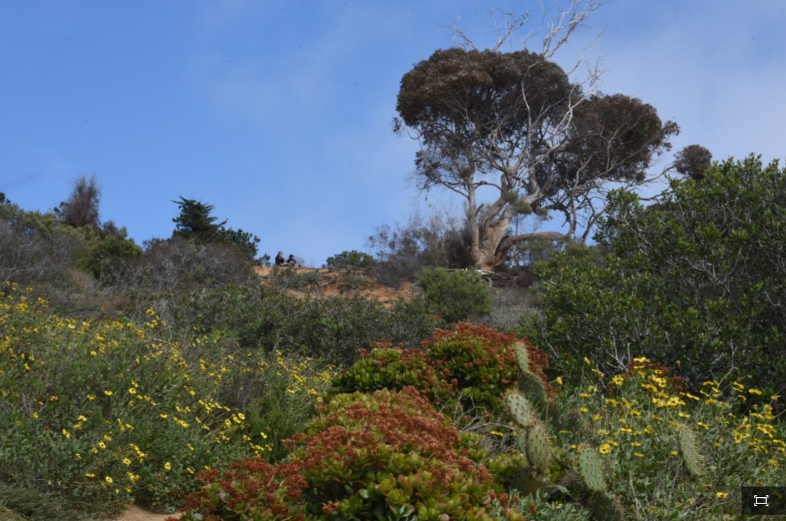
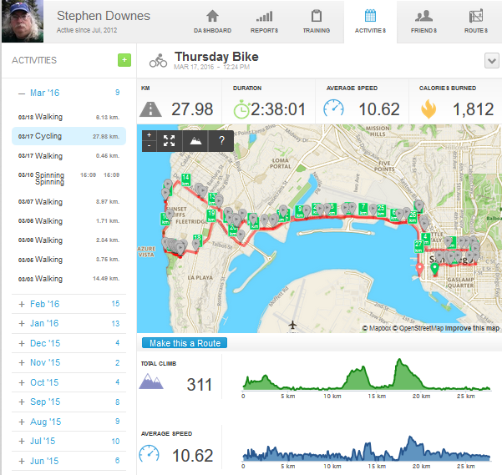
Exploring, not Following

Slide 7
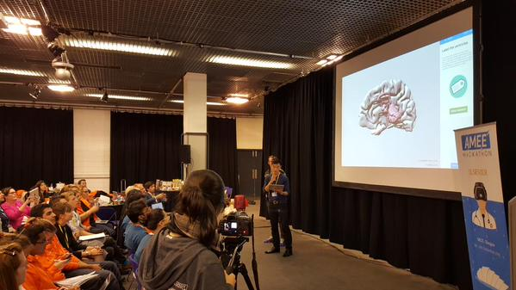
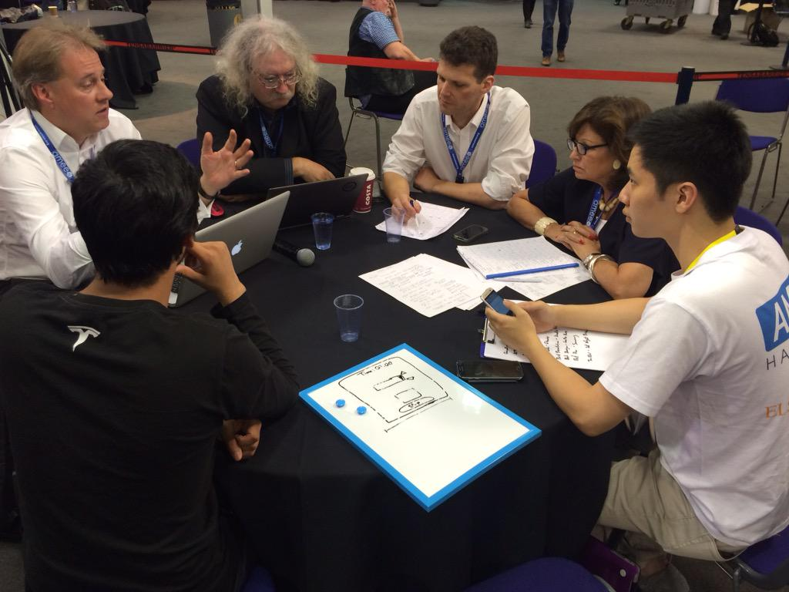
The Hackathon…
http://www.hackathon.io/events

Slide 8
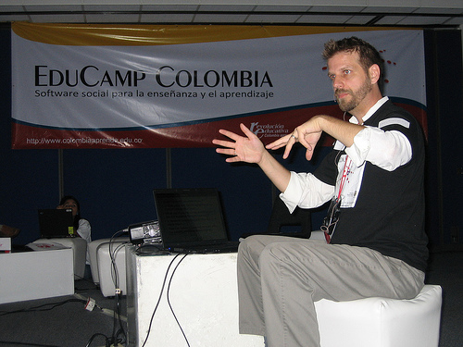
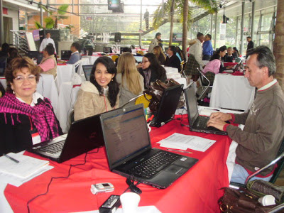
The EduCamp
http://www.flickriver.com/photos/qadmon/3106848811/
http://www.irrodl.org/index.php/irrodl/article/view/884/1677
http://pertinenciaeducativa09.blogspot.ca/2009/10/educamp-colombia-aprendizaje-en-un.html

Slide 9
2. Two Approaches…
Content
Practice
Practice
Content

Slide 10
Two Approaches…
Defines an ideal state
Defines a desired state
Content
Practice
Practice
Content
TEST
TRY
Person tests you
Person helps you

Slide 11
Two Approaches…
Defines an ideal state
Defines a desired state
Content
Practice
Correction
Iteration
GAP
Practice
Content
Opport-unity
TEST
TRY
Person tests you
Person helps you

Slide 12
Library Environment
Defines an ideal state
Defines a desired state
Content
Practice
Affordances
Correction
Requirements
Iteration
GAP
Practice
Content
Opport-unity
TEST
TRY
Person tests you
Person helps you

Slide 13
Personalized Personal
We do for you You do for yourself
Defines an ideal state
Defines a desired state
Content
Practice
Affordances
Correction
Requirements
Iteration
GAP
Practice
Content
Opport-unity
TEST
TRY
Person tests you
Person helps you

Slide 14
Personal vs. Personalized
Compare between:
  Personalized health care (something the National Health Service or Health Management Organization provides)
  Personal health care (something you do for yourself)
Personal goals versus institutional goals
Practice versus content

Slide 15
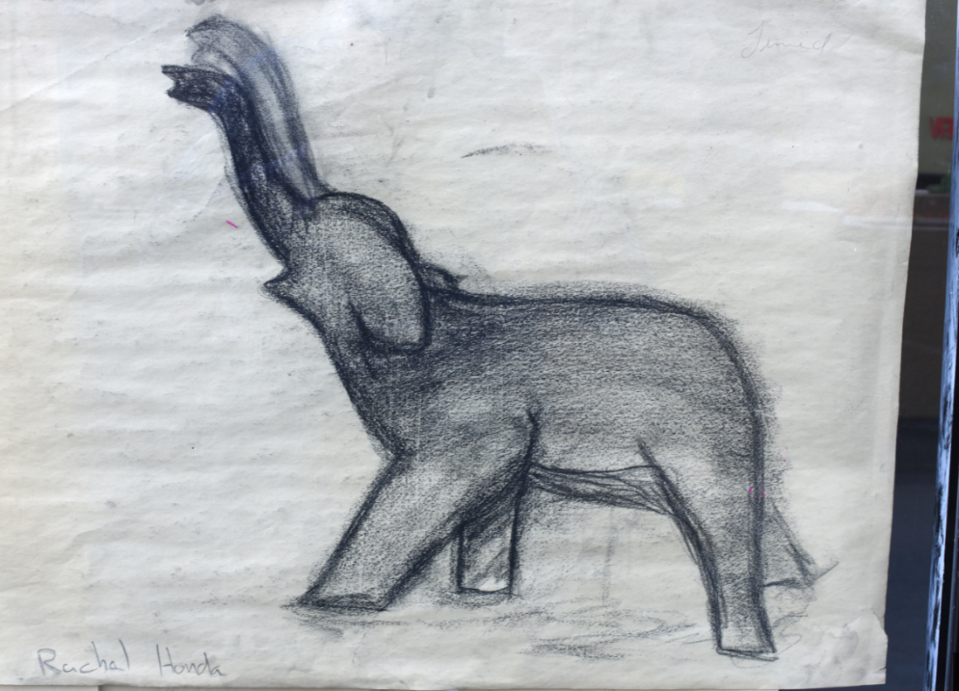
3. Learning Through Practice

Slide 16
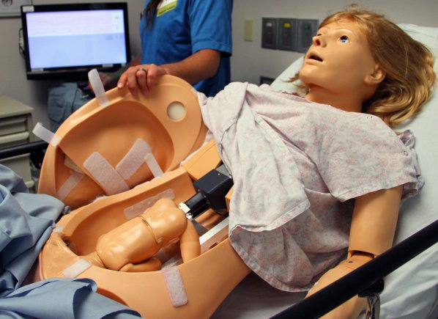
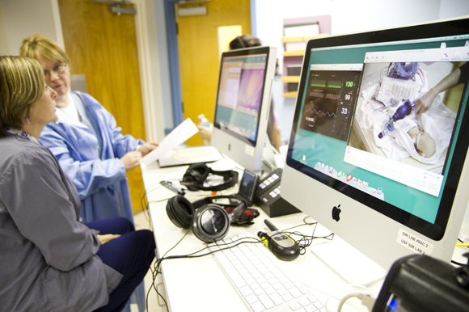
Medical Simulations
http://www.army.mil/article/127148/
http://www.83degreesmedia.com/features/camls011012.aspx

Slide 17
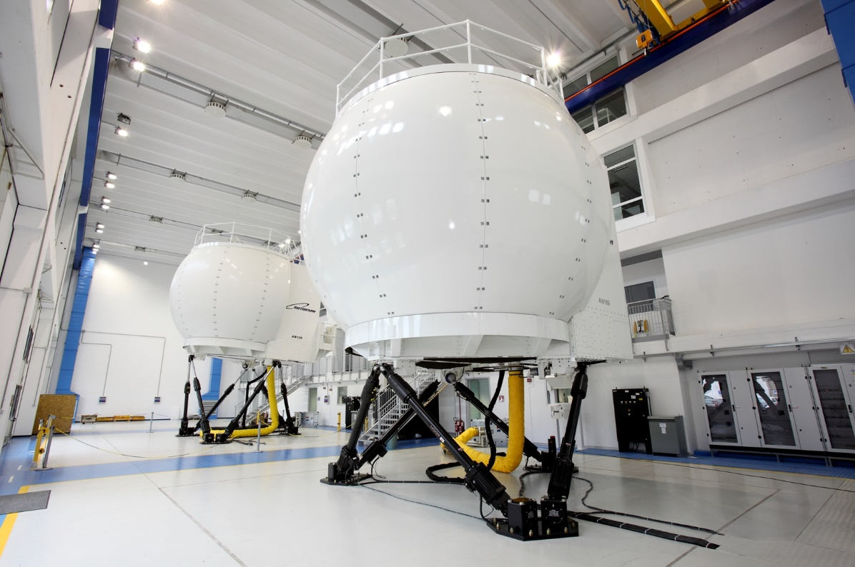
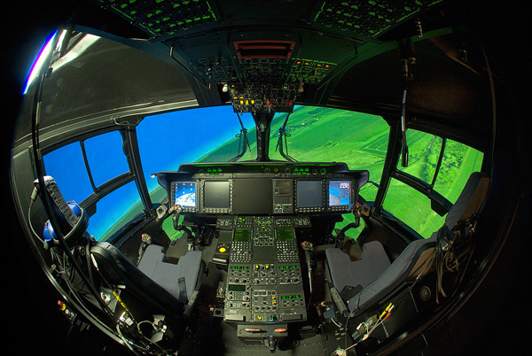
Flight Simulators
http://www.cae.com/World-s-first-AW189-full-flight-simulator-ready-for-training/
http://www.aiac.ca/canada-aerospace-industry/success-stories/cae-nh90-helicopter-simulator/
http://www.aiac.ca/canada-aerospace-industry/success-stories/cae-nh90-helicopter-simulator/

Slide 18
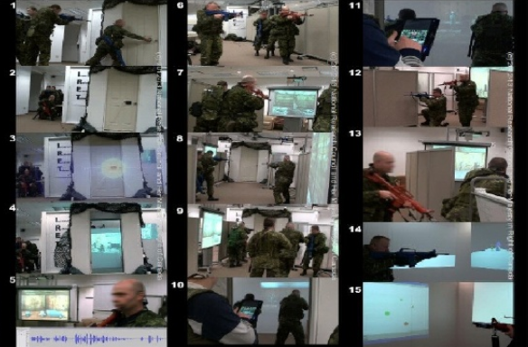
MINT - Mobile INteractive Trainer
http://www.downes.ca/post/59876

Slide 19
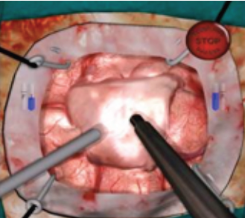
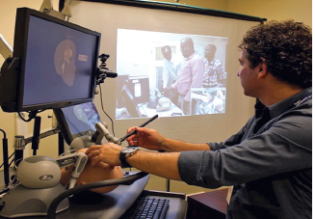
NeuroTouch Simulator

Slide 20
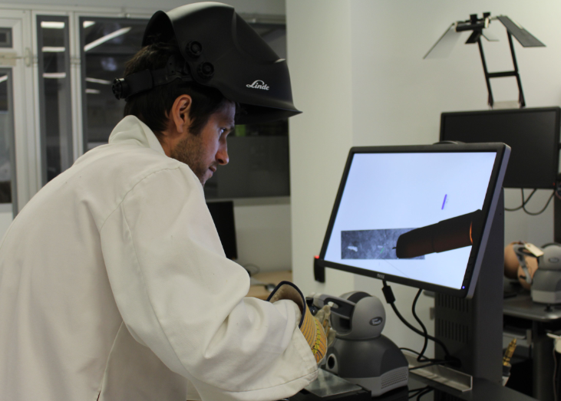

Sim-Welding

Slide 21
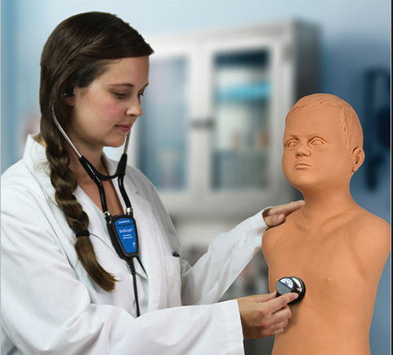
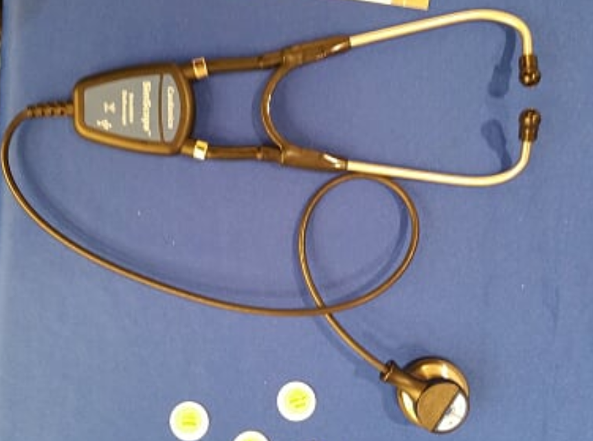
Auscultation
http://www.cardionics.com

Slide 22

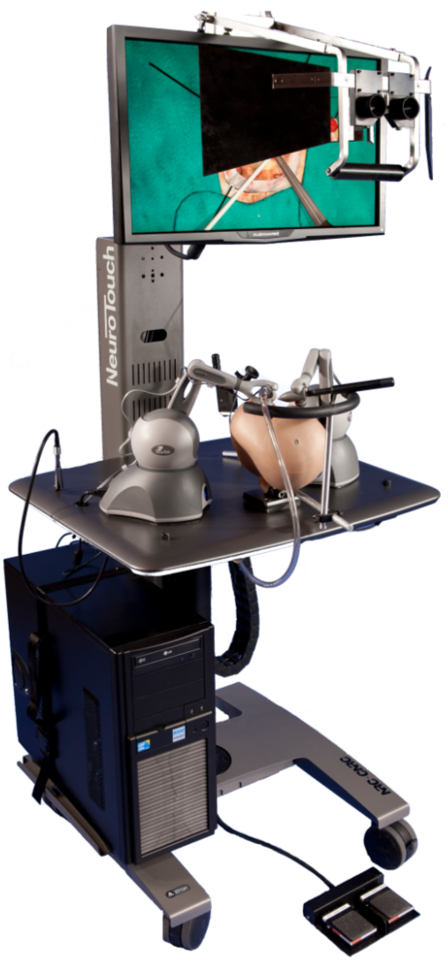
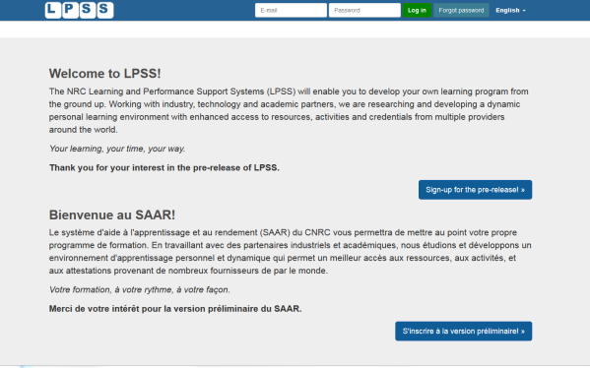

















Personal Learning – The Concept
Simulation
Learning Space
(SLS)

Slide 23
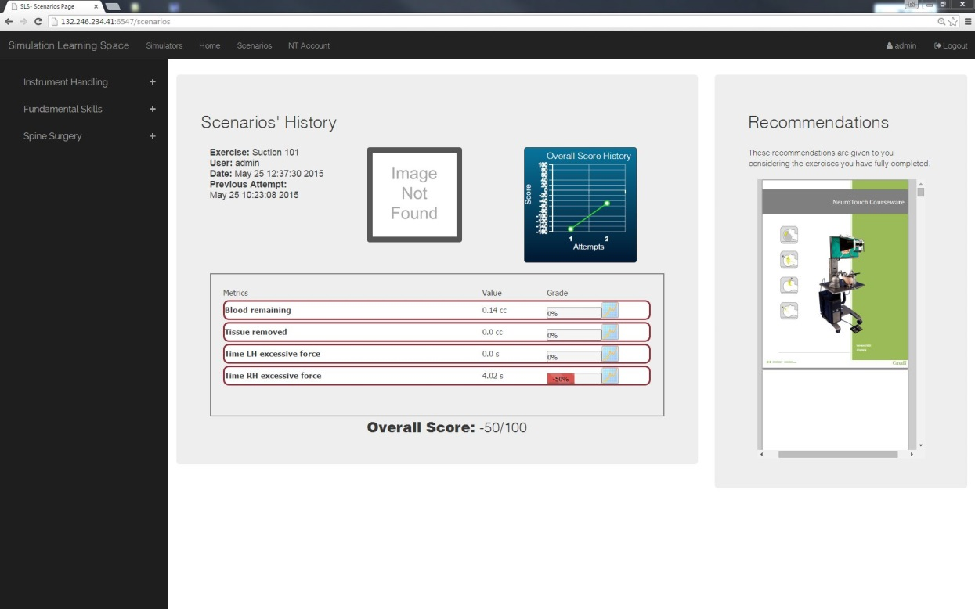
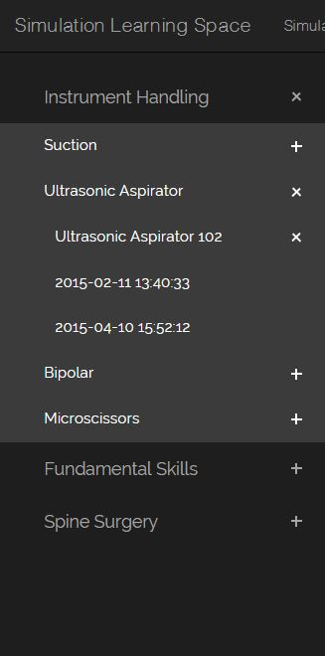
Combining Experiences
One place for all learning experiences
All performance results no matter where and when
they were carried out

Slide 24

4. Learning Communities - the cMOOC

Slide 25
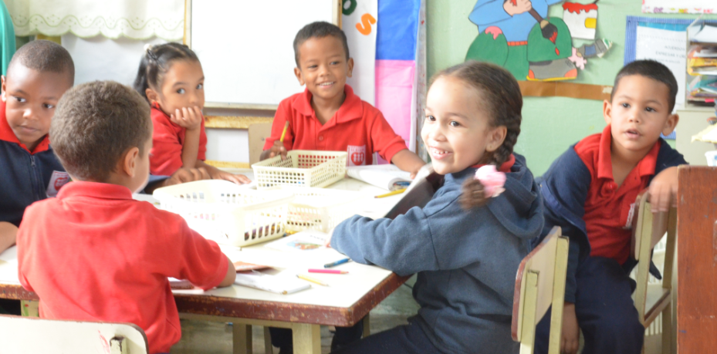
MOOC Design
Course structure – a series of topics
  The instructors will not ‘teach’ the topics, they ‘investigate’ or ‘work through’ the topics (model and demonstrate)

Slide 26
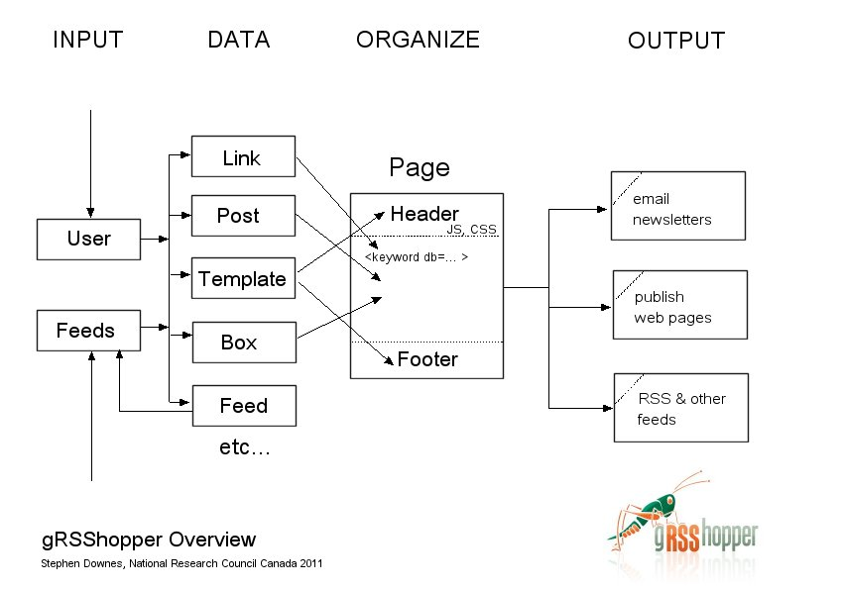
gRSShopper
http://grsshopper.downes.ca

Slide 27
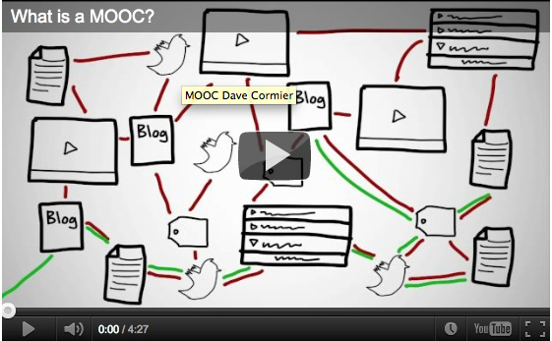
How to Learn in a cMOOC
Learning is a process of immersion into a knowing community
http://www.tonybates.ca/2012/03/03/more-reflections-on-moocs-and-mitx/

Slide 28
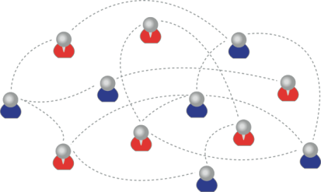
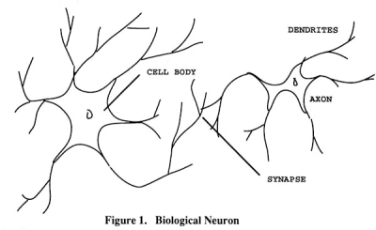
How to Create a Learning
It’s like creating a network
Don’t centralize
Concentrate on the creation of links
We use social networks...
… to create personal knowledge

Slide 29
How to Evaluate Learning
Learning is not possession of a collection of facts, it’s the expression of a capacity
Learning is recognized by a community of experts in a network
Learning analytics
We recognize our understandings…
…by the way we use them in our social network

Slide 30

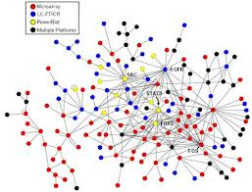
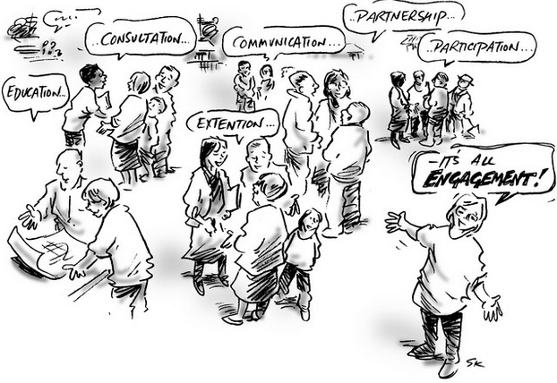
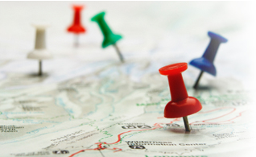
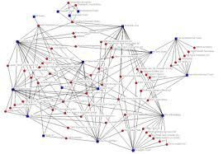
xLearning vs cLearning
contents
engagement
networks
http://www.corestandards.org/
http://www.magnet.edu/
http://lisahistory.net/wordpress/2012/08/three-kinds-of-moocs/

Slide 31
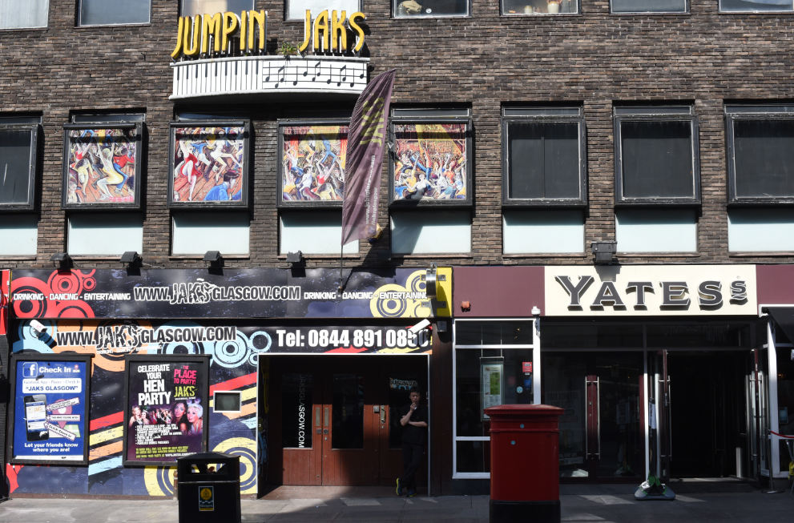
5. Personal Learning Environments

Slide 32
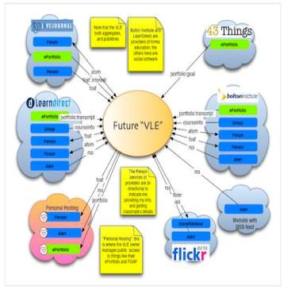
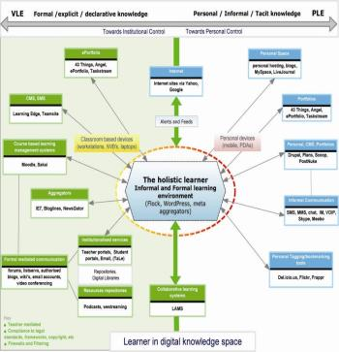
The design is based on putting the learner at the centre
Scott Wilson (left), Tim Hand (right)
https://www.google.com/search?q=ple+diagrams
http://www.edtechpost.ca/ple_diagrams/index.php/mind-map-3

Slide 33



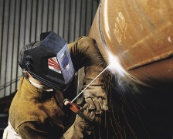


The Student’s Perspective
Site
A range of different resources and services

Slide 34
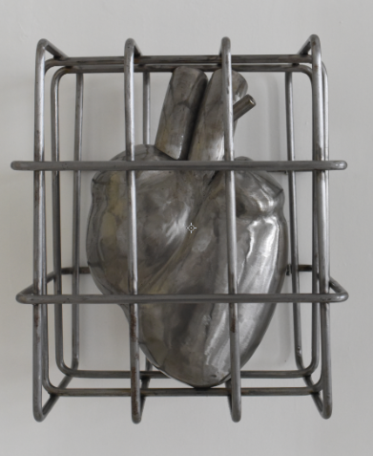
Personal Learning Record
The Personal Learning Record – data owned by the individual, shared only with permissions
http://halfanhour.blogspot.de/2014/12/eportfolios-and-badges-workshop-oeb14.html

Slide 35
Personal Learning Record
OERs
Portfolio, artifacts and evidence
Badges, certificates, credentials, competencies
Activity Record - LRS
PLR

Slide 36
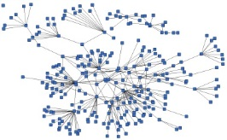
LPSS is Built Around the Personal Learning Record
This is a new type of data – we call it the personal graph.
Each person has their own private personal graph.
The PLR contains all a person’s learning records, including:
certificates, badges and credentials
activity records, test results, scores
Assignments, papers, drawings, things they create
Me

Slide 37
LPSS is Built Around the Personal Learning Record
Stuff Goes Out
Stuff Comes In
Learning Activities
I read and watch stuff
I play with toys
I make stuff
Things, Properties, Relations
Things I did
Stuff I make
Big stuff goes here
Me
Questions
Personal Library
Pictures
Books
Movies
Answers
Learning Analytics Services

Slide 38
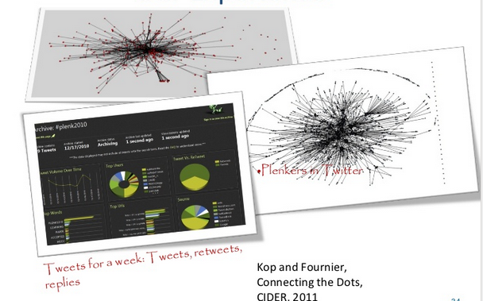
Plearn – Importance of the Graph
http://www.slideshare.net/Downes/after-moodle
http://www.slideshare.net/Ritakop/kopfourniercanadianinstitutedistanceeducationresearchple

Slide 39
Graph Aggregation and Storage
Personal
Context
Article
Photograph
Video
Person
Author
Publisher
Organization
Job Opportunity
Competency
Cetrificate
Event
Location / Place
Time / Date
Email
RSS
OAI
Sharepoint
Facebook
Twitter
Monster
Government
Repositories
Desire2Learn
Coursera
EdX
etc
Parsing
Scraping
Analytics
etc
Storage
RELATIONS

Slide 40
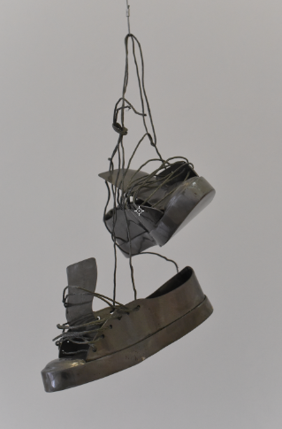
Future Projects…
OERs, Repositories, Marketplaces
Badges, Credentials, Recognition
Simulations & Workplace Support
Matching People to Opportunities

Slide 41
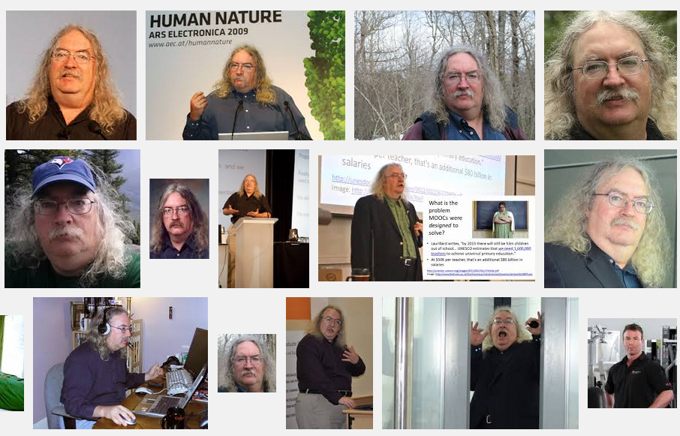
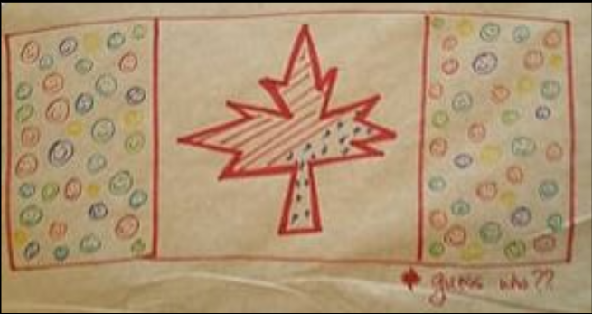
Stephen Downes
http://www.downes.ca

