Slide 1
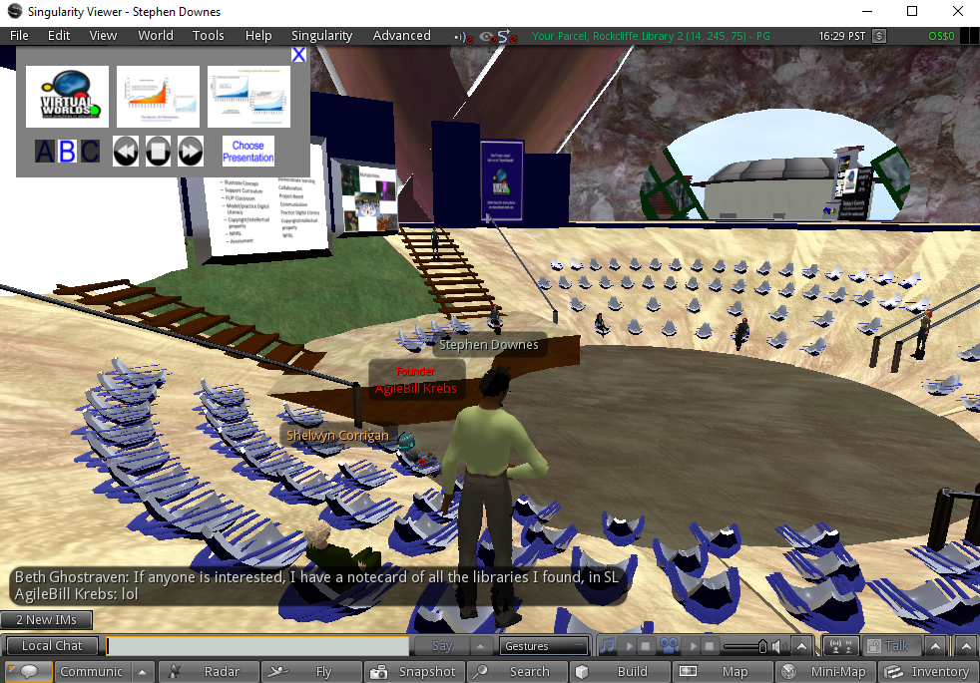
Virtual Worlds on the Go
Stephen Downes
March 10, 2016

Slide 2
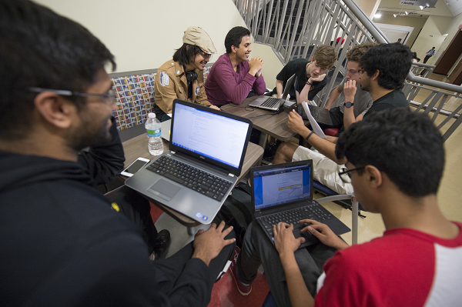
Social networking and learning communities
Gavriel Salomon - http://garfield.library.upenn.edu/classics1988/A1988Q406800001.pdf
Swan & Shea - http://www.rcet.org/research/publications/chapter_11.pdf
Image: http://success.students.gsu.edu/first-year-programs/freshman-learning-communities/
Notes:
Social networking and learning communities are essential support systems for online learning.
Social learning theories (Dewey, Vygotsky)
- Situated learning - learning is situated in the particular physical and social contexts in which it takes place (Brown, Collins & Duguid, 1989;
Lave & Wenger; 1990
Distributed Cognition - Gavriel Salomon
Learning communities

Slide 3
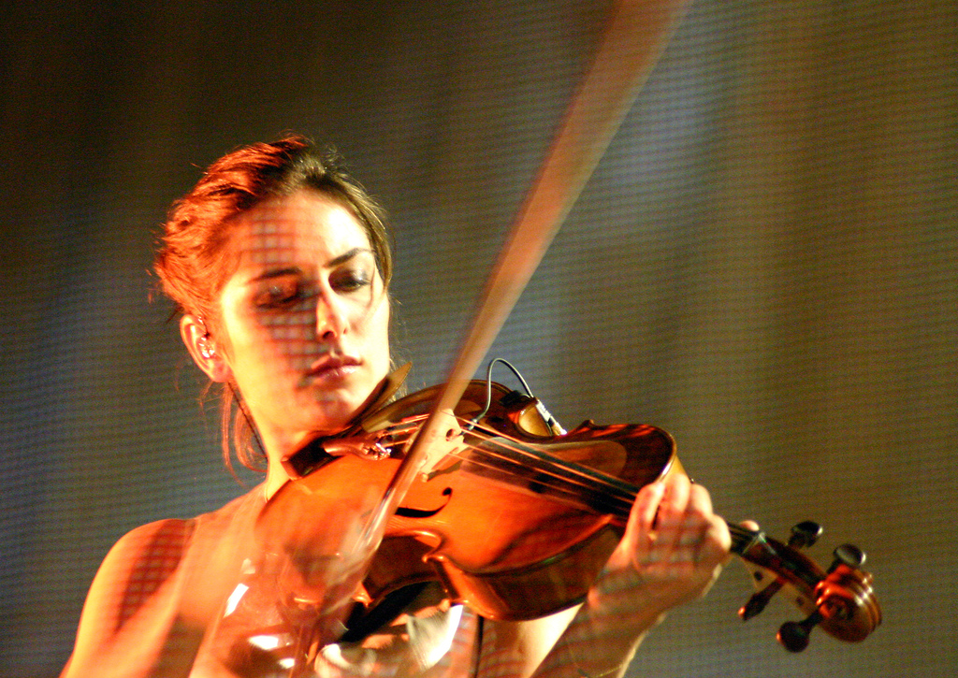
The need for deliberate practice
David V. Day https://www.researchgate.net/publication/229807474_The_Difficulties_of_Learning_From_Experience_and_the_Need_for_Deliberate_Practice
Image: http://expertenough.com/1423/deliberate-practice
Notes:
But is conversation enough?
David V. Day - The Difficulties of Learning From Experience and the Need for Deliberate Practice
“those who are overconfident in their abilities no longer believe there is anything to learn whether it is from other people or the experience itself
“

Slide 4
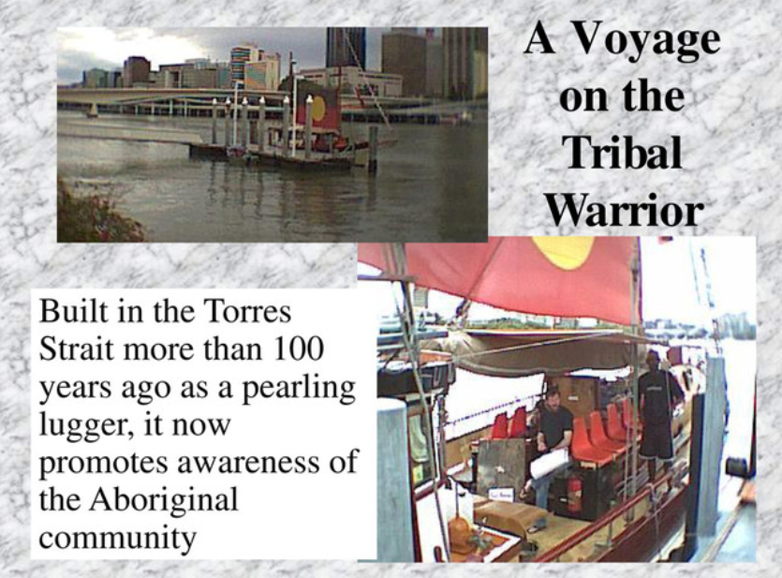
From virtual to reality
http://www.downes.ca/presentation/18
Notes:
One of the promises of online learning is that it can take education out of the classroom and into authentic environments.

Slide 5

Real world practice
Neurotouch - https://www.youtube.com/watch?v=XFErkYapAAA
Diana Oblinger - https://net.educause.edu/ir/library/pdf/eli3009.pdf
Notes:
This is also one of the advantages of online virtual worlds and simulation systems.
Oblinger - Learning-by-doing is generally considered the most effective way to learn
- Relevance – ill defined problem – sustained investigation – multiple sources and perspectives – interdisciplinary – integrated assessment

Slide 6

The move to mobile
Bonnington, Wired - http://www.wired.com/2015/02/smartphone-only-computer/
World Bank: http://blogs.worldbank.org/edutech/big-educational-laptop-and-tablet-projects-ten-countries
Notes:
Students are increasingly leaving their desktop and laptop computers behind and taking to mobile devices.
World Bank: “Impacting the teaching and learning process inside and outside of schools in positive ways, fuelling the aspirations of a new generation of Kenyan students (and their families), sustaining positive momentum and results over time”

Slide 7
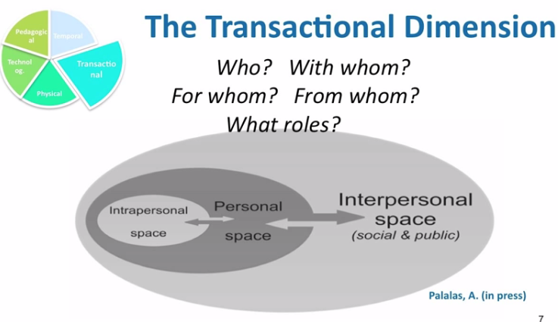
A mobile learning ecosystem
ASTD: https://www.td.org/Publications/Newsletters/Links/2015/12/The-Mobile-Learning-Ecosystem
Image: https://www.youtube.com/watch?v=KnOecJu4BjQ
Notes:
What does the learning ecosystem look like in such a world?
Mobile learning affordances:
content transmission and retrieval
Capturing data
Communicating, interacting with others
Computing algorithms
Contextual enquiry

Slide 8
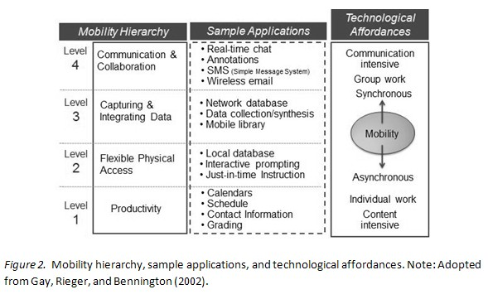
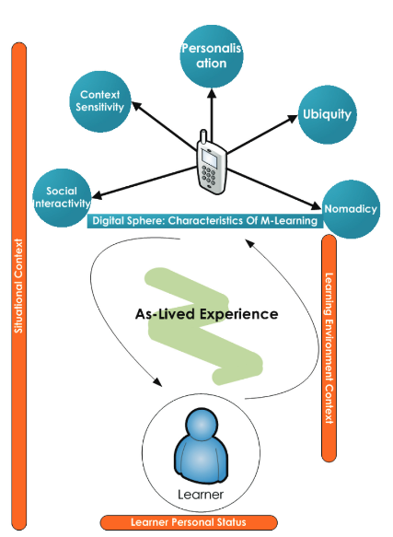
Pedagogical affordances
Yeonjeong Park - http://www.irrodl.org/index.php/irrodl/article/view/791/1699
Stanton & Ophoff - http://iisit.org/Vol10/IISITv10p501-523Stanton0091.pdf

Slide 9
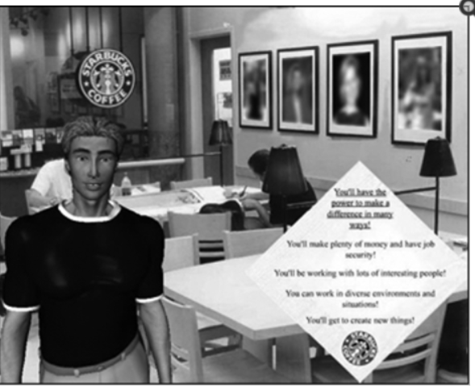
Mobile performance support…
… with virtual worlds?
ATD: https://www.td.org/Publications/Newsletters/Learning-Circuits/Learning-Circuits-Archives/2008/12/E-Learning-2009
NIH: http://www.ncbi.nlm.nih.gov/pmc/articles/PMC2781889/
Notes:
David Metcalfe: I think people will start to see the promise of mobile as part of the alternate reality games, as the use of point-and-shoot learning becomes more prolific, with the camera phone being so easy to use and access, and also the location-based learning. That whole notion of context is really becoming important. And I think those trends are going to happen in 2009 in big ways.
avatars in real-world performance support
Anthropomorphic virtual agents implemented as social models - One of the key attributes for a social model is appearance; how he/she looks influences the observer in making important assumptions regarding factors such as age, status, attractiveness and credibility.

Slide 10

Real world applications
Ambient performance - http://www.ambientperformance.com/sectors_securityandsafety.html
BrainLine - http://www.brainline.org/content/2008/07/analysis-assets-virtual-reality-applications-neuropsychology_pageall.html
3D Interactions - http://www.hindawi.com/journals/ahci/2011/684202/
Image: http://www.cnn.com/2009/TECH/04/07/second.life.singer/
Notes:
real world applications for this technology describing a variety of learning scenarios
remotely located collaborators to view the same rich, multimedia content together
conduct replays of completed sessions for debriefing participants or performing after action reviews
presence
http://www.brainline.org/content/2008/07/analysis-assets-virtual-reality-applications-neuropsychology_pageall.html
3D interactions between virtual world and real-life

Slide 11
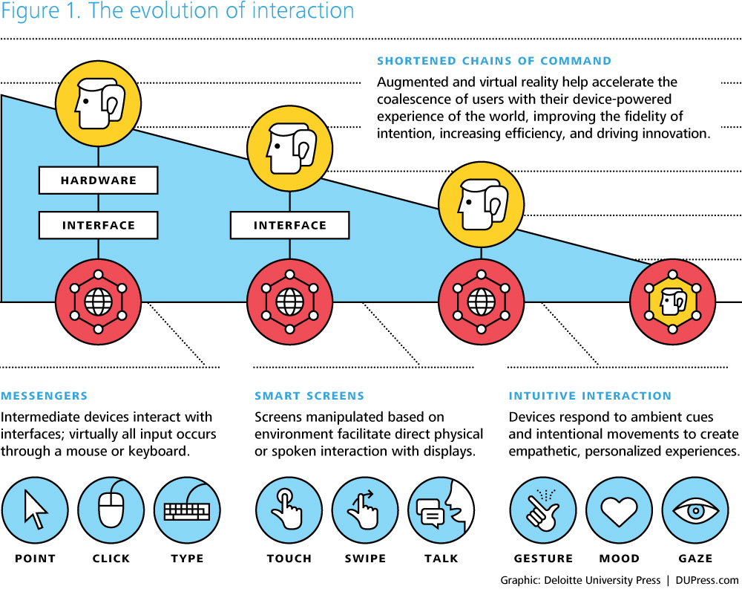
A mobile virtual worlds performance support infrastructure?
Drones: https://www.cbinsights.com/research-frontier-tech-report
Image: http://dupress.com/articles/augmented-and-virtual-reality/
Notes:
- the background and infrastructure needed to support such a system.
Point-click-type
Touch-swipe-talk
Gesture-mood-gaze
- Drones, robots and such and such

Slide 12

What will the educator’s job be?
Maria Roussou - http://citeseerx.ist.psu.edu/viewdoc/download?doi=10.1.1.7.102&rep=rep1&type=pdf
Image: http://techcrunch.com/2016/01/23/when-virtual-reality-meets-education/
Notes:
the role of educators and content publishers
Informal learning – support, scafford
Immersive learning – create scenarios, environments

Slide 13
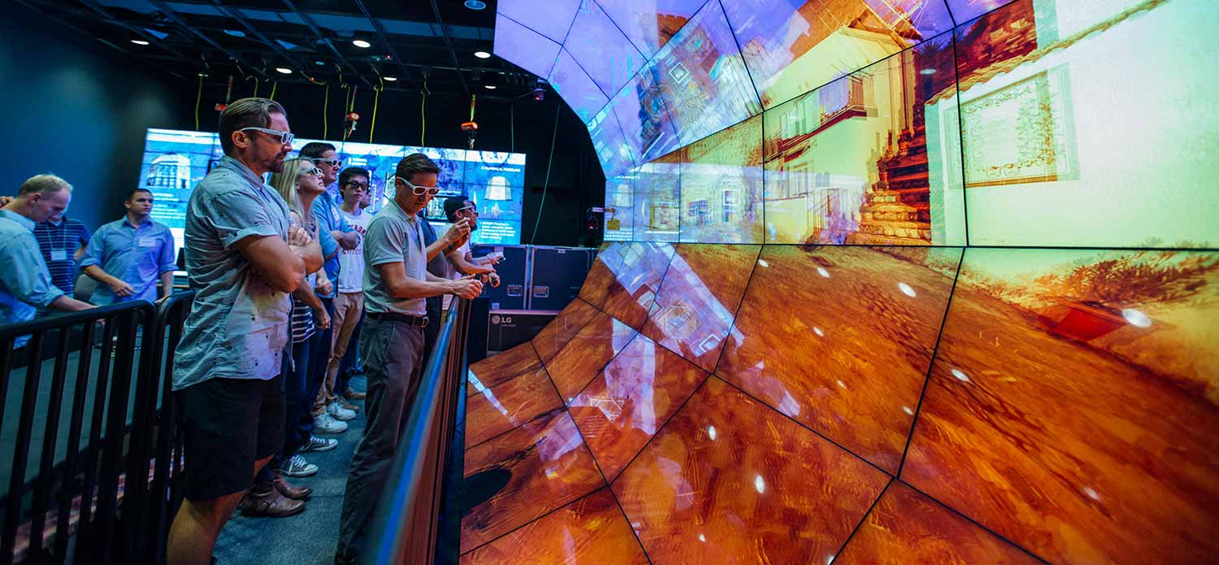
The new supportive learning agency
US Guide for High School Educators - http://www2.ed.gov/about/offices/list/ocr/transitionguide.html
AGOCG - http://www.agocg.ac.uk/reports/virtual/vrtech/toc.htm
Image: http://ucsdnews.ucsd.edu/pressrelease/actual_reality_beckons_at_conference_on_future_of_virtual_reality
Notes:
the need for institutions to provide learning support and scaffolding
- Infrastructure and platforms – AGOCG - Advisory Group on Computer Graphics (AGOCG) (1999!) - Exploiting Virtual Reality Techniques in Education and Training: Technological Issues

Slide 14

Virtual worlds on the go
Living in an imaginary world - http://www.scientificamerican.com/article/living-in-an-imaginary-world/
Notes:
to draw out the benefits of what might be called virtual worlds on the go.

Slide 15
Stephen Downes
http://www.downes.ca

