Slide 1


The Future of Educational Media
Stephen Downes
March 5, 2016
Istanbul, Turkey

Slide 2

The Inflexible Law of Learning
It's when we do stuff that we learn, not when stuff does something for us.

Slide 3
The Future in 2016
Machine learning and artificial intelligence
Handheld and Mobile Computing
Learning Analytics
Internet of Things
Games, Sims and Virtual Reality
Translation and Collaborative Technology
http://teachonline.ca/tools-trends/exploring-future-education/2016-look-future-online-learning-part-1
http://halfanhour.blogspot.com.tr/2016/03/the-2016-look-at-future-of-online.html

Slide 4
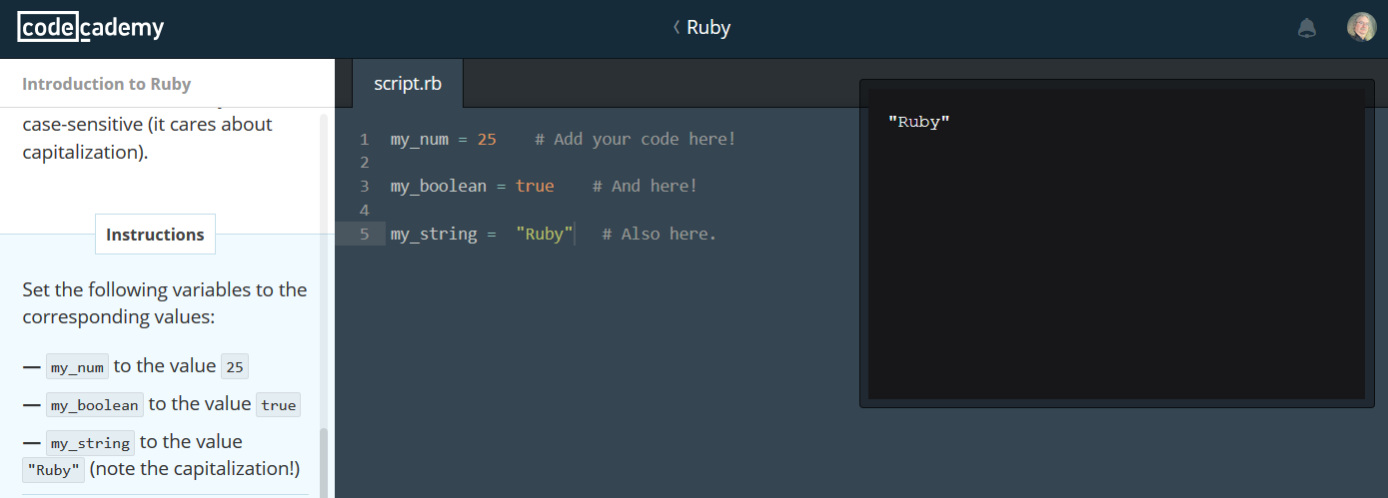
Machine learning and AI
Not simply for adaptive learning
The idea is to create an environment
https://www.codecademy.com/

Slide 5
Three Types of AI
decision engines - these are expert systems that are based on rule-driven strategies
pattern recognition - perceptual systems that identify patterns from partial or disorganized data
cluster detection - detecting nearest neighbours and categories of things
http://www.wtec.org/loyola/kb/c1_s1.htm
http://research.microsoft.com/en-us/um/people/cmbishop/prml/

Slide 6
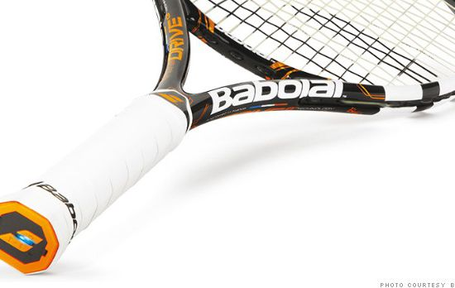
Handheld and Mobile Computing
The future of learning isn’t the mobile phone
It’s in the integrated performance support system
http://fortune.com/2014/05/27/a-tennis-racquet-that-isnt-just-strung-but-wired/

Slide 7
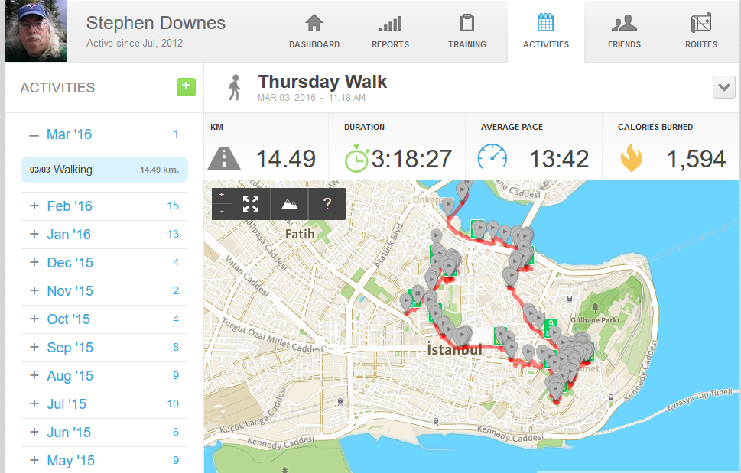
Learning Analytics
We talk about predictive analytics as though finishing a course is the problem
The real future is in the quantified self
http://quantifiedself.com/

Slide 8
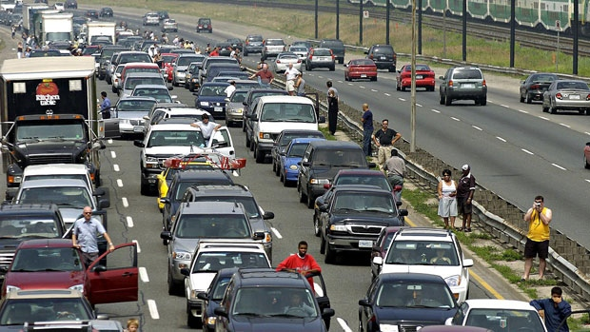
Internet of Things
What happens when companies know the state of all your devices?
http://www.cbc.ca/news/canada/car-tracking-devices-spark-privacy-concerns-1.1366687

Slide 9
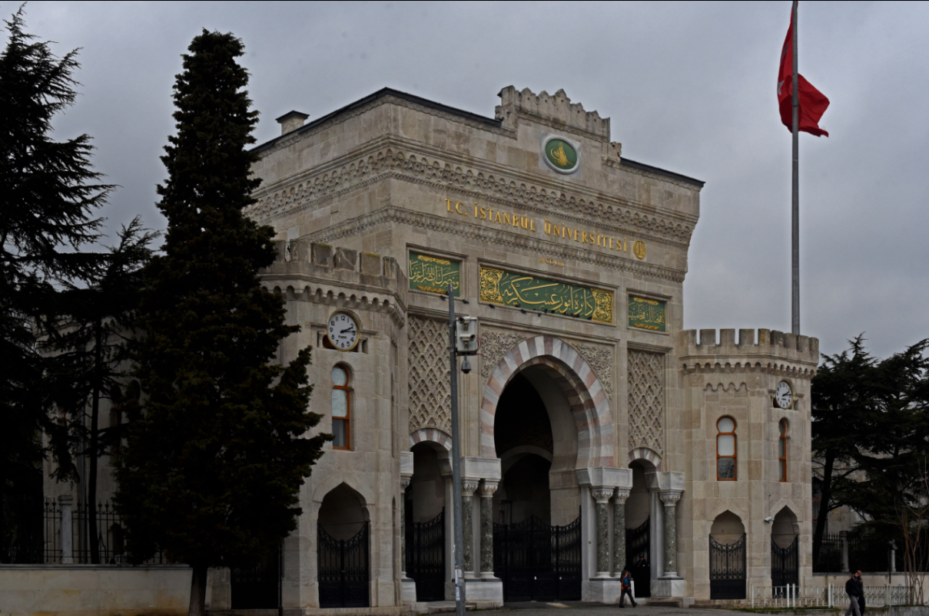
Games, Sims and Virtual Reality
‘Gamification’ – adds game elements to learning
‘Serious Games’ – employs a game to facilitate learning
https://badgeville.com/wiki/Gamification

Slide 10
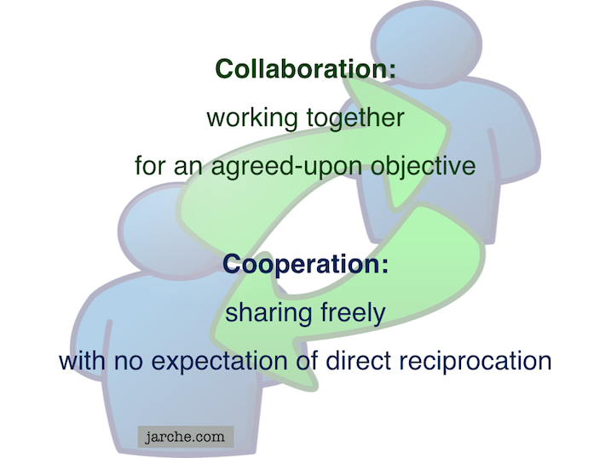
Translation and Collaborative Technology
Communication is and will be everywhere
But the future lies in cooperation, not collaboration
https://cyber.law.harvard.edu/research/cooperation
Image: http://Jarche.com

Slide 11

What Does Learning Become?
Context-Sensitive
Engaging
Personal

Slide 12

Any Time / Any Place?
It’s all about context
The airplane cockpit is no place for a two week course
Learning will be like water or electricity – or text
http://www.sciencedirect.com/science/article/pii/S1319157813000372

Slide 13
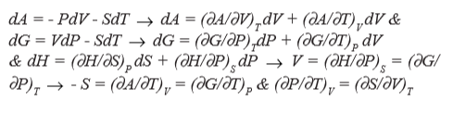
Engaging = Immersive + Wanted
Just because it’s interactive doesn’t make it engaging
We have to want to be there
And we have to believe that we’re there
http://www4.ncsu.edu/unity/lockers/users/f/felder/public/Columns/Active.pdf

Slide 14
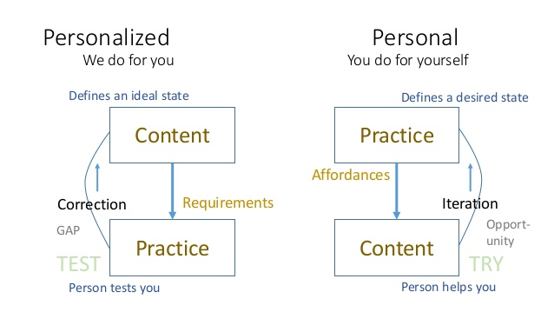
Learning is Personal

Slide 15
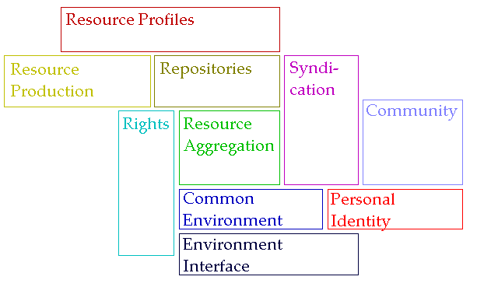
A Personal Learning Architecture
http://www.downes.ca/presentation/98

Slide 16
The New Institutional Perspective
From Management to Meaning
  Don’t do things to people, do things with people, help people do things
  If we have to ask “how do we motivate people” then we’re taking the wrong approach – Kohn
  “Knowledge sharing is your job” – Buckman
  Provide opportunities for autonomy, mastery, purpose – Pink
http://www.downes.ca/presentation/98

Slide 17
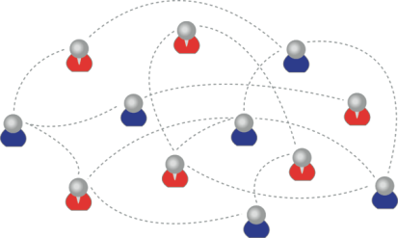
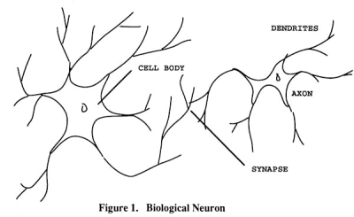
Learning Outcomes
We are using one of these
To create one of these
Personal knowledge consists of neural connections, not facts and data

Slide 18
Learning Outcomes
Learning a discipline is a total state and not a collection of specific states
It is obtained through immersion in an environment rather than acquisition of particular entities
It is expressed functionally (can you perform ‘as a geographer’?) rather than cognitively (can you state ‘geography facts’ or do ‘geography tasks’?)

Slide 19
Learning Outcomes
We recognize this
By perfomance in this
There are not specific bits of knowledge or competencies, but rather, personal capacities

Slide 20

The New Model of Work and Learning
Sharing - create linked documents, data, and objects within a distributed network
Contributing - employ social networking applications of the Web to facilitate group communication
Co-creating - work through networks that facilitate cooperative group work toward common goals
  (Dutton, p. 12)

Slide 21
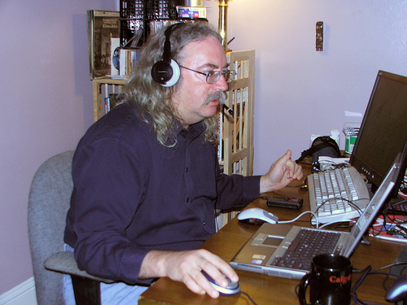
http://www.downes.ca

