Slide 1
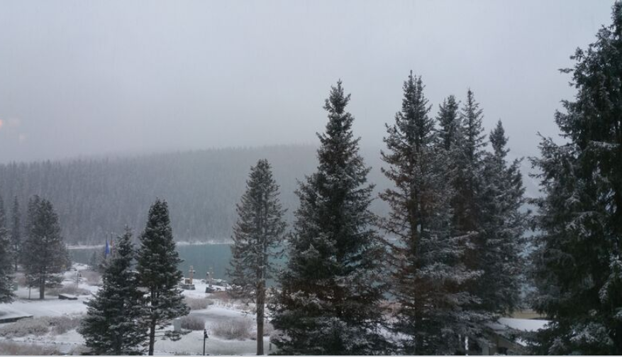
Critical Literacies and the Challenge of Online Learning
Stephen Downes, National Research Council Canada
to TESL Canada 2015, lake Louise, Alberta
October 30, 2015
http://www.downes.ca/presentation/369

Slide 2
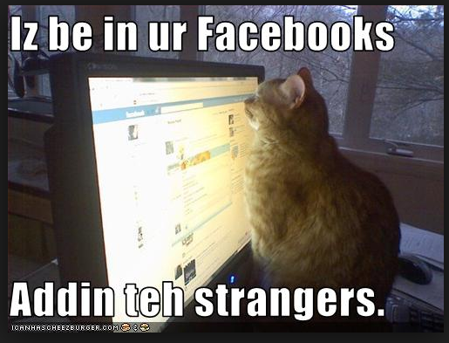
Why is this funny?
“An image macro of one or more cats. The image's text is often idiosyncratic and grammatically incorrect.”
Notes:
From Wikipedia: https://en.wikipedia.org/wiki/Lolcat

Slide 3
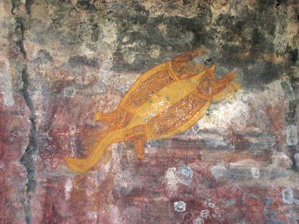
How do we know anything at all?
We can, as we understand the prehistoric, understand the future, by reading the artifacts.
Notes:
This is an image of a fish in a cave in Kakado
It teaches people what parts to each, what parts to avoid – it is an anatomy
Understanding what the picture means is a matter of recognizing what sort of thing this is, rather than a dictionary definition

Slide 4
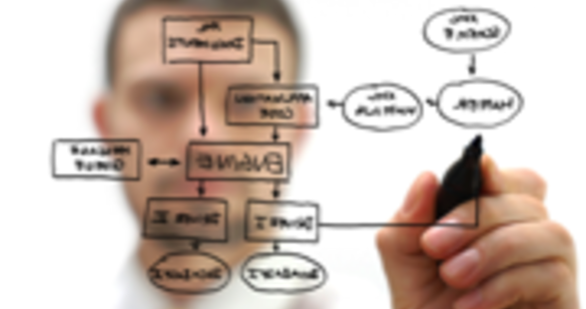
Science, knowledge are like language
They are not an accumulation of facts, they are a system or form of organization, a way of seeing the world.
Image: http://www.atelier.net/en/trends/articles/wolfram-alpha-plugging-vast-electronic-brain
Notes:
We have always (well, since the 1600s) thought of knowledge and learning as accumulations of facts, data.. Think of things like libraries, encyclopedias
Learning was therefore a matter of accumulating those fact… getting the basics, learning your ABCs… collecting subjects, courses, competencies
Our learning is structured this way – organized by topic, subject, program, class
Things are changing – gradually
One way to look at – knowledge is gradually shifting from knowledge of a domain to knowledge of a function
For example – you don’t study geology – you study how to be a geologist
Kuhn (Structure of Scientific Revolutions) – learning a subject is learning how to solve the problems at the end of the chapter
Another way to look at it…
Knowledge was thought of as having a bunch of sentences in the brain, that you could recall as needed
Today, knowledge is thought of more along the lines of a skill – Gilbert Ryle – a disposition to behave (Concept of Mind) – Michael Polanyi – tacit knowledge (Personal Knowledge)

Slide 5
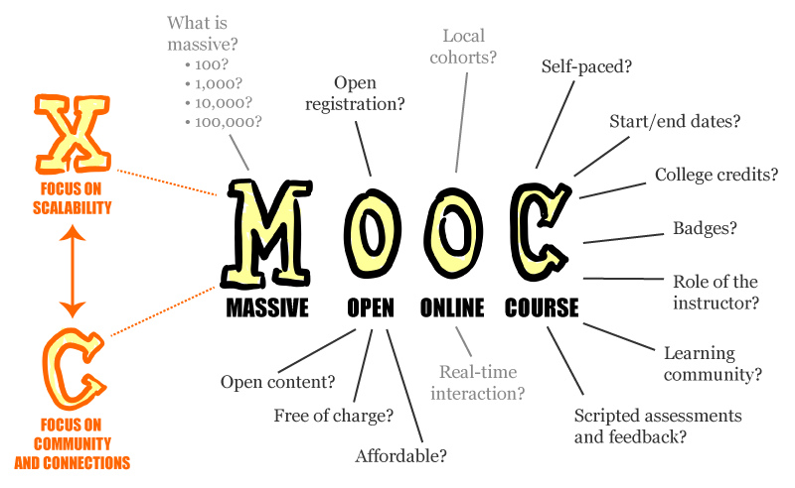
Their MOOCs, our MOOCs
‘MOOC’ stands for “Massive Open Online Course” and were developed in 2008. Examples include Coursera, FutureLearn.
Image: https://en.wikipedia.org/wiki/Massive_open_online_course

Slide 6
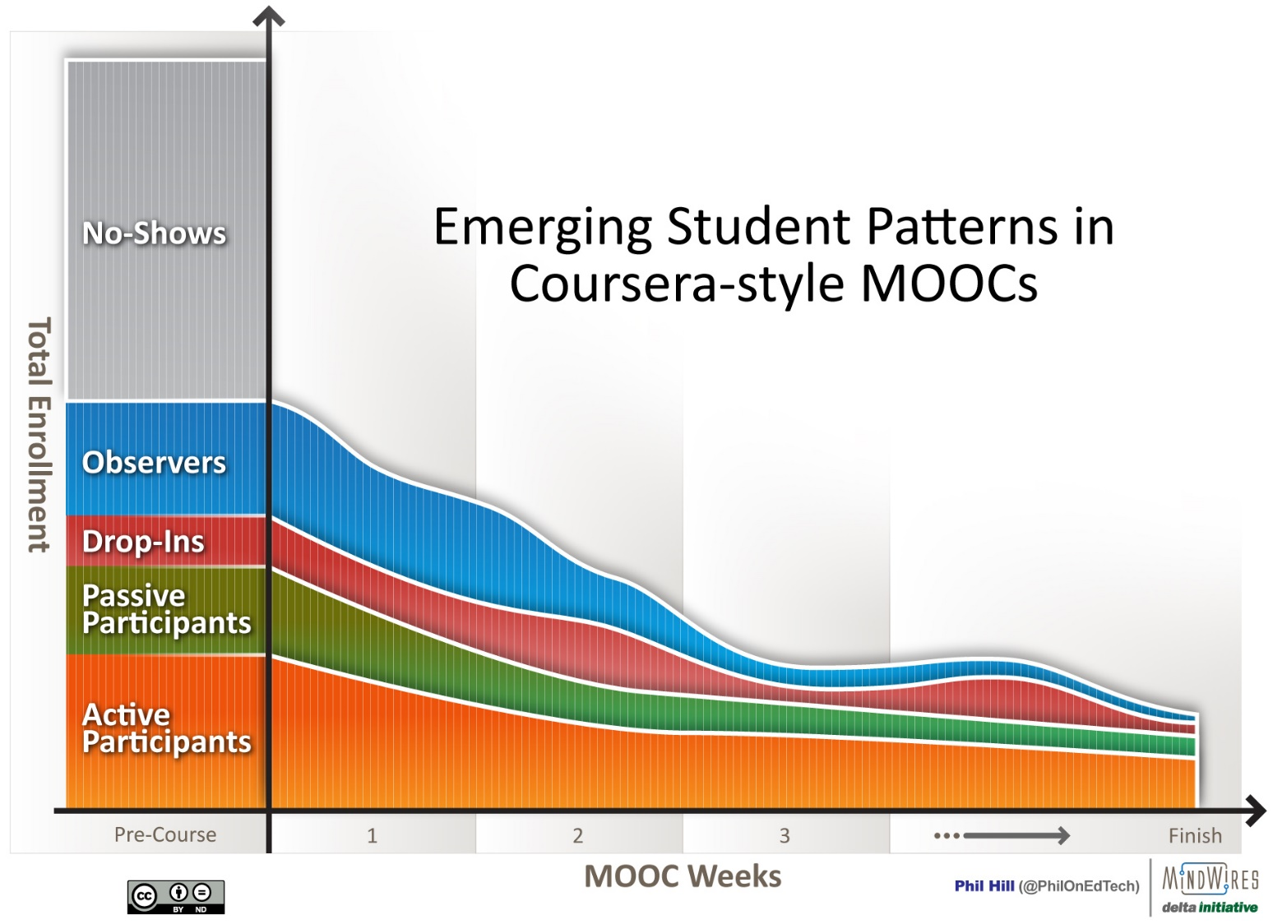
Criticisms of the MOOCs
MOOCs have face a storm of criticism – unprepared students, bad pedagogy, lack of educational standards, a failure to engage, and ultimately, dropouts.
Image: http://mfeldstein.com/emerging-student-patterns-in-moocs-a-revised-graphical-view/
Notes:
Lack of preparation - Eg. The Chronicle – “Why Delusions to Educate the world are absurd” - http://chronicle.com/blogs/worldwise/a-mooc-delusion-why-visions-to-educate-the-world-are-absurd/32599 – “lack the willingness to consider seriously what happens when thousands of students constituting a vast spectrum of proficiency levels and academic backgrounds try to catch up “
Bad pedagogy – EDUCAUSE, Five Myths about MOOCs - eg. http://er.educause.edu/articles/2013/10/five-myths-about-moocs
Failure to engage, mechanistic – ibid
Bad technology – HuffPost – The MOOC Backlash - http://www.huffingtonpost.com/jonathan-haber/the-mooc-backlash-udacity_b_4339487.html
Dropouts - http://edf.stanford.edu/readings/coursera-takes-nuanced-view-mooc-dropout-rates or https://campustechnology.com/articles/2015/07/01/mit-researchers-develop-model-to-predict-mooc-dropouts.aspx

Slide 7
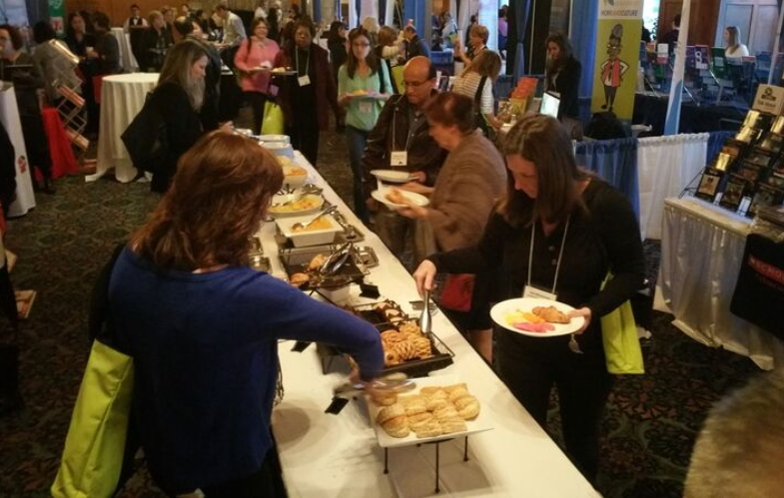
A Wider Conception of Learning
What does it mean to ‘complete’ a newspaper? What is the proper foundation for a buffet?
Notes:
What is it to ‘complete’ a course of learning?
The presumption that there is a linear order
The presumption that there are ‘foundational’ things to learn
The case of ‘addition’ and ‘multiplication’ in Common Core
The case of ‘to be’ in language “Me Grog. Me hungry.” or “I have six years.”

Slide 8
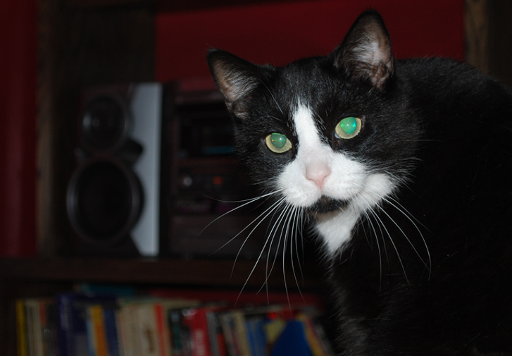
What does it mean to be literate?
Notes:
Go beyond traditional conceptions, conceptions like:
messages have a sender and a receiver
words get meaning from what they represent
truth is based on the real world
events have a cause, and causes can be known
science is based on forming and testing hypotheses
These, taken together, constitute, a static, linear, coherent picture of the world
Thinks we think of as ‘skills’ - performance, simulation, appropriation, etc - are actually languages and should be understood in terms of these six dimensions

Slide 9
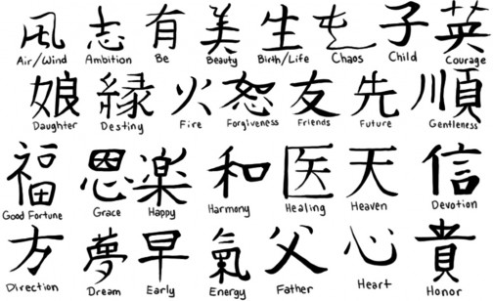
Meaning – it’s not just semantics any more
This brings us back to language – what is the ‘core’ of a language? What are the foundations?
Image: http://www.alegoo.com/pictures7/art-tattoos-2/tattoos-with-meaning-029/
Notes:
Tarski semantics – ‘snow is white’ is true iff snow is white
Meaning as ‘standing for’ - http://emojipedia.org/
Representationalism / models / coherence / community-agreement
Meaning – vs what it’s *not* - Derrida - difference
Meaning as performative - J.L. Austin – how to do things with words
Wittgenstein – meaning as use

Slide 10
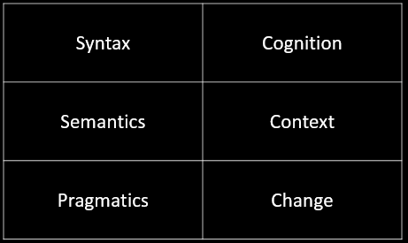
The Critical Literacies
This is a frame for understanding new media – and for understanding what it is to know, learn, and understand
Notes:
Syntax, semantics, pragmatics from Morris, foundation for a theory of signs
Syntax:
Forms: archetypes? Platonic ideals?
Rules: grammar = logical syntax
Operations: procedures, motor skills
Patterns: regularities, substitutivity (eggcorns, tropes)
Similarities: Tversky - properties, etc
Semantics
Sense and reference (connotation and denotation)
- Interpretation (Eg. In probability, Carnap - logical space; Reichenbach - frequency; Ramsey - wagering / strength of belief)
- Forms of association: Hebbian, contiguity, back-prop, Boltzmann
- Decisions and decision theory: voting / consensus / emergence

Slide 11
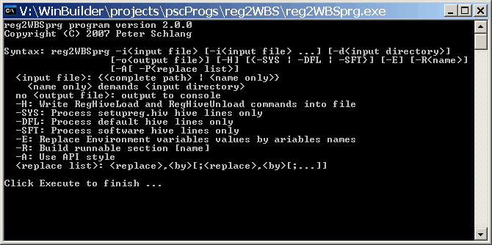
Syntax
Not just rules and grammar
Forms: archetypes? Platonic ideals?
Rules: grammar = logical syntax
Operations: procedures, motor skills
Patterns: regularities, substitutivity (eggcorns, tropes)
Similarities: Tversky - properties, etc

Slide 12
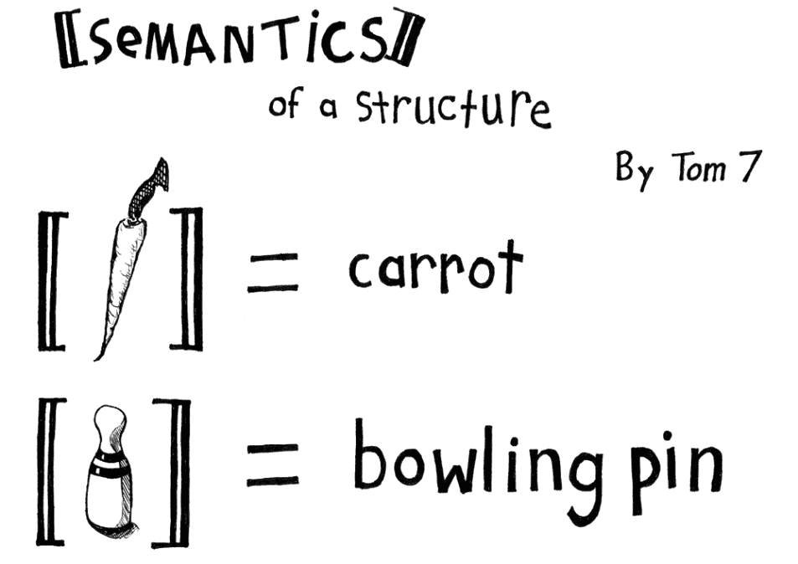
Semantics
Semantics
theories of truth / meaning / purpose / goal
http://www.cs.cmu.edu/~tom7/csnotes/fall02/semantics.gif
- Sense and reference (connotation and denotation)
- Interpretation (Eg. In probability, Carnap - logical space; Reichenbach - frequency; Ramsey - wagering / strength of belief)
- Forms of association: Hebbian, contiguity, back-prop, Boltzmann
- Decisions and decision theory: voting / consensus / emergence

Slide 13
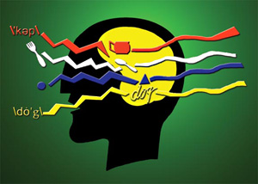
Pragmatics
use, actions, impact
Speech acts (J.L. Austin, Searle) assertives, directives, commissives, expressives, declarations (but also - harmful acts, harassment, etc)
Interrogation (Heidegger) and presupposition
Meaning (Wittgenstein - meaning is use)

Slide 14
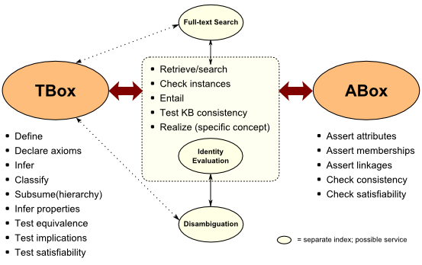
Cognition
reasoning, inference and explanation
http://www.mkbergman.com/category/description-logics/
description - X (definite description, allegory, metaphor)
definition - X is Y (ostensive, lexical, logical (necess. & suff conds), family resemblance - but also, identity, personal identity, etc
argument - X therefore Y - inductive, deductive, abductive (but also: modal, probability (Bayesian), deontic (obligations), doxastic (belief), etc.)
explanation - X because of Y (causal, statistical, chaotic/emergent)

Slide 15
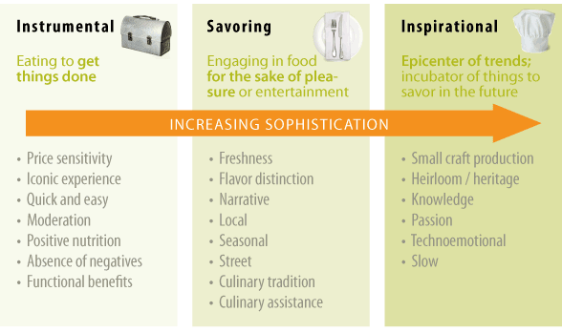
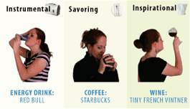
Context
placement, environment
http://www.occasionbasedmarketing.com/what-it-is
- explanation (Hanson, van Fraassen, Heidegger)
- meaning (Quine); tense - range of possibilities
- vocabulary (Derrida); ontologies, logical space
Frames (Lakoff) and worldviews

Slide 16
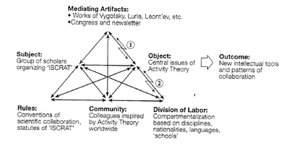
Change
relation and connection: I Ching, logical relation
flow: Hegel - historicity, directionality; McLuhan - 4 things
- progression / logic -- games, for example: quiz&points, branch-and-tree, database
- scheduling - timetabling - events; activity theory / LaaN

Slide 17
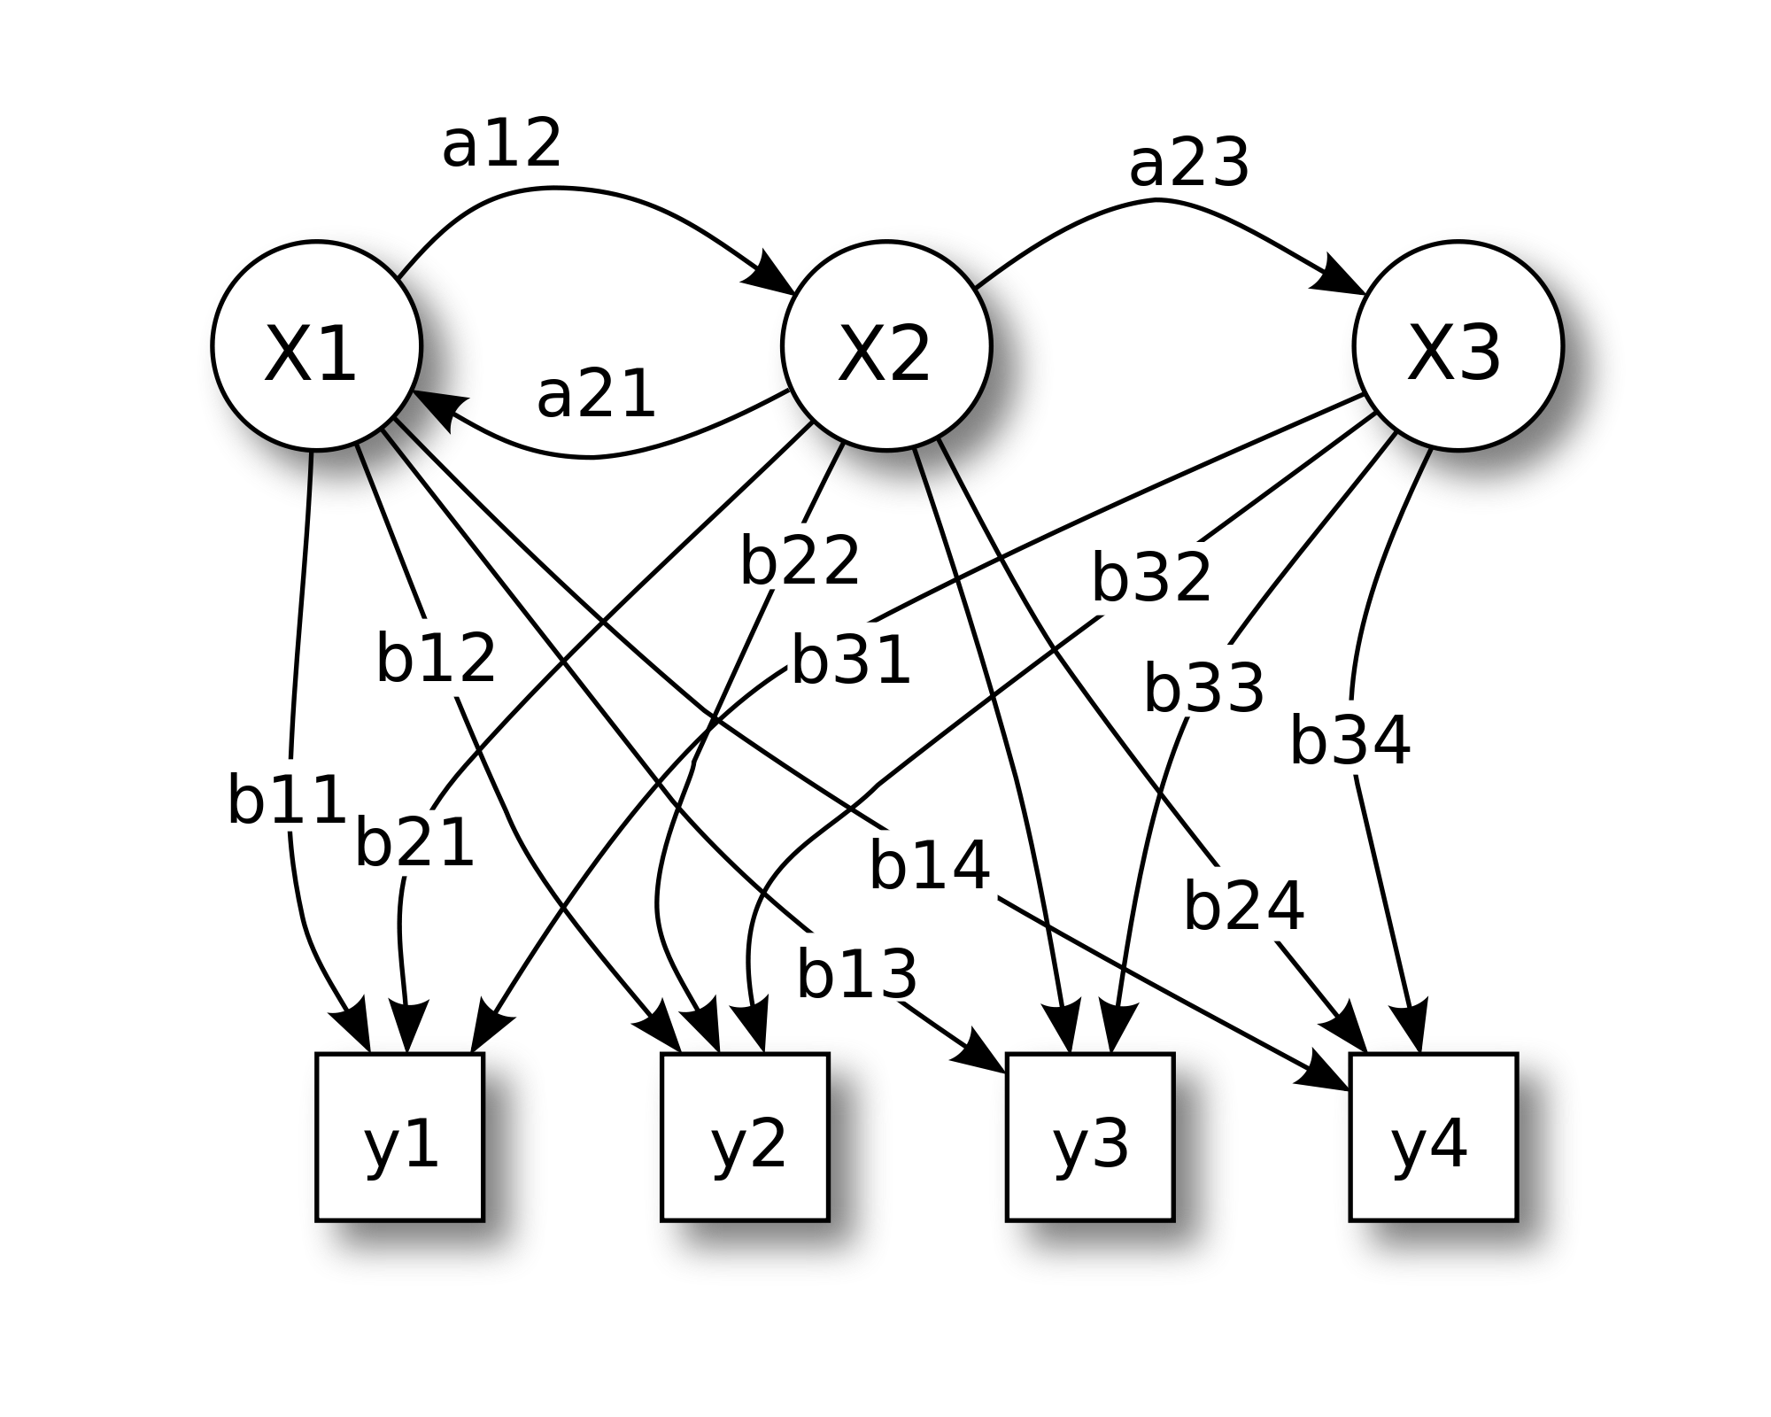
Knowledge as Recognition
Our conception o knowledge itself is insufficient to account for these various dimensions of literacy.
Image: https://en.wikipedia.org/wiki/How_to_Create_a_Mind
Notes:
The image is a hidden markov model - https://en.wikipedia.org/wiki/Hidden_Markov_model
The idea that the brain is a network of connections and we learn by forming connections
The contents of our mind do not ‘stand for’ or ‘represent’ phenomena in the work
Think of direct perception – JJ Gibson - http://ione.psy.uconn.edu/~cespaweb/docs/MC.pdf or http://ione.psy.uconn.edu/~cespaweb/docs/MC.pdf

Slide 18
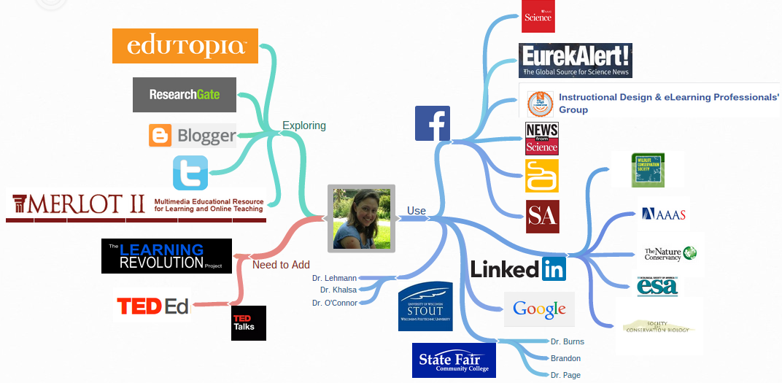
Learning Environment as a Place to Grow
Our work at NRC is devoted to creating a linked interconnected environment where people can experience and grow.
Image: http://taftportfolio.blogspot.ca/p/personal-learning-environment-ple.html
Notes:
LPSS

Slide 19
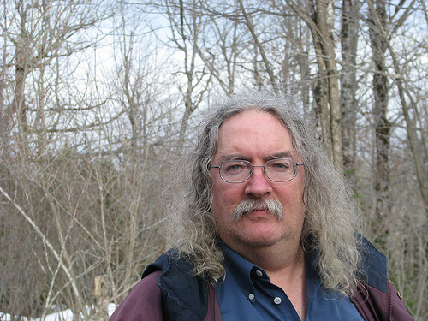
Stephen Downes
http://www.downes.ca

