Slide 1
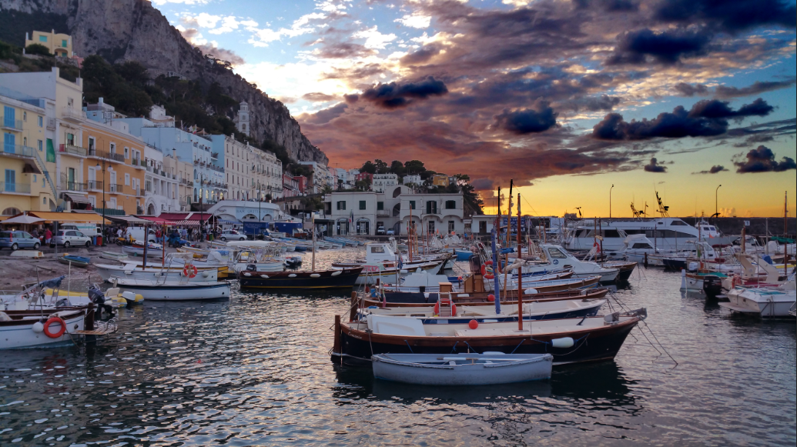
Where are MOOCs Going?
What is the Future of Distance Learning?
Stephen Downes
International MOOC Conference
Capri, Italy
September 25, 2015

Slide 2
MOOC Revolution?
Most of the ‘MOOC revolution’ has missed the point of MOOCs
  Not simply that they forgot the meaning of the word ‘open’
  They also forgot the meaning of the word ‘massive’
    It is not just another word for ‘broadcast’
  What does it mean to support universal access to learning and education?

Slide 3
Our primary innovation was two-fold:
  A distributed platform, that enabled scaling
  Courses based on practice and individual perspective
    Not many people getting the same experience & content
    Many people each getting personal experience & content

Slide 4
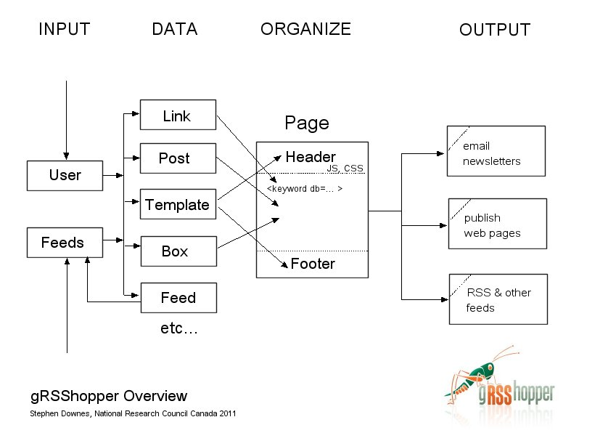
gRSShopper
http://grsshopper.downes.ca

Slide 5
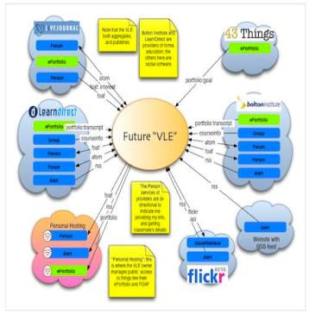
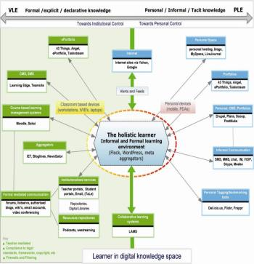
The design was based on putting the learner at the centre
Scott Wilson (left), Tim Hand (right)
https://www.google.com/search?q=ple+diagrams
http://www.edtechpost.ca/ple_diagrams/index.php/mind-map-3

Slide 6
Personal vs. Personalized
Compare between:
  Personalized health care (something the National Health Service provides)
  Personal health care (something you do for yourself)
Compare the focus:
  Focus on the institution, institutional needs
  Focus on the person, personal needs (not just ‘student’)

Slide 7
Two Approaches…
Content
Practice
Practice
Content

Slide 8
Two Approaches…
Defines an ideal state
Defines a desired state
Content
Practice
Practice
Content
TEST
TRY
Person tests you
Person helps you

Slide 9
Two Approaches…
Defines an ideal state
Defines a desired state
Content
Practice
Correction
Iteration
GAP
Practice
Content
Opport-unity
TEST
TRY
Person tests you
Person helps you

Slide 10
Library Environment
Defines an ideal state
Defines a desired state
Content
Practice
Affordances
Correction
Requirements
Iteration
GAP
Practice
Content
Opport-unity
TEST
TRY
Person tests you
Person helps you

Slide 11
Personalized Personal
We do for you You do for yourself
Defines an ideal state
Defines a desired state
Content
Practice
Affordances
Correction
Requirements
Iteration
GAP
Practice
Content
Opport-unity
TEST
TRY
Person tests you
Person helps you

Slide 12

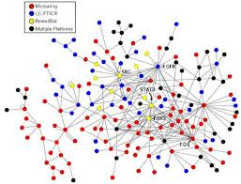
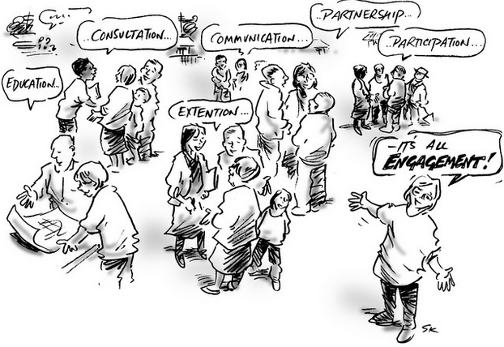

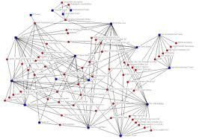
xLearning vs cLearning
contents
engagement
networks
http://www.corestandards.org/
http://www.magnet.edu/
http://lisahistory.net/wordpress/2012/08/three-kinds-of-moocs/

Slide 13
Personalized Personal
We do for you You do for yourself
Defines an ideal state
Defines a desired state
Content
Practice
Affordances
Correction
Requirements
Iteration
GAP
Practice
Content
Opport-unity
TEST
TRY
Person tests you
Person helps you

Slide 14
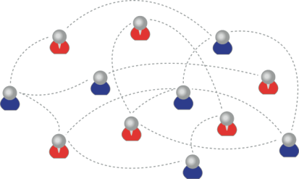
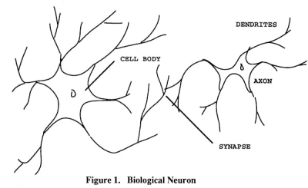
How to Create a cMOOC
It’s like creating a network
Don’t centralize
Concentrate on the creation of links
We use social networks...
… to create personal knowledge

Slide 15
LPSS (Learning & Performance Support Systems)
Data, Information Retrieval
Management Layer
Cleansing/Filtering/Profiling/Processing
Search/Recommendation Layer
Learning activity sequencing/modeling
Data Representation
RRN
CF
PLA
Prototype Repository
Standards/Communication protocols
PLR
Data Capture
Security Protocols
Security Protocols
Distributed Architecture
Personal Learning Record
PC
ACDR
Data synchronization
Personal Access to Network Storage
Cloud Storage and Management
Performance Trends Algorithm
Competence Development
Automated Assessment

Slide 16
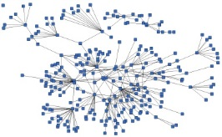
LPSS is Built Around the Personal Learning Record
This is a new type of data – we call it the personal graph.
Each person has their own private personal graph.
The PLR contains all a person’s learning records, including:
certificates, badges and credentials
activity records, test results, scores
Assignments, papers, drawings, things they create
Me

Slide 17
LPSS is Built Around the Personal Learning Record
Stuff Goes Out
Stuff Comes In
Learning Activities
I read and watch stuff
I play with toys
I make stuff
Things, Properties, Relations
Things I did
Stuff I make
Big stuff goes here
Me
Questions
Personal Library
Pictures
Books
Movies
Answers
Learning Analytics Services

Slide 18
RRN Aggregation and Storage
Personal
Context
Article
Photograph
Video
Person
Author
Publisher
Organization
Job Opportunity
Competency
Cetrificate
Event
Location / Place
Time / Date
Email
RSS
OAI
Sharepoint
Facebook
Twitter
Monster
Government
Repositories
Desire2Learn
Coursera
EdX
etc
Parsing
Scraping
Analytics
etc
Storage
RELATIONS

Slide 19
Personal Learning Record
OERs
Portfolio, artifacts and evidence
Badges, certificates, credentials, competencies
Activity Record - LRS
PLR

Slide 20
What is Learning?
Engagement and experience in professional networks
We grow our knowledge and capacities
We use social networks...
… to create personal knowledge

Slide 21
How to Evaluate Learning
Learning is not possession of a collection of facts, it’s the expression of a capacity
Learning is recognized by a community of experts in a network
Learning analytics
We recognize our understandings…
…by the way we use them in our social network

Slide 22
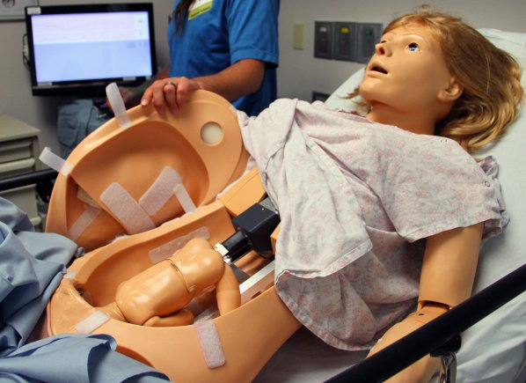
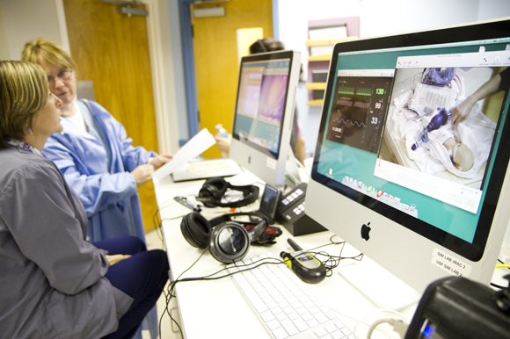
Medical Simulations
http://www.army.mil/article/127148/
http://www.83degreesmedia.com/features/camls011012.aspx

Slide 23
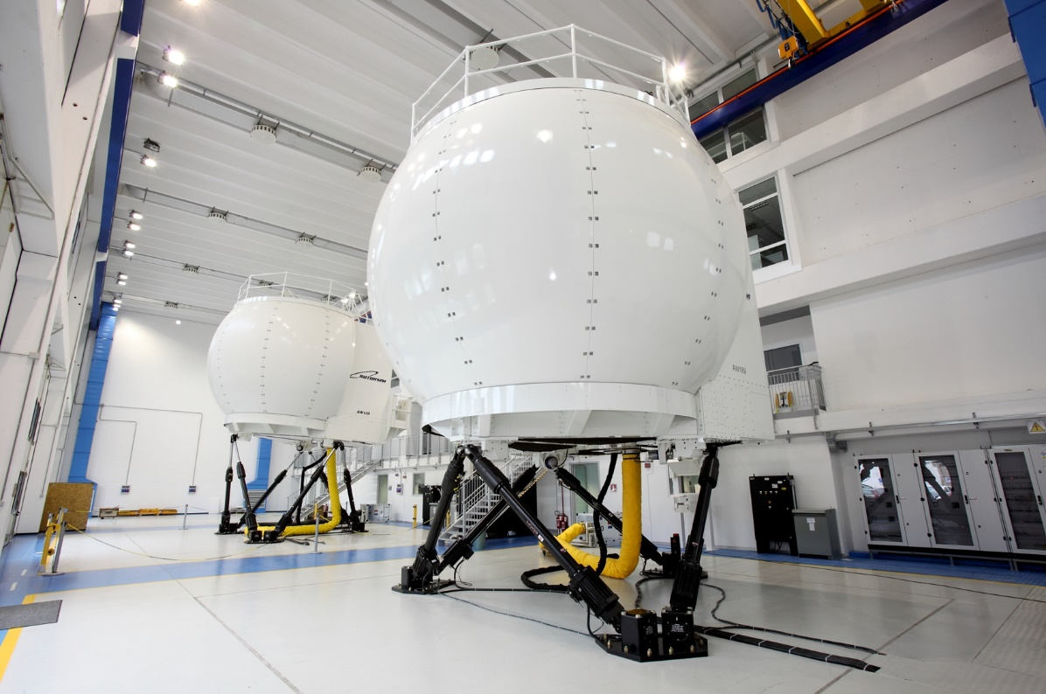
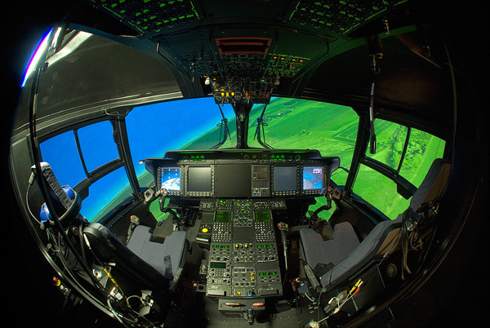
Flight Simulators
http://www.cae.com/World-s-first-AW189-full-flight-simulator-ready-for-training/
http://www.aiac.ca/canada-aerospace-industry/success-stories/cae-nh90-helicopter-simulator/
http://www.aiac.ca/canada-aerospace-industry/success-stories/cae-nh90-helicopter-simulator/

Slide 24
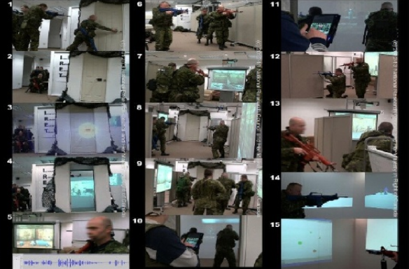
MINT - Mobile INteractive Trainer
http://www.downes.ca/post/59876

Slide 25
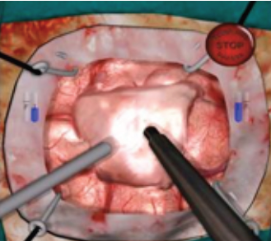
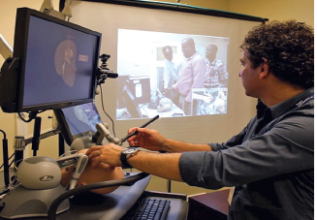
NeuroTouch Simulator

Slide 26
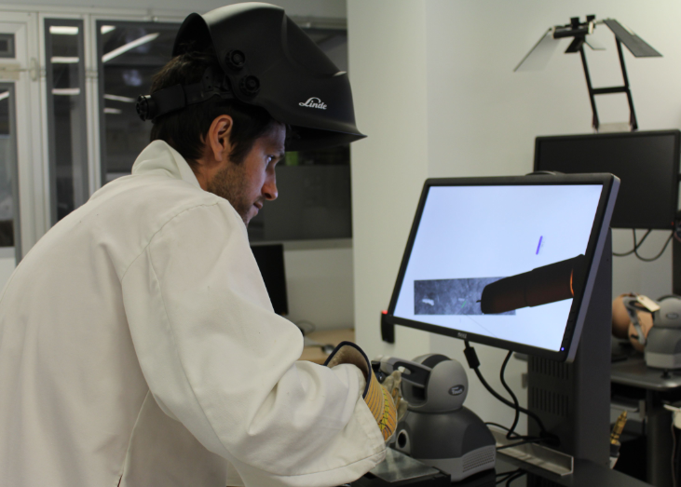

Sim-Welding

Slide 27
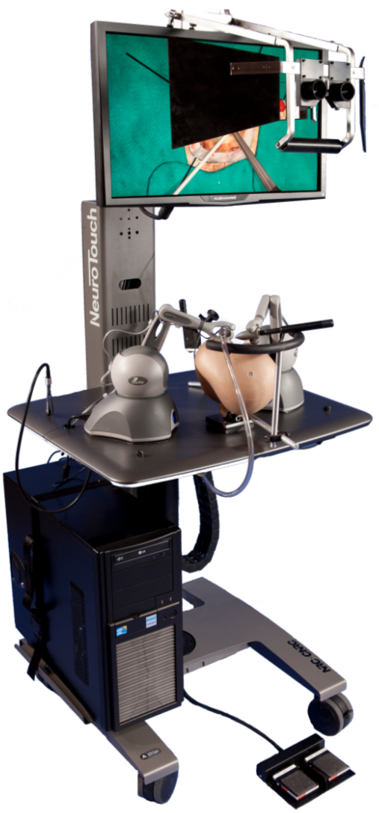
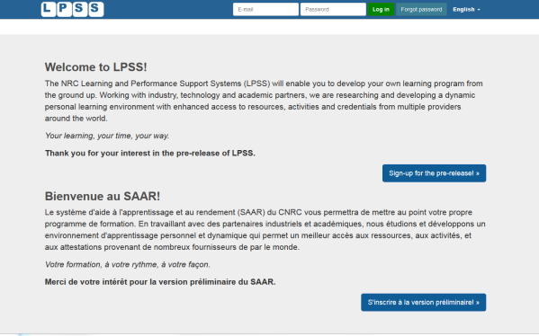

















LPSS-Sim Project Overview
Simulation
Learning Space
(SLS)

Slide 28
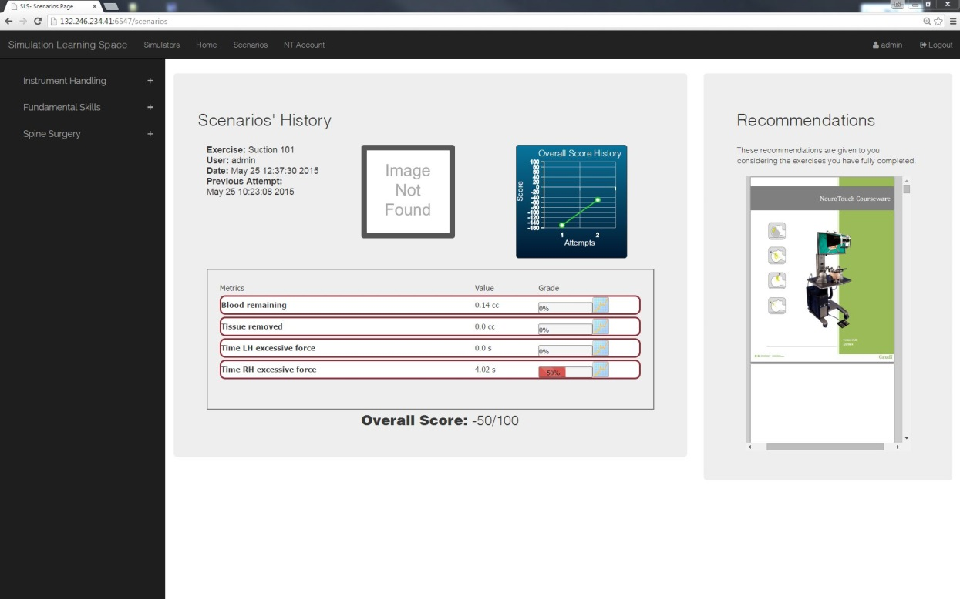
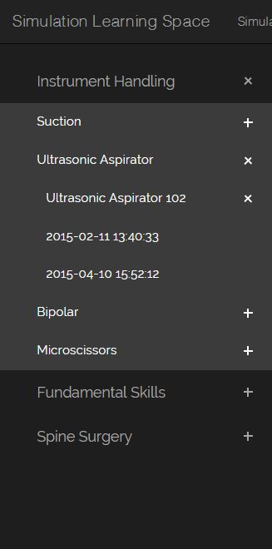
Combining Experiences
One place for all simulation experience
All performance results no matter where and when
they were carried out

Slide 29

Analytics and Big Data
Facebook
Twitter
EdX
Coursera
YouTube
Blackboard
Email
etc
Shallow
Tells us about the platform
Deep
Tells us about the person

Slide 30
Expanding LPSS
$20 Million Investment
NRC Technologies
Development Environment
$x + $y
Project
NRC
Funder
$y
Partner
University
Government
Development Agency
Foundation
UNESCO / UN
Corporate Partner
$x

Slide 31
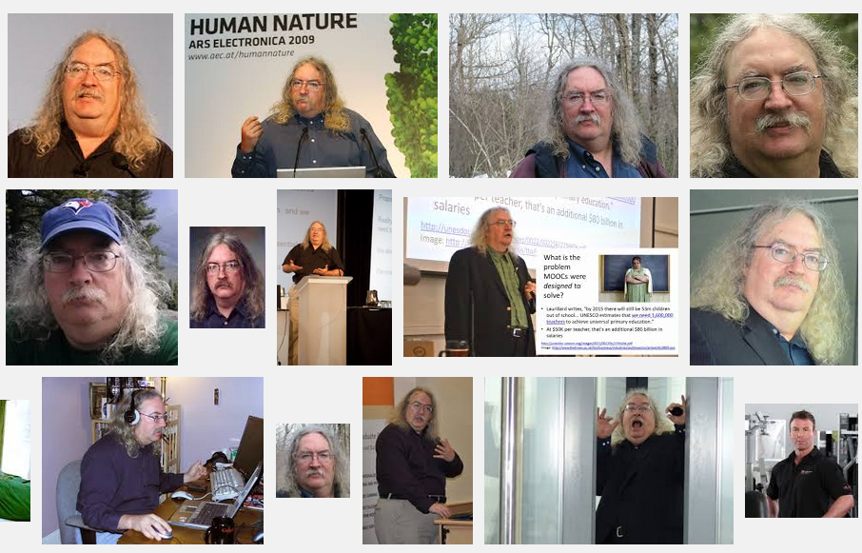
Stephen Downes
http://www.downes.ca

