Slide 1

Personal Learning in the Workplace
Stephen Downes
AMEE 2015
Glasgow, Scotland
September 7, 2015

Slide 2

1. Knowledge Translation

Slide 3
Knowledge Translation
CIHR – “CIHR, knowledge translation (KT) is defined as a dynamic and iterative process that includes synthesis, dissemination, exchange and ethically-sound application of knowledge to improve the health of Canadians.”
CIHR, http://www.cihr-irsc.gc.ca/e/39033.html

Slide 4
Criticisms…
“research should move beyond a narrow focus on the ‘know–do gap’ to cover a richer agenda…”
  situation-specific practical wisdom (phronesis)
  tacit knowledge shared among practitioners (‘mindlines’)
  complex links between power and knowledge; and
  macro-level knowledge partnerships
Greenhalgh and Weiringa, http://jrs.sagepub.com/content/104/12/501.full

Slide 5
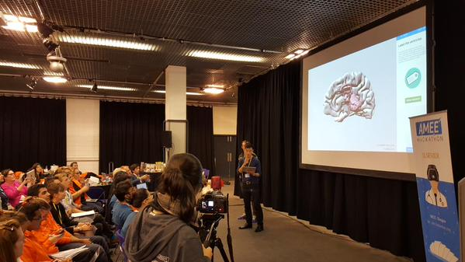
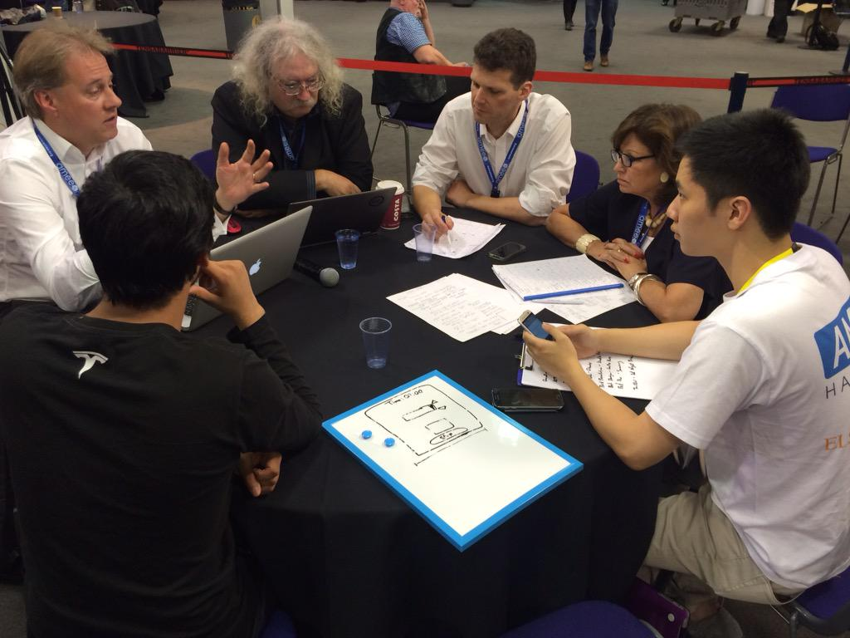
The Hackathon…

Slide 6
Two Approaches…
Content
Practice
Practice
Content

Slide 7
Two Approaches…
Defines an ideal state
Defines a desired state
Content
Practice
Practice
Content
TEST
TRY
Person tests you
Person helps you

Slide 8
Two Approaches…
Defines an ideal state
Defines a desired state
Content
Practice
Correction
Iteration
GAP
Practice
Content
Opport-unity
TEST
TRY
Person tests you
Person helps you

Slide 9
Library Environment
Defines an ideal state
Defines a desired state
Content
Practice
Affordances
Correction
Requirements
Iteration
GAP
Practice
Content
Opport-unity
TEST
TRY
Person tests you
Person helps you

Slide 10
Personalized Personal
We do for you You do for yourself
Defines an ideal state
Defines a desired state
Content
Practice
Affordances
Correction
Requirements
Iteration
GAP
Practice
Content
Opport-unity
TEST
TRY
Person tests you
Person helps you

Slide 11
Personal vs. Personalized
Compare between:
  Personalized health care (something the National Health Service provides)
  Personal health care (something you do for yourself)

Slide 12
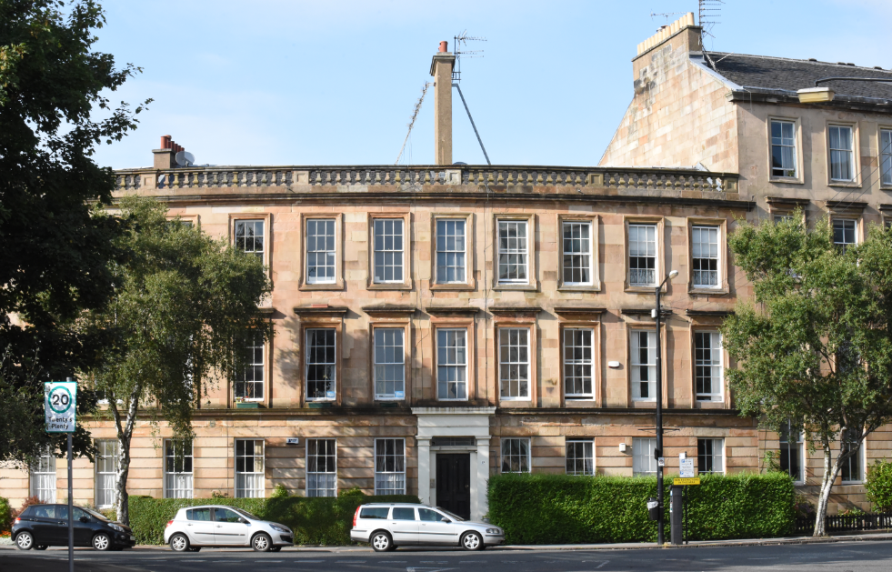
2. Learning Through Practice

Slide 13
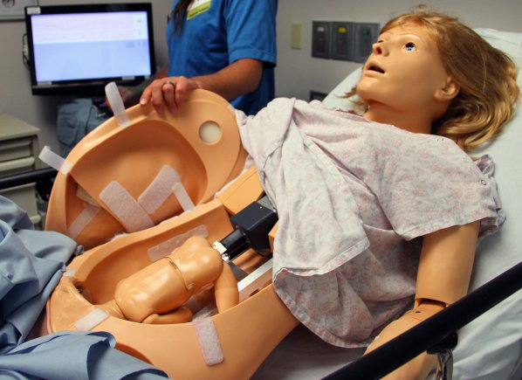
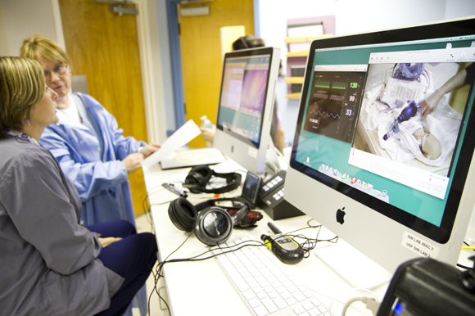
Medical Simulations
http://www.army.mil/article/127148/
http://www.83degreesmedia.com/features/camls011012.aspx

Slide 14
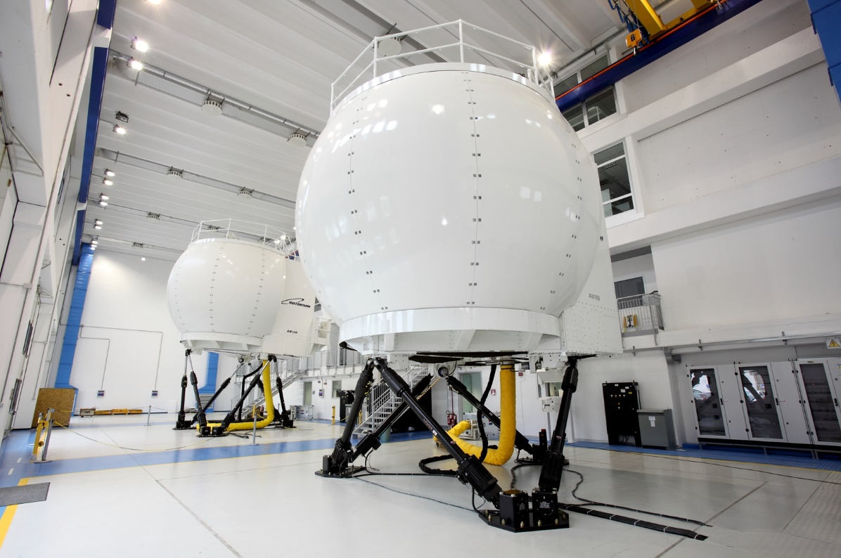
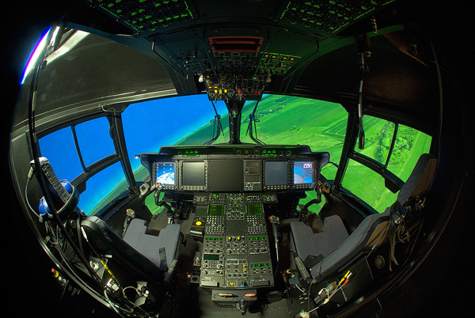
Flight Simulators
http://www.cae.com/World-s-first-AW189-full-flight-simulator-ready-for-training/
http://www.aiac.ca/canada-aerospace-industry/success-stories/cae-nh90-helicopter-simulator/
http://www.aiac.ca/canada-aerospace-industry/success-stories/cae-nh90-helicopter-simulator/

Slide 15
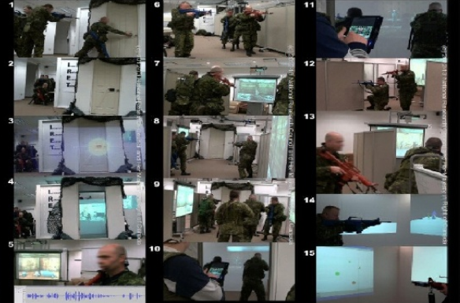
MINT - Mobile INteractive Trainer
http://www.downes.ca/post/59876

Slide 16
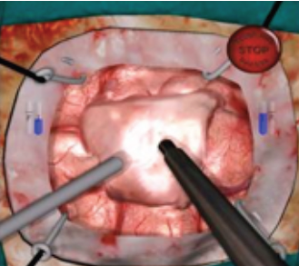
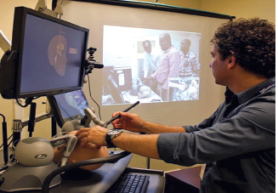
NeuroTouch Simulator

Slide 17
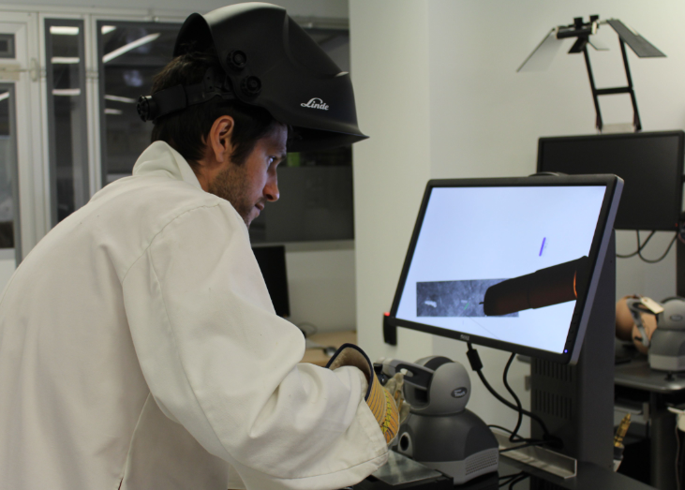

Sim-Welding

Slide 18
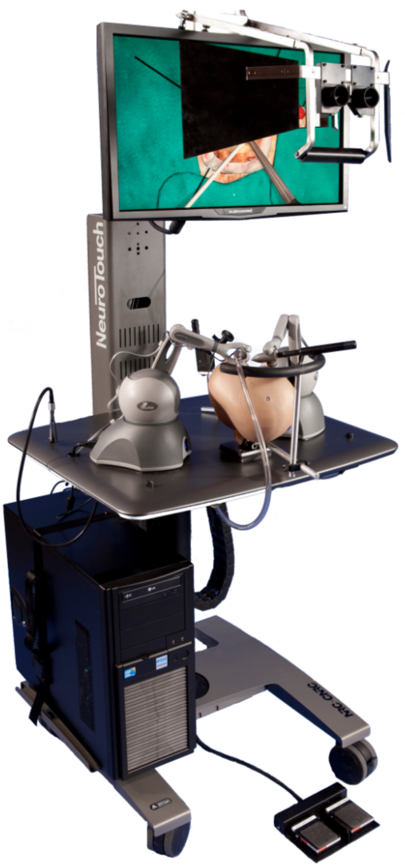
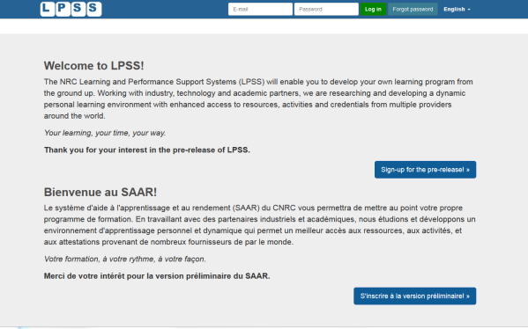

















LPSS-Sim Project Overview
Simulation
Learning Space
(SLS)

Slide 19
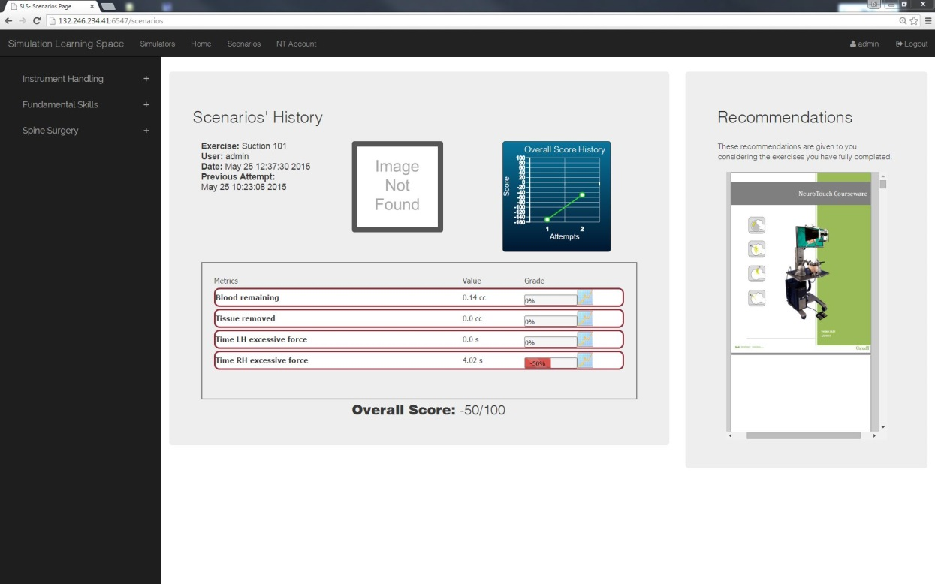
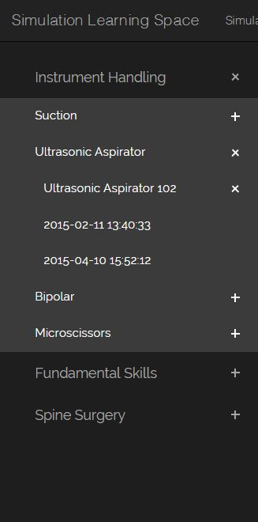
Combining Experiences
One place for all simulation experience
All performance results no matter where and when
they were carried out

Slide 20
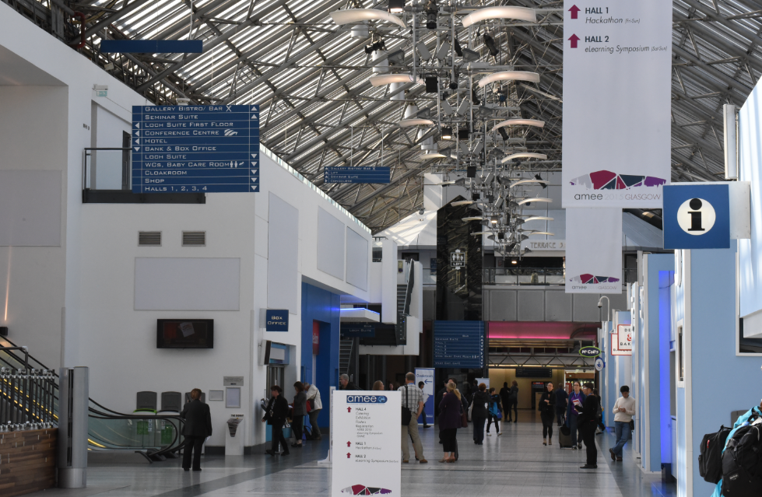
3. The Case of the cMOOC

Slide 21
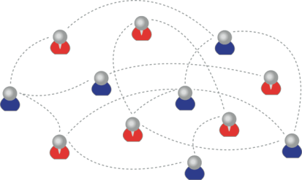
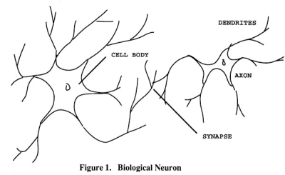
How to Create a cMOOC
It’s like creating a network
Don’t centralize
Concentrate on the creation of links
We use social networks...
… to create personal knowledge

Slide 22
Primary Course Components
  Wiki – to assist in planning, topics, guests, etc
  Email list – for announcements and mass communications
  Course Blog – for daily posts
  Synchronous Communications + Video

Slide 23
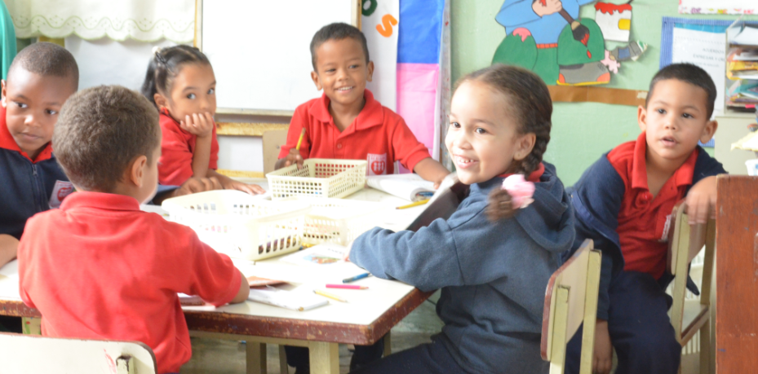
MOOC Design
Course structure – a series of topics
  The instructors will not ‘teach’ the topics, they ‘investigate’ or ‘work through’ the topics (model and demonstrate)

Slide 24
Additional Course Components
For Students – any online communications system, including
  Blogs – Blogger, WordPress, Tumblr
  Social Network – Facebook, Twitter, Google+
  Content site – Google Docs, Flickr, Instragram
  Aggregator – Feedly, OldReader, (new) Bli RSS

Slide 25
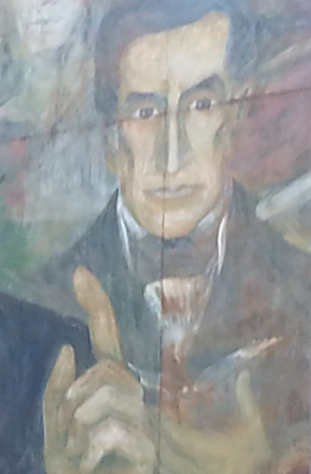
Process
Each Week
  Conversation or activity with guest
  Discussion and reflection
Each Day
  Aggregate student content
  Share via web site & newsletter

Slide 26
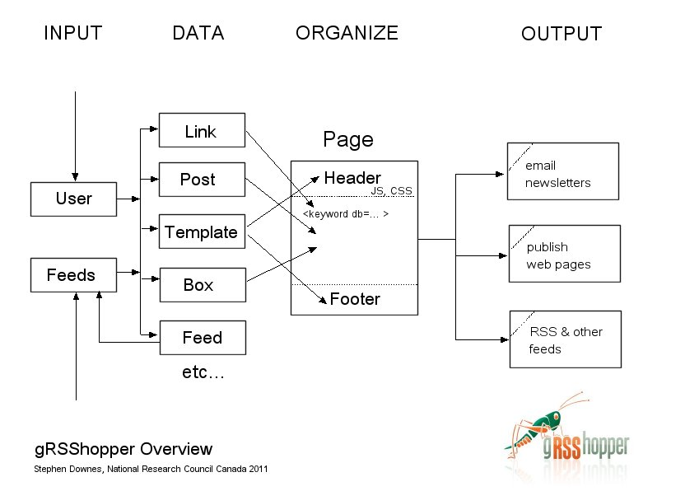
gRSShopper
http://grsshopper.downes.ca

Slide 27
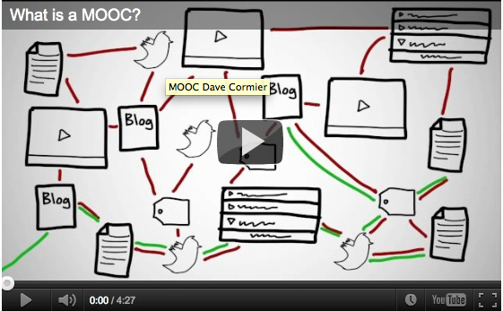
How to Learn in a cMOOC
Learning is a process of immersion into a knowing community
http://www.tonybates.ca/2012/03/03/more-reflections-on-moocs-and-mitx/

Slide 28
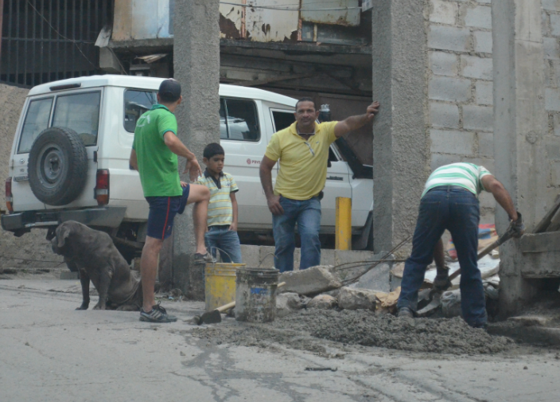
Learning is a process of recognizing and growing into or becoming an instantiation of those values…

Slide 29
How to Evaluate Learning
Learning is not possession of a collection of facts, it’s the expression of a capacity
Learning is recognized by a community of experts in a network
Learning analytics
We recognize our understandings…
…by the way we use them in our social network

Slide 30

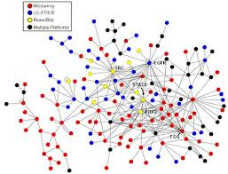
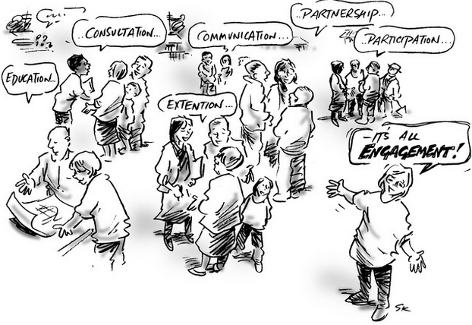

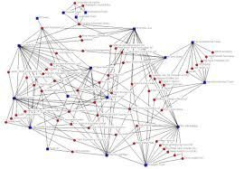
xLearning vs cLearning
contents
engagement
networks
http://www.corestandards.org/
http://www.magnet.edu/
http://lisahistory.net/wordpress/2012/08/three-kinds-of-moocs/

Slide 31
Personalized Personal
We do for you You do for yourself
Defines an ideal state
Defines a desired state
Content
Practice
Affordances
Correction
Requirements
Iteration
GAP
Practice
Content
Opport-unity
TEST
TRY
Person tests you
Person helps you

Slide 32
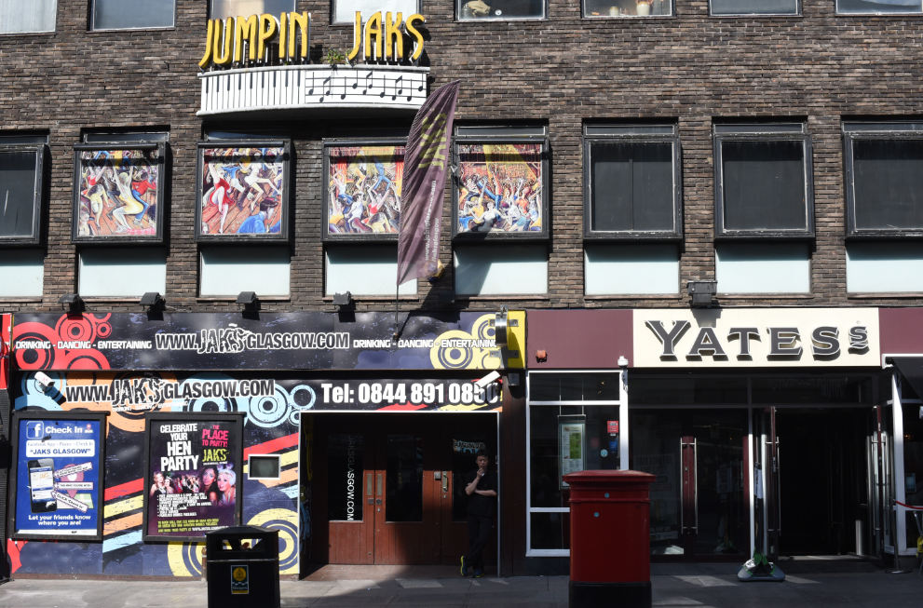
4. Personal Learning Environments

Slide 33
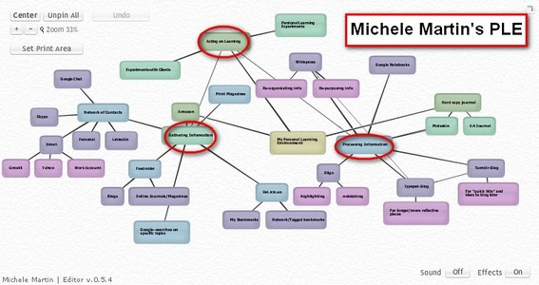
Personal Learning Environments
http://dmlcentral.net/blog/howard-rheingold/diy-u-interview-anya-kamenetz
http://www.downes.ca/post/58150
Notes:
Howard Rheingold searches for the new in Anya Kamenetz's Edupunk's Guide, suggesting that what has been added is the idea of the personal learning plan to the personal learning network. "Making a public commitment to something is going to increase your accountability," says Kamenetz. Rheingold writes, "Her work serves as a bridge between blended learning and peeragogy. I previously wrote about Shelly Terrell and personal learning networks" and asks here what it takes for a group to self-organize. Kamanetz responds that there needs to be a common understanding of the goal - of course, this would be the outcome of self-organization, not what makes it possible.

Slide 34
Underlying MOOC Support
1. First student creates resource and sends info to course
Site
2. Second student sees resource info in newsletter and RSS feed
3. Second student accesses the resource directly
4. Second student finds link to third student’s resource

Slide 35

















Course Provider Perspective
Subscribed
students
Student
content
Site
Course
content
Live online events
Event recordings

Slide 36
The Student’s Perspective
Site
A range of different resources and services

Slide 37
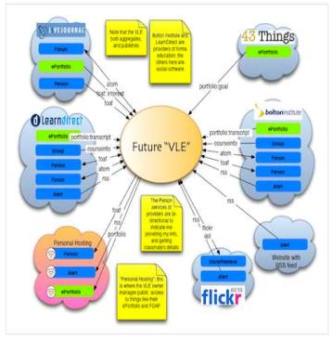
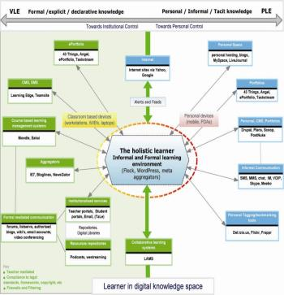
The design is based on putting the learner at the centre
Scott Wilson (left), Tim Hand (right)
https://www.google.com/search?q=ple+diagrams
http://www.edtechpost.ca/ple_diagrams/index.php/mind-map-3

Slide 38
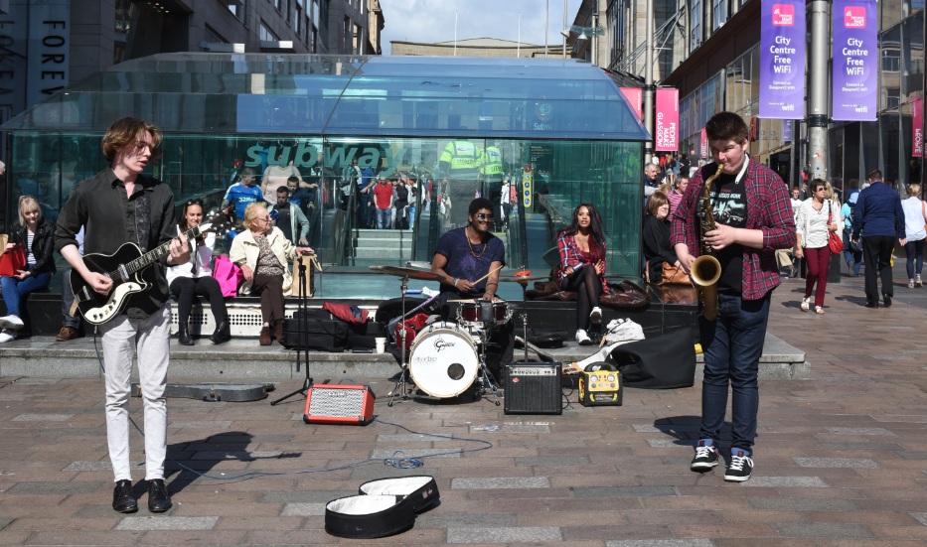
5. Learning and Performance Support Systems

Slide 39
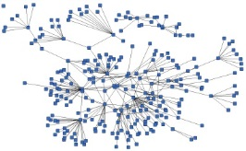
LPSS is Built Around the Personal Learning Record
This is a new type of data – we call it the personal graph.
Each person has their own private personal graph.
The PLR contains all a person’s learning records, including:
certificates, badges and credentials
activity records, test results, scores
Assignments, papers, drawings, things they create
Me

Slide 40
LPSS is Built Around the Personal Learning Record
Stuff Goes Out
Stuff Comes In
Learning Activities
I read and watch stuff
I play with toys
I make stuff
Things, Properties, Relations
Things I did
Stuff I make
Big stuff goes here
Me
Questions
Personal Library
Pictures
Books
Movies
Answers
Learning Analytics Services

Slide 41
LPSS Details
Data, Information Retrieval
Management Layer
Cleansing/Filtering/Profiling/Processing
Search/Recommendation Layer
Learning activity sequencing/modeling
Data Representation
RRN
CF
PLA
Prototype Repository
Standards/Communication protocols
PLR
Data Capture
Security Protocols
Security Protocols
Distributed Architecture
Personal Learning Record
PC
ACDR
Data synchronization
Personal Access to Network Storage
Cloud Storage and Management
Performance Trends Algorithm
Competence Development
Automated Assessment

Slide 42
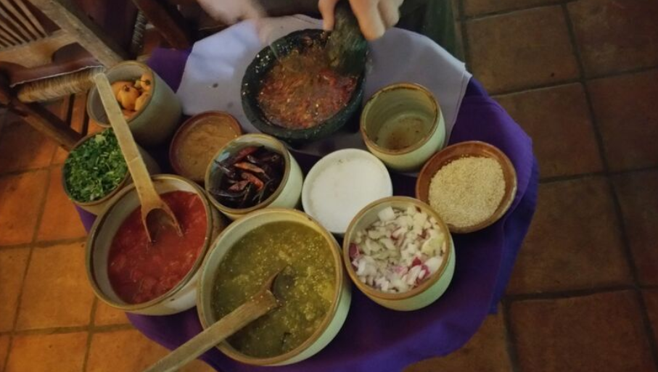
Resource Repository Network (RRN)
Assemble resources from multiple locations

Slide 43
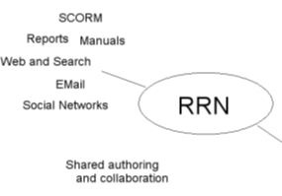
Resource Repository Network
Manage and discover list of sources and resources
Maintain authentication and credentials
Support APIs and metadata standards
Gather, analyze and sort resources and/or metadata

Slide 44
RRN Aggregation and Storage
Personal
Context
Article
Photograph
Video
Person
Author
Publisher
Organization
Job Opportunity
Competency
Cetrificate
Event
Location / Place
Time / Date
Email
RSS
OAI
Sharepoint
Facebook
Twitter
Monster
Government
Repositories
Desire2Learn
Coursera
EdX
etc
Parsing
Scraping
Analytics
etc
Storage
RELATIONS

Slide 45
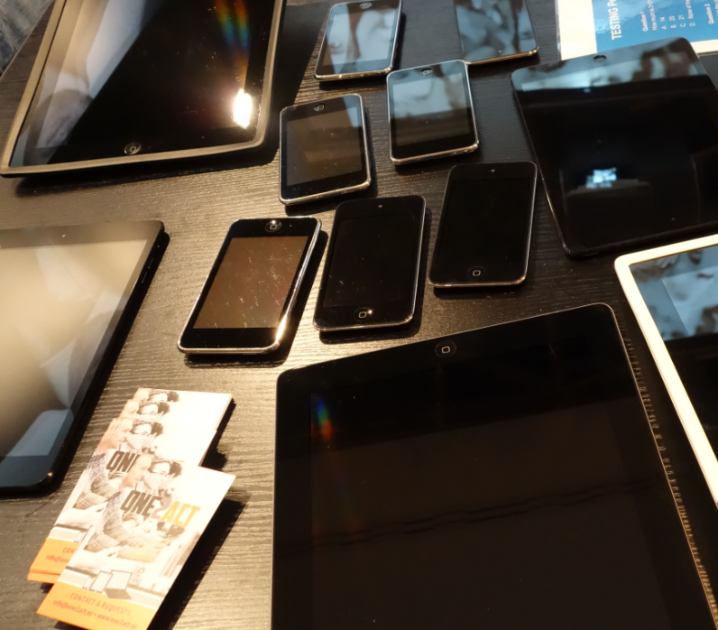
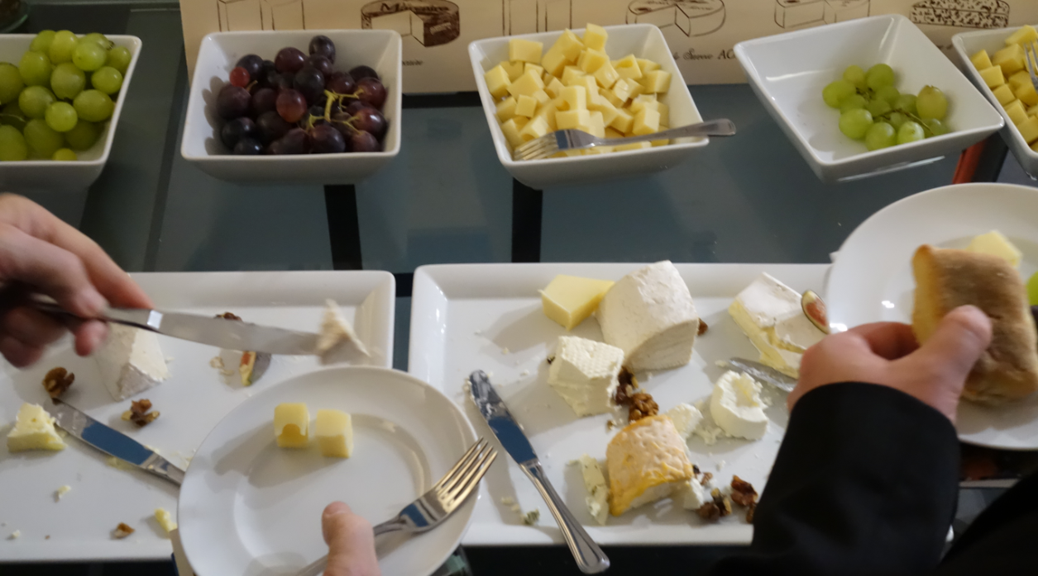
Personal Cloud
Synchronized cloud data services (including Owncloud) to support data portability

Slide 46
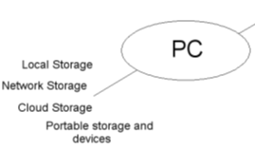
Personal Cloud
Manage list of local and remote storage systems
Maintain security, encryption, authentication and credentials
Include local or personal device storage
Manage and synchronize resource sets and data

Slide 47
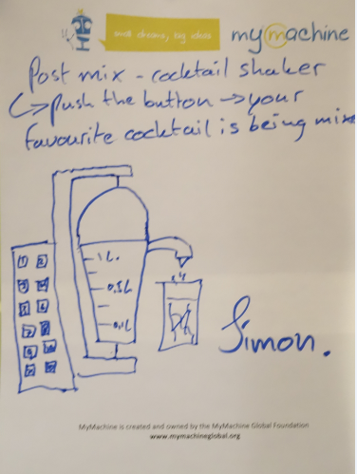
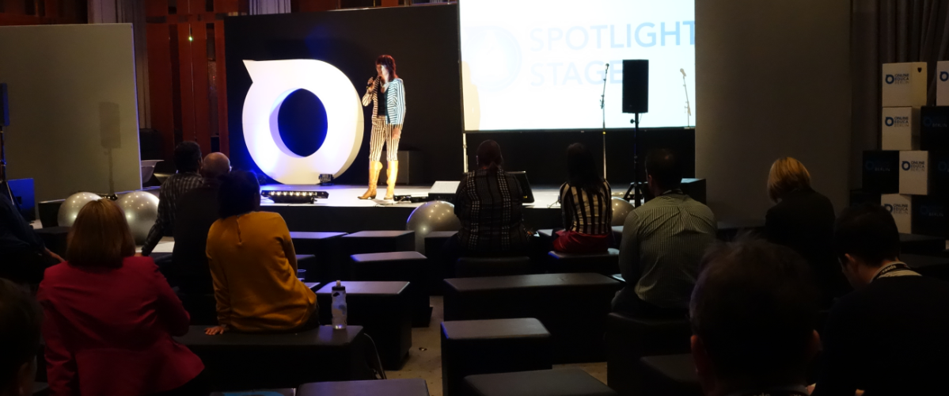
Personal Learning Assistant
Projection of learning services into multiple platforms

Slide 48
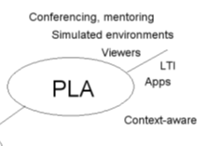
Personal Learning Assistant
Collect contextual information for system
Display resources of various formats, including SCORM, LTI, etc.
Support (scaffolded) authoring environments
Project LPSS capacity into external software and devices

Slide 49
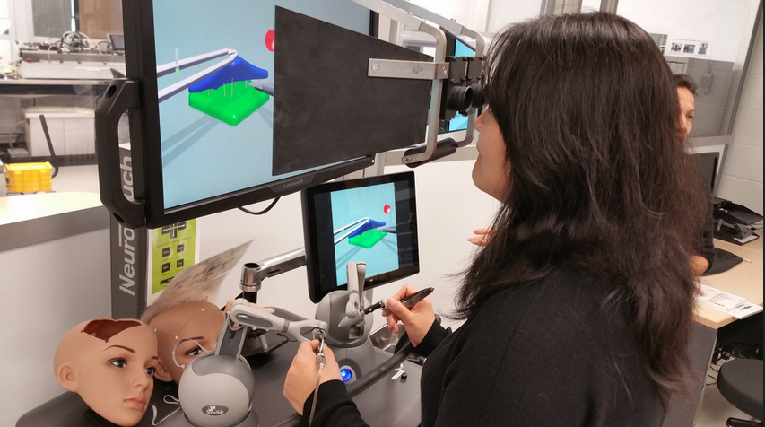
PLA: Collecting xAPI from Med Sims
https://www.flickr.com/photos/stephen_downes/15710336207/
http://www.nrc-cnrc.gc.ca/eng/rd/medical/

Slide 50

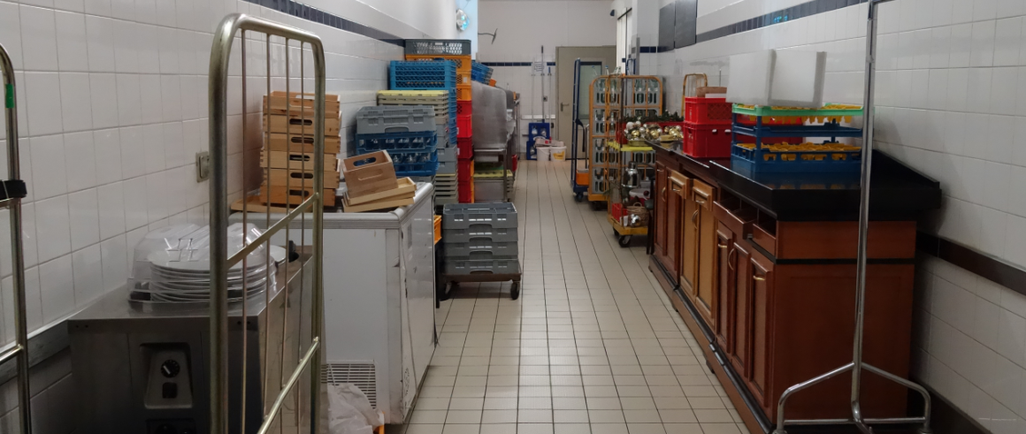
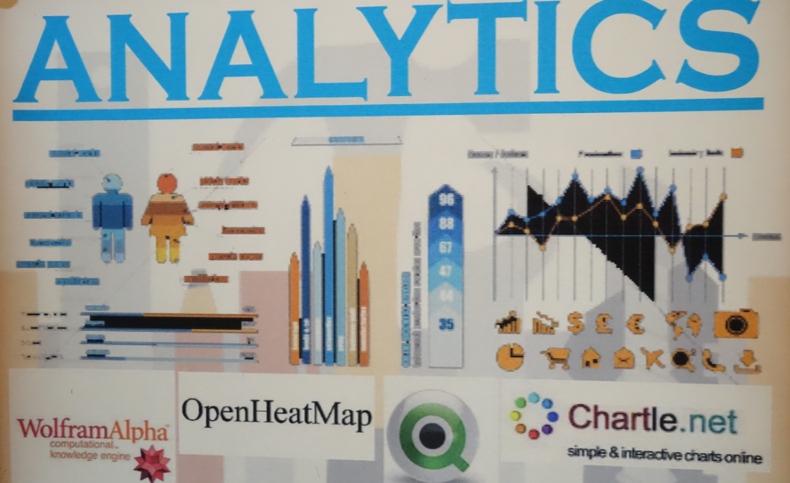
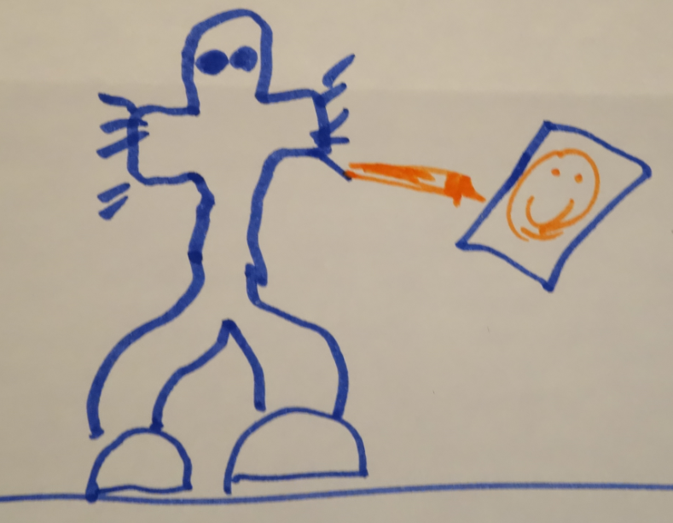
Automated Competency Recognition and Development

Slide 51
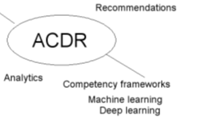
Automated Competency Recognition and Development
Import or create competency definitions
Analyze interactions for skills and learning gaps
Support development of learning plans
Provide resource and service recommendations

Slide 52
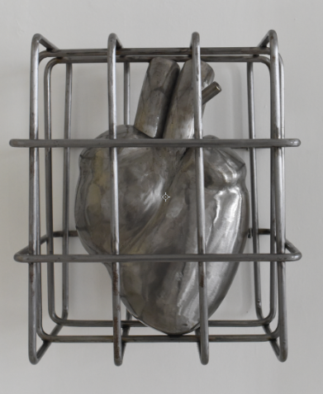
Personal Learning Record
The Personal Learning Record – data owned by the individual, shared only with permissions
http://halfanhour.blogspot.de/2014/12/eportfolios-and-badges-workshop-oeb14.html

Slide 53
Personal Learning Record
OERs
Portfolio, artifacts and evidence
Badges, certificates, credentials, competencies
Activity Record - LRS
PLR

Slide 54

Personal Learning Record
Collect full record of interactions with all resources, external systems
Support learning activity data exchange formats (eg. xAPI)
Collect and present a person’s personal portfolio
Display certifications and credentials (eg. badges)
Maintain 3rd party certification

Slide 55

6. Expanding LPSS

Slide 56
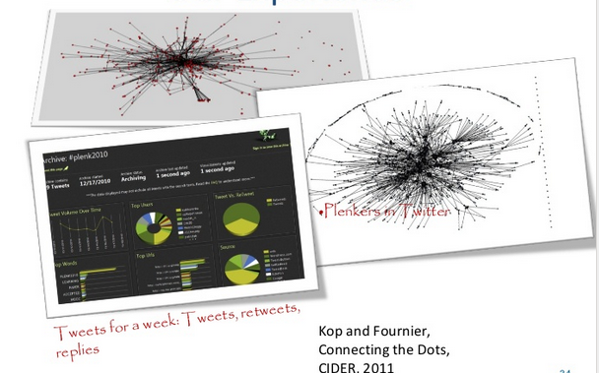
Plearn – Importance of the Graph
http://www.slideshare.net/Downes/after-moodle
http://www.slideshare.net/Ritakop/kopfourniercanadianinstitutedistanceeducationresearchple

Slide 57
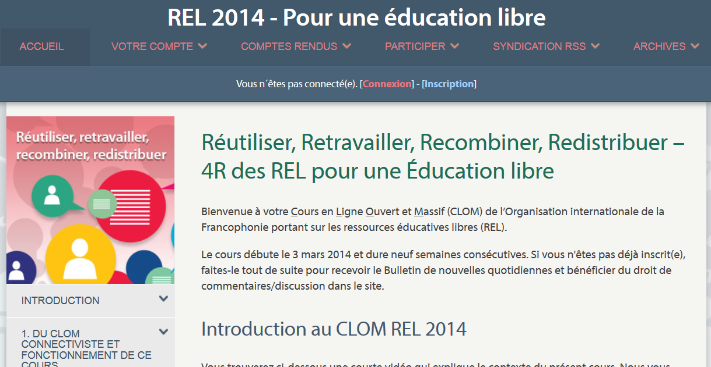
OIF – MOOC-REL
http://rel2014.mooc.ca/

Slide 58
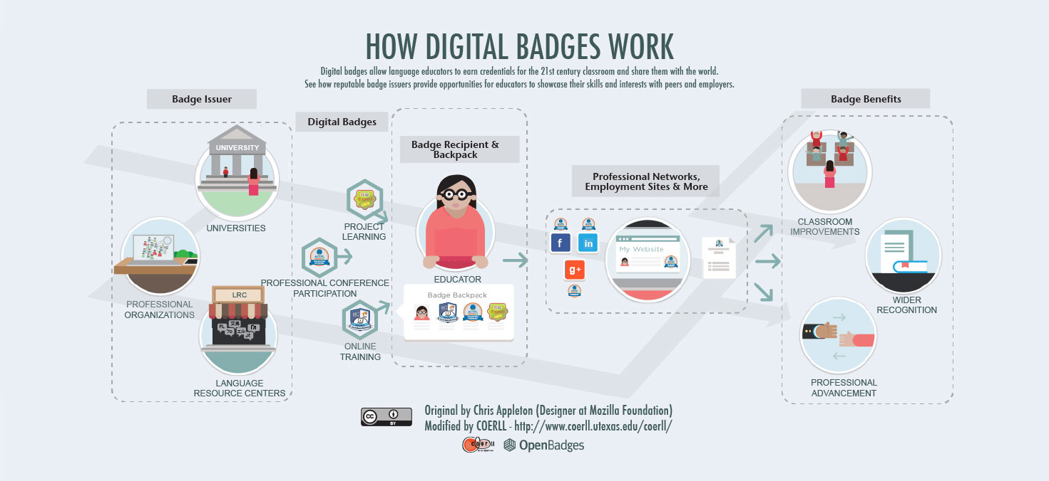
PCO Badges for Learning
http://www.downes.ca/post/63738

Slide 59
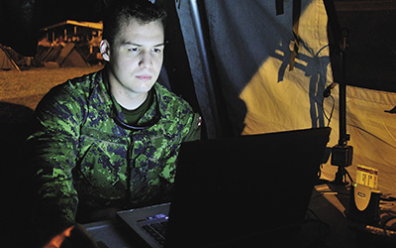
ONGARDE
http://www.journal.forces.gc.ca/vol14/no2/page70-eng.asp

Slide 60


ALECSO – Capacity Building
http://www.downes.ca/presentation/337

Slide 61

Concierge OMS
https://concierge.portal.gc.ca/

Slide 62

Implementation Projects
Ultimately, the objective is to support individual learning in a network
http://integralleadershipmanifesto.com/manifesto/making-subject-object/

Slide 63
Expanding LPSS
$20 Million Investment
NRC Technologies
Development Environment
$x + $y
Project
NRC
Funder
$y
Partner
University
Government
Development Agency
Foundation
UNESCO / UN
Corporate Partner
$x

Slide 64

Possible Projects…
OERs, Repositories, Marketplaces
Badges, Credentials, Recognition
Simulations & Workplace Support
Matching People to Opportunities

Slide 65

Stephen Downes
http://www.downes.ca

Slide 67
Success Factors

Slide 68

Success Factors (The Wealth of Nations)
What sort of decentralized network will best support learning-as-growth?

Slide 69



The Semantic Condition
Autonomy, diversity, openness, interactivity
These conditions are the conditions for a constructive dialogue…
And are thus the design principles for a MOOC
http://itforum.coe.uga.edu/paper92/paper92.html

Slide 70
The Objective of Learning
Learning is not acquisition, it is growth
It is about the personal development of each person
  Not just what the person ‘knows’
  Equally important is a person’s sense of value and place in society

Slide 71
Knowledge Translation

Slide 72
Knowledge Translation
CIHR – “CIHR, knowledge translation (KT) is defined as a dynamic and iterative process that includes synthesis, dissemination, exchange and ethically-sound application of knowledge to improve the health of Canadians.”
CIHR, http://www.cihr-irsc.gc.ca/e/39033.html

Slide 73
Synthesis
the contextualization and integration of research findings of individual research studies within the larger body of knowledge on the topic.
a systematic review, follow the methods developed by the Cochrane Collaboration, result from a consensus conference or expert panel or synthesize qualitative or quantitative results.

Slide 74
Dissemination
“…summaries for / briefings to stakeholders, educational sessions with patients, practitioners and/or policy makers, engaging knowledge users in developing and executing dissemination / implementation plan.”

Slide 75
Exchange
“interaction between the knowledge user (decision maker) and the researcher…”
“results in mutual learning through the process of planning, producing, disseminating, and applying existing or new research in decision-making…”

Slide 76
Application
“the iterative process by which knowledge is put into practice...”
“…while keeping in mind that principles, values and laws can compete among and between each other at any given point in time.”

Slide 77
Criticisms…
The ‘knowledge translation model implies a set of facts that can be ‘known’ and applied to practice
In practice, knowledge is often contextual and ‘constructed’ after the fact
  Consider, for example, the case of recognizing your mother at the train station
  Consider, for example, the practice of riding a bicycle (cf Polanyi)

Slide 78
Criticisms…
“research should move beyond a narrow focus on the ‘know–do gap’ to cover a richer agenda…”
  situation-specific practical wisdom (phronesis)
  tacit knowledge shared among practitioners (‘mindlines’)
  complex links between power and knowledge; and
  macro-level knowledge partnerships
Greenhalgh and Weiringa, http://jrs.sagepub.com/content/104/12/501.full

