Slide 1
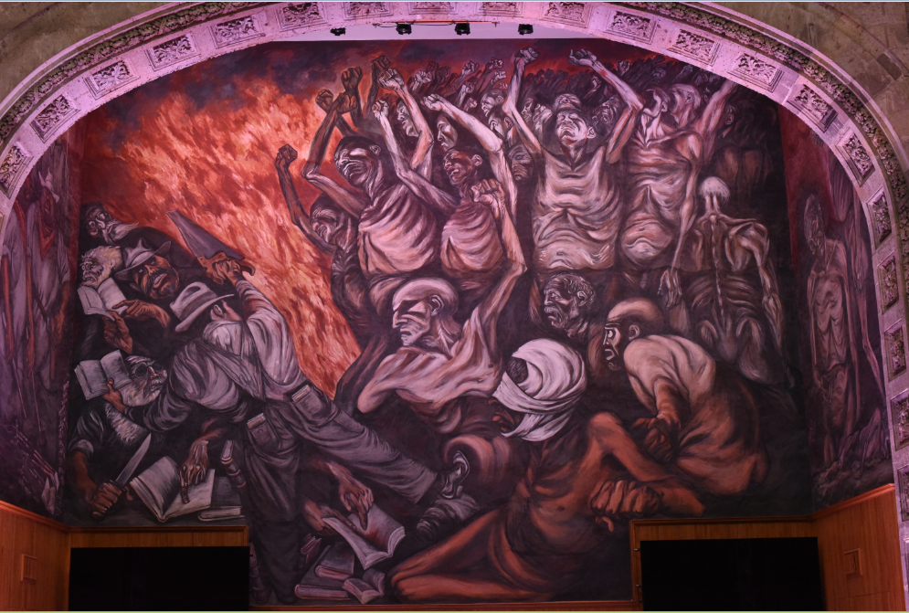
Design Elements in a Personal Learning Environment
Stephen Downes
Guadalajara, Mexico
August 17, 2015

Slide 2

Challenges and Opportunities
Technology surrounds us with new opportunities, yet we face historical challenges

Slide 3

… For Institutons
Changing business models are challenging established institutions
  Music Industry
  Publishing Industry
  Uber, AirBNB
Centralized design model making it difficult to adapt to changing needs
  Curricula
  Standardized Tests
  Robot Instructors

Slide 4






… For Government and Society
Skills shortages and productivity gaps
Canadian Oil and Gas (O&G) sector loses $4 billion per year due to skills shortages.
Skilled and professional unemployment rate less than 1%.
Training current and prospective employees time-consuming and expensive.
August 26, 2013

Slide 5

… For Individual Learners
Access to learning opportunities remain elusive
The cost of tuition and textbooks is too high
Learning and development needs continue after graduation
Difficulties exist in finding employment and matching skills to opportunities

Slide 6
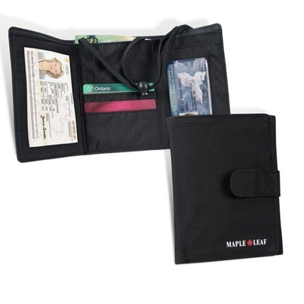
Our Approach: Personal Learning and Performance Support Systems
Single point of access
to all skills development and training needs
It’s personal and you carry it with you
It’s a network – we don’t put everything in one package
Different types of things, not just courses:
  Access to learning resources
  Calling cards and communications
  Credentials, permits and licenses
Notes:
Emphasize that it’s personal and you carry it with you
Note that it’s a network – we don’t put everything in one package, but develop an infrastructure that links relevant resources
Different types of things, not just courses:
Access to learning resources
Calling cards and communication tools
Credentials, permits and licenses

Slide 7


Why NRC? Our Distinct Leverage
NRC is a globally recognized leader in emerging learning technologies
  LPSS benefits from NRC’s research in other fields
NRC is deeply connected to the e-learning industry
  NRC by contrast has collaboration and commercialization experience
  Neutral broker reduces risk to technology development partners
Notes:
NRC owns existing component technologies that de-risk solution development and reduce time to market: TRL range from 3 to 9.
These are not technologies owned or likely to be developed by either O&G or learning technology industries
Expertise. NRC is a globally recognized leader in emerging learning technologies with a proven track record of forecasting where technology will be years in advance of the field.
Because we aren’t in the business of selling oil, software or content, we can provide a crucial horizontal link between the enterprises that do.
NRC has successfully developed, transferred and licensed learning technologies to solution providers, such as with Desire2Learn Inc.

Slide 8
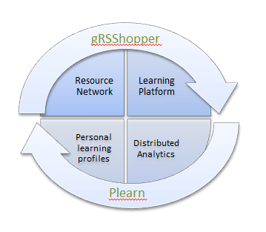
NRC – Previous Work in eLearning
eduSource Resource Repository Network (Canadian CANARIE Network)
Sifter/Filter Content Recommender (connercialized as RACOFI)
SHARE Sentiment Analysis
Synergic3 Collaborative Workflow (commecialized with Desire2Learn)
gRSShopper / MOOC / Connectivism
2Sim Haptic Simulations

Slide 9
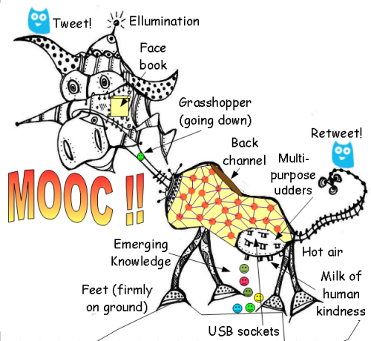
The MOOC
Massive – by design
Open – gratis and libre
Online – not blended, not wrapped
Courses – not communities, websites, video collections, etc

Slide 10
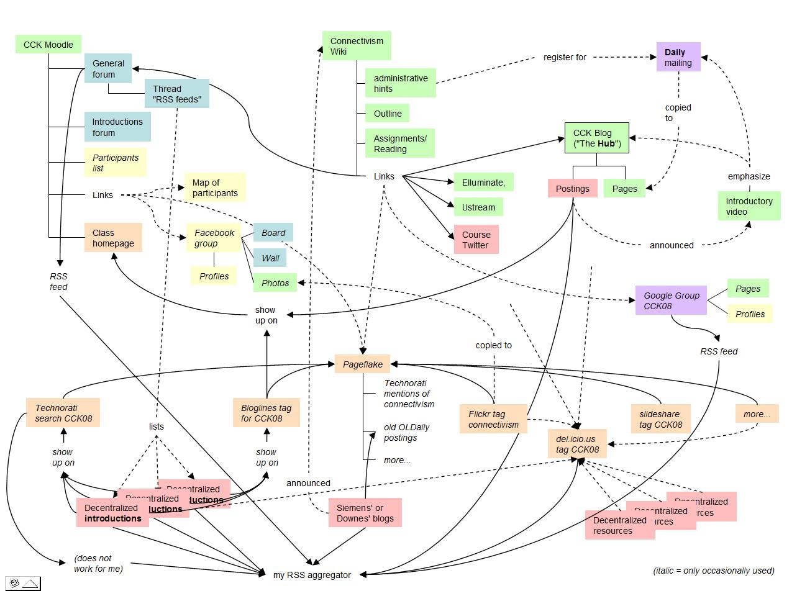
MOOC as Connected Applications
http://x28newblog.blog.uni-heidelberg.de/2008/09/06/cck08-first-impressions/

Slide 11
MOOC as One Part of a Wider Network
To us, a MOOC was not a single website or application, but instead, a way of connecting people to each other in order to share and learn cooperatively
MOOC

Slide 12
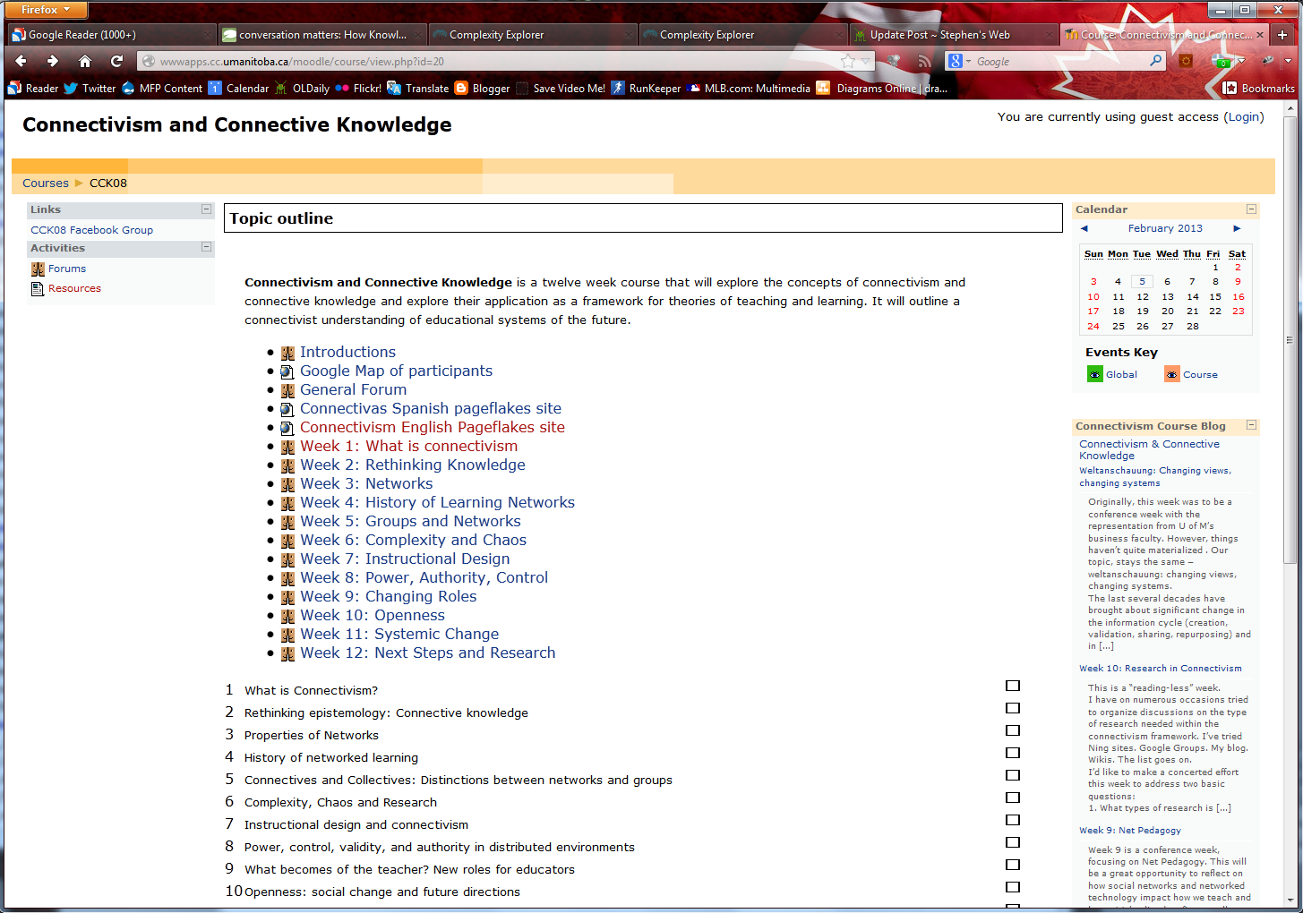
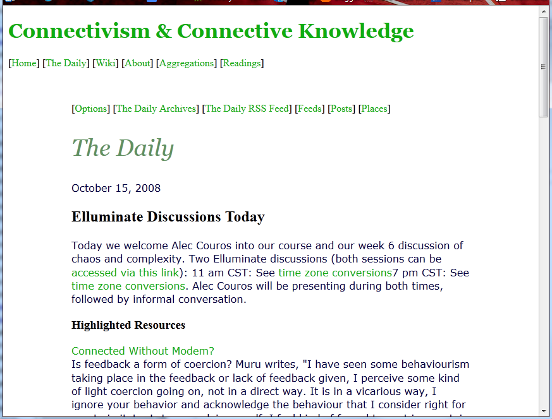
CCK08
http://wwwapps.cc.umanitoba.ca/moodle/course/view.php?id=20
2300 students
http://connect.downes.ca/cgi-bin/archive.cgi?page=thedaily.htm

Slide 13
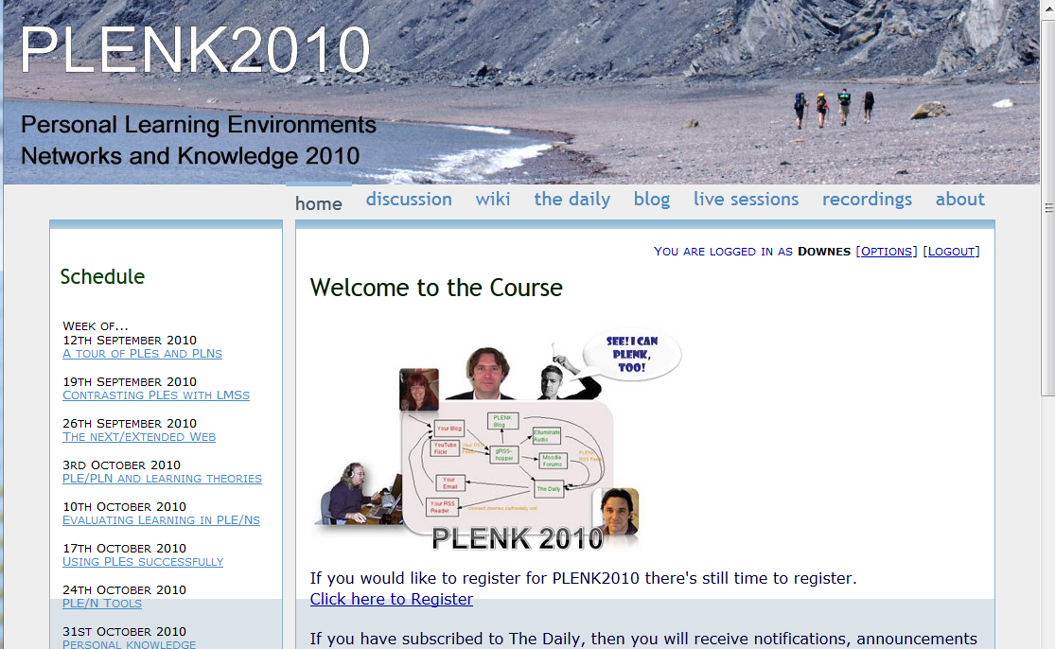
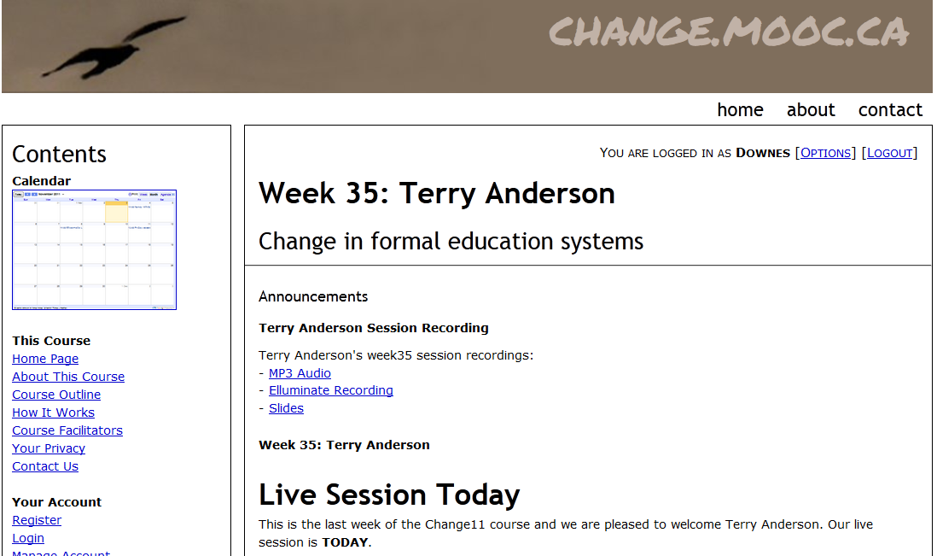

Other Courses
1800 students
http://connect.downes.ca/
2800 students
3000 students
http://change.mooc.ca/
http://edfuture.net/

Slide 14
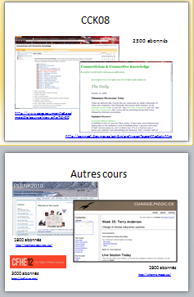

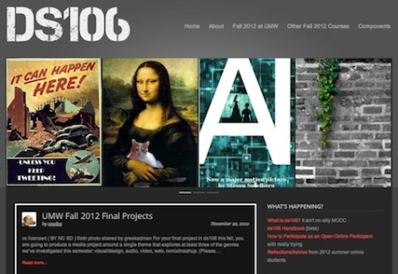
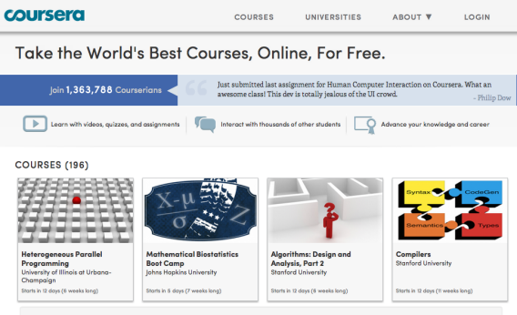

cMOOC vs xMOOC
networks
tasks
contents
https://www.ai-class.com/
http://ds106.us/history/
https://www.coursera.org/
http://lisahistory.net/wordpress/2012/08/three-kinds-of-moocs/

Slide 15

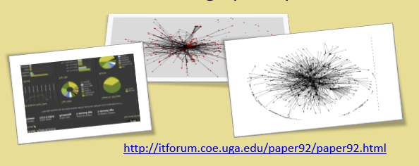
Design Principles
Autonomy
- Choice of contents
- Personal learning
- No curriculum
Openness
- Open access
- Open content
- Open activities
- Open assessment
Diversity
- Multiple tools
- Individual perspective
- Varied content
Interactivity
- Encourage communication
- Cooperative learning
- Emergent knowledge

Slide 16
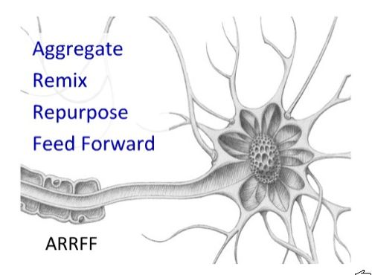
Pedagogy of the cMOOC
http://cogdogblog.com/2009/06/29/arrff/

Slide 17
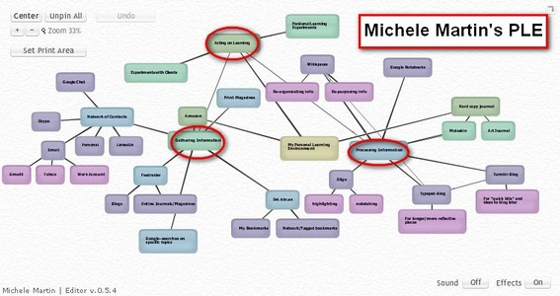
Personal Learning
http://dmlcentral.net/blog/howard-rheingold/diy-u-interview-anya-kamenetz
http://www.downes.ca/post/58150
Notes:
Howard Rheingold searches for the new in Anya Kamenetz's Edupunk's Guide, suggesting that what has been added is the idea of the personal learning plan to the personal learning network. "Making a public commitment to something is going to increase your accountability," says Kamenetz. Rheingold writes, "Her work serves as a bridge between blended learning and peeragogy. I previously wrote about Shelly Terrell and personal learning networks" and asks here what it takes for a group to self-organize. Kamanetz responds that there needs to be a common understanding of the goal - of course, this would be the outcome of self-organization, not what makes it possible.

Slide 18
Underlying MOOC Support
1. First student creates resource and sends info to course
Site
2. Second student sees resource info in newsletter and RSS feed
3. Second student accesses the resource directly
4. Second student finds link to third student’s resource

Slide 19

















Course Provider Perspective
Subscribed
students
Student
content
Site
Course
content
Live online events
Event recordings

Slide 20
The Student’s Perspective
Site
A range of different resources and services

Slide 21
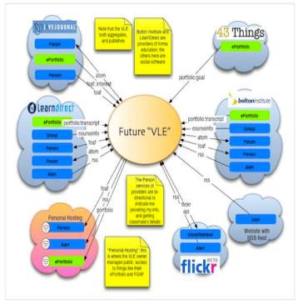
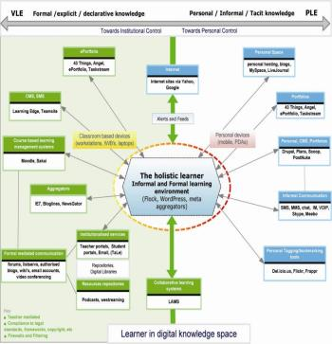
The design is based on putting the learner at the centre
Scott Wilson (left), Tim Hand (right)
https://www.google.com/search?q=ple+diagrams
http://www.edtechpost.ca/ple_diagrams/index.php/mind-map-3

Slide 22
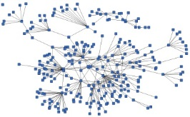
LPSS is Built Around the Personal Learning Record
This is a new type of data – we call it the personal graph.
Each person has their own private personal graph.
The PLR contains all a person’s learning records, including:
certificates, badges and credentials
activity records, test results, scores
Assignments, papers, drawings, things they create
Me

Slide 23
LPSS is Built Around the Personal Learning Record
Stuff Goes Out
Stuff Comes In
Learning Activities
I read and watch stuff
I play with toys
I make stuff
Things, Properties, Relations
Things I did
Stuff I make
Big stuff goes here
Me
Questions
Personal Library
Pictures
Books
Movies
Answers
Learning Analytics Services

Slide 24
Simplified Design of the LPSS Personal Learning Architecture
External Repositories
App
API
Resource Repository Network
Stand-alone Cloud
Personal Learning Assistant
Personal Learning Record
Personal Cloud
Automated Assessment
External Cloud Storage
External Graph

Slide 25
Learning and Performance Support System:
Core Technology Development Projects
Learning services network and marketplace
Automated skills development and recognition
Lifetime management of learning and training records and credentials
Personal learning assistant to view, update and access training
Simulations and Tools
Resource Network
Learning Assistant
Automate Skills Dev.
Personal Learning Records
Notes:
the solution would consist of the main components as shown on the slide
Resource Repository Network – will create a resource graph from multiple sources and multiple formats including live and dynamic data such as oilfield data, refinery instrumentation, or Oil and Gas market information.
Automated Competence Development And Recognition – whereas existing recommender systems depend on manually defined metrics, this system will detect new and emerging competences and automatically assess employee performance.
Personal Learning Record - this project will define how we represent, capture, and leverage user activity, including ratings, test results, performance measures, and the like, in a distributed learning and work environment.
Personal Learning Assistant – this project will develop an integrated learning appliance, a mechanism for looking up or finding references or resources inside other programs or environments.
Learning as a Cloud Service - will create a distributed learning layer, which is mechanism for working with data no matter where it is stored, through desktop, mobile and other devices.

Slide 26
Program Design and Scope
WAVE
Workflow Analysis, Visualization and Enhancement
MOOC-REL
Massive Open Online Course Ressources Éducatives Libres
MINT
Multimodal INteractive Trainer
RRN
PCL
PLR
ACDR
PLA
WORLD
DATA
EXTERNAL
DATA Services
EXTERNAL
APPS
COMMON PLATFORM
Services, Communications, Management
MATS
Program
Technologies
NRC Programs
Government
Departments
Blue: Core technology projects
Orange: Implementation projects with commercial clients
Grey: Infrastructure, other NRC programs, external services

Slide 27
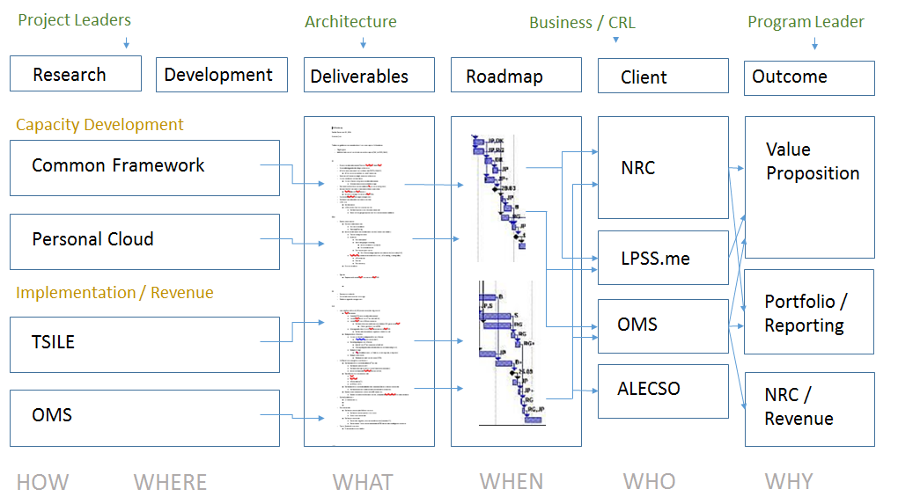
Program Organization

Slide 28
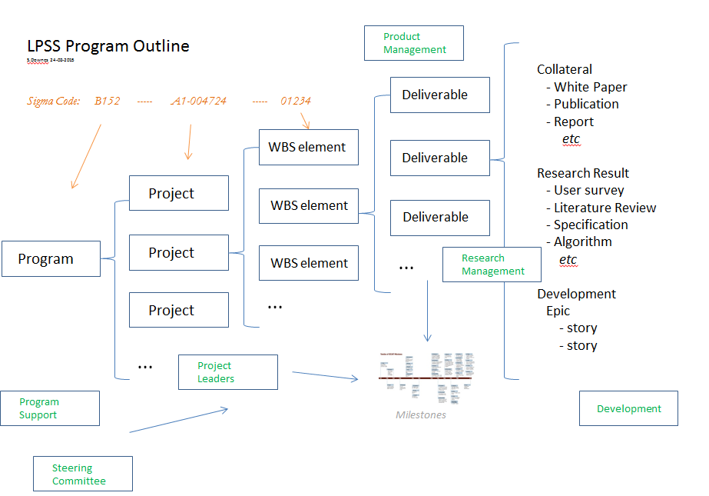
Program Outline

Slide 29
Project Details
Data, Information Retrieval
Management Layer
Cleansing/Filtering/Profiling/Processing
Search/Recommendation Layer
Data Representation
Learning activity sequencing/modeling
Prototype Repository
RRN
CF
PLA
Standards/Communication protocols
PLR
Data Capture
Security Protocols
Security Protocols
Distributed Architecture
Personal Learning Record
PC
ACDR
Data synchronization
Personal Access to Network Storage
TROI (Training Return on Investment) analytics
Cloud Storage and Management
Performance Trends Algorithm
Competence Development
Automated Assessment

Slide 30
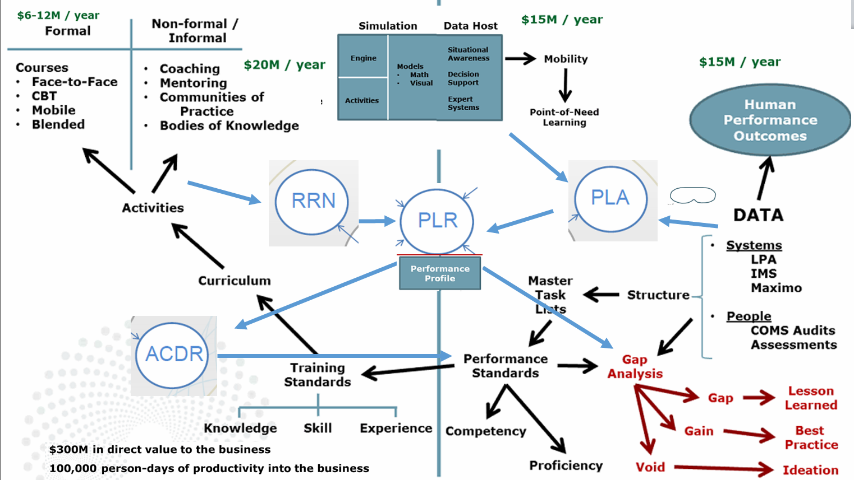
LPSS in Context

Slide 31
Why is this Difficult?
It’s not one big thing…
… but a set of many small things
Tasks that are simple in an enterprise system…
  Like data storage
  Like content distribution
  Like authentication
  Like analytics
… become that much more difficult

Slide 32
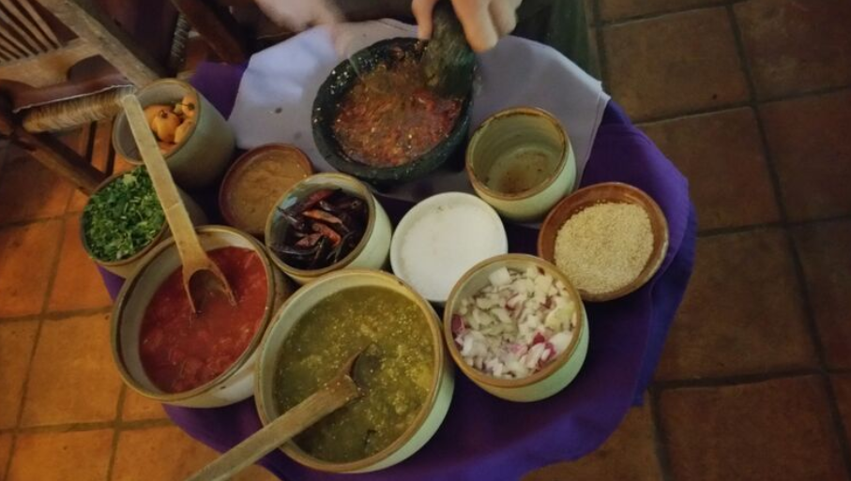
Resource Repository Network
Assemble resources from multiple locations

Slide 33
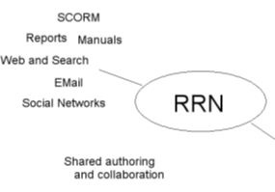

Resource Repository Network
* Manage and discover list of sources and resources
* Maintain authentication and credentials
* Support APIs and metadata standards
* Gather, analyze and sort resources and/or metadata

Slide 34
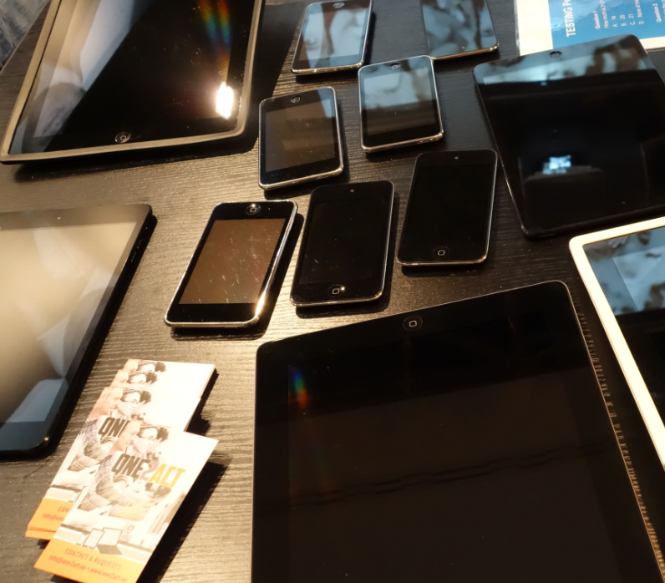
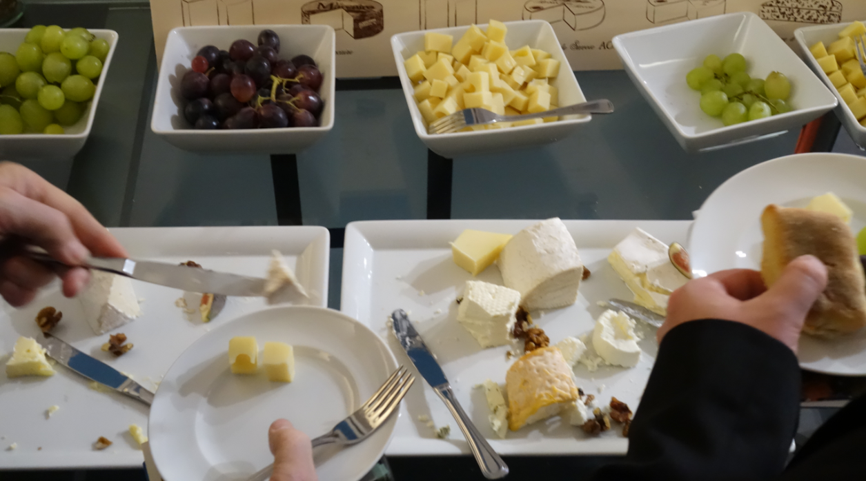
Personal Cloud
Synchronized cloud data services (including Owncloud) to support data portability

Slide 35
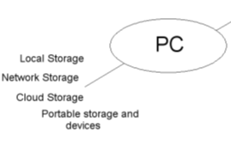
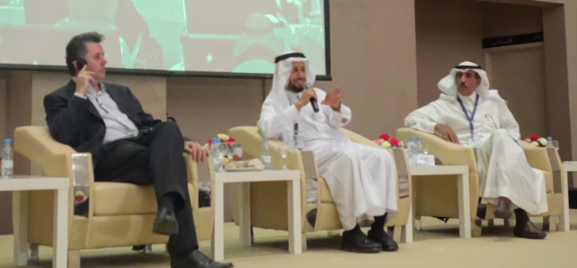
Personal Cloud
* Manage list of local and remote storage systems
* Maintain security, encryption, authentication and credentials
* Include local or personal device storage
* Manage and synchronize resource sets and data

Slide 36
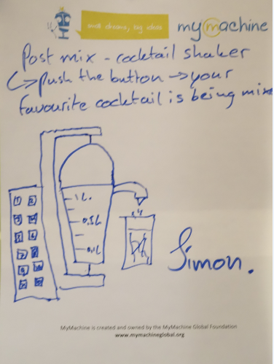
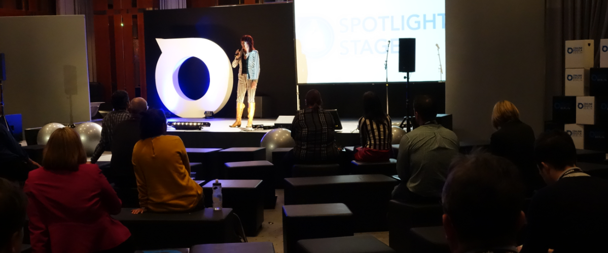
Personal Learning Assistant
Projection of learning services into multiple platforms

Slide 37
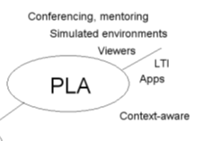
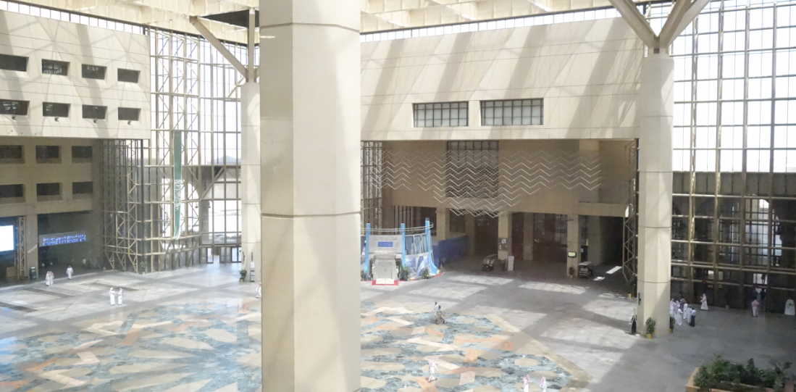
Personal Learning Assistant
* Collect contextual information for system
* Display resources of various formats, including SCORM, LTI, etc.
* Support (scaffolded) authoring environments
* Project LPSS capacity into external software and devices

Slide 38
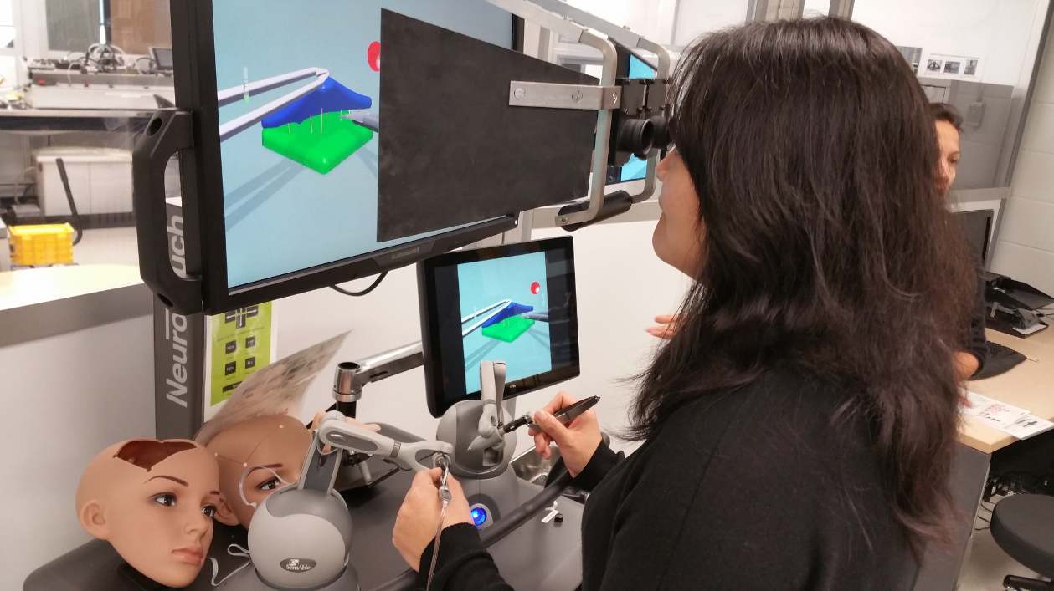
PLA Simulations Project
Connecting to real learning and workplace environments
http://www.nrc-cnrc.gc.ca/eng/rd/medical/

Slide 39

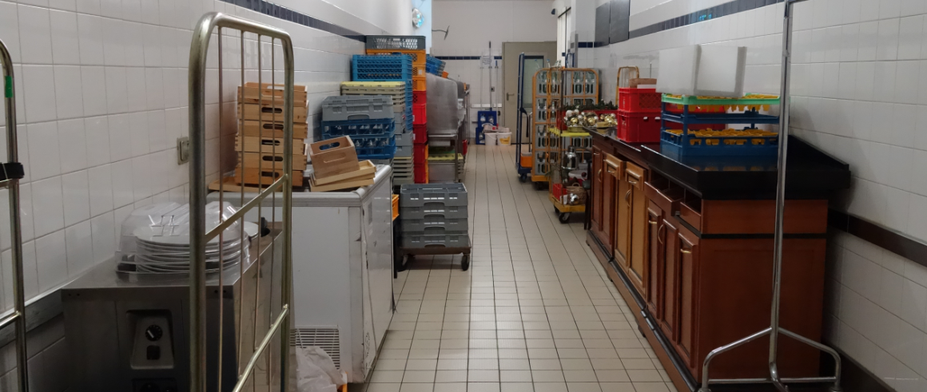
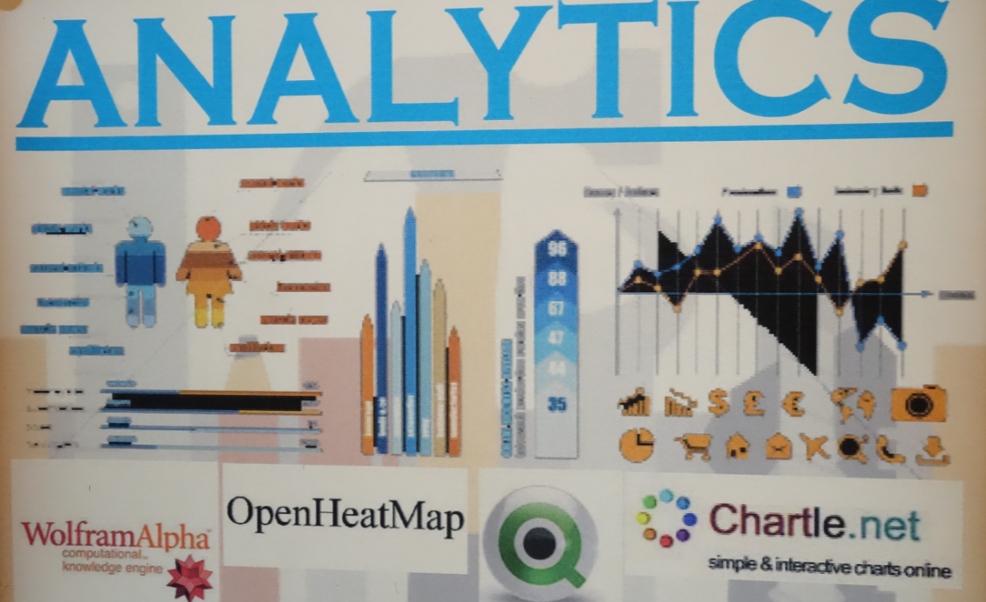
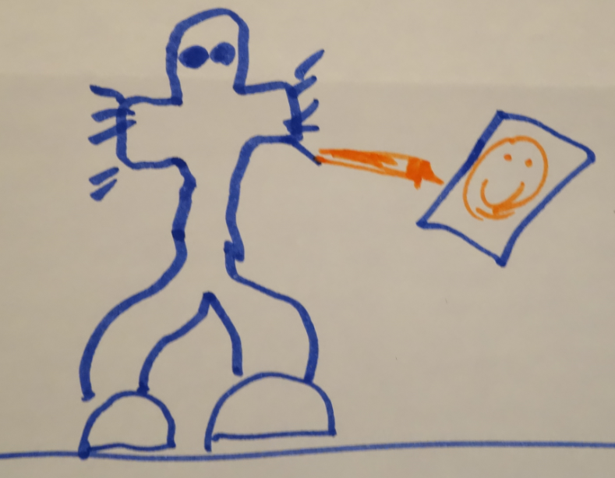
Automated Competency Recognition and Development
Analytics as a service – analogy with web translation

Slide 40
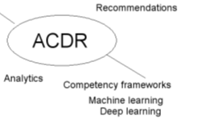
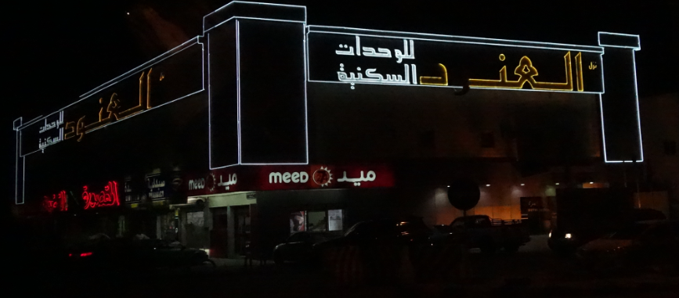
Automated Competency Recognition and Development
* Import or create competency definitions
* Analyze interactions for skills and learning gaps
* Support development of learning plans
* Provide resource and service recommendations

Slide 41

Personal Learning Record
The Personal Learning Record – data owned by the individual, shared only with permissions
http://halfanhour.blogspot.de/2014/12/eportfolios-and-badges-workshop-oeb14.html

Slide 42

Personal Learning Record
* Collect full record of interactions with all resources, external systems
* Support learning activity data exchange formats (eg. xAPI)
* Collect and present a person’s personal portfolio
* Display certifications and credentials (eg. badges)
* Maintain 3rd party certification

Slide 43
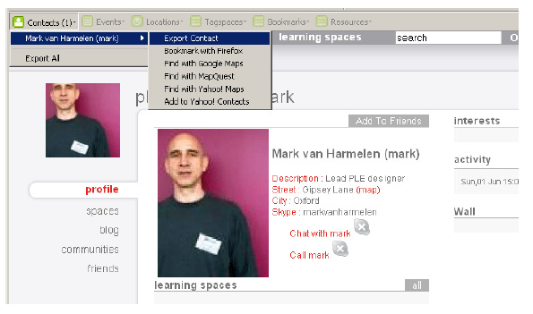
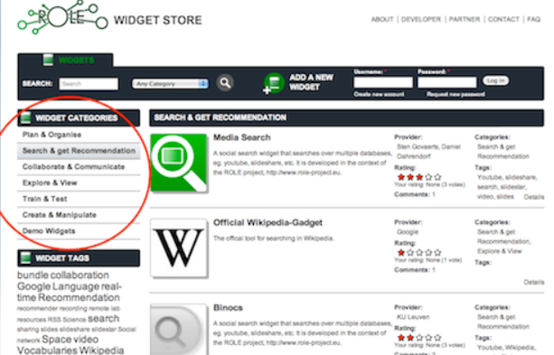
Relevant PLR Projects
Manchester PLE Project
Responsive Open Learning Environments (ROLE) http://www.role-project.eu/
Known http://withknown.com/
Learning Locker http://learninglocker.net/
Mahara https://mahara.org/
http://personalis.wikispaces.com/PLE+Projects

Slide 44
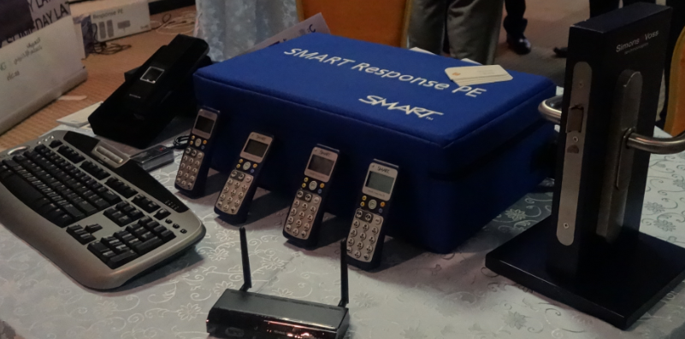
Implementation – from MOOC to Personal Learning
MOOC-REL (OIF)
ALECSO
MINT
PCO Badges
TSILE xAPI
2Sim Simulator xAPI
Workplace T&D

Slide 45
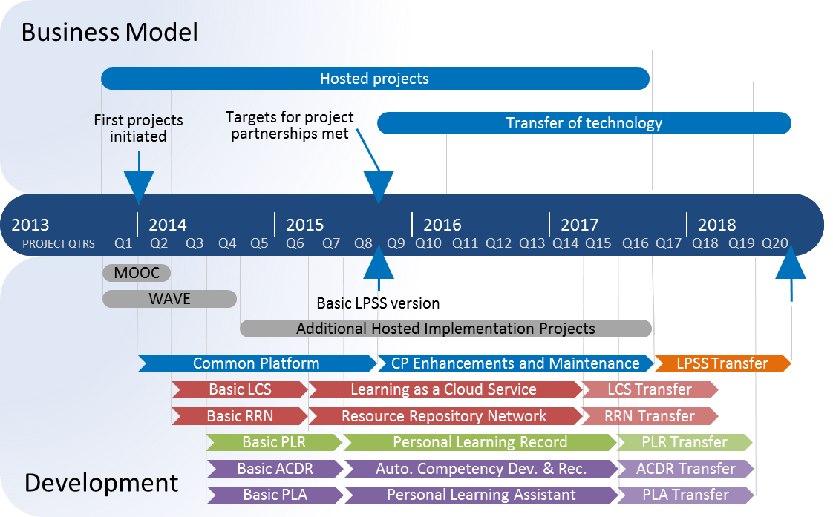
Program Implementation Timeline
Notes:
Note the two phases mentioned earlier are overlapping

Slide 46
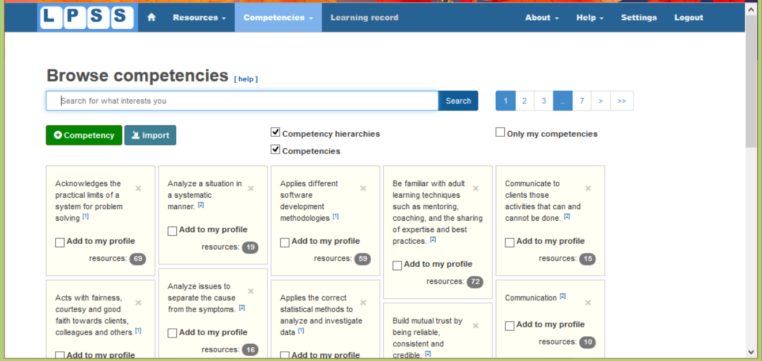
http://lpss.me – prototype PLE

Slide 47
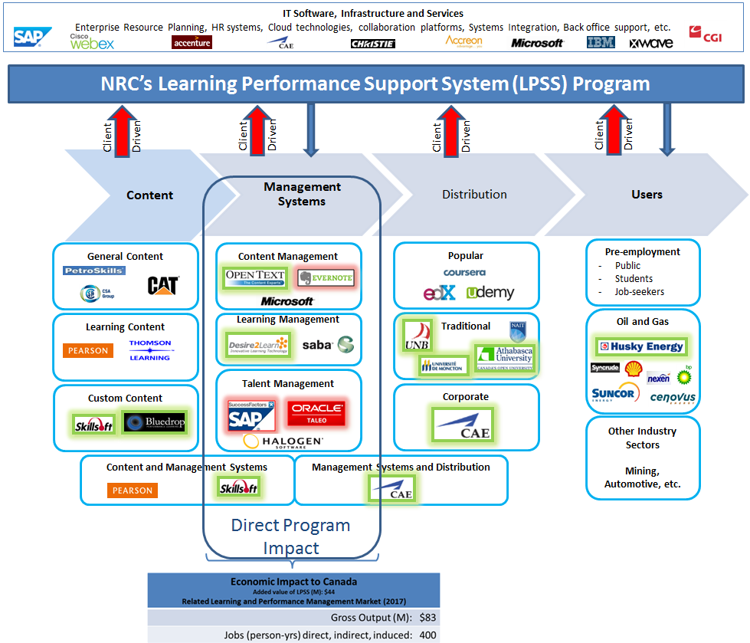
LPSS in Canada’s Learning Technology Marketplace
Notes:
A lot of movement and interest in the sector
D2L - $80-million from OMERS Ventures, the venture capital arm of the $55-billion pension giant, and New Enterprise Associates, a U.S.-based VC firm with about $11-billion in committed capital that has funded more than 650 companies.
Blackboard – taken private by Providence Equity Partners for about $1.64-billion
We fit in the Management Systems box
but work with providers and distributors to develop services, understand client needs
LMS – a lot of players, difficult to be first mover
very dependent on end-user needs but bound by legacy systems
we’ll work mostly with the Oil & Gas end users (to satisfy their needs)
but will help partners expand beyond to other verticals
partners within these two boxes will be chosen on their ability to invest and deliver.

Slide 48
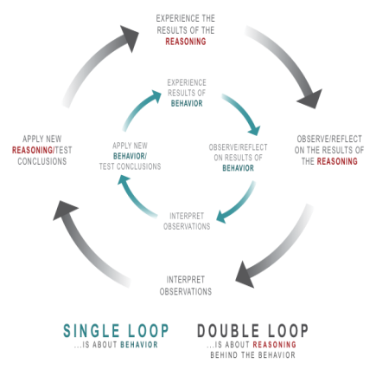
Implementation Projects
Ultimately, the objective is to support individual learning in a network
http://integralleadershipmanifesto.com/manifesto/making-subject-object/

Slide 49
Expanding LPSS
$20 Million Investment
NRC Technologies
Development Environment
$x + $y
Project
NRC
Funder
$y
Partner
University
Government
Development Agency
Foundation
UNESCO / UN
Corporate Partner
$x

Slide 50
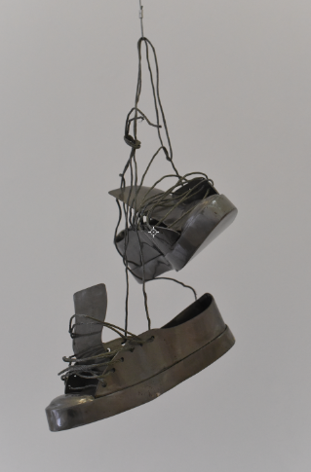
Possible Projects…
OERs, Repositories, Marketplaces
eg. OIF MOOC, ALECSO
Badges, Credentials, Recognition
eg. PCO Badge Project, TSILEE xAPI
Simulations & Workplace Support
eg. MINT, 2Sim
Matching People to Opportunities
eg. Concierge, Micromissions

Slide 51

Thank you
Stephen Downes
LPSS program Leader
+1 (506) 861-0955
Stephen.Downes@nrc-cnrc.gc.ca
http://www.nrc-cnrc.gc.ca

