Slide 1
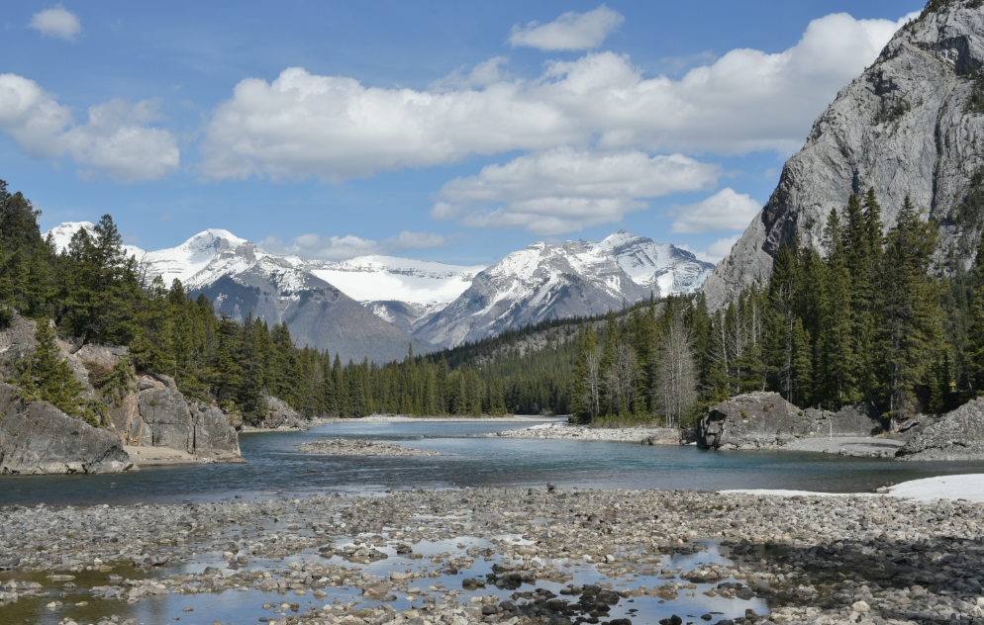
Open Education and
Personal Learning http://www.downes.ca/presentation/360
Stephen Downes
OE Global, Banff, Alberta
April 23, 2015

Slide 2
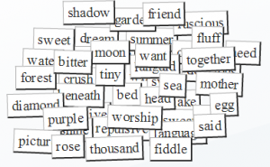
Think of OERs as words in a conversation

Slide 3

It forces us to think about how they can be used.
http://oerworkshop.pbworks.com/w/page/33932297/OER%20Workshop

Slide 4
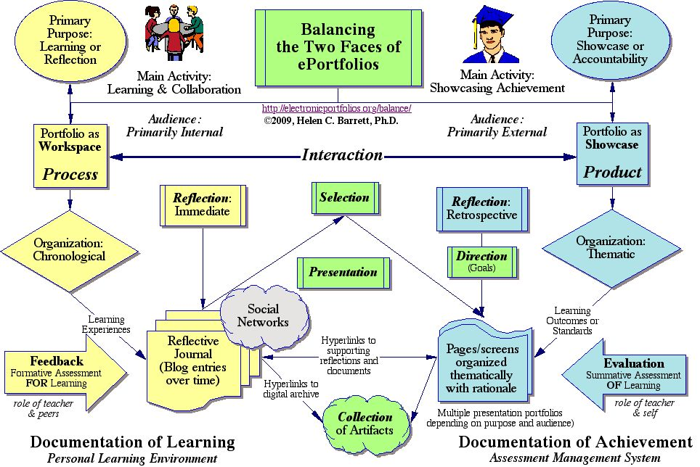
Consider how words are used in education.
http://electronicportfolios.org/balance/index.html

Slide 5
We are constrained in so many ways
Limited to objectives and educational purpose
The words have to contain educational content
They must perform (say) one of Gagne’s tasks
That pedagogy is limited to one of knowledge transfer
Students are rendered essentially mute
http://citt.ufl.edu/tools/gagnes-9-events-of-instruction/

Slide 6
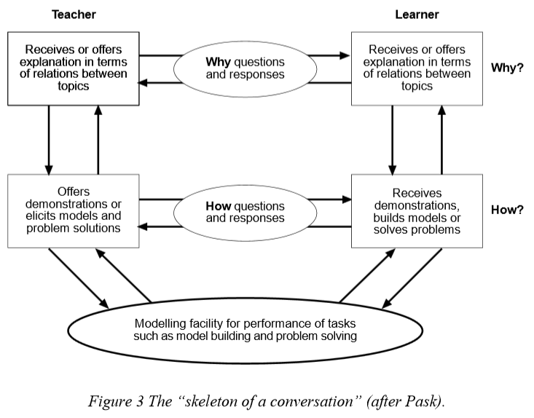
Pask: Conversational Theory
https://www.univie.ac.at/constructivism/pub/fos/pdf/scott.pdf

Slide 7
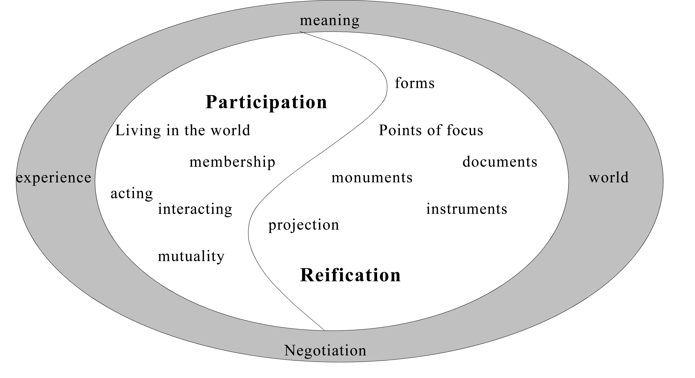
Knowledge is reified by, and is the product of, not only an individual, but of the wider community.
http://www.informationr.net/ir/8-1/paper142.html

Slide 8

What are OERs?
“OERs range from textbooks to curricula, syllabi, lecture notes, assignments, tests, projects, audio, video and animation.”
http://www.unesco.org/new/en/communication-and-information/access-to-knowledge/open-educational-resources/what-are-open-educational-resources-oers/

Slide 9

So what follows?
Deconstructing OERs
Representing knowledge and understanding
Students as authors of OERs

Slide 10
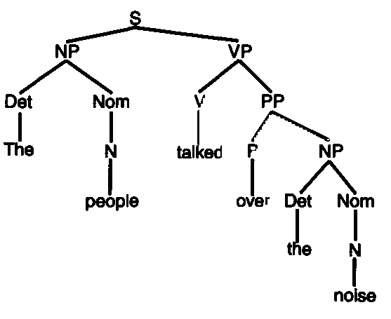
Deconstructing Sentences
A simple sentence has subject-object-verb
A complex sentence can have much more
http://language-theory.pl/language629.html

Slide 11
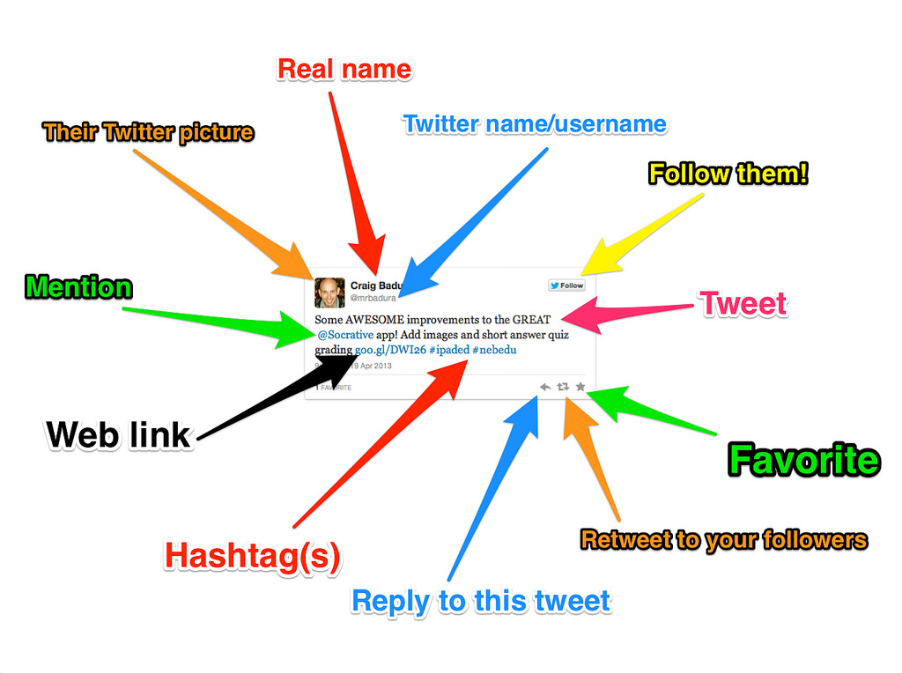
Anatomy of a Tweet

Slide 12
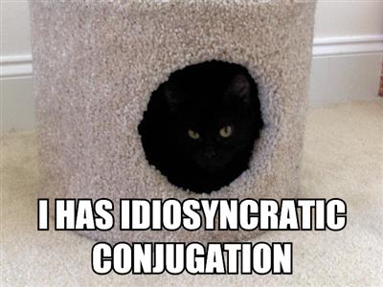
Understanding LOLcats & Memes
http://dashes.com/anil/2007/04/cats-can-has-gr.html

Slide 13

Where Conversations Happen
http://profitecture.com/how-to-get-conversations-going-on-social-media-2/

Slide 14
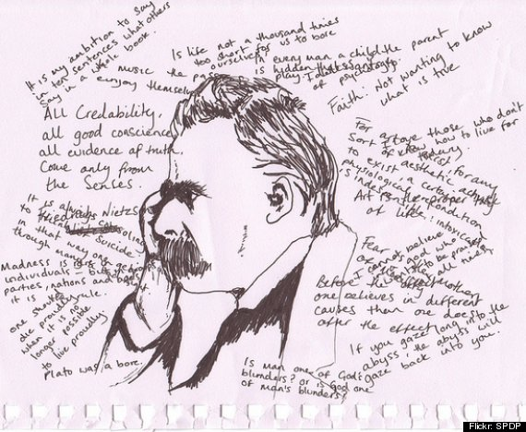
What Conversations Contain
http://www.huffingtonpost.com/2013/08/20/introverts-signs-am-i-introverted_n_3721431.html

Slide 15
RRN Aggregation and Storage
Personal
Context
Article
Photograph
Video
Person
Author
Publisher
Organization
Job Opportunity
Competency
Cetrificate
Event
Location / Place
Time / Date
Email
RSS
OAI
Sharepoint
Facebook
Twitter
Monster
Government
Repositories
Desire2Learn
Coursera
EdX
etc
Parsing
Scraping
Analytics
etc
Storage
RELATIONS

Slide 16
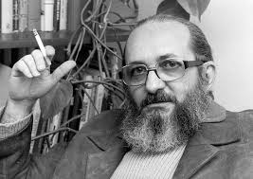
Understanding Knowledge
http://www2.webster.edu/~corbetre/philosophy/education/freire/freire-2.html

Slide 17

Knowing a Pile of Facts?
Image: http://www.rightattitudes.com/

Slide 18
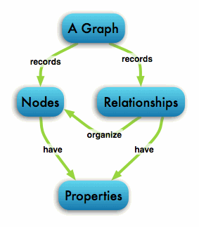
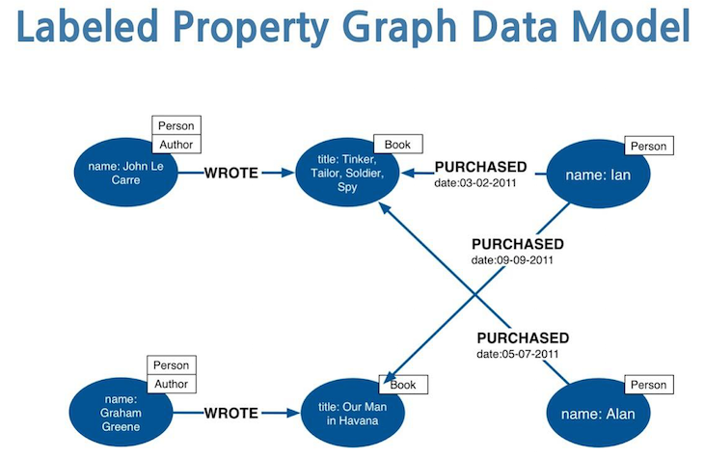
The Graph Database
http://neo4j.com/developer/graph-database/

Slide 19
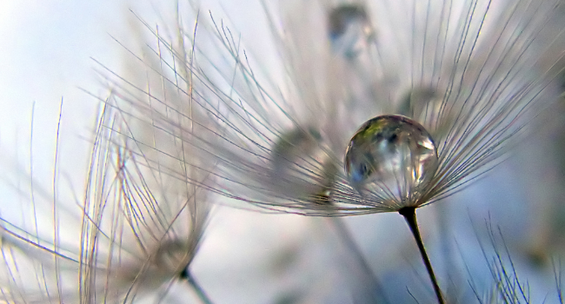
Quality & Narrative
Accuracy
Reputation of author/institution
Standard of technical production
Accessibility
Fitness for purpose
Really? These?
https://openeducationalresources.pbworks.com/w/page/24838164/Quality%20considerations

Slide 20
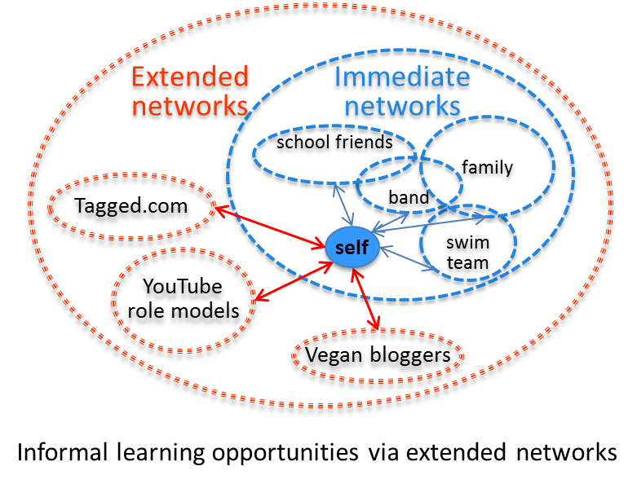
Learning in Context
Task-Focused
Network-based

Slide 21
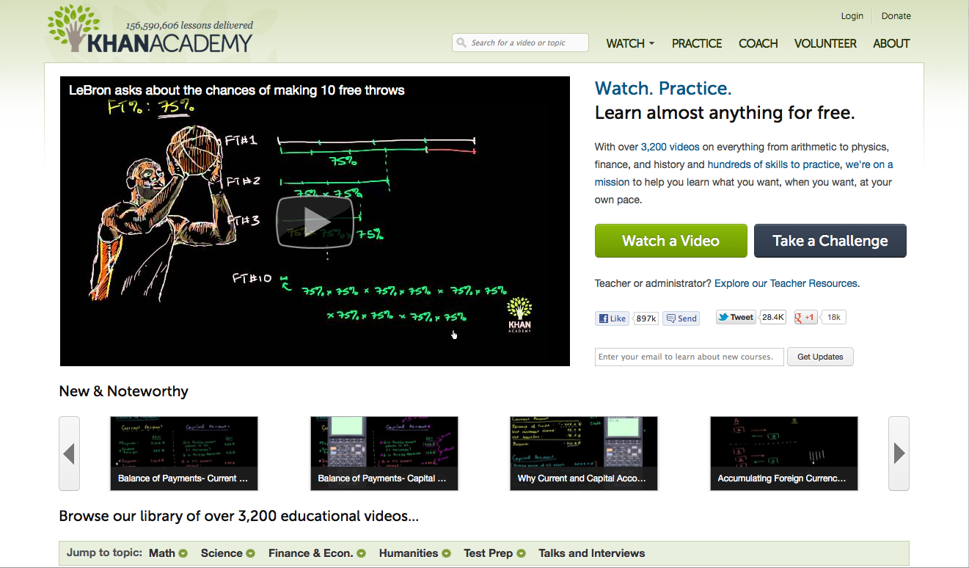
How OERs (Really) Begin
http://www.khanacademy.org/

Slide 22
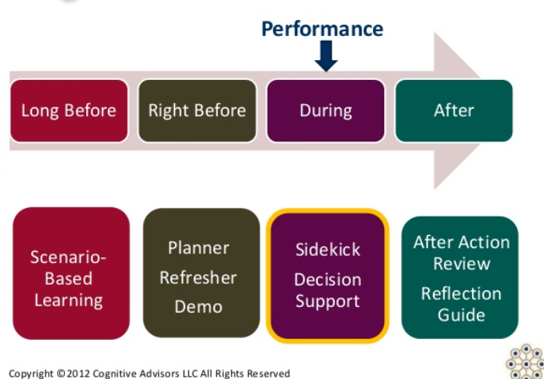
Performance Support
http://www.cognitiveadvisors.com/resources/mobile-performance-support-design-principles

Slide 23
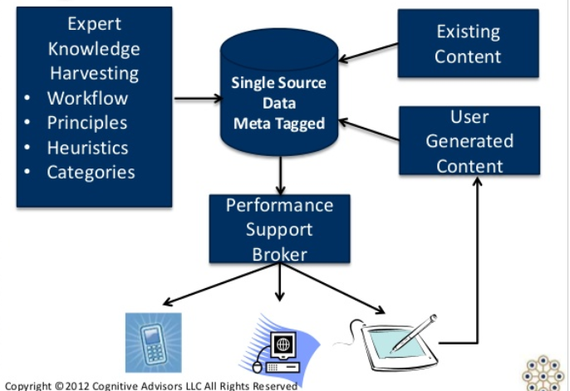
User-Generated OERs

Slide 24

Working Out Loud
http://johnstepper.com/2014/01/04/the-5-elements-of-working-out-loud/

Slide 25
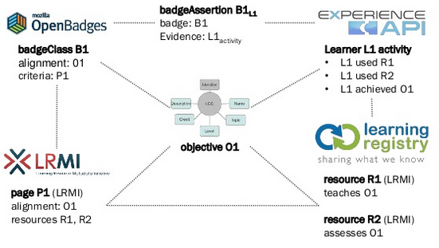
Personal Assistant for Learning
http://www.adlnet.org/adl-initiative-baa-new-submission-window-open-for-personal-assistant-for-learning-pal-proposals-2/index.html
http://www.slideshare.net/damonregan/regan-tla-infrastructureforfutureoflearningsintice2013

Slide 26
Personal Learning Record
OERs
Portfolio, artifacts and evidence
Badges, certificates, credentials, competencies
Activity Record - LRS
PLR

Slide 27





Informal OER Ecosystem

Slide 28
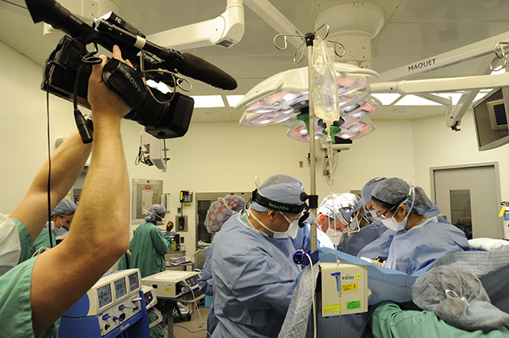
Creating Live OERs

Slide 29

LPSS: Some Case Studies

Slide 30
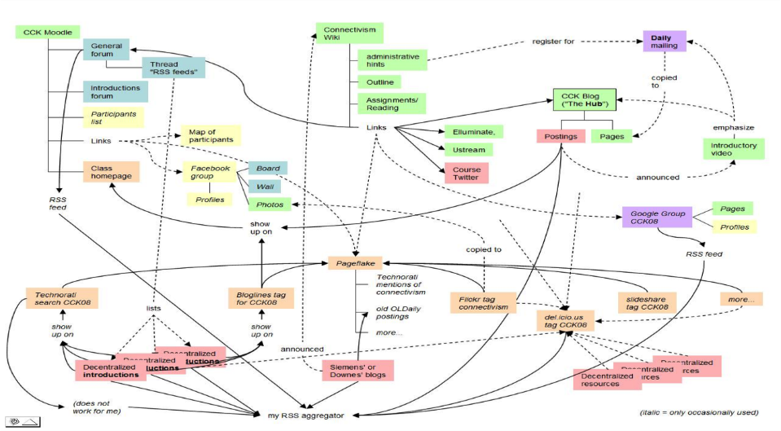
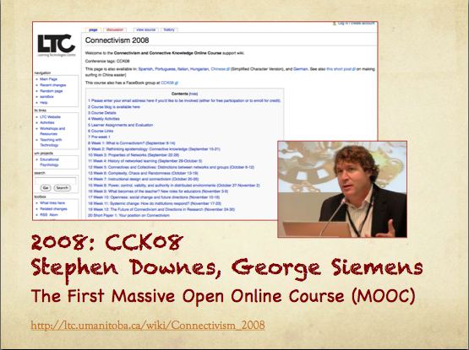
MOOC – CCK08
https://sites.google.com/site/themoocguide/3-cck08---the-distributed-course

Slide 31
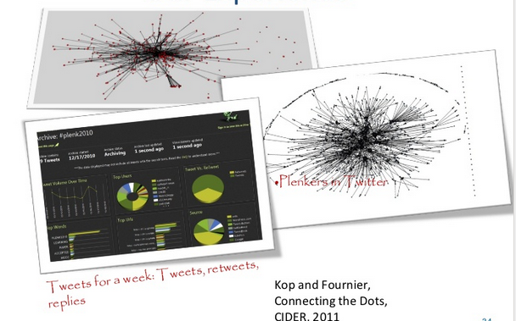
Plearn – Importance of the Graph
http://www.slideshare.net/Downes/after-moodle
http://www.slideshare.net/Ritakop/kopfourniercanadianinstitutedistanceeducationresearchple

Slide 32

OIF – MOOC-REL
http://rel2014.mooc.ca/

Slide 33
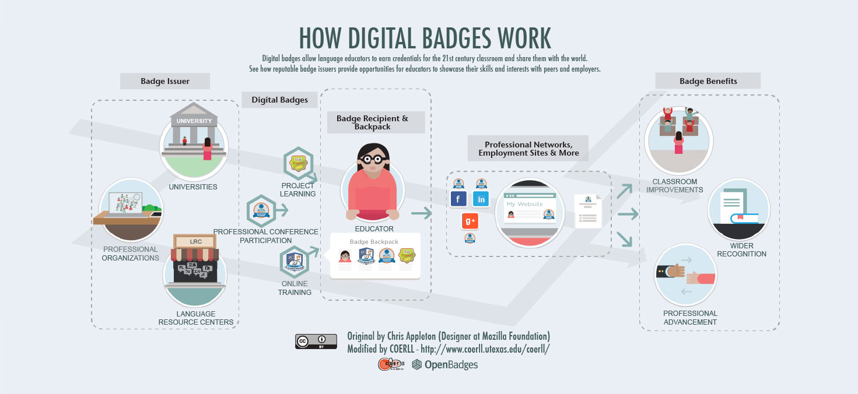
PCO Badges for Learning
http://www.downes.ca/post/63738

Slide 34
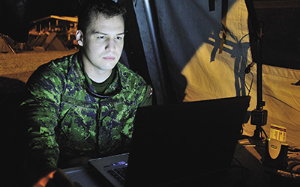
ONGARDE
http://www.journal.forces.gc.ca/vol14/no2/page70-eng.asp

Slide 35
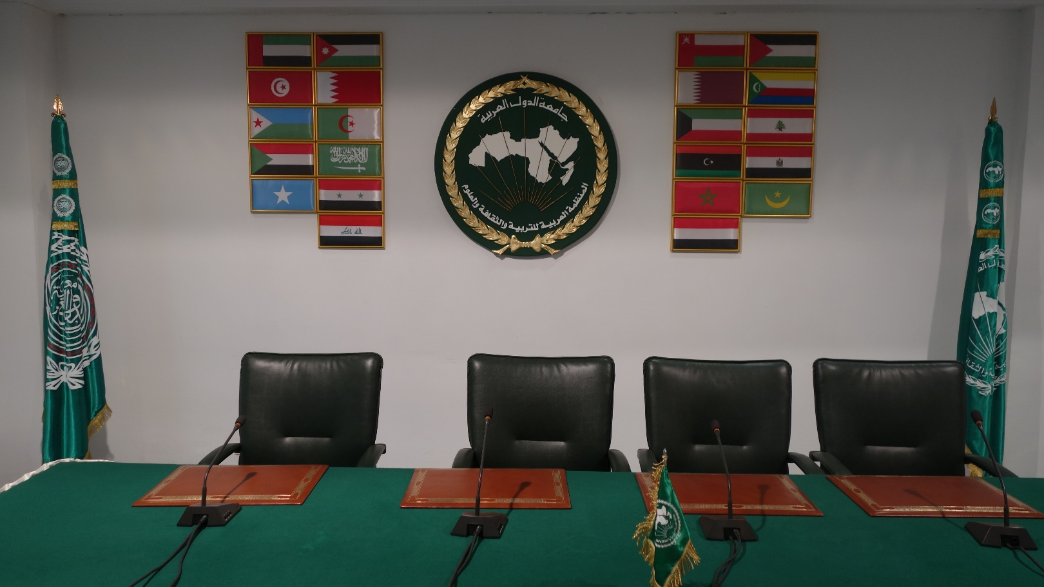
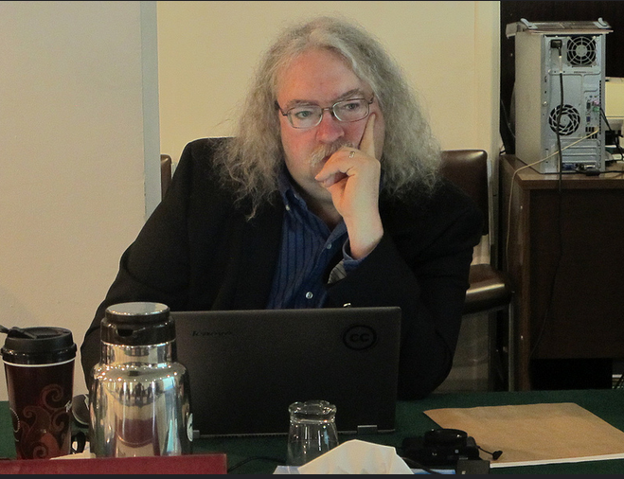
ALECSO – Capacity Building
http://www.downes.ca/presentation/337

Slide 36
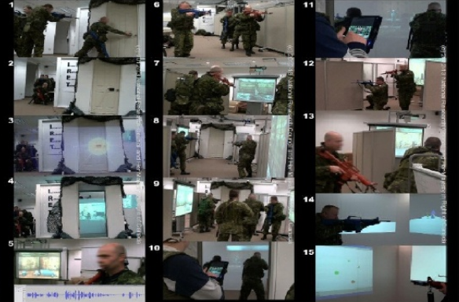
MINT - Mobile INteractive Trainer
http://www.downes.ca/post/59876

Slide 37
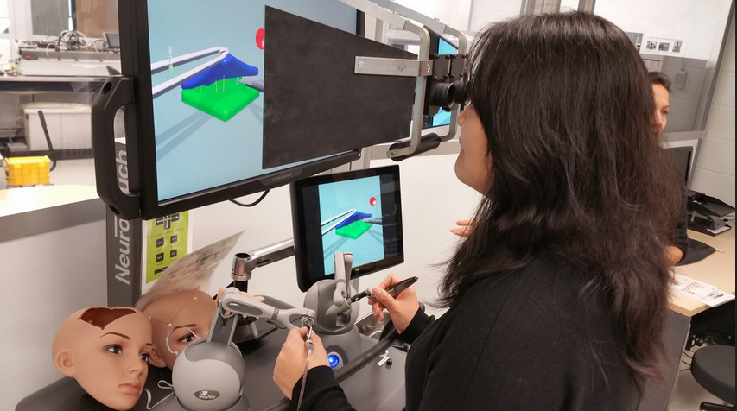
Collecting xAPI from Med Sims
https://www.flickr.com/photos/stephen_downes/15710336207/
http://www.nrc-cnrc.gc.ca/eng/rd/medical/

Slide 38
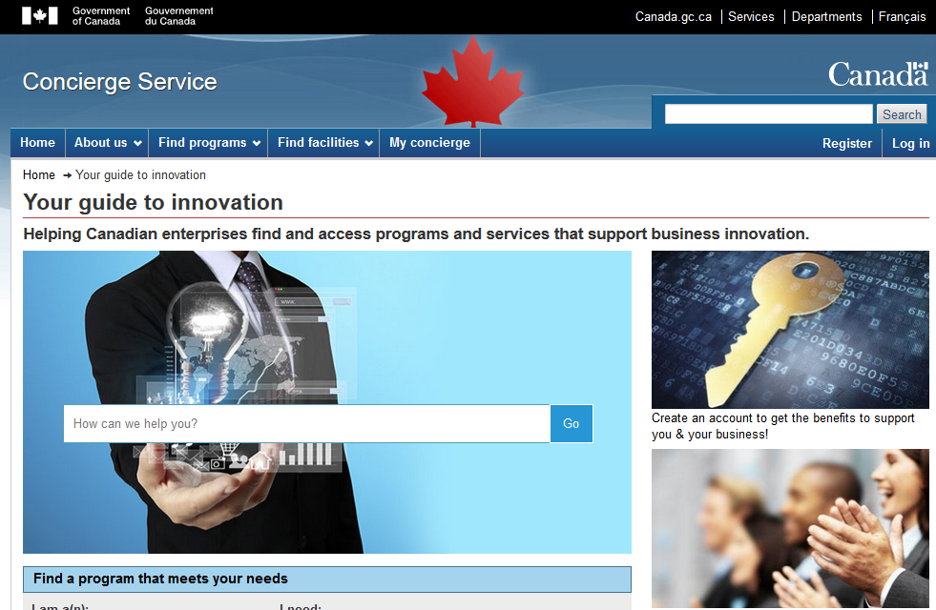
Concierge OMS
https://concierge.portal.gc.ca/

Slide 39
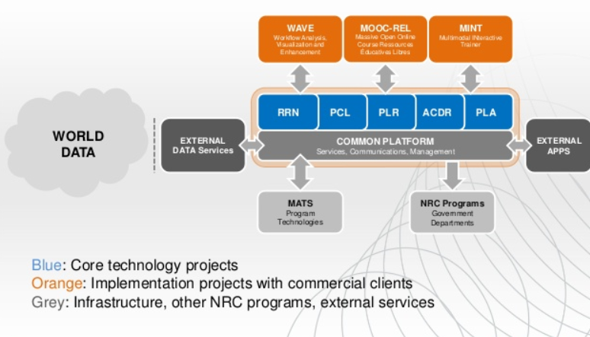
How to Engage
http://www.nrc-cnrc.gc.ca/eng/solutions/collaborative/lpss.html

Slide 40
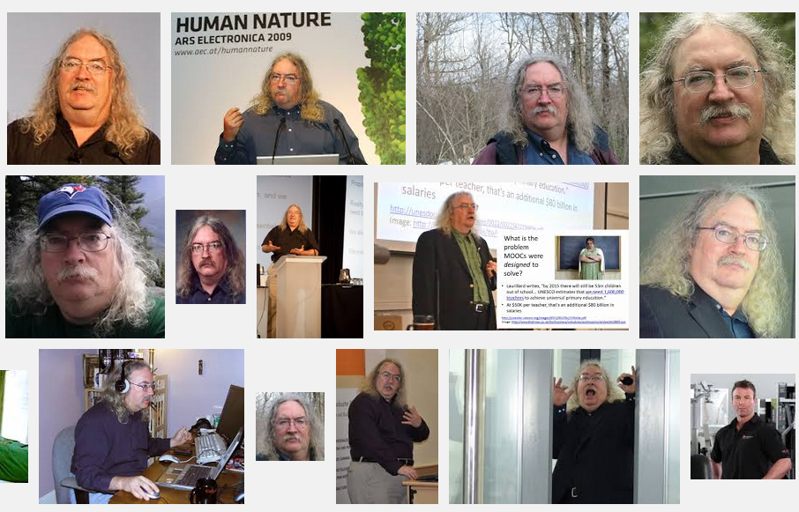
Stephen Downes
http://www.downes.ca

