Slide 1

A Blogger’s Springtime
Stephen Downes
Spring Blog Festival
March 21, 2015

Slide 2

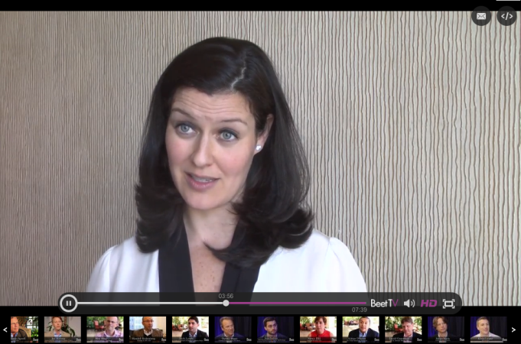
A Golden Age of Content
We don’t need to find content, content finds us
  Peter Csathy http://www.huffingtonpost.com/peter-csathy/a-new-golden-age-of-content_b_4508089.html
Unparallelled distribution mechanisms
  Sarah Personette http://www.beet.tv/2014/03/personettefacebook.html
Netflix, Hulu, and some less legal sources
  Janko Roettgers https://gigaom.com/2012/01/16/netflix-hulu-exclusive-content/
TVs new golden age
  David Carr http://www.nytimes.com/2014/03/10/business/media/fenced-in-by-televisions-excess-of-excellence.html

Slide 3
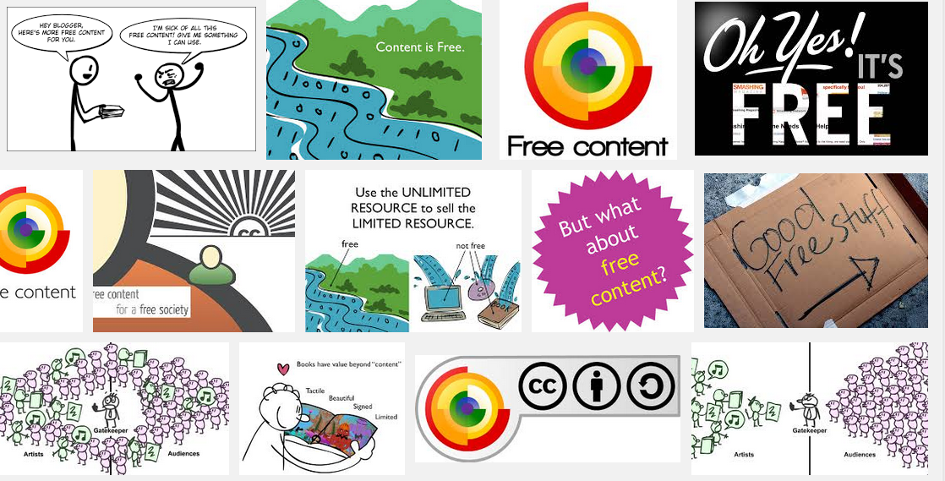
Most of It is Free

Slide 4

Music’s Rebirth
Streaming music sales surpass CDs, DVDs
  Devinda Hardawar http://www.engadget.com/2015/03/19/streaming-music-beats-cds
Canadian music renaissance
  http://canadianmusician.com/news/2013/08/16/canadian-music-sales-seeing-big-international-growth-socan/

Slide 5
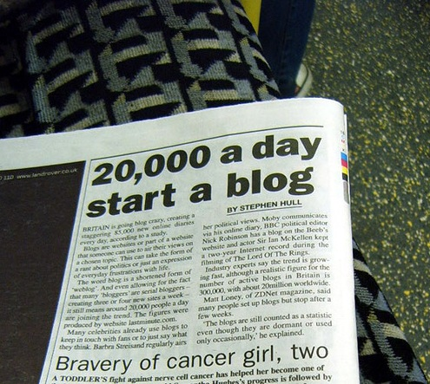
Blogging Remains Strong

Slide 6
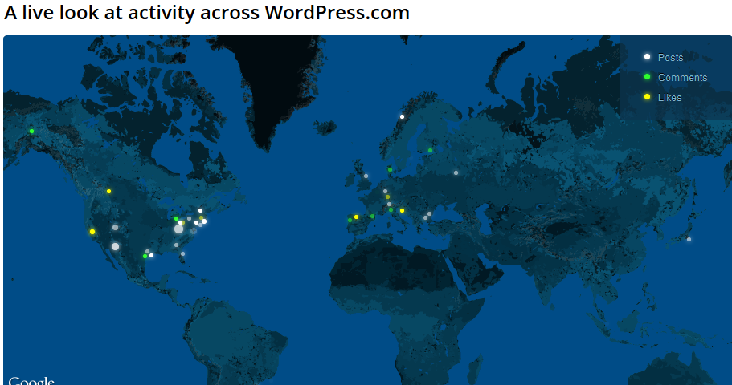
Wordpress, for Example…
https://wordpress.com/activity/

Slide 7
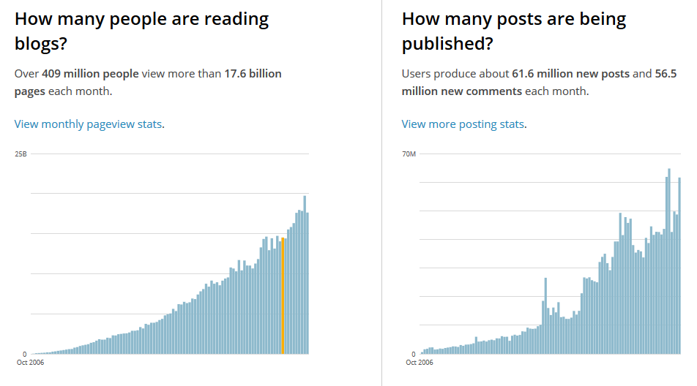
Rumours of Death Greatly Exaggerated

Slide 8
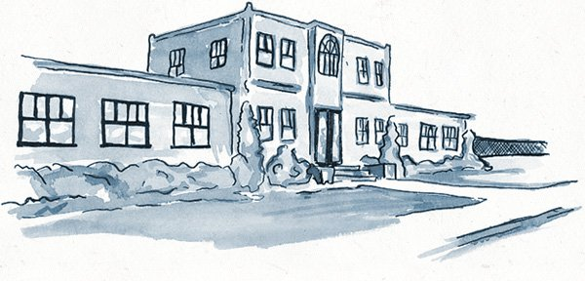
Edublogs
Powering 3,086,061 Edublogs since 2005
http://edublogs.org/

Slide 9
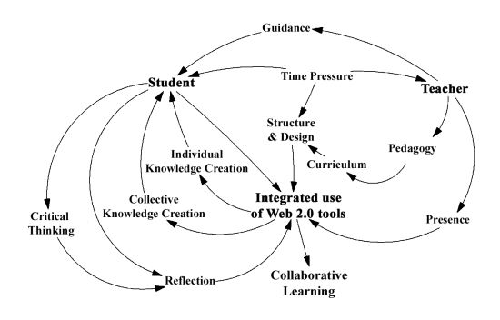
Using Blogs in Learning
Den Exter, Rowe, lloyd and Boyd http://www.mdpi.com/1999-5903/4/1/216

Slide 10
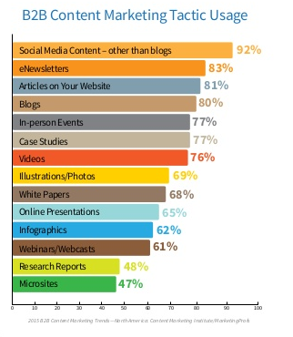
Blogs and Social Media Messaging
92% of B2B marketers report using social media content. Robert Brecht http://www.dmn3.com/dmn3-blog/how-to-pick-the-right-social-media-platform-for-b2b

Slide 11
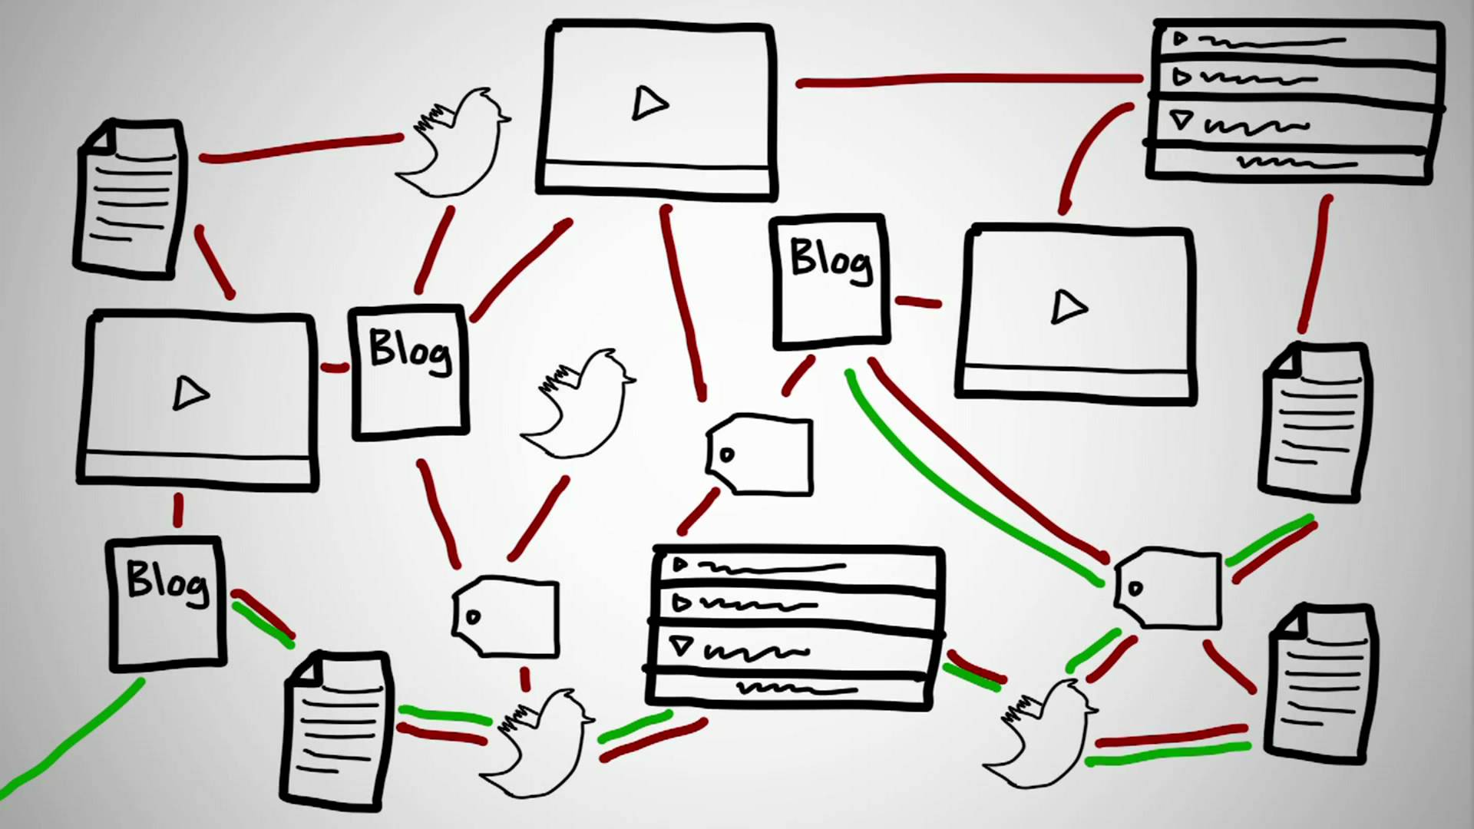
MOOCs and Blogs

Slide 12
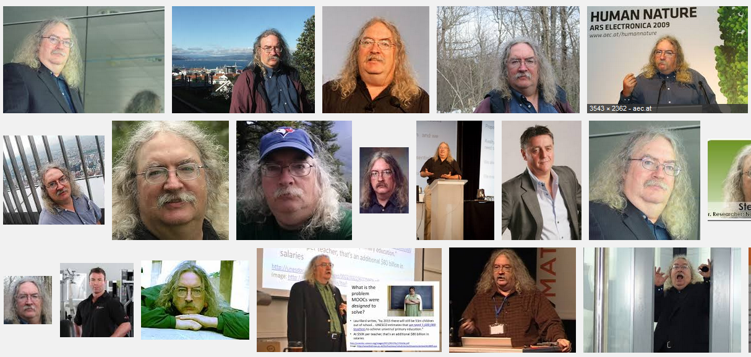
Stephen Downes
http://www.downes.ca

