Slide 1
Learning and
Connectivism in MOOCs
12 March 2015
Stephen Downes

Slide 2
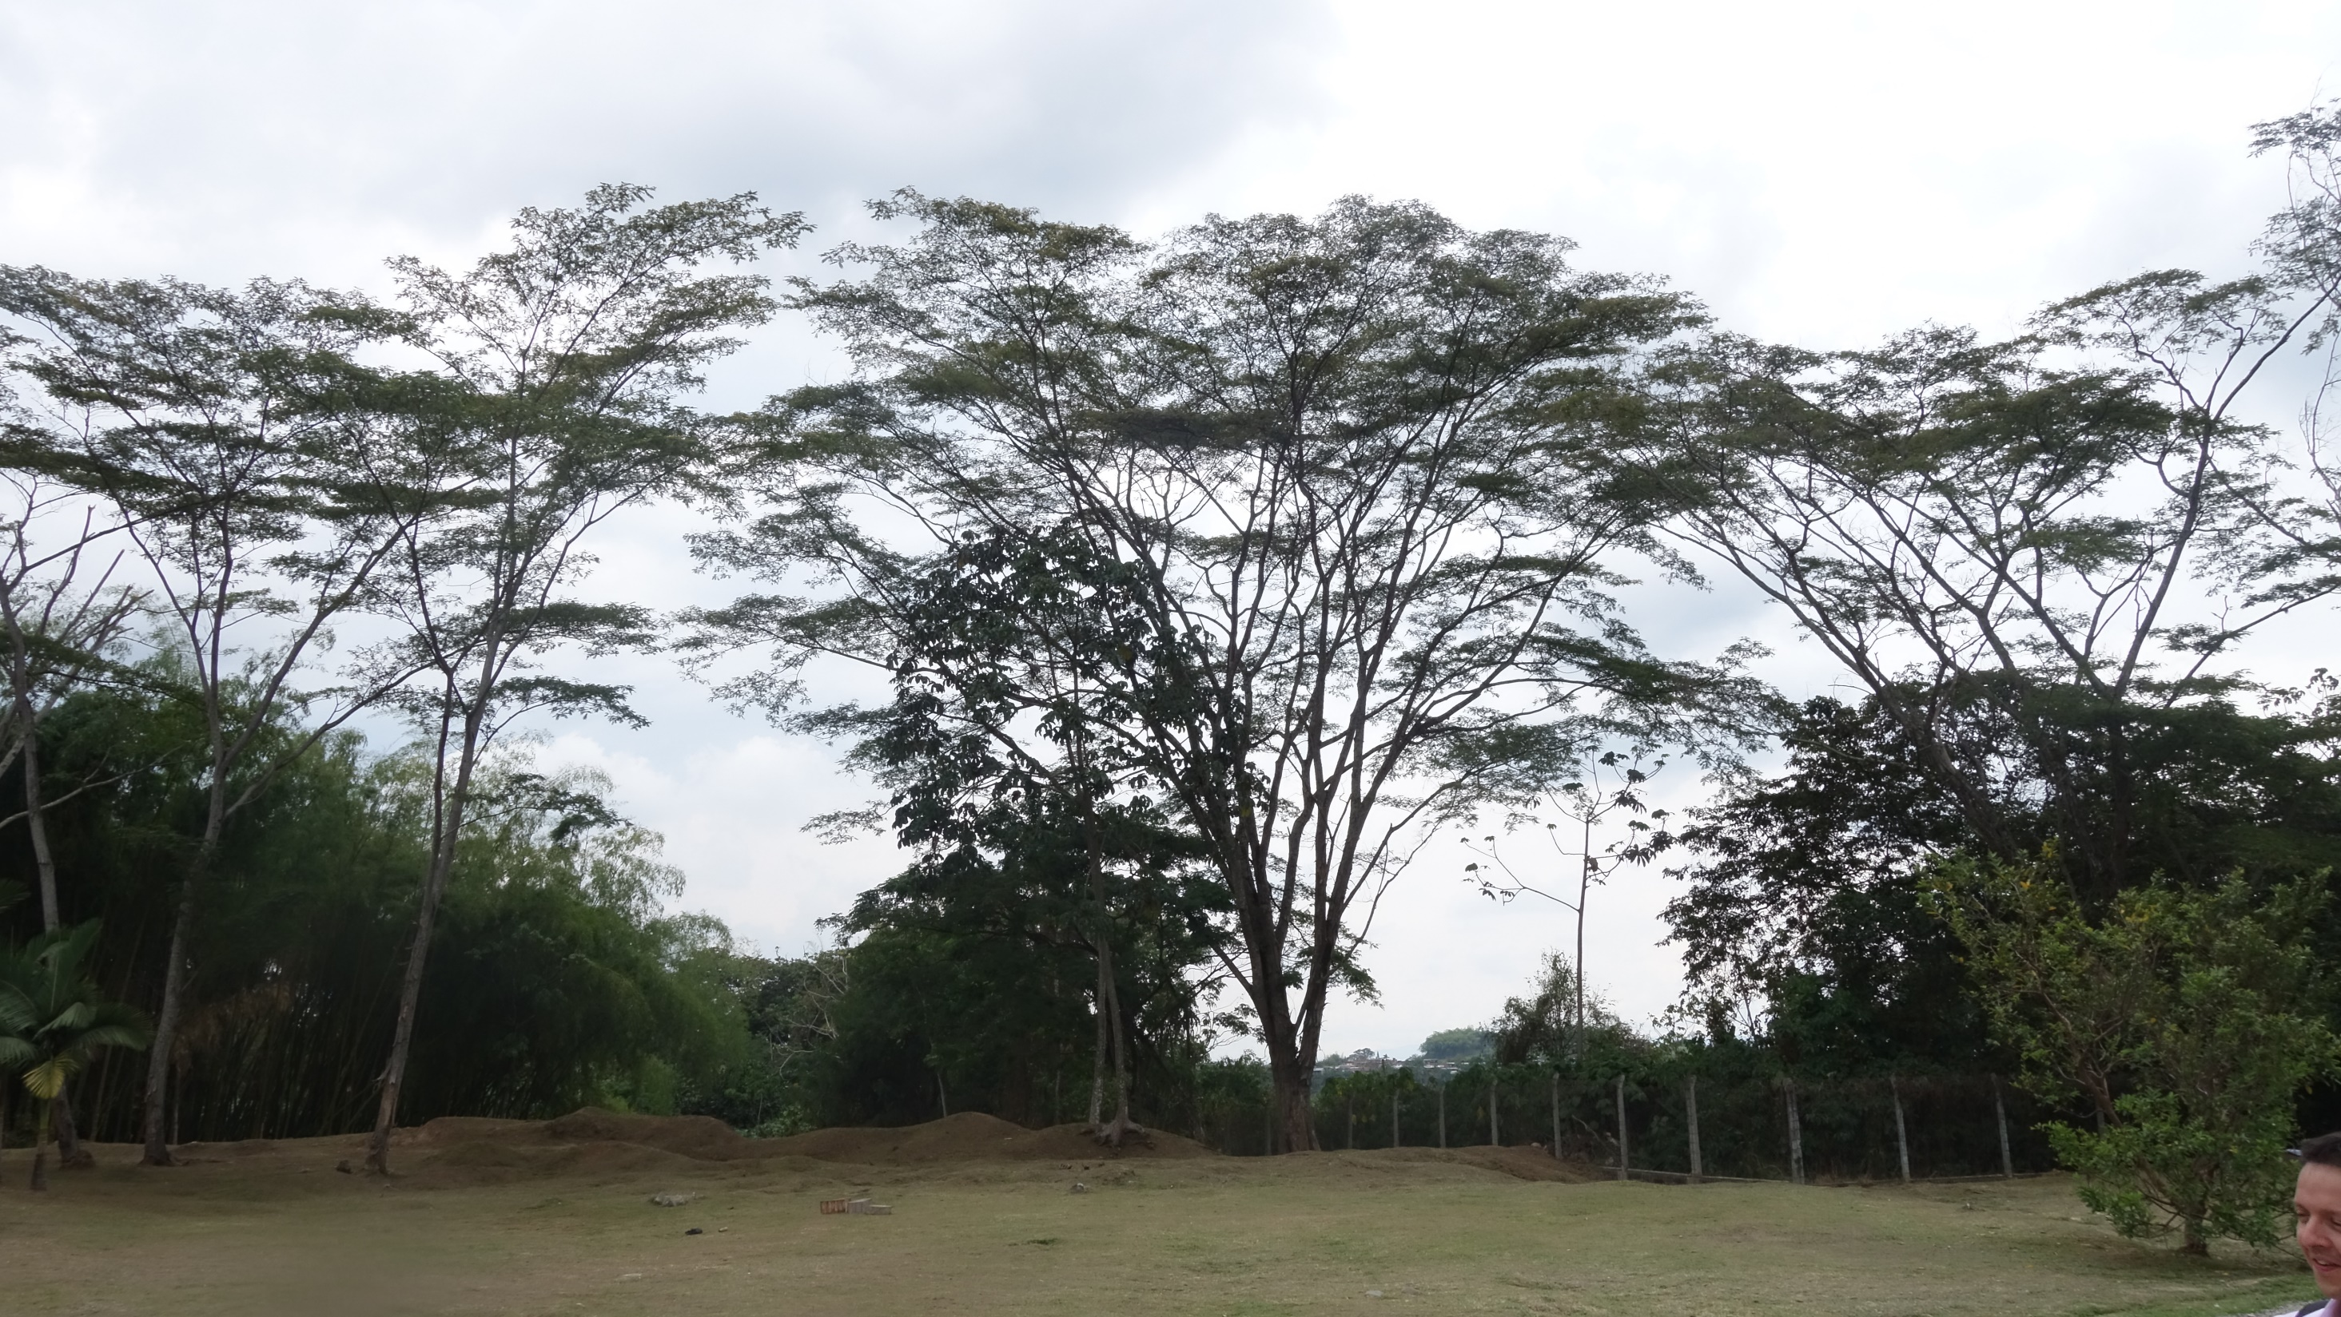
How I See the World

Slide 3

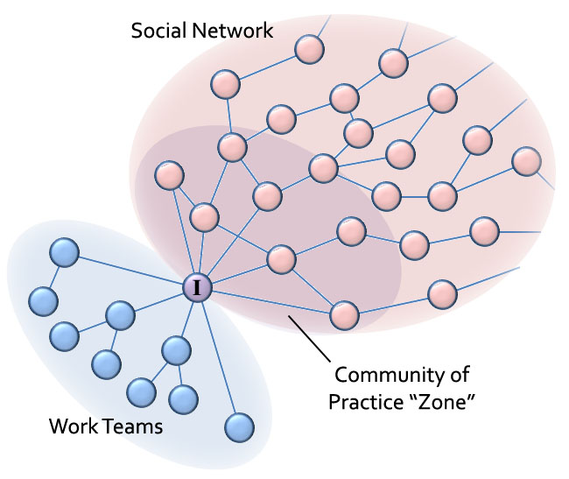


How I See the World
A connectivist perspective
The World
People, things, ideas, concepts, all connected to each other
My Brain
Neurons and neural connections
Perception and Communication
The world speaks to me and I speak to the world

Slide 4
How I See the World
The MOOC
MOOC
A learning network
My Brain
Neurons and neural connections
Perception and Communication

Slide 5
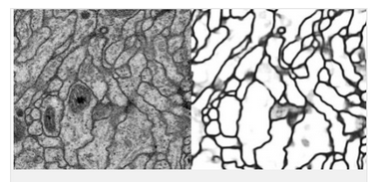

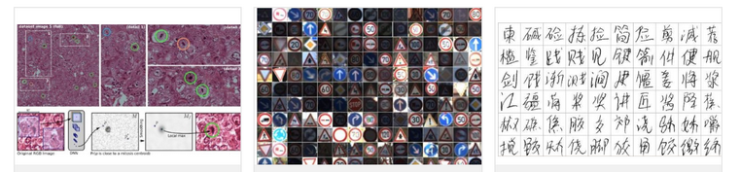
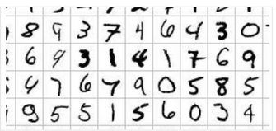

How I See the World
Perception and Communication
Image: http://devblogs.nvidia.com/parallelforall/cuda-spotlight-gpu-accelerated-deep-neural-networks/

Slide 6
How I See the World
Literacies
Comprehension, understanding and communication
Skills
Abilities, habits, competencies
 | Syntax | Semantics | Context | Use | Cognition | Change
Aggregate
Remix
Repurpose
Feed Forward
Autonomy
Diversity
Values
Openness
Interaction

Slide 7


How I See the World
The Critical Literacies

Slide 8
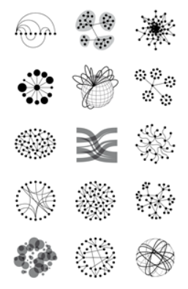
Syntax
Not just rules and grammar
Forms: archetypes? Platonic ideals?
Rules: grammar = logical syntax
Operations: procedures, motor skills
Patterns: regularities, substitutivity
Similarities: Tversky ‐ properties, etc
Image: http://www.visualcomplexity.com/vc/blog/?author=1

Slide 9
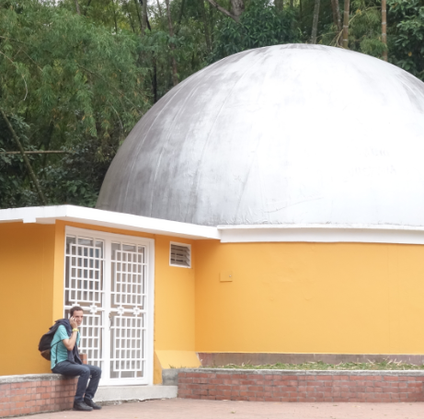
Syntax
Learning Theories: trying to find patterns in phenomena
Behaviourism – learning & practice
Instructivism – learning from worked examples, testing
Cognitivist – the importance of models and comprehension
Constructivist – creating our own learning
Image: http://www.visualcomplexity.com/vc/blog/?author=1

Slide 10
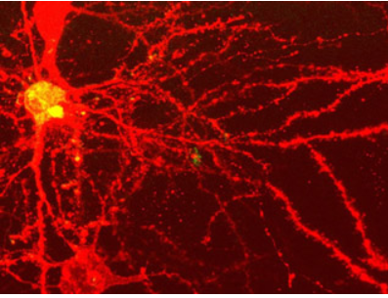
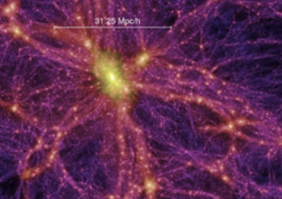
Syntax
Networks and Connections in the World
The way things are organized in the world is important
A pile of sand is different from a sand castle
We observe individual entities self-organizing
These form complex networks from the brain to galaxies
Image: http://www.visualcomplexity.com/vc/blog/?p=1312

Slide 11
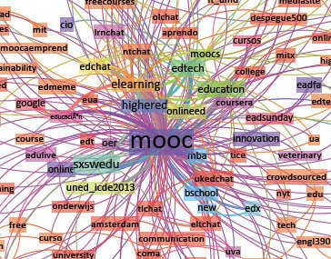
Syntax
Massive / Open / Online / Course
Massive – networks grow
Open – networks have no edges
Online – creates the first real networks for learning
Courses – creating temporary networks
Image: http://themoocexperience.wordpress.com/2013/03/08/being-social-in-a-mooc/

Slide 12
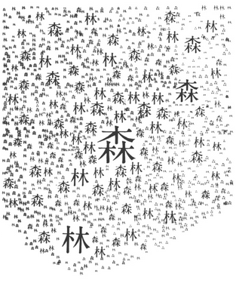
Semantics
Theories of truth / meaning / purpose / goal
‐ Truth and belief: sense and reference
‐ Interpretation and models (probability, logical space, frequency, wagering / strength)
‐ Learning theories: Hebbian, back‐prop, Boltzmann
‐ Decisions: voting / consensus / emergence
Image: https://darkjapanese.wordpress.com/tag/collocations/

Slide 13
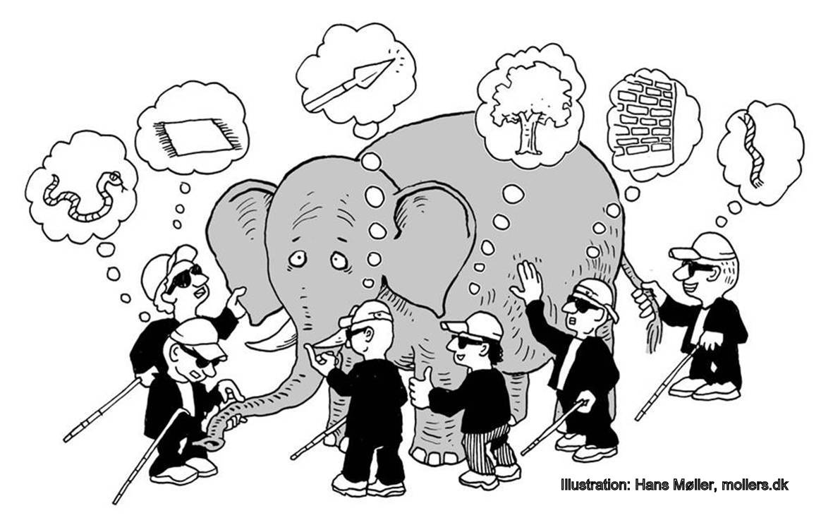
Semantics
A MOOC as a way of Seeing the World
The MOOC brings together many perspectives
No one perspective is correct or true
The whole is created by interaction
Image: http://rathchakra.wordpress.com/

Slide 14
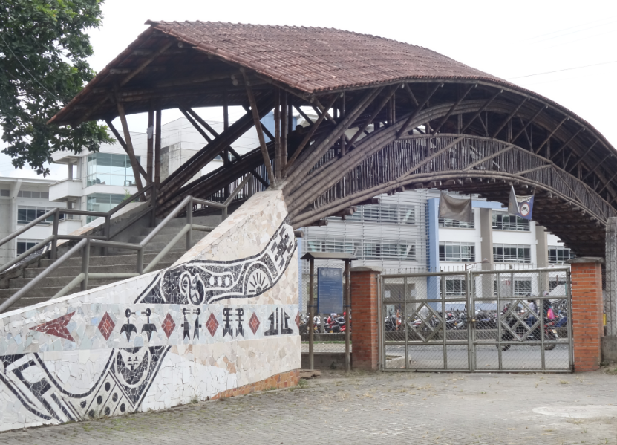
Semantics
Knowledge is not Transmitted, it is Created
Each piece contributes to the whole
Each person sees the new from a certain perspective
We feed back and forth

Slide 15
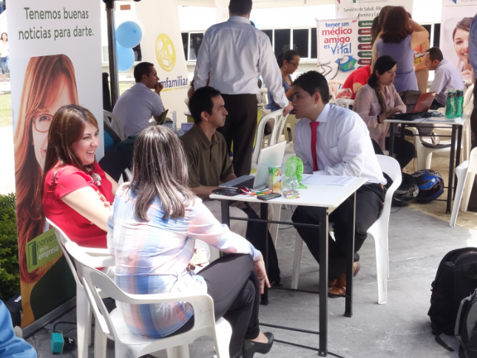
Semantics
What We Learn Depends on How We Interact
Autonomy – each individual decides for him or her self
Diversity – each person has their own values and goals
Openness – new members and new ideas are welcome
Interactivity – we learn through communication

Slide 16
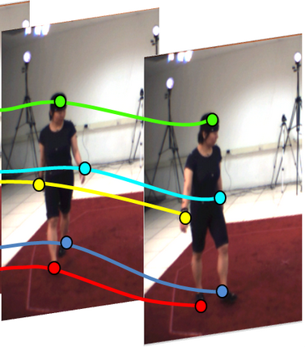
Pragmatics
Use / actions / impact
• Speech acts (J.L. Austin, Searle) assertives, directives,
commissives, expressives, declarations (but also ‐ harmful acts,
harassment, etc)
• Interrogation (Heidegger) and presupposition
Image: http://ftp.tnt.uni-hannover.de/print/papers/view.php?ind=1&ord=month&mod=DESC

Slide 17
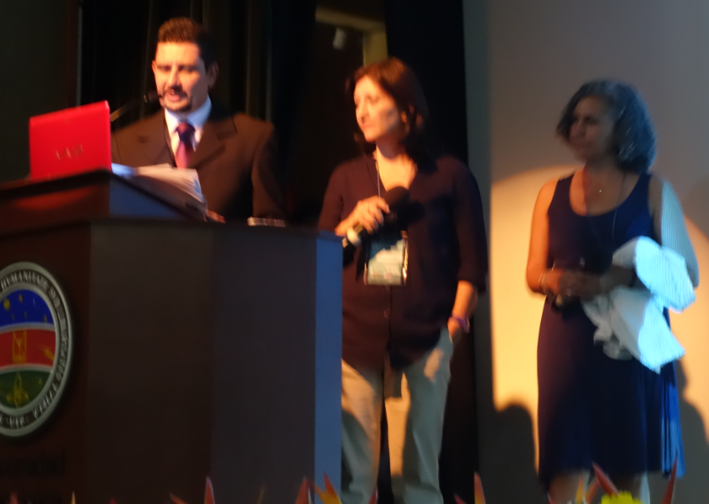
Pragmatics
How to Do Things With MOOCs
Educate – model and demonstrate processes and actions
Inform – tell stories, recount experiences
Promote - Pass on an idea or a way of life (memetics)
Recruit – find others to join

Slide 18
Pragmatics
How to do things in MOOCs
Aggregate – listen to many diverse sources
Remix – bring these different perspective together
Repurpose – reform these new ideas in your own way
Feed Forward – share your perspectives
Image: http://www.lifeaftercoffee.com/2008/11/03/hello-iamthenode-and-im-here-to-make-you-vomit/

Slide 19
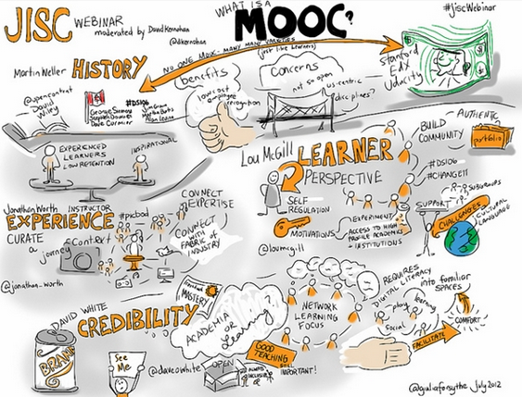
Pragmatics
What a MOOC Does
Asks questions
Experiments
Explores
Discovers
Creates
Image: http://www.jiscinfonet.ac.uk/topics/moocs/

Slide 20
Context
Placement, environment
‐ explanation (Hanson, van Fraassen, Heidegger)
‐ meaning (Quine); tense ‐ range of possibilities
‐ vocabulary (Derrida); ontologies, logical space
‐ Frames (Lakoff), worldviews
Image: http://www.visualcomplexity.com/VC/index.cfm?domain=Pattern%20Recognition

Slide 21

Context
Possibilities for Learning on the Internet
The internet created a location where networks could form
Online communities already learning in self-organizing groups
eg. OSS, Napster…

Slide 22

Context
Learning in the Workplace
‐ the skills gap
‐ informal learning
‐ just-in-time learning (vs just-in-case)
‐ learning as something we support rather than provide
Image: http://www.goodpractice.com/blog/future-of-workplace-learning-in-2015/

Slide 23
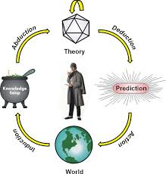
Cognition
Reasoning, inference and explanation
• description ‐ X (definite , allegory, metaphor)
• definition ‐ X is Y (ostensive, lexical, logical (necess. & suff conds), family
resemblance, identity, personal identity, etc
• argument ‐ X therefore Y ‐ inductive, deductive, abductive, modal, probability (Bayesian), deontic (obligations), doxastic (belief), etc.)
• explanation ‐ X because of Y (causal, statistical, chaotic/emergent)
Image: http://www.jfsowa.com/pubs/challenge

Slide 24
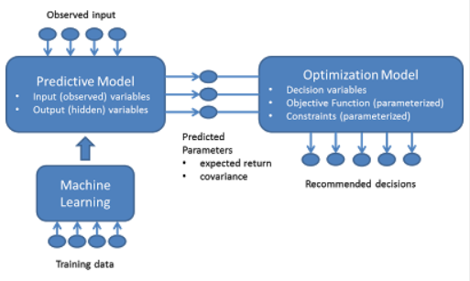
Cognition
The Challenge of Learning Analytics
‐ Analytics predict performance using neural network techniques (machine learning)
- But this process requires ‘Big Data’ – with resulting privacy issues
Image: http://horicky.blogspot.com/2013/01/optimization-in-r.html

Slide 25
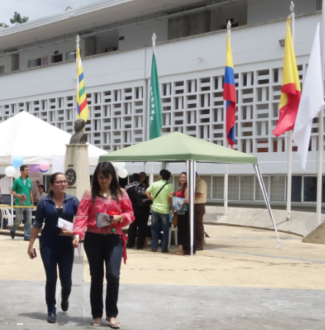
Cognition
How do we infer someone has learned?
Traditional testing is a very poor sort of induction
We identify good doctors, good food, good writers by recognizing them
In a MOOC, achievement is demonstrated in open work, and recognized by peers

Slide 26
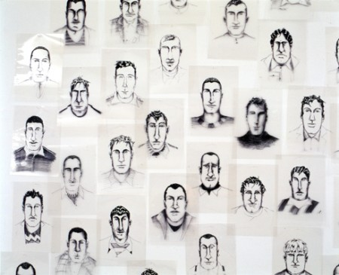
Change
Graphs / Drivers / Attractors / Forces
‐ relation and connection: I Ching, logical relation
‐ flow: Hegel ‐ historicity, directionality; McLuhan
‐ games, for example: branch and tree, database
‐ scheduling ‐ events; activity theory / LaaN
Image: http://www.motikon.com/2011/12/19/from-data-to-design/

Slide 27
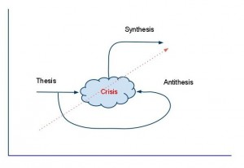
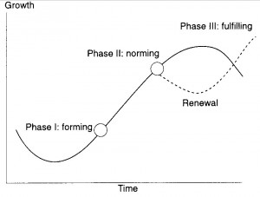
Change
Varieties of Change
Easy to think things will always be the same (vs the Tipping Point)
Cycles and Arcs
The dialectic

Slide 28
Change
Consequences of Change
What do MOOCs and connectivism enhance?
What do they reverse?
What thing from the past do they retrieve and make new?
What current thing do MOOCs make obsolete?
Image: http://www.provenmodels.com/18/four-laws-of-media/marshall-mcluhan/

Slide 29
Change
Drivers and (Strange) Attractors
We think of the future in terms of today’s imperatives: jobs, money, security
But what is important to us today may not always be
There’s no way to predict but we can imagine what will matter…
Image: http://chaoticatmospheres.deviantart.com/art/Strange-Attractors-The-Dadras-Attractor-376066266

Slide 30
How I See the World

Slide 31
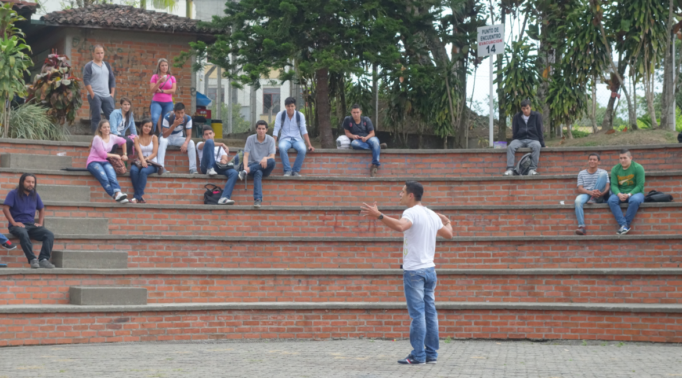
How I See the World

Slide 32
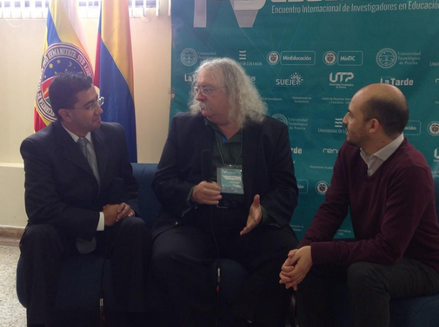
Stephen Downes http://www.downes.ca

