Slide 1

Design Elements in a Personal Learning Environment
Stephen Downes
March 5, 2015

Slide 2






The Problem:
The Skills Shortage in Canadian Industry
Canadian Oil and Gas (O&G) sector loses $4 billion per year due to skills shortages.
Skilled and professional unemployment rate less than 1%.
Training current and prospective employees time-consuming and expensive.
August 26, 2013
Notes:
Overall opportunity cost
25 job groups representing 21% of employment in Canada
Formal modes of education and training can’t keep pace with the changing environment:
$3000 course over a weekend to Houston – too little, too expensive, too late
Traditional platforms focus on the organizations using them.
And they are based on the one size fits all mentality (just like traditional education)

Slide 3
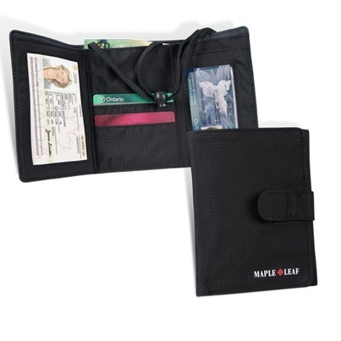
The Solution:
Personal Learning and Performance Support
Single point of access to all skills development and training needs
Individual learning path
Context-aware support
Searchable and verifiable
Tailored to industry needs
Always available
Point of need performance support
Notes:
Emphasize that it’s personal and you carry it with you
Note that it’s a network – we don’t put everything in one package, but develop an infrastructure that links relevant resources
Different types of things, not just courses:
Access to learning resources
Calling cards and communication tools
Credentials, permits and licenses

Slide 4


Why NRC? Our Distinct Leverage
NRC is a globally recognized leader in emerging learning technologies
  Not core competencies for target clients
  LPSS benefits from NRC’s research in other fields
NRC is deeply connected to the e-learning industry
  University researchers not driven to spend the time with industry
  NRC by contrast has collaboration and commercialization experience
  Neutral broker reduces risk to technology development partners
Notes:
NRC owns existing component technologies that de-risk solution development and reduce time to market: TRL range from 3 to 9.
These are not technologies owned or likely to be developed by either O&G or learning technology industries
Expertise. NRC is a globally recognized leader in emerging learning technologies with a proven track record of forecasting where technology will be years in advance of the field.
Because we aren’t in the business of selling oil, software or content, we can provide a crucial horizontal link between the enterprises that do.
NRC has successfully developed, transferred and licensed learning technologies to solution providers, such as with Desire2Learn Inc.

Slide 5
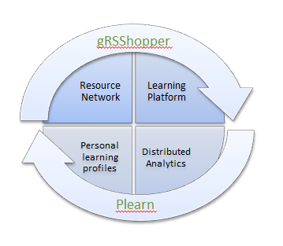
NRC – Previous Work in eLearning
eduSource Resource Repository Network (Canadian CANARIE Network)
Sifter/Filter Content Recommender (connercialized as RACOFI)
SHARE Sentiment Analysis
Synergic3 Collaborative Workflow (commecialized with Desire2Learn)
gRSShopper / MOOC / Connectivism
2Sim Haptic Simulations

Slide 6
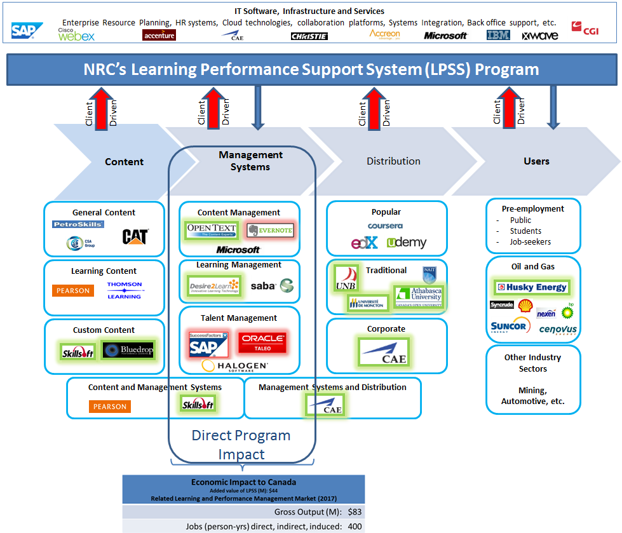
LPSS in Canada’s Learning Technology Marketplace
Notes:
A lot of movement and interest in the sector
D2L - $80-million from OMERS Ventures, the venture capital arm of the $55-billion pension giant, and New Enterprise Associates, a U.S.-based VC firm with about $11-billion in committed capital that has funded more than 650 companies.
Blackboard – taken private by Providence Equity Partners for about $1.64-billion
We fit in the Management Systems box
but work with providers and distributors to develop services, understand client needs
LMS – a lot of players, difficult to be first mover
very dependent on end-user needs but bound by legacy systems
we’ll work mostly with the Oil & Gas end users (to satisfy their needs)
but will help partners expand beyond to other verticals
partners within these two boxes will be chosen on their ability to invest and deliver.

Slide 7
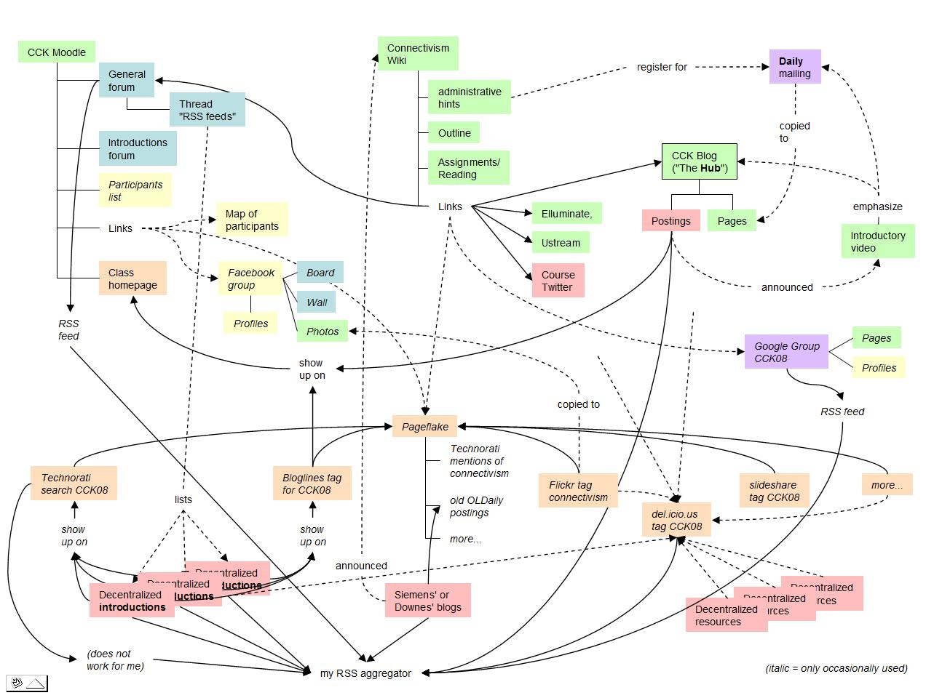
The Connected Application
http://x28newblog.blog.uni-heidelberg.de/2008/09/06/cck08-first-impressions/

Slide 8
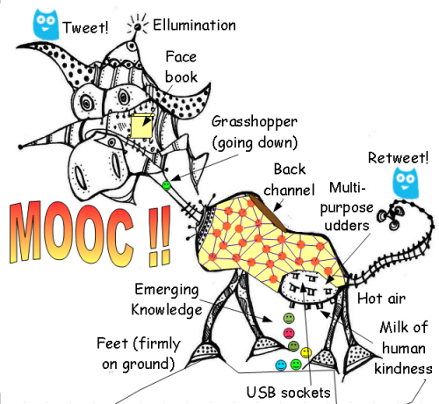
The MOOC
Massive – by design
Open – gratis and libre
Online – not blended, not wrapped
Courses – not communities, websites, video collections, etc

Slide 9
Massive Open Online Course
Site
A MOOC is a Web, not a Website

Slide 10

Design Principles
Autonomy
- Choice of contents
- Personal learning
- No curriculum
Openness
- Open access
- Open content
- Open activities
- Open assessment
Diversity
- Multiple tools
- Individual perspective
- Varied content
Interactivity
- Encourage communication
- Cooperative learning
- Emergent knowledge

Slide 11
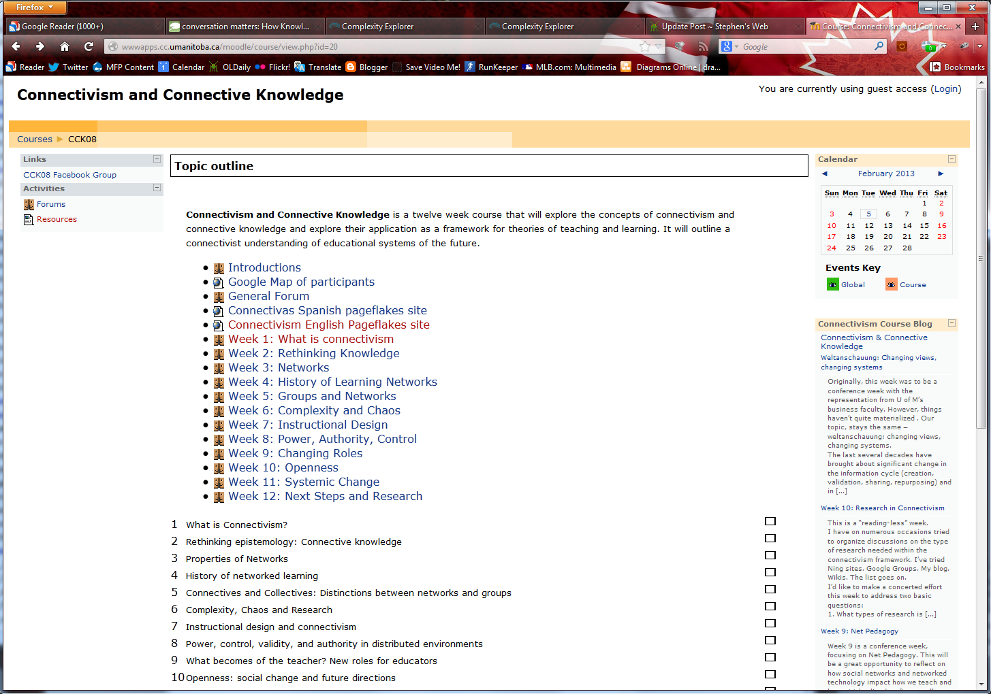
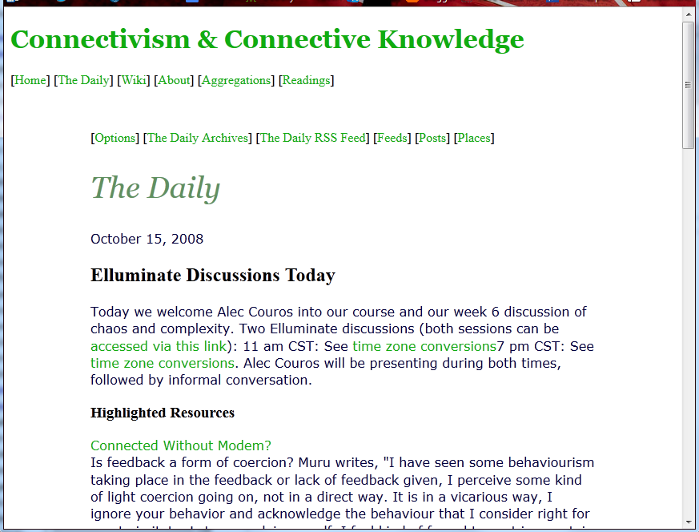
CCK08
http://wwwapps.cc.umanitoba.ca/moodle/course/view.php?id=20
2300 students
http://connect.downes.ca/cgi-bin/archive.cgi?page=thedaily.htm

Slide 12
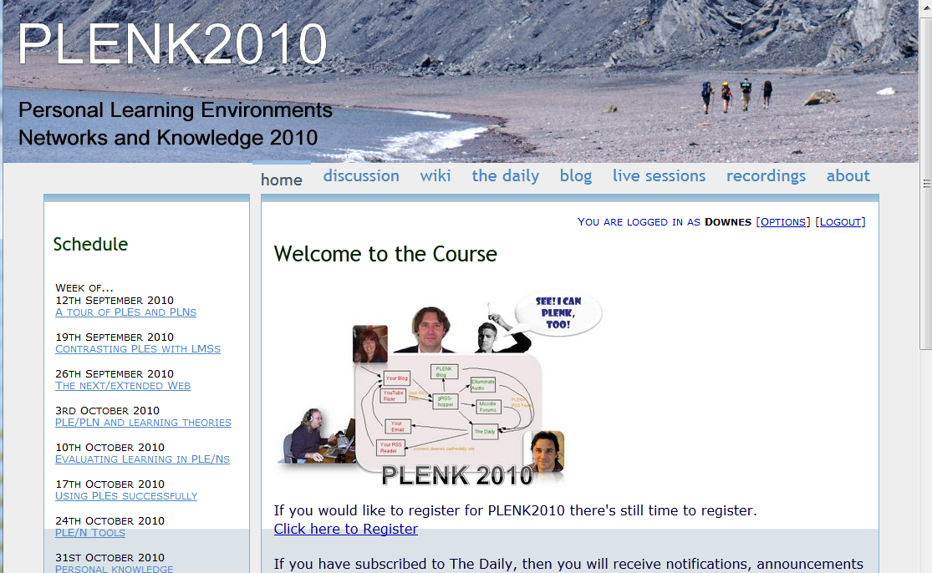
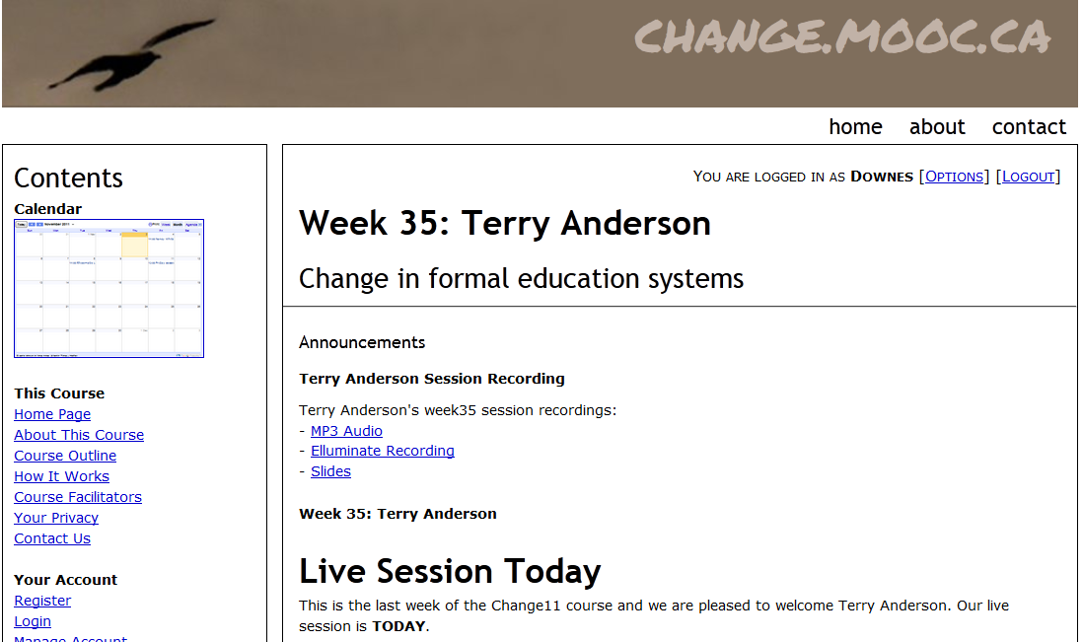

Other Courses
1800 students
http://connect.downes.ca/
2800 students
3000 students
http://change.mooc.ca/
http://edfuture.net/

Slide 13
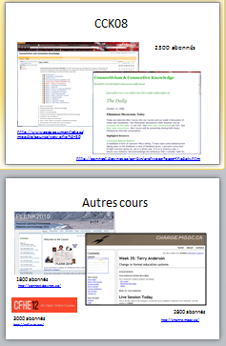

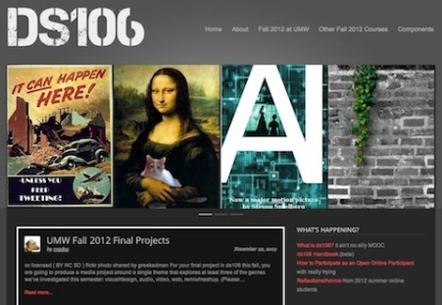
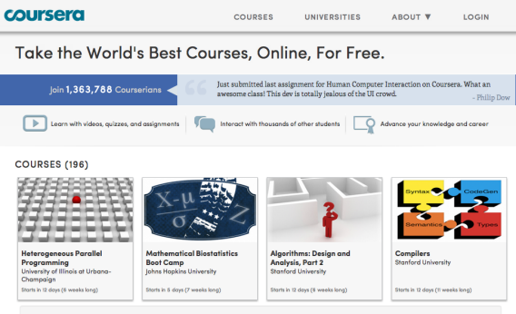

cMOOC vs xMOOC
networks
tasks
contents
https://www.ai-class.com/
http://ds106.us/history/
https://www.coursera.org/
http://lisahistory.net/wordpress/2012/08/three-kinds-of-moocs/

Slide 14
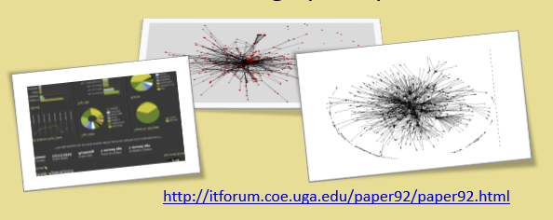
Design principles of the cMOOC
Autonomy, diversity, openness, interactivity

Slide 15
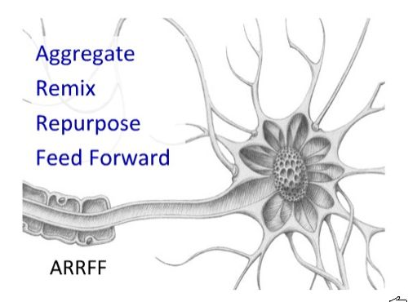
Pedagogy of the cMOOC
http://cogdogblog.com/2009/06/29/arrff/

Slide 16
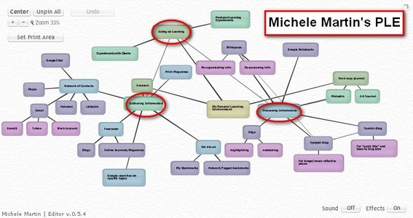
Personal Learning
http://dmlcentral.net/blog/howard-rheingold/diy-u-interview-anya-kamenetz
http://www.downes.ca/post/58150
Notes:
Howard Rheingold searches for the new in Anya Kamenetz's Edupunk's Guide, suggesting that what has been added is the idea of the personal learning plan to the personal learning network. "Making a public commitment to something is going to increase your accountability," says Kamenetz. Rheingold writes, "Her work serves as a bridge between blended learning and peeragogy. I previously wrote about Shelly Terrell and personal learning networks" and asks here what it takes for a group to self-organize. Kamanetz responds that there needs to be a common understanding of the goal - of course, this would be the outcome of self-organization, not what makes it possible.

Slide 17
Underlying MOOC Support
1. First student creates resource and sends info to course
Site
2. Second student sees resource info in newsletter and RSS feed
3. Second student accesses the resource directly
4. Second student finds link to third student’s resource

Slide 18

















Course Provider Perspective
Subscribed
students
Student
content
Site
Course
content
Live online events
Event recordings

Slide 19
The Student’s Perspective
Site
A range of different resources and services

Slide 20
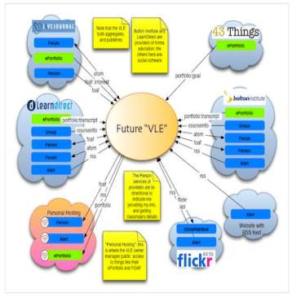
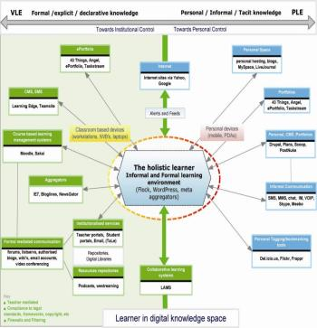
The design is based on putting the learner at the centre
Scott Wilson (left), Tim Hand (right)
https://www.google.com/search?q=ple+diagrams
http://www.edtechpost.ca/ple_diagrams/index.php/mind-map-3

Slide 21
Simplified Design
External Repositories
App
API
Resource Repository Network
Stand-alone Cloud
Personal Learning Assistant
Personal Learning Record
Personal Cloud
Automated Assessment
External Cloud Storage
External Graph

Slide 22
Learning and Performance Support System:
Core Technology Development Projects
Learning services network and marketplace
Automated skills development and recognition
Lifetime management of learning and training records and credentials
Personal learning assistant to view, update and access training
Resource Network
Learning Assistant
Automate Skills Dev.
Personal Learning Records
Learning as a cloud service and deep integration with external systems
Notes:
the solution would consist of the main components as shown on the slide
Resource Repository Network – will create a resource graph from multiple sources and multiple formats including live and dynamic data such as oilfield data, refinery instrumentation, or Oil and Gas market information.
Automated Competence Development And Recognition – whereas existing recommender systems depend on manually defined metrics, this system will detect new and emerging competences and automatically assess employee performance.
Personal Learning Record - this project will define how we represent, capture, and leverage user activity, including ratings, test results, performance measures, and the like, in a distributed learning and work environment.
Personal Learning Assistant – this project will develop an integrated learning appliance, a mechanism for looking up or finding references or resources inside other programs or environments.
Learning as a Cloud Service - will create a distributed learning layer, which is mechanism for working with data no matter where it is stored, through desktop, mobile and other devices.

Slide 23
Program Design and Scope
WAVE
Workflow Analysis, Visualization and Enhancement
MOOC-REL
Massive Open Online Course Ressources Éducatives Libres
MINT
Multimodal INteractive Trainer
RRN
PCL
PLR
ACDR
PLA
WORLD
DATA
EXTERNAL
DATA Services
EXTERNAL
APPS
COMMON PLATFORM
Services, Communications, Management
MATS
Program
Technologies
NRC Programs
Government
Departments
Blue: Core technology projects
Orange: Implementation projects with commercial clients
Grey: Infrastructure, other NRC programs, external services

Slide 24
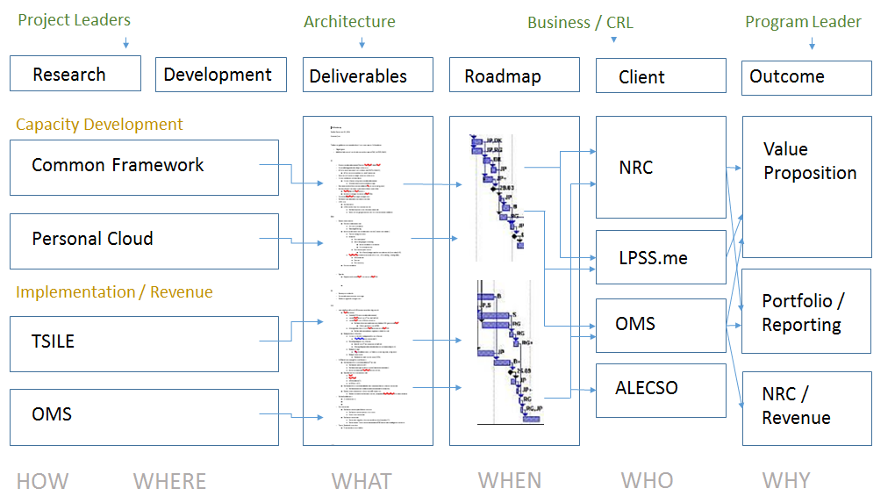
Program Organization

Slide 25
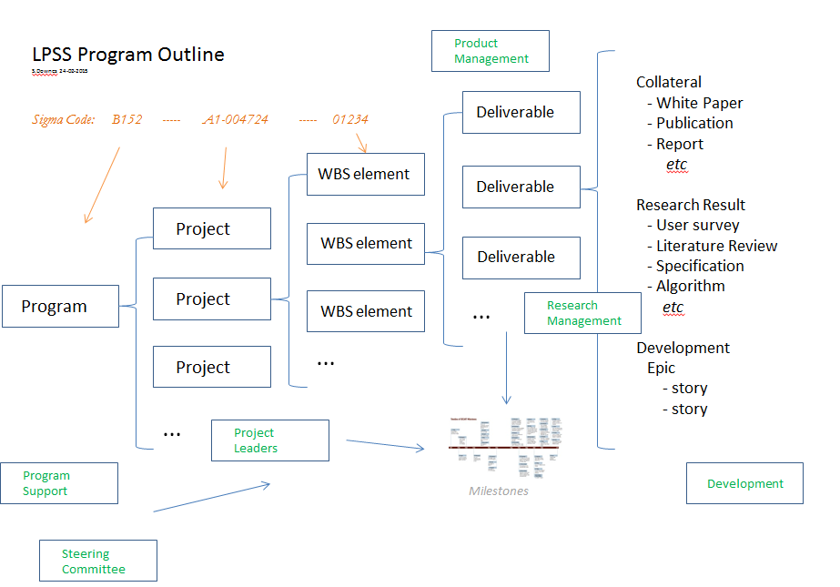
Program Outline

Slide 26
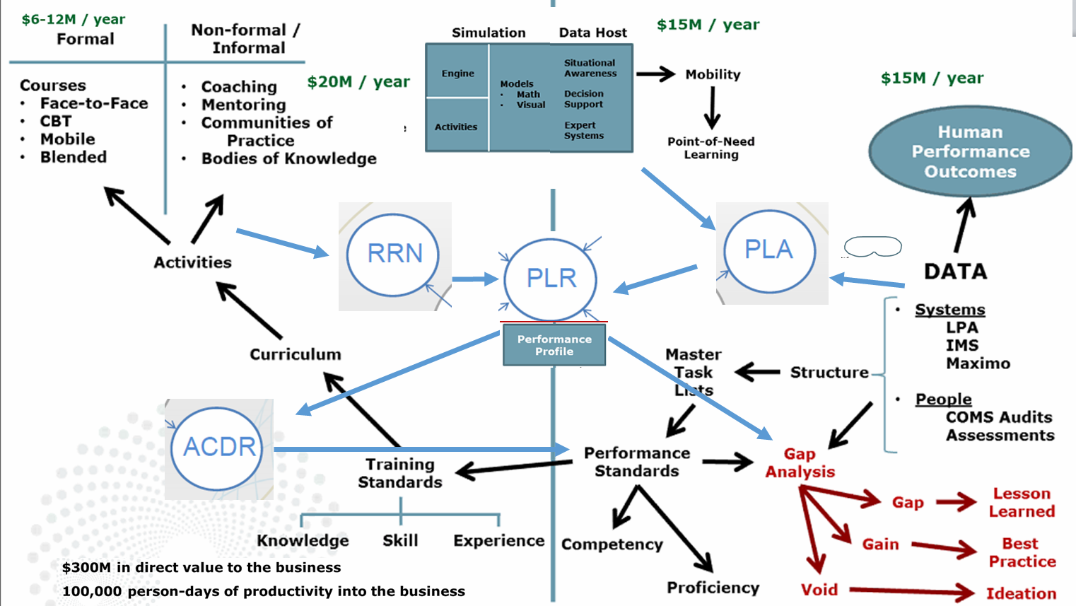
LPSS in Context

Slide 27
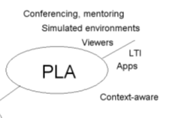
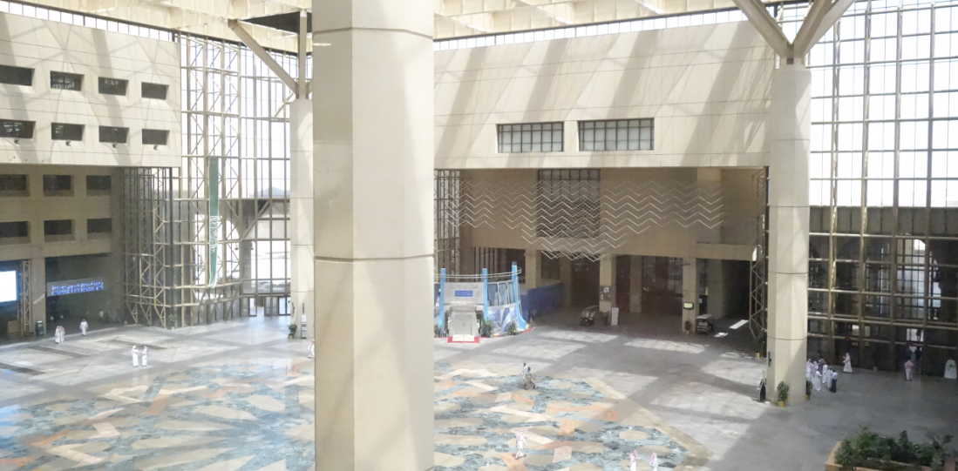
Personal Learning Assistant
Collect contextual information for system
Display resources of various formats, including SCORM, LTI, etc.
Support (scaffolded) authoring environments
Project LPSS capacity into external software and devices

Slide 28
Project Details
Data, Information Retrieval
Management Layer
Cleansing/Filtering/Profiling/Processing
Search/Recommendation Layer
Data Representation
Learning activity sequencing/modeling
Prototype Repository
RRN
CF
PLA
Standards/Communication protocols
PLR
Data Capture
Security Protocols
Security Protocols
Distributed Architecture
Personal Learning Record
PC
ACDR
Data synchronization
Personal Access to Network Storage
TROI (Training Return on Investment) analytics
Cloud Storage and Management
Performance Trends Algorithm
Competence Development
Automated Assessment

Slide 29
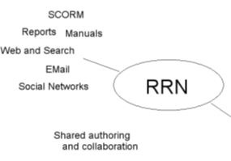

Resource Repository Network
Manage and discover list of sources and resources
Maintain authentication and credentials
Support APIs and metadata standards
Gather, analyze and sort resources and/or metadata

Slide 30
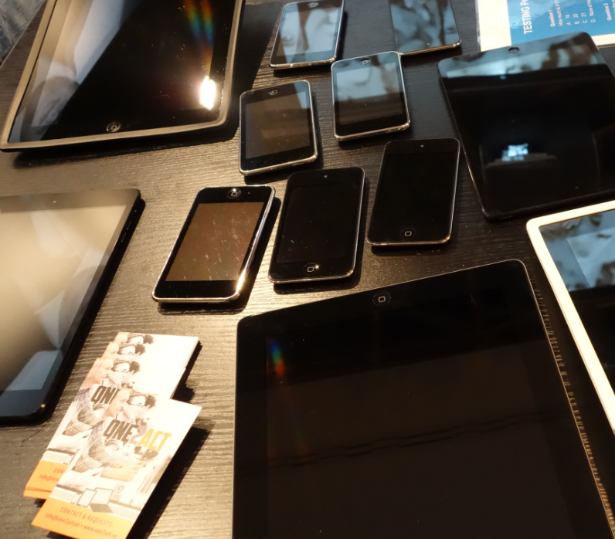
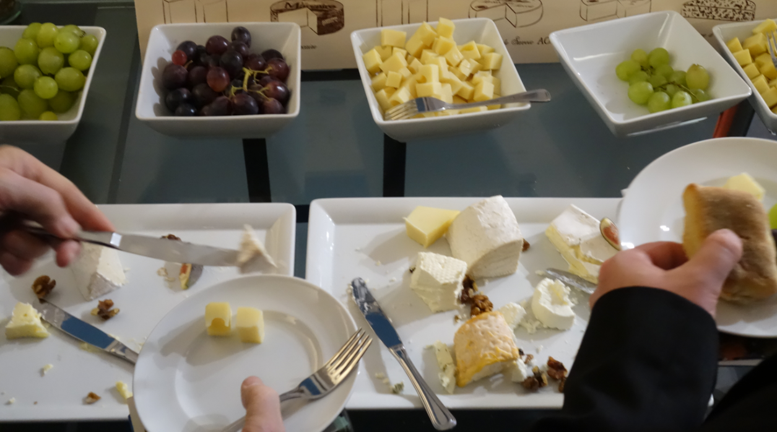
Synchronized cloud data services (including Owncloud) to support data portability

Slide 31
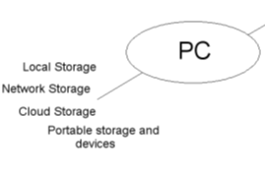
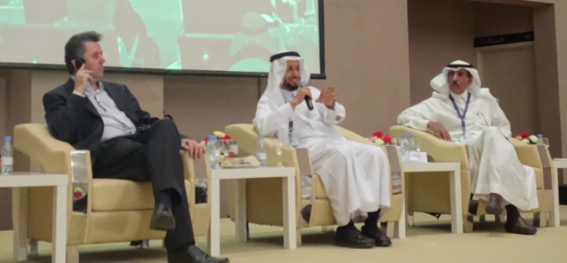
Personal Cloud
Manage list of local and remote storage systems
Maintain security, encryption, authentication and credentials
Include local or personal device storage
Manage and synchronize resource sets and data

Slide 32
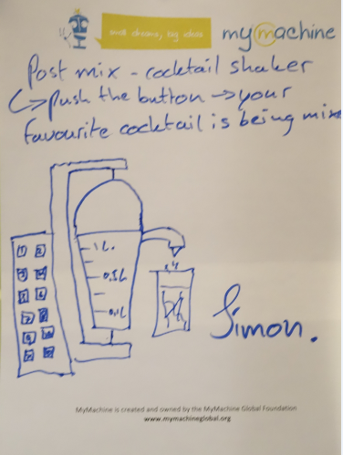
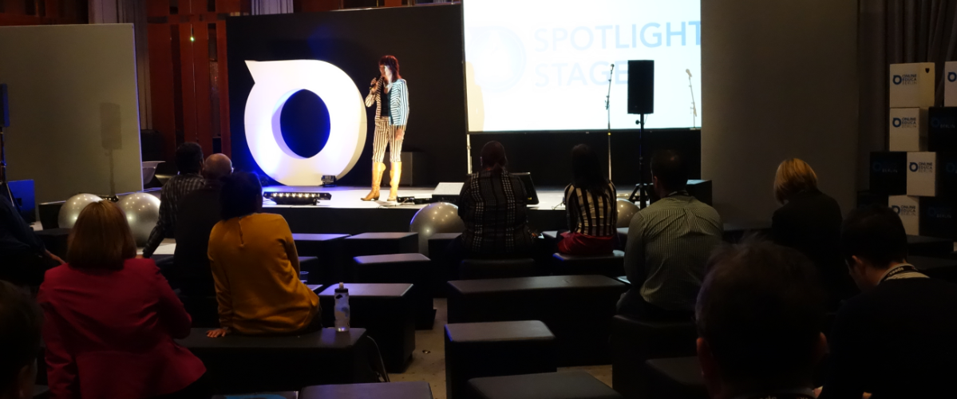
Projection of learning services into multiple platforms

Slide 33
Personal Learning Assistant
Collect contextual information for system
Display resources of various formats, including SCORM, LTI, etc.
Support (scaffolded) authoring environments
Project LPSS capacity into external software and devices

Slide 34
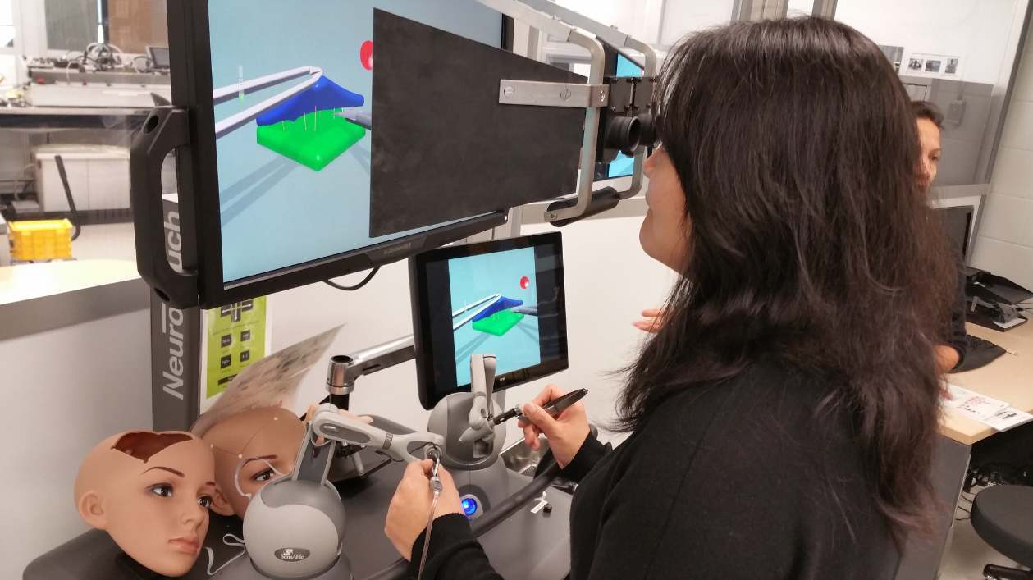
Connecting to real learning and workplace environments
http://www.nrc-cnrc.gc.ca/eng/rd/medical/

Slide 35
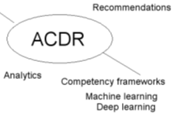

Competency Recognition and Development
Import or create competency definitions
Analyze interactions for skills and learning gaps
Support development of learning plans
Provide resource and service recommendations

Slide 36

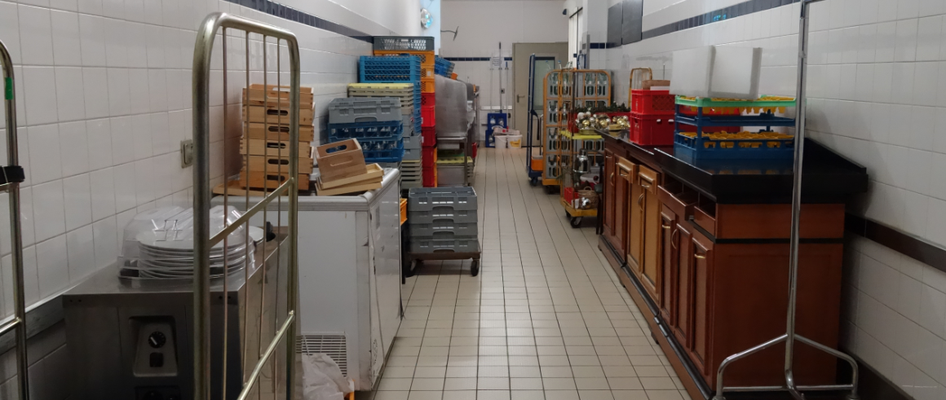
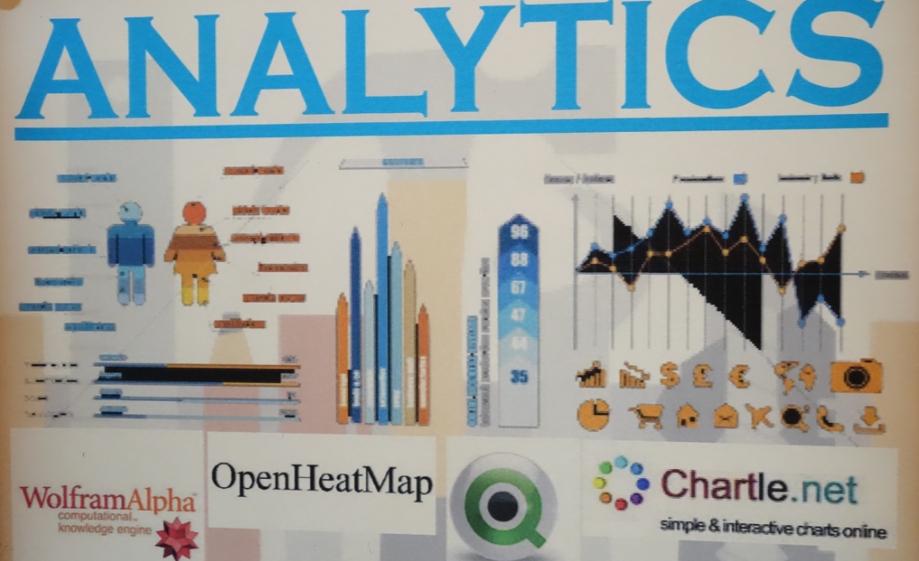
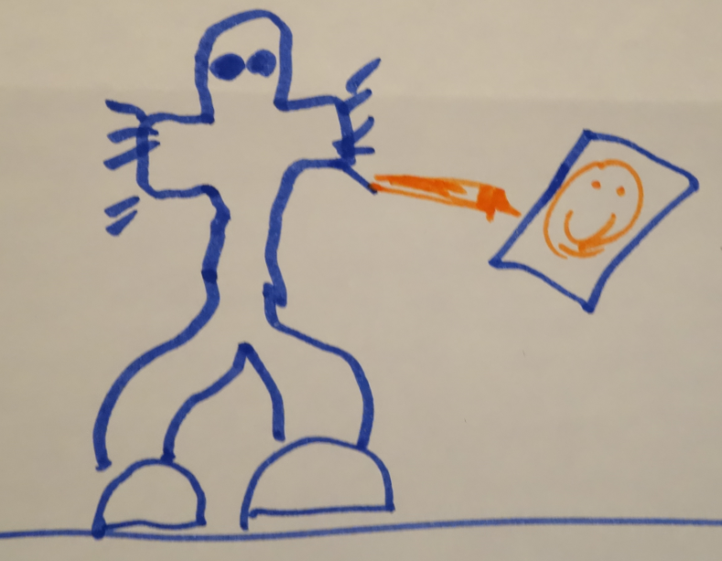
Analytics as a service – analogy with web translation

Slide 37

The Personal Learning Record – data owned by the individual, shared only with permissions
http://halfanhour.blogspot.de/2014/12/eportfolios-and-badges-workshop-oeb14.html

Slide 38

Personal Learning Record
Collect full record of interactions with all resources, external systems
Support learning activity data exchange formats (eg. xAPI)
Collect and present a person’s personal portfolio
Display certifications and credentials (eg. badges)
Maintain 3rd party certification

Slide 39
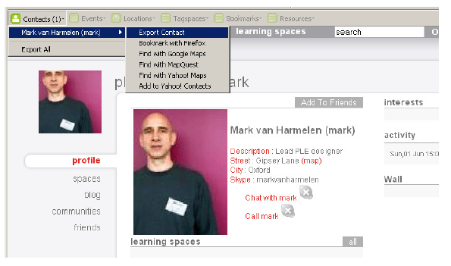
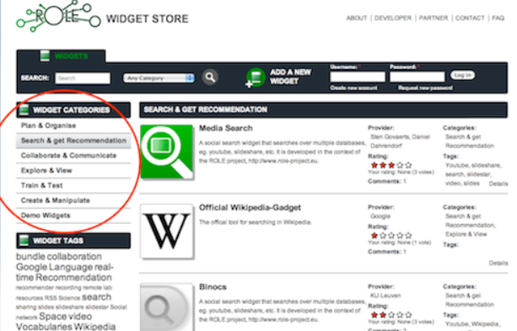
Relevant PLR Projects
Manchester PLE Project
Responsive Open Learning Environments (ROLE) http://www.role-project.eu/
Known http://withknown.com/
Learning Locker http://learninglocker.net/
Mahara https://mahara.org/
http://personalis.wikispaces.com/PLE+Projects

Slide 40
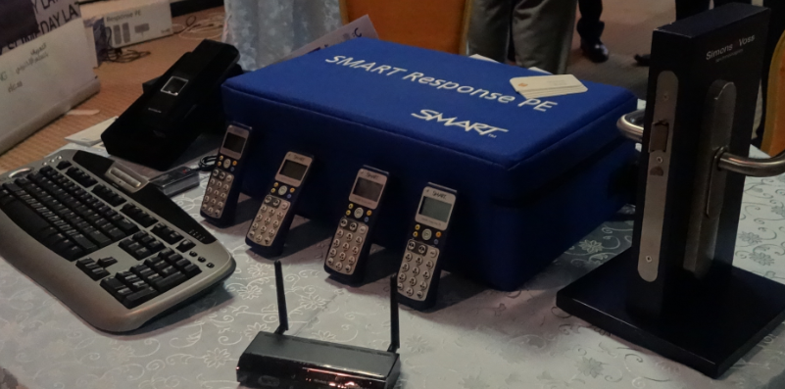
Implementation – from MOOC to Personal Learning
MOOC-REL (OIF)
ALECSO
MINT
PCO Badges
TSILE xAPI
2Sim Simulator xAPI
Workplace T&D

Slide 41
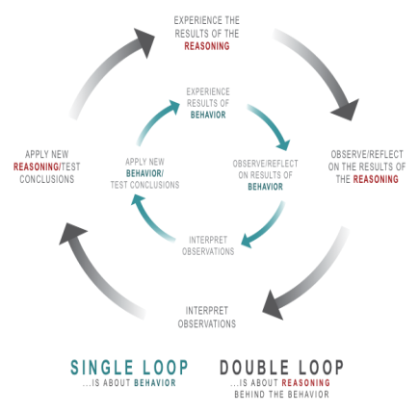
Implementation Projects
Ultimately, the objective is to support individual learning in a network
http://integralleadershipmanifesto.com/manifesto/making-subject-object/

Slide 42
Why is this Difficult?
It’s not one big thing…
… but a set of many small things
Tasks that are simple in an enterprise system…
  Like data storage
  Like content distribution
  Like authentication
  Like analytics
… become that much more difficult

Slide 43
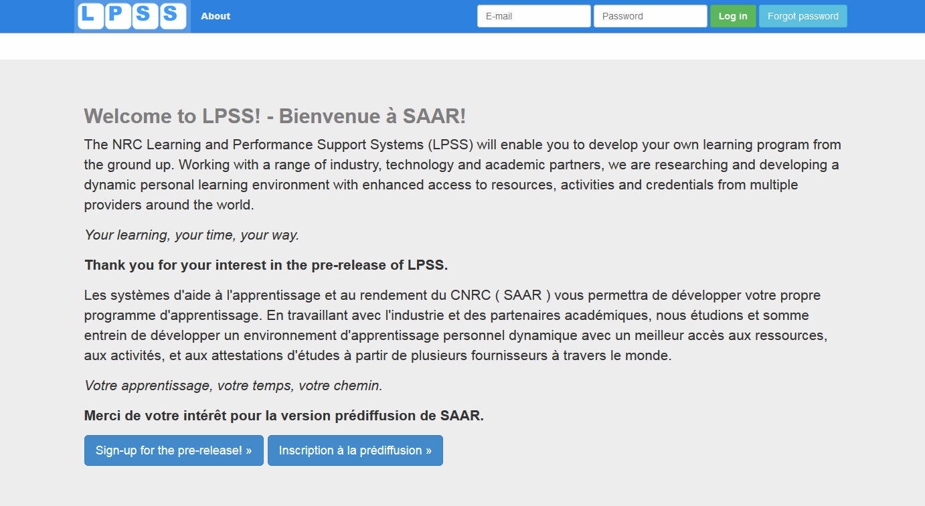
Launch Day

Slide 44
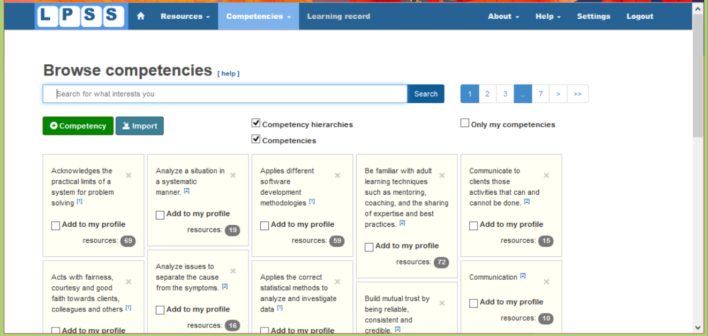
http://lpss.me – prototype PLE

Slide 45
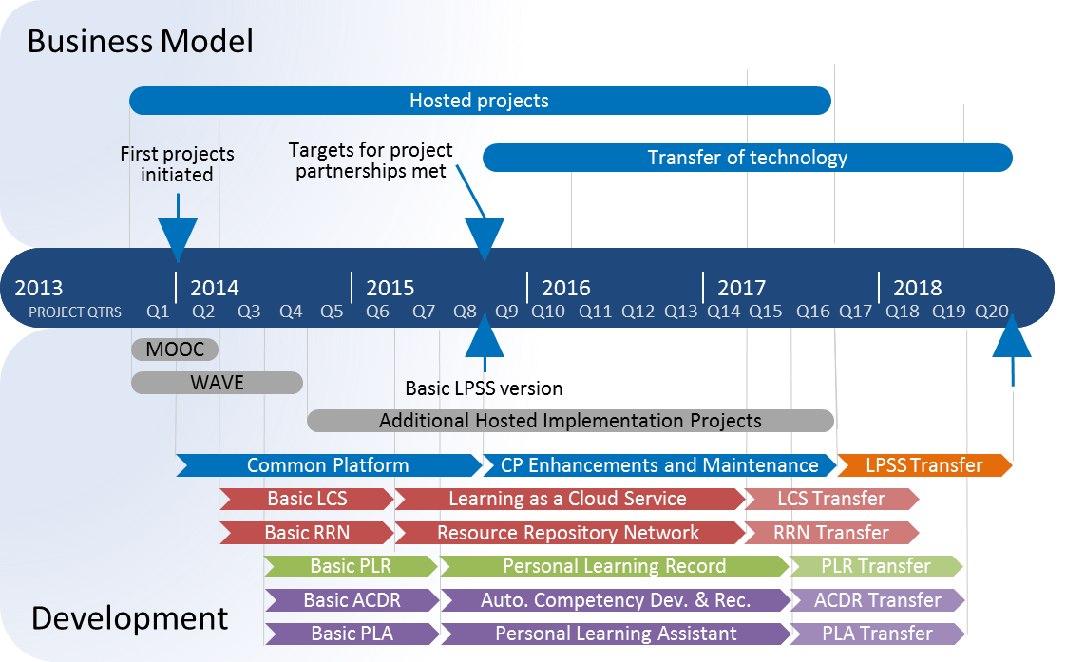
Program Implementation Timeline
Notes:
Note the two phases mentioned earlier are overlapping

Slide 46
Stephen Downes
LPSS program Leader
+1 (506) 861-0955
Stephen.Downes@nrc-cnrc.gc.ca
http://www.nrc-cnrc.gc.ca

