Slide 1
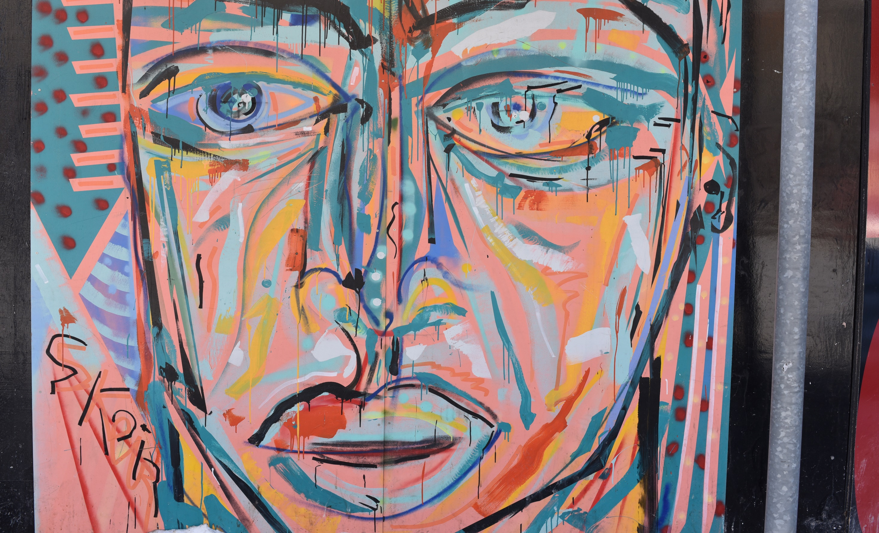
New learning, new society
  Stephen Downes
  February 19, 2015
  Ryerson University: The Chang School

Slide 2
The Right Model
1
Notes:
“The dominance of narrow free-market theories at top universities harms the world's ability to confront challenges such as financial stability and climate change”

Slide 3
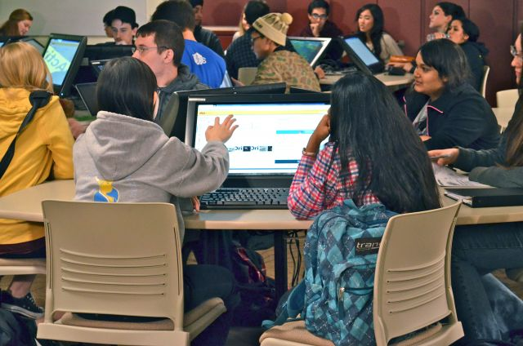
Existing models are failing
Notes:
Dan Rockmore: “Our “digital assistants” are platforms for play and socializing”
The study (comparing taking notes by typing and by hand) should be rejected as irrelevant
A summary of 225 recent studies, "provides overwhelming evidence that active learning works better than lecture."
"Everyone knows that knowledge is growing at an increasing depth and an increasing breadth, so you need people which can constantly learn and bridge that gap even while they’re in their current jobs." Iyadunni Olubode

Slide 4

What’s the best model for learning?

Slide 5

What’s the best model for learning?

Slide 6
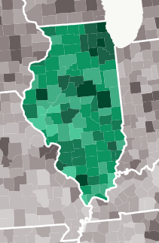
The pundits have their own models to propose
Data-driven management
Notes:
Economists have their own view of what academia needs…
If the Economist says something is good, I begin to worry. And so too with this article touting the destruction of the universities at the hands of the MOOC.
Three trends ‘worth watching’ in the higher education space:
Tiered service models at universities
Analytics and data-driven management
Alternative credentials
Economics and education – two domains in which models prevail

Slide 7
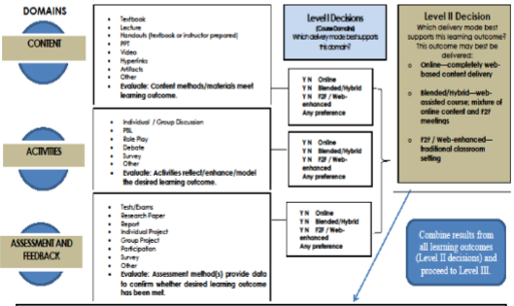
The pundits have their own models to propose
Tiered service models at universities
Notes:
Economists have their own view of what academia needs…
If the Economist says something is good, I begin to worry. And so too with this article touting the destruction of the universities at the hands of the MOOC.
Three trends ‘worth watching’ in the higher education space:
Tiered service models at universities
Analytics and data-driven management
Alternative credentials
Economics and education – two domains in which models prevail

Slide 8
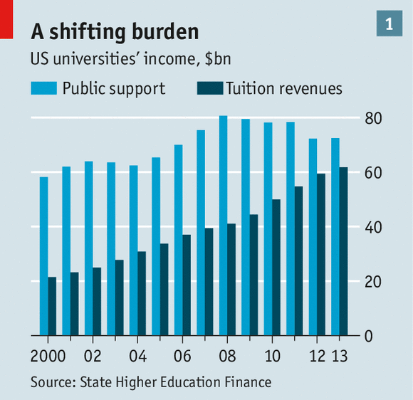
The pundits have their own models to propose
Notes:
Economists have their own view of what academia needs…
If the Economist says something is good, I begin to worry. And so too with this article touting the destruction of the universities at the hands of the MOOC.
Three trends ‘worth watching’ in the higher education space:
Tiered service models at universities
Analytics and data-driven management
Alternative credentials
Economics and education – two domains in which models prevail

Slide 9
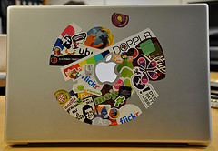
Designers are full of models
Notes:
A model of the workflow process employed to assist LMS selection
A step-by-step guide to LMS selection; a customized list of LMS features
Learning design patterns
via Grainne Conole
“see how a particular pedagogic approach can be migrated successfully across different topics”
“Best Practices” for typical learning tasks
For example, the phenomenon of 'conditional release of material' - that is, showing students course content only after they have reached a certain threshold
How should I offer this course: the online, hybrid or traditional models…

Slide 10
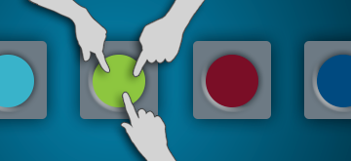
Designers are full of models
Notes:
A model of the workflow process employed to assist LMS selection
A step-by-step guide to LMS selection; a customized list of LMS features
Learning design patterns
via Grainne Conole
“see how a particular pedagogic approach can be migrated successfully across different topics”
“Best Practices” for typical learning tasks
For example, the phenomenon of 'conditional release of material' - that is, showing students course content only after they have reached a certain threshold
How should I offer this course: the online, hybrid or traditional models…

Slide 11
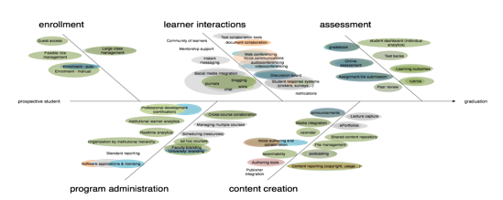
Designers are full of models
Notes:
A model of the workflow process employed to assist LMS selection
A step-by-step guide to LMS selection; a customized list of LMS features
Learning design patterns
via Grainne Conole
“see how a particular pedagogic approach can be migrated successfully across different topics”
“Best Practices” for typical learning tasks
For example, the phenomenon of 'conditional release of material' - that is, showing students course content only after they have reached a certain threshold
How should I offer this course: the online, hybrid or traditional models…

Slide 12
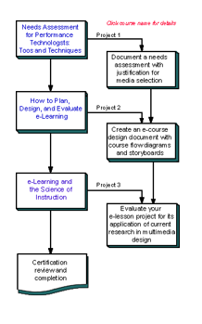
Technology is full of models
Notes:
These models are being implemented as educational technology
Dozens of LMS companies are re-examining their business plans this week after the launch of Google's preview of Classroom, part of the Google Apps for Education suite.
According to their official blog, Classroom helps teachers:
help teachers create and collect assignments
make announcements and ask questions
create folders for each assignment and for each student.
With models, the answers are determined before the system or simulation is ever run…
“Carnegie Melon University received a two-year grant for research on and development of MOOCs platforms 'intelligent enough to mimic the traditional classroom experience'.”
But it’s not new just because you’ve added “on a computer” to some pre-existing model or idea
The courts have spoken on this
It’s not even new on a computer… today’s online learning models are yesterday’s models with new names
“This isn’t simply a matter of forgetting history -- the history of technology or the history of education or the history of ed-tech… It’s a rewriting of history” - Watters
Take, for example, LRMI, a model of learning resources
You’ll recognize AICC, IMS, IEEE-LOM, SCORM, IMS-MLR…

Slide 13

Technology is full of models
'intelligent enough to mimic the traditional classroom experience’
Notes:
These models are being implemented as educational technology
Dozens of LMS companies are re-examining their business plans this week after the launch of Google's preview of Classroom, part of the Google Apps for Education suite.
According to their official blog, Classroom helps teachers:
help teachers create and collect assignments
make announcements and ask questions
create folders for each assignment and for each student.
With models, the answers are determined before the system or simulation is ever run…
“Carnegie Melon University received a two-year grant for research on and development of MOOCs platforms 'intelligent enough to mimic the traditional classroom experience'.”
But it’s not new just because you’ve added “on a computer” to some pre-existing model or idea
The courts have spoken on this
It’s not even new on a computer… today’s online learning models are yesterday’s models with new names
“This isn’t simply a matter of forgetting history -- the history of technology or the history of education or the history of ed-tech… It’s a rewriting of history” - Watters
Take, for example, LRMI, a model of learning resources
You’ll recognize AICC, IMS, IEEE-LOM, SCORM, IMS-MLR…

Slide 14
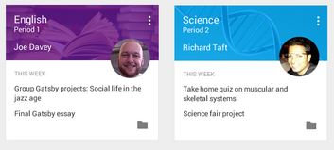
Technology is full of models
Notes:
These models are being implemented as educational technology
Dozens of LMS companies are re-examining their business plans this week after the launch of Google's preview of Classroom, part of the Google Apps for Education suite.
According to their official blog, Classroom helps teachers:
help teachers create and collect assignments
make announcements and ask questions
create folders for each assignment and for each student.
With models, the answers are determined before the system or simulation is ever run…
“Carnegie Melon University received a two-year grant for research on and development of MOOCs platforms 'intelligent enough to mimic the traditional classroom experience'.”
But it’s not new just because you’ve added “on a computer” to some pre-existing model or idea
The courts have spoken on this
It’s not even new on a computer… today’s online learning models are yesterday’s models with new names
“This isn’t simply a matter of forgetting history -- the history of technology or the history of education or the history of ed-tech… It’s a rewriting of history” - Watters
Take, for example, LRMI, a model of learning resources
You’ll recognize AICC, IMS, IEEE-LOM, SCORM, IMS-MLR…

Slide 15
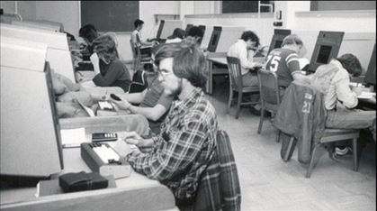
New versions of old models don’t produce new results
Notes:
And the results are pretty much what you’d expect
This post offers a short selection of sites where it can be found. Despite Barker's qualification this seems to me to be a very short list.
New versions of old models don’t produce new results
Phil Richards “highlighted the NHS as an example of a sector in which large sums of money had been invested in the development of interoperable systems based on open standards which had failed to deliver.”

Slide 16
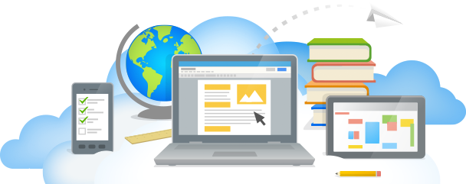
New versions of old models don’t produce new results
Notes:
And the results are pretty much what you’d expect
This post offers a short selection of sites where it can be found. Despite Barker's qualification this seems to me to be a very short list.
New versions of old models don’t produce new results
Phil Richards “highlighted the NHS as an example of a sector in which large sums of money had been invested in the development of interoperable systems based on open standards which had failed to deliver.”

Slide 17
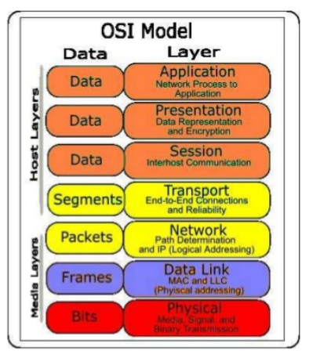
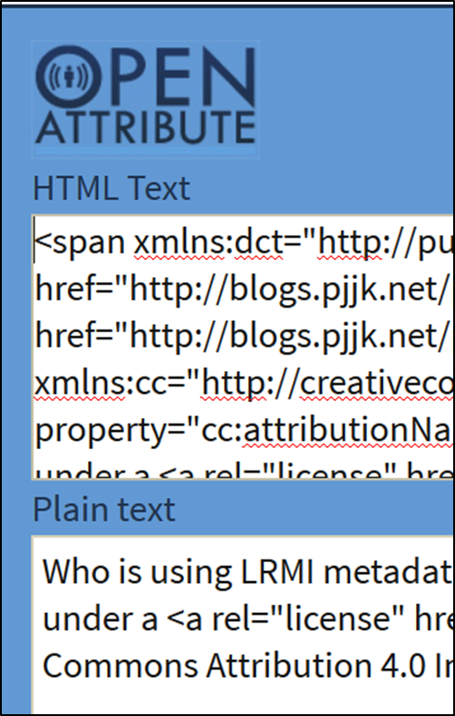
New versions of old models don’t produce new results
Notes:
And the results are pretty much what you’d expect
This post offers a short selection of sites where it can be found. Despite Barker's qualification this seems to me to be a very short list.
New versions of old models don’t produce new results
Phil Richards “highlighted the NHS as an example of a sector in which large sums of money had been invested in the development of interoperable systems based on open standards which had failed to deliver.”

Slide 18
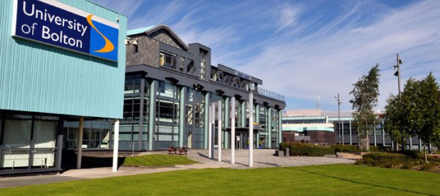
People are looking for learning that is relevant and practical
Notes:
And the results are pretty much what you’d expect
This post offers a short selection of sites where it can be found. Despite Barker's qualification this seems to me to be a very short list.
New versions of old models don’t produce new results
Phil Richards “highlighted the NHS as an example of a sector in which large sums of money had been invested in the development of interoperable systems based on open standards which had failed to deliver.”

Slide 19
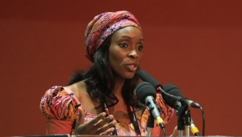
People are looking for learning that is relevant and practical
Iyadunni Olubode
Notes:
And the results are pretty much what you’d expect
This post offers a short selection of sites where it can be found. Despite Barker's qualification this seems to me to be a very short list.
New versions of old models don’t produce new results
Phil Richards “highlighted the NHS as an example of a sector in which large sums of money had been invested in the development of interoperable systems based on open standards which had failed to deliver.”

Slide 20
People are looking for learning that is relevant and practical
"Everyone knows that knowledge is growing at an increasing depth and an increasing breadth, so you need people which can constantly learn and bridge that gap even while they’re in their current jobs." Iyadunni Olubode
Notes:
And the results are pretty much what you’d expect
This post offers a short selection of sites where it can be found. Despite Barker's qualification this seems to me to be a very short list.
New versions of old models don’t produce new results
Phil Richards “highlighted the NHS as an example of a sector in which large sums of money had been invested in the development of interoperable systems based on open standards which had failed to deliver.”

Slide 21
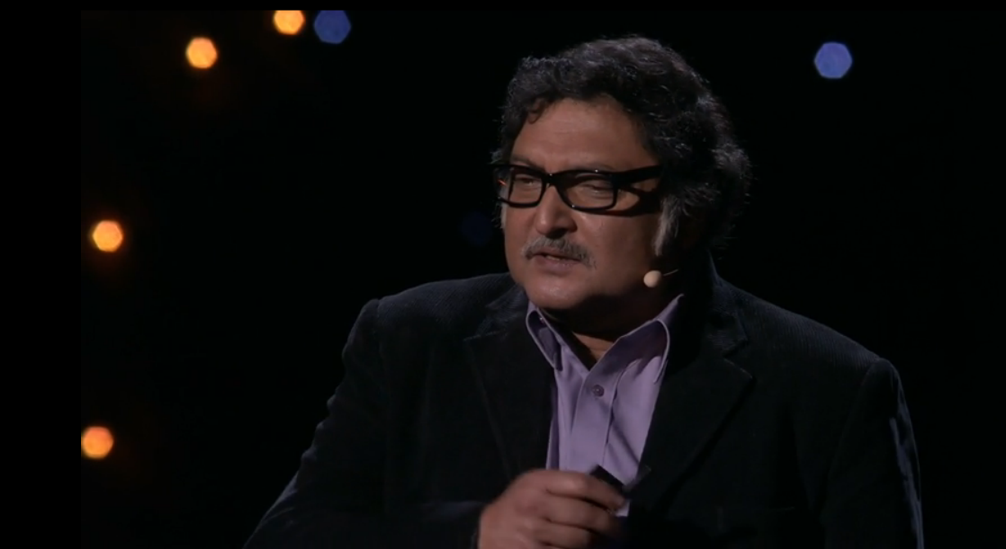
Maybe the ‘right model’ is to do away with the models altogether
Sugata Mitra
Notes:
People are looking for learning that is relevant and practical
"students expect universities to be more accessible, flexible and focused on jobs, according to a new survey.“
Of course, it would help if we surveyed people and not just students
And maybe the ‘right model’ is to do away with the models altogether
It could be "non-standards based systems, such as “innovative, successful learning technology without standards” such as "Sugata Mitra's 'hole in the wall' work as an example of successful self-organised learning

Slide 22
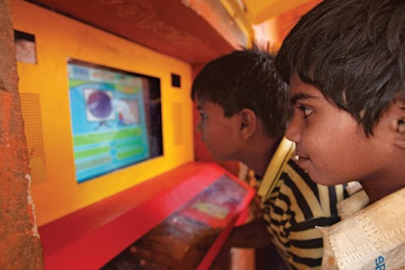
Maybe the ‘right model’ is to do away with the models altogether
Notes:
People are looking for learning that is relevant and practical
"students expect universities to be more accessible, flexible and focused on jobs, according to a new survey.“
Of course, it would help if we surveyed people and not just students
And maybe the ‘right model’ is to do away with the models altogether
It could be "non-standards based systems, such as “innovative, successful learning technology without standards” such as "Sugata Mitra's 'hole in the wall' work as an example of successful self-organised learning

Slide 23
Self-Organized Learning
2

Slide 24

The idea of control is an illusion
Sally Satel: Control is an illusion and always has been an illusion. It is a Hobbesian paradox that we cannot enforce change unless change has already occurred.
Notes:
The personal isn’t designed. It is
Each bird is actually reacting to the birds nearest to it, that the movement is the result of a series of short-range reactions... one bird's movement only affects its seven closest neighbors.
The great wildebeest migration is a similarly unplanned event
“There is neither start nor finish to their endless search for food and water, as they circle the Serengeti- Mara ecosystem in a relentless sequence of life and death…”
There is no single cause of events; landmark ideas are created by societies, not individuals
Charles Darwin’s grandfather, Erasmus, was also an evolutionist, as was this man, Jean Baptiste Lamarck.
Hashtags: categorizing using self-organizing networks rather than standard metadata and ontologies
Though commonly associated with Twitter, they existed before Twitter monetized them
Hashtag networks can be seen as self-organizing ideas
A concept map isn't the same as a network. But insofar as concepts are dynamic, interacting things they can and do form networks.
Mary Meeker…
The rise of mobile, the proliferation of apps... "the edge is becoming more important than the node"
Students in academia: not the start of a trend, but the continuation of one
Even a search for Ed Tech student panels specifically yields more than 2,000 results. So I think that the trend is well-established;

Slide 25
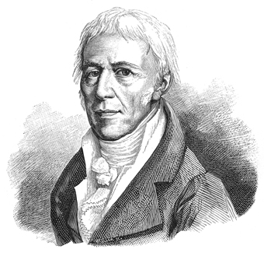
The idea of control is an illusion
Jean Baptiste Lamarck
Notes:
The personal isn’t designed. It is
Each bird is actually reacting to the birds nearest to it, that the movement is the result of a series of short-range reactions... one bird's movement only affects its seven closest neighbors.
The great wildebeest migration is a similarly unplanned event
“There is neither start nor finish to their endless search for food and water, as they circle the Serengeti- Mara ecosystem in a relentless sequence of life and death…”
There is no single cause of events; landmark ideas are created by societies, not individuals
Charles Darwin’s grandfather, Erasmus, was also an evolutionist, as was this man, Jean Baptiste Lamarck.
Hashtags: categorizing using self-organizing networks rather than standard metadata and ontologies
Though commonly associated with Twitter, they existed before Twitter monetized them
Hashtag networks can be seen as self-organizing ideas
A concept map isn't the same as a network. But insofar as concepts are dynamic, interacting things they can and do form networks.
Mary Meeker…
The rise of mobile, the proliferation of apps... "the edge is becoming more important than the node"
Students in academia: not the start of a trend, but the continuation of one
Even a search for Ed Tech student panels specifically yields more than 2,000 results. So I think that the trend is well-established;

Slide 26

The future of ed tech is a reclamation project
We must reclaim control of the data, content, and knowledge we create.”
Lucy Gray
Notes:
Watters: the future of ed tech is a reclamation project
“We can reclaim the Web and more broadly ed-tech for teaching and learning. But we must reclaim control of the data, content, and knowledge we create.”
We are not resources to be mined. Learners do not enter our schools and in our libraries to become products for the textbook industry
Lucy Gray, who saw all of her Slideshare presentations deleted and her account closed without notice or explanation.
Known
“You can still share selfies, make friends, listen to music together and share links, but now you do it in a space that's really yours, and that you get to have more control over.”

Slide 27
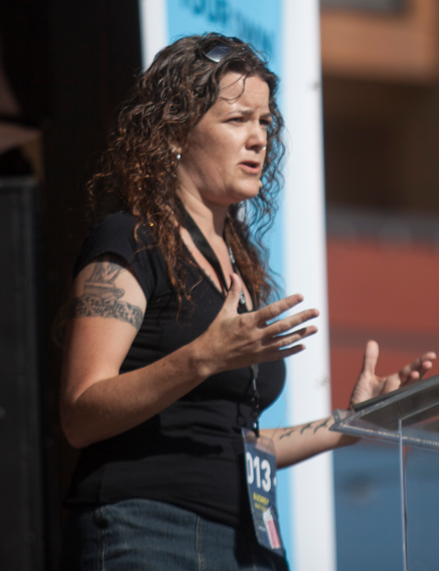
The future of ed tech is a reclamation project
“We must reclaim control of the data, content, and knowledge we create.”
Audrey Watters
Notes:
Watters: the future of ed tech is a reclamation project
“We can reclaim the Web and more broadly ed-tech for teaching and learning. But we must reclaim control of the data, content, and knowledge we create.”
We are not resources to be mined. Learners do not enter our schools and in our libraries to become products for the textbook industry
Lucy Gray, who saw all of her Slideshare presentations deleted and her account closed without notice or explanation.
Known
“You can still share selfies, make friends, listen to music together and share links, but now you do it in a space that's really yours, and that you get to have more control over.”

Slide 28
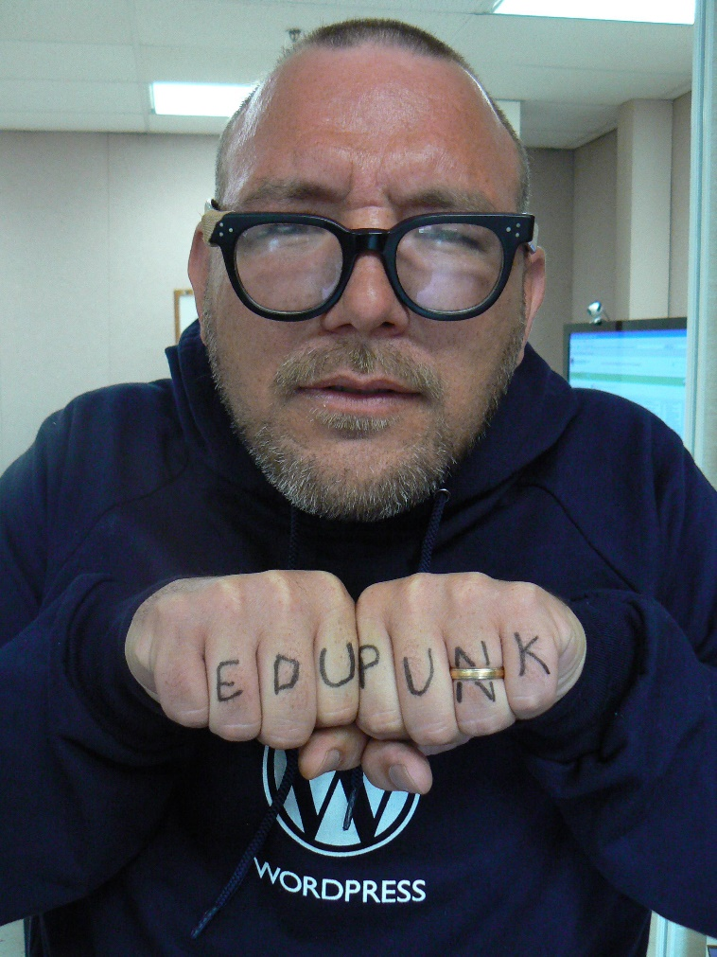
The future of ed tech is a reclamation project
Jim Groom
Notes:
Watters: the future of ed tech is a reclamation project
“We can reclaim the Web and more broadly ed-tech for teaching and learning. But we must reclaim control of the data, content, and knowledge we create.”
We are not resources to be mined. Learners do not enter our schools and in our libraries to become products for the textbook industry
Lucy Gray, who saw all of her Slideshare presentations deleted and her account closed without notice or explanation.
Known
“You can still share selfies, make friends, listen to music together and share links, but now you do it in a space that's really yours, and that you get to have more control over.”

Slide 29
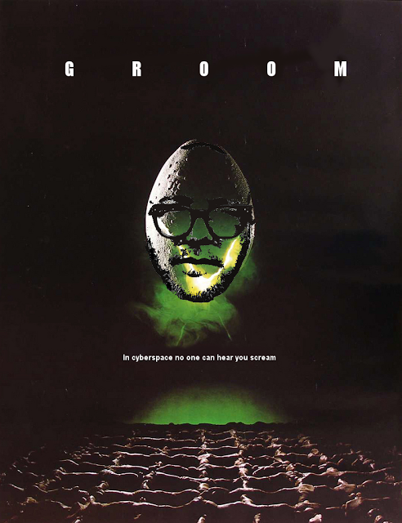
The future of ed tech is a reclamation project
Notes:
Watters: the future of ed tech is a reclamation project
“We can reclaim the Web and more broadly ed-tech for teaching and learning. But we must reclaim control of the data, content, and knowledge we create.”
We are not resources to be mined. Learners do not enter our schools and in our libraries to become products for the textbook industry
Lucy Gray, who saw all of her Slideshare presentations deleted and her account closed without notice or explanation.
Known
“You can still share selfies, make friends, listen to music together and share links, but now you do it in a space that's really yours, and that you get to have more control over.”

Slide 30
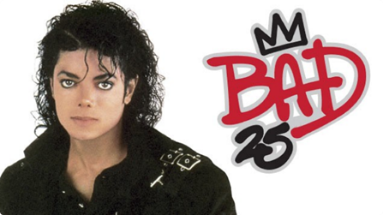
What’s missing is BAD
Bricolage
Affordances
Distribution
Notes:
What’s missing in the standard-based models-based approach is what we used to think of as BAD
Bricolage – the doesn’t allow or cater for bricolage.
Affordances – everage the technology to improve learning and teaching.
Distribution – implications for the institutional practice of e-learning."
We need to question the presumption that we have too much or that it must be organized a certain way
Weinberger: We don't feel overloaded by the effects of 1.3 million apple pie recipes or 7.6 million cute cat photos. Why not?
We’re not expected to master them. We’re expected to pick and choose and apply as needed

Slide 31
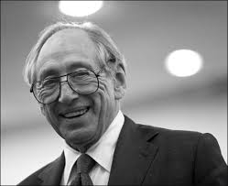
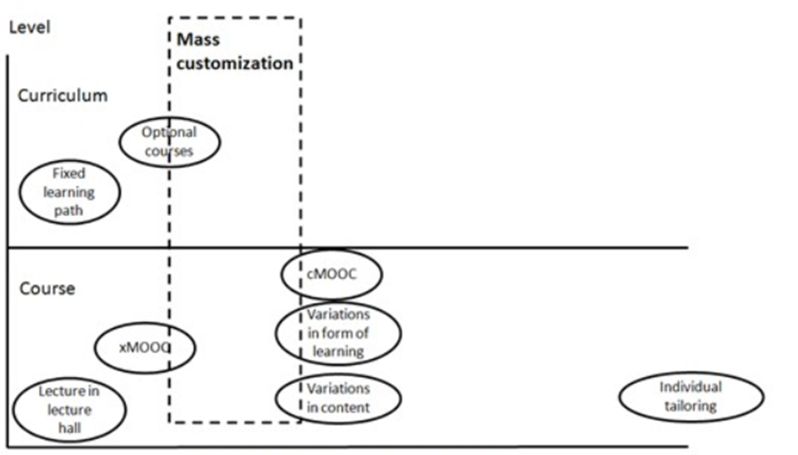
Personal vs Personalized
Alvin Toffler
Notes:
That’s the difference between personal learning and personalized learning
‘personalized’ is off-the-shelf and customized from a menu of options; ‘personal’ is made to order (and generally made by hand and made by and for oneself)
Institutions understand personalized. But they don’t understand personal.
“The widespread adoption of social media among students brings shared interactional practices that does not match university arrangements for learning.
“This, we argue, invites reappraisal of the framing of established educational practices and the metaphorical work that precedes it.”
Autonomy, rather than control, is essential in education
Satel: Control is an illusion and always has been an illusion. It is a Hobbesian paradox that we cannot enforce change unless change has already occurred. Higher status—or even a persuasive presentation full of facts—is of limited utility.
The design theories are nothing more than abstractions of the actual process, that they are most useful as descriptions of what was done, as opposed to prescriptions of what should be done
"designers should aim and accept that design is often based on informed guessing."

Slide 32
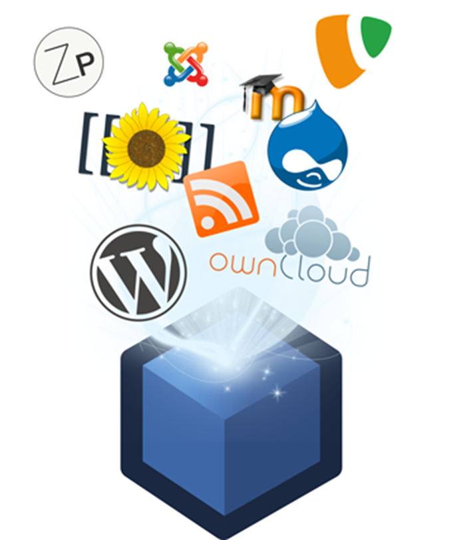
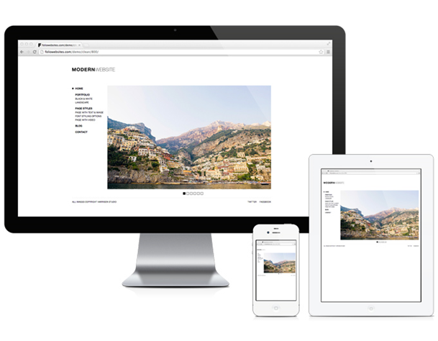
Personal vs Personalized
Notes:
That’s the difference between personal learning and personalized learning
‘personalized’ is off-the-shelf and customized from a menu of options; ‘personal’ is made to order (and generally made by hand and made by and for oneself)
Institutions understand personalized. But they don’t understand personal.
“The widespread adoption of social media among students brings shared interactional practices that does not match university arrangements for learning.
“This, we argue, invites reappraisal of the framing of established educational practices and the metaphorical work that precedes it.”
Autonomy, rather than control, is essential in education
Satel: Control is an illusion and always has been an illusion. It is a Hobbesian paradox that we cannot enforce change unless change has already occurred. Higher status—or even a persuasive presentation full of facts—is of limited utility.
The design theories are nothing more than abstractions of the actual process, that they are most useful as descriptions of what was done, as opposed to prescriptions of what should be done
"designers should aim and accept that design is often based on informed guessing."

Slide 33
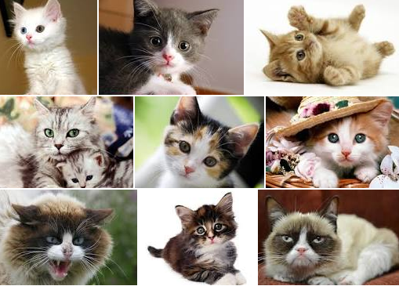
Personal vs Personalized
Notes:
That’s the difference between personal learning and personalized learning
‘personalized’ is off-the-shelf and customized from a menu of options; ‘personal’ is made to order (and generally made by hand and made by and for oneself)
Institutions understand personalized. But they don’t understand personal.
“The widespread adoption of social media among students brings shared interactional practices that does not match university arrangements for learning.
“This, we argue, invites reappraisal of the framing of established educational practices and the metaphorical work that precedes it.”
Autonomy, rather than control, is essential in education
Satel: Control is an illusion and always has been an illusion. It is a Hobbesian paradox that we cannot enforce change unless change has already occurred. Higher status—or even a persuasive presentation full of facts—is of limited utility.
The design theories are nothing more than abstractions of the actual process, that they are most useful as descriptions of what was done, as opposed to prescriptions of what should be done
"designers should aim and accept that design is often based on informed guessing."

Slide 34
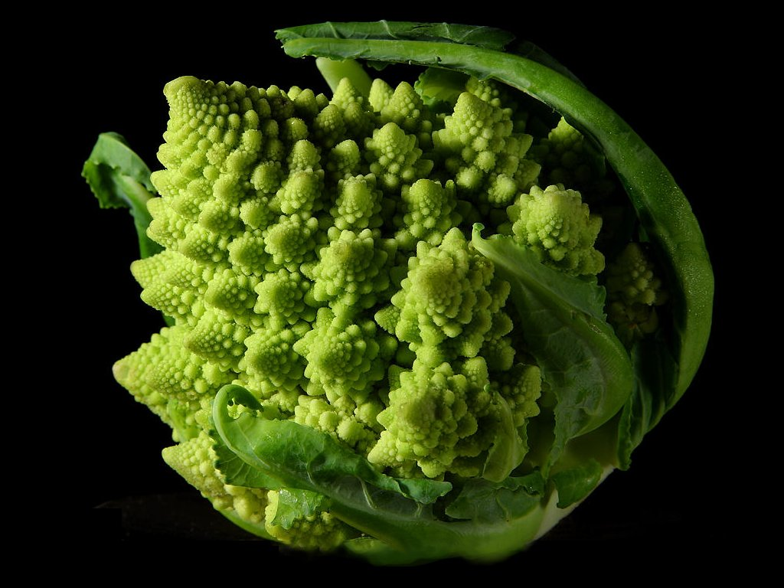
The personal isn’t designed. It is based on self-organization
Notes:
The personal isn’t designed. It is
Each bird is actually reacting to the birds nearest to it, that the movement is the result of a series of short-range reactions... one bird's movement only affects its seven closest neighbors.
The great wildebeest migration is a similarly unplanned event
“There is neither start nor finish to their endless search for food and water, as they circle the Serengeti- Mara ecosystem in a relentless sequence of life and death…”
There is no single cause of events; landmark ideas are created by societies, not individuals
Charles Darwin’s grandfather, Erasmus, was also an evolutionist, as was this man, Jean Baptiste Lamarck.
Hashtags: categorizing using self-organizing networks rather than standard metadata and ontologies
Though commonly associated with Twitter, they existed before Twitter monetized them
Hashtag networks can be seen as self-organizing ideas
A concept map isn't the same as a network. But insofar as concepts are dynamic, interacting things they can and do form networks.
Mary Meeker…
The rise of mobile, the proliferation of apps... "the edge is becoming more important than the node"
Students in academia: not the start of a trend, but the continuation of one
Even a search for Ed Tech student panels specifically yields more than 2,000 results. So I think that the trend is well-established;

Slide 35
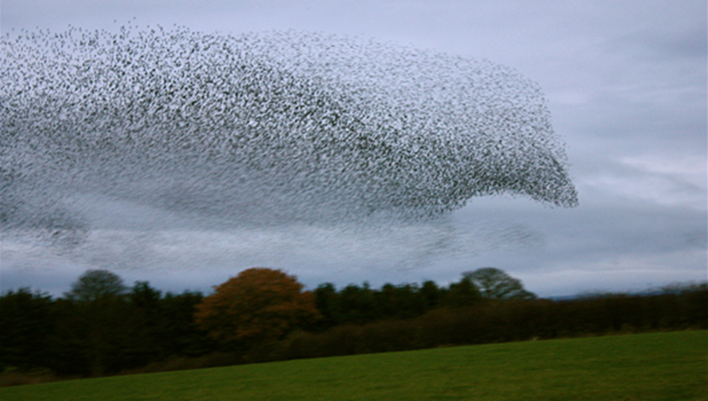
The personal isn’t designed. It is based on self-organization
Notes:
The personal isn’t designed. It is
Each bird is actually reacting to the birds nearest to it, that the movement is the result of a series of short-range reactions... one bird's movement only affects its seven closest neighbors.
The great wildebeest migration is a similarly unplanned event
“There is neither start nor finish to their endless search for food and water, as they circle the Serengeti- Mara ecosystem in a relentless sequence of life and death…”
There is no single cause of events; landmark ideas are created by societies, not individuals
Charles Darwin’s grandfather, Erasmus, was also an evolutionist, as was this man, Jean Baptiste Lamarck.
Hashtags: categorizing using self-organizing networks rather than standard metadata and ontologies
Though commonly associated with Twitter, they existed before Twitter monetized them
Hashtag networks can be seen as self-organizing ideas
A concept map isn't the same as a network. But insofar as concepts are dynamic, interacting things they can and do form networks.
Mary Meeker…
The rise of mobile, the proliferation of apps... "the edge is becoming more important than the node"
Students in academia: not the start of a trend, but the continuation of one
Even a search for Ed Tech student panels specifically yields more than 2,000 results. So I think that the trend is well-established;

Slide 36
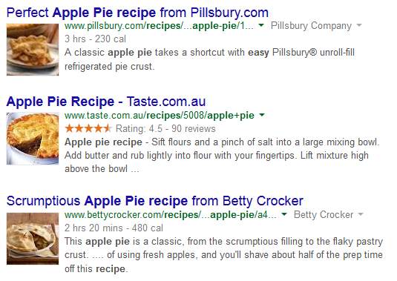
The personal isn’t designed. It is based on self-organization
David Weinberger :We don't feel overloaded by the effects of 1.3 million apple pie recipes or 7.6 million cute cat photos.
Notes:
The personal isn’t designed. It is
Each bird is actually reacting to the birds nearest to it, that the movement is the result of a series of short-range reactions... one bird's movement only affects its seven closest neighbors.
The great wildebeest migration is a similarly unplanned event
“There is neither start nor finish to their endless search for food and water, as they circle the Serengeti- Mara ecosystem in a relentless sequence of life and death…”
There is no single cause of events; landmark ideas are created by societies, not individuals
Charles Darwin’s grandfather, Erasmus, was also an evolutionist, as was this man, Jean Baptiste Lamarck.
Hashtags: categorizing using self-organizing networks rather than standard metadata and ontologies
Though commonly associated with Twitter, they existed before Twitter monetized them
Hashtag networks can be seen as self-organizing ideas
A concept map isn't the same as a network. But insofar as concepts are dynamic, interacting things they can and do form networks.
Mary Meeker…
The rise of mobile, the proliferation of apps... "the edge is becoming more important than the node"
Students in academia: not the start of a trend, but the continuation of one
Even a search for Ed Tech student panels specifically yields more than 2,000 results. So I think that the trend is well-established;

Slide 37

Reclaimed learning is network learning
Notes:
The silos of today will become the syndication endpoints of tomorrow
Publish (on your) Own Site, Syndicate Elsewhere”. .. The POSSE antimodel - promoted here through everything from #indiweb to Diaspora to app.net to syndication itself - that we've been taking about here for years.
“Starting now. A technology that allows for limitless reproduction of knowledge resources, instantaneous global sharing and cooperation, and all the powerful benefits of digital manipulation, recombination, and computation…” – Jim Groom
Learning reclaimed is network learning…
For example, Adapt Learning to develop a freely available authoring tool for organisations people that wish to develop their own responsive e-learning content..”

Slide 38
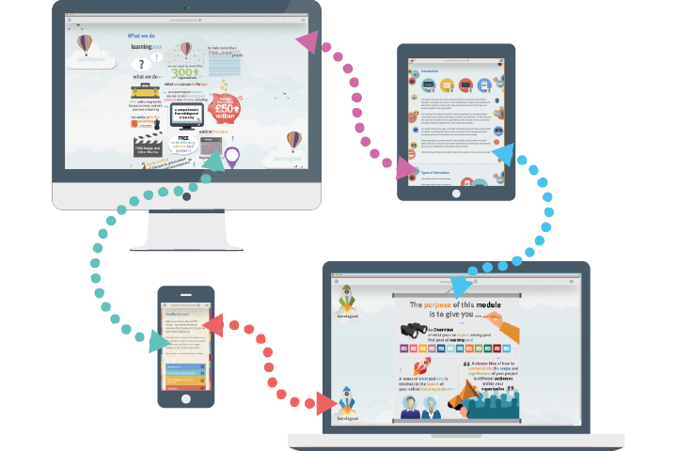
Reclaimed learning is network learning
Notes:
The silos of today will become the syndication endpoints of tomorrow
Publish (on your) Own Site, Syndicate Elsewhere”. .. The POSSE antimodel - promoted here through everything from #indiweb to Diaspora to app.net to syndication itself - that we've been taking about here for years.
“Starting now. A technology that allows for limitless reproduction of knowledge resources, instantaneous global sharing and cooperation, and all the powerful benefits of digital manipulation, recombination, and computation…” – Jim Groom
Learning reclaimed is network learning…
For example, Adapt Learning to develop a freely available authoring tool for organisations people that wish to develop their own responsive e-learning content..”

Slide 39
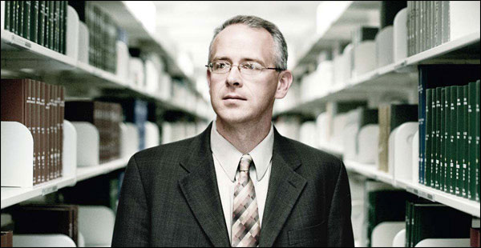
Reclaimed learning is network learning
David Wiley
Publish (on your) Own Site, Syndicate Elsewhere”... The POSSE antimodel
Notes:
The silos of today will become the syndication endpoints of tomorrow
Publish (on your) Own Site, Syndicate Elsewhere”. .. The POSSE antimodel - promoted here through everything from #indiweb to Diaspora to app.net to syndication itself - that we've been taking about here for years.
“Starting now. A technology that allows for limitless reproduction of knowledge resources, instantaneous global sharing and cooperation, and all the powerful benefits of digital manipulation, recombination, and computation…” – Jim Groom
Learning reclaimed is network learning…
For example, Adapt Learning to develop a freely available authoring tool for organisations people that wish to develop their own responsive e-learning content..”

Slide 40
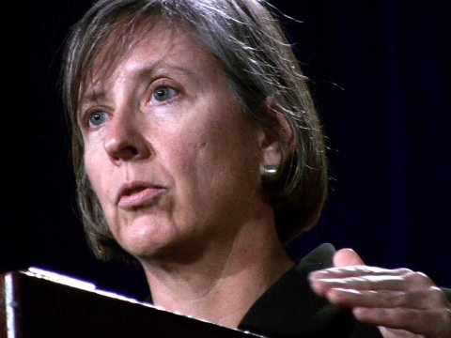
“The edge is becoming more important than the node.”
Mary Meeker
The rise of mobile, the proliferation of apps...
Notes:
That’s what we were building when we were building something like this…

Slide 41
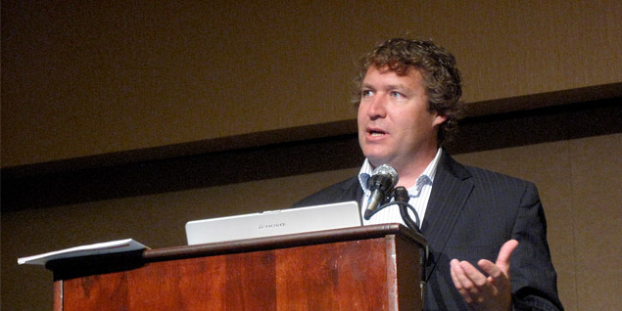
“The edge is becoming more important than the node.”
George Siemens
Notes:
That’s what we were building when we were building something like this…

Slide 42
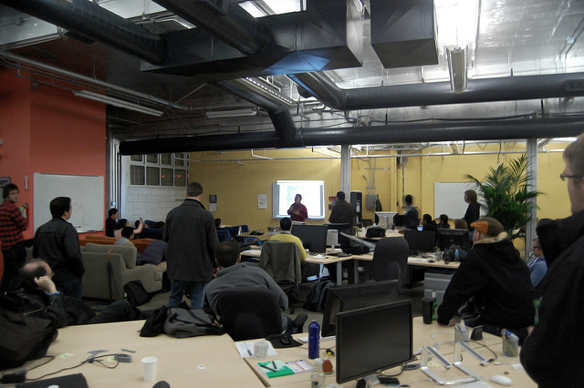
“The edge is becoming more important than the node.”
Ben Werdmuller may have a startup invested in the concept, but his view of an indieweb
Notes:
That’s what we were building when we were building something like this…

Slide 43
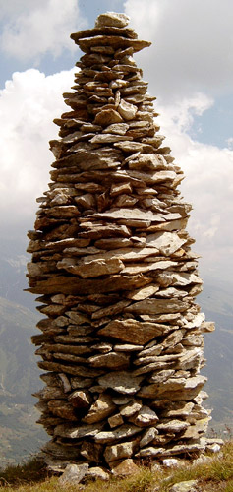
The distributed developer’s stack
Notes:
Some of the technology behind the reclaimed web…
“digital tools that will make it easier for readers to post comments and photos on news sites and to interact with journalists and each other."
Toolset: the Distributed Developer’s Stack (DDS)
they're built on distributed computing. Coursera, for example, relies on Amazon Web Services (AWS).
Schema.org – making it easier for search engines to index tour site
a joint initiative of the search engines Google, Bing, Yahoo and Yandex
An app store for server software
Install your favorite applications in your own servers or run them in the cloud.
Take back your data from Google
"a personal web server preloaded with open source software that lets you run your own web services from your home network.”
QR codes, open search, Windows Live tiles, touch icons for mobile and android, RSS autodiscovery, humans.txt – these are features of the modern website

Slide 44
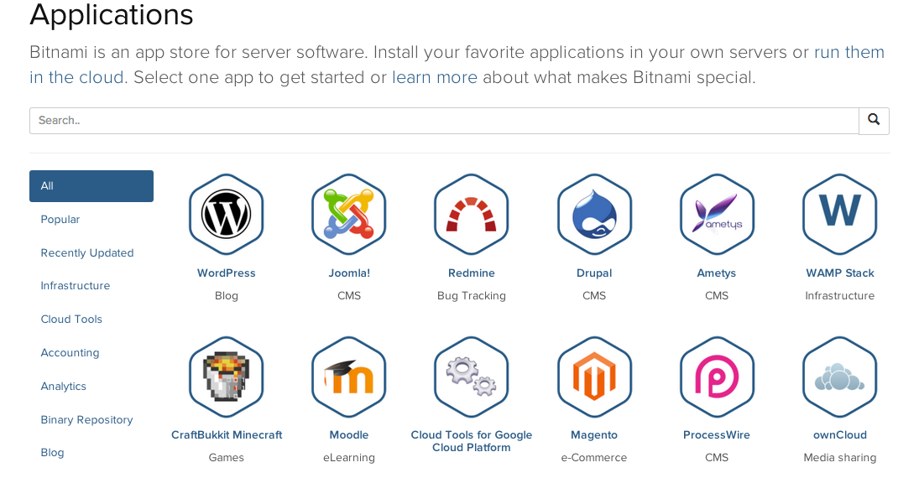
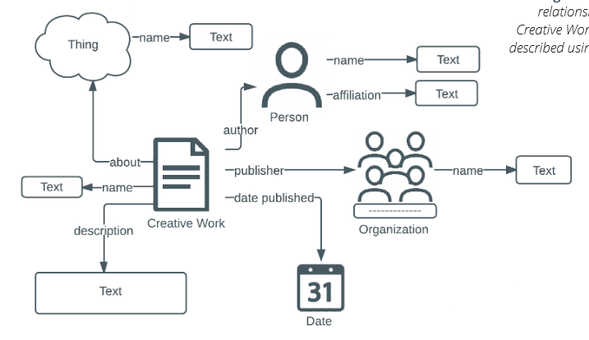
The distributed developer’s stack
https://bitnami.com/stacks
Schema.org
Notes:
Some of the technology behind the reclaimed web…
“digital tools that will make it easier for readers to post comments and photos on news sites and to interact with journalists and each other."
Toolset: the Distributed Developer’s Stack (DDS)
they're built on distributed computing. Coursera, for example, relies on Amazon Web Services (AWS).
Schema.org – making it easier for search engines to index tour site
a joint initiative of the search engines Google, Bing, Yahoo and Yandex
An app store for server software
Install your favorite applications in your own servers or run them in the cloud.
Take back your data from Google
"a personal web server preloaded with open source software that lets you run your own web services from your home network.”
QR codes, open search, Windows Live tiles, touch icons for mobile and android, RSS autodiscovery, humans.txt – these are features of the modern website

Slide 45
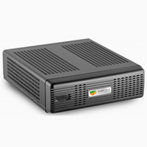
The distributed developer’s stack
Notes:
Some of the technology behind the reclaimed web…
“digital tools that will make it easier for readers to post comments and photos on news sites and to interact with journalists and each other."
Toolset: the Distributed Developer’s Stack (DDS)
they're built on distributed computing. Coursera, for example, relies on Amazon Web Services (AWS).
Schema.org – making it easier for search engines to index tour site
a joint initiative of the search engines Google, Bing, Yahoo and Yandex
An app store for server software
Install your favorite applications in your own servers or run them in the cloud.
Take back your data from Google
"a personal web server preloaded with open source software that lets you run your own web services from your home network.”
QR codes, open search, Windows Live tiles, touch icons for mobile and android, RSS autodiscovery, humans.txt – these are features of the modern website

Slide 46
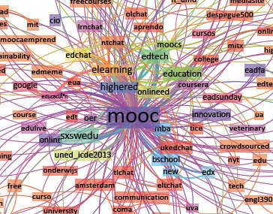
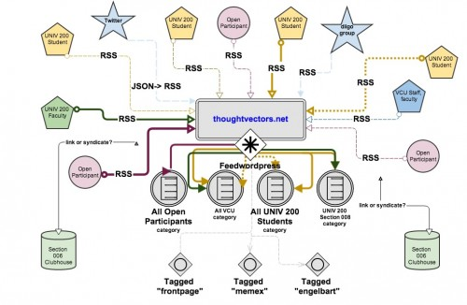
Network Learning - Building the MOOC
Notes:
That’s what we were building when we were building something like this…

Slide 47
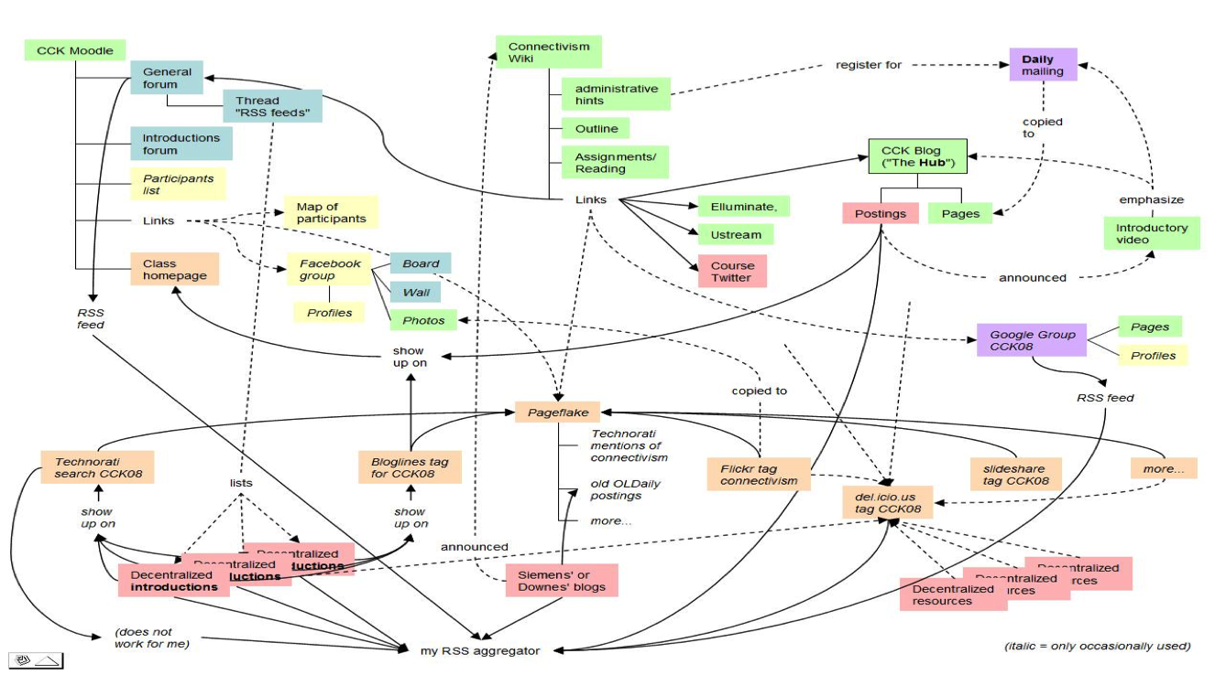
Network Learning - Building the MOOC
Notes:
That’s what we were building when we were building something like this…

Slide 48
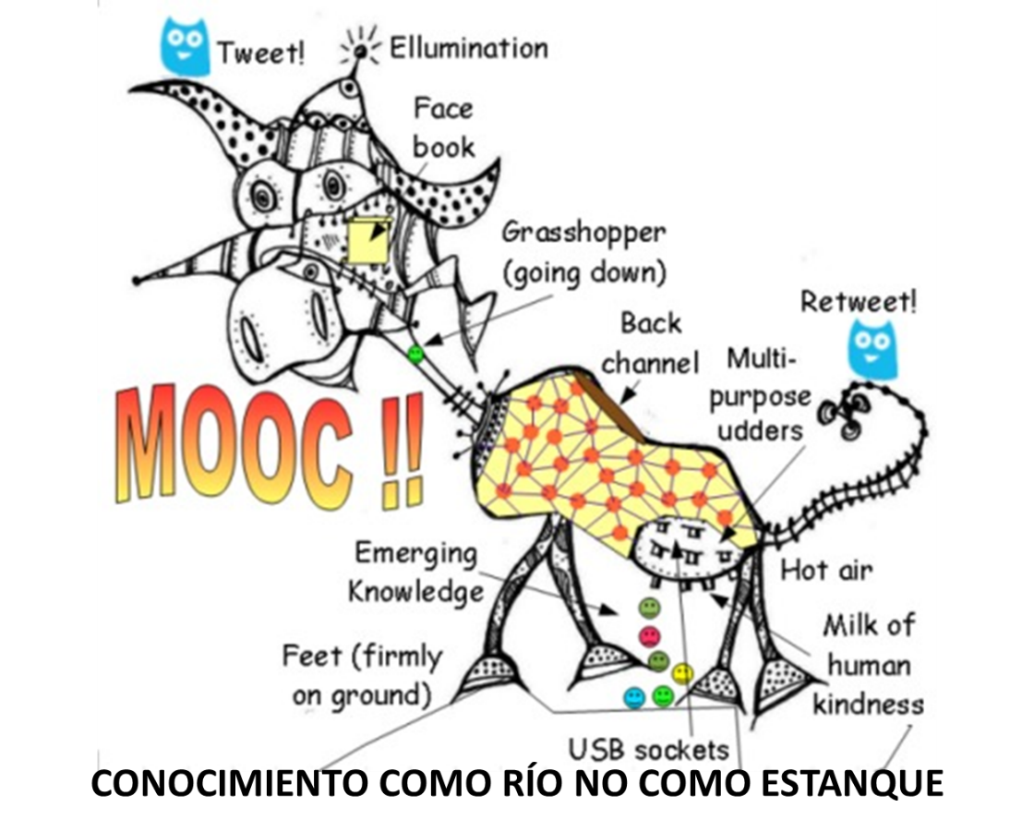
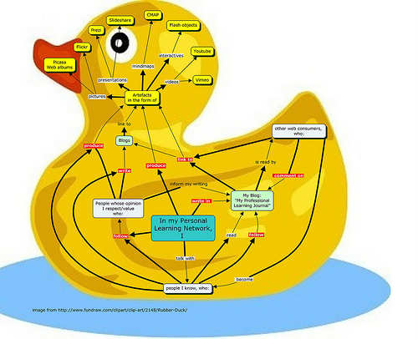
Network Learning - Building the MOOC
Notes:
That’s what we were building when we were building something like this…

Slide 49
Interactions in a Problem Space
3

Slide 50
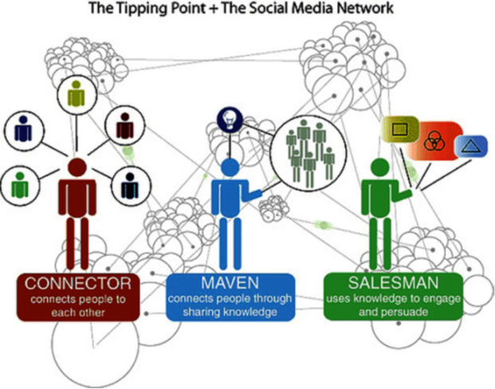
Connectivism as a learning theory
“Connectivism repositions media as a type of content, in that media, as tools of cognitive engagement, have the potential to transform the content of learning.”
Notes:
How this changes learning: the theory of connectivism
“Connectivism repositions media as a type of content, in that media, as tools of cognitive engagement, have the potential to transform the content of learning.”
What’s the connection between social networks and neural networks?
The Siemens answer is multimodal extension. The networks reach out and integrate with each other.
The Downes answer: pattern recognition. One network perceives patterns in another network and interprets or recognizes these patterns as something.
Connectivism as a learning theory
Cain writes, "for me, a theory must
account for current theories
sufficiently explain where we are now
make predictions
be subject to testing.”

Slide 51
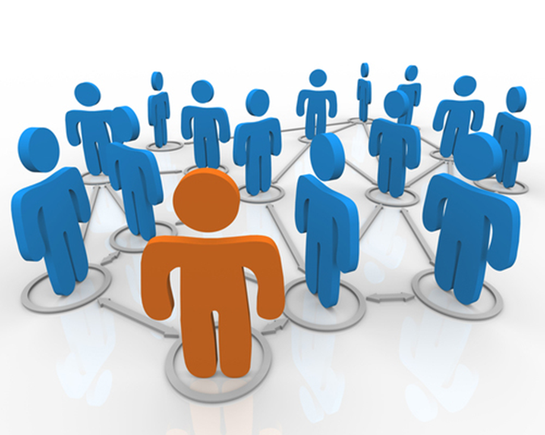
Connectivism as a learning theory
The Siemens answer is multimodal extension.
Notes:
How this changes learning: the theory of connectivism
“Connectivism repositions media as a type of content, in that media, as tools of cognitive engagement, have the potential to transform the content of learning.”
What’s the connection between social networks and neural networks?
The Siemens answer is multimodal extension. The networks reach out and integrate with each other.
The Downes answer: pattern recognition. One network perceives patterns in another network and interprets or recognizes these patterns as something.
Connectivism as a learning theory
Cain writes, "for me, a theory must
account for current theories
sufficiently explain where we are now
make predictions
be subject to testing.”

Slide 52
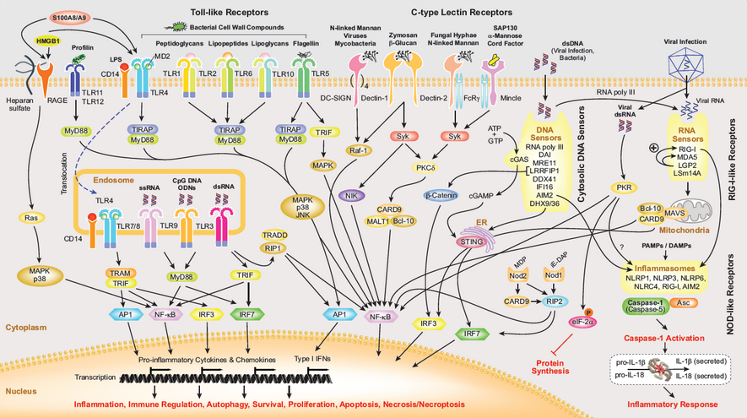
Connectivism as a learning theory
The Downes answer: pattern recognition.
Notes:
How this changes learning: the theory of connectivism
“Connectivism repositions media as a type of content, in that media, as tools of cognitive engagement, have the potential to transform the content of learning.”
What’s the connection between social networks and neural networks?
The Siemens answer is multimodal extension. The networks reach out and integrate with each other.
The Downes answer: pattern recognition. One network perceives patterns in another network and interprets or recognizes these patterns as something.
Connectivism as a learning theory
Cain writes, "for me, a theory must
account for current theories
sufficiently explain where we are now
make predictions
be subject to testing.”

Slide 53
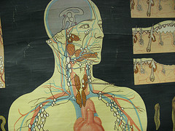
Elements of MOOC design
Connection across systems
Notes:
Connectivism’s respose: researching the MOOC
The MOOC was developed by Siemens and myself to instantiate the principles of connectivism
Our courses were designed as networks, testing both aspects of our theories
Participants’ perceptions in MOOCs
"creating networks and developing professional connections through networking technologies are advantages of participating in cMOOCs"

Slide 54
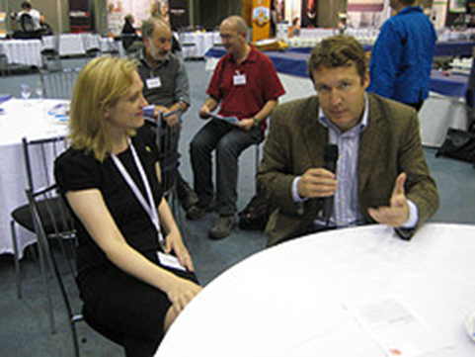
Elements of MOOC design
Conversation
Notes:
Connectivism’s respose: researching the MOOC
The MOOC was developed by Siemens and myself to instantiate the principles of connectivism
Our courses were designed as networks, testing both aspects of our theories
Participants’ perceptions in MOOCs
"creating networks and developing professional connections through networking technologies are advantages of participating in cMOOCs"

Slide 55

Elements of MOOC design
Notes:
Connectivism’s respose: researching the MOOC
The MOOC was developed by Siemens and myself to instantiate the principles of connectivism
Our courses were designed as networks, testing both aspects of our theories
Participants’ perceptions in MOOCs
"creating networks and developing professional connections through networking technologies are advantages of participating in cMOOCs"

Slide 56

Reading and networking will become one and the same thing
Utopia developer Steve Pettifer
Notes:
How this changes learning: the theory of connectivism
“Connectivism repositions media as a type of content, in that media, as tools of cognitive engagement, have the potential to transform the content of learning.”
What’s the connection between social networks and neural networks?
The Siemens answer is multimodal extension. The networks reach out and integrate with each other.
The Downes answer: pattern recognition. One network perceives patterns in another network and interprets or recognizes these patterns as something.
Connectivism as a learning theory
Cain writes, "for me, a theory must
account for current theories
sufficiently explain where we are now
make predictions
be subject to testing.”

Slide 57

Content and literacy will become one and the same thing
Notes:
How this changes learning: the theory of connectivism
“Connectivism repositions media as a type of content, in that media, as tools of cognitive engagement, have the potential to transform the content of learning.”
What’s the connection between social networks and neural networks?
The Siemens answer is multimodal extension. The networks reach out and integrate with each other.
The Downes answer: pattern recognition. One network perceives patterns in another network and interprets or recognizes these patterns as something.
Connectivism as a learning theory
Cain writes, "for me, a theory must
account for current theories
sufficiently explain where we are now
make predictions
be subject to testing.”

Slide 58

The learner at the centre of the networked world
Notes:
Where to now? The learner at the centre of the networked world
Aspen Institute:
empower learners to learn any time, any place
support and guide learners in a networked learning environment
interoperability across learning networks
Learner control has moved beyond computer assisted programs…
“towards authentic learning contexts mediated by technology in which the learner may have a greater control of either tangible or intangible elements of a learning environment”
Reading and networking will become one and the same thing
for instance, when a document in Utopoa is opened, "a sidebar opens up on the right-hand side and fills with relevant data from external databases and services like Mendeley, SHERPA/RoMEO, and Wikipedia."

Slide 59

The learner at the centre of the networked world
Notes:
Where to now? The learner at the centre of the networked world
Aspen Institute:
empower learners to learn any time, any place
support and guide learners in a networked learning environment
interoperability across learning networks
Learner control has moved beyond computer assisted programs…
“towards authentic learning contexts mediated by technology in which the learner may have a greater control of either tangible or intangible elements of a learning environment”
Reading and networking will become one and the same thing
for instance, when a document in Utopoa is opened, "a sidebar opens up on the right-hand side and fills with relevant data from external databases and services like Mendeley, SHERPA/RoMEO, and Wikipedia."

Slide 60

The learner at the centre of the networked world
Interactions in a problem space
Notes:
Where to now? The learner at the centre of the networked world
Aspen Institute:
empower learners to learn any time, any place
support and guide learners in a networked learning environment
interoperability across learning networks
Learner control has moved beyond computer assisted programs…
“towards authentic learning contexts mediated by technology in which the learner may have a greater control of either tangible or intangible elements of a learning environment”
Reading and networking will become one and the same thing
for instance, when a document in Utopoa is opened, "a sidebar opens up on the right-hand side and fills with relevant data from external databases and services like Mendeley, SHERPA/RoMEO, and Wikipedia."

Slide 61

Connective technology transforming the workplace
Notes:
Connective learning technology is already transforming the workplace
“Combine ambient data on just about any physically manufactured object with pervasive wearable technologies that constantly present us with dashboards, notifications, analyses, and visualizations of all this data…”
Teams and collaborations will be transformed into networks and cooperatives
For example, the "oscillation principle" where developers meet three times a year for three days.
The rest of the time "team members are … using various forms of social media.
Interactions in a problem space
“Cooperative work is accomplished by the division of labour among participants, as an activity where each person is responsible for a portion of the problem solving.”

Slide 62

The collaboration of the future: cooperation
we no longer share models, designs, visions, goals, or objectives
Notes:
In cooperation, we no longer share models, designs, visions, goals, or objectives
"virtual distance had significant influences on trust, goal clarity and OCB and indirectly influenced innovation and success."
Axelrod: Cooperation does not require centrality, commonality, management, control or even trust
It requires only a durable relationship… a network infrastructure
Which is a good thing, because my most useful cooperations are with those I trust least
Cooperation means working with others without all the overhead
“Cooperation can be achieved if all participants do their assigned parts separately and bring their results to the table; collaboration, in contrast … involves negotiations, discussions, and accommodating others’ perspectives.”

Slide 63

The collaboration of the future: cooperation
Notes:
In cooperation, we no longer share models, designs, visions, goals, or objectives
"virtual distance had significant influences on trust, goal clarity and OCB and indirectly influenced innovation and success."
Axelrod: Cooperation does not require centrality, commonality, management, control or even trust
It requires only a durable relationship… a network infrastructure
Which is a good thing, because my most useful cooperations are with those I trust least
Cooperation means working with others without all the overhead
“Cooperation can be achieved if all participants do their assigned parts separately and bring their results to the table; collaboration, in contrast … involves negotiations, discussions, and accommodating others’ perspectives.”

Slide 64
The collaboration of the future: cooperation
Notes:
In cooperation, we no longer share models, designs, visions, goals, or objectives
"virtual distance had significant influences on trust, goal clarity and OCB and indirectly influenced innovation and success."
Axelrod: Cooperation does not require centrality, commonality, management, control or even trust
It requires only a durable relationship… a network infrastructure
Which is a good thing, because my most useful cooperations are with those I trust least
Cooperation means working with others without all the overhead
“Cooperation can be achieved if all participants do their assigned parts separately and bring their results to the table; collaboration, in contrast … involves negotiations, discussions, and accommodating others’ perspectives.”

Slide 65

The new skills are network skills
Notes:
The new skills are network skills
You need to understand the real meaning of such arcania as lists, loops and APIs.
People forget about Codeacademy… ‘the other MOOC’
"The problem with MOOCs, according to Codecademy founder Zach Sims, is that they simply try to replicate the offline learning experience. The web presents the opportunity to learn in an entirely new way, he says."
People, passion and play
The Media Lab model of "projects and peers and passion and play" grew out of Papert's work

Slide 66

What is it we need when we say we need education?
Notes:
The Superuniversity
We are being told “future universities will be rewarded by governments for their performance in economic development, employability of graduates, immigration and commercialisation of research.”
One slide points out that universities have survived since the 16th century "because societies need them."
What Is that what we need?
More designs and models?
More standards and measurement?
More centralization and control?
The same mistakes, repeated again?
It is worth asking at this juncture exactly what it is that societies need
The citizens of Leiden famously opted for a university as a reward from William of Orange instead of the economic advantage of tax-free status. The citizens of Tubingen famously rejected industrial development in favour of remaining a university city.

Slide 67

What is it we need when we say we need education?
Nicholas Negroponte, Alan Kay, and Marvin Minsky and Mitchel Resnick
Notes:
The Superuniversity
We are being told “future universities will be rewarded by governments for their performance in economic development, employability of graduates, immigration and commercialisation of research.”
One slide points out that universities have survived since the 16th century "because societies need them."
What Is that what we need?
More designs and models?
More standards and measurement?
More centralization and control?
The same mistakes, repeated again?
It is worth asking at this juncture exactly what it is that societies need
The citizens of Leiden famously opted for a university as a reward from William of Orange instead of the economic advantage of tax-free status. The citizens of Tubingen famously rejected industrial development in favour of remaining a university city.

Slide 68


New learning, new society
Notes:
We have an alternative for today’s society
We can reclaim learning
We are moving beyond institutions… toward a cooperative knowing society based on network knowledge
activities that will promote extending learning beyond formal education.
There is this tendency to suggest that the number of universities will dwindle to a very few. But in fact, universities will proliferate. They will be accessible and available, and number in the hundreds of thousands, not in the dozens. What will change is that universities will no longer be bastions of privilege and elitism.

Slide 69

Stephen Downes http://www.downes.ca

