Slide 1
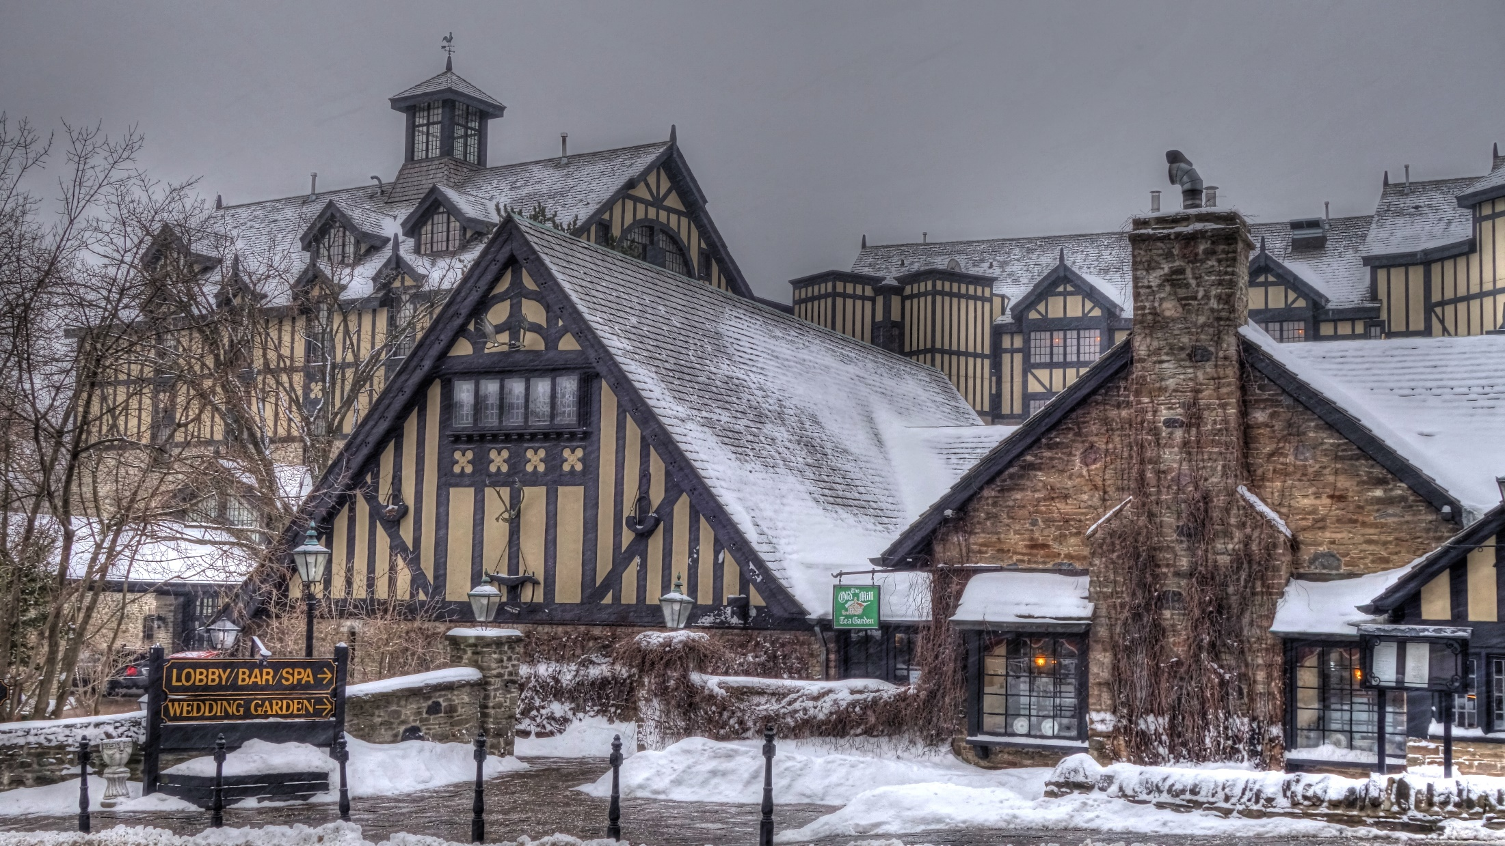
The MOOC Workshop
Stephen Downes – Toronto – February 5, 2015

Slide 2
“Walk away with a plan to integrate MOOCs within your higher education learning environments.”
What would such a plan look like?
http://www.downes.ca/post/63374/rd

Slide 4
What do we need to support MOOCs?
What would such a plan look like?
http://www.downes.ca/post/63375/rd

Slide 5
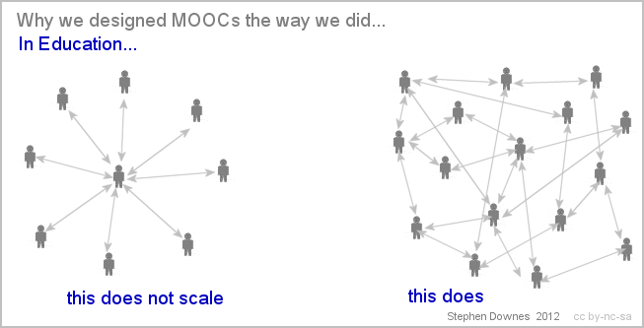

Slide 6
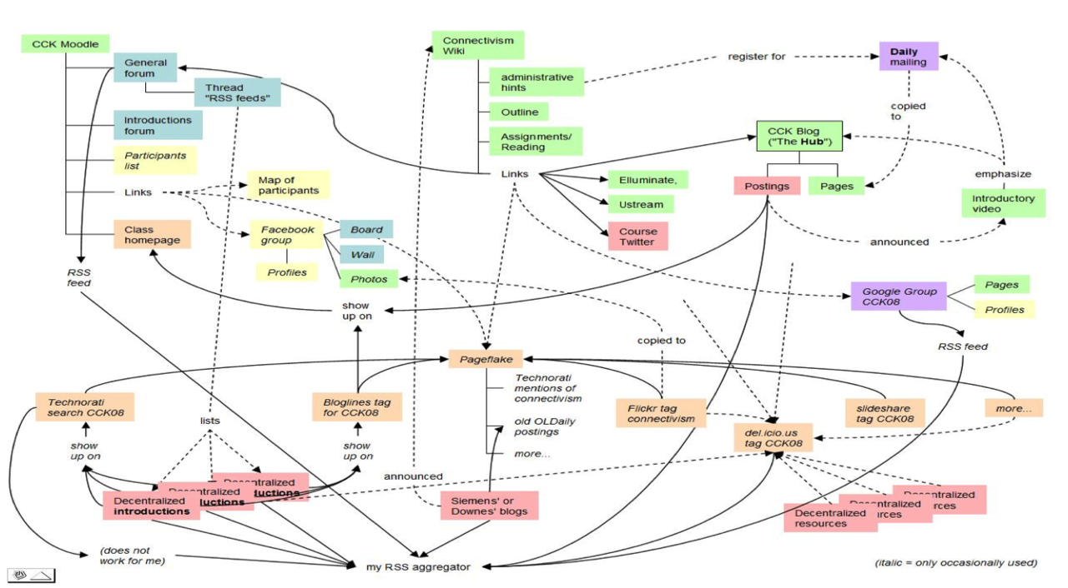

Slide 7
What does content look like in a MOOC?
What would we consider ‘MOOC Pedagogy’?
http://www.downes.ca/post/63376/rd

Slide 8
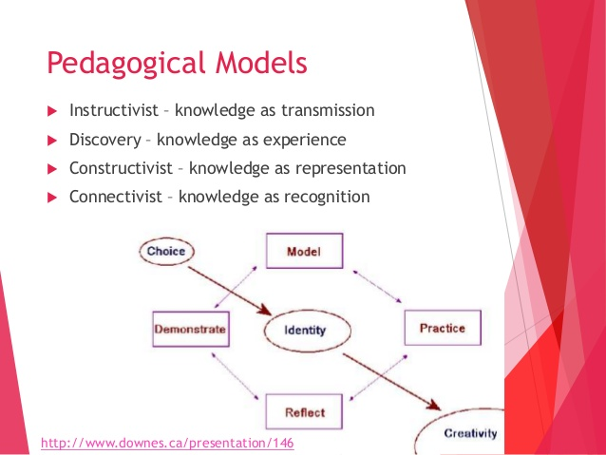

Slide 9
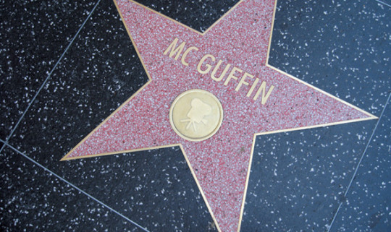
http://jackiegloves.com/en/2013/02/18/ana-locking-2013-mcguffin/

Slide 10
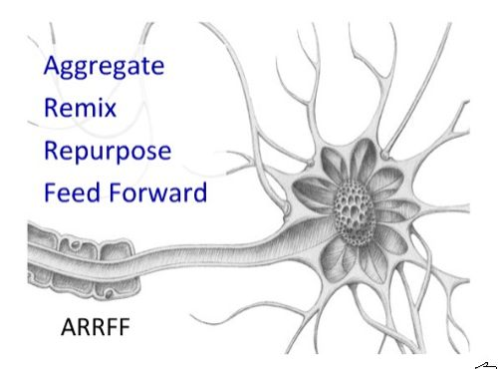

Slide 11
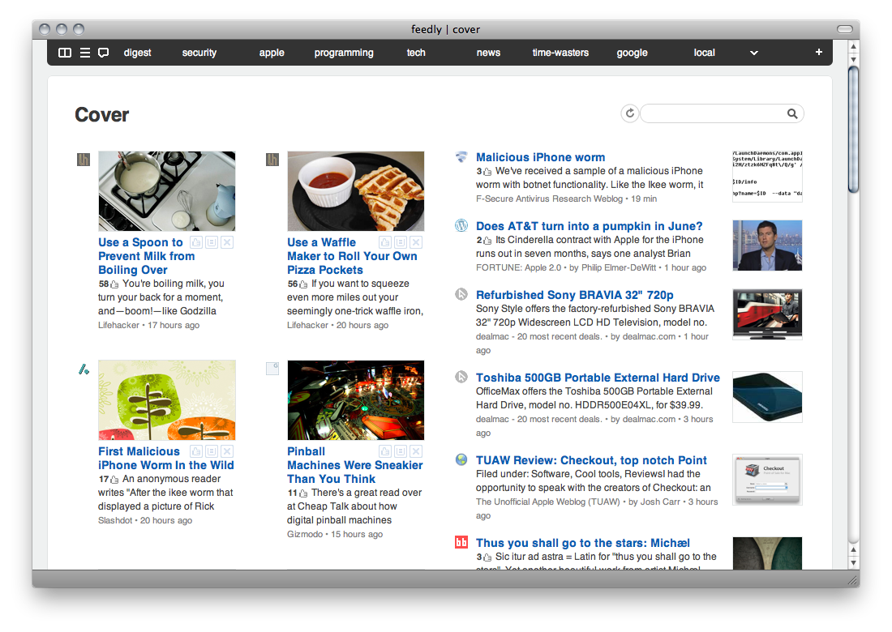
http://rudis.net/content/2009/11/22/feedly-safari-fluidapp-painless-updates
http://feedly.com

Slide 12
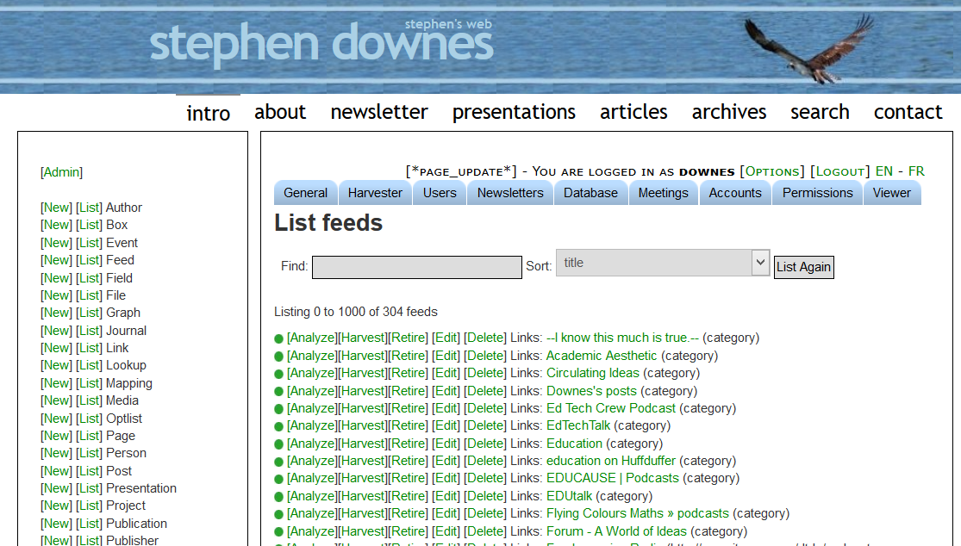
http://www.downes.ca/cgi-bin/admin.cgi?db=feed&action=list&number=1000

Slide 13
Let’s talk about ‘open’
What is it? Why should we care?
http://www.downes.ca/post/63378/rd

Slide 14
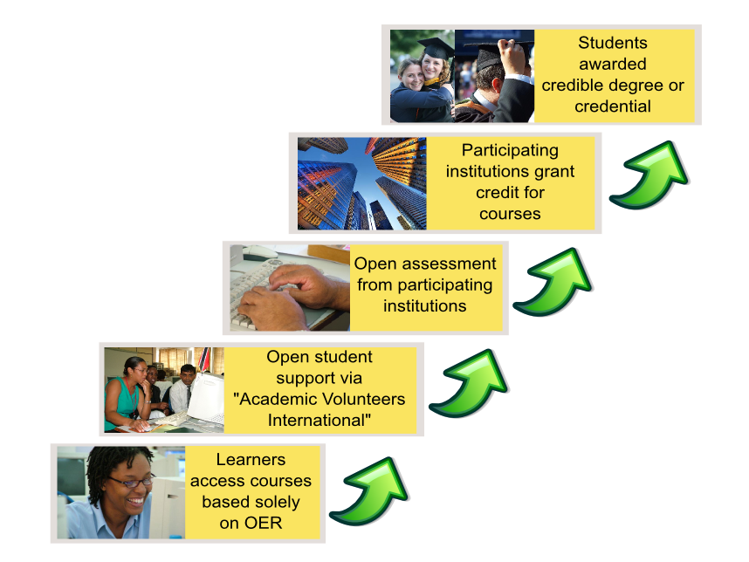
Logic
Model
http://creativecommons.org.nz/2012/10/the-oer-university/

Slide 15
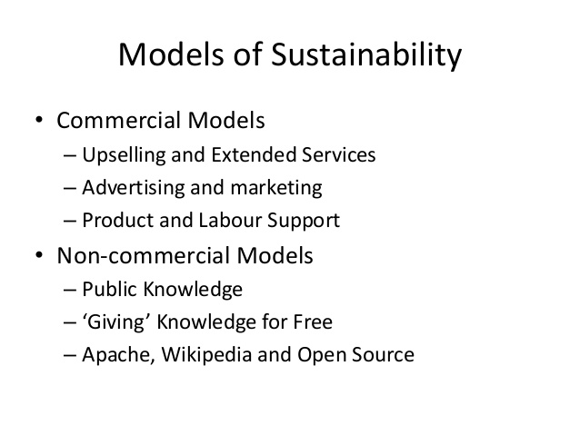

Slide 16
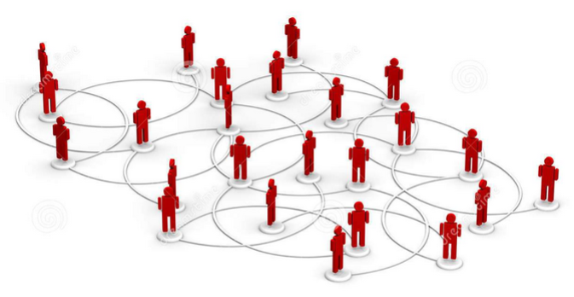
Why it matters
https://frankounl.wordpress.com/tag/massive-open-online-course/

Slide 17
“Advance Higher Education?”
Let’s talk about deep learning
http://www.downes.ca/post/63379/rd

Slide 18
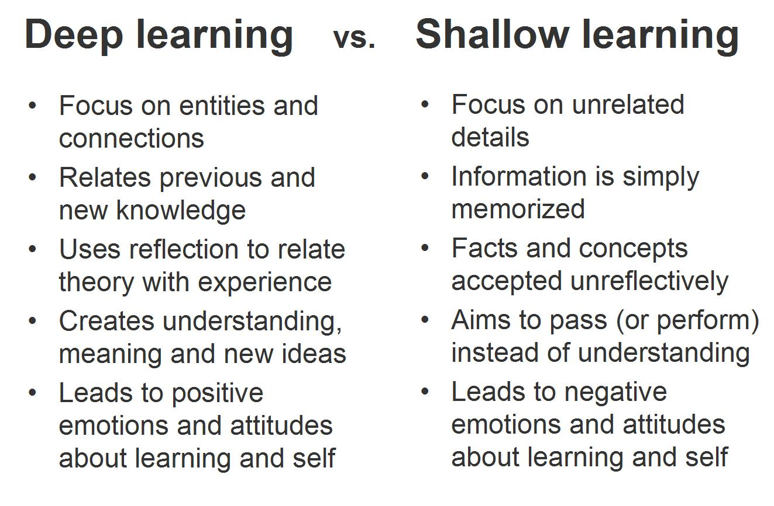
http://e-learning-teleformacion.blogspot.ca/2014/08/deep-learning-tutorials-deeplearnng-01.html

Slide 19
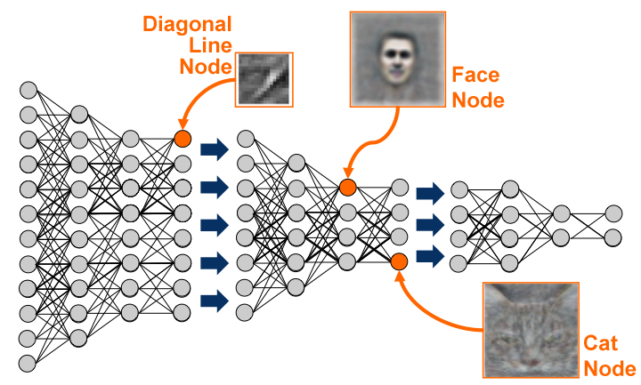

Slide 20
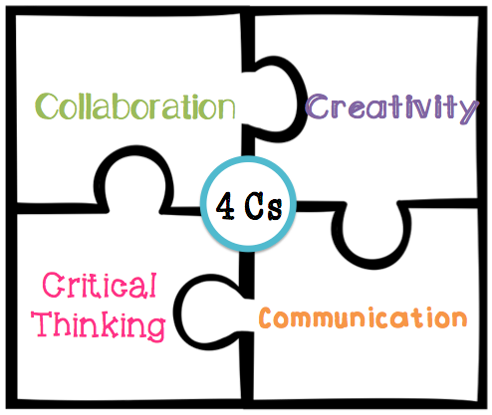
21st century Literacies
http://runteacherrunriley.blogspot.ca/

Slide 21
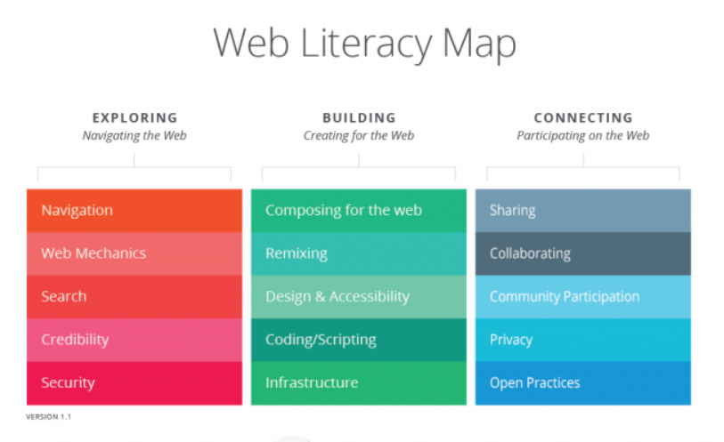
https://wiki.mozilla.org/Webmaker/WebLiteracyMap

Slide 22
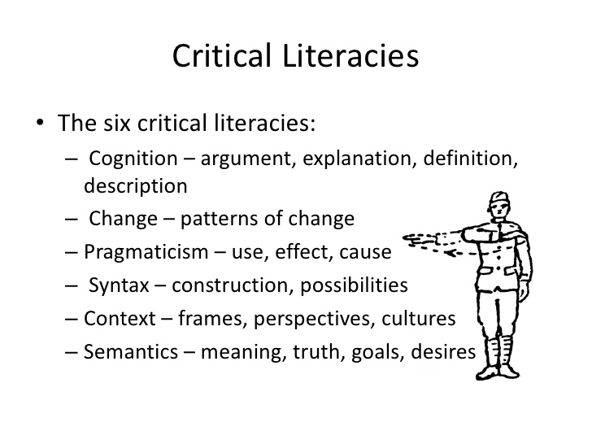
http://www.downes.ca/presentation/233

Slide 23
“Help to achieve learning goals”
What does success look like?
http://www.downes.ca/post/63380/rd

Slide 24
Criteria for aligning the use of technologies
enhances collaboration
rigorous engagement with curriculum
increases opportunities for authentic learning
supports differentiated learning through various modalities
creates greater efficiency in the delivery of the lesson
increases opportunities for self-regulation
promotes and supports generative thinking
allows for a wider range of perspectives to be represented
Garfield Gini Newman

Slide 25
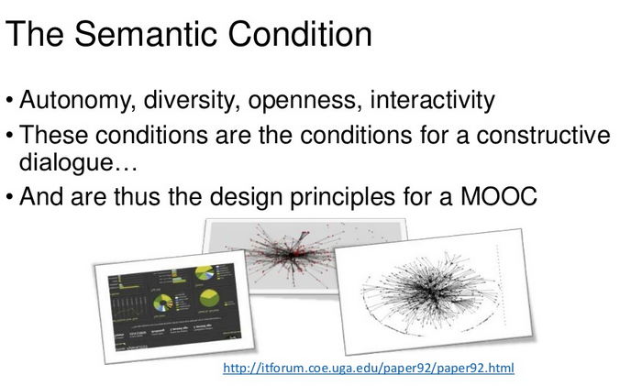
http://www.slideshare.net/Downes/free-learning-and-the-wealth-if-nations
The Semantic Condition
http://www.downes.ca/presentation/323

Slide 26
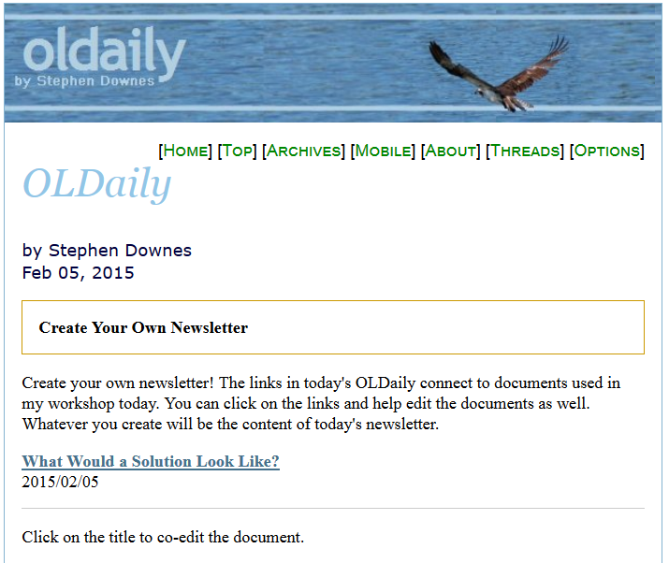
http://www.downes.ca/archive/15/02_05_news_OLDaily.htm

Slide 27
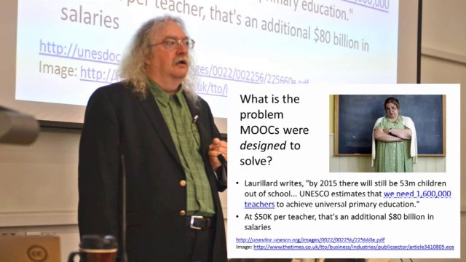
Stephen Downes
http://www.downes.ca

Slide 28
00:00 - 00:10 Introductions
00:10 - 00:15 Interactivity - how it works
00:15 - 00:25 Solution to the problem - http://www.downes.ca/post/63374/rd
00:25 - 00:40 What is a MOOC?
00:40 - 00:50 Supporting a MOOC - http://www.downes.ca/post/63375/rd
00:50 - 01:05 Design and Structure of a MOOC
01:05 - 01:10 Curriculum and Content - http://www.downes.ca/post/63376/rd
01:15 - 01:30 AARFF
01:30 - 01:45 Break
01:45 - 01:55 What is Openness? Why Should We Care?
- http://www.downes.ca/post/63378/rd
01:55 - 02:10 OER Logic Model / Models for Sustainability
02:10 - 02:20 Higher learning / Digital Literacies - http://www.downes.ca/post/63379/rd
02:20 - 02:30 Critical literacies
02:30 - 02:40 What is Success? - - http://www.downes.ca/post/63380/rd
02:40 - 02:50 The Semantic Condition
02:50 - 03:00 Wrap Up

Slide 29
Massive Open Online Courses are an alternative to the traditional classroom setting within higher education. The opportunity to take part in these classes from anywhere that is convenient for a student is an advantage. Weigh the pros and cons to including MOOCs within a diverse learning environment. Walk away with the knowledge and know-how of implementing these kinds of courses. Learn about the following:
Support learning environments
Current and future impacts of curriculums
Open education format
Advance higher education
Help to achieve learning goals
Walk away with a plan to integrate MOOCs within your higher education learning environments.

