Slide 1
Developing Personal Learning
Stephen Downes
December 20, 2014
In this talk Stephen Downes describes work toward developing next-generation personal learning environments. This is the next iteration of online learning, following the deployment of the Massive Open Online Course (MOOC) in 2008. With personal learning environments, individual students access learning resources and events from multiple providers from within their own custom-designed environment. Downes will describe major aspects of the personal learning environment being developed by his Learning and Performance support Systems research program, which is funded by the Canadian government to enhance skills development and professional education, seeking to increase employability and reduce the skills gap in advanced industries.
Notes:
This template can be used as a starter file to give updates for project milestones.
Sections
Right-click on a slide to add sections. Sections can help to organize your slides or facilitate collaboration between multiple authors.
Notes
Use the Notes section for delivery notes or to provide additional details for the audience. View these notes in Presentation View during your presentation.
Keep in mind the font size (important for accessibility, visibility, videotaping, and online production)
Coordinated colors
Pay particular attention to the graphs, charts, and text boxes.
Consider that attendees will print in black and white or grayscale. Run a test print to make sure your colors work when printed in pure black and white and grayscale.
Graphics, tables, and graphs
Keep it simple: If possible, use consistent, non-distracting styles and colors.
Label all graphs and tables.

Slide 2
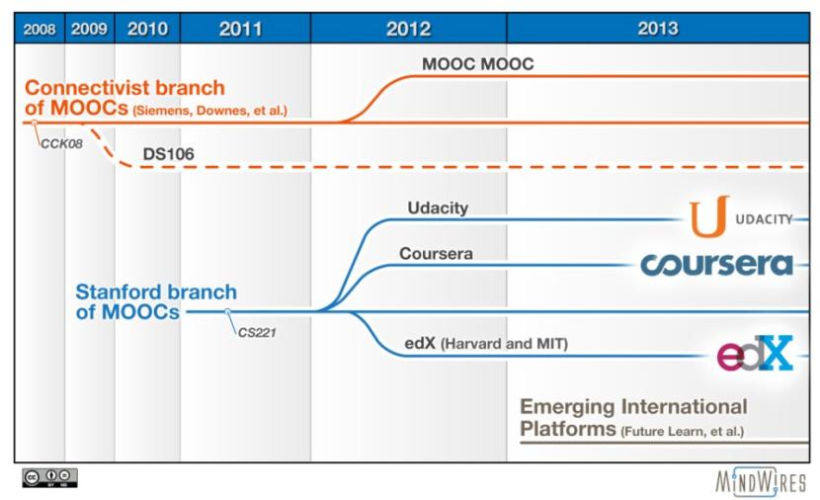
The MOOC Revolution
http://mfeldstein.com/mooc-history-presented-aacn13-conference/

Slide 3

Connectivist Learning Design
A non-curricular based approach
course content is the ‘McGuffin’
learning takes places through interaction and creativity

Slide 4
But… why
It’s a formal recognition that people have different destinations, different tastes
Based on an understanding that knowledge varies according to these
Expresses the principle that networks – communities – are stronger with multiple diverse perspectives
Knowledge learned is better – indeed, known

Slide 5
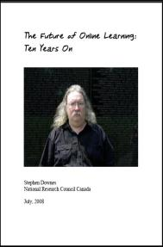
In 1998 I predicted…
High-speed wireless access
Importance of audio and video
The iPad (even got the name right)
Learning objects (called ‘modules’)
Learning management systems
Personalized education
http://www.downes.ca/future/
http://www.downes.ca/me/mybooks.htm

Slide 6

How do we predict the future?
We predict the future the way we understand the past: by reading the signs
This is also how we understand the world in general, and how we learn

Slide 7
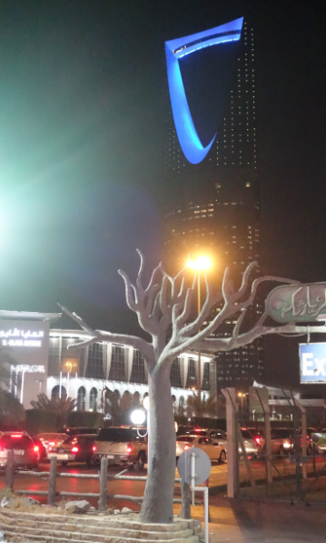
Learning is a form of recognition
It’s what we do naturally, as humans, from the day we are born
And it’s something that grows and evolves into a complex set of basic literacies, including pattern recognition, critical thinking, action and behaviour, awareness of context, inference and imagination, and change (the ‘critical literacies’)

Slide 8
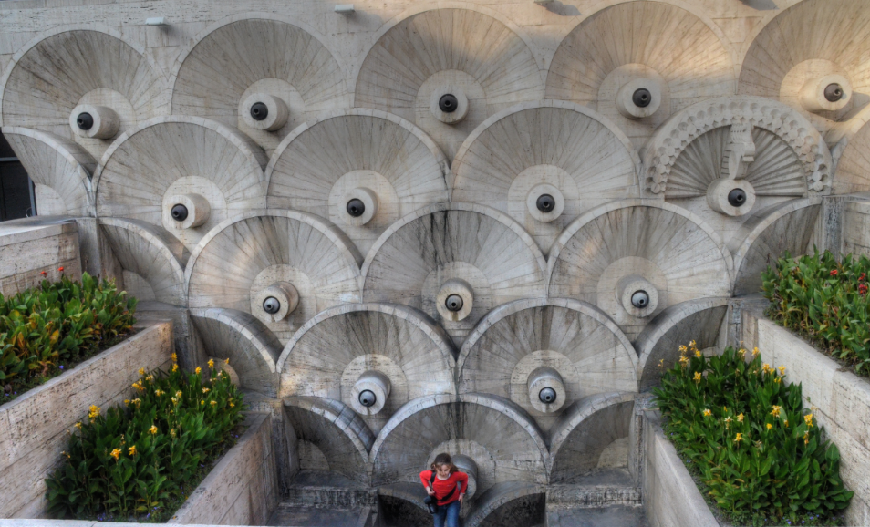
Learning is a matter of personal growth, not an accumulation of facts

Slide 9

The learning process is interactive
Aggregate
Remix
Repurpose
Feed Forward
To teach is to model and demonstrate, to learn is to practice and reflect

Slide 10

This is the basis of our approach to learning technologies
1999 – Learning communities
2001 – The learning marketplace
2004 – E-Learning 2.0
2005 – Learning Networks / Connectivism
2005 – Open Educational Resources
2008 – MOOC
2010 – Personal Learning Environments
2013 – LPSS

Slide 11
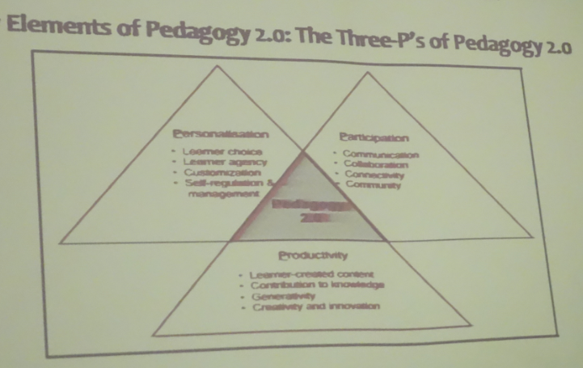
You can also see it in Pedagogy 2.0
Bader A. Alsaleh - http://halfanhour.blogspot.com/2014/09/bader-alsaleh-september-17-riyadh.html

Slide 12
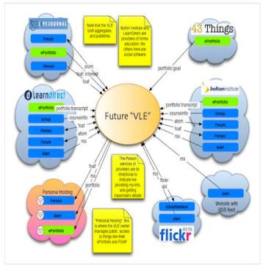
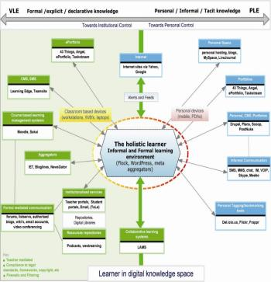
The design is based on putting the learner at the center
Scott Wilson (left), Tim Hand (right)
https://www.google.com/search?q=ple+diagrams
http://www.edtechpost.ca/ple_diagrams/index.php/mind-map-3

Slide 13
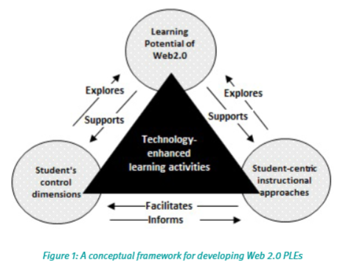
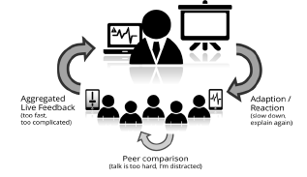
This is known generally as the ‘Personal Learning Environment’ (PLE)
The PLE as concept
Web 2.0 supported PLEs
Game-based approaches and ‘quantified self’
Mobile learning
The PLE as an assessment tool
http://en.wikipedia.org/wiki/History_of_personal_learning_environments
http://pleconf.org/2013/files/2014/07/v3.0_PLE_Conference2013_ResearchReport_BeuthUniversity_MonashUniversity.pdf
Images: Ebrahim Rahimi, Jan van den Berg, Wim Veen; Benedikt S. Morschheuser, Verónica Rivera-Pelayo, Athanasios Mazarakis,
Valentin Zacharias

Slide 14
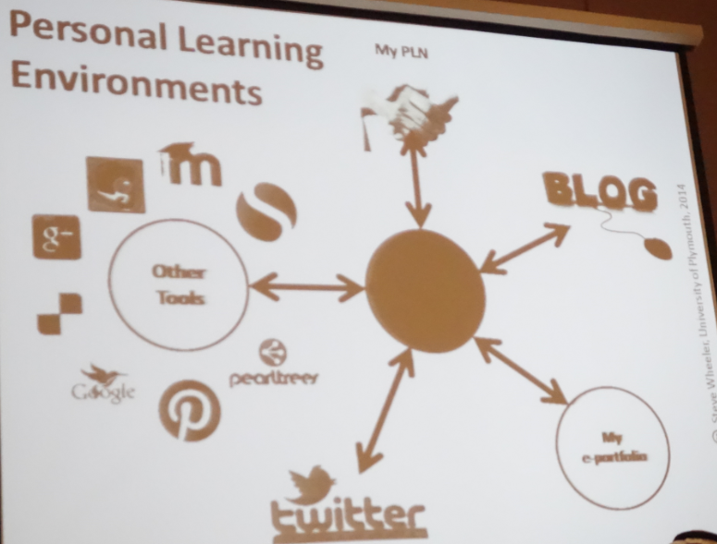
We are focused at the technology at the center
?
http://halfanhour.blogspot.com/2014/09/steve-wheeler-september-17-riyadh-notes.html

Slide 15
Learning and Performance Support Systems
PCO
Workflow Analysis, Visualization and Enhancement
MOOC-REL
Massive Open Online Course Ressources Éducatives Libres
MINT Multimodal INteractive Trainer
RRN
PCL
PLR
ACDR
PLA
WORLD
DATA
EXTERNAL DATA Services
EXTERNAL APPS
COMMON PLATFORM
Services, Communications, Management
MATS Program
Technologies
NRC Programs Government
Departments
It’s a network of personal learning environments…
… connected to a large array of learning services

Slide 16

Launch
Limited beta starting at the end of September
Hosted service offered at http://lpss.me
Slow roll-out of capacity over next 18 months
Development of partnerships and capacity building projects

Slide 17
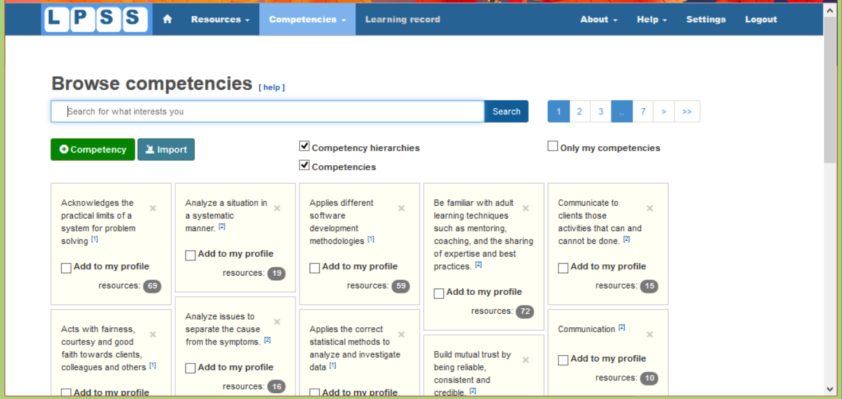
http://lpss.me – prototype PLE

Slide 18


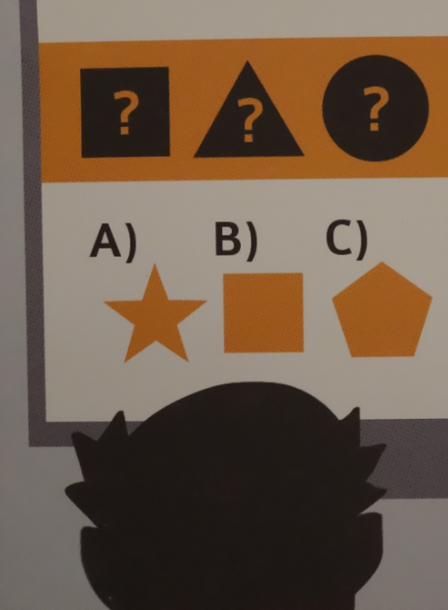

Not a platform, but a connector of resources and services

Slide 19
Core Technology Development Projects
Resource Network
Learning Assistant
Automate Skills Dev.
Personal Learning Records
Learning services network and marketplace
Automated skills development and recognition
Lifetime management of learning and training records and credentials
Personal learning assistant to view, update and access training
Learning as a cloud service and deep integration with external systems
Notes:
the solution would consist of the main components as shown on the slide
Learning as a Cloud Service - will create a distributed learning layer, which is mechanism for working with data no matter where it is stored, through desktop, mobile and other devices.
Resource Repository Network – will create a resource graph from multiple sources and multiple formats including live and dynamic data such as oilfield data, refinery instrumentation, or Oil and Gas market information.
Personal Learning Record - this project will define how we represent, capture, and leverage user activity, including ratings, test results, performance measures, and the like, in a distributed learning and work environment.
Automated Competence Development And Recognition – whereas existing recommender systems depend on manually defined metrics, this system will detect new and emerging competences and automatically assess employee performance.
Personal Learning Assistant – this project will develop an integrated learning appliance, a mechanism for looking up or finding references or resources inside other programs or environments.

Slide 20
LPSS Core Projects

Slide 21
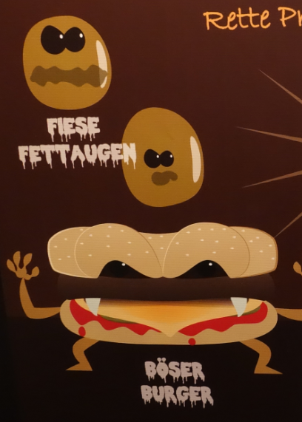
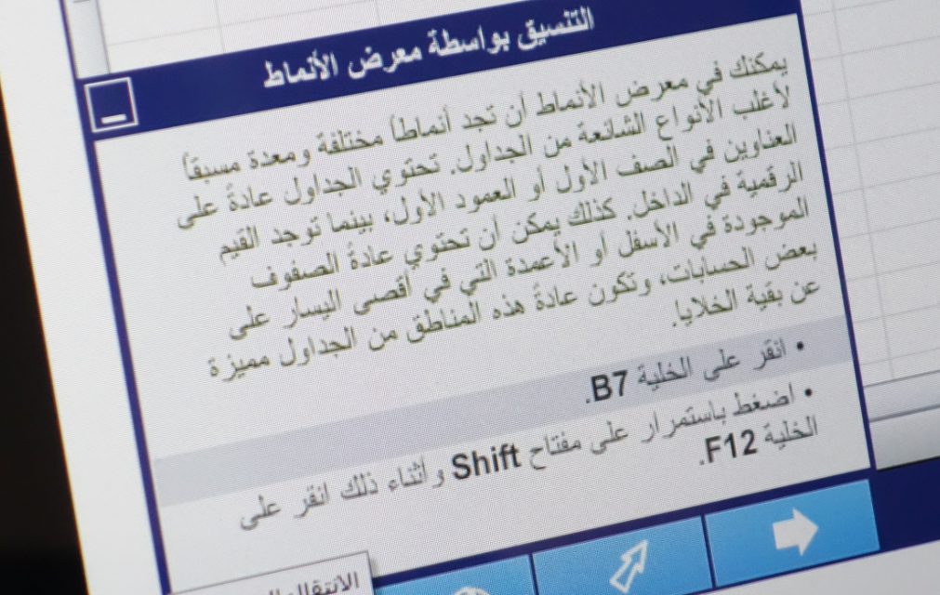
An open marketplace of free and non-free educational goods and services (all this and Ed Net Neutrality?)

Slide 22
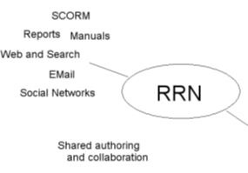

Resource Repository Network
Manage and discover list of sources and resources
Maintain authentication and credentials
Support APIs and metadata standards
Gather, analyze and sort resources and/or metadata

Slide 23
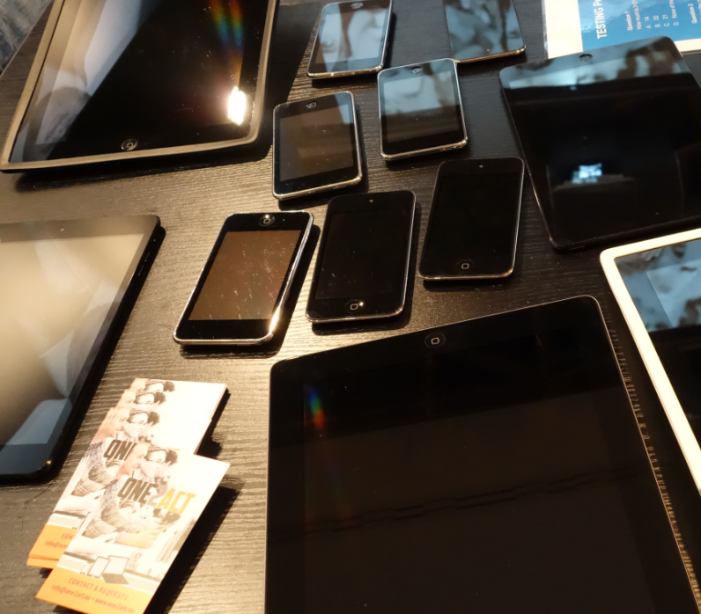
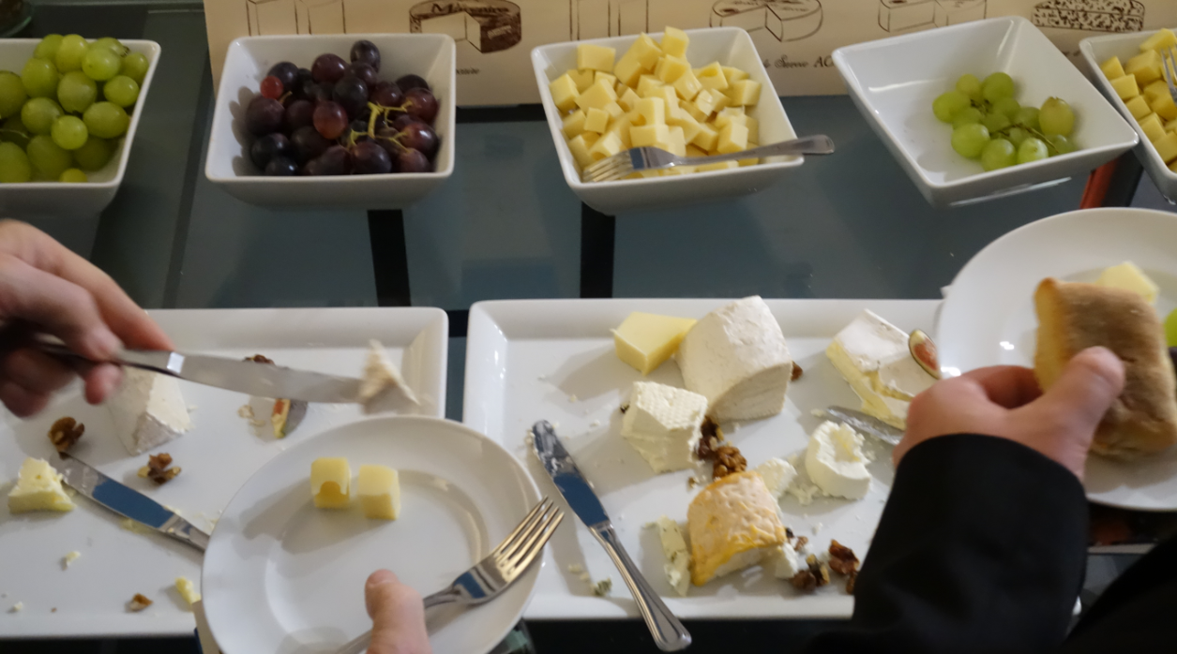
Synchronized cloud data services (including Owncloud) to support data portability

Slide 24
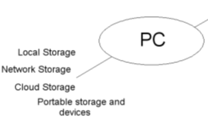
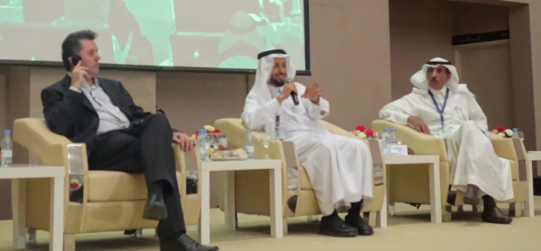
Personal Cloud
Manage list of local and remote storage systems
Maintain security, encryption, authentication and credentials
Include local or personal device storage
Manage and synchronize resource sets and data

Slide 25
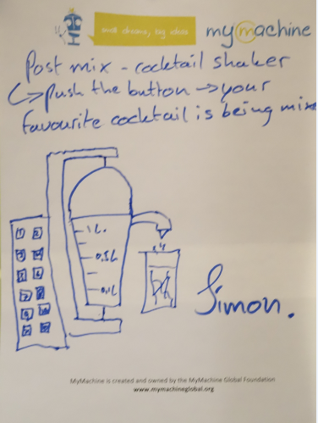
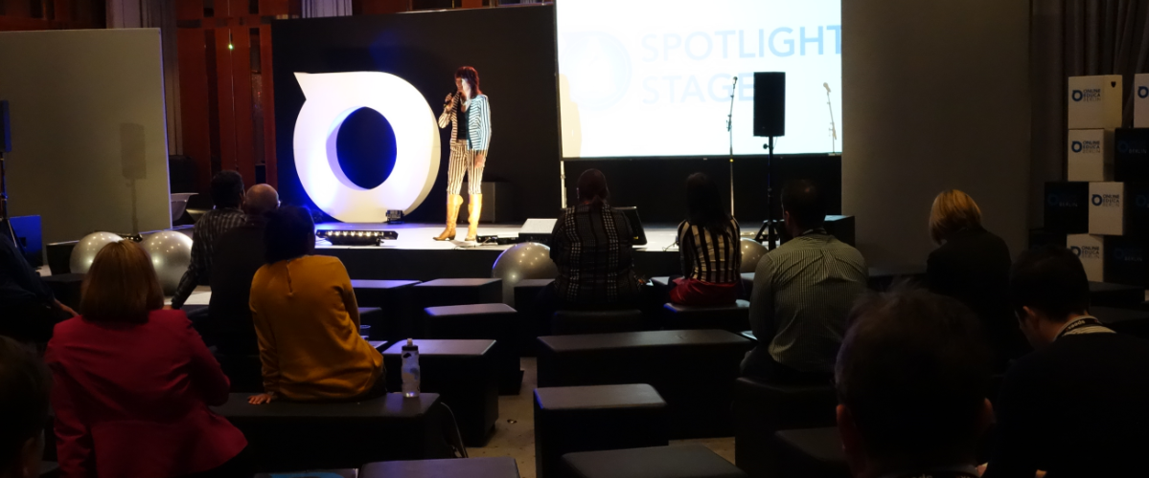
Projection of learning services into multiple platforms

Slide 26
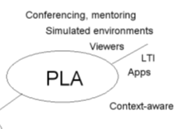
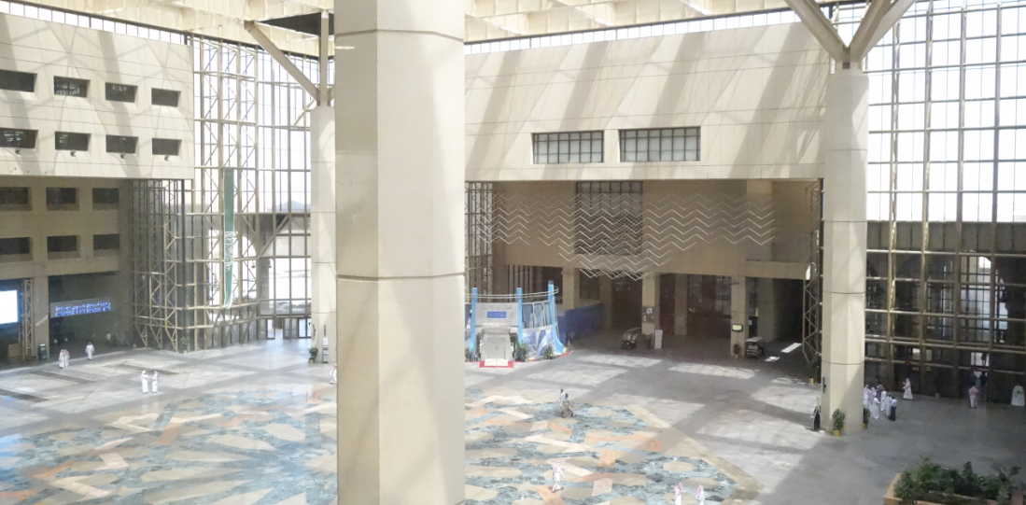
Personal Learning Assistant
Collect contextual information for system
Display resources of various formats, including SCORM, LTI, etc.
Support (scaffolded) authoring environments
Project LPSS capacity into external software and devices

Slide 27
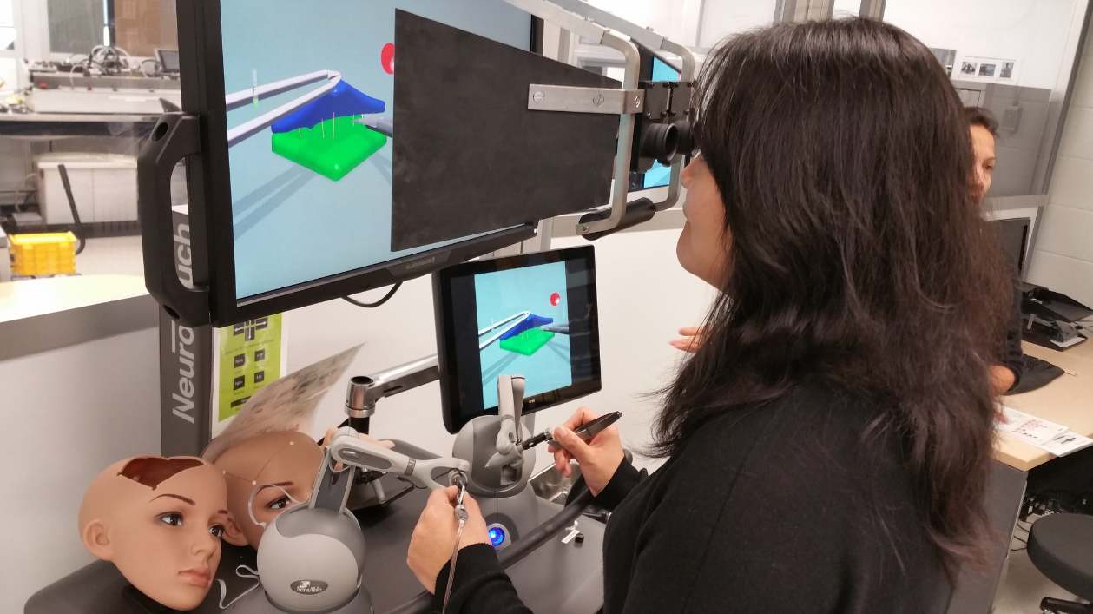
Connecting to real learning and workplace environments
http://www.nrc-cnrc.gc.ca/eng/rd/medical/

Slide 28
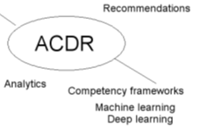
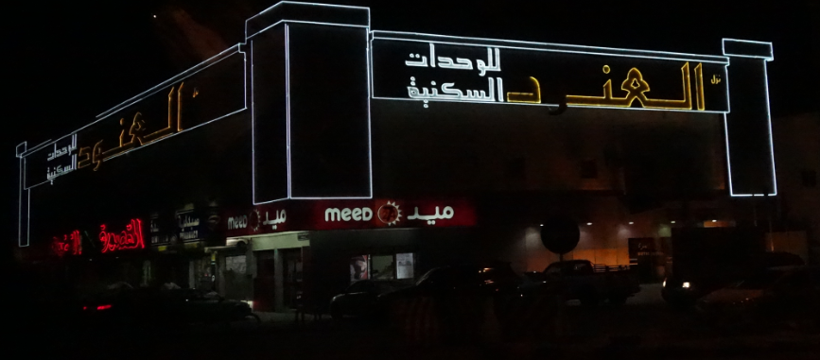
Competency Recognition and Development
Import or create competency definitions
Analyze interactions for skills and learning gaps
Support development of learning plans
Provide resource and service recommendations

Slide 29

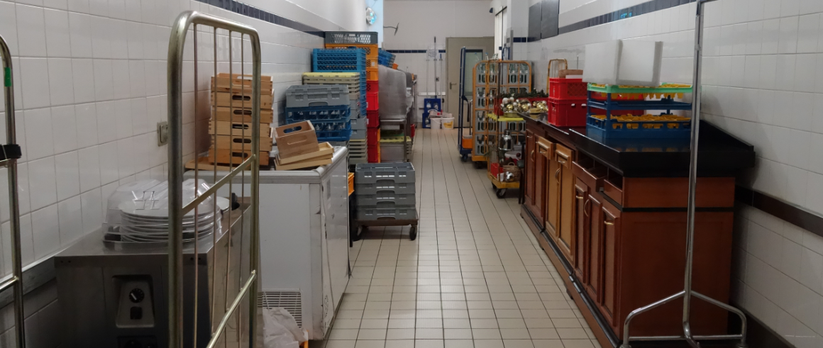
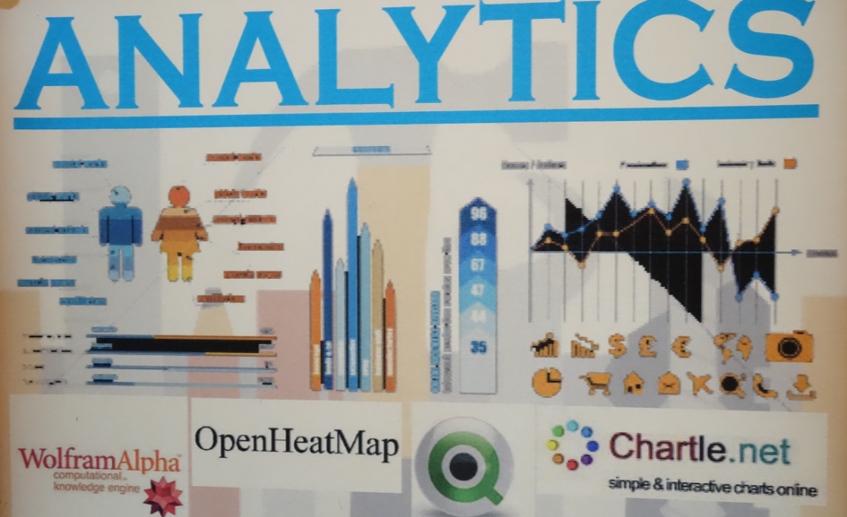
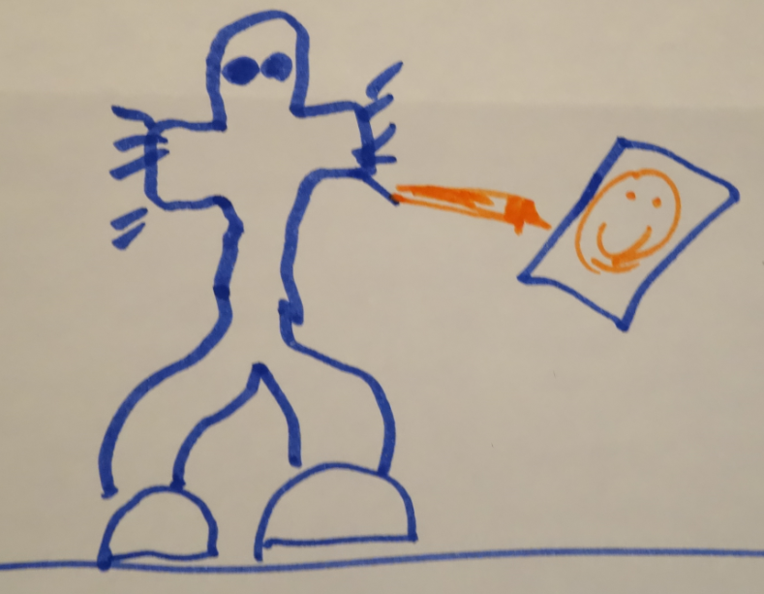
Analytics as a service – analogy with web translation

Slide 30

The Personal Learning Record – data owned by the individual, shared only with permissions
http://halfanhour.blogspot.de/2014/12/eportfolios-and-badges-workshop-oeb14.html

Slide 31
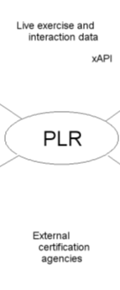
Personal Learning Record
Collect full record of interactions with all resources, external systems
Support learning activity data exchange formats (eg. xAPI)
Collect and present a person’s personal portfolio
Display certifications and credentials (eg. badges)
Maintain 3rd party certification

Slide 32
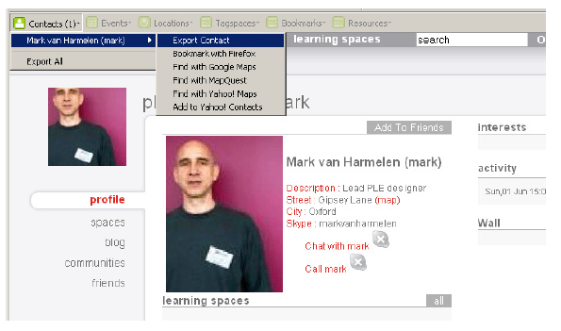
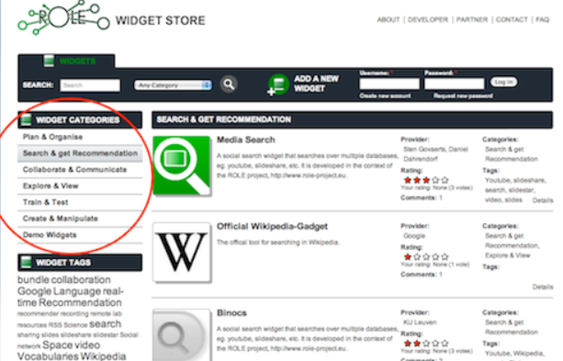
Relevant PLR Projects
Manchester PLE Project
Responsive Open Learning Environments (ROLE) http://www.role-project.eu/
Known http://withknown.com/
Learning Locker http://learninglocker.net/
Mahara https://mahara.org/
http://personalis.wikispaces.com/PLE+Projects

Slide 33
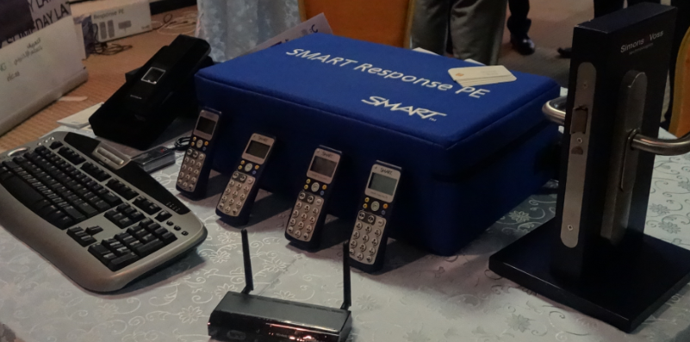
Implementation – from MOOC to Personal Learning
MOOC-REL (OIF)
ALECSO
MINT
Badges
Simulator
Workplace T&D

Slide 34
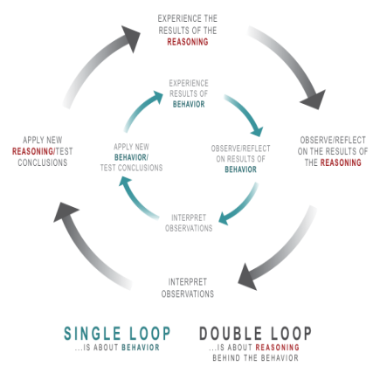
Implementation Projects
Ultimately, the objective is to support individual learning in a network
http://integralleadershipmanifesto.com/manifesto/making-subject-object/

Slide 35
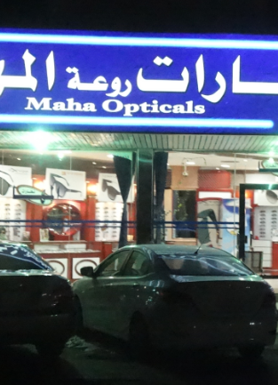
Why is this important?
Because technology is not just a tool
It gives us the capacity to do new things (the ‘affordances argument’)
It represents an extension of our perceptions (the McLuhan argument)
“We shape technology, and then technology shapes us”

Slide 36
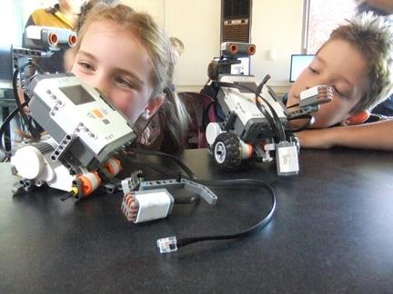
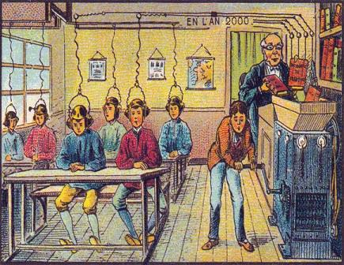
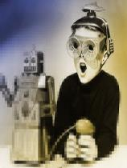
What kind of learner we become depends on what kind of learning technology we choose
http://singularityhub.com/2012/10/15/19th-century-french-artists-predicted-the-world-of-the-future-in-this-series-of-postcards/
http://www.alter-inc.com/wearable.html
http://www.keithcotps.sa.edu.au/Learning.htm

Slide 37
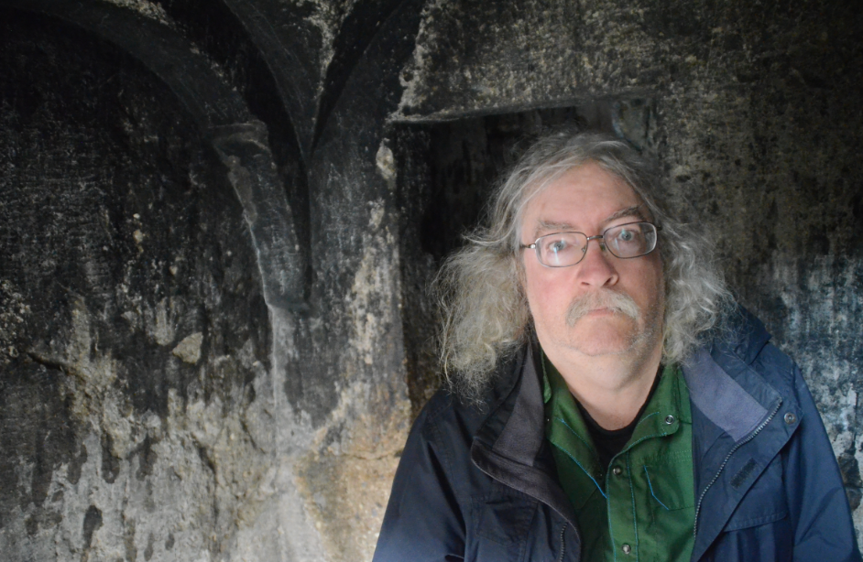
Stephen Downes
http://www.downes.ca

