Slide 1

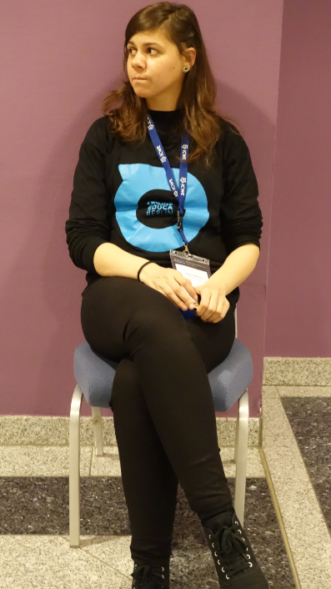
Reclaiming Personal Learning
Stephen Downes
Online Educa Berlin
December 5, 2014

Slide 2
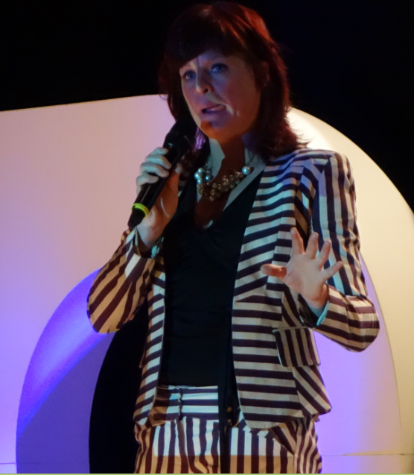
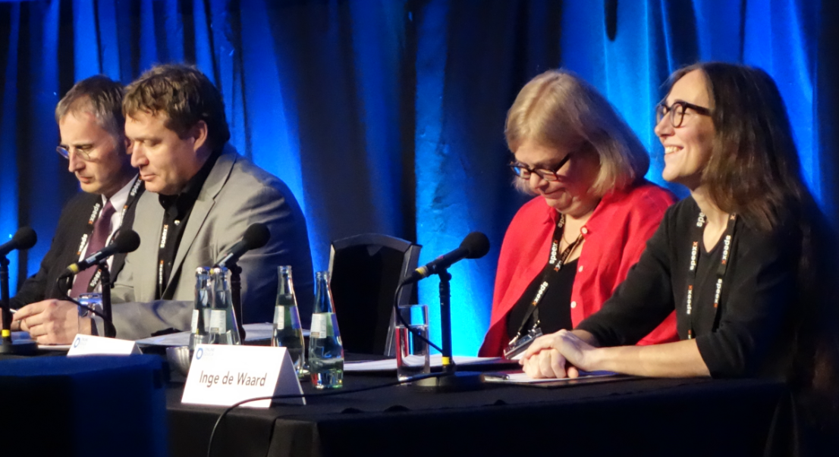
Education is in for a reality check

Slide 3
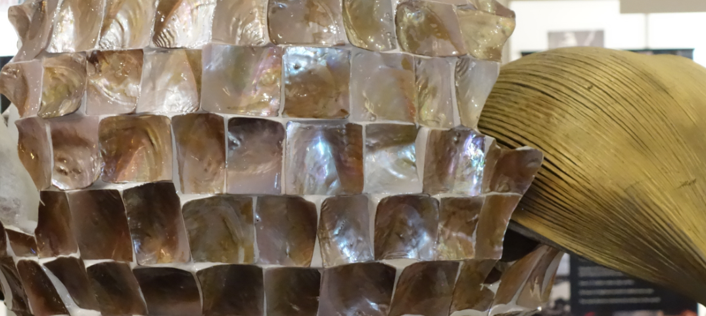
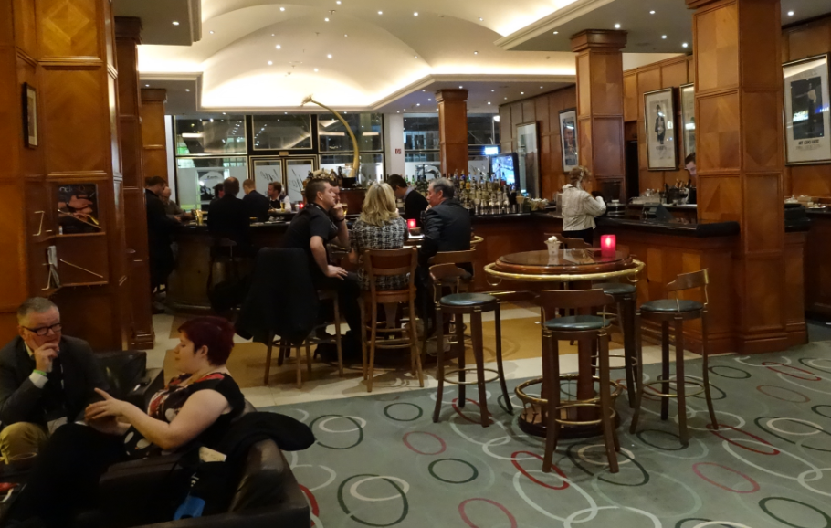
Educators and education technology companies will have to come to grips with the fact that they no longer own students or student work

Slide 4
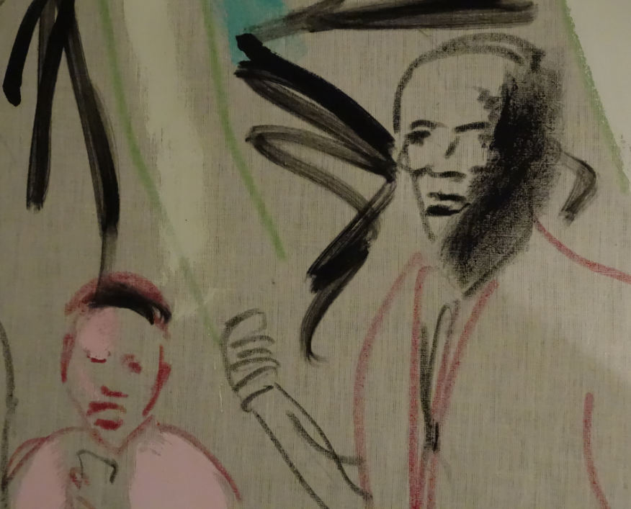

Facebook: you are not a customer, you are the product
“Facebook's boardroom isn't talking about how to make Johnny more friends. It's talking about how to monetise Johnny's social graph.”
Douglas Rushkoff – Wired
http://www.wired.co.uk/news/archive/2011-09/21/doug-rushkoff-hello-etsy

Slide 5
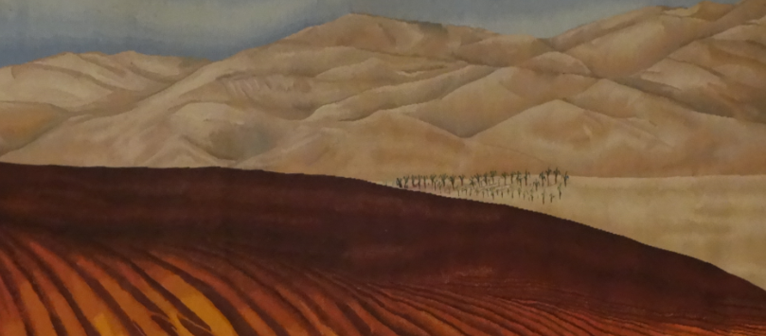
The learning process is interactive
Aggregate
Remix
Repurpose
Feed Forward
To teach is to model and demonstrate, to learn is to practice and reflect

Slide 6
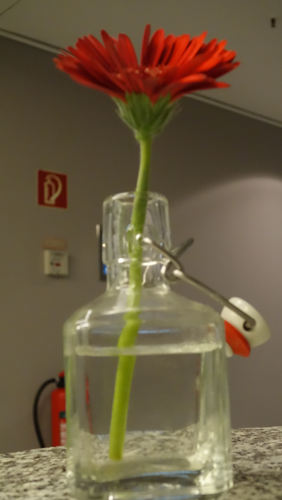
Learning is a form of recognition
It’s what we do naturally, as humans, from the day we are born
And it’s something that grows and evolves into a complex set of basic literacies, including pattern recognition, critical thinking, action and behaviour, awareness of context, inference and imagination, and change (the ‘critical literacies’)
http://halfanhour.blogspot.de/2014/11/knowledge-as-recognition.html

Slide 7
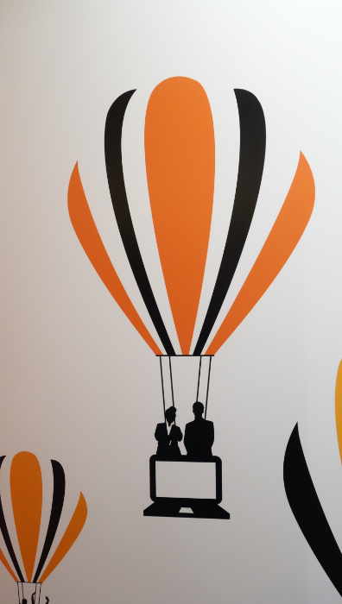
This has been the basis of our approach to learning technologies
1999 – Learning communities
2001 – The learning marketplace
2004 – E-Learning 2.0
2005 – Learning Networks / Connectivism
2005 – Open Educational Resources
2008 – MOOC
2010 – Personal Learning Environments
2013 – LPSS

Slide 8
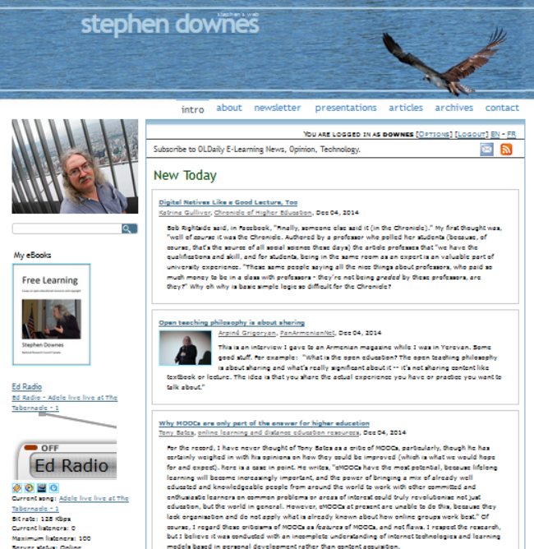
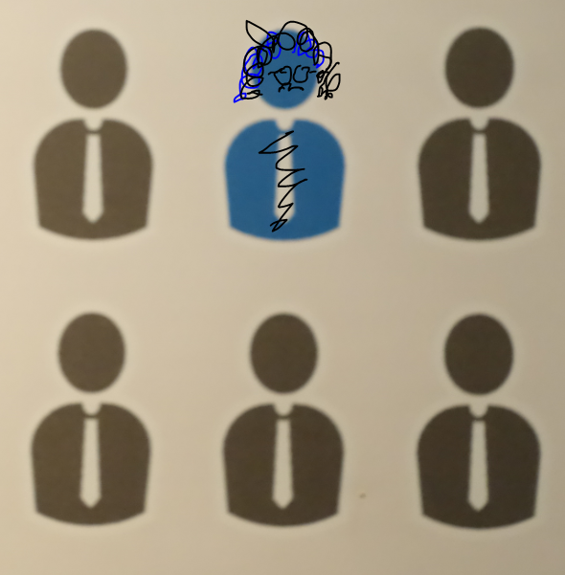
My own web –
http://www.downes.ca

Slide 9


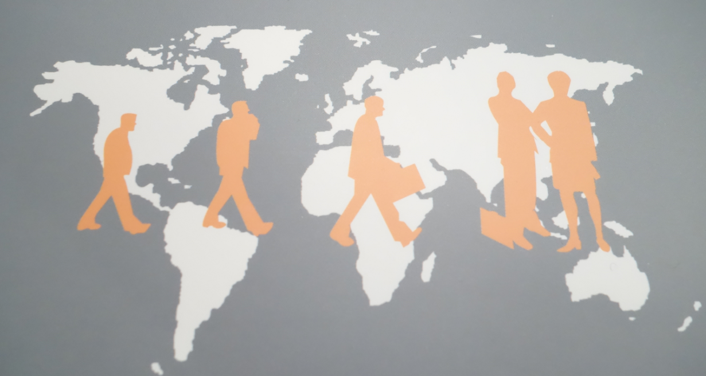

This is what is meant by ‘reclaiming’
Image credit: “No Dash for Gas” http://www.nodashforgas.org.uk/
From http://bavatuesdays.com/reclaim-the-web-with-reclaim-hosting/

Slide 10
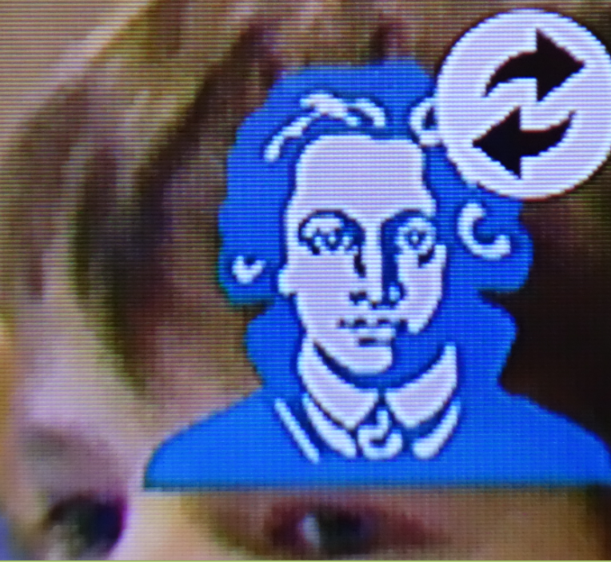
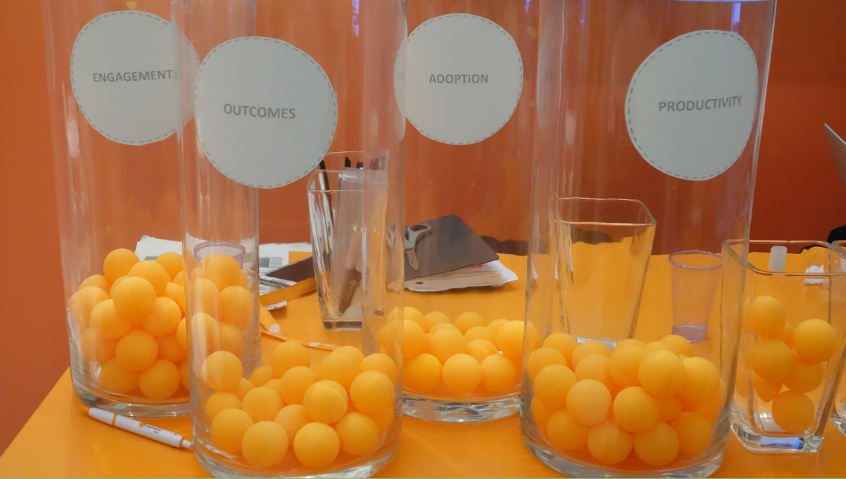
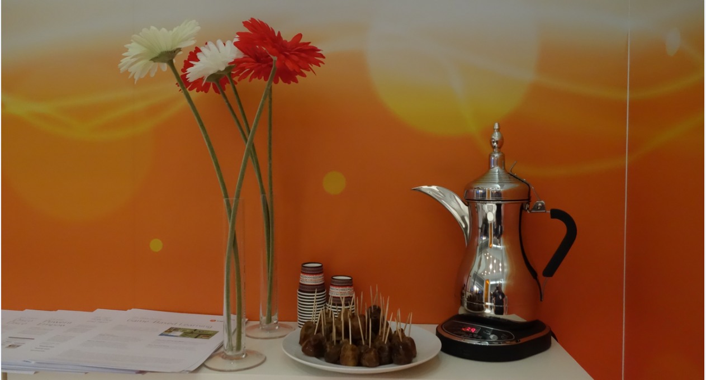
Education – march of the LMS – the giant silos of learning

Slide 11
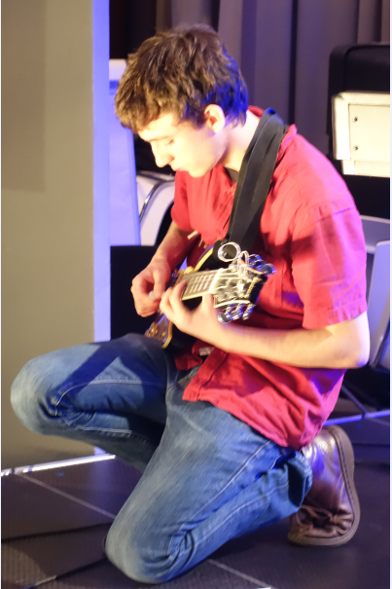
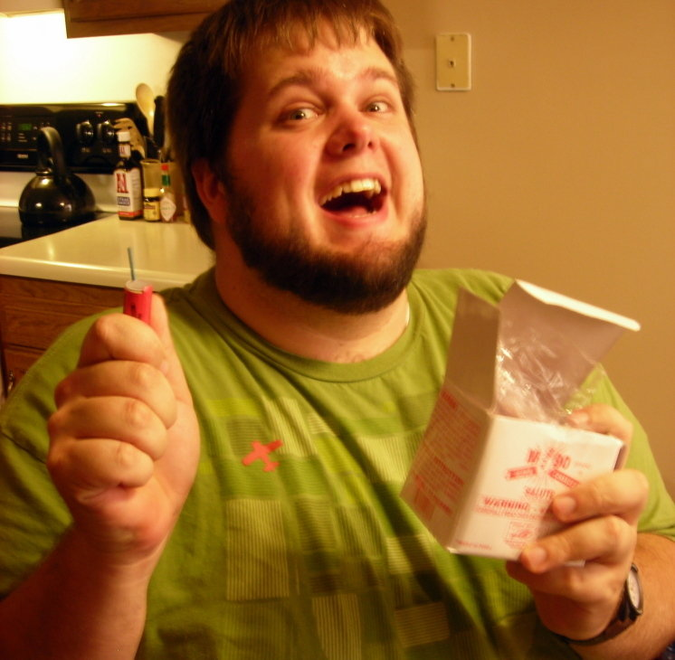
Reality: students will no longer be the products
“Students, like citizens, are free and equal, and they have the power of reason.”
NPR 2010-11-05 http://www.npr.org/blogs/13.7/2010/11/05/131088812/politics-respect-and-the-teacher

Slide 12
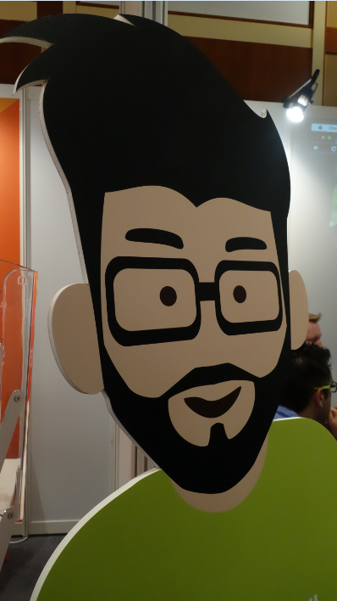
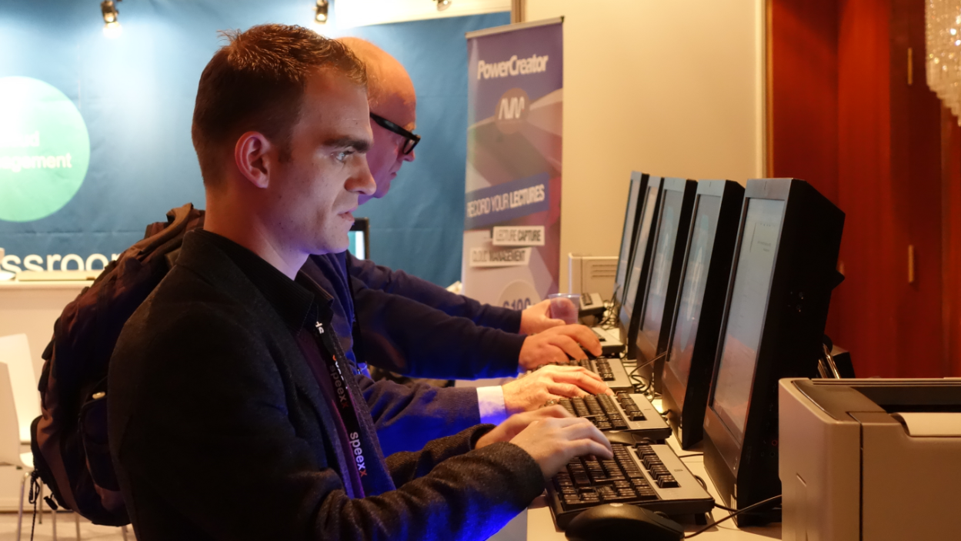
This is where ‘personal’ comes in

Slide 13
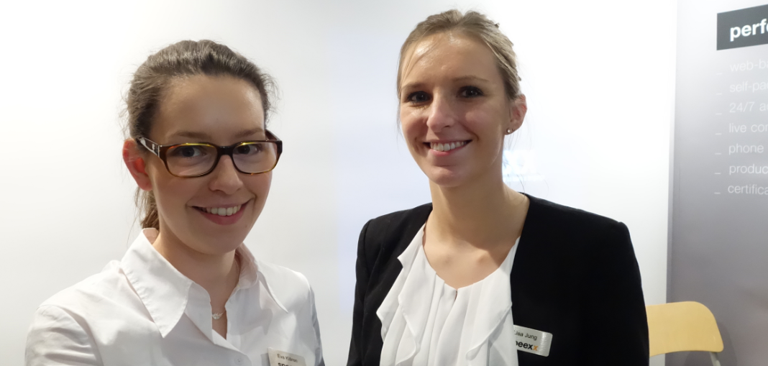

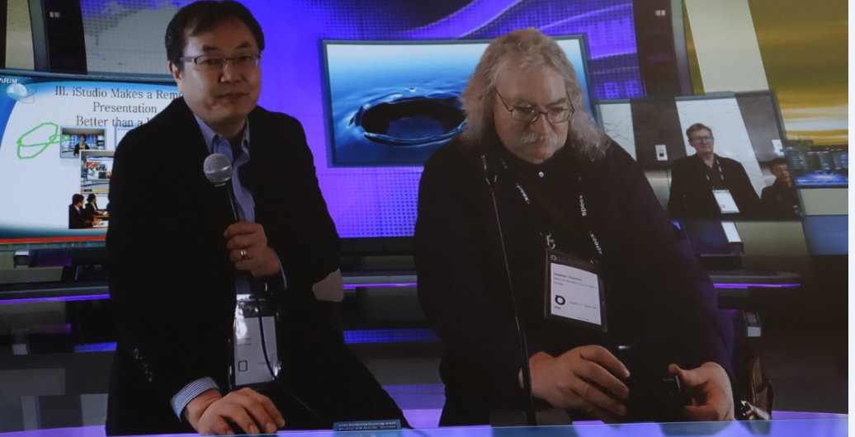
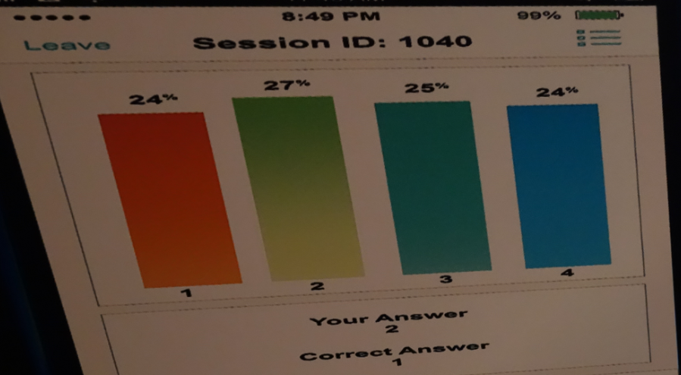
‘personal’ vs ‘personalized’

Slide 14
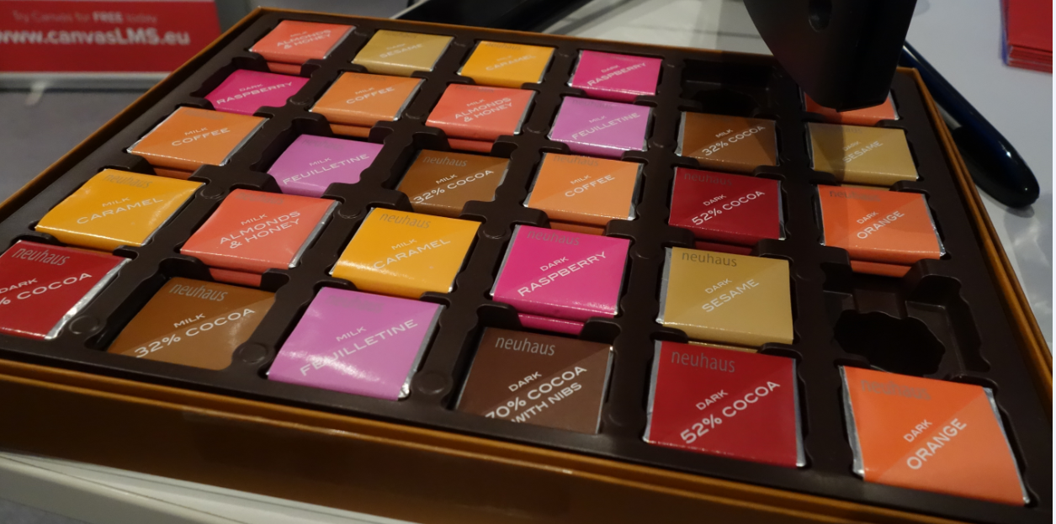
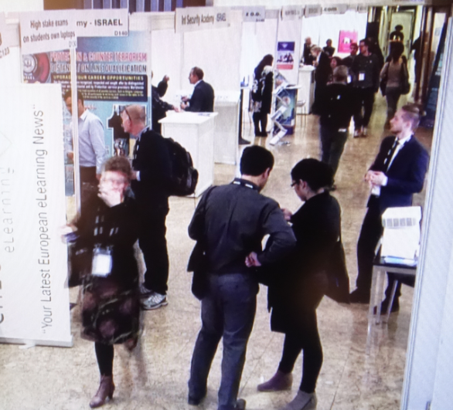
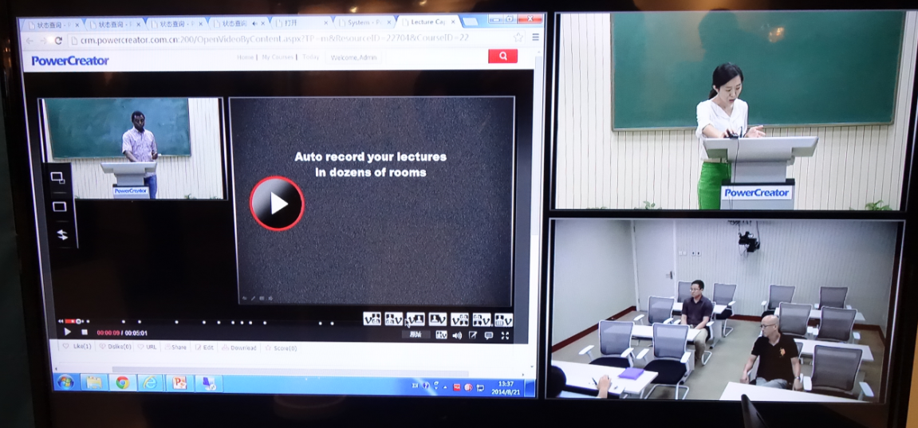
The web isn’t One Big Thing – it isn’t a ‘platform’

Slide 15
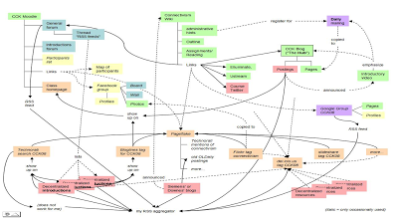

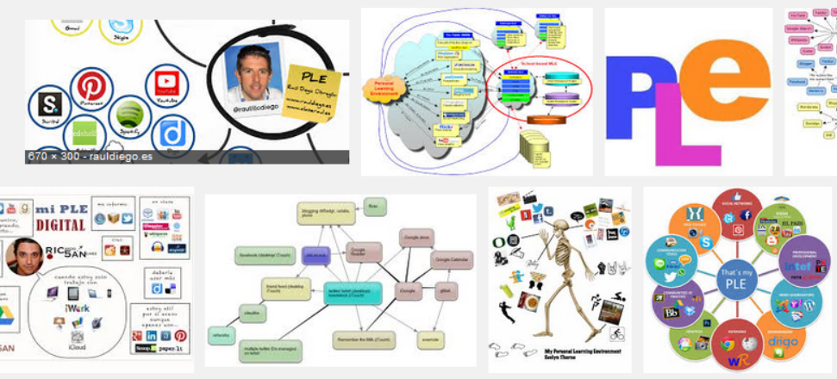

The design of the (original) MOOCs
https://sites.google.com/site/themoocguide/

Slide 16

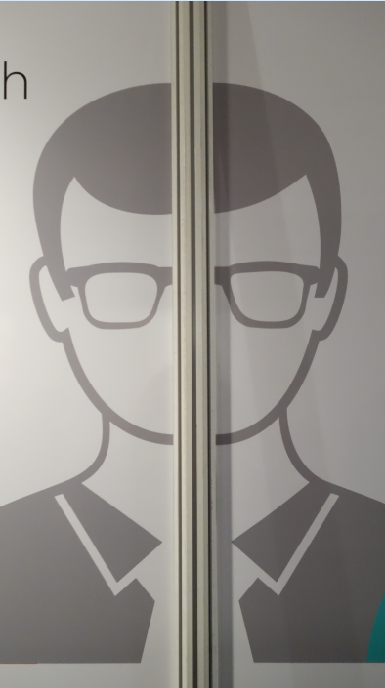
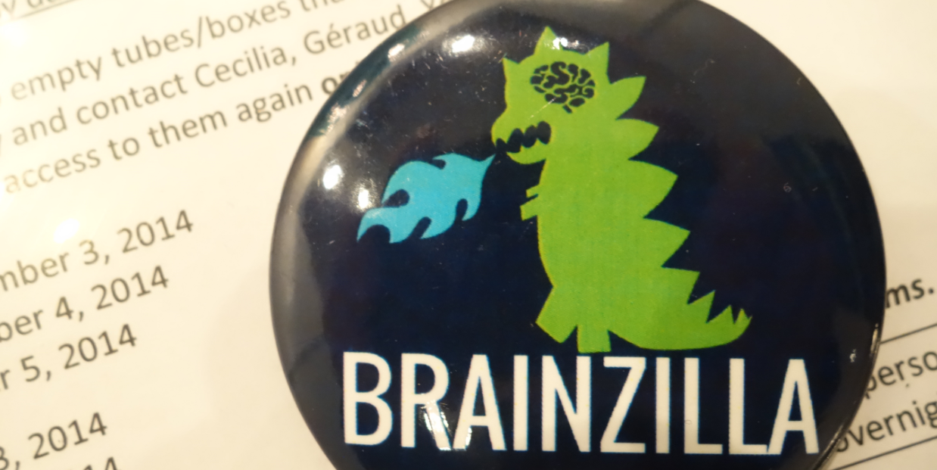
The need to reclaim once again
http://moocnewsandreviews.com/ultimate-guide-to-xmoocs-and-cmoocso/

Slide 17
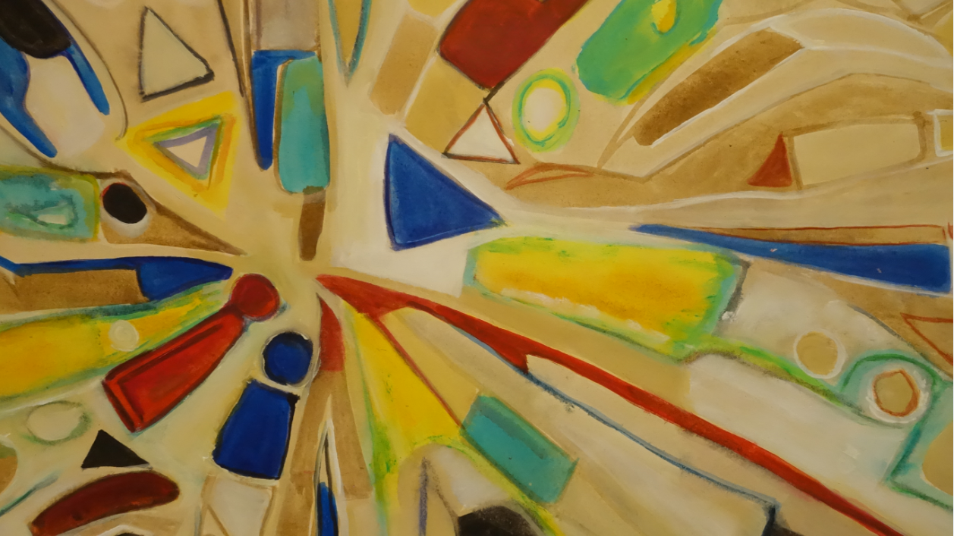
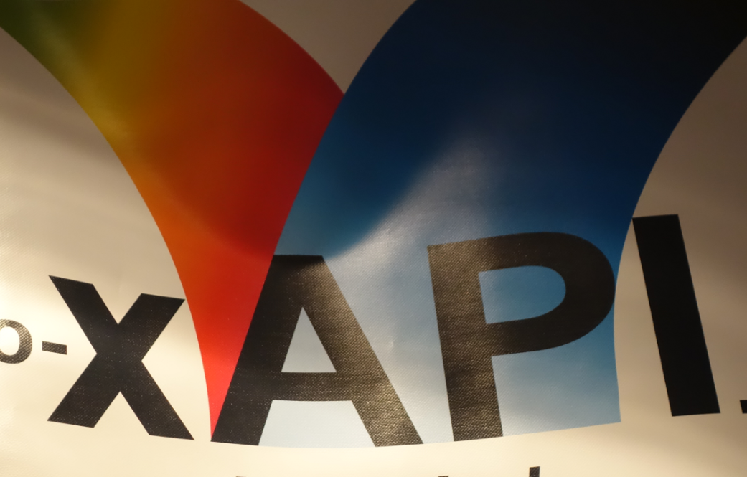
Learning data, explained (the layers of data – actions, interactions, credentials, artifacts)

Slide 18



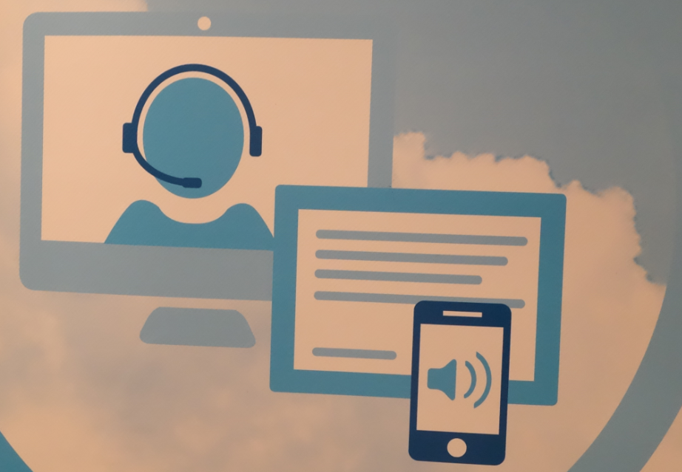
Platforms and proprietors do not own this data

Slide 19
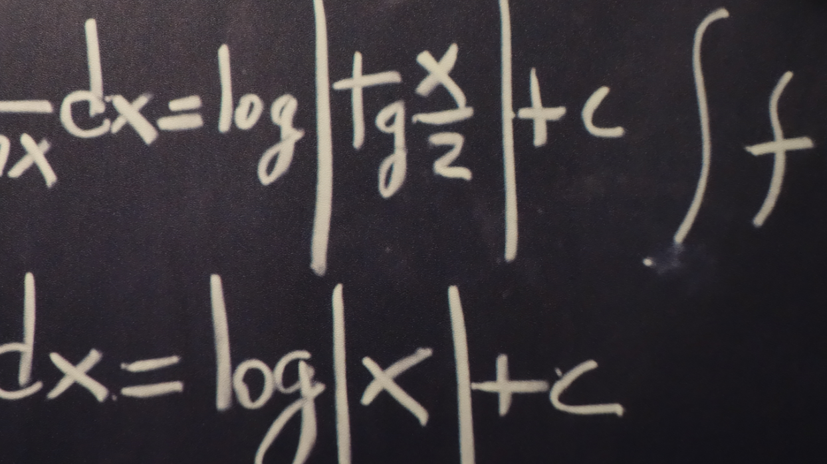
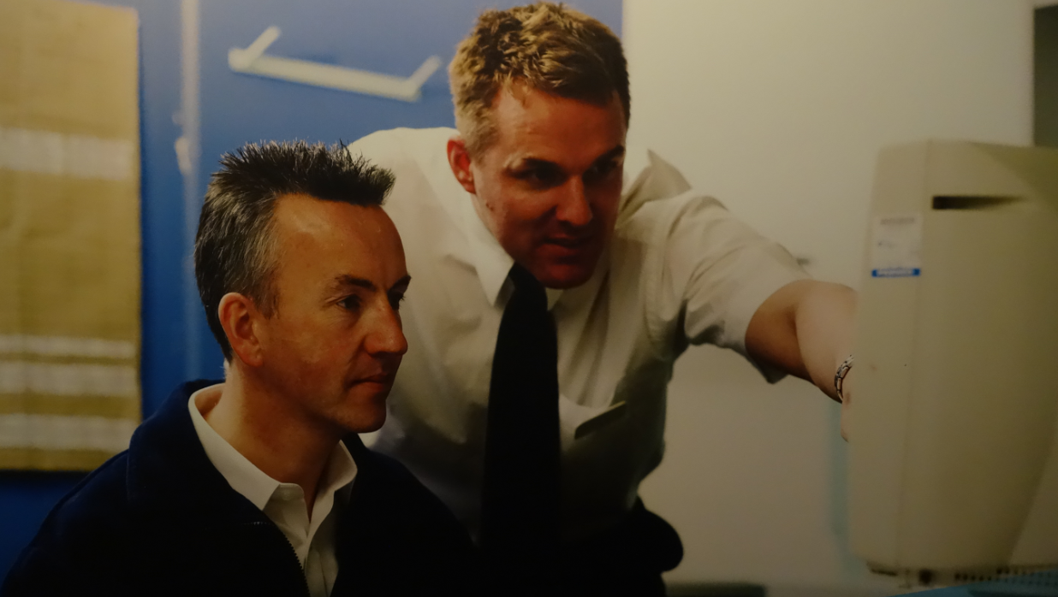
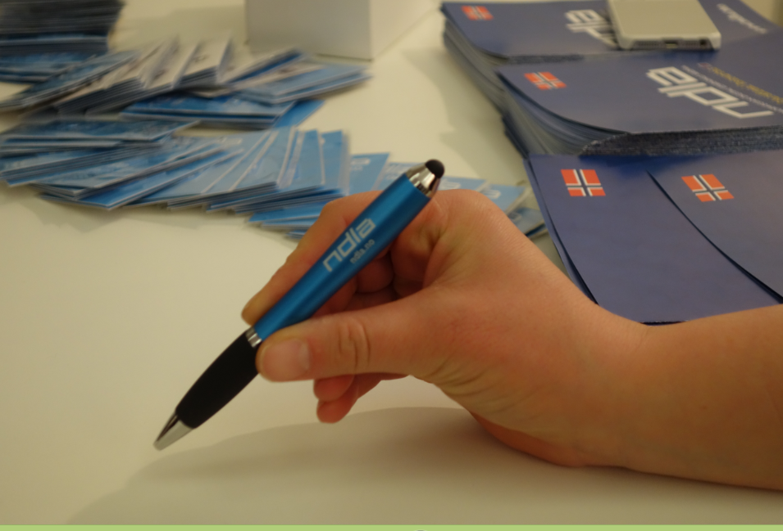
They do not own this market

Slide 20
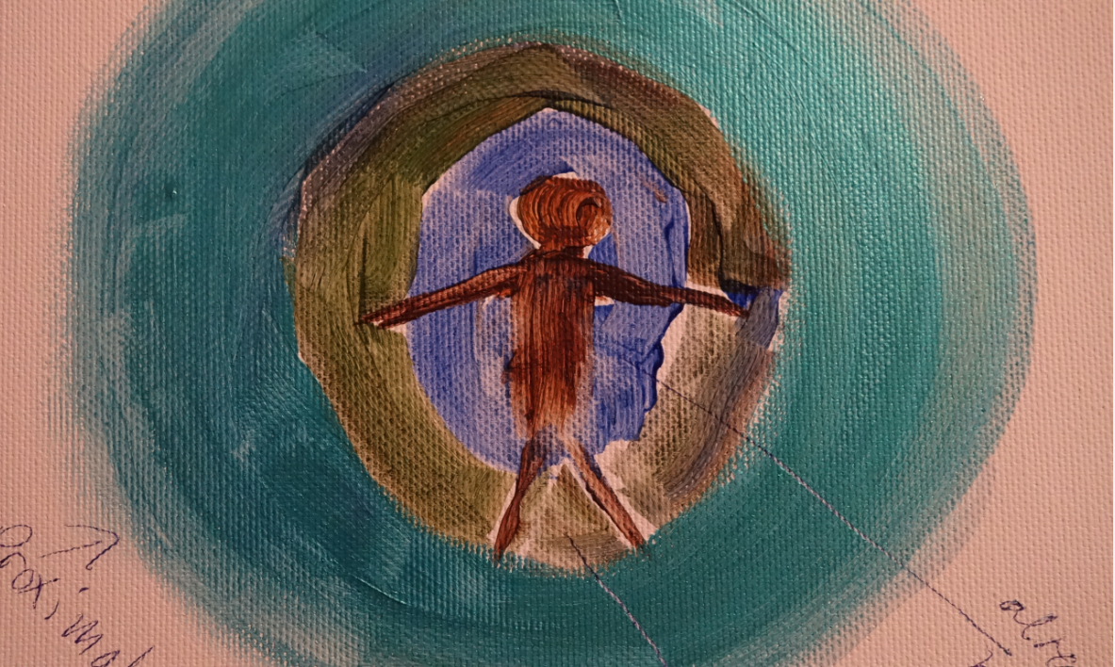
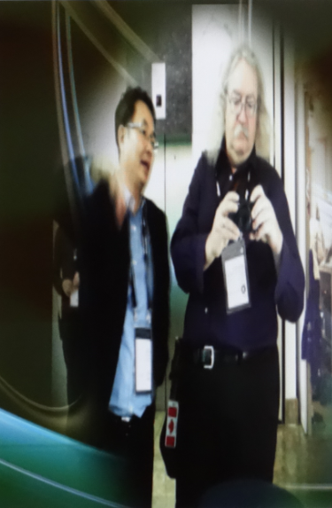
Learning – acquiring something vs becoming something

Slide 21


Analytics – purports to tell you who you are

Slide 22
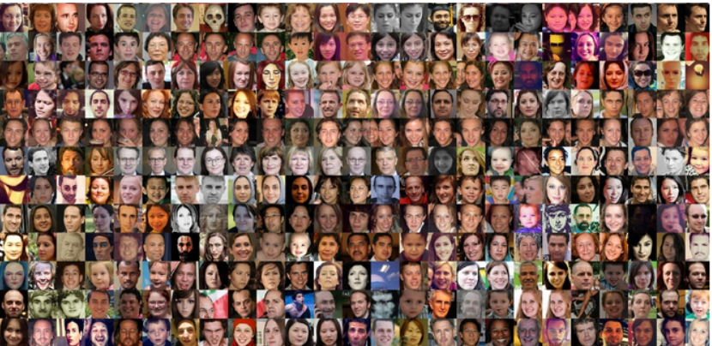
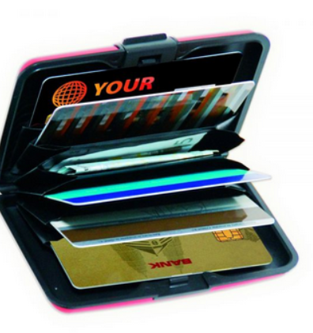
Big Data
vs Personal Data
Many people, one service
= shallow analysis
One person, many services
= deep analysis

Slide 23



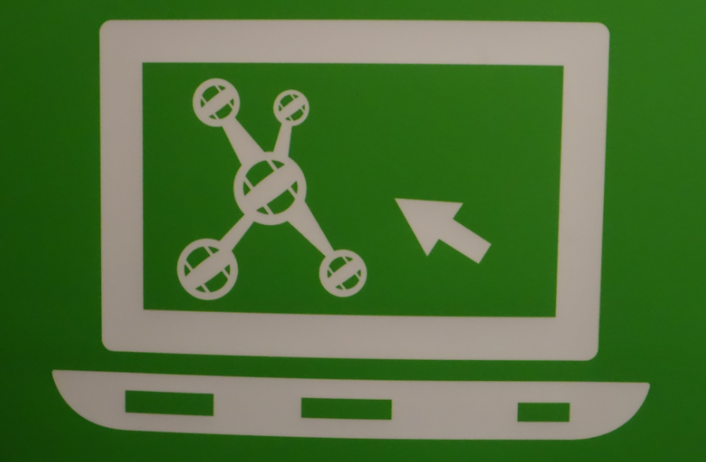
Personal network vs institutional library

Slide 24
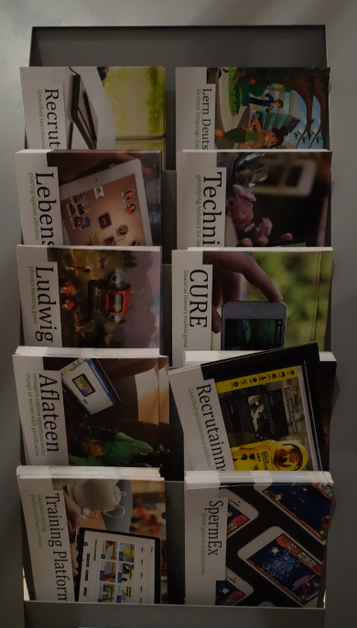
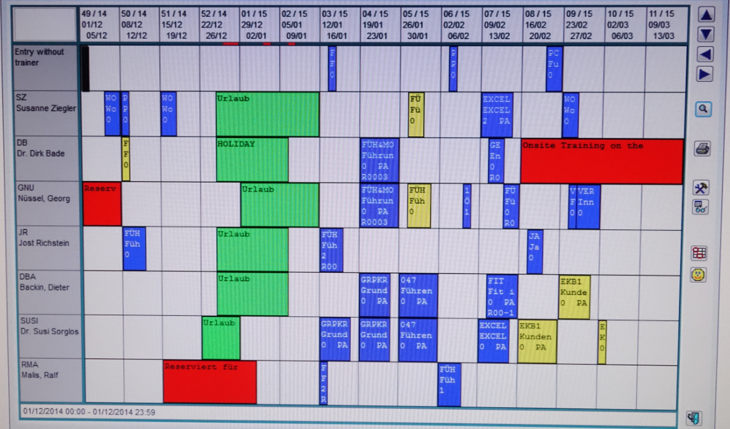
Education as the commodity, not the student

Slide 25
Learning and Performance Support Systems
WAVE
Workflow Analysis, Visualization and Enhancement
MOOC-REL
Massive Open Online Course Ressources Éducatives Libres
MINT
Multimodal INteractive Trainer
RRN
PCL
PLR
ACDR
PLA
WORLD
DATA
EXTERNAL
DATA Services
EXTERNAL
APPS
COMMON PLATFORM
Services, Communications, Management
MATS
Program
Technologies
NRC Programs
Government
Departments
It’s a network of personal learning environments…
… connected to a large array of learning services

Slide 26
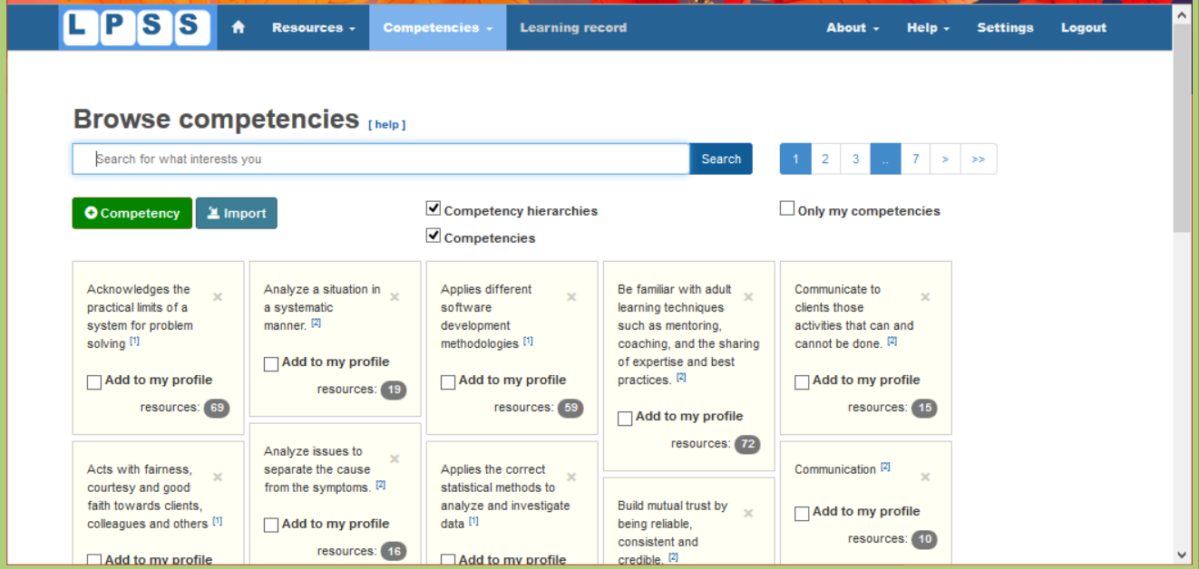
http://lpss.me – prototype PLE

Slide 27
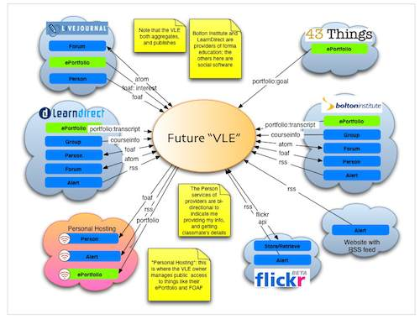
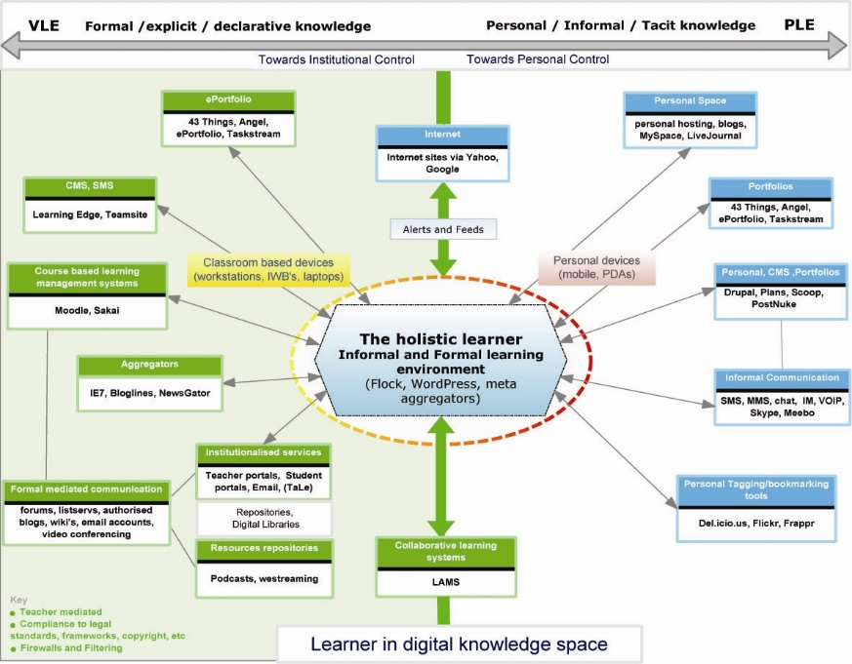
The design is based on putting the learner at the center
Scott Wilson (left), Tim Hand (right)
https://www.google.com/search?q=ple+diagrams
http://www.edtechpost.ca/ple_diagrams/index.php/mind-map-3

Slide 28

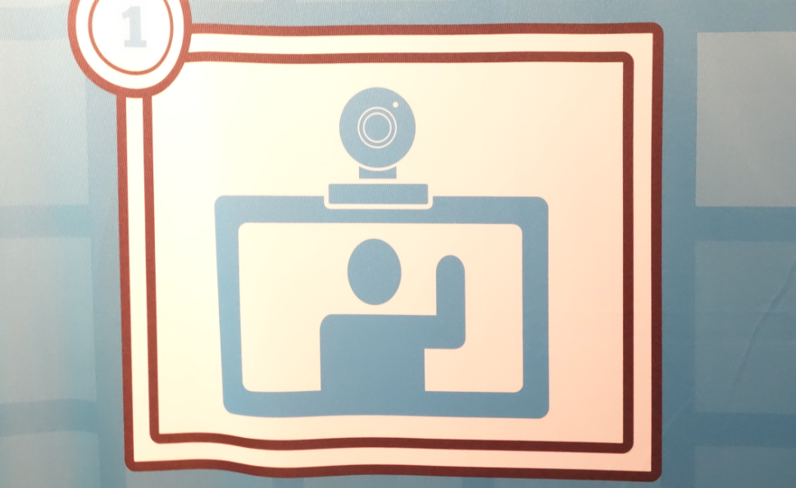
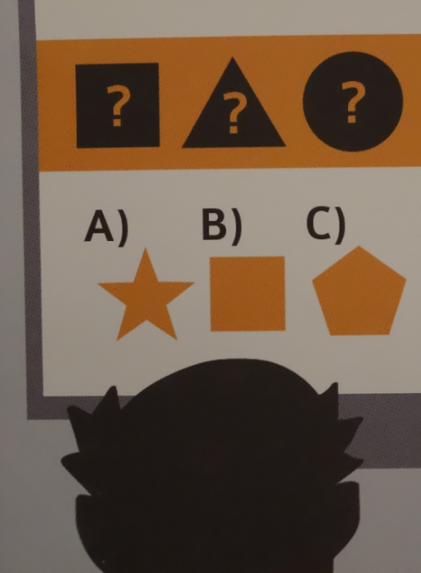
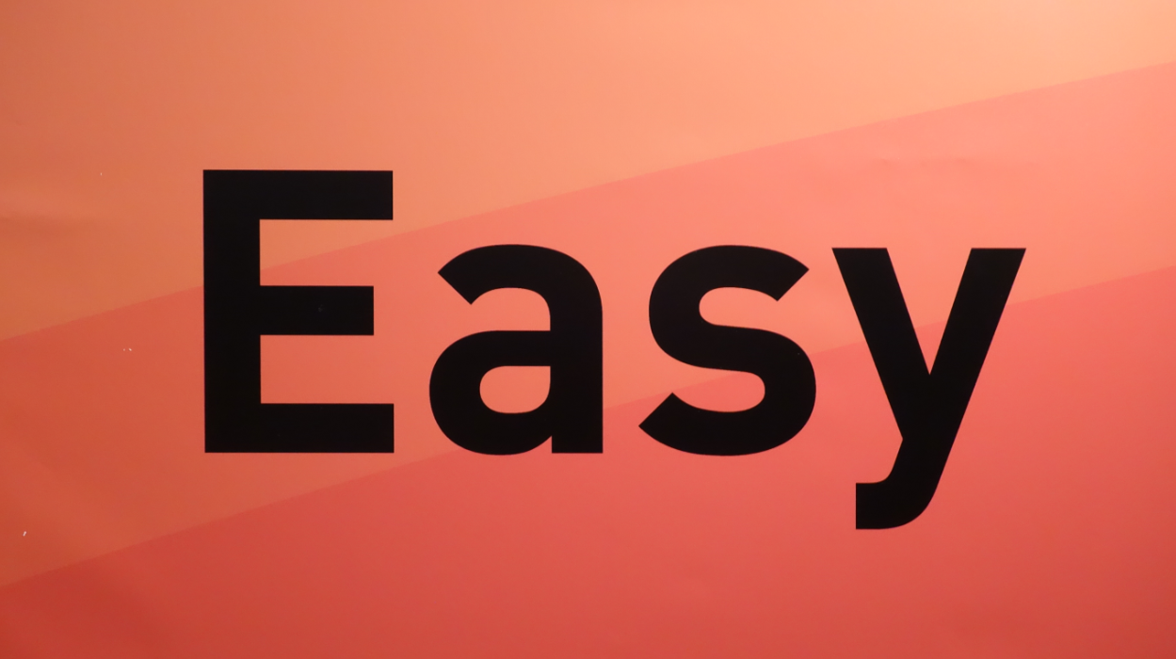
Not a platform, but a connector of resources and services

Slide 29

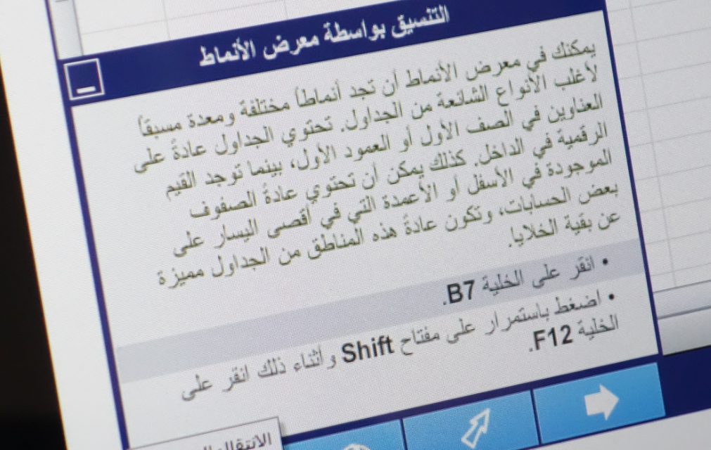
An open marketplace of free and non-free educational goods and services (all this and Ed Net Neutrality?)

Slide 30

The Personal Learning Record – data owned by the individual, shared only with permissions
http://halfanhour.blogspot.de/2014/12/eportfolios-and-badges-workshop-oeb14.html

Slide 31
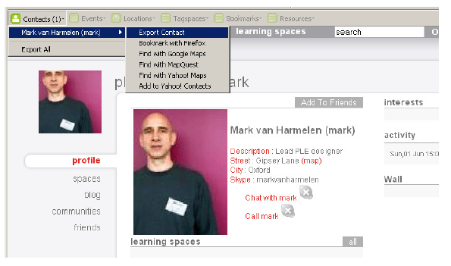

Relevant PLR Projects
Manchester PLE Project
Responsive Open Learning Environments (ROLE) http://www.role-project.eu/
Known http://withknown.com/
Learning Locker http://learninglocker.net/
Mahara https://mahara.org/
http://personalis.wikispaces.com/PLE+Projects

Slide 32


Third parties can provide analytics services, but they don’t get free unfettered access to the data any more (think of data like money)

Slide 33


Synchronized cloud data services (including Owncloud) to support data portability

Slide 34


Projection of learning services into multiple platforms

Slide 35

Connecting to real learning and workplace environments
http://www.nrc-cnrc.gc.ca/eng/rd/medical/

Slide 36




Analytics as a service – analogy with web translation

Slide 37

What’s Next?

Slide 38

Stephen Downes
http://www.downes.ca

