Slide 1
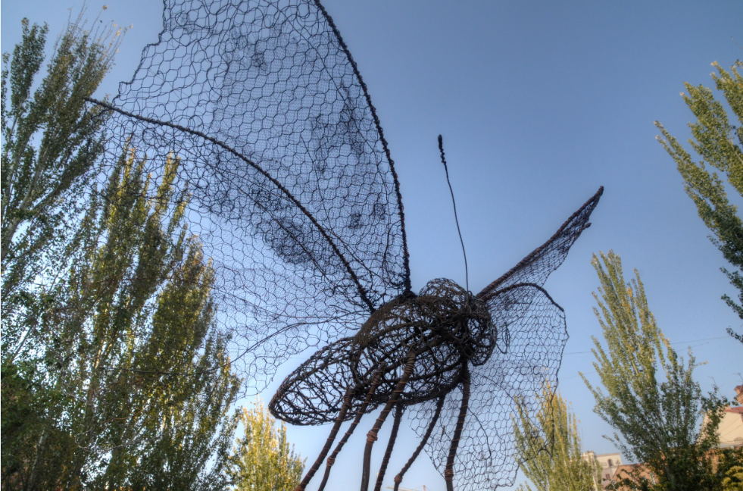
Beyond Borders: Global Learning in a Networked World
Stephen Downes
Yerevan, Armenia
November 2, 2014

Slide 2
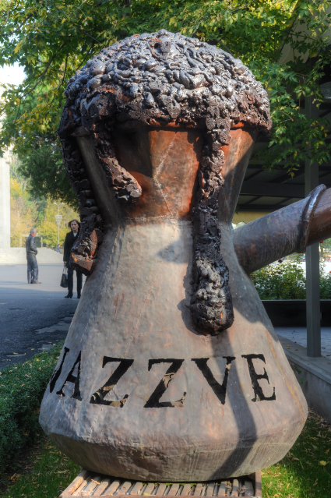
Beyond Borders…
We speak many different languages
This is both the challenge and the opportunity

Slide 3
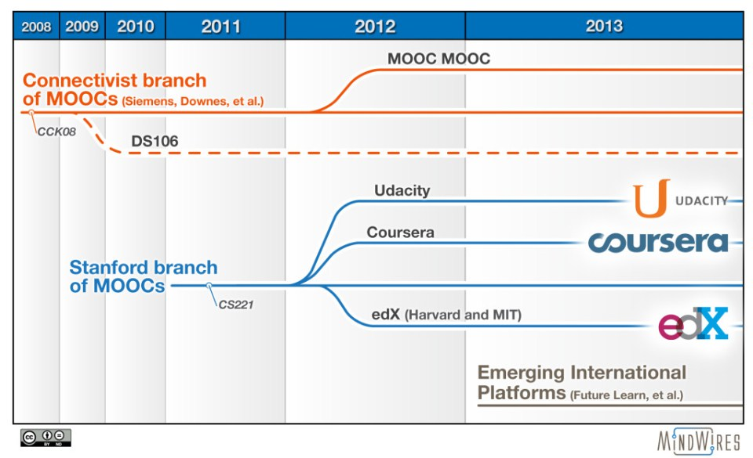
The MOOC Revolution
http://mfeldstein.com/mooc-history-presented-aacn13-conference/

Slide 4
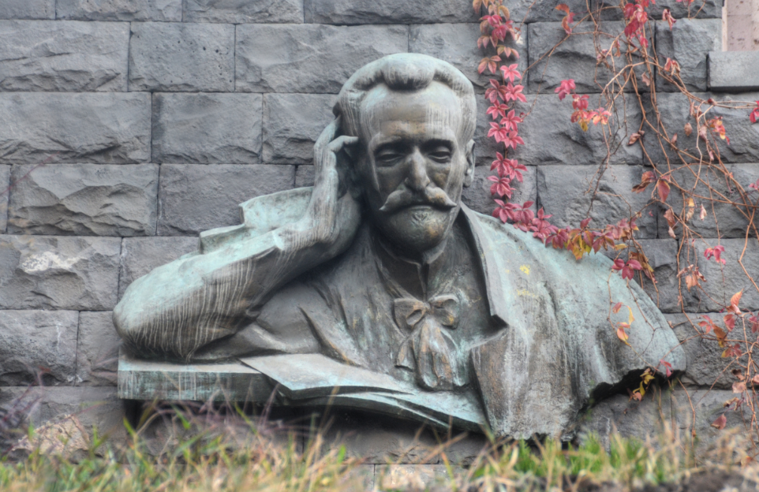
What does it mean?

Slide 5

The point of the MOOC is to be open
But that means more than just free stuff, and more than just online videos

Slide 6
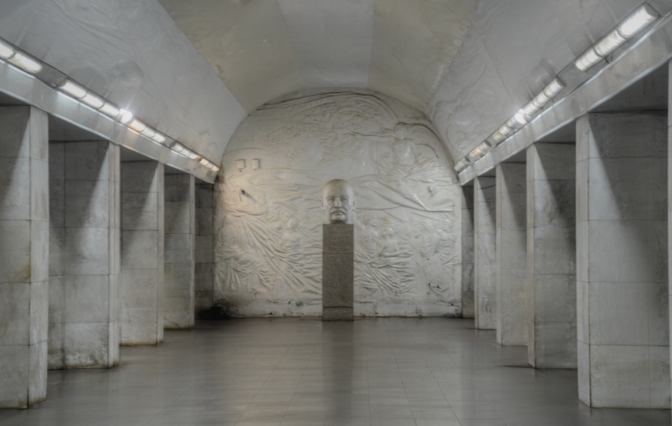
It’s a way of thinking, a way of relating to the world

Slide 7
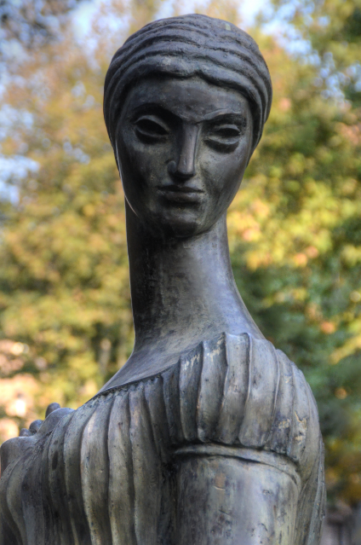
It’s a way of creating harmony through diversity
When each of us speaks a different language we all have something unique to say

Slide 8
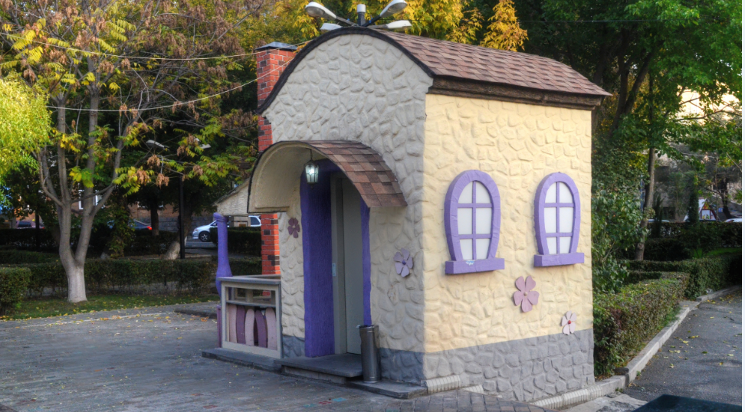
Open learning…
Open University opens in 1971
Athabasca University (1970/72)
Indira Gandhi National Open University (1985)

Slide 9
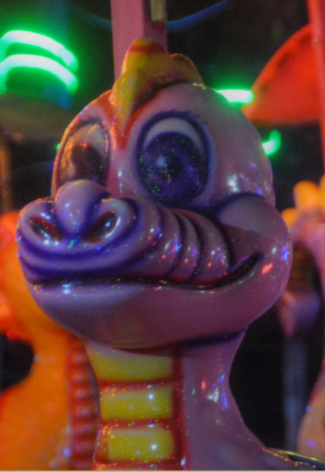
Open learning (2)
Over time – enhanced accessibility
  distance learning
  reduction of financial barriers
    tuition reductions
    subsidies
  progressive pedagogies
    Creation of distance learning pedagogies
    Moore, Merrill, Gagne

Slide 10
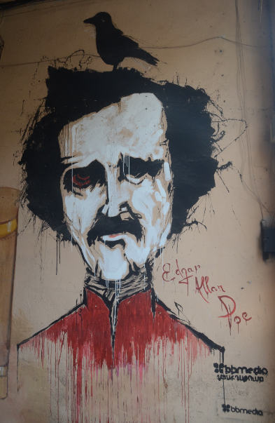
Open resources
Project Gutenberg
Open Archives Initiative
  BOAI
  Dspace
  ROAR
Wikipedia
  Curricki
  Wikiversity
  WikiEducator

Slide 11
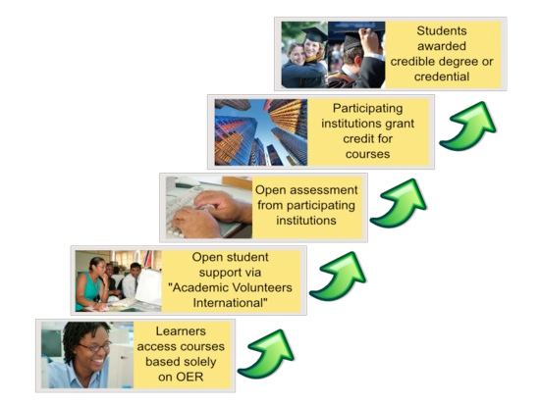
The OERu Logic Model
Taylor, J.C. 2007. Open courseware futures: Creating a parallel universe. e-Journal of Instructional Science and Technology (e-JIST), Vol 10, No. 1. Online: http://www.ascilite.org.au/ajet/e-jist/docs/vol10_no1/papers/full_papers/taylorj.htm

Slide 12
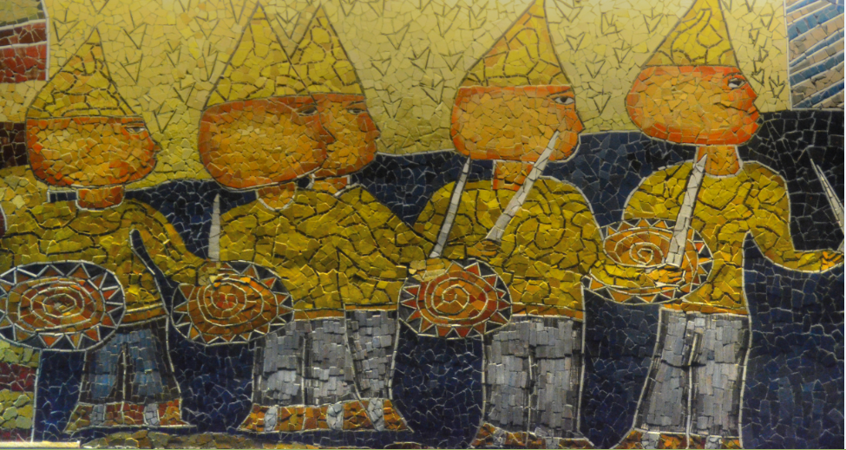
Criticism of the Logic Model
Traditional Curricular based approach
  a focus on articulation & credit transfer
  closed federation of traditional institutes
Tight link to traditional credentials

Slide 13
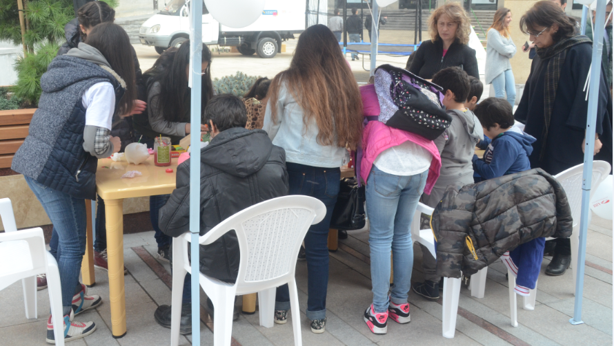
It’s open delivery, but it’s not open learning…
Friere: it’s the banking method of education

Slide 14
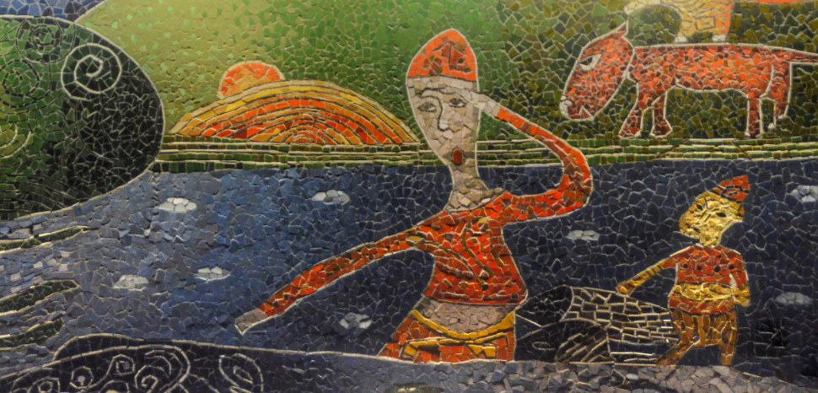
Open versus closed delivery
Learning objectives
  concrete and stated Learning Objectives vs. unstated and multiple objectives
Organization of subject matter
  knowledge of vs knowledge about
  linear organization vs knowledge community

Slide 15
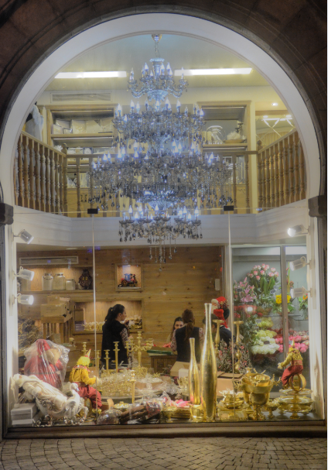
Open versus closed assessment
Subject and content-focused assessment, vs. performance-based and networked-based
Assessment against external criteria vs. self-assessment
Assessment by-instructor vs. 3rd-party assessment

Slide 16
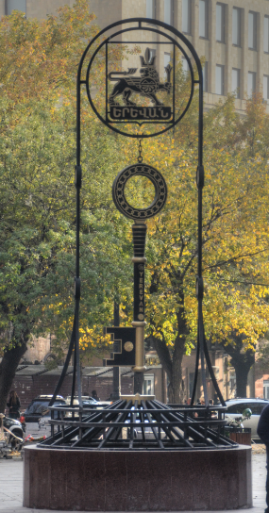
Free Learning
Connectivist, or network, learning
Network design principles: distributed, disintermediated, dynamic
Design based on the ‘semantic principle’

Slide 17
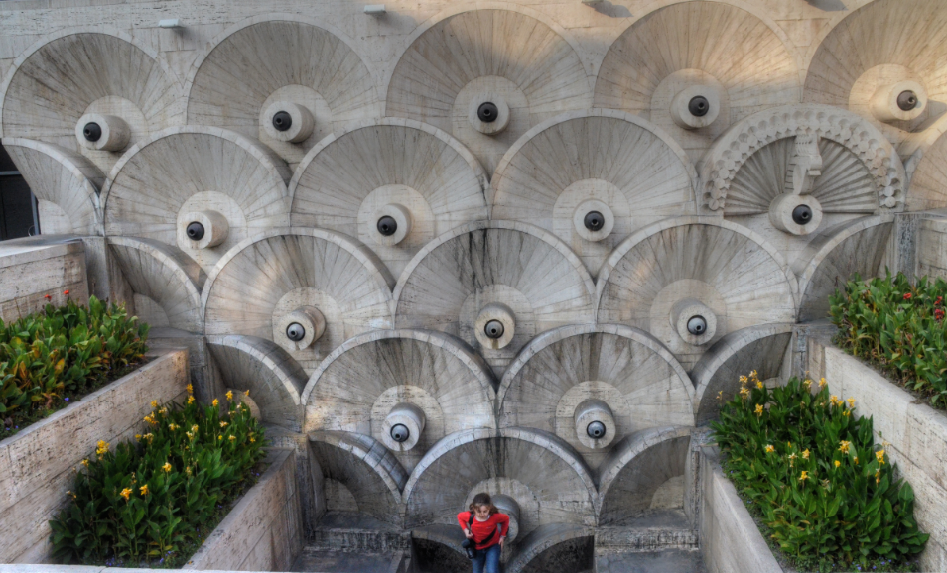
Learning is a matter of personal growth, not an accumulation of facts

Slide 18
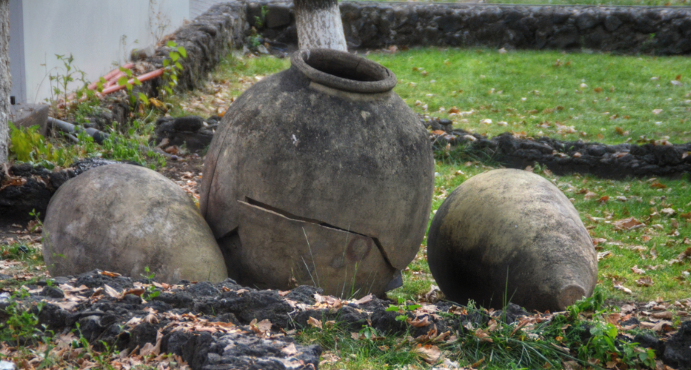
Connectivist Learning Design
A non-curricular based approach
  course content is the ‘McGuffin’
  learning takes places through interaction and creativity

Slide 19
But… why
It’s a formal recognition that people have different destinations, different tastes
Based on an understanding that knowledge varies according to these
Expresses the principle that networks – communities – are stronger with multiple diverse perspectives
Knowledge learned is better – indeed, known

Slide 20
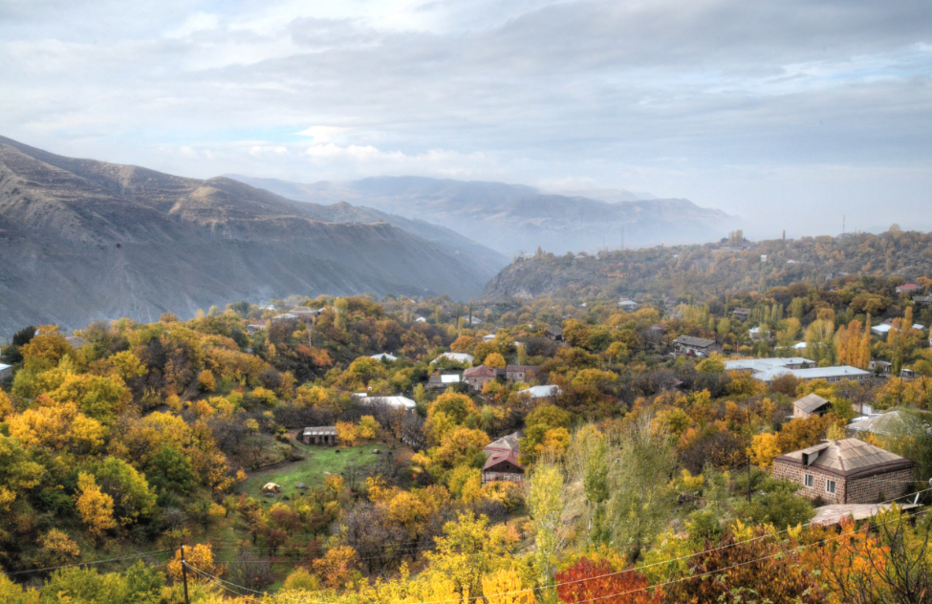
In diversity, harmony and growth

Slide 21
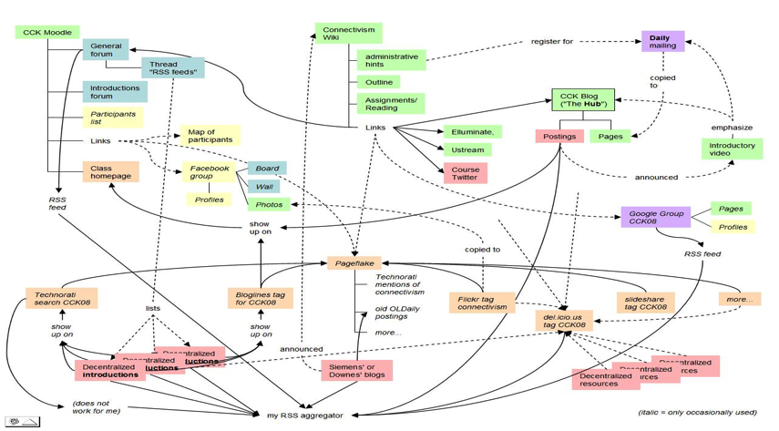
A Map of the Community
Connectivism: A Theory of Personal Learning
Stephen Downes, December 3, 2008, Educational Development Centre, Ottawa
http://www.downes.ca/presentation/208

Slide 22
Our MOOC Model
MOOC: Massive Open Online Course
There is no central core feature – no core content, group, etc
Course design is a network, or a map, or a community
Resources are distributed, and aggregated
Participants are encouraged to create their own resources, communities, groups

Slide 23
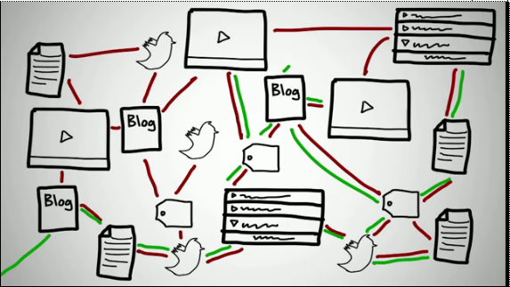
Connectivism & Connective Knowledge
http://www.youtube.com/watch?v=eW3gMGqcZQc

Slide 24
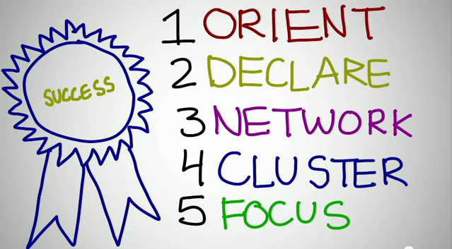
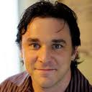
How to be Successful in a MOOC
Dave Cormier
http://www.youtube.com/watch?v=r8avYQ5ZqM0

Slide 25
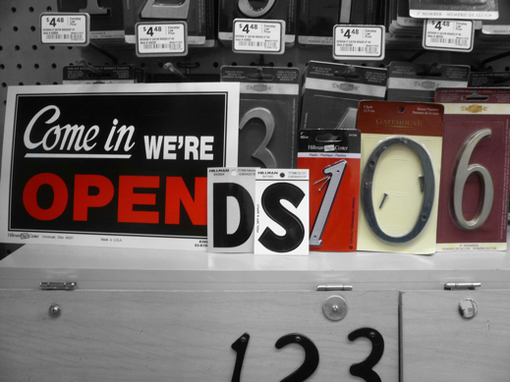
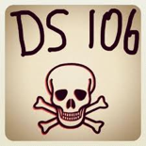
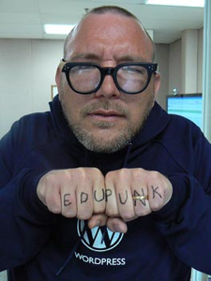
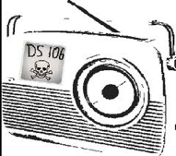
The madness and mayhem of DS106
Jim Groom
DS = Digital Storytelling
DS106 redefined activities and participation
http://ds106.us/

Slide 26
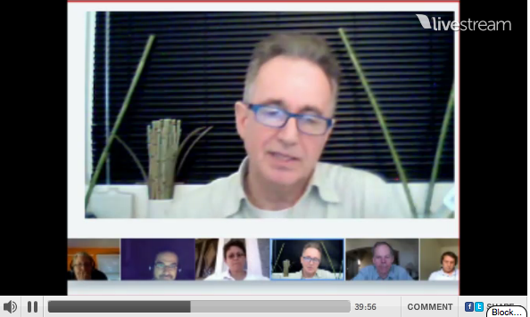
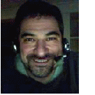
eduMOOC underground
Jeff Lebow
Jeff Lebow, Google+ hangout, and Livestream:
Taking something ordinary, and making it something special – YOU make the MOOC
http://www.livestream.com/jefflebow/

Slide 27
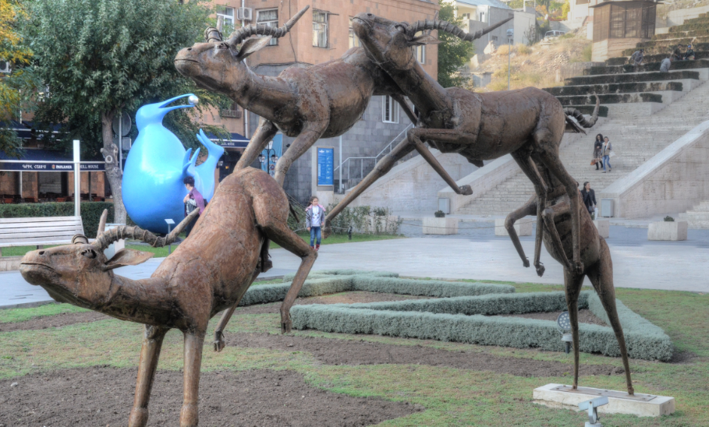
2011: Year of the MOOC

Slide 28

AI-Class: Redefining Massive
More than 100,000 people signed up for pre-registration – they got videos and online quizzes
http://www.ai-class.com/

Slide 29
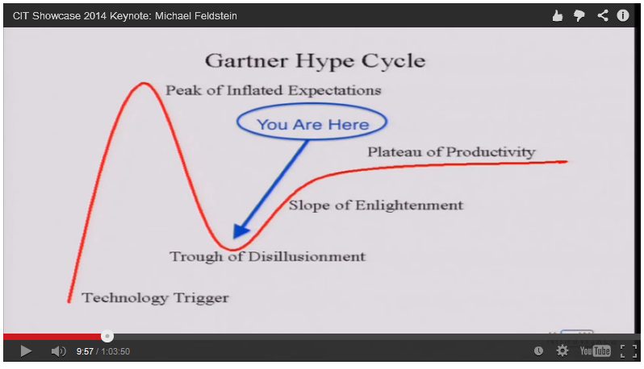
2014: Year of the Anti-MOOC

Slide 30

Transforming the system

Slide 31
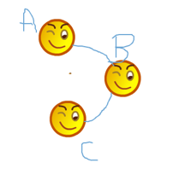
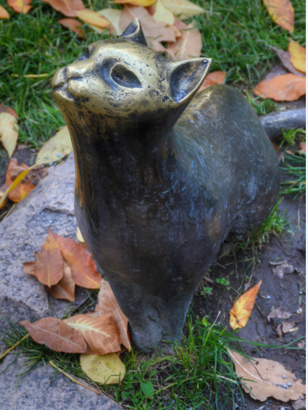
New cultures of learning

Slide 32
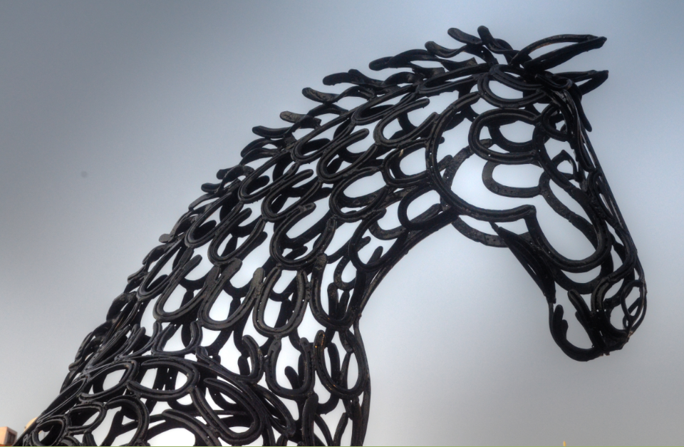
Autonomy
Freedom as the factors affecting mental states (empirical, cognitive, psychological)

Slide 33

Freedom as the capacity to act on mental states (physical, social, structural, resources)

Slide 34
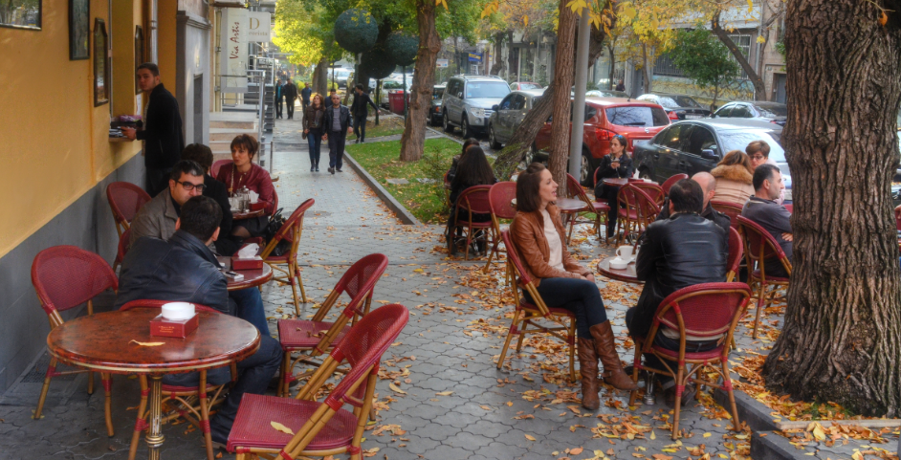
Scope and range of autonomous behaviour (expression, association, selection, method)

Slide 35
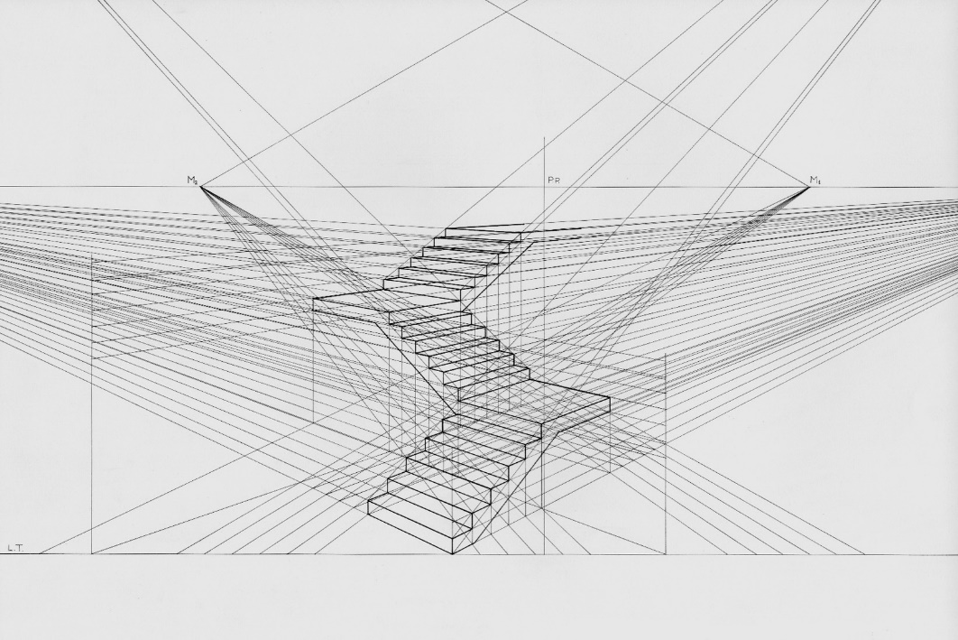
Diversity
Composition - many types of entities
Intention (of goals, desires (cf JS Mill))
Perspective (uniqueness of point of view, language)

Slide 36
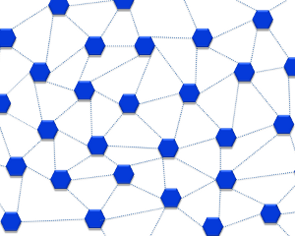
Mathematics of diversity (multiple inputs produce mesh networks)
Putnam, Florida, and the rest of it
Homophily and associationism
http://lemire.me/fr/documents/publications/DiversityTechReport_October2008.pdf
http://profesorbaker.wordpress.com/2011/01/30/homophily-and-heterophily-what-fires-together-wires-together-cck11/

Slide 37
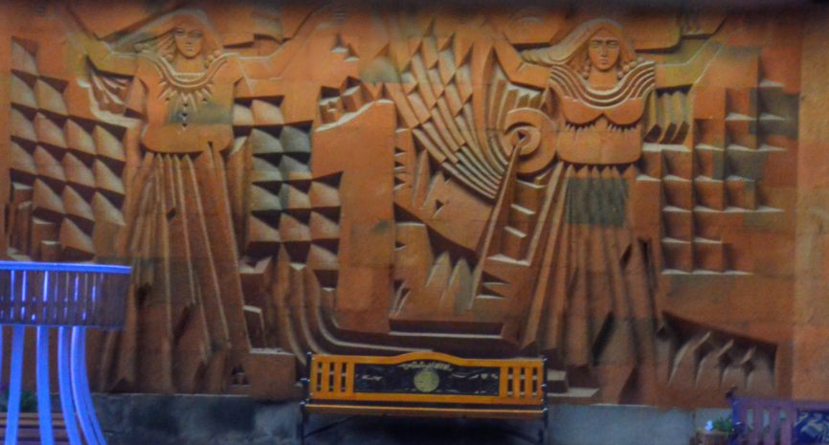
Openness
Open education, yes
  Open content, teaching, assessment
  Stages of openness and terminal path

Slide 38
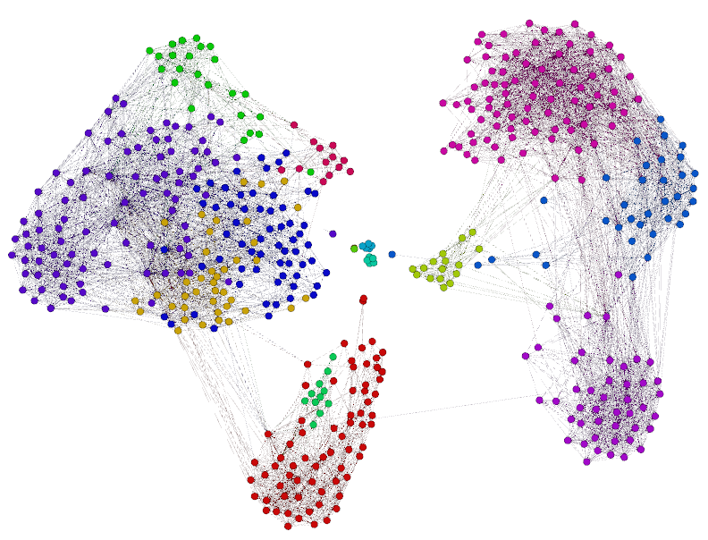
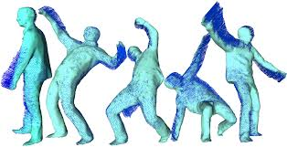
Open networks (clustering instead of grouping)
Flow (input, output, feedback, plasticity)
Open Educational Resources as the medium of communication

Slide 39
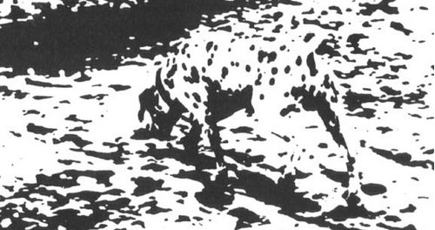
Interactivity
Influence vs emergence (thought-bubbles – “we perceive wholes where there are only holes”)
http://www.downes.ca/post/55001
http://connect.downes.ca/post/44222

Slide 40

Knowledge as pattern recognition
  Ontological (real) vs perceptual (recognized)

Slide 41
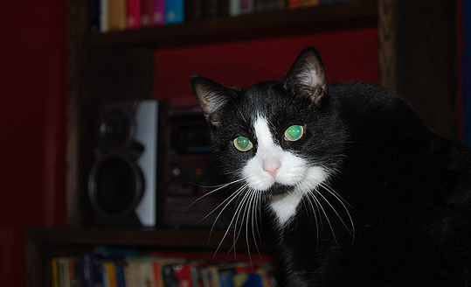
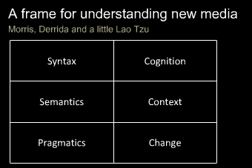
Critical Literacies
Understanding how we use artifacts to communicate in online and other learning networks
http://www.downes.ca/presentation/232

Slide 42
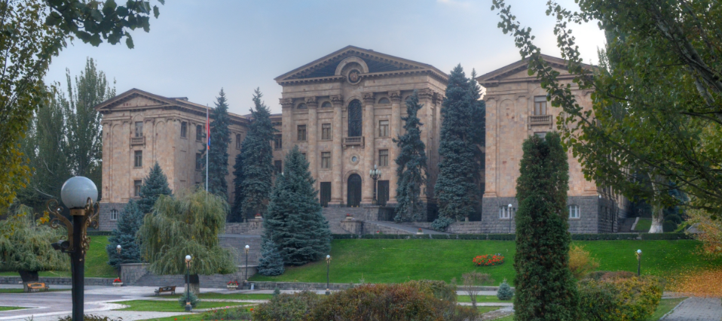
New Roles for Government
Communications and Education Infrastructure
Support for Open Educational Resources
Support for Free Learning
Management of assessments and credentialing

Slide 43
The Digital Infrastructure
Public high-speed backbone networks
  used not only for education but for other public services: police, fire and emergency, hospital, municipalities, etc.
Local Access
  eg. Community Access Points
Legal Framework
  policy on digital rights and copyright
  net neutrality and similar regulations

Slide 44
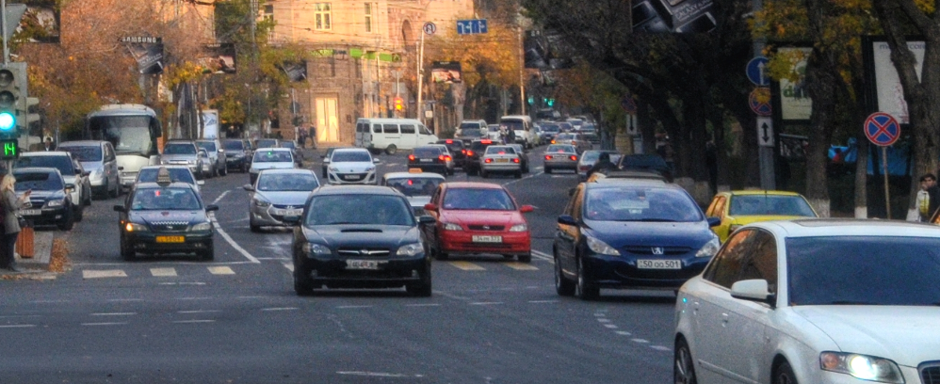
A Note on Sustainability
Whatever we really want is sustainable
Like, say, highways and roads

Slide 45
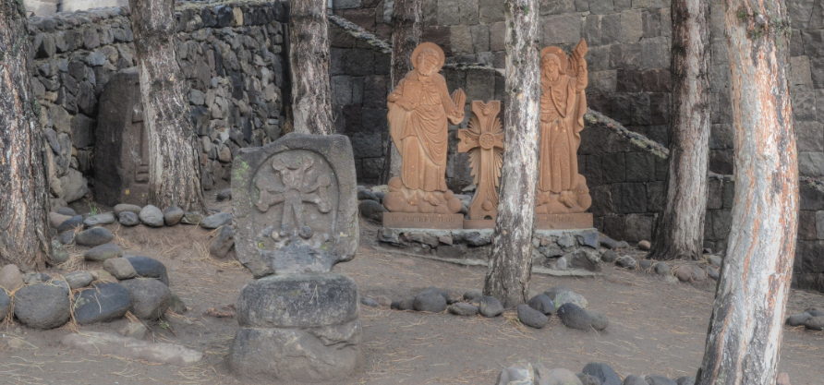
Sustaining Infrastructure
Support for existing programs and services
  cost reductions in communications overhead
  improved efficiency of public service delivery
Overhead on entertainment and commercial infrastructure
  similar to broadcast ‘CanCon’ requirements

Slide 46
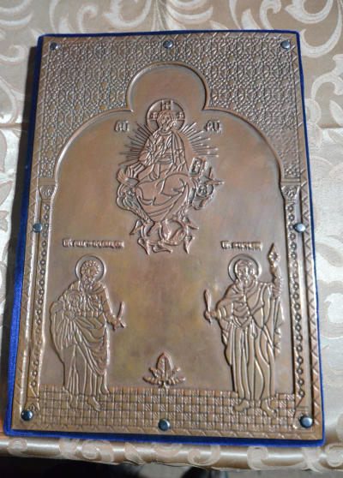
Open Educational Resources
Traditional Resources
  Already developed and paid for by government
  Open access initiatives
Public Policy Resources
  design to serve a public end or objective
  focus on basic literacies & community empowerment

Slide 47
Sustaining OERs
Redirection of existing resource allocations
  eg. OA mandates for grants and programs
  community outreach for existing agencies
    eg, NASA
Support for community-based OER process
  integration of OER development and use within publicly supported curricula
  use of OERs in public services and programs
- Stephen Downes, Models for sustainable Open Educational Rsources, ijklo.org/Volume3/IJKLOv3p029-044Downes.pdf http://www.downes.ca/presentation/76
- OER Help with Keynote Slides, OER-Forum http://lists.esn.org.za/pipermail/oer-forum/2011-October/thread.html

Slide 48
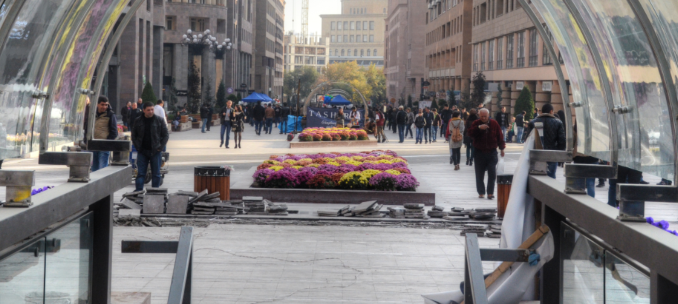
Software and Service Support
Software and environment support
  eg. Public Knowledge Project,
  Open Journal Systems, Moodle, et
Service networks and support
  JISC / CETIS, EdNA, etc.
  Common Services - eFramework

Slide 49
Sustaining Support Systems
Development and systems research support
Public adoption of open licensing
  FLOSS
    GNU/GPL, BSD, etc
    Creative Commons
  directs resources toward multi-sector development
Community service requirement for commercially sourced software

Slide 50
Assessment and Credentialing
Support for Personal Learning
  provision of personal learning environments and frameworks
    promote lifelong learning
    link to skills database, corporate training registries
    direct support for employment and funding
  personal portfolios and credential banks
    voluntary, self-managed
    optional identity frameworks

Slide 51
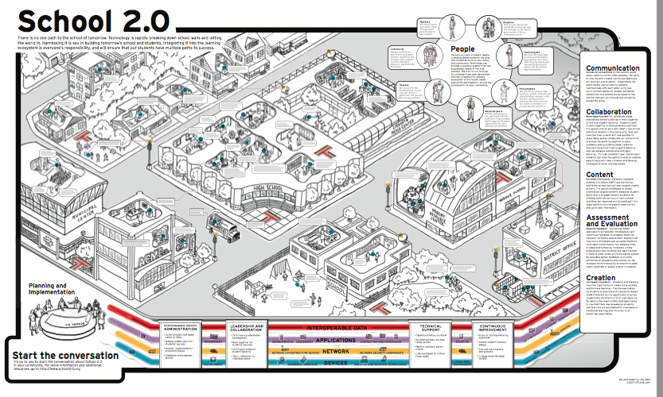
The Old School 2.0
School 2.0 etoolkit http://etoolkit.org/etoolkit/

Slide 52
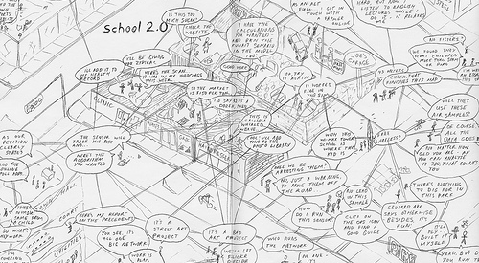
New Models for Schools

Slide 53
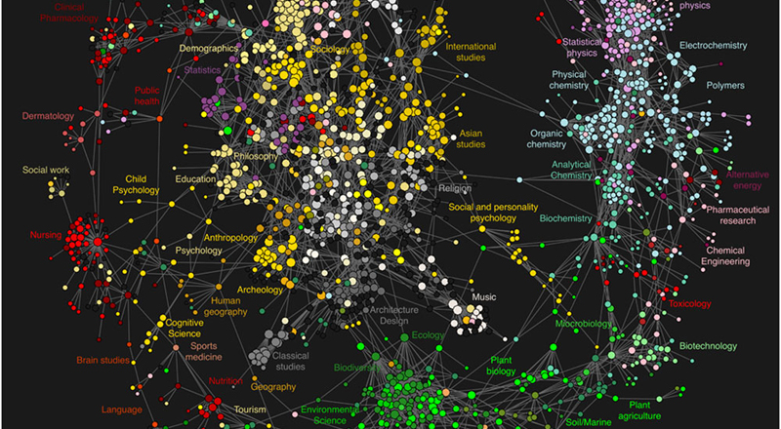
New Roles for Research

Slide 54

Community = Interactions
Not simply ‘spreading the word’
Not ‘amplification’
But rather, the creation of our own society, together
  emergent from the free actions of each of us
  not based on the ideas of one (or a small number) of individuals

Slide 55

Open communities speak many languages

Slide 56

Stephen Downes http://www.downes.ca

