Slide 1
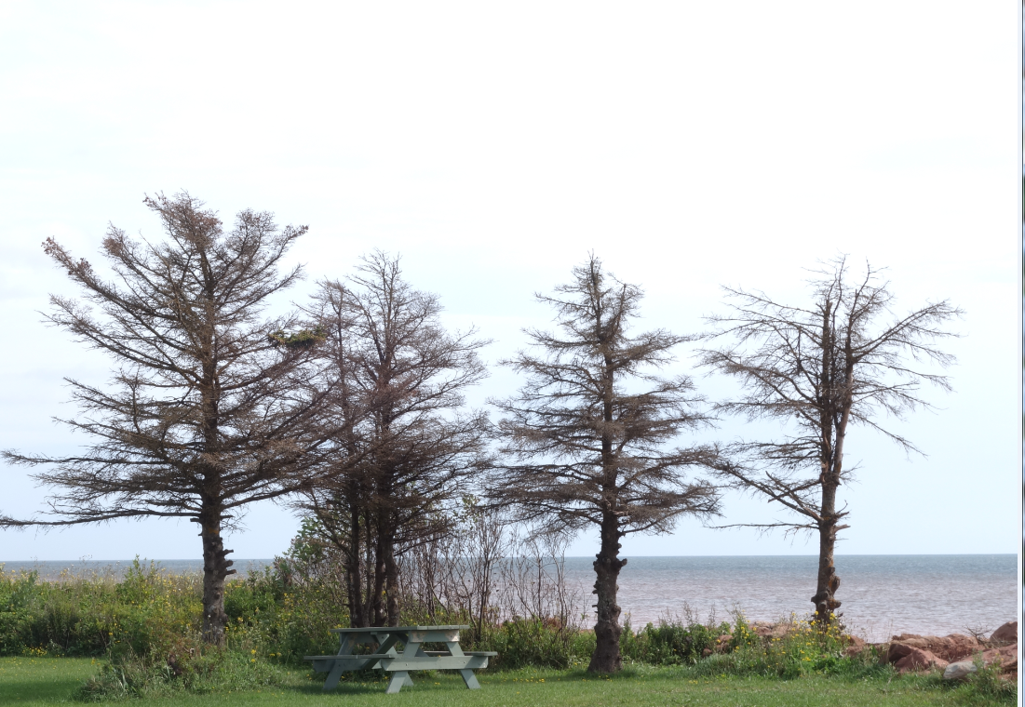
The Challenges (and Future) of Networked Learning
Stephen Downes ~ September 5, 2014

Slide 2

Overview
A look at Networked Learning
Skills Related to Networked Learning
Dependence and Independence

Slide 3
What is Networked Learning?
The Official Definition:
  Networked learning is a process of developing and maintaining connections with people and information, and communicating in such a way so as to support one another's learning. The central term in this definition is connections.
Wikipedia: http://en.wikipedia.org/wiki/Networked_learning

Slide 4

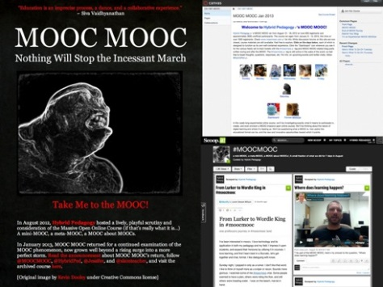
What is Networked Learning?
The Core Idea
  Instruction does not equate to learning. This is the fundamental fly in the ointment of instructional design, and the epistemological failing of learning management systems and most MOOC platforms
Sean Michael Morris and Jesse Stommel: http://www.hybridpedagogy.com/journal/moocagogy-assessment-networked-learning-and-the-meta-mooc/

Slide 5
What is Networked Learning?
Rhizomatic Learning
  Curriculum is not driven by predefined inputs from experts; it is constructed and negotiated in real time by the contributions of those engaged in the learning process. This community acts as the curriculum, spontaneously shaping, constructing, and reconstructing itself and the subject of its learning.
Dave Cormier: http://davecormier.com/edblog/2008/06/03/rhizomatic-education-community-as-curriculum/

Slide 6
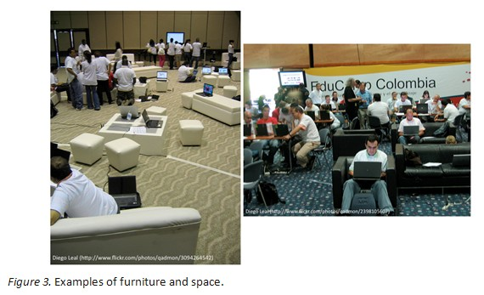
What is Networked Learning?
EduCamp Colombia
Diego Leal: http://www.irrodl.org/index.php/irrodl/article/view/884/1677

Slide 7
Potential of Networked Learning
More than just Banking
  Meaningful learning occurs with knowledge construction, not reproduction; conversation, not reception; articulation, not repetition; collaboration, not competition; and reflection, not prescription (Jonassen et al., 2003)
Wendy Drexler: http://www.ascilite.org.au/ajet/ajet26/drexler.html

Slide 8
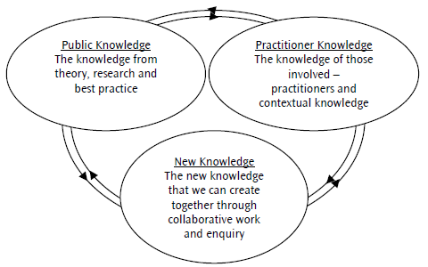
Potential of Networked Learning
A Broader Conception of Knowledge
David Jackson and Julie Temperley: http://innovationunit.org/sites/default/files/From%20professional%20learning%20community%20to%20networked%20learning%20community.pdf

Slide 9
Supporting Networked Learning
New Roles for Systems and Providers
  Building Networks
  Mapping and Analyzing
  Supporting Community
  Expanding Boundaries
Will Allen: http://learningforsustainability.net/social_learning/networks.php

Slide 10
Supporting Networked Learning
The Role of the Educator
The new opportunities they offer students, though there is that. It's that all of them redefine the educator's role in some significant way. They create entirely new categories of educator, such as "online lecturer" or "scientist studying polar bears". Entire disciplines, far removed from traditional "instructional design", are being created and populated by people who direct online videos, design learning communities, program massive games
Downes: http://www.downes.ca/post/54312

Slide 11
What Skills Are Needed?
The Semantic Condition
  diversity in knowledge, expertise, and application;
  autonomy to learners, who act according to their own values and decisions;
  interactivity (expand, grow and reform the social network of participants, creating new bonds);
  openness among participants, allowing the entry of any perspective, without disqualifying any in advance.

Slide 12
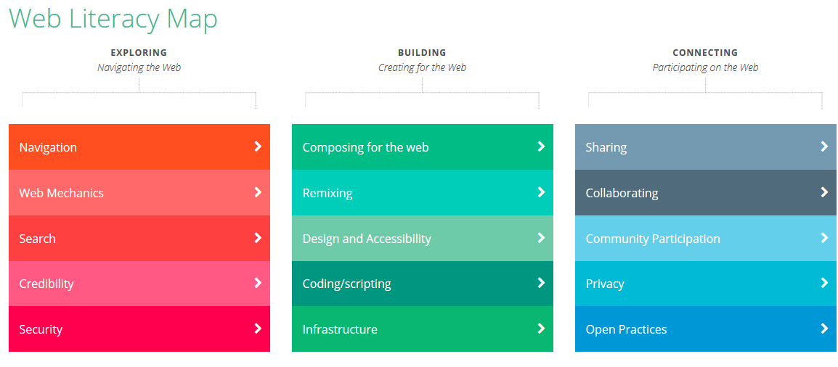
What Skills Are Needed?
Web Literacy
Doug Belshaw: https://webmaker.org/resources

Slide 13
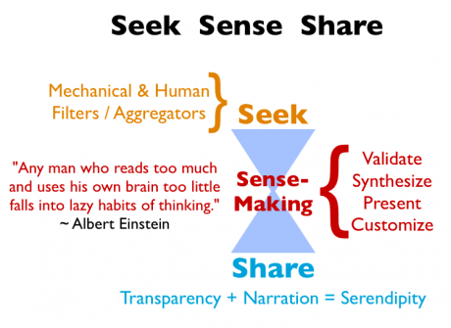
What Skills Are Needed?
The Core of Interactivity: 1-2-3
Harold Jarche: http://www.jarche.com/2012/03/the-pkm-value-add/

Slide 14
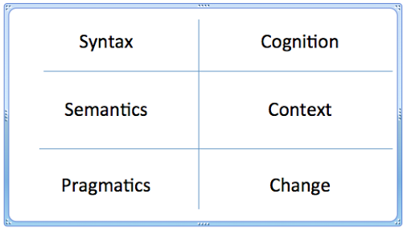
What Skills Are Needed?
Critical Literacies
Downes: http://www.downes.ca/presentation/274

Slide 15
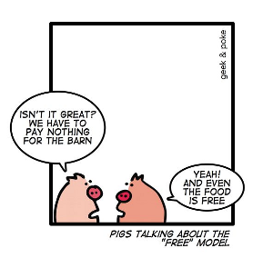
If We Don’t Develop These Skills…
You Are The Product
Scott Goodson: http://www.forbes.com/fdc/welcome_mjx.shtml

Slide 16
Tech Supporting Skills Development
Blogging and Authoring
Collaborative Calendaring
Podcasting
Feed Readers
Collaborative Mapping & Drawing
Microblogging & Messaging
Publishing Photos and Videos
Jane Hart: http://c4lpt.co.uk/resources/social-learning-handbook/100-examples-of-use-of-social-media-for-learning/

Slide 17

Who Owns Information?

Slide 18
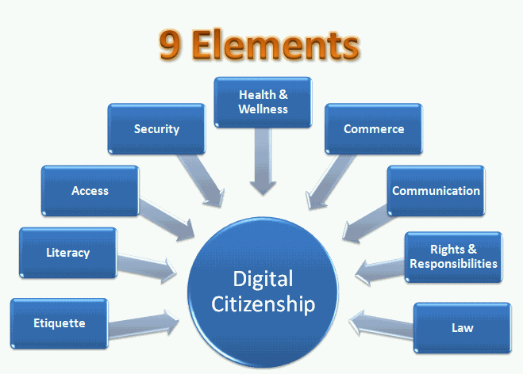
Digital Citizenship
http://www.tidesinc.org/resources/digital-citizenship/

Slide 19
The POSSE Model
The Core Idea
  The POSSE media model is built on two basic levels of activity: to produce and distribute content. The better you do these two things (and the more it is based on listening and understanding your audience) the more media exposure you will earn.
Daniel Goodall: http://danielgoodall.com/2012/04/17/the-posse-media-model/

Slide 20
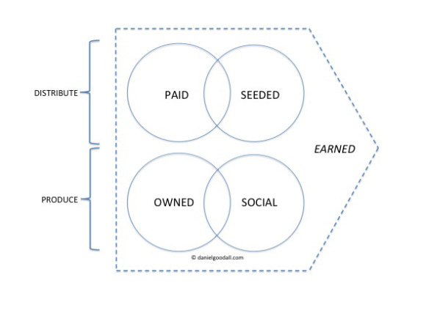
The POSSE Model
Owned, Bought and Earned Media
Daniel Goodall: http://danielgoodall.com/2012/04/17/the-posse-media-model/

Slide 21
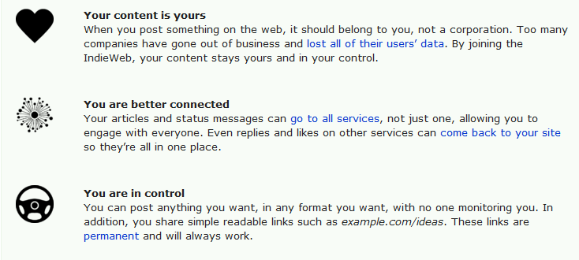
IndieWeb
IndieWebCamp
http://indiewebcamp.com/

Slide 22
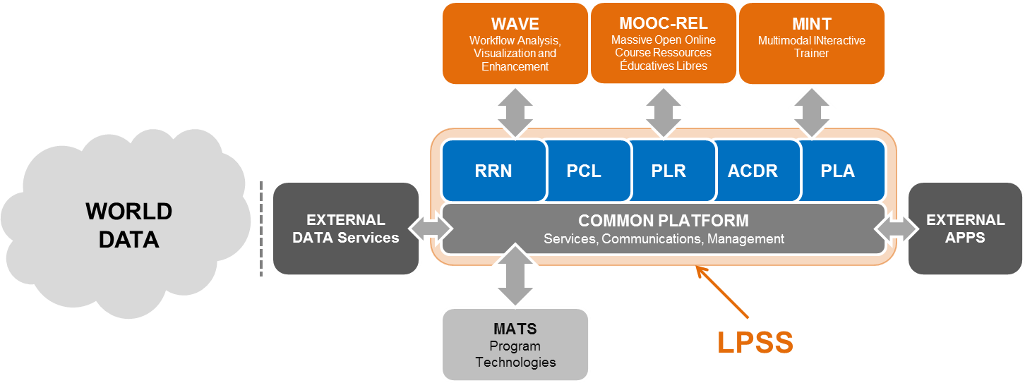
Personal Learning
Downes: http://halfanhour.blogspot.ca/2013/12/learning-and-performance-support-systems.html

Slide 23
A conversation about challenges (and future?) of networked learning. A broad understanding of the meaning and potential of networked learning can help educational institutions to rethink their role beyond the provision of LMS and centralized information systems. What skills are needed? What happens if we don't develop them? What kind of technology supports the development of said skills? What’s the relation between this and issues of information property and citizenship in a digital context (POSSE models, Indie web movement)?

