Slide 1

Digital Research Methodologies Redux
Stephen Downes
May 23, 2014

Slide 2
Caveats
This is a report, not a prescription
I’m not arguing – at best, I’m explaining, but not in the sense that you can generalize from that

Slide 3
The traditional view
The steps of the scientific
method are to:
Ask a Question
Do Background Research
Construct a Hypothesis
Test Your Hypothesis by Doing an Experiment
Analyze Your Data and Draw a Conclusion
Communicate Your Results
Via Science Buddies http://www.sciencebuddies.org/science-fair-projects/project_scientific_method.shtml
See also: http://philosophy.hku.hk/think/sci/hd.php

Slide 4
Research Methods
This model is pretty much the
core of most research mothods
Design Research
Observational Research
Qualitative Research / Grounded Theory
http://depts.washington.edu/rural/RURAL/design/scimethod.html
http://www.public.asu.edu/~kroel/www500/Observation.pdf
http://www.edu.plymouth.ac.uk/resined/qualitative%20methods%202/qualrshm.htm
http://www.methods.manchester.ac.uk/events/whatis/gt.pdf

Slide 5
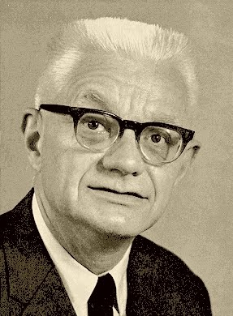
HD-Method
This model is known as the
Hypothetico-Deductive Method
cf. mid-1800s
Updated by Carl Hempel as the
  Deductive-Nomological Model
“Inference to the Best Explanation”
http://en.wikipedia.org/wiki/Hypothetico-deductive_model
https://en.wikipedia.org/wiki/Deductive-nomological_model
Hempel

Slide 6
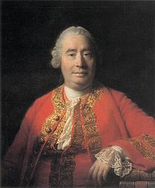
I am an Empiricist
Observation and experience are the foundation of knowledge
There is no ‘synthetic a priori’
“Hume maintained that all knowledge, even the most basic beliefs about the natural world, cannot be conclusively established by reason. Rather, he maintained, our beliefs are more a result of accumulated habits, developed in response to accumulated sense experiences.”
http://en.wikipedia.org/wiki/Empiricism
Hume

Slide 7
People Falling Into Holes
https://www.youtube.com/watch?v=YABCazKQpfI
https://www.youtube.com/watch?v=MmqhqjRLeNQ
https://www.youtube.com/watch?v=s1C6q42AfqY
My science is not based on believing there are no holes. On the contrary, my science is based on the realization that there’s always the possibility that the earth will open and swallow you up.

Slide 8
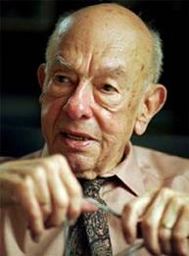
Two Dogmas of Empiricism
that there is a principled distinction between analytic and synthetic propositions
that reductionism is true
http://www2.drury.edu/cpanza/quinereview.html
My take: If this is the case, you cannot even state a theory, much less find one
Quine

Slide 9
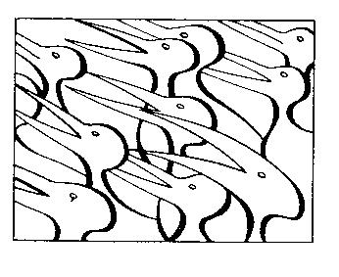
The Fallacy of Theory
Elusive Truth – what distinguishes sense from nonsense?
Theory-laden data – you see what you expect to see (gorilla video)
Incommensurability and paradigms
Empty consensus replacing rationality and truth
Scientific Method in Brief
Hugh G., Hugh G Gauch, Jr., pp. 53-66

Slide 10
Research Methods…
Research methods, in a certain sense, presuppose their own conclusions: they are silent on complex questions, for example, whether certain software ought to be developed, which options ought users to be given, what subjects ought learners be taught to learn?

Slide 11
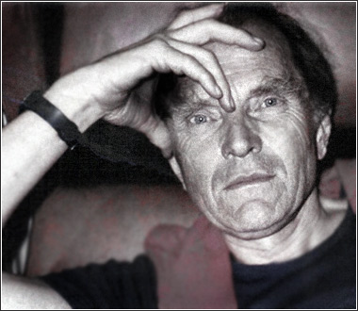
Against Method
“Against Method explicitly drew the “epistemological anarchist” conclusion that there are no useful and exceptionless methodological rules governing the progress of science or the growth of knowledge. The history of science is so complex that if we insist on a general methodology which will not inhibit progress the only ‘rule’ it will contain will be the useless suggestion: ‘anything goes’.”
http://plato.stanford.edu/entries/feyerabend/
Feyerabend

Slide 12

Voltaire’s Bastards
Voltaire (and contemporaries) – thought (correctly) that reason was the best defense against arbitrary political and religious authority
However, "Among the illusions which have invested our civilization is an absolute belief that the solutions to our problems must be a more determined application of rationally organized expertise. The reality is that our problems are largely the product of that application."
http://www.scottlondon.com/reviews/saul.html

Slide 13
Dimensions of Change
Design is no longer based on research
  Because the theory that will be ‘observed’ is presupposed in the theory
Users are no longer ‘subjects’
  Because casting myself in the role of ‘expert’ renders illegitimate the valid experiences of others
Wittgenstein: meaning is use

Slide 14
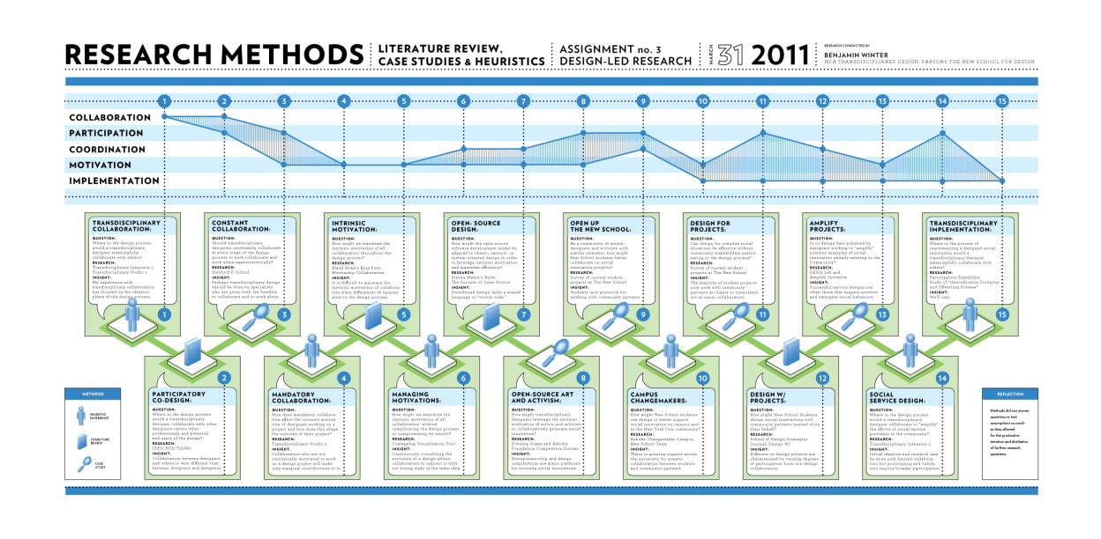
Research-Led Design
Winter: “I had always assumed that case studies, literature reviews, and ethnographic research were necessary precursors to every well-informed design project I did.”
Vs. Design-Led Research
http://transdesign.parsons.edu/wp-content/uploads/2011/04/DLR-Research-Methods-01.png

Slide 15
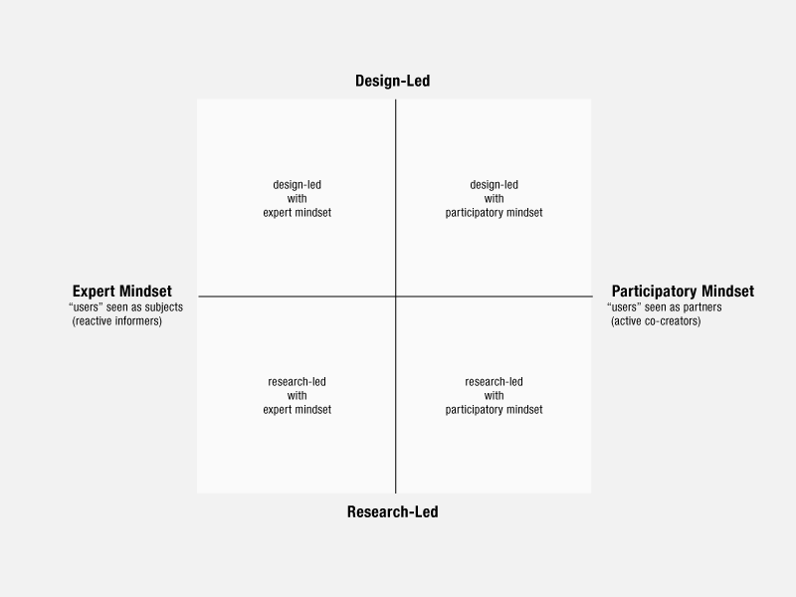
Design-Led Research
Liz Sanders http://www.dubberly.com/articles/an-evolving-map-of-design-practice-and-design-research.html

Slide 16
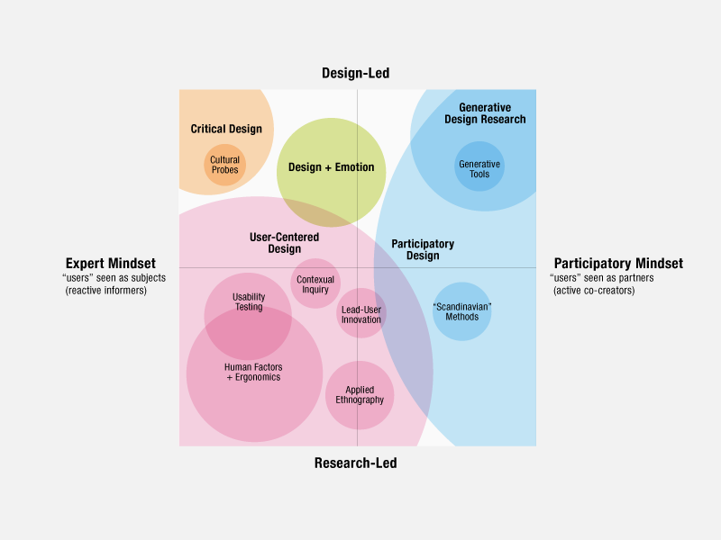
Design-Led Research
Liz Sanders http://www.dubberly.com/articles/an-evolving-map-of-design-practice-and-design-research.html

Slide 17
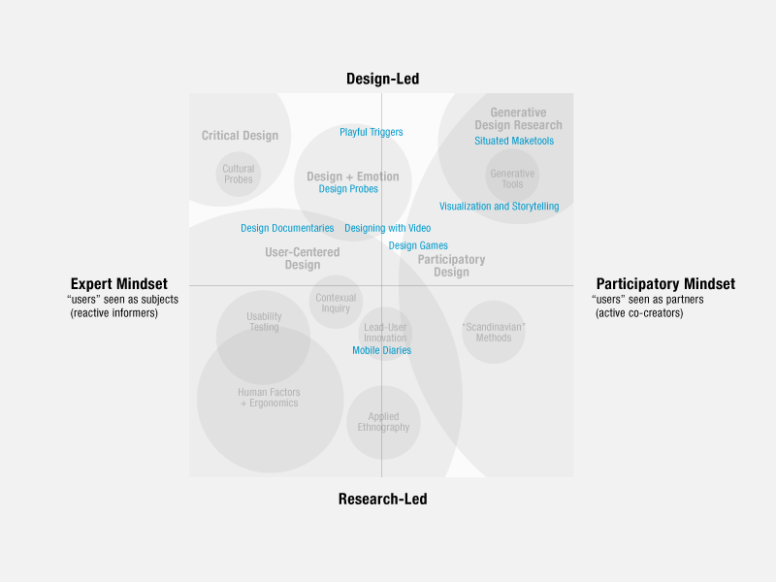
Design-Led Research
Liz Sanders http://www.dubberly.com/articles/an-evolving-map-of-design-practice-and-design-research.html

Slide 18
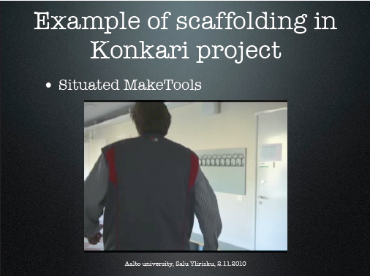
Situated Maketools
They situated the study at the workplace
Then grounded the designing in the workersʼ explanations
And scaffolded the designing, i.e. used temporary stuff
Salu Ylirisku http://designresearch.fi/blogs/uid10/wp-content/uploads/2010/11/frame_it_simple_handouts.pdf

Slide 19
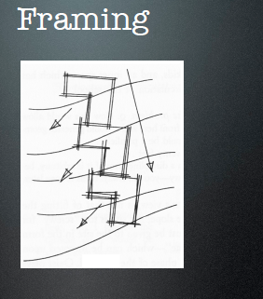
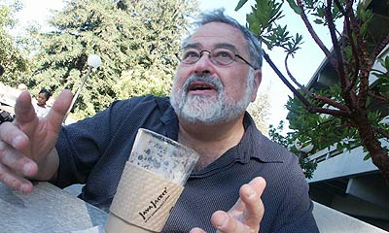
Situating as Framing
To ‘situate’ is to theorize, only with a smaller universe of discourse
Lakoff – ‘Framing’
Lakoff

Slide 20
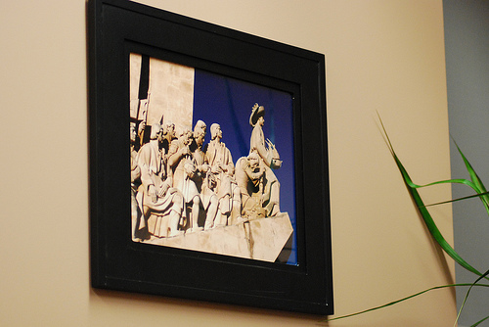
Beyond Theory
Design without theory is discovery
(And I recognize that I am able to sample only the edge of a complex landscape)

Slide 21
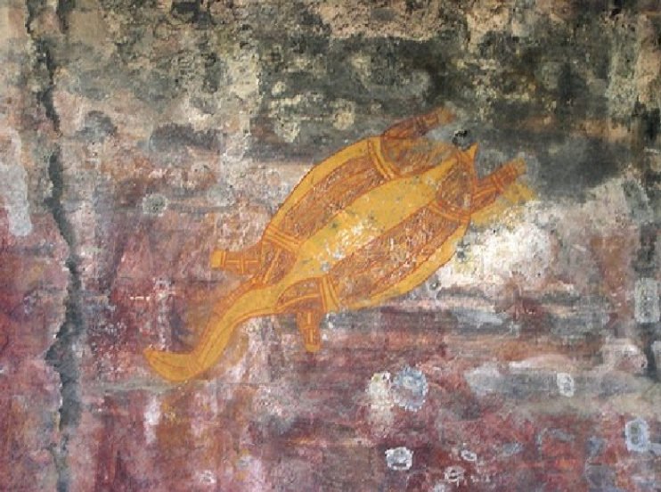
Reading the World
I don’t see the world as neat and ordered, like logic and mathematics – I see it as messy and complex, like a language
“We see the future in the same way that we see the past, by reading the signs”
Wittgenstein: Meaning is Use

Slide 22
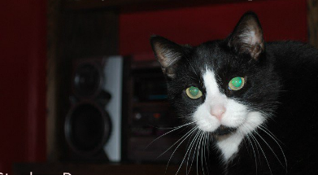
Method as Literacy
What we call ‘theory’ is just one aspect of world literacy, and not even the most important one
http://www.downes.ca/presentation/233

Slide 23
A frame for understanding new media
Morris, Derrida and a little Lao Tzu
Syntax | Cognition
Semantics | Context
Pragmatics | Change
We need this frame because (as Jukes said) if we aren’t looking for these things, we just won’t see them.

Slide 24
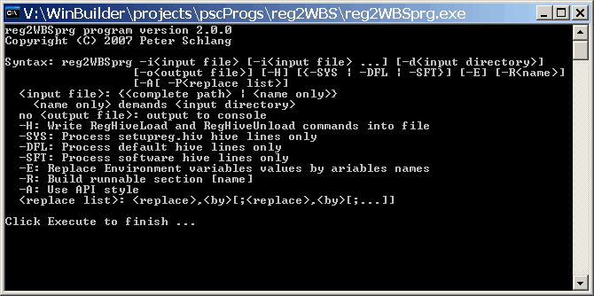
Theories / Syntax
Not just rules and grammar
Forms: archetypes? Platonic ideals?
Rules: grammar = logical syntax
Operations: procedures, motor skills
Patterns: regularities, substitutivity (eggcorns, tropes)
Similarities: Tversky - properties, etc

Slide 25
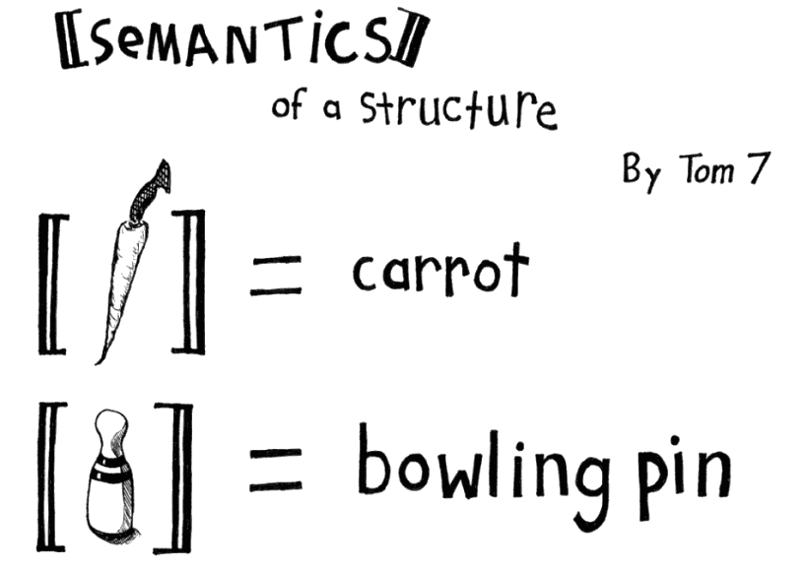
Semantics
theories of truth / meaning / purpose / goal
http://www.cs.cmu.edu/~tom7/csnotes/fall02/semantics.gif
- Sense and reference (connotation and denotation)
- Interpretation (Eg. In probability, Carnap - logical space; Reichenbach - frequency; Ramsey - wagering / strength of belief)
- Forms of association: Hebbian, contiguity, back-prop, Boltzmann
- Decisions and decision theory: voting / consensus / emergence

Slide 26
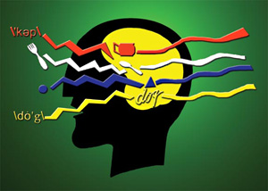
Pragmatics
use, actions, impact
Speech acts (J.L. Austin, Searle) assertives, directives, commissives, expressives, declarations (but also - harmful acts, harassment, etc)
Interrogation (Heidegger) and presupposition
Meaning (Wittgenstein - meaning is use)

Slide 27
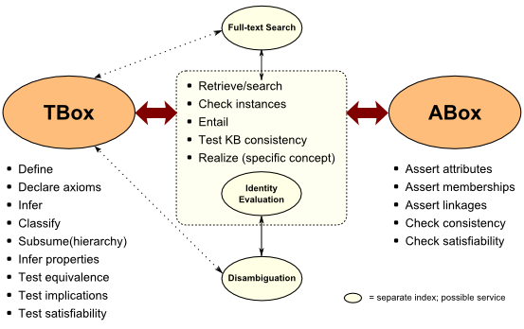
Cognition
reasoning, inference and explanation
http://www.mkbergman.com/category/description-logics/
  description - X (definite description, allegory, metaphor)
  definition - X is Y (ostensive, lexical, logical (necess. & suff conds), family resemblance - but also, identity, personal identity, etc
  argument - X therefore Y - inductive, deductive, abductive (but also: modal, probability (Bayesian), deontic (obligations), doxastic (belief), etc.)
  explanation - X because of Y (causal, statistical, chaotic/emergent)

Slide 28
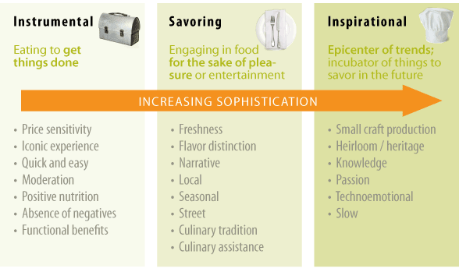
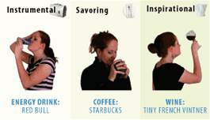
Context
placement, environment
http://www.occasionbasedmarketing.com/what-it-is
- explanation (Hanson, van Fraassen, Heidegger)
- meaning (Quine); tense - range of possibilities
- vocabulary (Derrida); ontologies, logical space
Frames (Lakoff) and worldviews

Slide 29
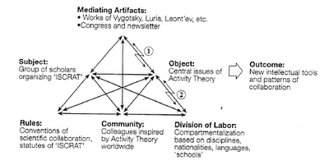
Change
relation and connection: I Ching, logical relation
flow: Hegel - historicity, directionality; McLuhan - 4 things
- progression / logic -- games, for example: quiz&points, branch-and-tree, database
- scheduling - timetabling - events; activity theory / LaaN

Slide 30
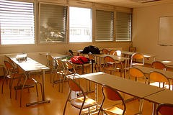
21st Century Science
Languages
http://spotlight.macfound.org/btr/entry/new_media_literacies/
The ‘skills’ described by Jenkins – performance, simulation, appropriation, etc - are actually languages and should be understood in terms of these six dimensions

Slide 31
Discovery
You don’t learn a language, you discover it
To discover a language is to be immersed in it, to speak it and listen to people speaking in it
My scientific method (if it can be called that) is to go to the office each day and immerse myself in the world – to try listening, and to try speaking

Slide 32
I am the universe of discourse

Slide 33
I’m not trying to theorize, I’m just trying to do

Slide 34
The ‘theory’ (not properly-co-called) emerges from the interactions between myself and my colleagues

Slide 35
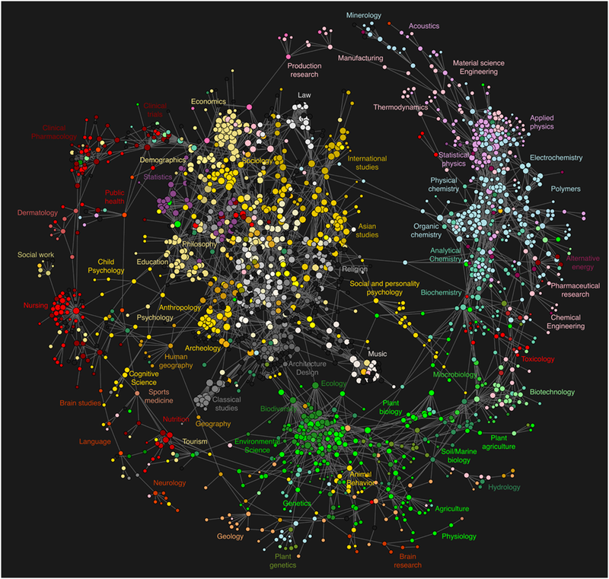
The Disunity of the Sciences

Slide 36
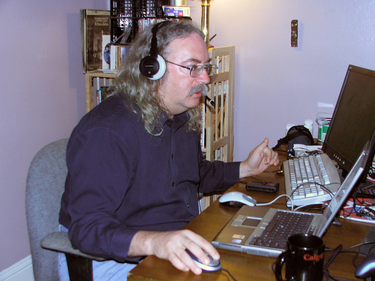
http://www.downes.ca

