Slide 1
MOOCs 4 Development
Stephen Downes
Philadelphia, April 11, 2014

Slide 2
Democratization?
- getting people into jobs, etc (India - 500 million people need employment skills)
- question of how much is a production problem and how much is a distribution problem
- how much of this economy depends on creating scarcities rather than responding to them
- issues of licensing
- 'giving knowledge for free' vs 'creating knowledge'

Slide 3
- democratic MOOCs - vs? what leads us closer to meeting needs of developing world
- & education isn't a 'delivery problem' so much as a creation problem
- we need to get away from delivering learning

Slide 4
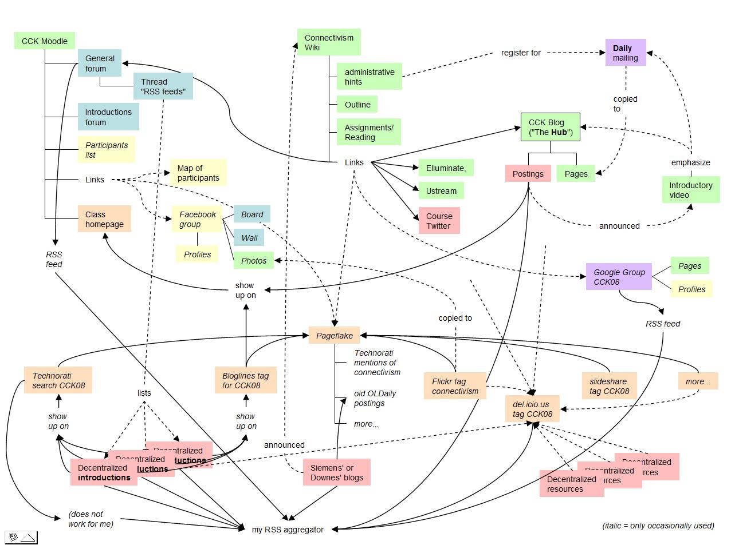
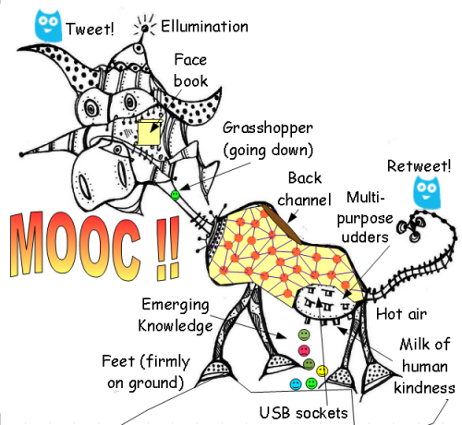
The Invention of MOOCs
Developed in 2008 in Canada
Based on network principles
  No central organizing principle or content
  Knowledge created rather than propagated
Image: Matthias Melcher
https://www.flickr.com/photos/37794987@N00/2843707657/
Image: Gordon Lockhart
http://gbl55.wordpress.com/2011/03/08/cck11-man-this-mooc-is-something-else/

Slide 5
MOOCs Defined
‘Massive’ by design
  Network design avoids bottlenecks; scaling achieved by mesh
‘Open’ as in door
  Free as in ‘beer’ and ‘libre’, Open as in ‘content’ and in ‘door’
‘Online’ as in online
  Local events encouraged, but the course isn’t offline
Course (as opposed to community)
  In the sense of ‘a course of lectures’

Slide 6
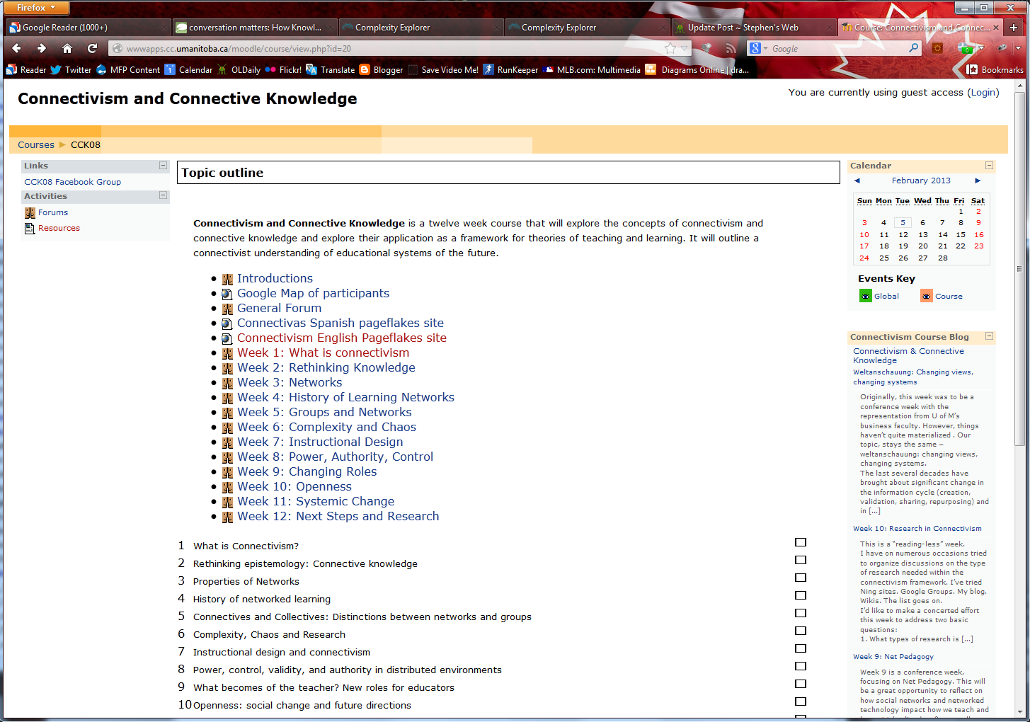
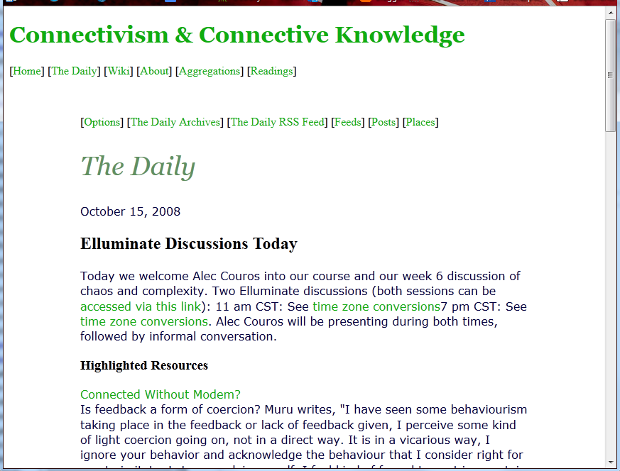
CCK08
http://wwwapps.cc.umanitoba.ca/moodle/course/view.php?id=20
2300 students
http://connect.downes.ca/cgi-bin/archive.cgi?page=thedaily.htm

Slide 7
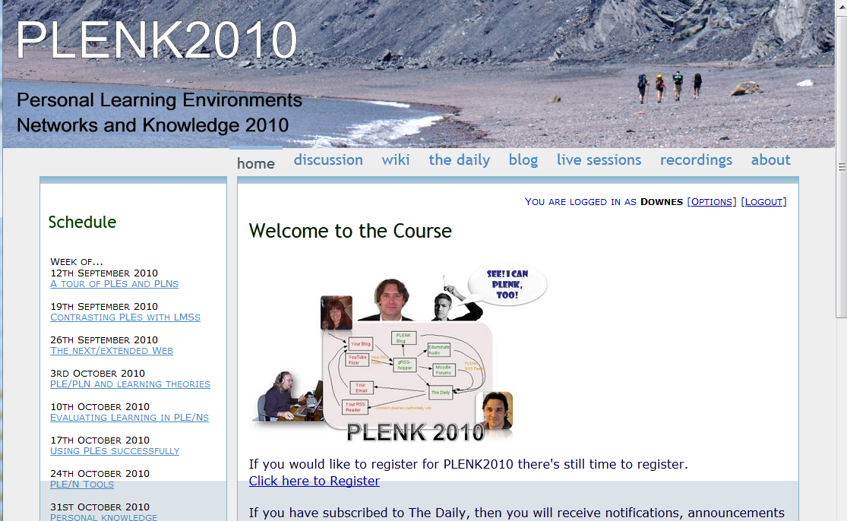

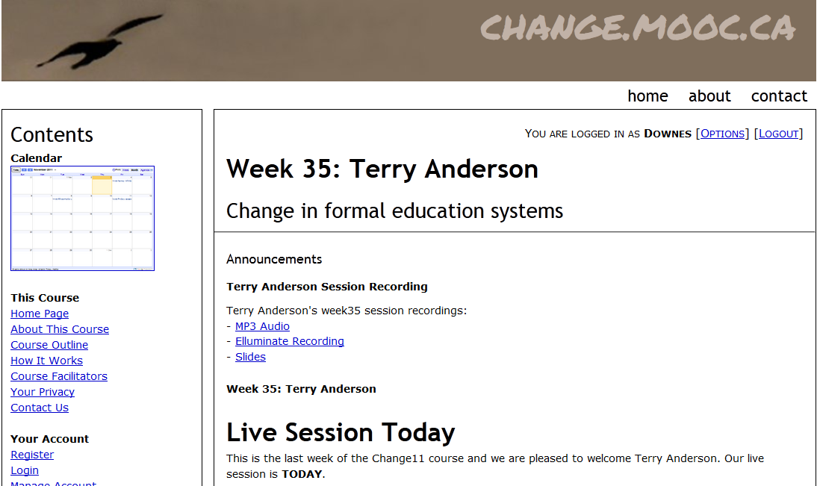
Other Courses
3000 students
http://edfuture.net/
1800 students
http://connect.downes.ca/
2800 students
http://change.mooc.ca/

Slide 8
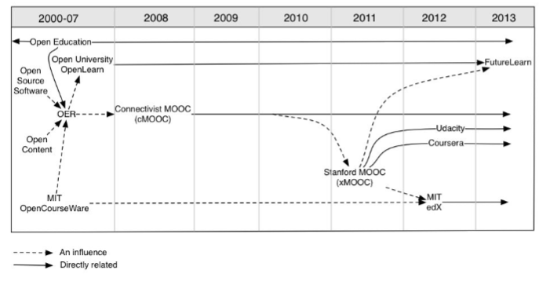
Evolution of MOOCs
http://publications.cetis.ac.uk/wp-content/uploads/2013/03/MOOCs-and-Open-Education.pdf

Slide 9
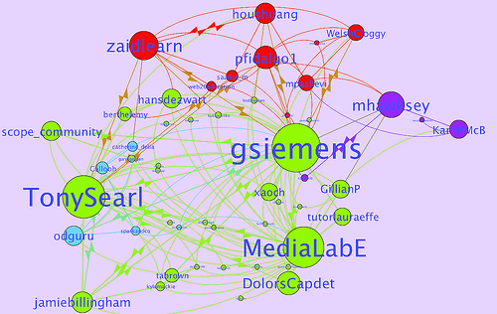
Learning Analytics
LAK11: How to measure success in a MOOC
http://scope.bccampus.ca/course/view.php?id=365

Slide 10
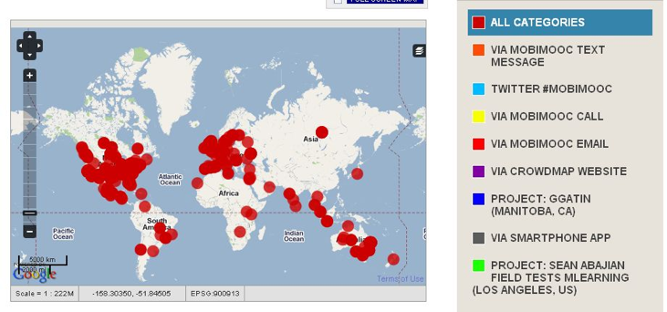
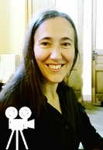
MobiMOOC
Inge de Waard
Supporting Mobile Learning Technology
http://mobimooc.wikispaces.com/

Slide 11


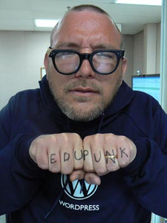

The madness and mayhem of DS106
Jim Groom
DS = Digital Storytelling
DS106 redefined activities and participation
http://ds106.us/

Slide 12
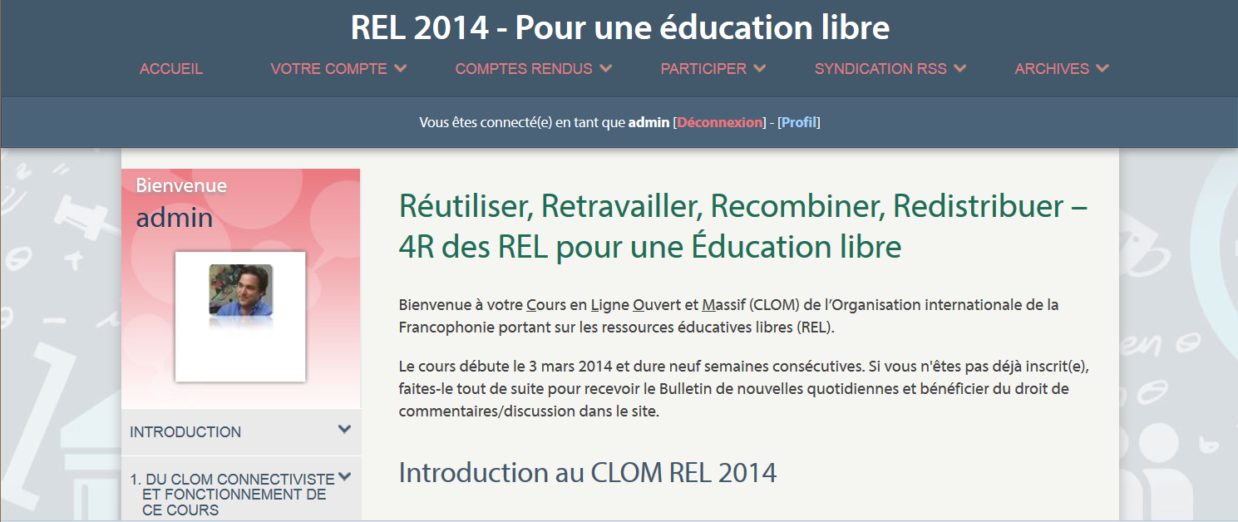
Currently
MOOC REL 2014
http://rel2014.mooc.ca

Slide 13
Design PrInciples
Autonomy - People make their own choices, select their own path
Openness - Content in and out, people can come and go
Diversity – a mosaic not a melting pot
    Overt recognition that people have multiple motives, objectives, values
    Includes but not limited to culture, language, technology, etc.
  Interactivity – knowledge that scales
    Not a ‘transmission’ model of learning
    Learning the result of growth and development

Slide 14
Future Technology
Personal learning and performance support systems
Based on network principles designed for individual interactivity
Our LPSS Program:
  Personal Learning Record – badges and beyond
  Resource Repository Network – syndication, not silos
  Personal Cloud – distributed ubiquitous computing
  Personal Learning Assistant – a projection of services into platforms
  Competency Development – smart credentials

Slide 15
Core Projects

Slide 16
Thank you
Stephen Downes
Program Leader, Learning and Performance Support Systems
National Research Council Canada
http://www.downes.ca
stephen@downes.ca Stephen.Downes@nrc-cnrc.gc.ca

