Slide 1
LPSS : Update
Stephen Downes
February 13, 2014
Learning and Performance Support Systems

Slide 2
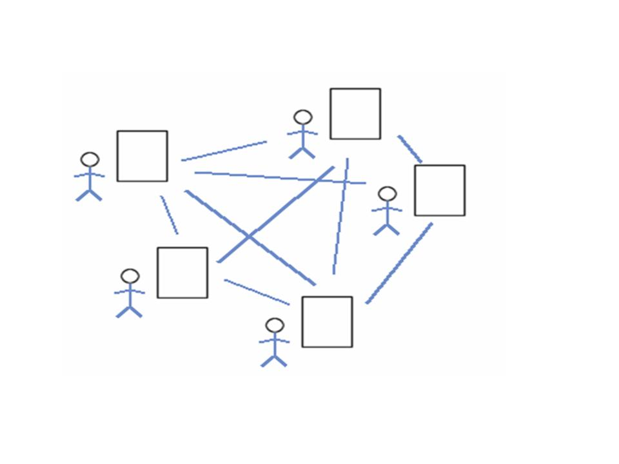
Collective Connective Intelligence
Highlights
Draft Implementation Plan has been completed and is being reviewed and revised
Most of the projects have received Sigma A-Codes
Project leaders receiving training
Program workshop scheduled for February 25-27
Program-wide use case exercise is under way

Slide 3
Projects
Resource Repository Network (RRN) – Chaouki Regoui to become interim project lead
Personal Cloud (PC) - working on project documentation, environmental scan, brainstorming on wiki
Personal Learning Record (PLR) – focus is on use cases, high-level requirements
Personal Learning Assistant (PLA) – later start date, beginning work on use cases
Automatic Competence Recognition and Development (ACDR) – Focus on automatic clustering, using sequence mining on data

Slide 4
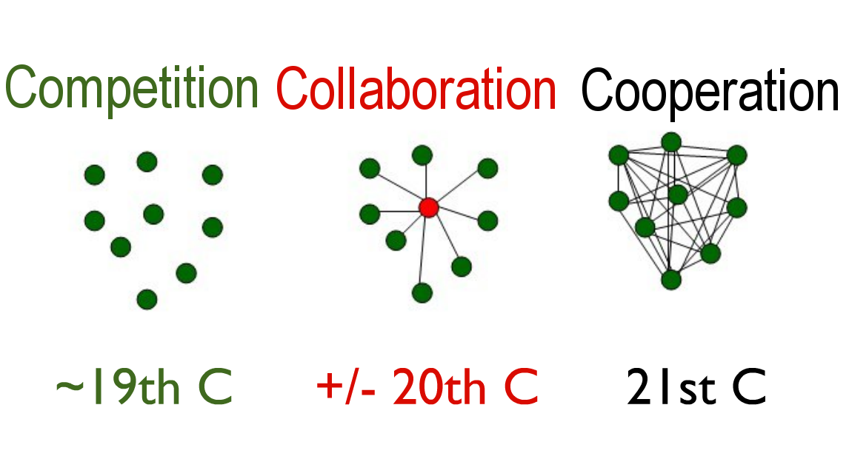
Projects (2)
Common Framework (CF) – working on use cases, developing specifications for hosted system
SSHRC – Finished; follow-up possible
MOOC-REL – site transferred to mooc.ca, gRSShopper about 70% bilingual

Slide 5
Commercialization and Implementation Projects
Meggitt – expecting statement of requirements February 21st leading to technical discussions and use cases
D2L – February 18 - Knowillage LEArning Path (LeaP) demo and discussion of NRC’s potential role
CAE – needs statement expected late February
DND/DRDC – LPSS invited to participate in ALT-WG with speaking slot in Toronto Feb 27-28

Slide 6
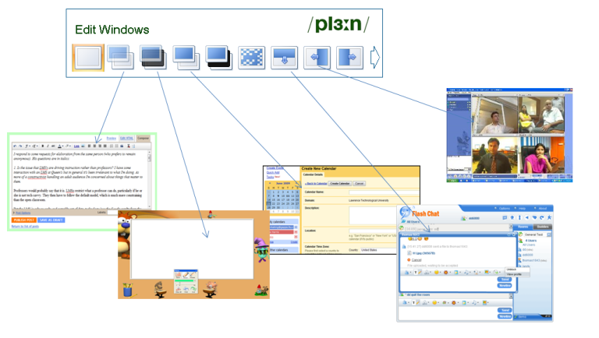
Telling the Story
Brochure / Website in Final Edits
Article in NRC’s REACH
Presentations:
  CO14 online presentation - http://www.downes.ca/presentation/335
  DND February 27-28
  Valencia March12

Slide 7


Thank you
Stephen Downes
Program Leader, LPSS
Stephen.Downes@nrc-cnrc.gc.ca stephen@downes.ca
www.nrc-cnrc.gc.ca www.downes.ca
7

