Slide 1
Open Access and Open Learning
Stephen Downes
October 22, 2013

Slide 2
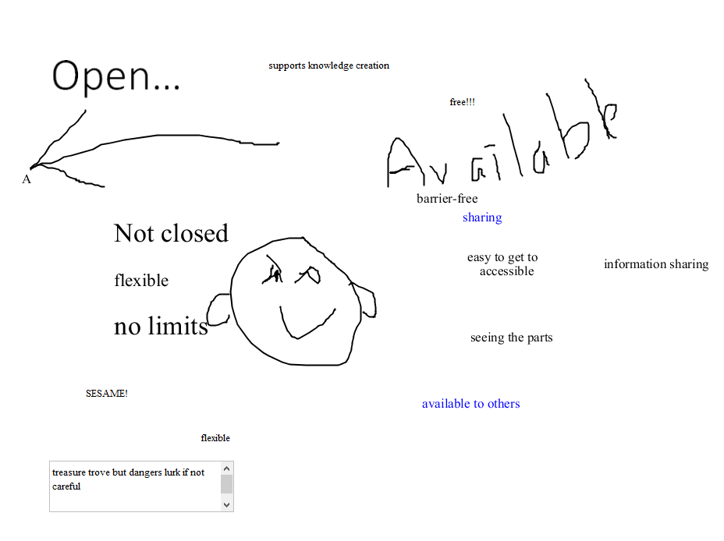
Open…

Slide 3
Open Source – GPL – Stallman’s four freedoms
OERs – UNESCO – “teaching, learning or research materials that are in the public domain or released with an intellectual property license that allows for free use, adaptation, and distribution.”
Open Archives Initiative – “interoperability standards that aim to facilitate the efficient dissemination of e-prints and other electronic content…”

Slide 4
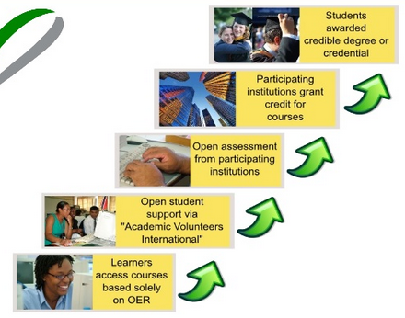
The OERu ‘Logic Model’
http://www.slideshare.net/mackiwg/oeru2011-11meetinginputs

Slide 5
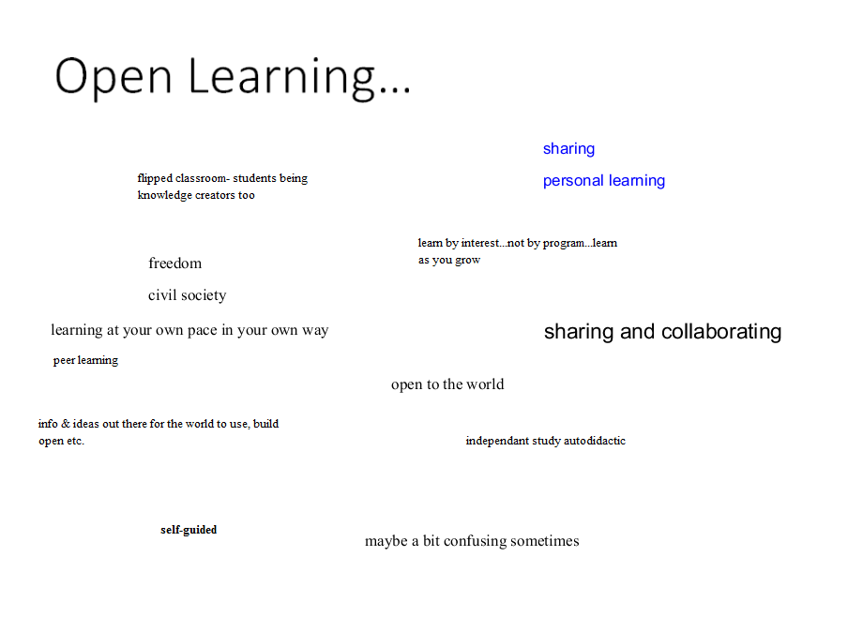
Open Learning…

Slide 6
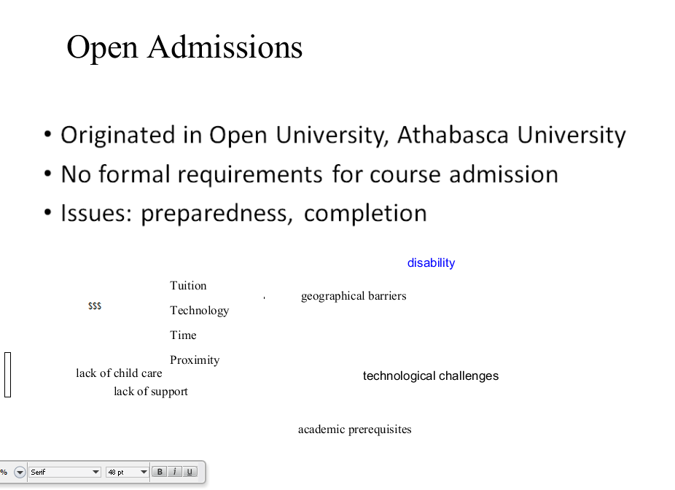
Originated in Open University, Athabasca University
No formal requirements for course admission
Issues: preparedness, completion

Slide 7
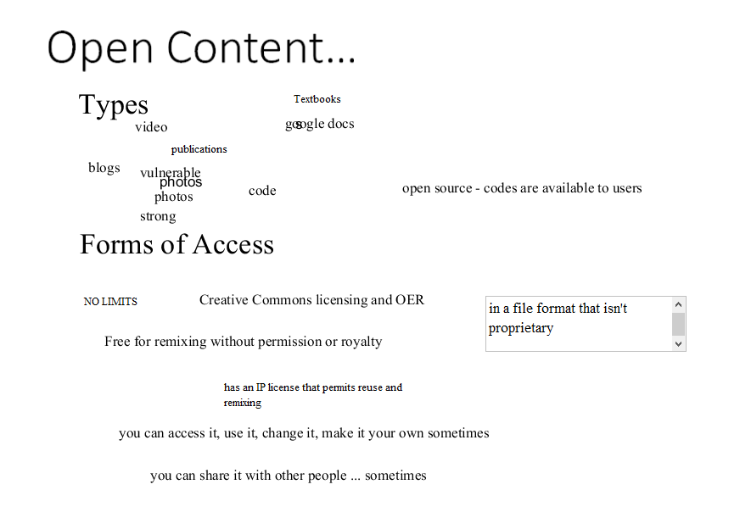
Open Content…

Slide 8
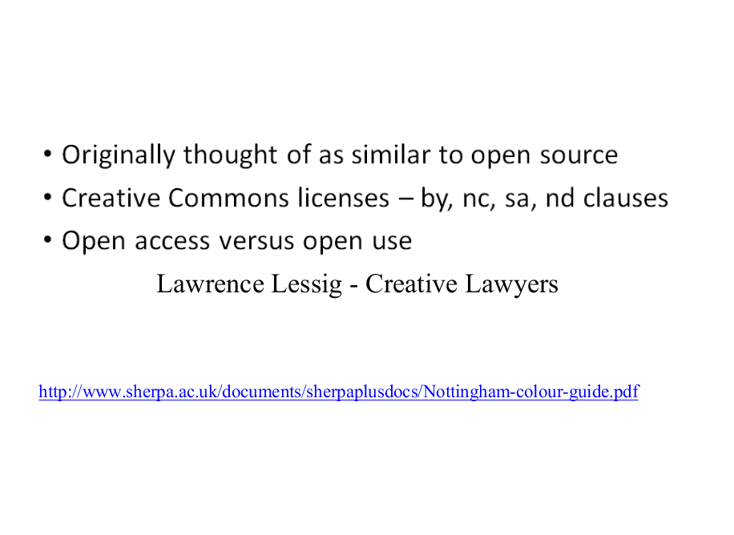
Originally thought of as similar to open source
Creative Commons licenses – by, nc, sa, nd clauses
Open access versus open use

Slide 9
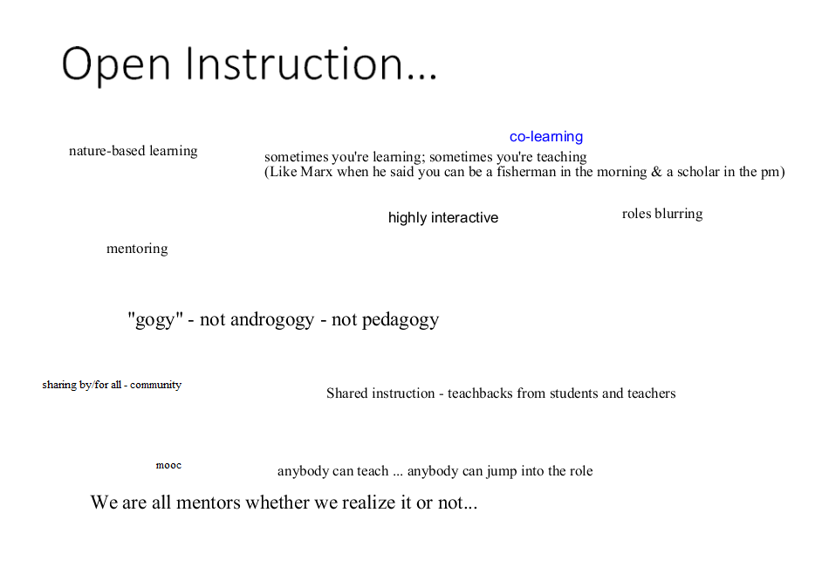
Open Instruction…

Slide 10
Early open instruction – the Couros course, the Wiley Wiki
MOOCs as open instruction
Elements of open instruction:
  Resources
  Lectures
  Activities and projects

Slide 11
Open Design…

Slide 12
‘Learning Design’ = the organization and structure of a course – eg., IMS LD
Open design – enabling participants to create their own organization and structure
  Example: touring a city vs being taken on a tour
  The course as ‘environment’ rather than ‘book’
Open design in MOOCs

Slide 13
Open Assessment

Slide 14
What is assessment?
The paucity of ‘learning contracts’
Assessment - criteria and metrics
  Content based – formal learning
  Task based – informal learning
“You decide what counts as success”

Slide 15
Open Credentials

Slide 16
The argument for closed credentials
Badges?
‘You are what you do’
  Privacy and security considerations

Slide 17
Stephen Downes
http://www.downes.ca

