Slide 1

What Are Cultures of Learning?
Stephen Downes
ALT-C, Nottingham, UK
12 September 2013

Slide 2
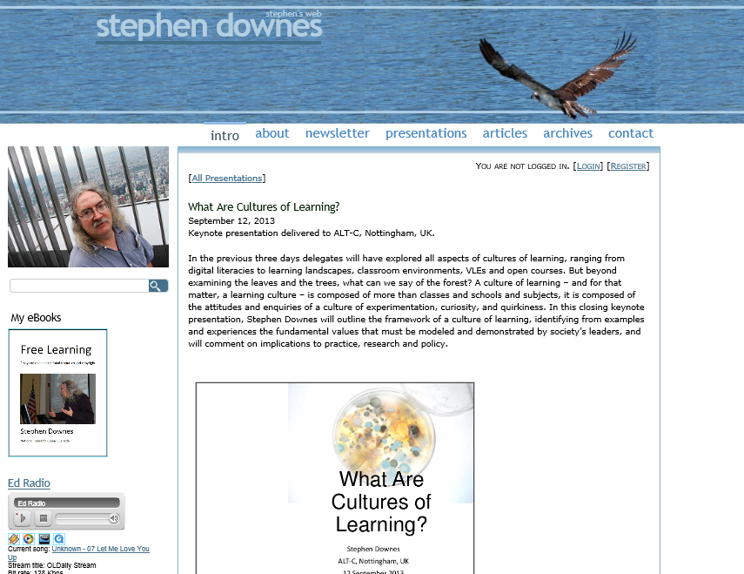
Presentation page:
http://www.downes.ca/presentation/326

Slide 3
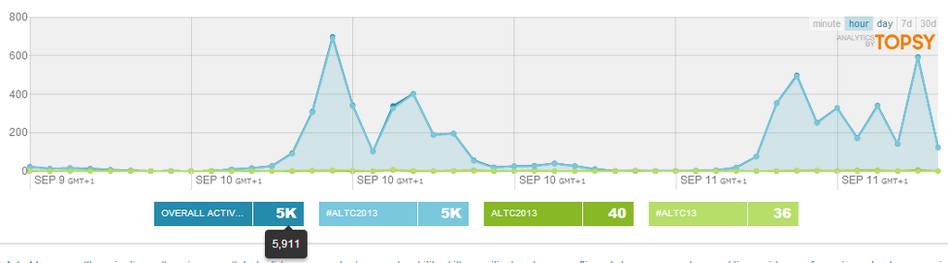
Backchannel
www.downes.ca/chat
- or -
Tweet with #altc2013

Slide 4

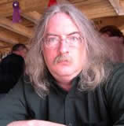

Exploring the frontiers of e-learning - borders, outposts and migration
http://www.alt.ac.uk/altc2005/

Slide 5
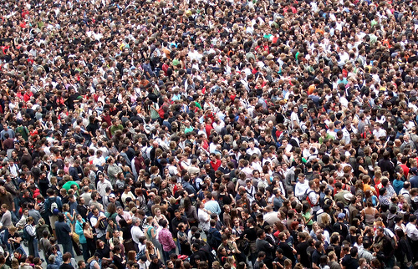
How many of you would be here if you were not being paid by your employer?

Slide 6
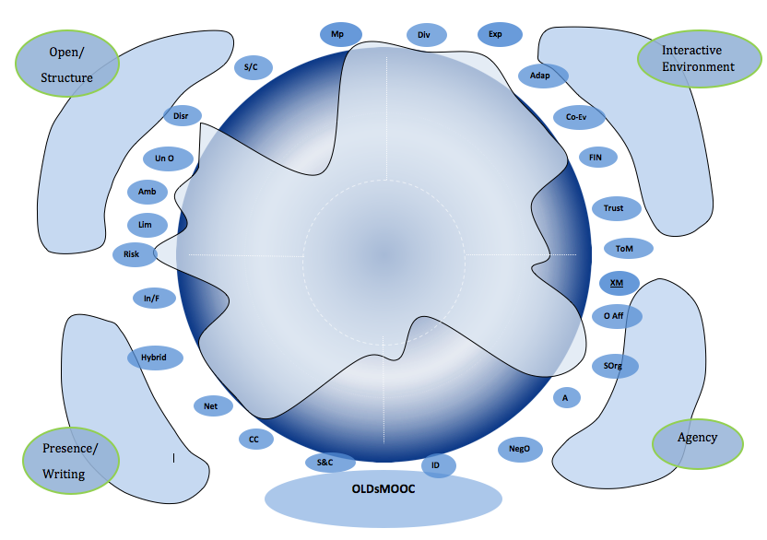
‘Collaboration is the joining together of things that do not naturally want to be joined’, which drew audible sucking in of breath from the audience. (Mackness)
http://jennymackness.wordpress.com/2013/09/03/alt-c-2013-learning-in-the-open/

Slide 7
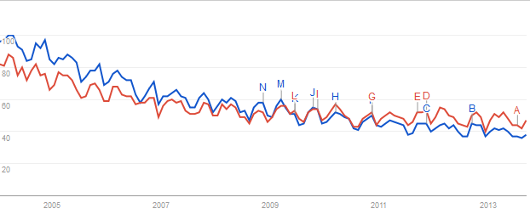
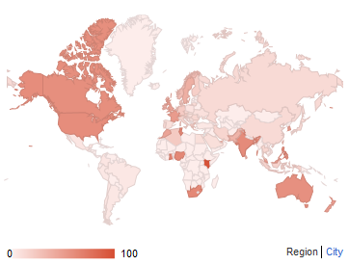
Collaboration

Slide 8
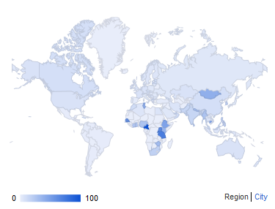
Cooperation

Slide 9
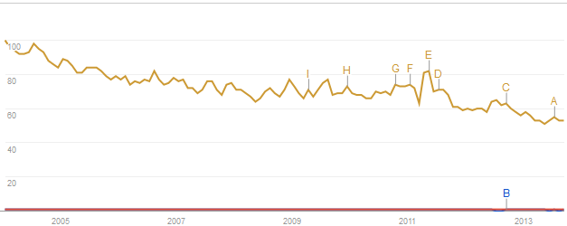
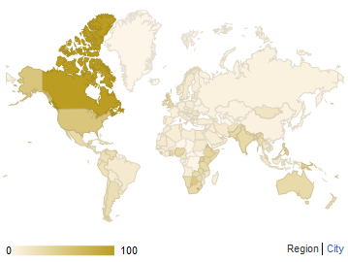
Network
http://www.google.com/trends/explore#geo&q=cooperation,++collaboration,+network&cmpt=q

Slide 10
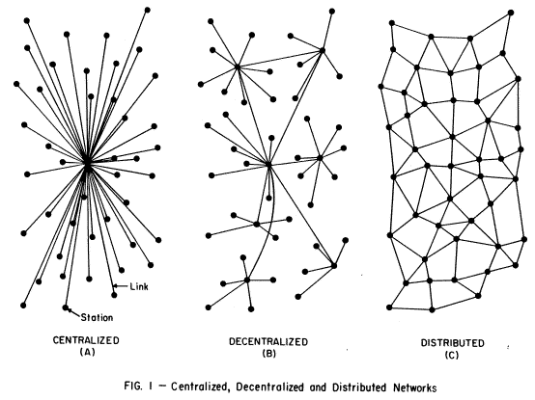
Progression of Networks

Slide 11
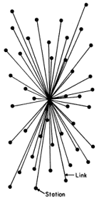
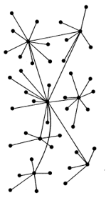
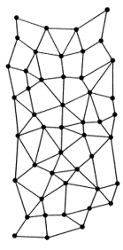

Types of Network
Collaborative
Cooperative
Competitive

Slide 12
Learning Cultures?
In the previous three days you have explored all aspects of cultures of learning, ranging from digital literacies to learning landscapes, classroom environments, VLEs and open courses.

Slide 13
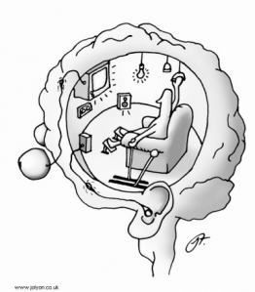
‘Building New Cultures of Learning’ ???
Ryle – category errors – the mistaking of a compositional property for an emergent property
http://criticalscience.com/consciousness-meditation-phenomenology-neuroscience.html

Slide 14
Learning Cultures?
In the previous three days you have explored all aspects of cultures of learning, ranging from digital literacies to learning landscapes, classroom environments, VLEs and open courses.

Slide 15
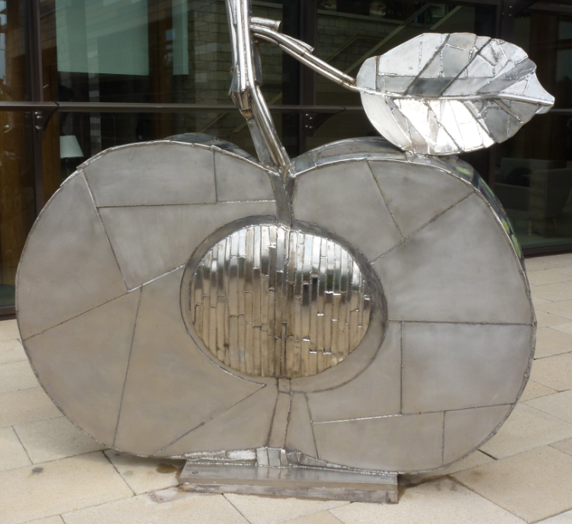
But beyond examining the leaves and the trees, what can we say of the forest?

Slide 16
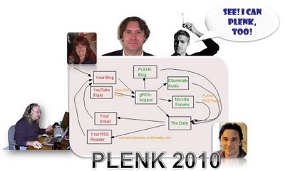
The MOOC
aka. Our effort to actually demonstrate the principles of learning we were talking about

Slide 17
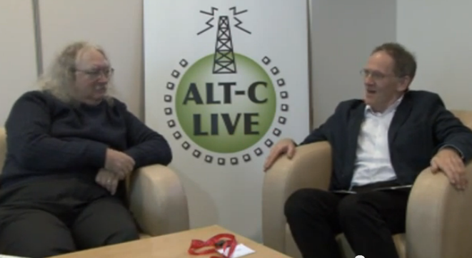
Talking With Seb
Example – 7 million students need math remediation
Would a MOOC be the answer? To the subset that is actively looking for the course
What about the rest?
http://www.youtube.com/watch?v=cJWLxoUnIY0&list=UUAF9f1EcwVDM0_QkkAjeN3g

Slide 18
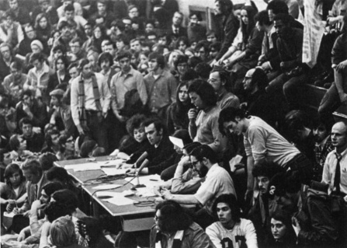
Change
"The notion of students as change agents is a relatively new concept." -- Malcom Ryan
http://www.buffalo.edu/news/releases/2013/04/029.html

Slide 19
Rachel Winston
Learning culture: students should be active participants in the learning process.
In the bulk of literature, student participation means making selections based on time and effort
Instead: involve and empower students in shaping the learning environment

Slide 20
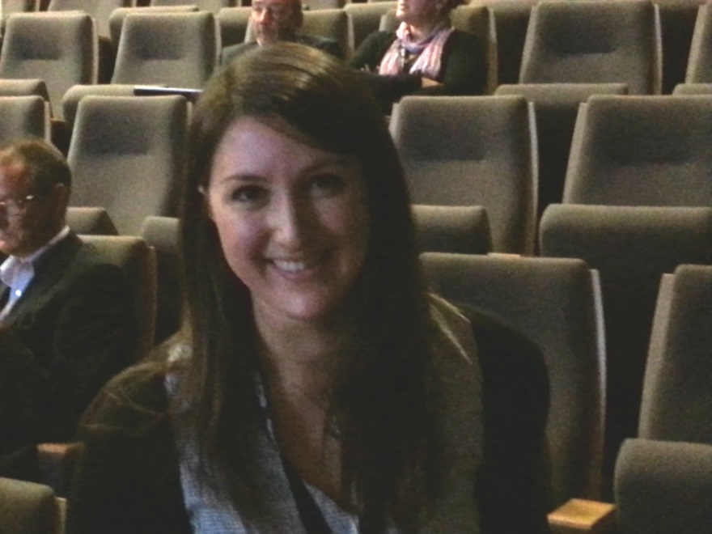
Why define engagement this way?
- because it's the right thing to do?
- offering an alternative to the consumer model of education (which reduces complex interactions to mere transactions)

Slide 21
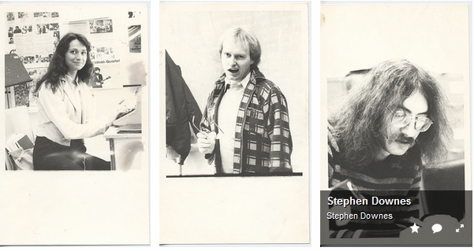
Rachel Winston (cont)
What does partnership look like?
- Just as academics are critical, and act to change things active students can do this too
- when that student graduates, she takes that ethos of responsibility into the wider world

Slide 22
A Culture of Learning
A culture of learning – and for that matter, a learning culture – is composed of more than classes and schools and subjects.
It is composed of the attitudes and enquiries of a culture of experimentation, curiosity, and quirkiness.

Slide 23

SooperMOOC
Google said yesterday that it will develop software for edX…

Slide 24

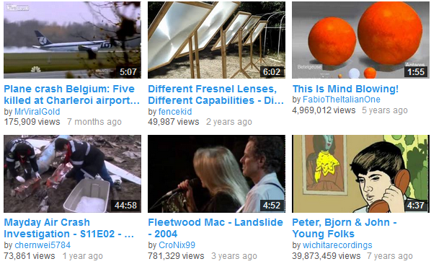
…EdX, a nonprofit created by Harvard and MIT that solicits and distributes online courses for free... the idea is to spur development of so-called massive online open courses, building what edX's president told Slate could become 'a YouTube for MOOCs.

Slide 25
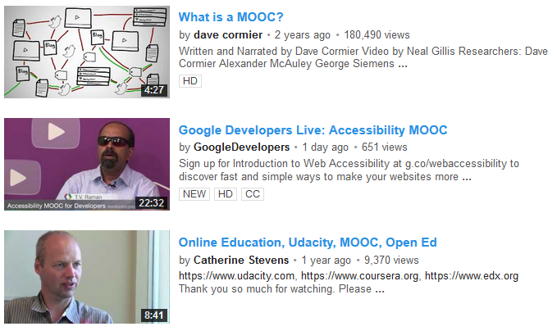
The danger for them is that MOOCs will be:
something that don't really resemble videos, and instead resemble RSS readers, and
something created by learners for each other, rather than by publishers to be sold as consumables

Slide 26
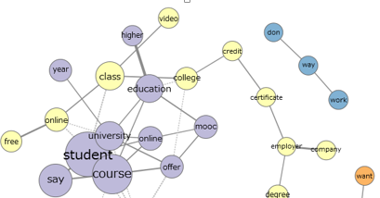
David Kernohan
"Open was the first organ that we lost. From a nuanced and specific position in the world of the open educational resource, it is a word reduced to a synonym for two senses of free..."
http://followersoftheapocalyp.se/education_is_broken/

Slide 27
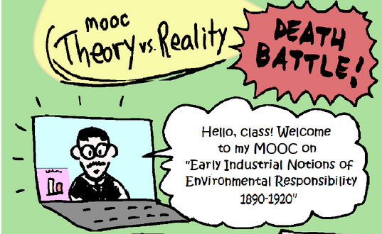
The Failure of MOOCs?

Slide 28
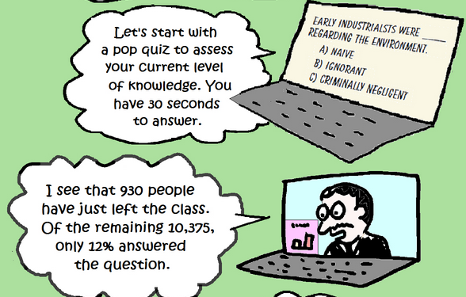
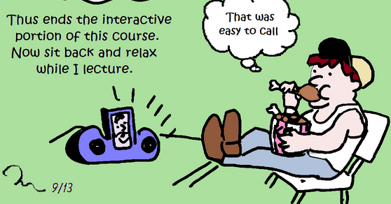
http://edreach.us/2013/09/06/mooc-death-battle-theory-vs-reality/

Slide 29
John Clayton
The 'deficit model' approach - "you are lacking and I will bring you up to speed" - is essentially a broadcast model, *vs*
Empowerment model - based on learner reflection and decision-making on what *they* want to learn
We say we do this, but then we don't allow this to occur..

Slide 30
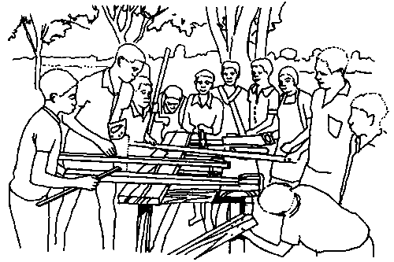
Why Do MOOCs Fail?
Because they’re courses
Because they try to do something formal in an environment that is essentially informal
http://www.nzdl.org/

Slide 31
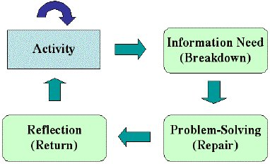
Formal / Informal
Formal: dedicated to obtaining or acquiring a base of knowledge
Informal: dedicated to the completion of some task or activity
http://shell5.tdl.com/~jaycross/metalearn/elf_presentation/

Slide 32
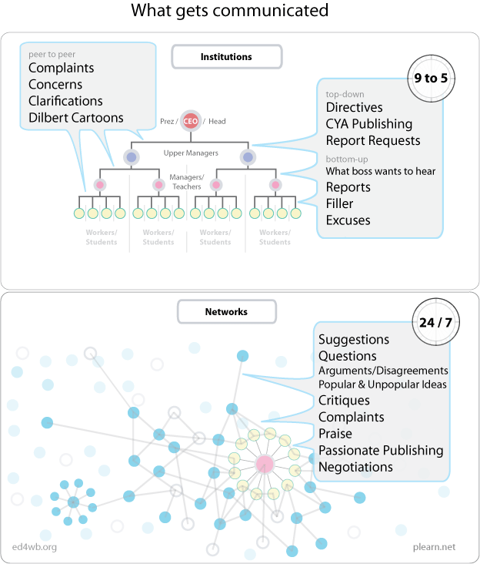
http://www.plearn.net/

Slide 33
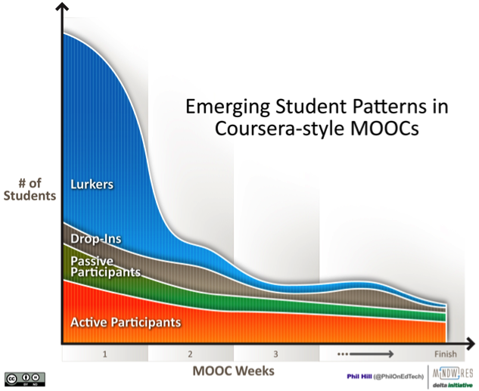
Participation Rates
Phil Hill http://mfeldstein.com/emerging_student_patterns_in_moocs_graphical_view/

Slide 34

Courses vs….
Anderson: It may be best to conceptualize MOOCs as learning resources (much as a library) that learners can use in very many different ways, with equally diverse learning outcomes.
http://terrya.edublogs.org/2013/06/24/moocs-and-distance-education-institutions/#_ENREF_12

Slide 35
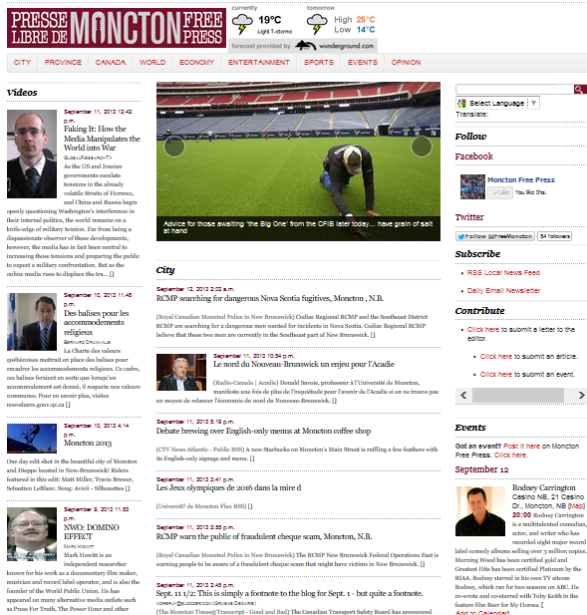
http://monctonfreepress.ca

Slide 36

Browsing
Compare a MOOC with a newspaper – or with a …?
Self-organization = exactly the mechanism by which individuals make decisions, iterated

Slide 37
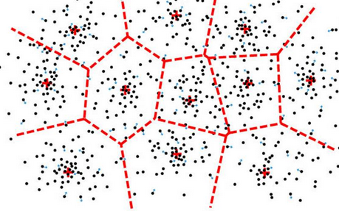
Emergence
Roy Williams and Jenny Mackness
we're looking at emergence....
self-organizing = independent, adaptive, unpredictable
when you start self-organizing your learning, emergence and emergent learning will occur
http://claytonfaulkner.com/tag/new/

Slide 38
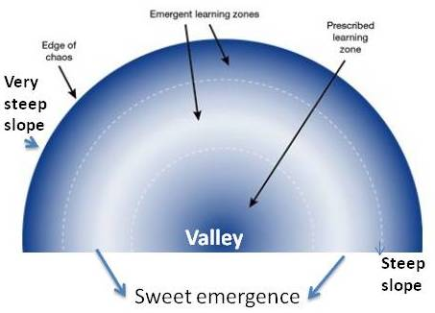
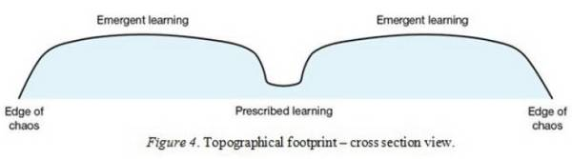
Describing Emergence
http://helistudies.edublogs.org/2013/08/28/emergent-learning-as-a-landscape/

Slide 39

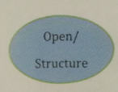
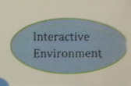
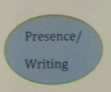

Alt-C Style

Slide 40
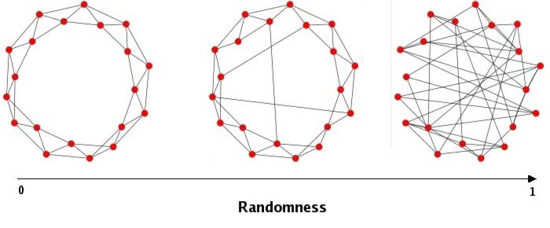
Order and Chaos

Slide 41
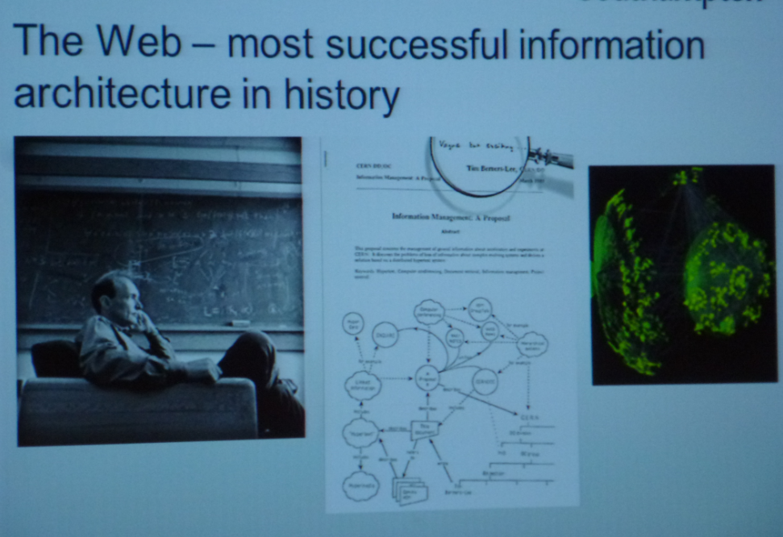
Wendy Hall

Slide 42
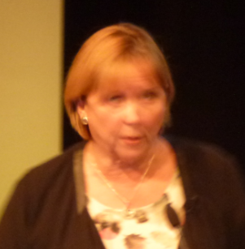
Why the Web Won
big is beautiful – one network prevails – think Facebook
scruffy works: let the links fail to make it scale
democracy rules: open, free and universal
but we lost (for a time) conceptual and contextual - the semantic web

Slide 43

Decentralization
Why do MOOC forums fail?
"Ironically, the biggest obstacle preventing MOOC students from forming relationships is the feature most relied on to encourage them."
http://acreelman.blogspot.co.uk/2013/09/the-silent-majority-why-are-mooc-forums.html
http://campustechnology.com/Articles/2013/09/03/Building-a-Sense-of-Community-in-MOOCs.aspx

Slide 44

Decentralization
"online learning is bad because I can't ask questions when I get stuck“ (Rob Farmer & Kate Littlemore)

Slide 45
Experiences…
delivery: daily maintenance, intro week (which was the busiest), after that it was largely self-running (Angie Clonan & Luke Miller)
the style we adopt as tutors/facilitators shapes the length and tone of students postings (so be careful how you model things) (Helen Whitehead)

Slide 46
More Experiences…
the reaction of business people to student interviewers was very different than to staff (Roger Henry)
change in value proposition - questioning the value of higher ed, driven by enormous costs to attend (Larry Reagan) – analogous to buying a large house in case you are going to have a family

Slide 47

New Models, New Approaches

Slide 48
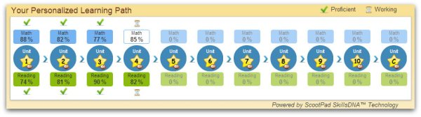
Personalized…
Adaptive path
Custom selection, etc etc

Slide 49
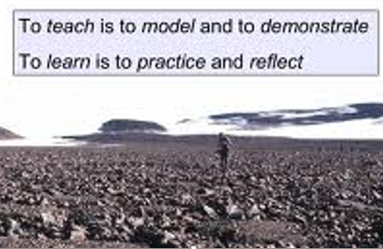
Personal…
Sharing experience vs describing and telling…

Slide 50
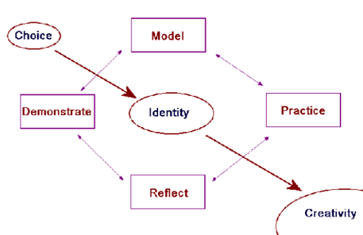
Learning Environment

Slide 51
Evaluating Outcomes
What is success in a MOOC – can only be observed from outside the MOOC
model of emergent knowledge that develops inside the MOOC
did it take shape, replicate or influence the world outside (was the MOOC an agent of change?)

Slide 52
Being Open
Brian Lamb: We share a dedication to working in ways that exploit network effects to inform, amplify and augment our practice. We share what we do because it feels good, because it makes what we do better, because it represents a human-scale way of being, one with global reach.
http://abject.ca/open-for-business/

Slide 53
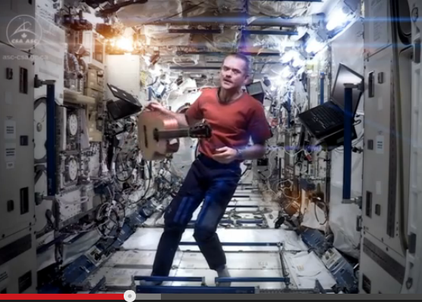
What Difference Will MOOCs Make?
http://www.youtube.com/watch?v=KaOC9danxNo
http://www.youtube.com/watch?v=KaOC9danxNo
https://twitter.com/Cmdr_Hadfield

Slide 54

What Are Cultures of Learning?
What we do, what we model, what we share, what we create…

Slide 55
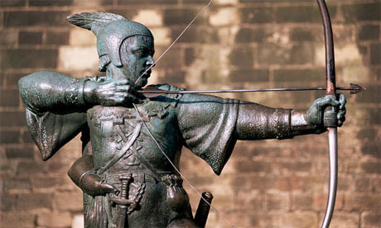
Stephen Downes
http://www.downes.ca

