Slide 1
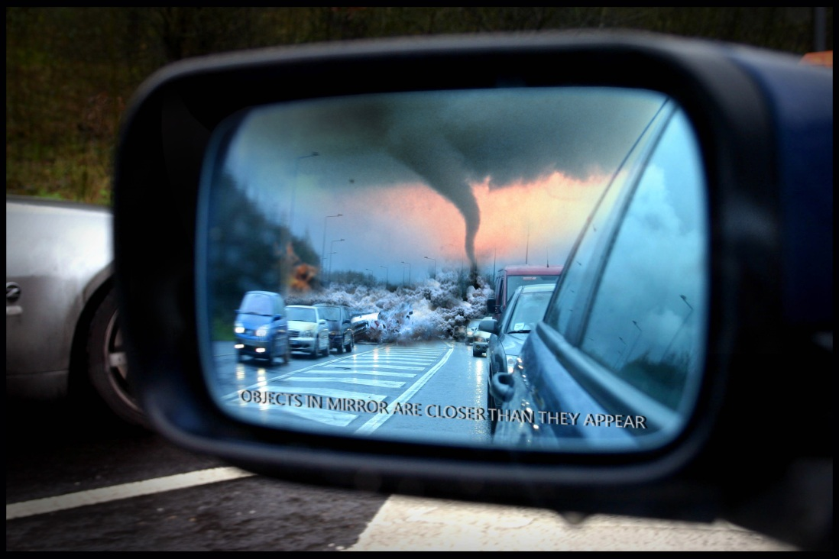
Through the MOOC Darkly:
Reflections on Life, Learning and the Future of Education
Stephen Downes
Presentation for the Saylor Foundation
24 July 2013

Slide 2
Who I am…
  The philosopher
  The journalist
  The technologist
  The educator

Slide 3
Learning has a lot in common with growing up
    Love never fails. But where there are prophecies, they will cease; where there are tongues, they will be stilled; where there is knowledge, it will pass away. For we know in part and we prophesy in part, but when completeness comes, what is in part disappears. When I was a child, I talked like a child, I thought like a child, I reasoned like a child. When I became a man, I put the ways of childhood behind me. For now we see only a reflection as in a mirror; then we shall see face to face. Now I know in part; then I shall know fully, even as I am fully known. – 1 Corinthians 13

Slide 4
Future of Education/Higher Education
  Understanding the value proposition
    Learning / Content / Job Training
    Socialization / Networking / Identity
      → more and more the first is morphing into the second as we begin to understand what learning actually is (ie., not just remembering a set of facts)

Slide 5
Thoughts on Free Online Courses/MOOCs
  it’s not just replacing one kind of course with a diff kind of course
  Problems with the course model in general
    & especially with the idea that we can shortcut the learning process through structured presentations of information
  The ‘MOOC out of water’ phenomenon – you have these students flip-flopping on the MOOC shore, gasping for air

Slide 6
Open Ed Overview
  - Varieties of openness
    Free learning – no cost, no limits
    Open Learning – a la OU or AU – no entrance barriers
    Open access – the fundamental openness
      Access not just to content, but to the community itself (ie the second half of the value proposition)
    Open assessment
    Open credentials - badges

Slide 7
Tech innovations
  wither the MOOC
  personal learning in a cloud world
  assessing the person, not the memorization

Slide 8
Your favorite topic of the day
  Yes, everybody needs a job & needs to eat, but
  It’s not about jobs and the economy
    These won’t be addressed through education
    Fundamental issues of fairness need to be addressed
  Who speaks for us? Who speaks for earth?

