Slide 1
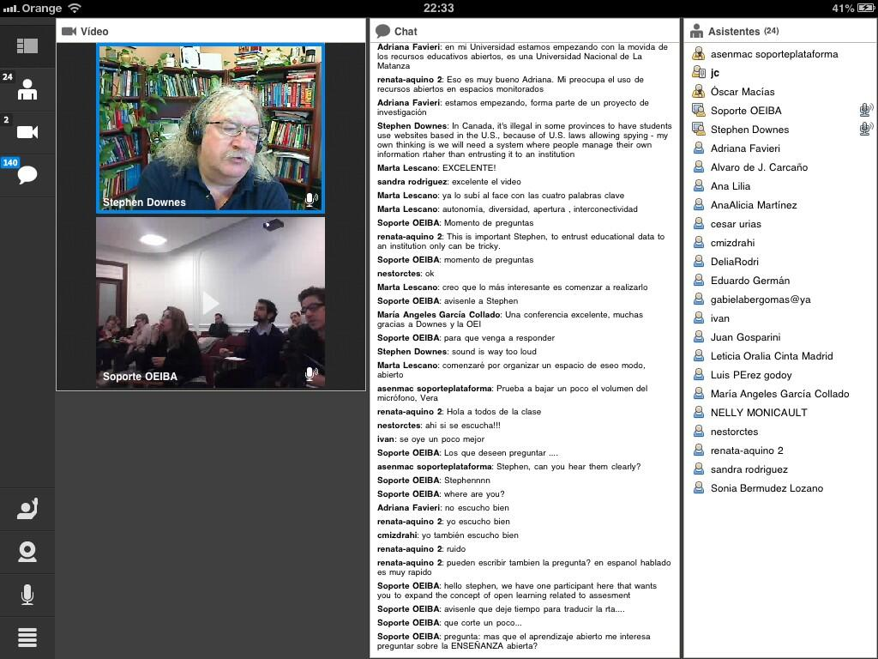
The Semantic Condition: Connectivism and Open Learning
Stephen Downes
July 10, 2013

Slide 2
The principles of connectivism - autonomy, diversity, openness and connectedness in practice.
“Our findings suggest that these might all be achievable in a complex learning network, but in a course (as opposed to a network), particularly a massive open online course, they can be compromised.”
Jenny Mackness, Sui Fai John Mak, Roy Williams
http://eprints.port.ac.uk/5605/1/The_Ideals_and_Realilty_of_Participating_in_a_MOOC.pdf

Slide 3
Autonomy

Slide 4
Factors affecting mental states
Empirical, cognitive, psychological
http://halfanhour.blogspot.com/2010/11/model-of-autonomy.html

Slide 5
Capacity to act on mental states
Physical, social, structural, resources

Slide 6
Scope and range of autonomous behaviour
Expression, association, selection, method…

Slide 7
Effects of autonomous behaviour
Impact, improvement

Slide 8
From the study…
Autonomy was equated to flexibility and control over learning and exemplified by the participants’ choices of how, and how much, to engage with the course.
“Thanks to the learner autonomy I thought would be provided in the course, I started following the course. If it would have been a more rigid structure, I would not have done so (due to time/work schedule reasons). “
“We had a lot of autonomy because we could basically do what we wanted; participate fully for credit, fully for no credit or on the varying scale of ‘partial participation’. “

Slide 9
However learners new to the environment and concepts lacked confidence and preferred structure, guidance and even intervention to autonomy.
Autonomy was less important when I needed full instructions
I felt like some guidance would have helped. Freedom is great, but this course was all over the place. There was no one place to follow the latest thinking on any one subject.

Slide 10
It was also found that autonomy was equated with lack of assessment and that learner autonomy can be difficult for the course instructors.
I loved the freedom to work outside assessment guidelines – choose what I wanted to focus on.
Learner control is not without frustration for the instructor. I recall feeling a bit frustrated that the concept of connectivism that I was trying to communicate - the neural, conceptual, and social/external dimensions of networked learning – was not resonating with participants.

Slide 11
Discussion of Autonomy
not all CCK08 participants wanted the level of autonomy offered – the ‘expertise divide’
it does require learners to embrace independent learning.
autonomy is, paradoxically, jeopardised in the absence of constraints
‘An agent's authority over her actions is no guarantee that she has the power to determine how she exercises this authority’. (Buss, 2008)

Slide 12
Diversity

Slide 13
Composition
Many types of entities
http://lemire.me/fr/abstracts/DIVERSITY2008.html
http://www.huffingtonpost.com/stephen-downes/democratizing-education_b_794925.html

Slide 14
Intention
Different goals, desires (Mill)

Slide 15
Perspective
Uniqueness of point of view, language

Slide 16
Mathematics of diversity
Multiple inputs produce mesh networks

Slide 17
Putnam, Florida, and the rest of it
Homophily and associationism
http://www.downes.ca/post/53544
http://profesorbaker.wordpress.com/2011/01/30/homophily-and-heterophily-what-fires-together-wires-together-cck11/

Slide 18
Teaching what we have in common instead of our differences? No
http://secondlanguagewriting.com/explorations/Archives/2007/August/TheDownsideofDiversity.html

Slide 19
From the Study
Diversity was ensured by the large numbers enrolled on CCK08 from all over the world.
Different nationalities, cultures, ages and backgrounds were very much in evidence on the course.
Diversity was also reflected in the learning preferences, individual needs and choices expressed by interview respondents.

Slide 20
little support for the hugely diverse group of participants, some of whom did not necessarily have all the skills or disposition needed to learn successfully, or to become autonomous learners
CCK08 was designed on the principles of an open network, with minimum instructor intervention. The complex diversity and minimal moderation were difficult to reconcile
in a MOOC diversity needs to be managed, which paradoxically, adds another layer of constraint on autonomy.

Slide 21
Openness

Slide 22
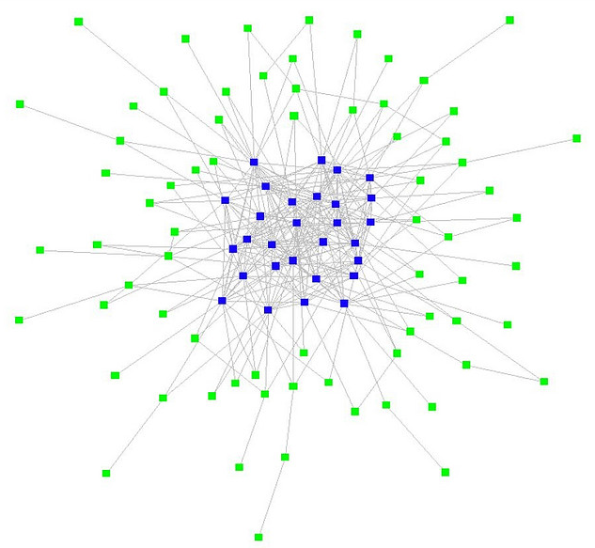
Open education
Open content, teaching, assessment
Stages of openness and terminal path
http://www.downes.ca/presentation/271
http://www.flickr.com/photos/ross/2916958593/

Slide 23
Open networks
Clustering instead of grouping

Slide 24
Flow
Input, output, feedback
plasticity

Slide 25
CCK08 was an open course: there were no entry requirements and
it was free to any interested non-credit participant. Credit participants paid a fee.
Numbers were not limited.

Slide 26
assumption in the course was that participants would be willing or ready to give and receive information, knowledge, opinions and ideas; in other words to share freely.
‘Openness’ within the Open Source (OS) community is usually interpreted similarly: i.e. ‘free’, as in beer; ‘free’ as in liberty, or speech; and there is an additional sense of ‘free’ as in transparent, and therefore shared.

Slide 27
In CCK08 active participation and interaction was only sustained by a small percentage (14%) of the total number of participants. The remaining 86% had probably either dropped out of the course or were ‘lurking’. There are at least two possible explanations:
they were getting a free ride (free as in ‘beer’), or
they were demonstrating ‘novice’ behaviour; many novices ‘lurk’ until they feel confident enough to expose their views in ‘public’ forums.
The differences in the responses of interview respondents suggested that there was no common understanding of openness as a characteristic of connectivism.

Slide 28
Open Educational Resources
OERs enable people to pursue their own personal interests in their own way
But, more importantly, OERs become the medium of communication
We need to view OERs, not as resources created by publishers at great cost, but as created by learners to interact with each other
The role of professionals and publishers becomes the production of ‘seed OERs’

Slide 29
Interactivity

Slide 30

Influence vs emergence
Thought-bubbles – “we perceive wholes where there are only holes”
http://www.downes.ca/post/55001
http://connect.downes.ca/post/44222

Slide 31
‘Scope’ vs ‘Level’
http://www.downes.ca/post/42066

Slide 32
Ontology of emergence
Ontological (real) vs perceptual (recognized)

Slide 33
Connection to complexity & chaos

Slide 34
As commented by one of the instructors, ‘My main goal was to connect with other learners’. The other instructor puts it slightly differently:
I don't consider either 'making connections' or 'theoretical conceptual framework' to be the essence of connectivism. As I have stated many times, knowledge is pattern recognition; learning is becoming able to recognize patterns. (CI)
In other words, connectivity is not an end, but a means: this shifts the gist of learning theory away from connectivity per se to pattern recognition.

Slide 35
Wide range of possible connections. As one participant noted,
I connected through e-mail ….. a few times – back and forth (that was very good)……I connected to the course learners by texting on these live and audio/text streams. I responded to blogs – at least twenty posts in different CCK08 blogs from other students. I responded to many of the introductions in the Forum …..These nodes of connectivism were meaningful places for me, even if temporary connections only. (NCP)

Slide 36
Whilst connectedness was afforded by technology, it did not necessarily ensure interaction. As Siemens (2009c) says, ‘The question for me is not ‘how are people connected?’ but rather ‘what are the implications of people being connected in a certain way?’ … Frequency of contact isn’t that important to me’. There were some significant barriers to interaction and connectedness:
Interaction was key to the experience for me…[I] would like to add that the two barriers to participation on the forums IMHO were X’s appalling behaviour and XX’s patronising and ‘teachery’ posts and actions ….. (who knows how many timid people or those whose first language is not English we lost). (NCP)

Slide 37
Other barriers to connectedness and interactivity:
were the quality of personal connections (‘I was fed up with tittle tattle, bad behaviour, trolling … so did not need the connection socially’)
levels of expertise. The expertise divide is critical in all online learning and can effectively undermine openness, connectedness and interactivity, e.g. ‘The reason I stopped is because I cannot understand the issues being discussed anymore’

Slide 38
The more open the course, the more this becomes a dilemma for the course designers. These quotes reveal that the dynamics of connectivism are perceived as both enablers and inhibitors for learning in a massive open online course designed on the basis of these principles alone.

Slide 39
Stephen Downes
http://www.downes.ca

