Slide 1
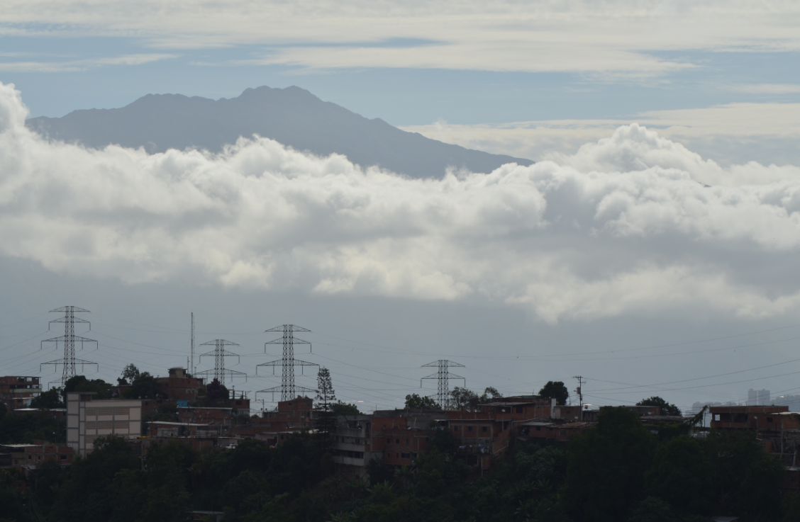
Free Learning and the Wealth of Nations
Stephen Downes
Caracas, Venezuela
June 28, 2013

Slide 2
There are two sides to the learning equation; this presentation is focused on teaching
Open Courses
MOOC
(gRSShopper)
Model and demonstrate
Practice and reflect
PLE
(Plearn)
Personal Learning
Image, adapted from Garrison, Barbara Stäuble http://otl.curtin.edu.au/professional_development/conferences/tlf/tlf2005/refereed/stauble.html

Slide 3
Two Parts to this Presentation
Order out of Chaos
  Creating personal learning through the development of massive open online courses (MOOCs)
The Wealth of Nations
  Looking at why to a more inclusive and personalized education requires open knowledge
What we are doing, and why we do it

Slide 4
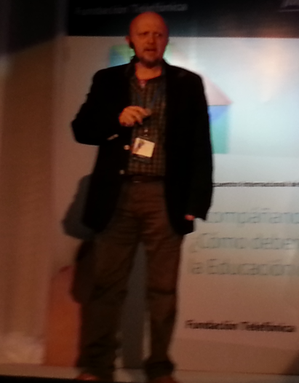
Embracing Chaos
Juan Domingo
Internet, social networks, change
Eg. Folksonomy, disruption, social ecology

Slide 5
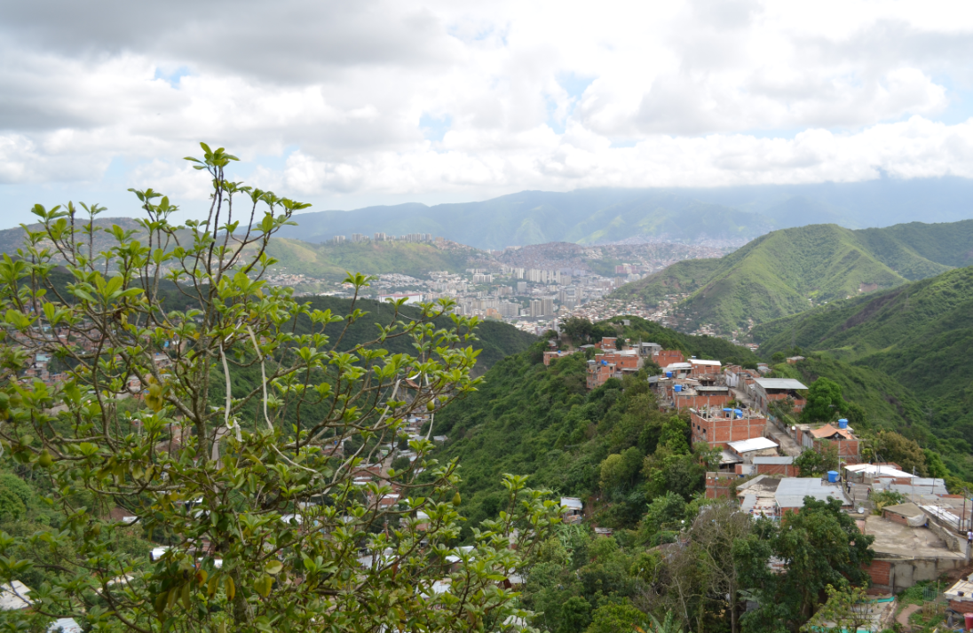
We are Perceiving Beings

Slide 6
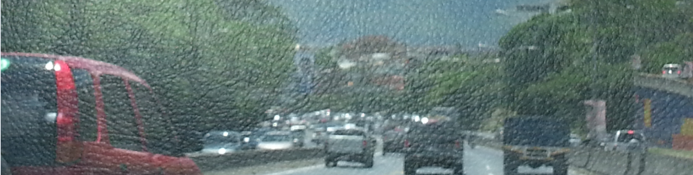
Order Out of Chaos
Knowledge – as a set of connections between entities
Learning – mechanisms to form these connections
But what is important is what this mechanism does
The connective network is a perceptual system
It recognizes patterns in the chaos

Slide 7
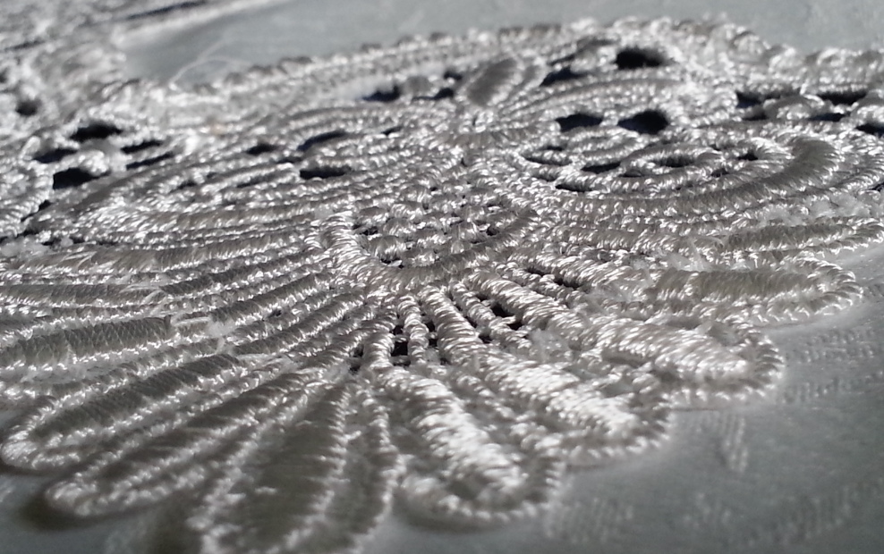
Pattern Recognition

Slide 8
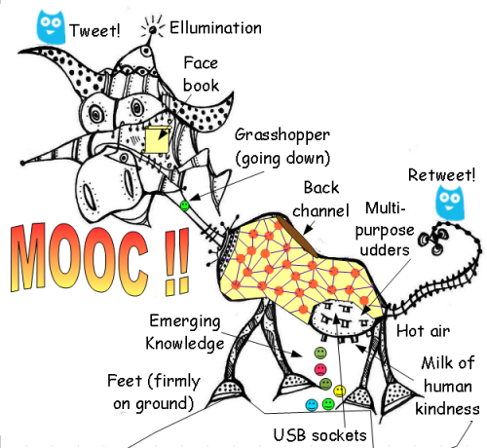
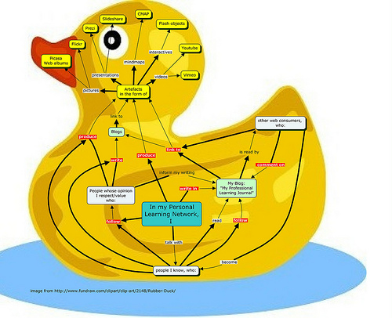
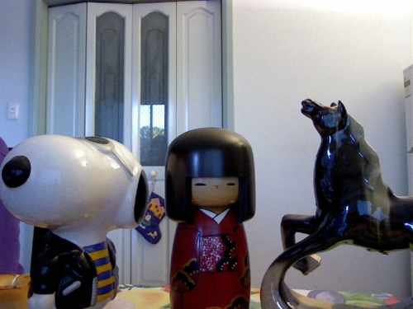
The MOOC...
http://www.mooc.ca
http://cck11.mooc.ca
http://suifaijohnmak.wordpress.com/2011/03/10/cck11-how-to-explain-connectivism-mooc-and-plepln/

Slide 9
What are MOOCs
Massive – by design
Open – gratis and libre
Online – vs. blended and wrapped
Courses – vs. communities, websites, video collections, etc
http://mooc.ca

Slide 10
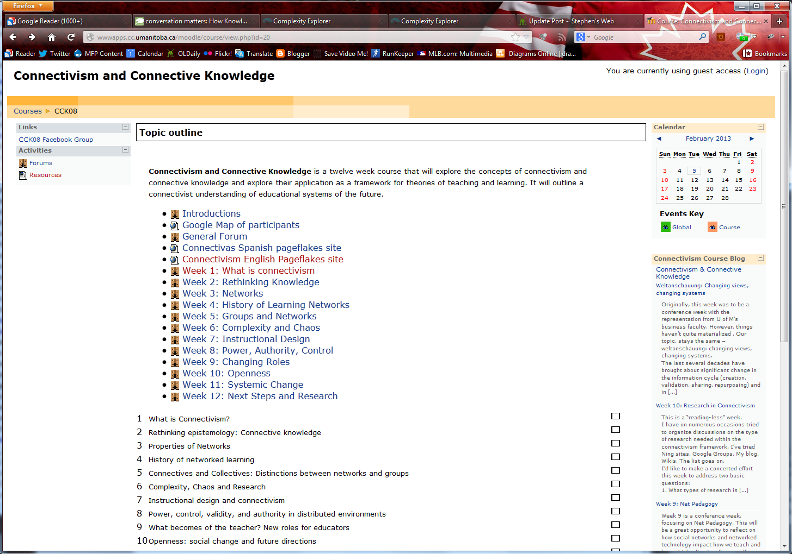
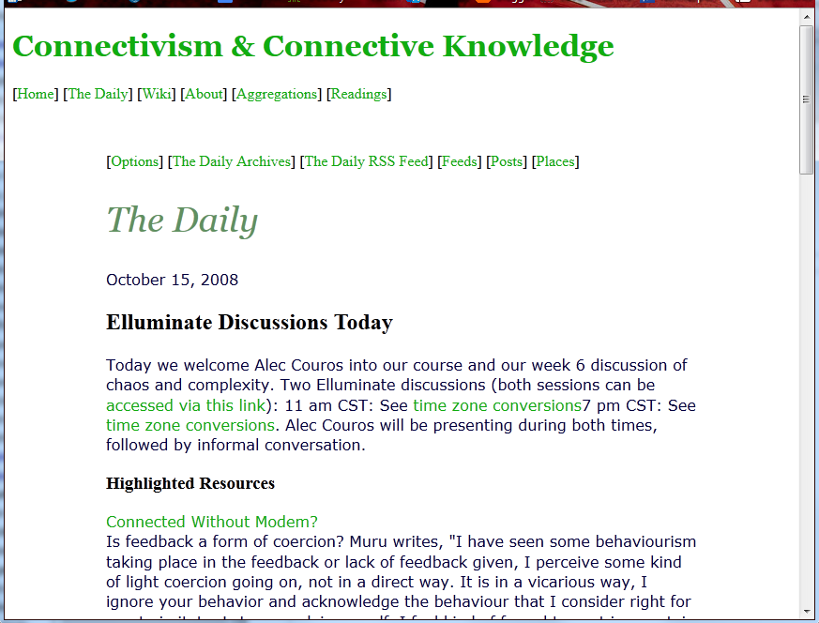
CCK08
2300 students
http://wwwapps.cc.umanitoba.ca/moodle/course/view.php?id=20
http://connect.downes.ca/cgi-bin/archive.cgi?page=thedaily.htm

Slide 11
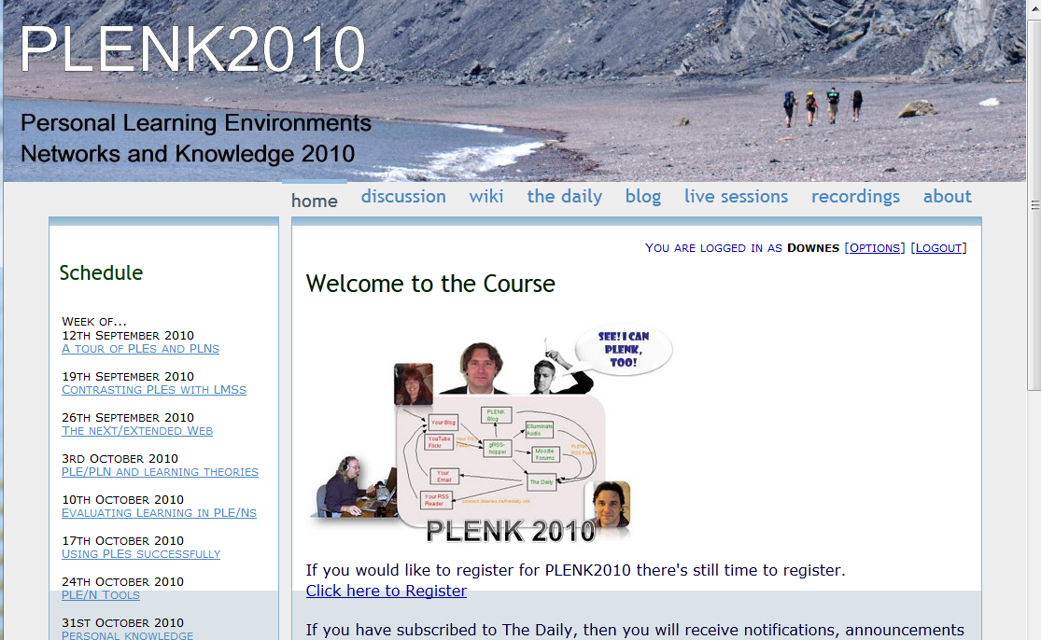
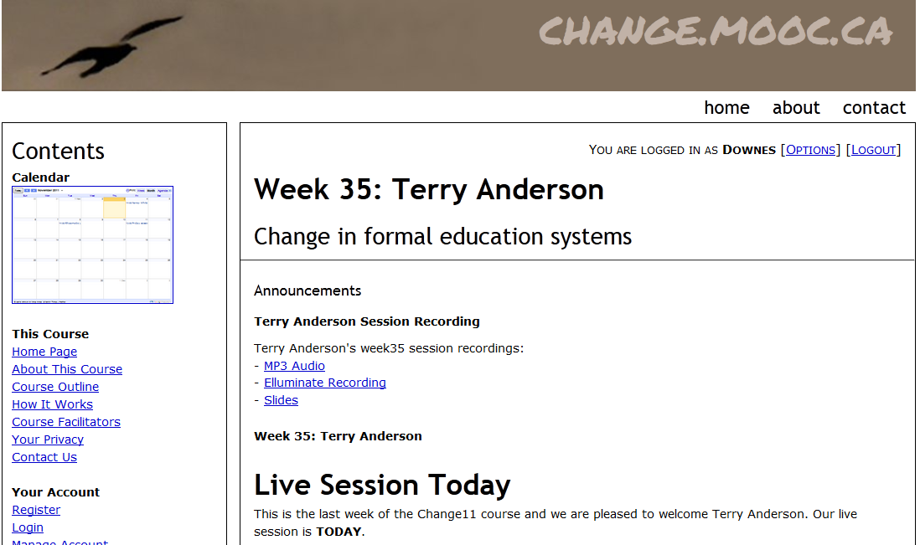

Other Courses
1800 students
http://connect.downes.ca/
2800 students
3000 students
http://change.mooc.ca/
http://edfuture.net/

Slide 12
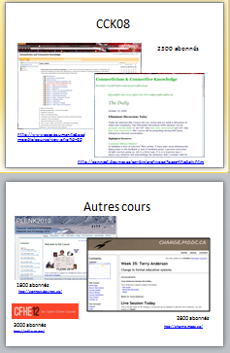

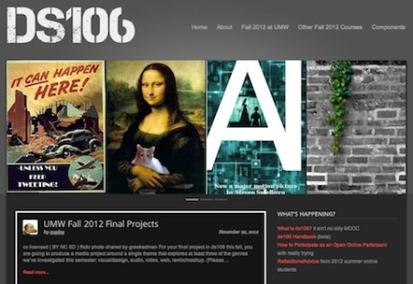
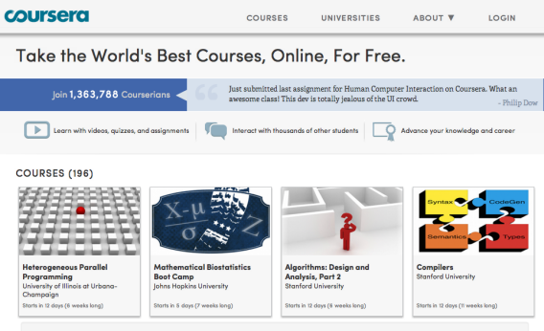
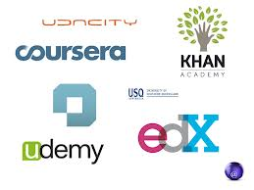
cMOOC vs xMOOC
networks
tasks
contents
https://www.ai-class.com/
http://ds106.us/history/
https://www.coursera.org/
http://lisahistory.net/wordpress/2012/08/three-kinds-of-moocs/

Slide 13
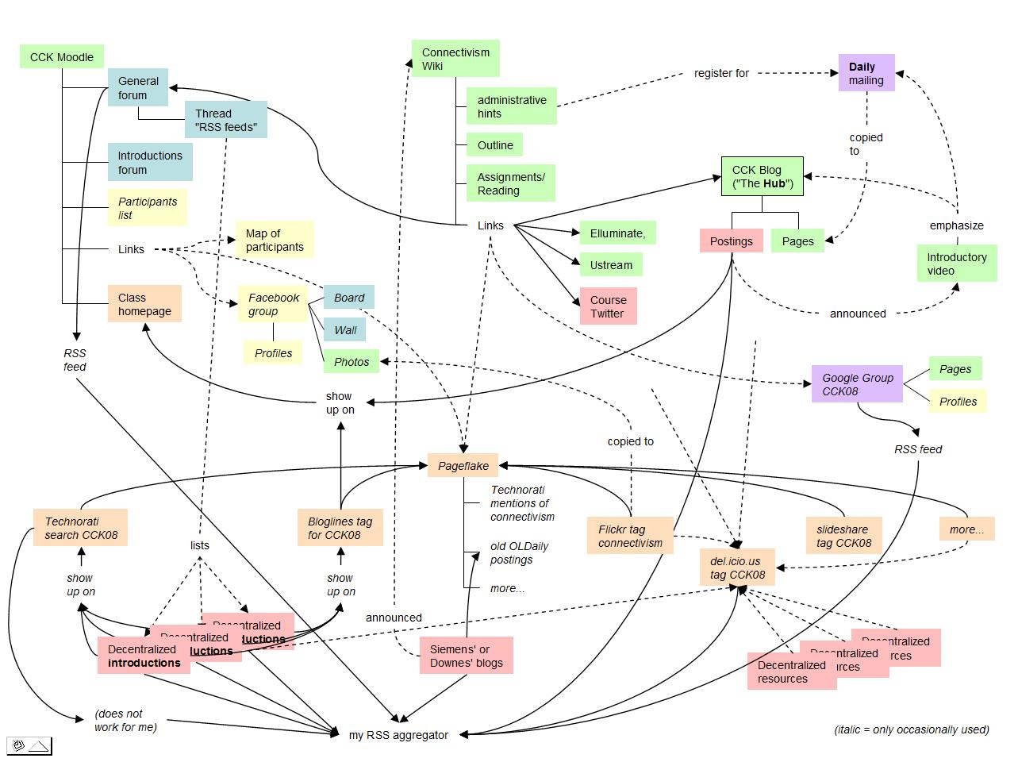
Connectivist MOOCs
http://x28newblog.blog.uni-heidelberg.de/2008/09/06/cck08-first-impressions/

Slide 14
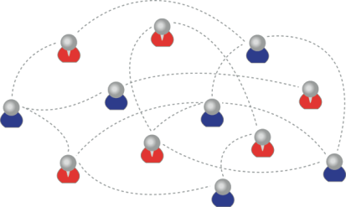
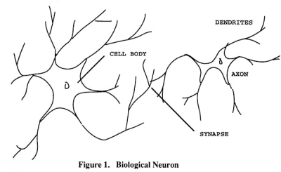
How to Create a cMOOC
It’s like creating a network
Don’t centralize
Concentrate on the creation of links
We use social networks...
… to create personal knowledge

Slide 15
Primary Course Components
  Wiki – to assist in planning, topics, guests, etc
  Email list – for announcements and mass communications
  Course Blog – for daily posts
  Synchronous Communications + Video

Slide 16
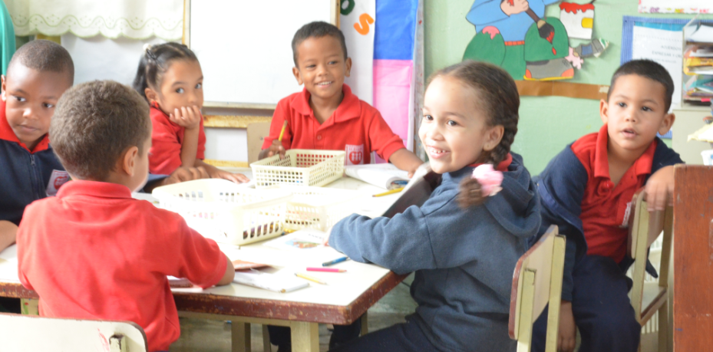
MOOC Design
Course structure – a series of topics
  The instructors will not ‘teach’ the topics, they ‘investigate’ or ‘work through’ the topics (model and demonstrate)

Slide 17
Additional Course Components
For Students – any online communications system, including
  Blogs – Blogger, WordPress, Tumblr
  Social Network – Facebook, Twitter, Google+
  Content site – Google Docs, Flickr, Instragram
  Aggregator – Feedly, OldReader, (new) Bli RSS

Slide 18
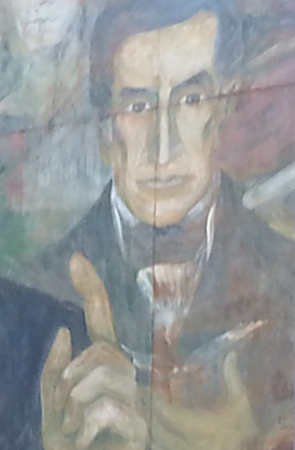
Process
Each Week
  Introduce topic
  Share resources
  Conversation or activity with guest
  Discussion and reflection
Each Day
  Aggregate student content
  Share via web site & newsletter

Slide 19
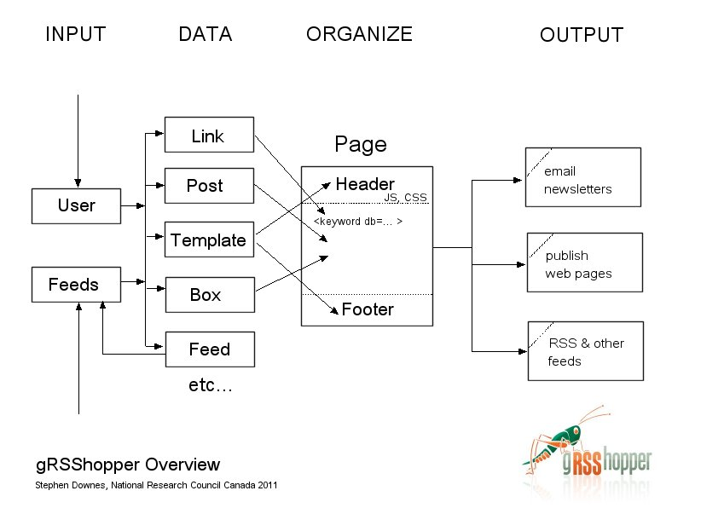
gRSShopper
http://grsshopper.downes.ca

Slide 20
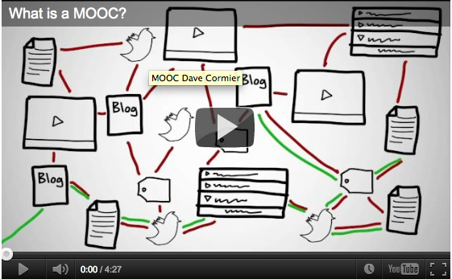
How to Learn in a cMOOC
Learning is a process of immersion into a knowing community
http://www.tonybates.ca/2012/03/03/more-reflections-on-moocs-and-mitx/

Slide 21
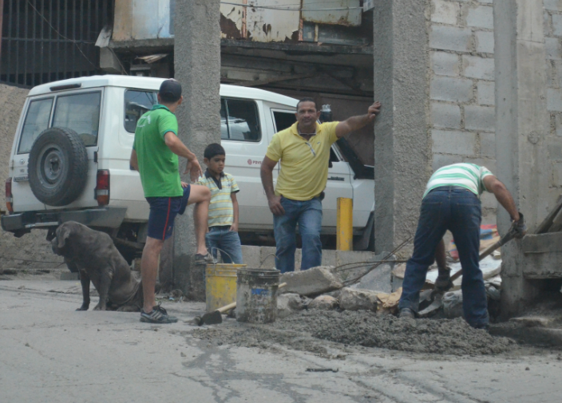
Learning is a process of recognizing and growing into or becoming an instantiation of those values…

Slide 22
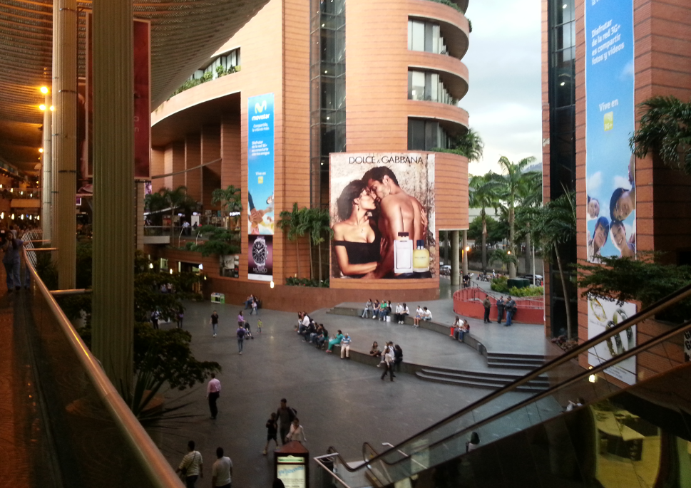
But what is the community that we recognize and grow into – how is it formed? What is it worth?

Slide 23
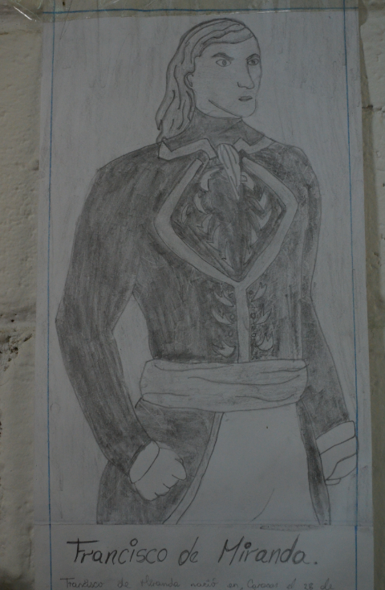
The Wealth of Nations
What is the wealth of a society?
Is it the wealth of the oil and minerals in the ground? No…

Slide 24
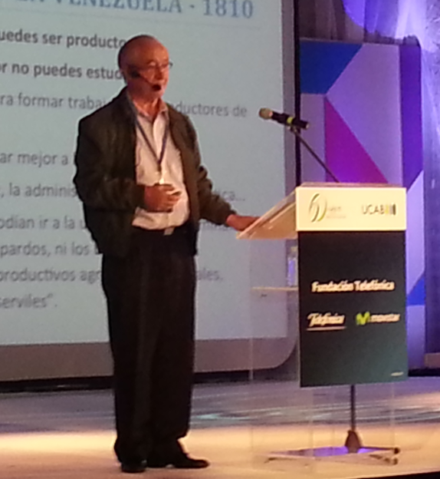
Luis Ugalde s.j.
Is it the sum of goods and services produced?
  That’s the traditional version, today
  But we know this is not the case
Necessary but not sufficient…

Slide 25
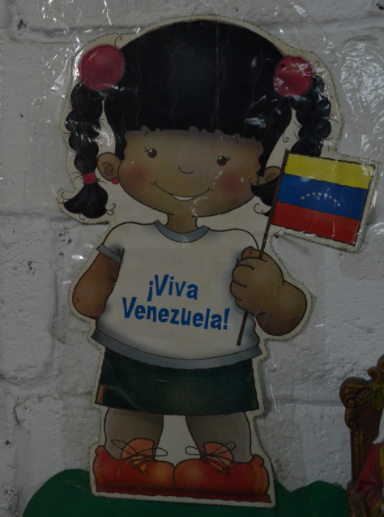
The Outcomes of Society
The United States: Life, Liberty and the Pursuit of Happiness
Canada: Peace, Order and Good Government
France: Liberty, Equality, Fraternity
When you think of other nations, do you think of their productive capacity?

Slide 26
Cultura educativo-productiva de calidad
If we define ourselves as consumers and producers, that’s all we will ever be
If the motivation for learning and work is only production and consumption, we will never aspire to more
The ‘lost generations’ (Fitzgerald, Hemingway, Kerouac, Salinger) did not lose goods and services, they lost meaning and relevance

Slide 27
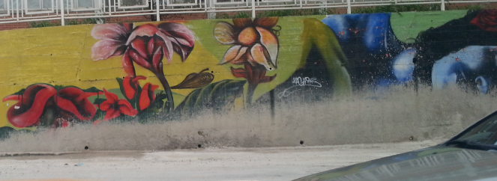
Consuming and Producing Knowledge?
Like the oil in the ground and the goods in the factory, content and knowledge are necessary to become education, but they are not sufficient

Slide 28
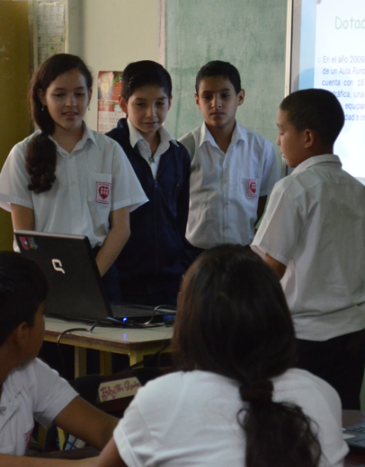
They are the means by which we achieve our ends, but they are not the ends in themselves
If we concentrate on content and knowledge as the source of wealth, we become no more than producers of content and knowledge – we become a lost generation

Slide 29
How to Evaluate Learning
Learning is not possession of a collection of facts, it’s the expression of a capacity
Learning is recognized by a community of experts in a network
Learning analytics
We recognize our understandings…
…by the way we use them in our social network

Slide 30
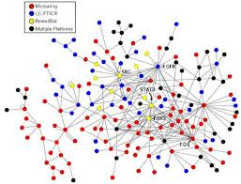

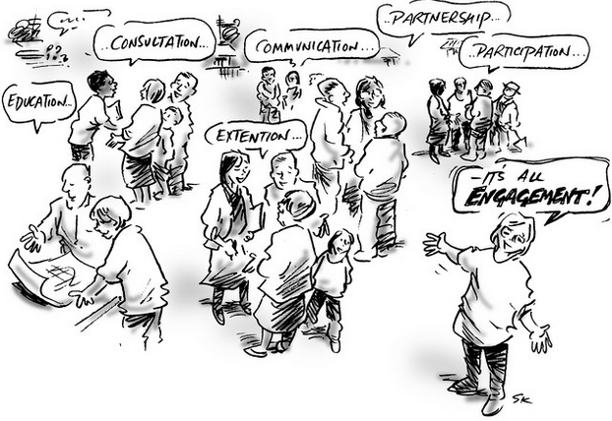
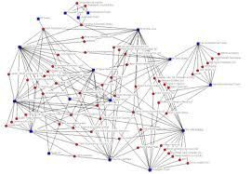

cLearning vs xLearning
networks
engagement
contents
http://www.corestandards.org/
http://www.magnet.edu/
http://lisahistory.net/wordpress/2012/08/three-kinds-of-moocs/

Slide 31

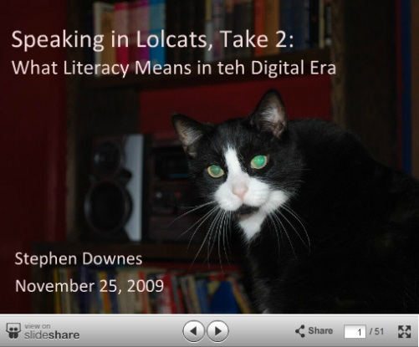
Why Open Educational Resources?
Learning activities are essentially conversations
OERs are the words used in those conversations
http://www.downes.ca/presentation/233

Slide 32
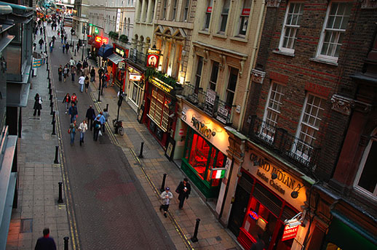
Success Factors (The Wealth of Nations)
What sort of decentralized network will best support learning-as-growth?

Slide 33
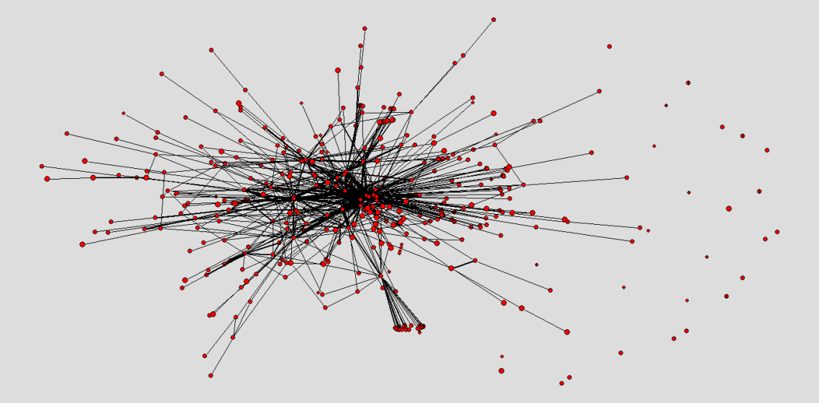
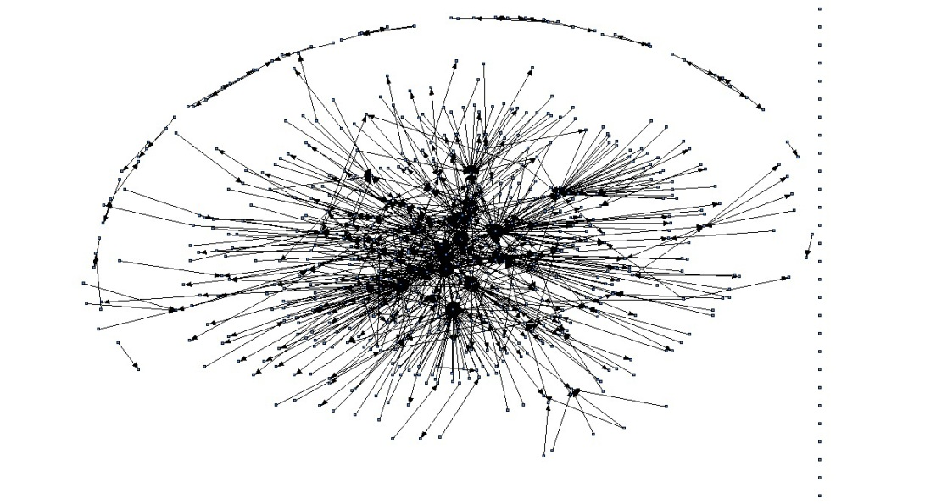
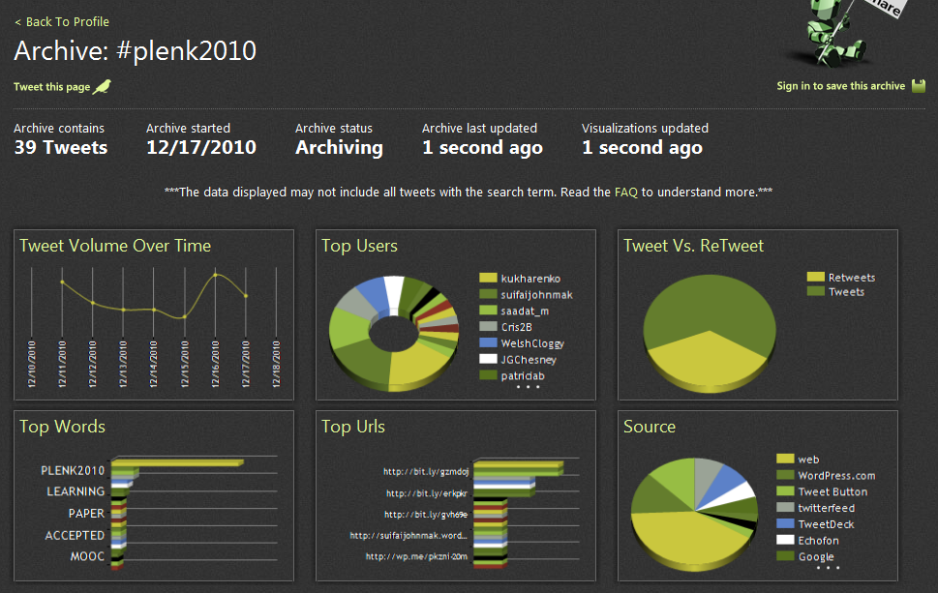
The Semantic Condition
Autonomy, diversity, openness, interactivity
These conditions are the conditions for a constructive dialogue…
And are thus the design principles for a MOOC
http://itforum.coe.uga.edu/paper92/paper92.html

Slide 34
The Objective of Learning
Learning is not acquisition, it is growth
It is about the personal development of each person
  Not just what the person ‘knows’
  Equally important is a person’s sense of value and place in society

Slide 35
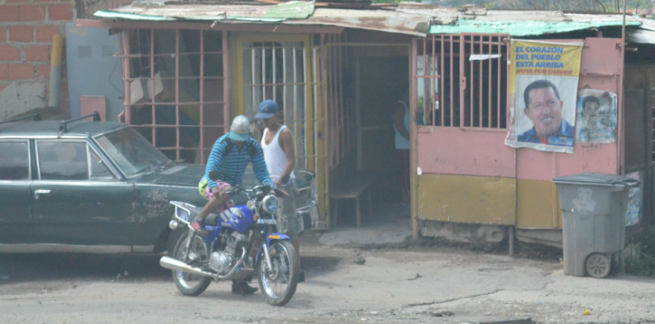
When Luis Ugalde talks of the need we need humanitarian doctors and engineers - people who work with humanity – this is what he means
When Luis Ugalde talks of 'Education to Transform the Country' - child has to learn how to do things & how to do them better – this is what he means

Slide 36
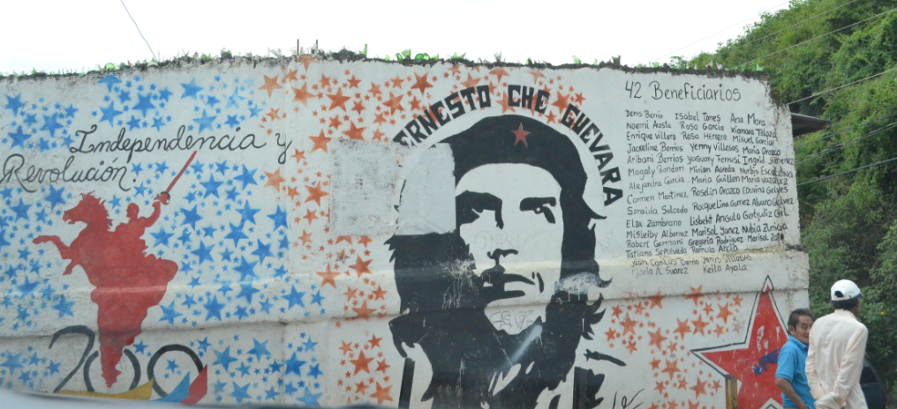
Advertisers, Politicians, Prophets
They know this very well – they are willing to provide you with a community to join and a purpose to make life meaningful… but personal learning is about building these for ourselves.

Slide 37
How to Value Yourself …
What is it to value yourself? It's actually many things. For example, it's the belief that you are good enough to have an opinion, have a voice, and have a say, that your contributions do matter. It's the belief that you are capable, that you can learn to do new things and to be creative. It is your ability to be independent, and to not rely on some particular person or institution for personal well-being, and autonomous, capable of making your own decisions and living your live in your own way.

Slide 38
How to Live Meaningfully
Living meaningfully is actually a combination of several things. It is, in one sense, your dedication to some purpose or goal. But it is also your sense of appreciation and dedication to the here and now. And finally, it is the realization that your place in the world, your meaningfulness, is something you must create for yourself.

Slide 39
But all of these things are yours by right. But they will never be given to you. You have to take them, you have to earn them, by actually believing in yourself (no matter what anyone says) and by actually being autonomous.
As educators, our foundational role is to understand that we do not give (or sell) learning and education, but that we act as role models and facilitators to help people learn and educate themselves.

Slide 40
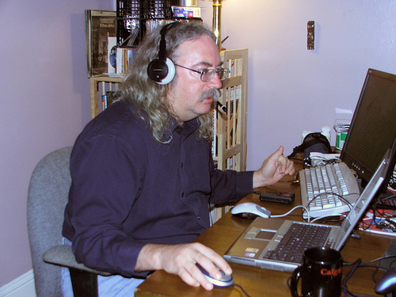
http://www.downes.ca

