Slide 1
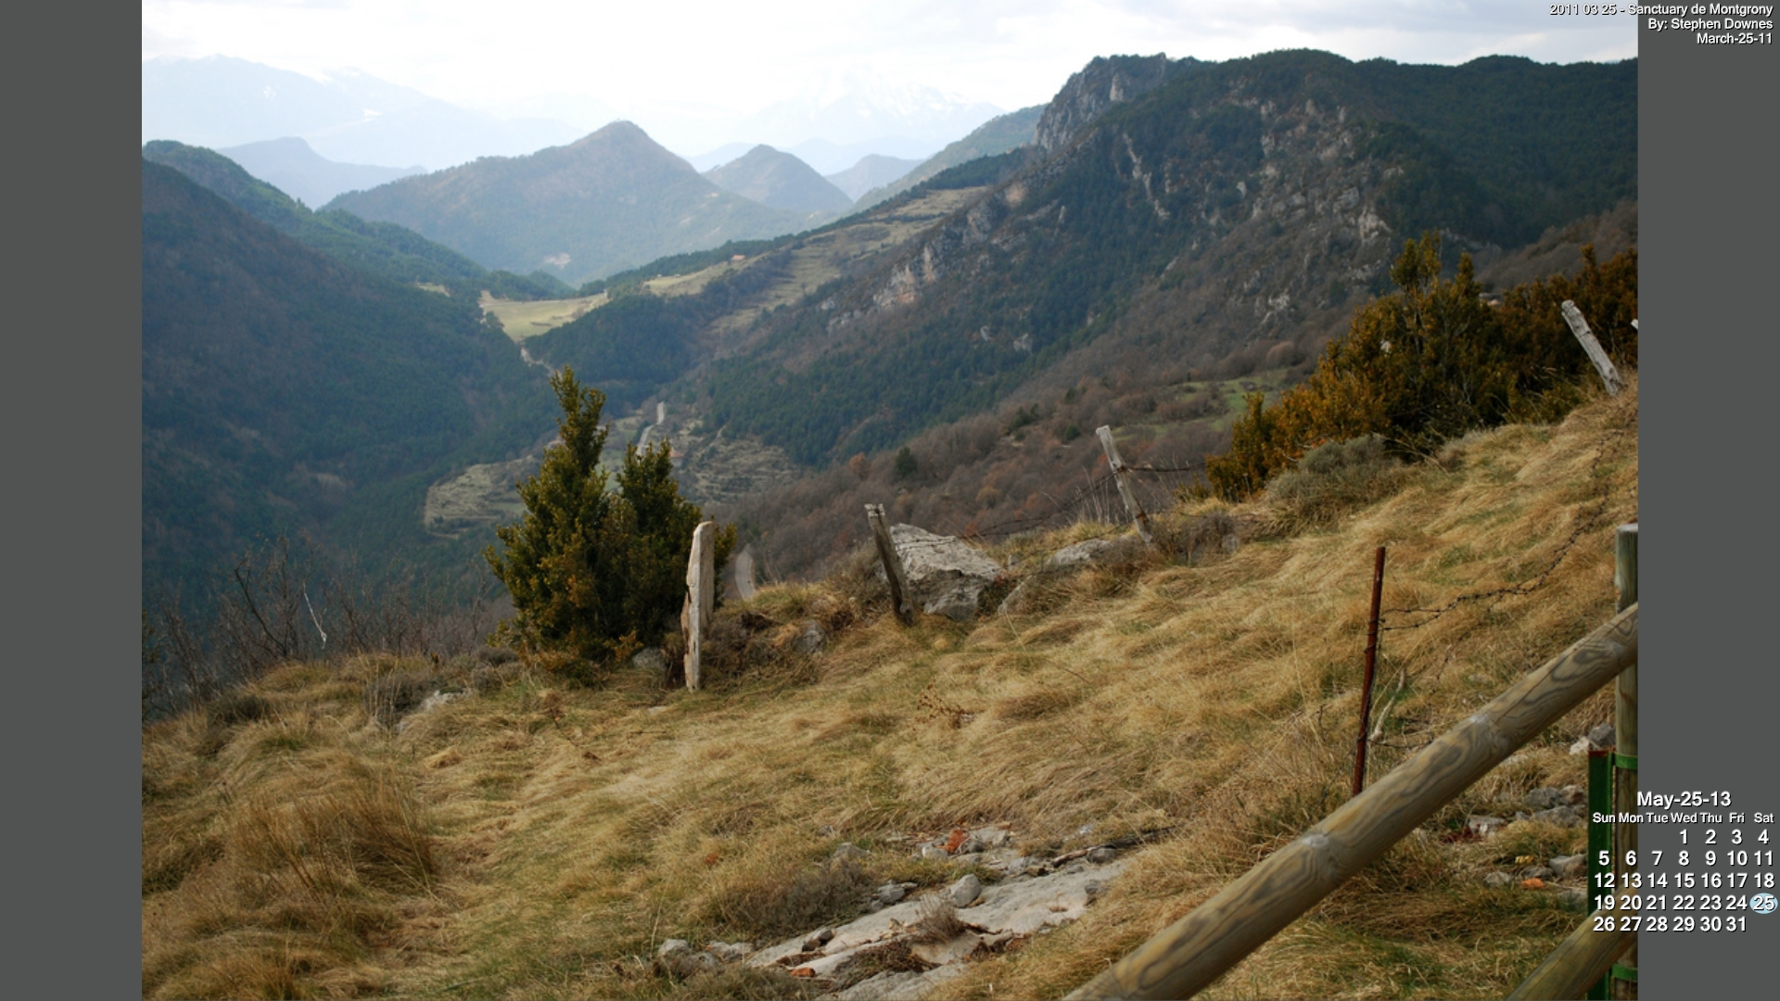
Vancouver Island University's Online Learning and Teaching Diploma
OLTD 505: OERs
OERS, MOOCs, and the Future
Stephen Downes -- May 25, 2013

Slide 2
OERs, MOOCs and the Future
OERs: Open Educational Resources
MOOCs: Massive Open Online Courses
The Future: stuff that hasn’t happened yet

Slide 3
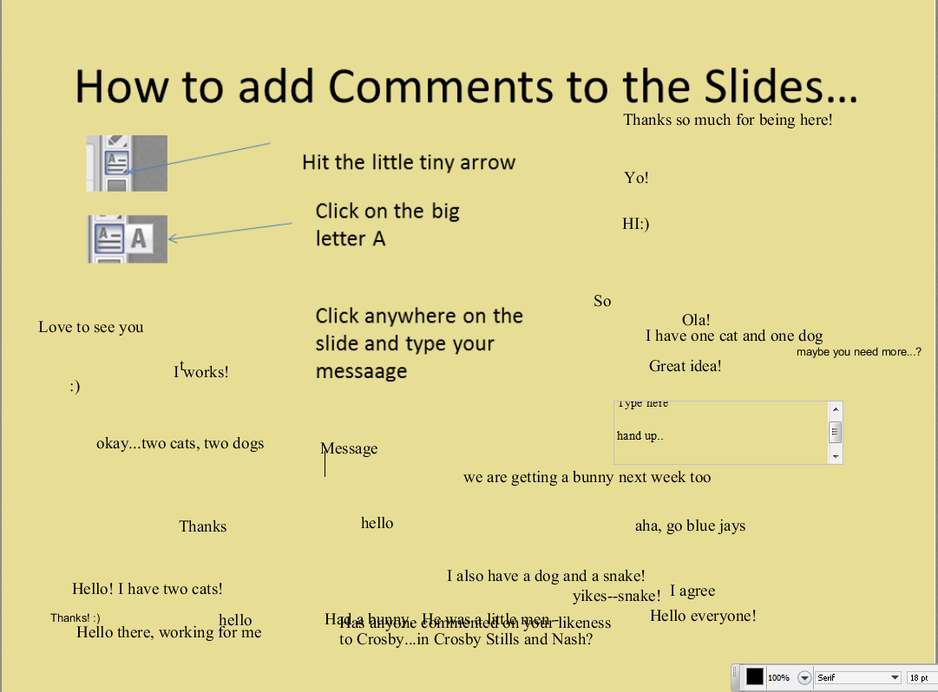


How to add Comments to the Slides…
Hit the little tiny arrow
Click on the big letter A
Click anywhere on the slide and type your messaage

Slide 4
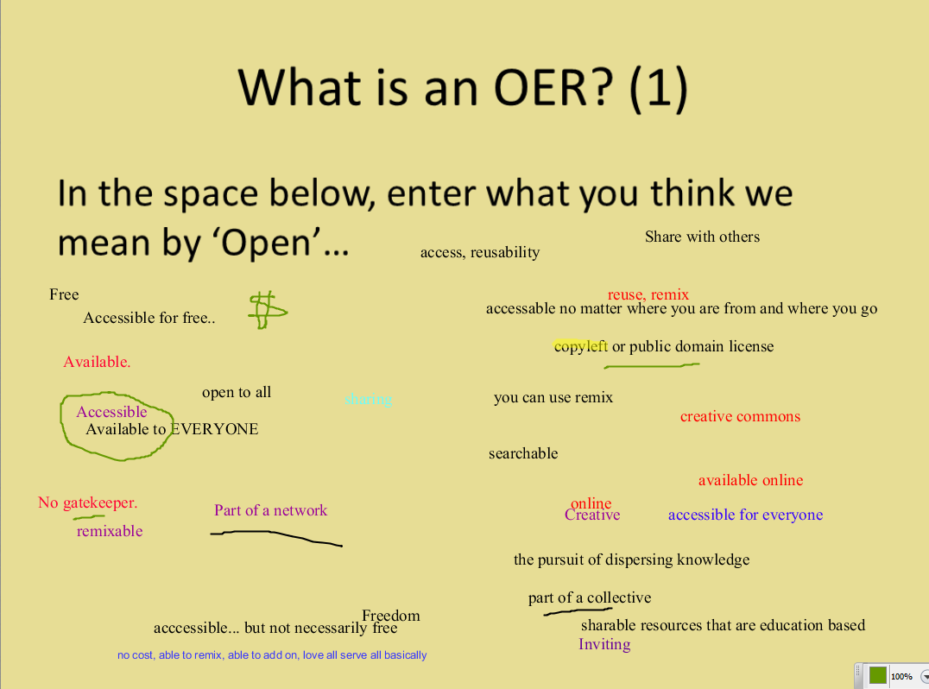
What is an OER? (1)
In the space below, enter what you think we mean by ‘Open’…

Slide 5
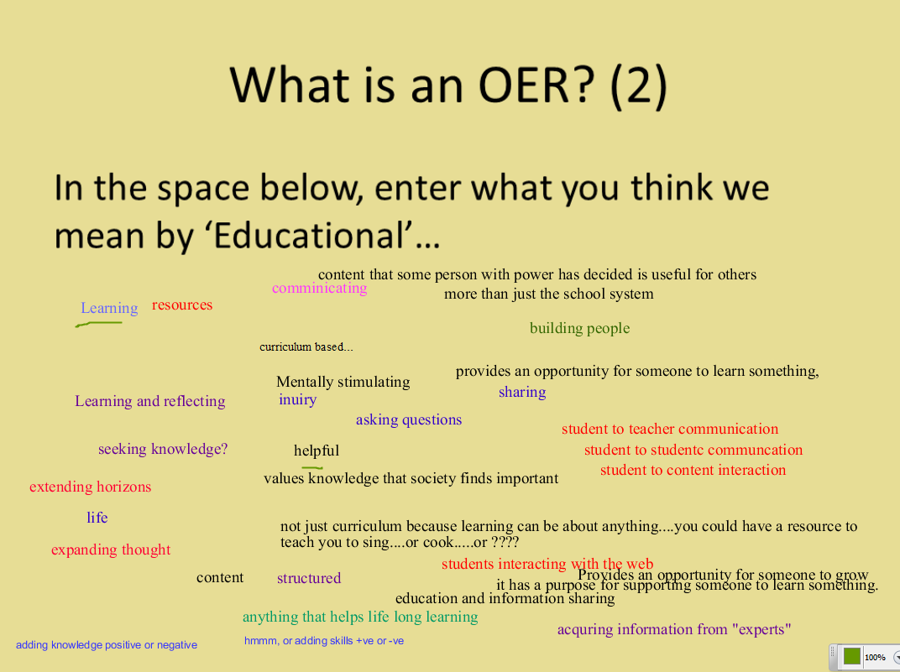
What is an OER? (2)
In the space below, enter what you think we mean by ‘Educational’…

Slide 6
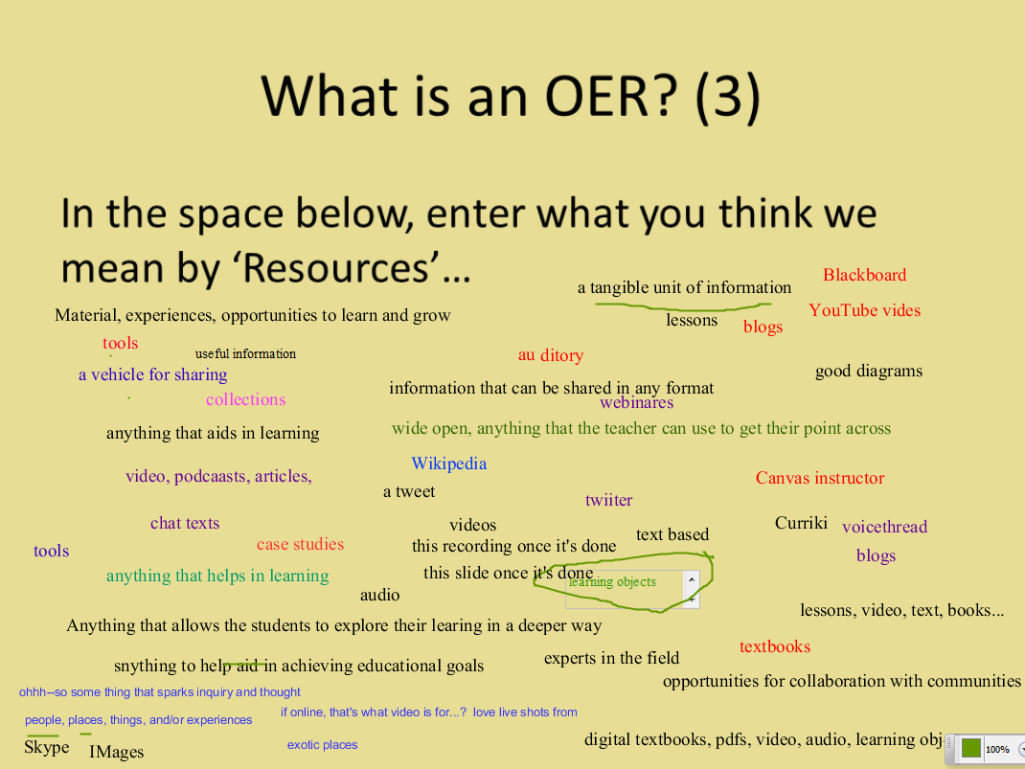
What is an OER? (3)
In the space below, enter what you think we mean by ‘Resources’…

Slide 7

Some Definitions…
“Open Educational Resources (OER) are freely accessible, usually openly licensed documents and media that are useful for teaching, learning, educational, assessment and research purposes.” – Wikipedia http://en.wikipedia.org/wiki/Open_educational_resources

Slide 8

Some Definitions (2)
“Open Educational Resources are freely available teaching and learning materials which the author has licensed in an open format to allow others to re-use and adapt.” CLT http://clt.lse.ac.uk/digital-and-information-literacy/OERs.php

Slide 9

Some Definitions (3)
“Open Educational Resources are teaching, learning or research materials that are in the public domain or released with an intellectual property license that allows for free use, adaptation, and distribution.” UNESCO http://www.unesco.org/new/en/communication-and-information/access-to-knowledge/open-educational-resources/

Slide 10

Some Definitions (4)
“(Open Educational Resources are) materials offered freely and openly to use and adapt for teaching, learning, development and research.” Commonwealth of Learning http://www.col.org/resources/crsMaterials/Pages/OCW-OER.aspx

Slide 11
Repositories
OpenLearn (OU) - http://www.open.edu/openlearn/
Open Courseware (MIT) - http://ocw.mit.edu/
China Quality Open Courseware - http://www.core.org.cn/en/
Japan Open Courseware Consortium - http://www.jocw.jp/
Directory of OER Repositories http://oerqualityproject.wordpress.com/2012/10/22/directory-of-oer-repositories/

Slide 12




Licensing
Creative Commons CC - http://creativecommons.org/
  By – Attribution
  NC – Non-commercial
  ND – No Derivatives
  SA – Share Alike
  CC-0 – Public Domain http://creativecommons.org/choose/zero/
  ‘Free Culture License’ - http://freedomdefined.org/Licenses/CC-BY
  No-DRM

Slide 13
Use
Finding CC Resources - http://search.creativecommons.org/
Evaluating OERs - http://www.slideshare.net/SCORE/finding-and-evaluating-oer-score-workshop-activity-non-scantlebury
What criteria would you consider?

Slide 14
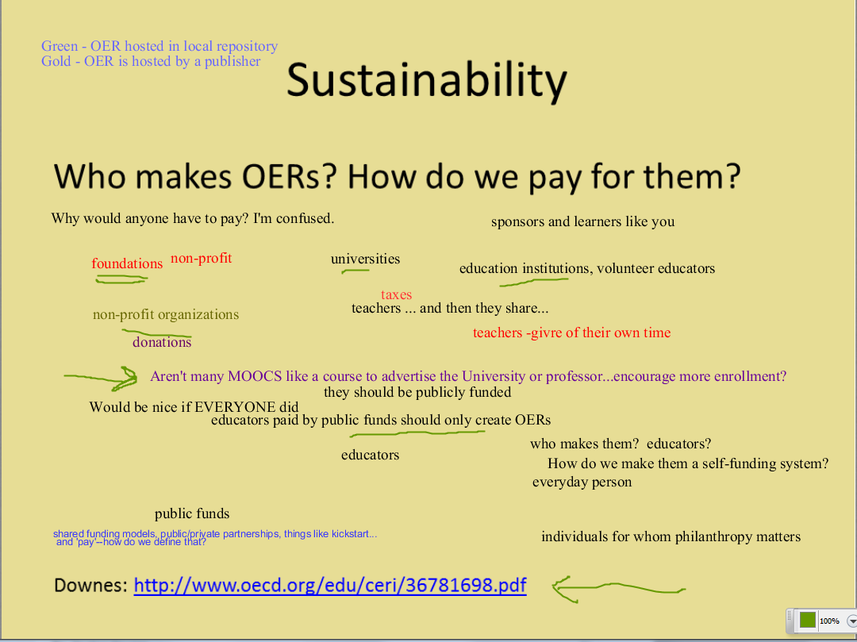
Sustainability
Who makes OERs? How do we pay for them?
Downes: http://www.oecd.org/edu/ceri/36781698.pdf

Slide 15
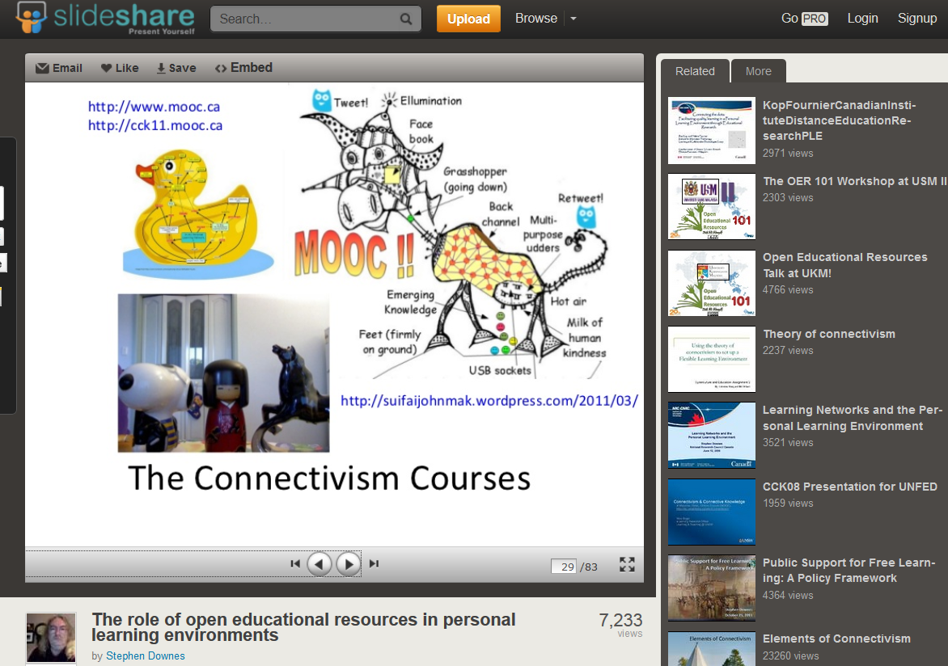
Massive Open Online Course
The original conception: an open course made up of OERs
http://www.slideshare.net/Downes/the-role-of-open-educational-resources-in-personal-learning-environments

Slide 16
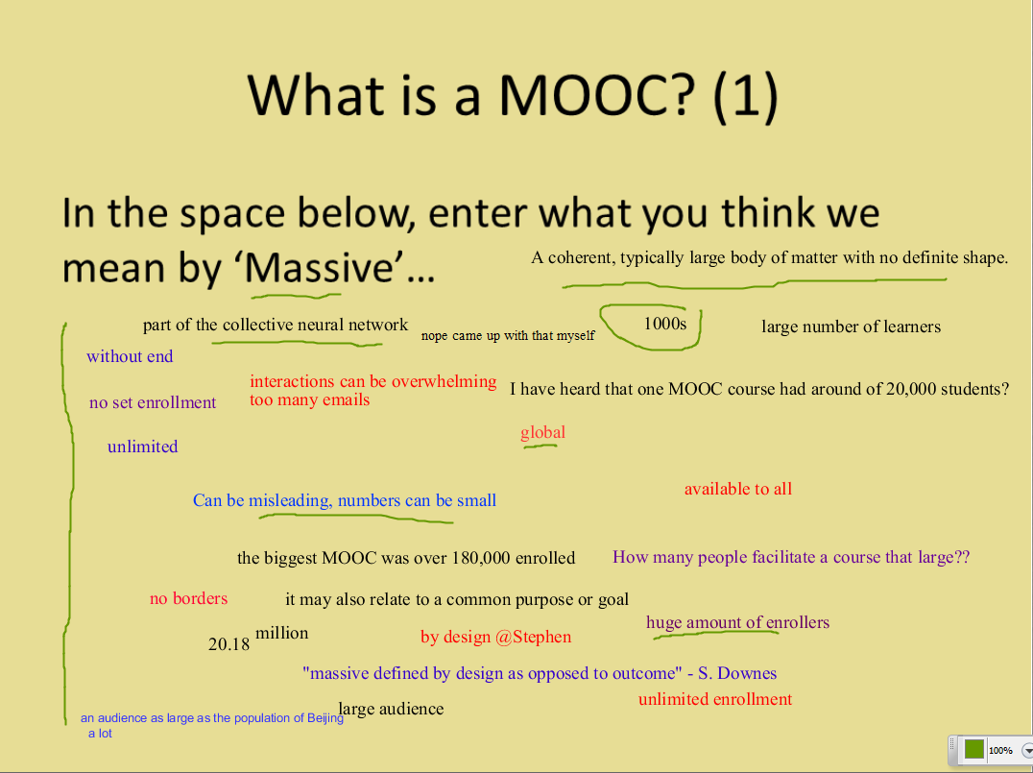
What is a MOOC? (1)
In the space below, enter what you think we mean by ‘Massive’…

Slide 17
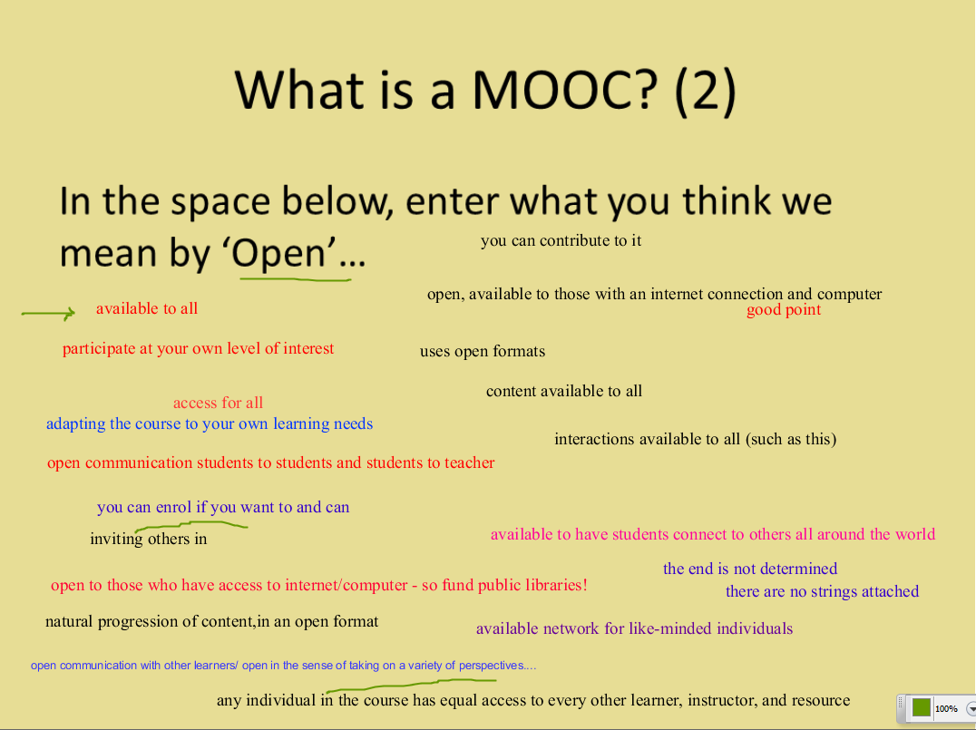
What is a MOOC? (2)
In the space below, enter what you think we mean by ‘Open’…

Slide 18
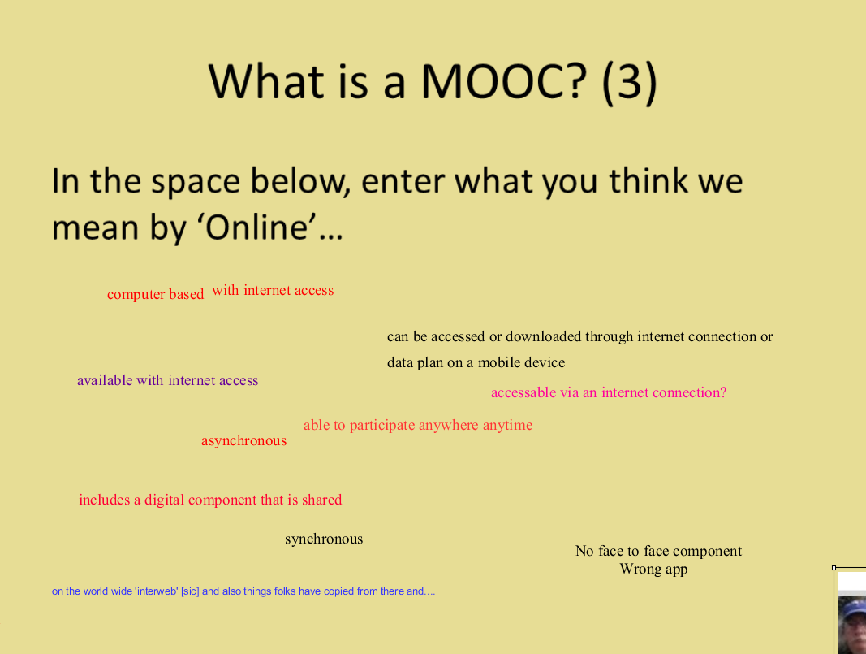
What is a MOOC? (3)
In the space below, enter what you think we mean by ‘Online’…

Slide 19
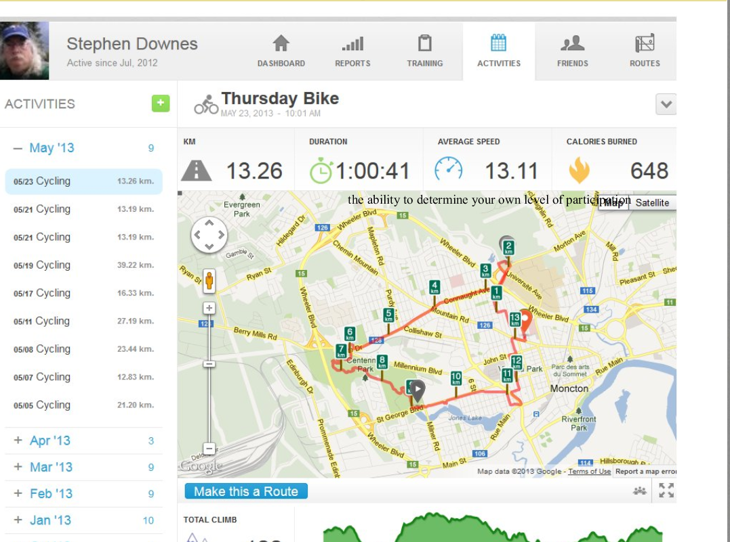

Slide 20
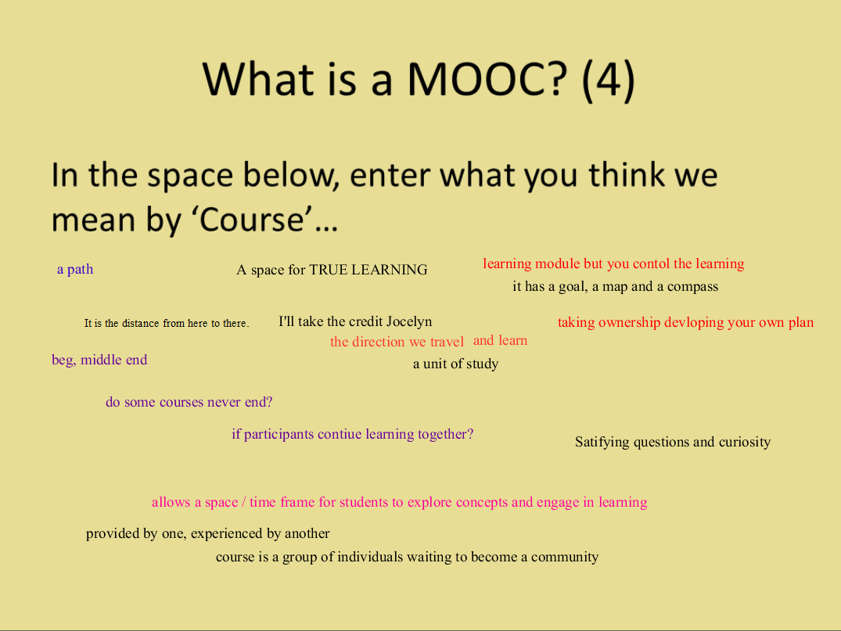
What is a MOOC? (4)
In the space below, enter what you think we mean by ‘Course’…

Slide 21
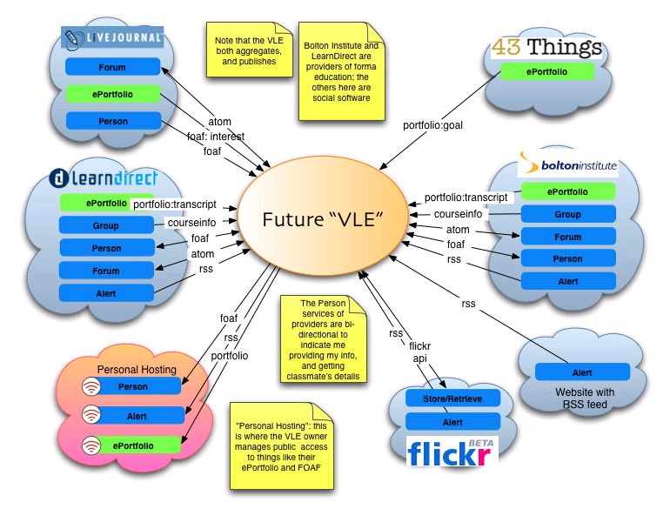
Personal Learning Networks

Slide 22
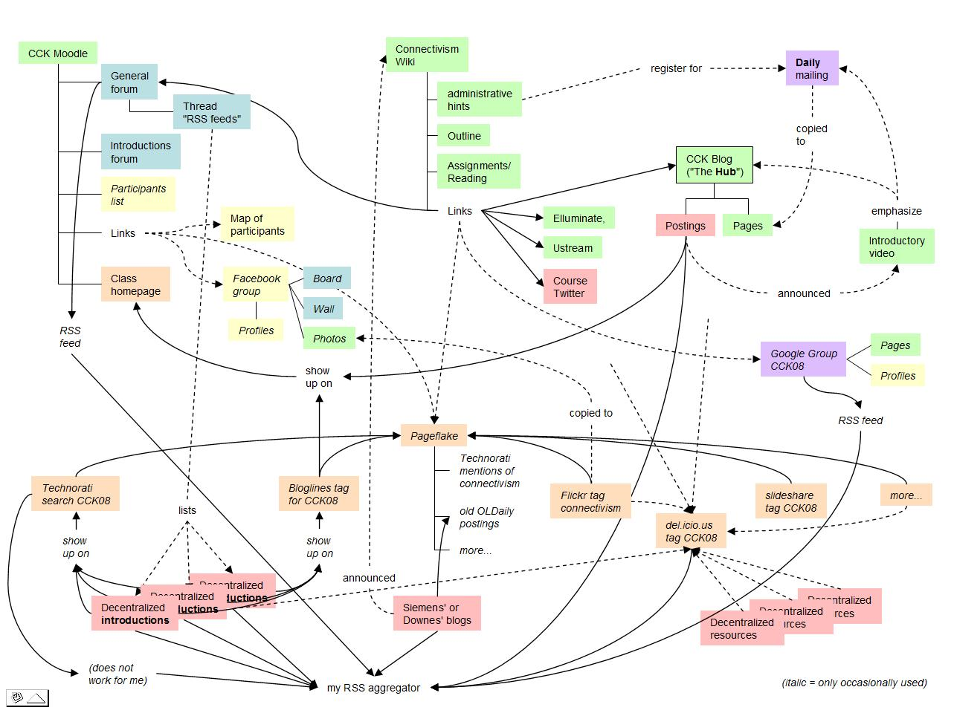
The Course as Network

Slide 23
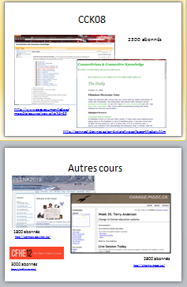

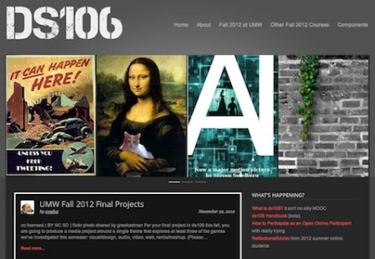
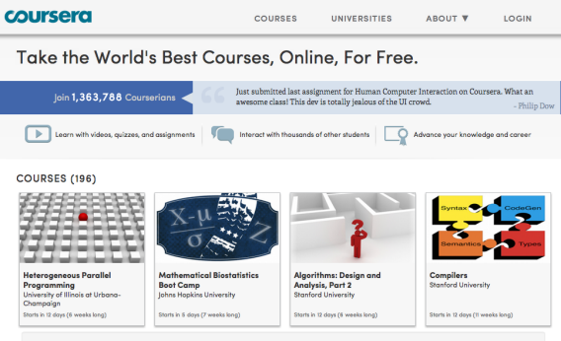

cMOOC vs xMOOC
networks
tasks
contents
https://www.ai-class.com/
http://ds106.us/history/
https://www.coursera.org/
http://lisahistory.net/wordpress/2012/08/three-kinds-of-moocs/

Slide 24
Success Factors
What sort of decentralized network will best support learning-as-growth?

Slide 25
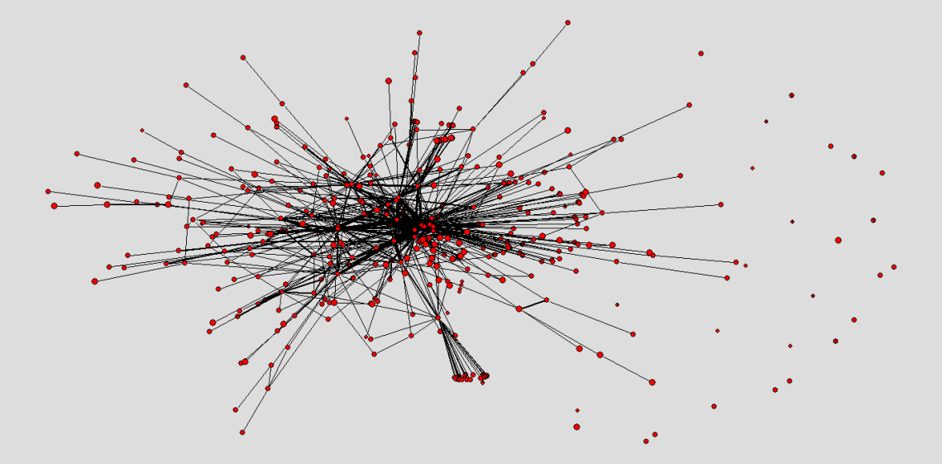
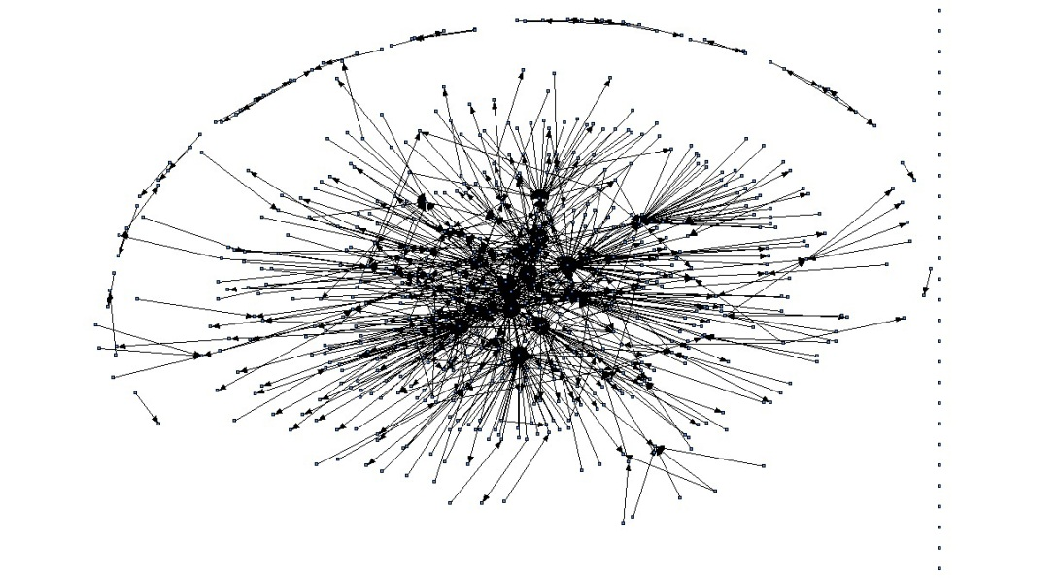
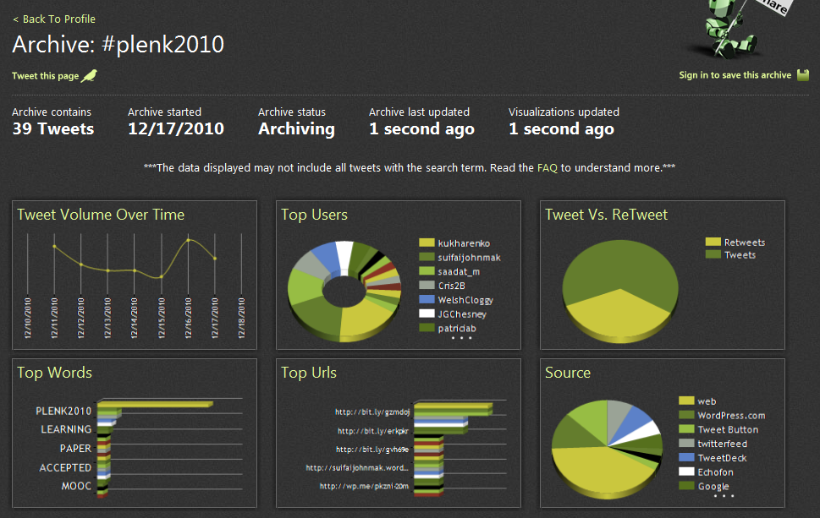
The Semantic Condition
Autonomy, diversity, openness, interactivity
These conditions are the conditions for a constructive dialogue…
And are thus the design principles for a MOOC
http://itforum.coe.uga.edu/paper92/paper92.html

Slide 26
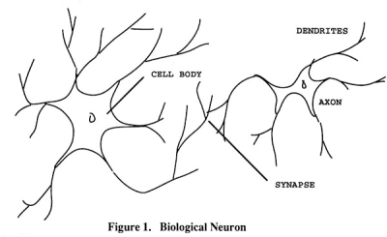
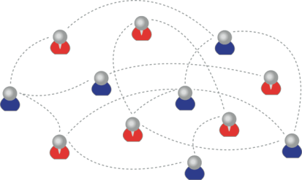
How to Evaluate Learning
Learning is not possession of a collection of facts, it’s the expression of a capacity
Learning is recognized by a community of experts in a network
Learning analytics
We recognize our understandings…
…by the way we use them in our social network

Slide 27
The Future
The future grows out of the present (it is not a mysterious black box)
It is created through a process of change - http://www.downes.ca/post/53662
We read the future the way we read the past

Slide 28
The Future (2)
What is the future of OERs and MOOCs

Slide 29
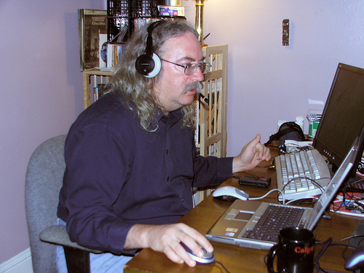
http://www.downes.ca

