Slide 1
Moocs and K12 Cloud
Privacy regulations and Risk Management
Discovery Education Canada(Dean Shareski), BD&P (Jim Swanson), Alberta Distance Learning Centre (Verena Roberts), National Research Council Canada (Stephen Downes)

Slide 2
What are MOOCs
Massive – by design
Open – gratis and libre
Online – vs. blended and wrapped
Courses – vs. communities, websites, video collections, etc

Slide 3
cMOOCs vs xMOOCs
xMOOCs – the Big Elite Universities Way
  Collections of centralized resources
  Mass events (like videos, live events)
  Automated grading etc.
cMOOCs – the Connectivist Way
  Based on community, conversation, culture
  Most importantly, are distributed

Slide 4
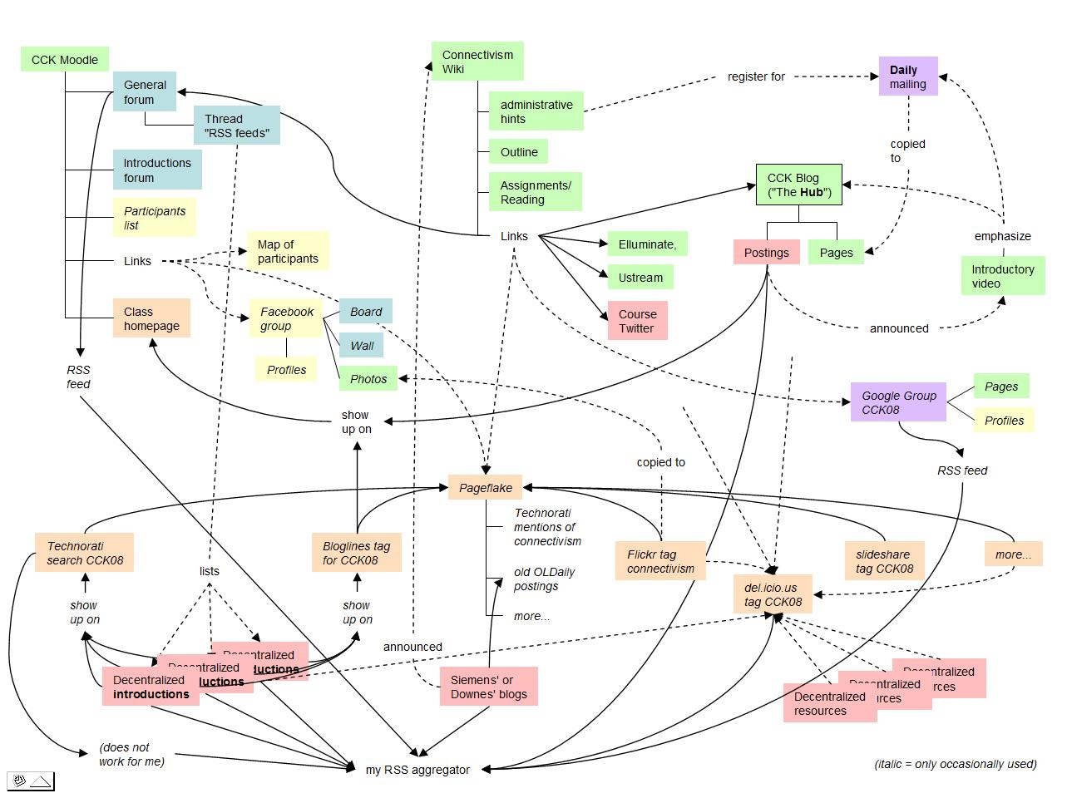
The Connected Application
http://x28newblog.blog.uni-heidelberg.de/2008/09/06/cck08-first-impressions/

Slide 5
Privacy & Security: the Centralized Version
Downloading and Reuse – copyright implications, tracking, and phone calls from large corporations
Data collection – “all your student records are belong to us”
Data breaches – password reuse, identity information
Spam, marketing and other unwanted messaging

Slide 6
Privacy & Security: the Decentralized Version
Downloading and Reuse – copyright implications, tracking, and phone calls from large corporations
Introduction of untested resources in to the network
Bullying and abuse in hidden nooks and crannies
Information policies of third party applications, such as Facebook

