Slide 1
LCT Groupe de recherche
Technologies d'apprentissage et de collaboration | 2013.02.04

Slide 2

Le CNRC une présence pancanadienne http://www.nrc-cnrc.gc.ca
auparavant partie du CNRC
Atomic Energy Canada
Canadian Space Agency
Communications Security Establishment
Defense Research Board
Canadian Institutes of Health Research
Natural Sciences and Engineering Research Council
Institute for Biological Sciences (Ottawa)
Institute for Aerospace Research (Ottawa)
Institute for Chemical Process and Environmental Technology (Ottawa)
Institute for Information Technology (Ottawa, Gatineau)
Institute for Microstructural Sciences (Ottawa)
Institute for National Measurement Standards (Ottawa)
Institute for Research in Construction (Ottawa)
Steacie Institute for Molecular Sciences (Ottawa, Chalk River)
Canadian Hydraulics Centre (Ottawa)
Centre for Surface Transportation Technology (Ottawa)
Regional Innovation Centre (Ottawa)
+ IRAP et CISTI dans divers endroits à travers le Canada
Institute for Information Technology (F, M)
Institute for Marine Biosciences (Halifax)
Institute for Biodiagnostics (Halifax)
Institute for Marine Dynamics (St. John's)
Institute for Nutrisciences and Health (Charlottetown)
Herzberg Institute of Astrophysics (Victoria, Penticton)
Institute for Fuel Cell Innovation (Vancouver)
Centre for Surface Transportation Technology (Vancouver)
National Institute of Nanotechnology (Edmonton)
Plant Biotechnology Institute (Saskatoon)
Institute for Biodiagnostics (Winnipeg, Calgary)
Biotechnology Research Institute (Montréal)
Industrial Materials Institute (Boucherville)
Aluminum Technologies Centre - (Ville Saguenay)
Aerospace Manufacturing Technologies Centre (Montreal)
Integrated Manufacturing Technologies Institute (London)

Slide 3
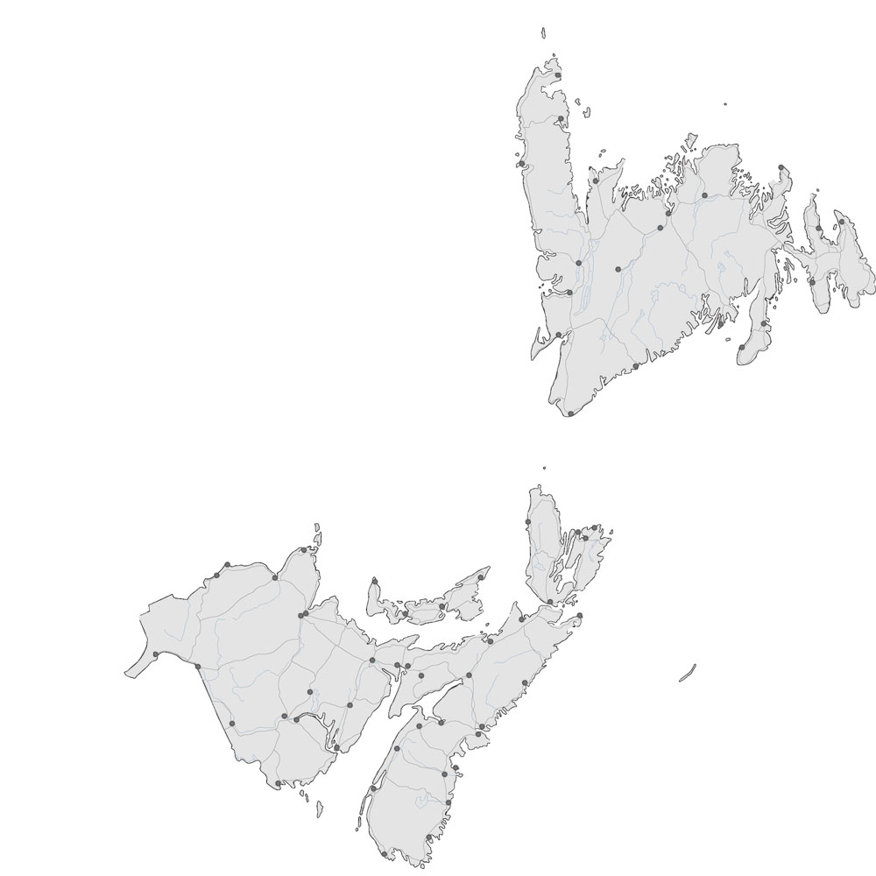
IIT – 3 locations
Technologies d'apprentissage et de collaboration
Connaissances et données
Systèmes orientés vers les personnes
E-business
themes include: knowledge discovery, visual processing, pervasive computing, software systems development, security and privacy, broadband communication, grid computing, collaborative computing
IIT
(Nouveau-Brunswick)
LCT, KD
DG, PM, BDO,
HR, Fi …
IIT Ottawa
Moncton
3D Imaging, Modeling and Visualization
Data and Text Mining
Human-Computer Interaction
Intelligent Internet Applications
Natural Language Processing
Fredericton

Slide 4
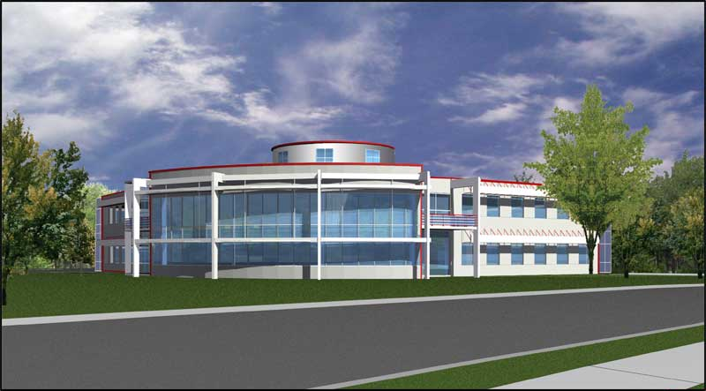
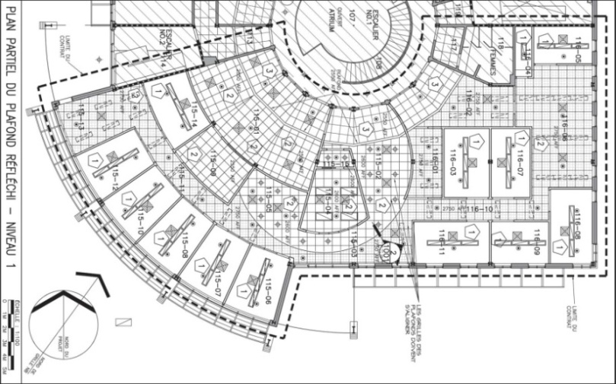
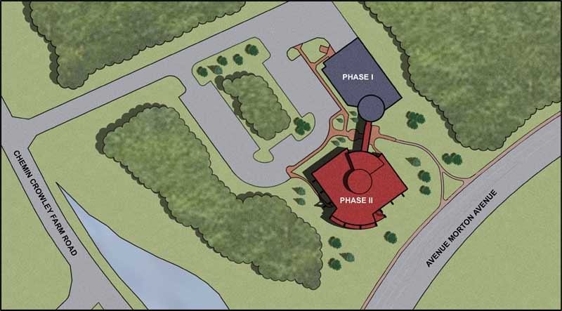
LCT Recherche
Technologies d'apprentissage et de collaboration
Moncton
  U de Moncton campus
10 + staff
  2 Ottawa
  2 Fredericton
  6 + Moncton
Notes:
The core is in Moncton
Varied backgrounds
Staff not within the LCT group also working on our projects
We collaborate accross Groups
Aussi: Centre de Formation Médicale du Nouveau-Brunswick

Slide 5
several projects a sampling within the L&CT RG
SynergiC3
  e-Learning productivity enhancement framework (content production)
  Front end to an LCMS
CMSF – Cognitive Modeling Simulation Framework
  One focus: building intelligent agents into game-based training
PLE – Personal Learning Environments
  Bridging the “informal” with the “formal” sides of learning
DND’s IRET (Immersive Reflexive Engagement Trainer)
  ILT for CTS: Simulation based training of troops
MDXtract – Automated MD extraction for legacy assets
  To help discover legacy assets (i.e. non-described assets)

Slide 6
d'autres initiatives through the years
  OLDaily
  CCL (Canadian Council on Learning)
  PATS (Projects and Activities Tracking System)
  VELtic (http://www.veltic.ca, U of Ottawa, SSHRC)
  Créatic (http://www.creatic.ca, U de M)
  Learning Networks (merged with PLE)
    Edu_RSS, DLORN, RSS_LOM, LO-XSLT, DDRM, gRSShopper
  Immersive 3D learning environments (NBCC Bathurst, U de M)
  Blogs in Schools (with U de M, C@HM)
  LCeL (Learner Centric e-Learning, Innovatia AIF)
  ÉDUCAM (Éducation par apprentissage mobile, CFORP | SAMFO)
  ADOP (Accès direct à un ordinateur portatif, “NBED laptops”)
  eduSource (pan Canadian)

Slide 7


Slide 8
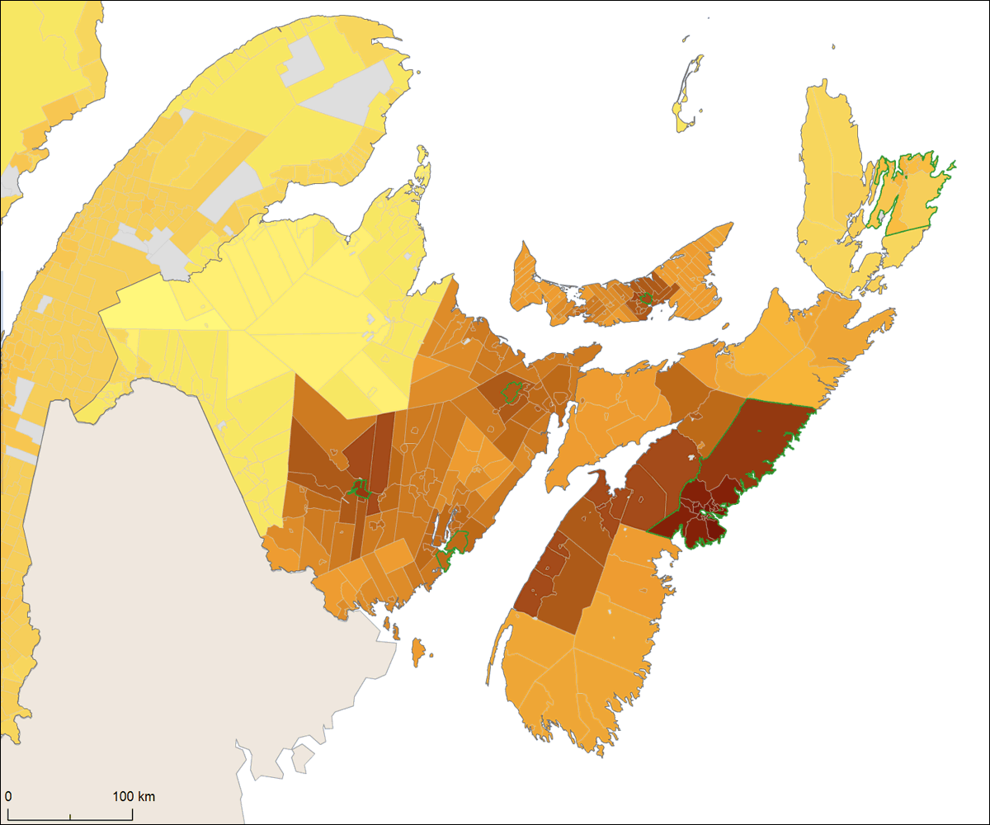
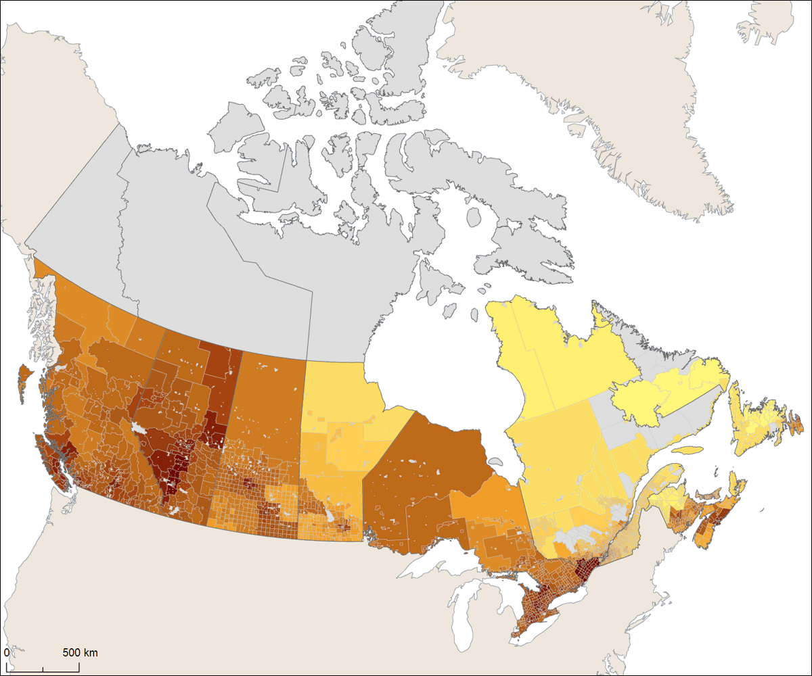
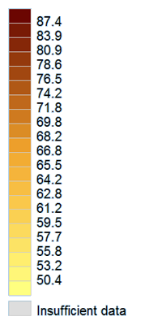
why LCT? an example: learning conditions in rural regions as compared to those in urban regions
CCL’s Composite Learning Index (2008)
  Canadian Council on Learning: “The Composite Learning Index (CLI) … provides an annual measure of Canada’s performance in a number of areas related to lifelong learning” (http://www.ccl-cca.ca/ccl/reports/cli).
Notes:
“A high CLI score means that a particular city or community possesses learning conditions that support social and economic success. Although not the sole factor contributing to such success, learning at every stage of life is increasingly important in today’s economy” (http://www.ccl-cca.ca/CCL/Reports/CLI/AboutCLI.htm).
LCT can serve as a leverage for those rural and far away regions that do not have urban type “learning conditions” conducive to helping raise the likelihood of social and economic success.
Knowledge exchange is not only about access to the right information, but also access to the right expertise that resides in individuals: thus the emphasis on both “learning” and “collaboration”.

