Slide 1

The Virtual Learning Organization
Stephen Downes
Ibagué, Colombia
December 5, 2012

Slide 2

This Presentation:
http://www.downes.ca/presentation/308
Slides, Audio, etc.

Slide 3

Three meanings:
  the organization that manages virtual learning
  the learning organization that is virtual
  the virtual organization that learns

Slide 4

1. The organization that manages virtual learning

Slide 5
The organization that manages virtual learning
  To this point in time, virtual learning has been organized the same way as traditional learning
  Characteristics:
    fixed cohort with start and end date
    fixed curriculum with learning objectives
    assigned activities and assessments

Slide 6
The Creation of the MOOC
  MOOC: Massive Open Online Course
  Started in 2008 by George Siemens and myself
Characteristics:
  No fixed cohort – open to all
  No fixed curriculum – students define their own
  No assignments – process of engagement
http://www.youtube.com/watch?v=eW3gMGqcZQc

Slide 7
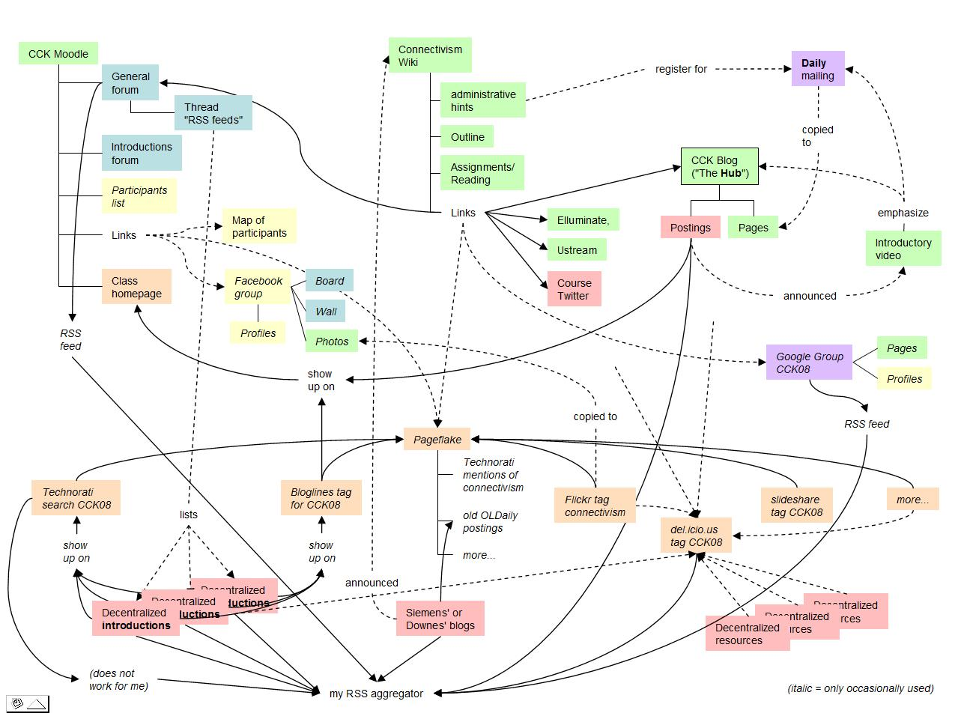
MOOC Course Structure

Slide 8
The MOOC Model: Course as Network
  Process – aggregate, remix, repurpose, feed forward
  Structure – no central course location, people use their own blogs or websites
  Content – no single thread – content as a web of related concepts and resources

Slide 9
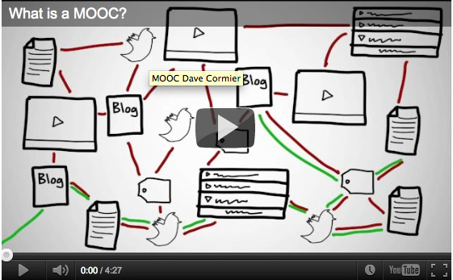
Success in a MOOC
http://www.youtube.com/watch?v=r8avYQ5ZqM0
Notes:
Bates: “MOOCs themselves are highly dependent, as Stephen acknowledges, on students already having a high level of understanding and an ability to learn independently, and to think critically.”
Formal education should be “developing and fostering such abilities so that learners can participate meaningfully in MOOCs and other forms of self-learning.”

Slide 10
Success Factors in a MOOC
  Openness – open content, open technology, open discussion, open assessment
  Autonomy – self-determination of content, success, process, expertise
  Diversity – plurality of technologies, of resources and information, of perspectives, of expression
  Interactivity – emergent knowledge created by connections, no single voice or message

Slide 11

  2. The learning organization that is virtual

Slide 12
  The learning organization that is virtual
    Learning organizations today are concrete
        they exist
        they have staff and funding structures
        they are physically based
    The inherent conflict between hierarchical organizations and non-hierarchal learning

Slide 13
The xMOOC and the cMOOC
The MIT and Stanford approach:
  one single course centre, run by experts
  open content, automated assessment
The OERu ‘Logic Model’
The new barriers
  payment for special tutoring
  payment for assessment
http://www.tonybates.ca/2012/03/03/more-reflections-on-moocs-and-mitx/

Slide 14
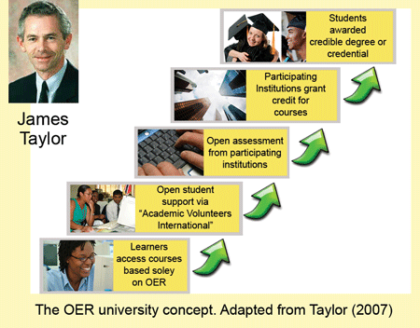
Dimensions of Openness
Open Content / Resources
Open Teaching / Open Classes
Open Assessment
http://www.col.org/blog/Lists/Posts/Post.aspx?ID=134

Slide 15
Managed Learning
  education as focused on outcomes
  standardized curricula
    defined as ‘competences’
    centralized testing
Education in the Service of industry
  learning vs. ‘skills shortages’

Slide 16
The Virtual Learning Organization
  Learning networks live in a domain in between institutions
  Points of interaction exist
    institutions contribute content, expertise
    institutions recognize achievement
  New, distributed learning organziations
    integrated with ‘real world’ activities
    ‘success’ defined by performance

Slide 17
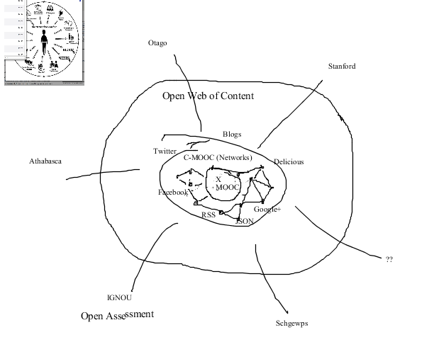
A Rough Concept

Slide 18

  3. The virtual organization that learns

Slide 19
  The virtual organization that learns
    Traditional organizations:
      built on a founding principle
      establishes vision and mission
      direction from the centre to the edges
    Criticism:
      susceptible to mismanagement
      unable to learn or adapt
      becomes corrupt and inbred

Slide 20
How Learning Happens
  what it is not: the communication of an idea from person to person, neuron to neuron
    (this is communication, not learning)
  what it is: development of organizational states in response to input or stimulus
    knowledge is grown, not created
    we can stimulate it; we can’t manage it
http://davecormier.com/edblog/2012/03/04/seeing-rhizomatic-learning-and-moocs-through-the-lens-of-the-cynefin-framework/

Slide 21
Groups
  Two forms or organization typically in conflict
    ‘Atomism’ – no cohesion or organization
      characterized by competition
    ‘Collectivism’ – individuals united as a body politic
      characterized by collaboration
  How these organizations ‘learn’:
    they don’t – neither form learns
    they communicate and replicate (either by imitation or control)

Slide 22
The Learning Network
  A third way: network organization
    individuals connected but not united
    characterized by cooperation
  Cooperation creates network structures
    learning happens when connections form between members
    the resulting organization is stronger than any individual

Slide 23
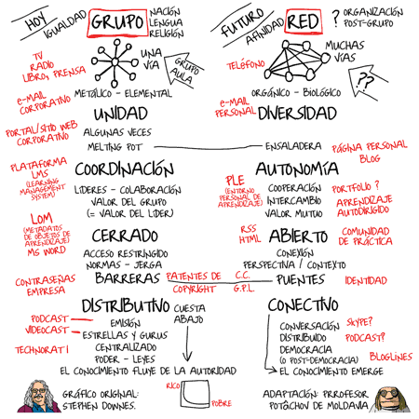
Groups vs Networks

Slide 24
The Principle of Self-Organization
  the mechanisms of interaction are defined
    (the syntax)
  individuals remain autonomous
  cohesion and organization occur as a result of feedback mechanisms

Slide 25
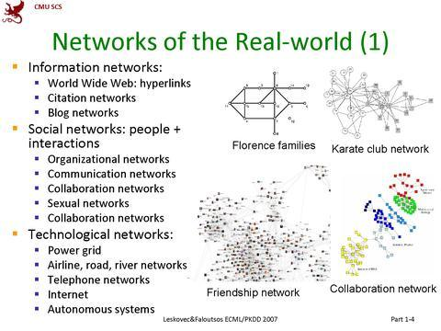
Networks in the Real World
https://suifaijohnmak.wordpress.com/2009/10/23/cck09-metaphors-for-the-social-ecosystems/

Slide 26
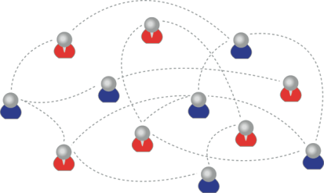
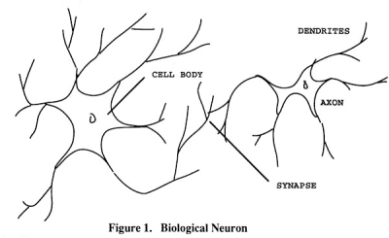
We are using one of these
To create one of these
Personal knowledge consists of neural connections, not facts and data

Slide 27
Learning a discipline is a total state and not a collection of specific states
It is obtained through immersion in an environment rather than acquisition of particular entities
It is expressed functionally (can you perform ‘as a geographer’?) rather than cognitively (can you state ‘geography facts’ or do ‘geography tasks’?)

Slide 28
We recognize this
By perfomance in this
There are not specific bits of knowledge or competencies, but rather, personal capacities

Slide 29
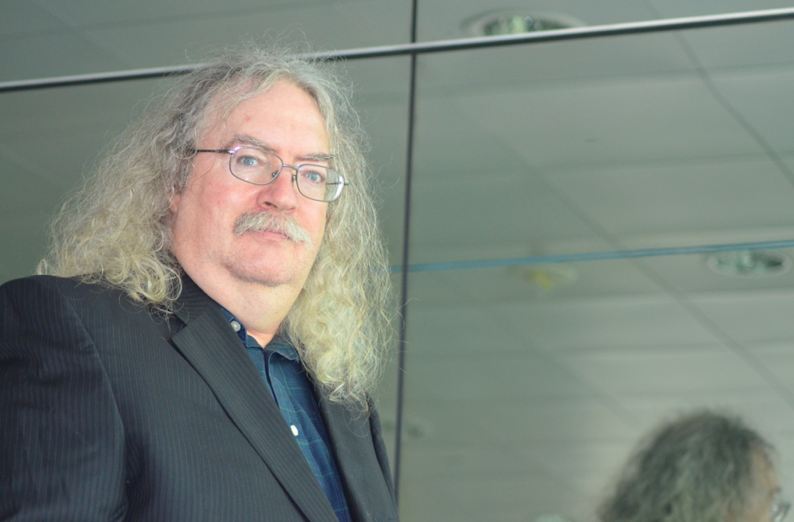
Stephen Downes
http://www.downes.ca

