Slide 1
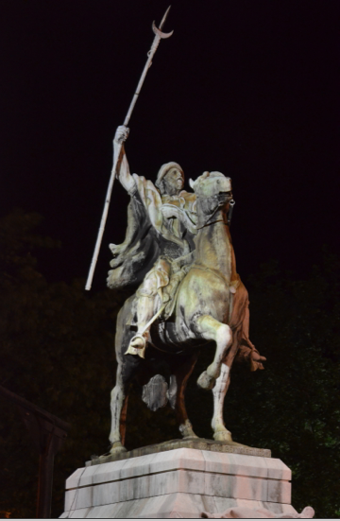
The LMS and the MOOC
Stephen Downes
MoodleMootUY, Montevideo, Uruguay
November 22, 2012

Slide 2
Title: The LMS and the MOOC
Abstract: With the widespread adoption of the massive open online course (MOOC) over the last year, questions are now being raised about the role of a learning management system (LMS) such as Moodle. Where previously the focus was on the management of course materials and cohorts progressing according to predefined objectives and curricula, the learning environment of the future is more open-ended and less overtly managed. In this talk Stephen Downes, one of the originators of the MOOC format, describes the differences between types of MOOCs, compares them to the LMS, and outlines the changes LMSs such as Moodle are looking at in the future.

Slide 3
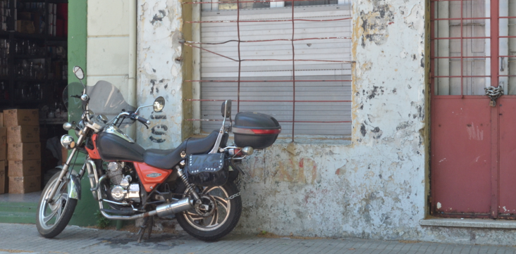
The Classic Model
A bit about MOOC Structure
The Connectivist Courses
Improving MOOCs
Reconceptualizing MOOCs
The Education Platform
Notes:
Right now (that is, today!) I'd like to explore the idea of education as platform. We've had some good experience now with massive open online courses over the last three or four years. A pretty good set of design elements are falling into place, and I'd like to talk about these and how they relate to the pedadgogy used to design the course. We have also encountered some design challenges, especially with regard to offering an orchestrated view of a wide variety of distributed learning materials. How do we improve the concept of the open online course to support a proliferation of new media and environments? How do we sustain conversation and communication among dynamic, constantly changing, groups? How do we comprehend and represent the learning experience in such a way as to be able to demonstrate progress?

Slide 4
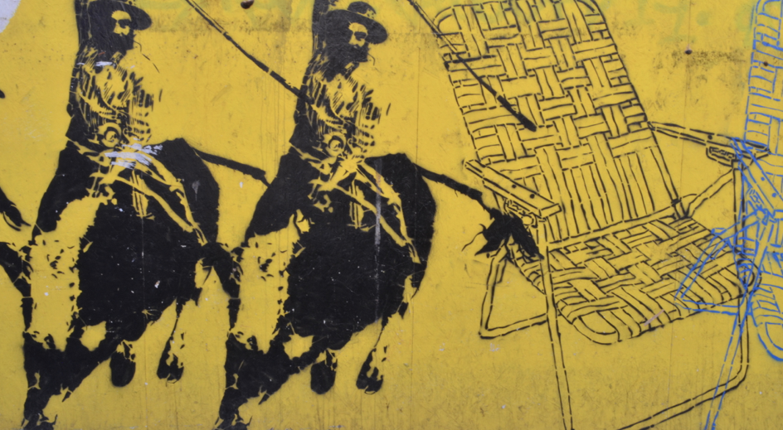
1. The Classic Model

Slide 5
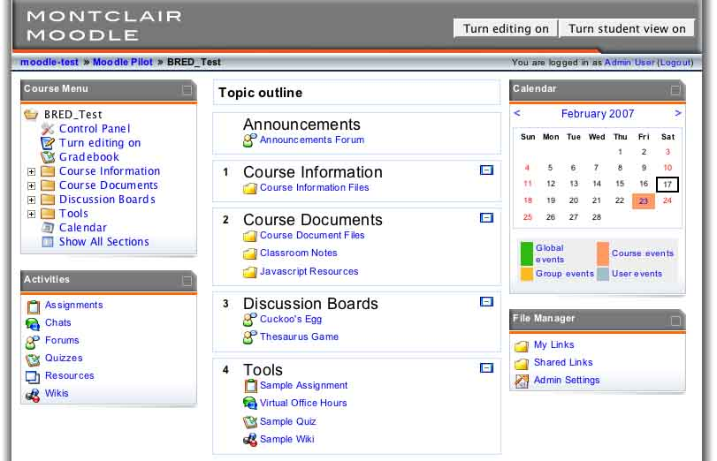
A Typical Course

Slide 6
The Classic Model
Objectives / Competences
(Pre-test or warmup)
Presentation of content
Learning Activity
Discussion / Reflection
Evaluation or Assessment
Reflection

Slide 7
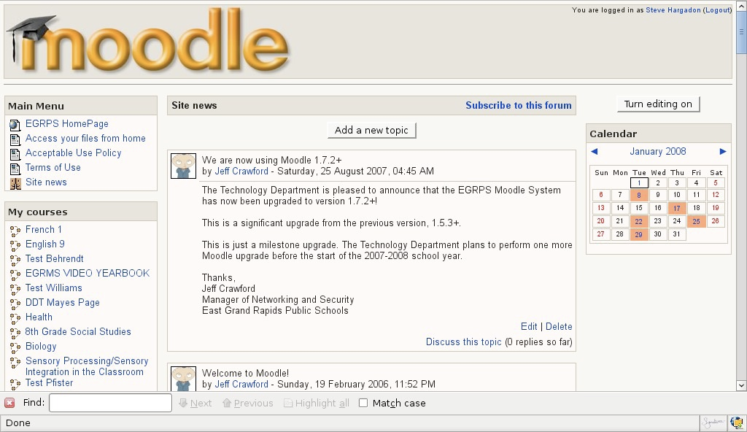
Discussion List

Slide 8
Characteristics
Managed enrollment
Linear structure
Organized local content
Set curriculum to be remembered
Competitive assessment
Knowledge as constructed or created

Slide 9

A bit about MOOC Structure
Notes:
George on disruption – not disrptive enough
Udacity, Khan Academy, Coursera – “I’ll tell you what you need to know”

Slide 10
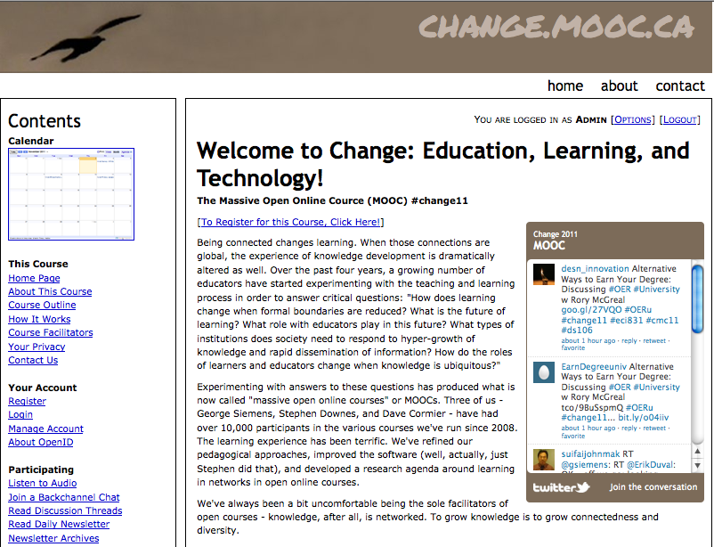
The MOOC Experience

Slide 11
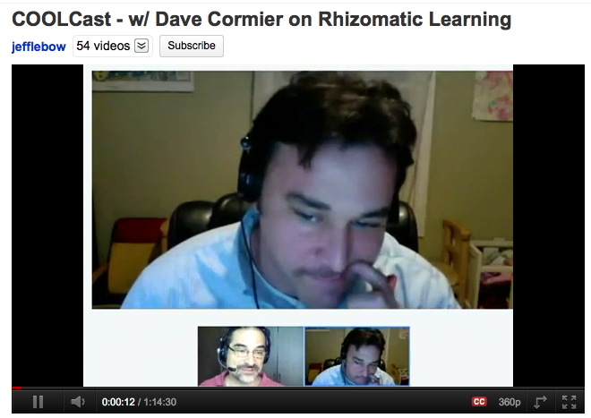
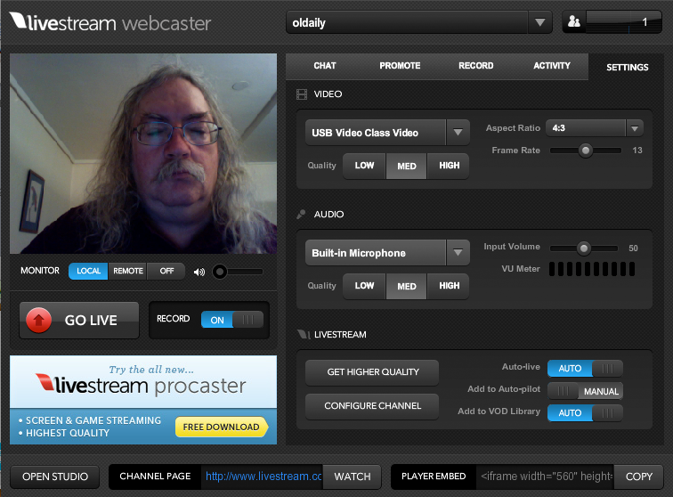
Open
Mix of levels – novice and experienced

Slide 12
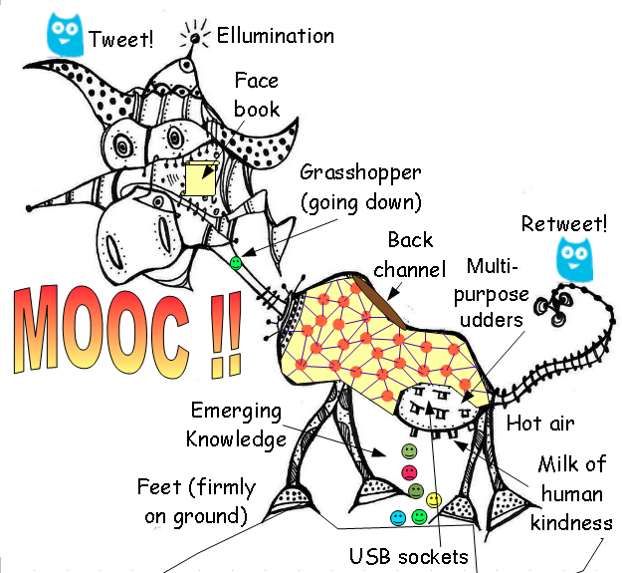
The network structure
http://cor-ar.blogspot.in/2012/03/two-distinct-course-formats-in-delivery.html
Notes:
distributed learning / distributed resources
Oswaldo – the central versus the aggregated
Format 1:
Many MOOCs have utilized a daily newsletter named “The Daily” which basically aggregates contributions from all blogs (or other resources) from participants tagged in a certain way. Examples are CCK08, PLEN2010, Change11 and LAK12.
Format 2:
Some MOOCs employ a “centralizing “web page used by the facilitators for announcing all activities and a mailing list open to contributions from participants(mostly Google Groups).

Slide 13
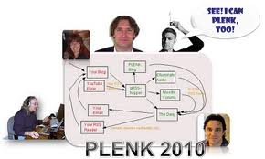

Aggregation – bringing together

Slide 14
The abundance of content
Some analogies:
  following football – there are more games in the world than you could possibly watch
  recipes – there is more food int eh world than you could possibly eat, more ways of eating food than you could experience in a lifetime
  places to visit – the world is vast, ou cannot possibly see everything

Slide 15
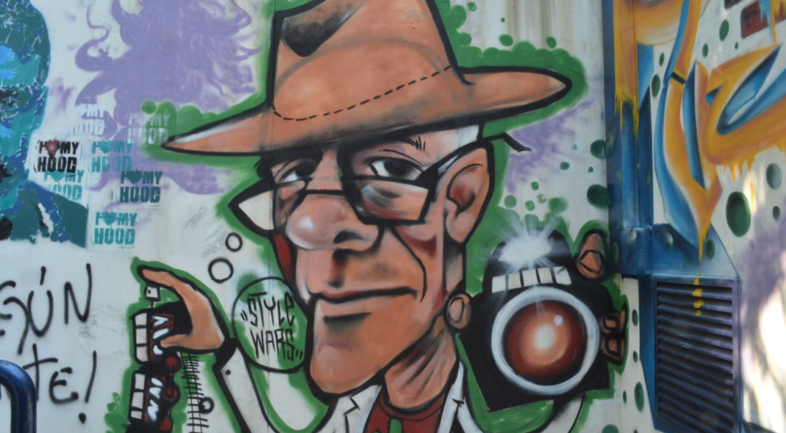
Social versus Solo
http://blog.learnlets.com/?p=2562
Notes:
Clark Quinn – contrasting Stanford AI with CCK: “The Stanford model, as I understand it (and I haven’t taken one), features a rigorous curriculum of content and assessments, in technical fields like AI and programming. The goal is to ensure a high quality learning experience to anyone with sufficient technical ability and access to the Internet. Currently, the experience does support a discussion board, but otherwise the experience is, effectively, solo.
The connectivist MOOCs, on the other hand, are highly social. The learning comes from content presented by a lecturer, and then dialog via social media, where the contributions of the participants are shared. Assessment comes from participation and reflection, without explicit contextualized practice.”

Slide 16
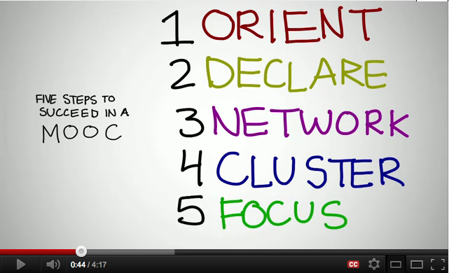
Success in a MOOC
http://www.youtube.com/watch?v=r8avYQ5ZqM0
Notes:
Cormier - http://www.youtube.com/watch?v=r8avYQ5ZqM0
Orient – finding stuff, figure out times
Declare – create a place for your thoughts+tags
Network – follow other people, make connections – reply and interact
Cluster – find a cluster to work with
Focus – find a purpose for the work you are doing

Slide 17
Self-Education
Bates: “They belong philosophically within the context of thinkers such as R. H. Tawney, Ivan Illich and Paulo Freire, who believed strongly in self-education, as part of their broader socialist views on equality, the need to open access to knowledge, and to educate the workers in order to break the existing hegemony, etc.”
http://www.tonybates.ca/2012/03/03/more-reflections-on-moocs-and-mitx/

Slide 18
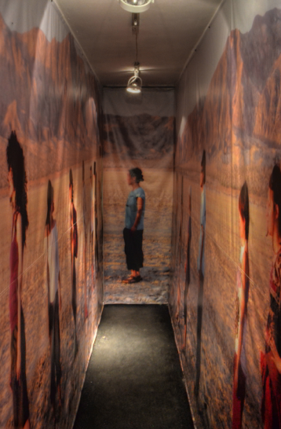
Knowledge as Grown
There is a contrast between knowledge as something that is acquired, ingested, retained, remembered, and knowledge that is something that is grown as a response to experience rather than as a representation of it

Slide 19
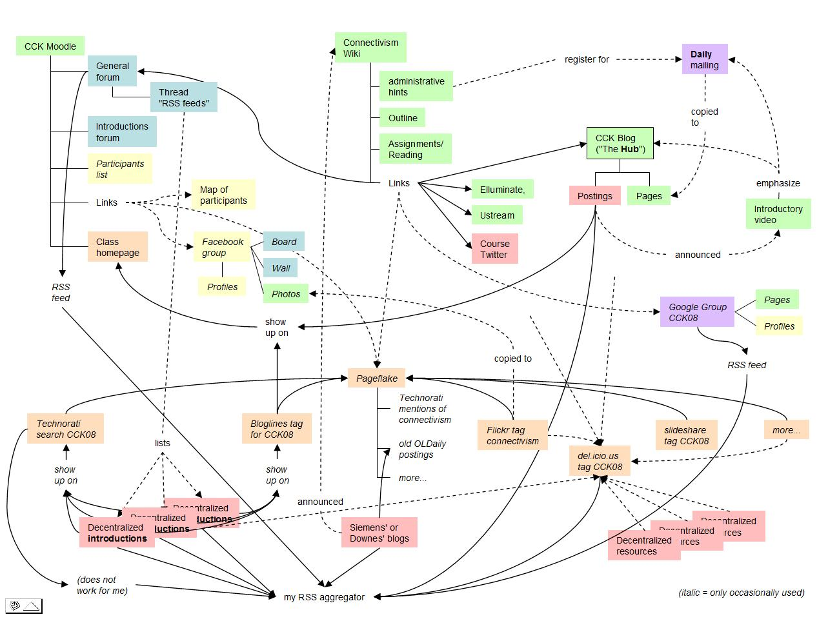
3. The Connectivism Courses

Slide 20
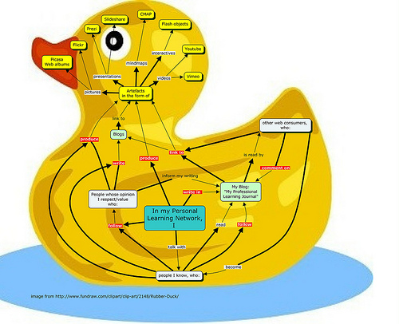
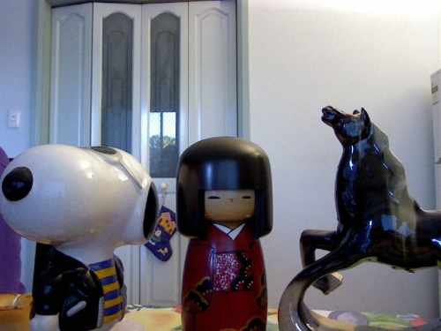
The Connectivism Courses
http://connect.downes.ca
http://www.mooc.ca
http://cck11.mooc.ca
http://change.mooc.ca
http://edfuture.mooc.ca
http://suifaijohnmak.wordpress.com/2011/03/10/cck11-how-to-explain-connectivism-mooc-and-plepln/

Slide 21
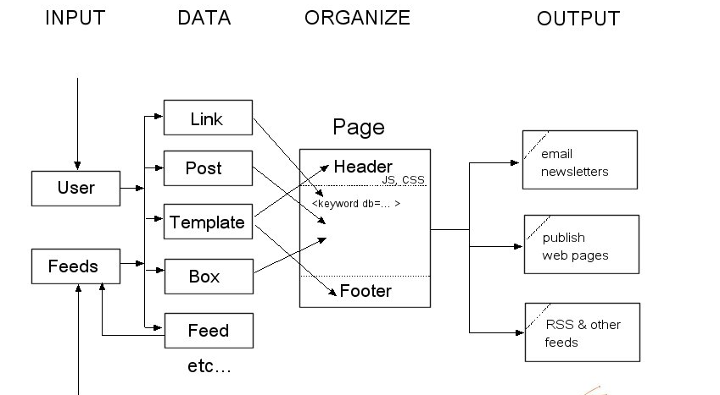
gRSShopper

Slide 22
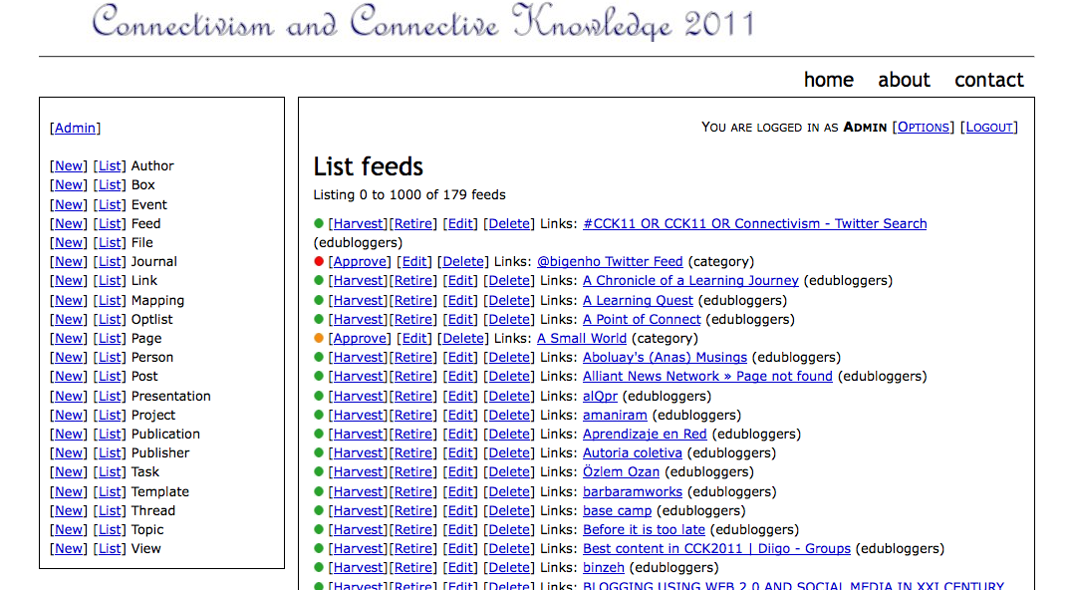
Feeds

Slide 23
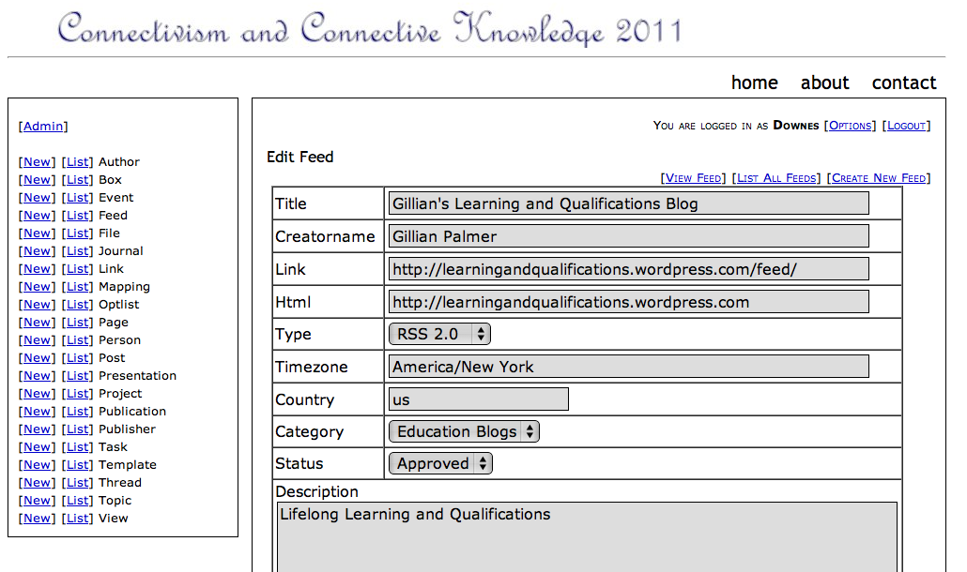
Feed Management

Slide 24
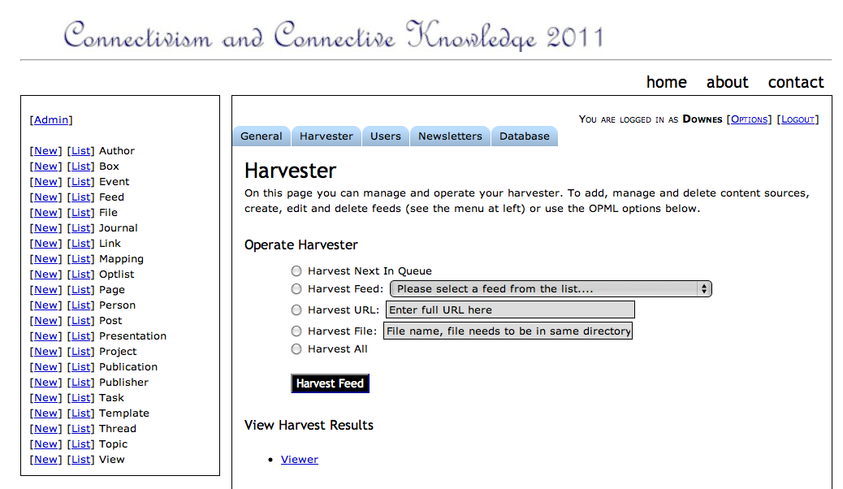
Harvester

Slide 25
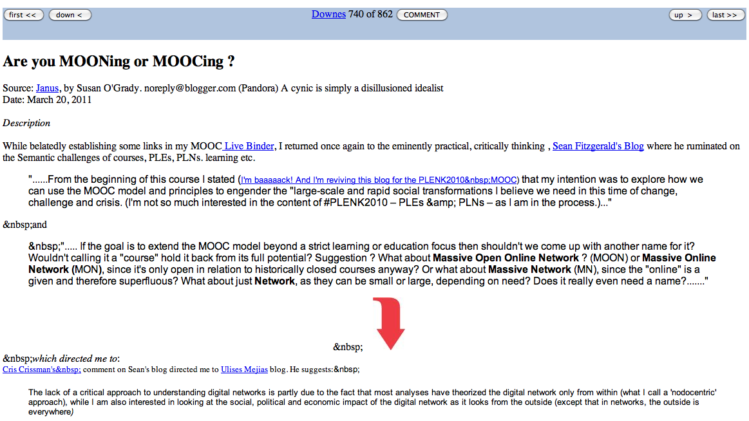
Viewer

Slide 26
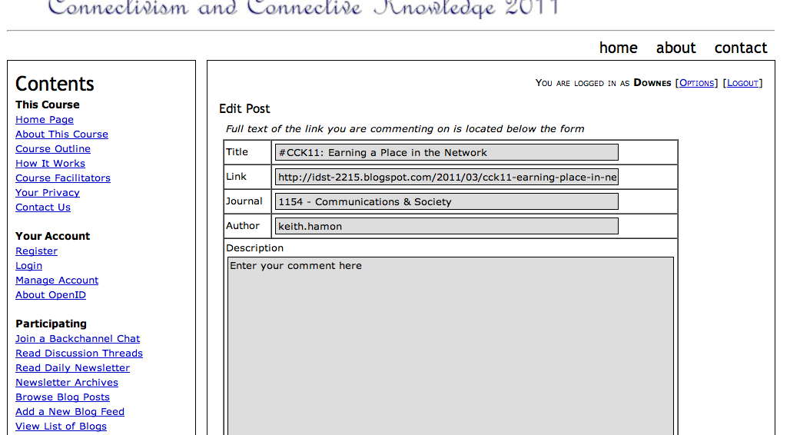
Commenter

Slide 27
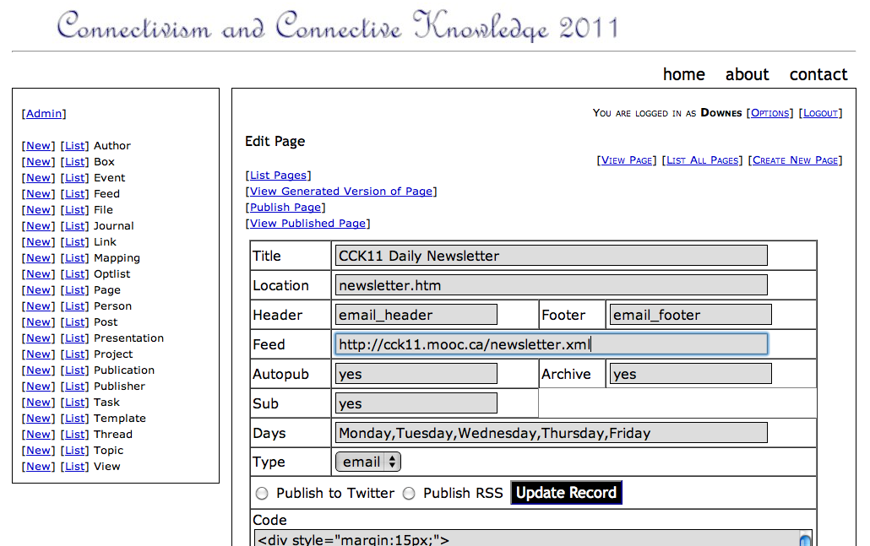
Newsletter

Slide 28
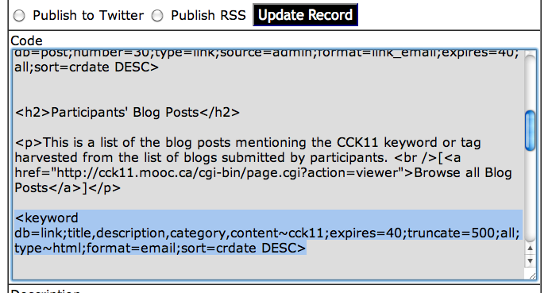
Page Design Code

Slide 29
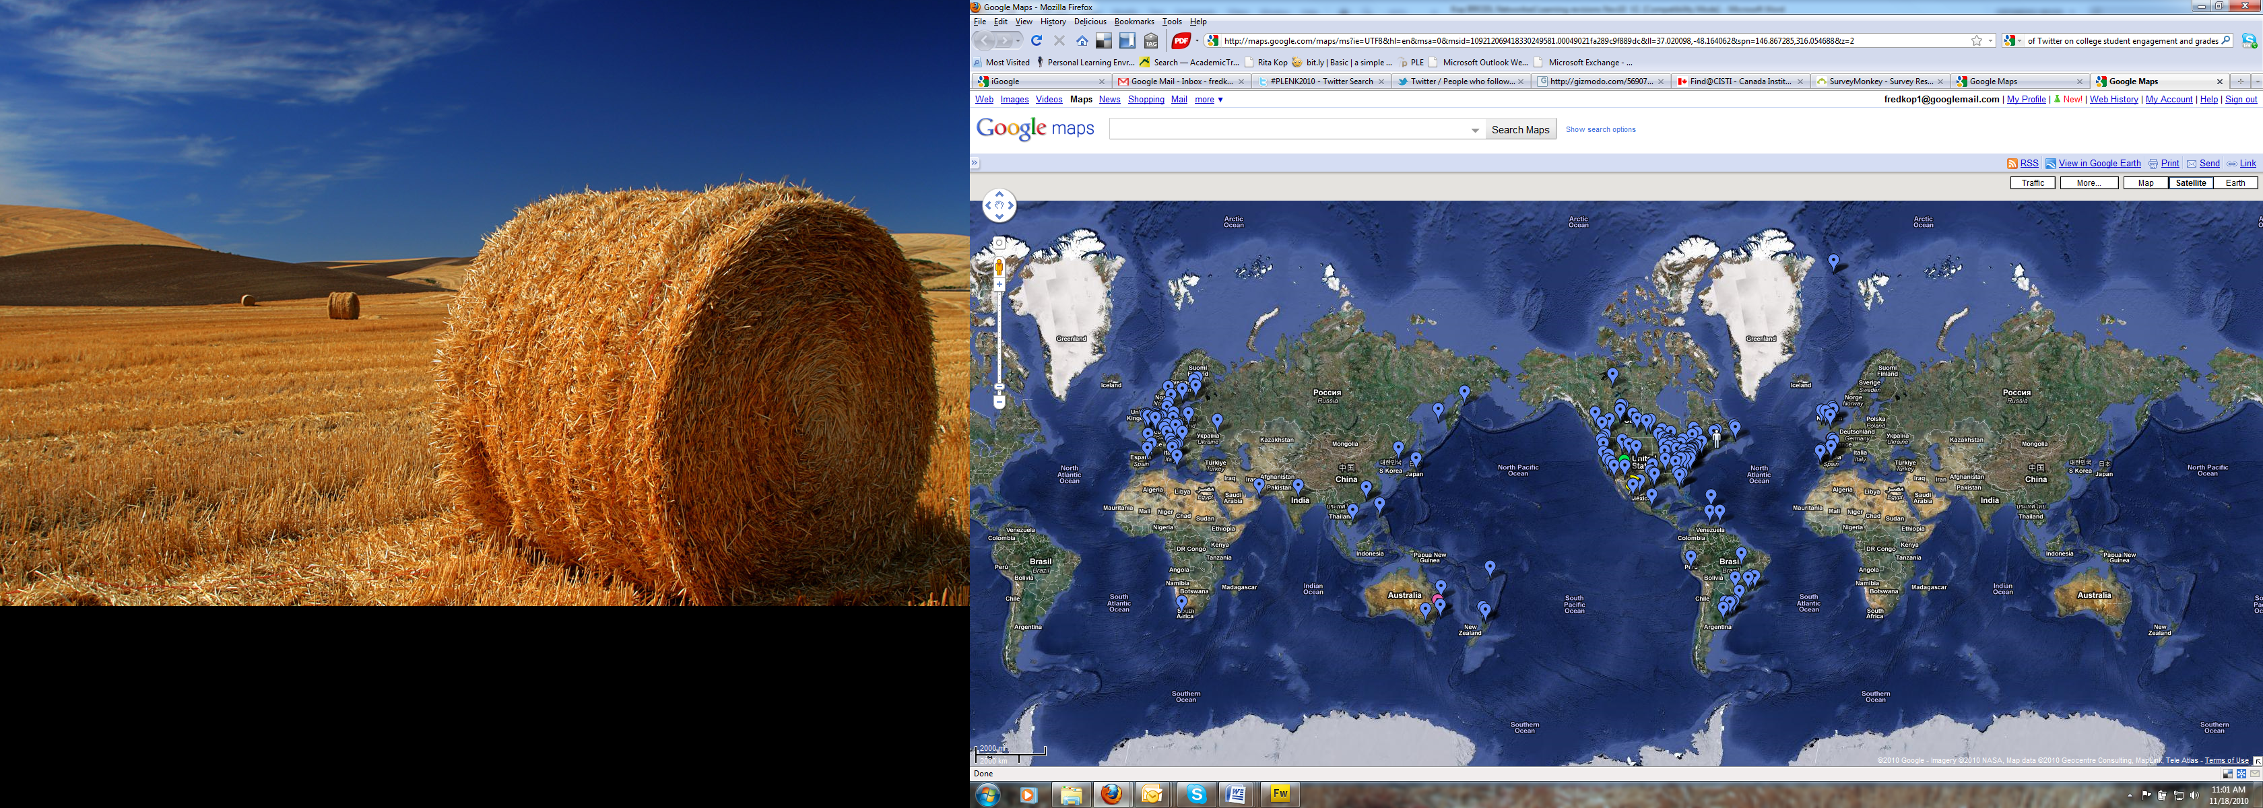
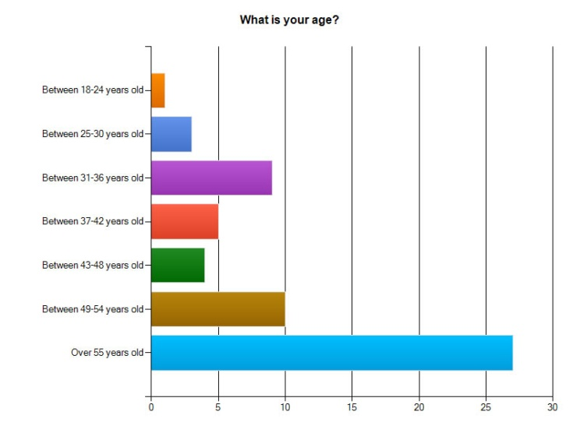
Our Experience
Kop and Fournier, Connecting the Dots, CIDER, 2011

Slide 30
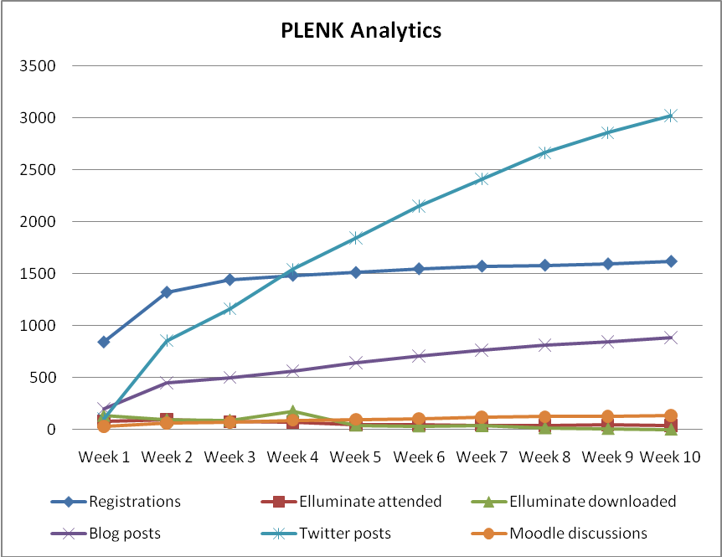
Our Experience
Kop and Fournier, Connecting the Dots, CIDER, 2011
PLENK participation rates
Notes:
Challenges of analyzing and visualizing participation on the course. When the course started, 846 had registered, which steadily increased to 1641 at the end of the course, as shown in Chart 2. People took part in the twice weekly meeting sessions that were hosted on Elluminate, once a week with an invited speaker and once as a discussion session amongst the group and facilitator(s). Actual presence at these synchronous sessions decreased over the weeks from 97 people in week two, when attendance was the highest, to 40 in the final week and there was a similar trend in the access of the recordings.
Global participation and multiple time zones influenced who were present and who accessed the Elluminate recordings. A high number of blog posts were generated related to the course (949) and an even higher number of Twitter contributions (3459). The #PLENK2010 identifier facilitated the easy aggregation of blog posts, del.icio.us links and Twitter messages produced by participants, which highlighted a wide number of resources and links back to participant’s blogs and discussion forums, and thus connecting different areas of the course. Although the number of course registrations was high, an examination of contributions across weeks (i.e., Moodle discussions, blogs, Twitter posts marked with #PLENK2010 course tag, and participation in live Elluminate sessions) suggested that about 40-60 individuals on average contributed actively to the course on a regular basis by producing blog posts and discussion posts, while others’ visible participation rate was much lower.

Slide 31
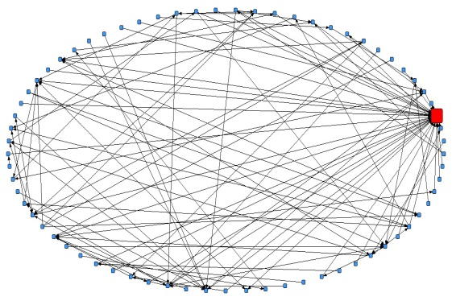
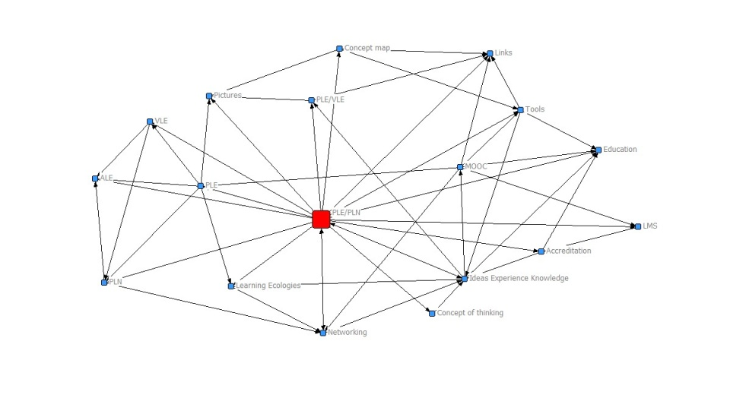
Our Experience
The complex network a facilitator's post generated
Kop and Fournier, Connecting the Dots, CIDER, 2011
Relationships between topics in a discussion in week 1
Notes:
The chart on the last slide shows the number of times people used particular tools but does not show how these interactions took place and we have been experimenting with several analytics tools, such as social network analysis tool SNAPP used as a bookmarklet to the browser. The activation of the SNAPP tool results in an online network visualization and the results of these interactions have been exported to both VNA (Edgelist format) and GraphML formats and used in the NetDraw tool to create network visualizations to understand the role that an actor plays in a particular discussion.
The figure on the left shows that the facilitator is important (the red dot), but that there are other participants with a strong influence on the network through their connections with others. In addition, the second figure shows the relationship between some of the course topics of discussion.

Slide 32
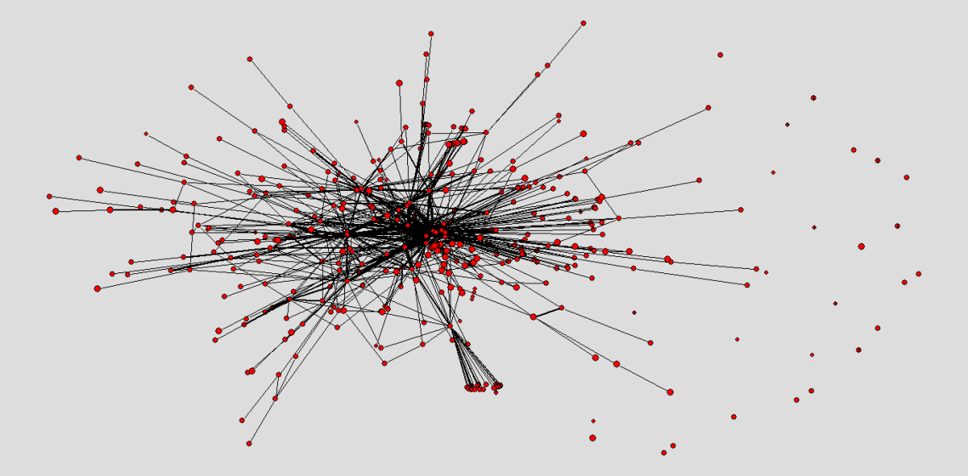
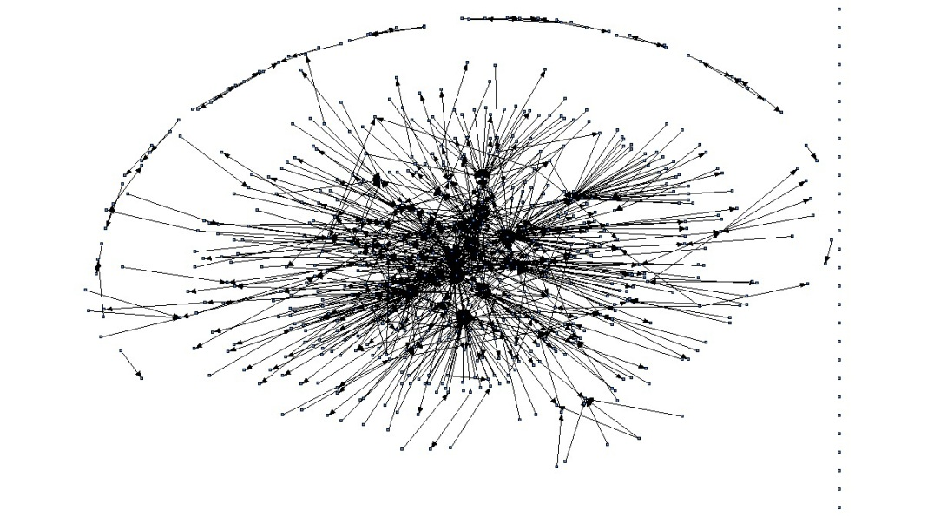
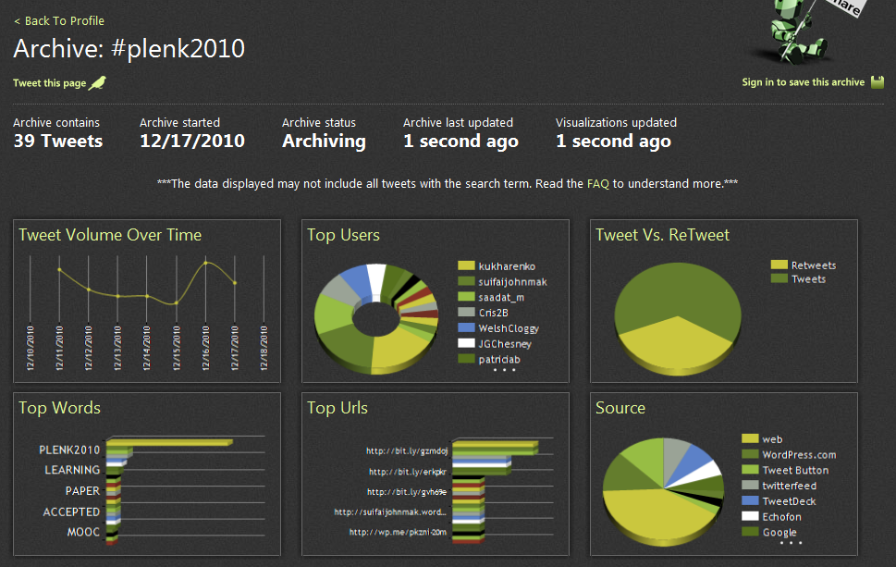
Our Experience
Plenkers in Twitter
Tweets for a week: Tweets, retweets, replies
Kop and Fournier, Connecting the Dots, CIDER, 2011

Slide 33
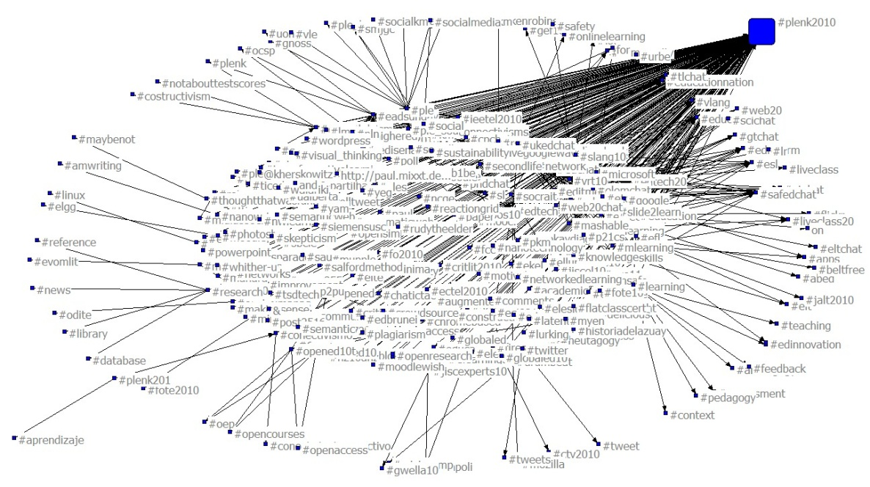
Our Experience
Twitter PLENK connections to hash-tag networks
Kop and Fournier, Connecting the Dots, CIDER, 2011
#tags related to Twitter posts in the PLENK Daily - six weeks duration
Notes:
And the two images here show the connections of the people on PLENK while using Twitter. The one on the right represents, over a six week period, to what other communities people sent tweets. A #tag can be used as an identifyer of a particular subject, in this case a course, and as you can see PLENK participants also sent messages and links to these other #tag communities. It doesn’t tell anything about the quality of the interactions, but it shows the connectedness.
The image on the left shows Twitter communications within PLENK and it shows that some people are ‘information hubs’ while others did not communicate much.

Slide 34
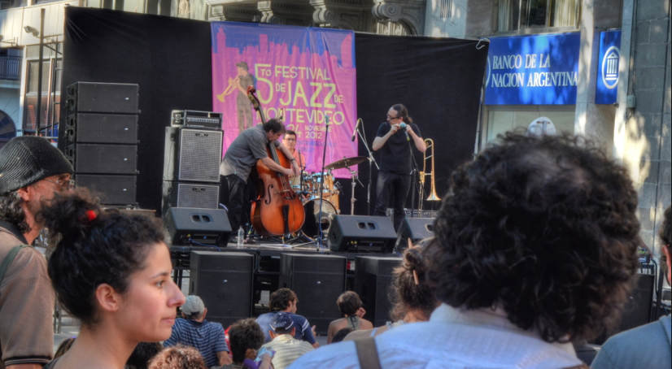
4. Improving MOOCs

Slide 35
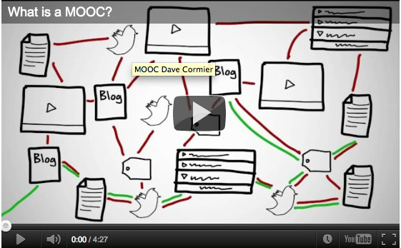
The Bootstrap Problem
http://www.tonybates.ca/2012/03/03/more-reflections-on-moocs-and-mitx/
Notes:
Bates: “MOOCs themselves are highly dependent, as Stephen acknowledges, on students already having a high level of understanding and an ability to learn independently, and to think critically.”
Formal education should be “developing and fostering such abilities so that learners can participate meaningfully in MOOCs and other forms of self-learning.”

Slide 36
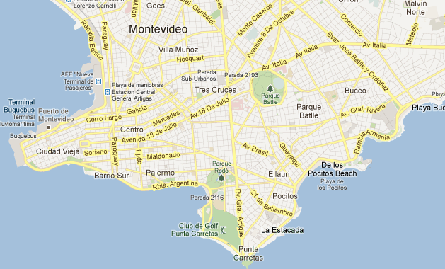
Navigation
Notes:
We often found navigating the MOOC waters frustrating. Once we got started it was not difficult to find the course material and a few other participants, but where was everything else? There didn't seem to be any discussion happening in one easily-accessible place. Why should content have to be so difficult to find? If you don't user Twitter, you can miss a vital discussion thread. Facebook groups or Google groups exist, but if you join the wrong one you could be one of 10 voices instead of one of 1700 participants. That's a lot of missed connections.
Synchronous forums—hosted during the run of the MOOC—are also prone to limited participation, while many blog posts lack comments. The problems with architecture and tools often subvert the promise of "connectedness" that MOOCs should provide.
Another concern lies with existing material. As fellow participants we question the value of simply retrieving old information from previous versions of a course. Since some participants are simply using the labor of previous learners to clarify difficult topics, are current learners getting as much out of the topic as they should?

Slide 37

Size versus Connectedness
Lisa Chamberlin and Tracy Parish
http://elearnmag.acm.org/featured.cfm?aid=2016017
Notes:
“The number of people in a course can be overwhelming! How does someone connect with 2000-plus people? How does a learner even begin to make sense of all those voices adding commentary, questions, and posts? How does a learner get instructor feedback in this kind of a situation? It is impossible for an instructor to interact with even 1/10th of the class or even manage to address 1/10th of what is posted. The size of the MOOC size, while impressive, might work against the "connectedness" the facilitators and participants often seek.”

Slide 38
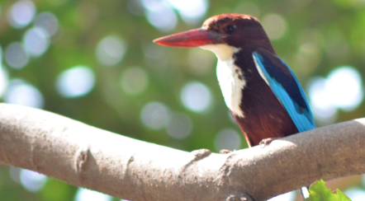
Elitism
Notes:
“Those who will not reach the academic level set by the organizers will remain lurkers who can only profit in discussing with the those in the crowd that can argue at the same level. But they cannot increase their skills. What’s that good for? The courses silently separate the elite from the mass. It looks like democracy but is quite the opposite of [real] teaching. Education normally tries to help people to enhance their understanding and make up their minds. MOOCs don’t take care of this. They are a non-educational approach. The new freedom and openness is a freedom for nothing.”

Slide 39

Effectiveness
What is learning if it isn’t learning content? How can we assess it, credentialize it?

Slide 40
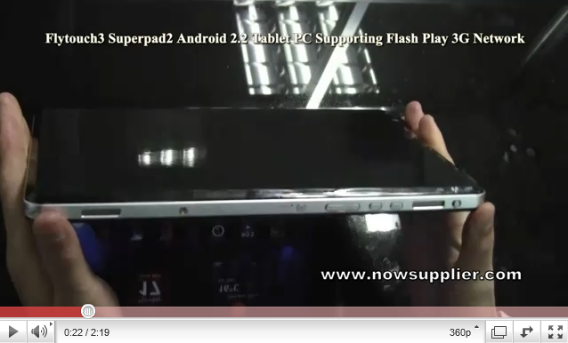
Assessment and Analytics
It makes no sense to rely on quizzes and tests
Big Data, Web of Data, Semantic Web, RSS, Geo, FOAF…
Mash-ups, APIs, the Cloud, Social Network

Slide 41
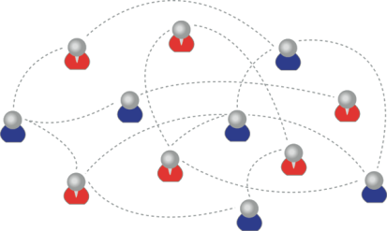
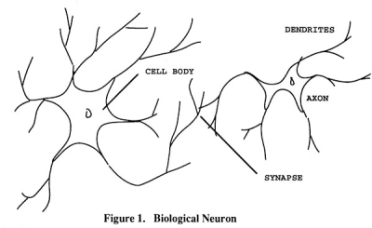
Learning Outcomes
We are using one of these
To create one of these
Personal knowledge consists of neural connections, not facts and data

Slide 42
Learning Outcomes
Learning a discipline is a total state and not a collection of specific states
It is obtained through immersion in an environment rather than acquisition of particular entities
It is expressed functionally (can you perform ‘as a geographer’?) rather than cognitively (can you state ‘geography facts’ or do ‘geography tasks’?)

Slide 43
Learning Outcomes
We recognize this
By perfomance in this
There are not specific bits of knowledge or competencies, but rather, personal capacities
(more on this later)

Slide 44
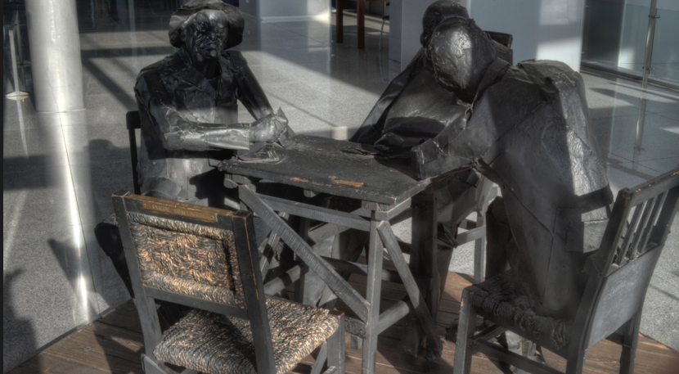
5. Reconceptualizing MOOCs

Slide 45
Open
everybody can participate – but more importantly, there are many ways to participate
  ‘open’ means being able to watch
  ‘open’ means being able to participate at your own level
  ‘open’ means participating publicly, so others can watch

Slide 46
Online
means that it is connective, interactive
You can’t put a MOOC on a DVD
The MOOC is the process
It is a process that is greatly aided by being online
  many tasks are automated, scaffolded
  much greater communicative capacity
  more access to data, calculations

Slide 47
Connective
To the extent that a MOOC is about content, the MOOC fails
  it’s like confusing the learning of a game, or the playing of a game with memorizing the rules of a game
  it’s like confusing enjoying food and knowing how to cook with the memorization of recipes
  it’s like confusing the experience of travel with knowing where things are on a map

Slide 48
Restating the Problem
our MOOCs are insufficiently connective, and tend to slip toward an emphasis on content
  the form of connectivity – online conversation – is at once too simplistic and too complex
  looking for other ways to connect – eg., artwork (a la ds106) or activities/projects (but these have been very poorly defined in our courses)

Slide 49
Rediscovering Process
As we fail to provide process, the courses revert to their old ways
  people think the course is about the content
  they gravitate toward dependence on the leadership, and away from personal participation
It’s not that we don’t scaffold enough, it’s that there are not opportunities for participants to ‘play’

Slide 50
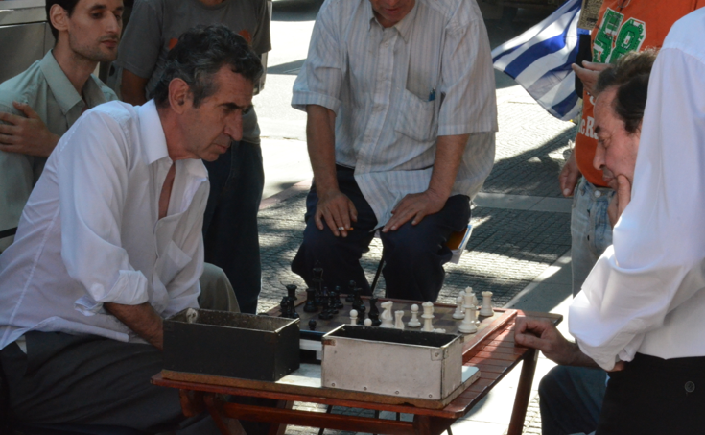
MOOC, Meet Game
The MOOCs we have offered have been very high level, involving professional presentations and conversations – but what would a MOOC look like for a 10-year old?
My answer: it would look like a game

Slide 51
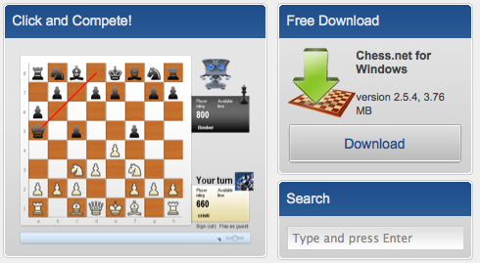
Searching for Chess Net
Chess.net
http://www.chess.net
Notes:
Chess.net
Commercial service - For Chess.net enthusiasts - $8/quarter and $4/month options available!

Slide 52
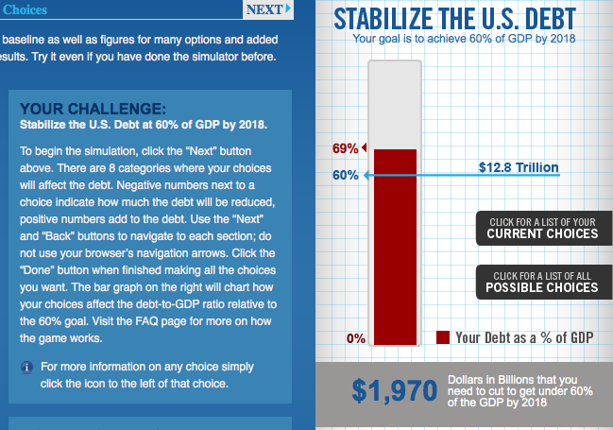
Budget Simulators
http://crfb.org/stabilizethedebt/
Notes:
Simulators – eg. http://crfb.org/stabilizethedebt/ from ‘The Committee for a Responsible Federal Budget’ –focus on cutting the debt

Slide 53
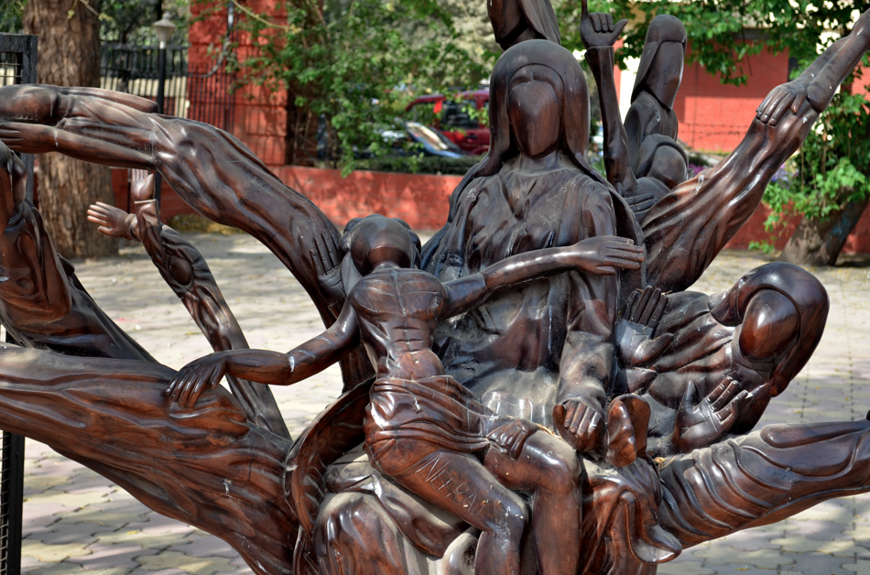
What’s Wrong With The Simulators
they try to ‘teach’ – but instead become propaganda
they reduce complex problems to simple fixes

Slide 54
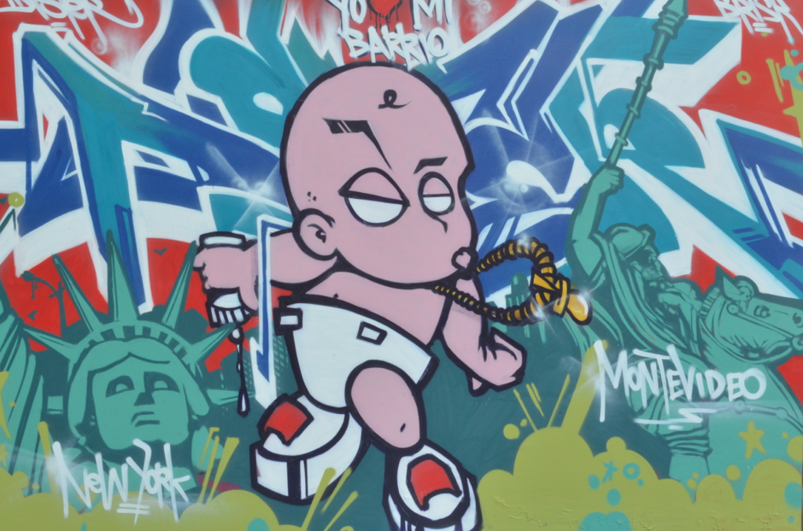
6. The Education Platform

Slide 55
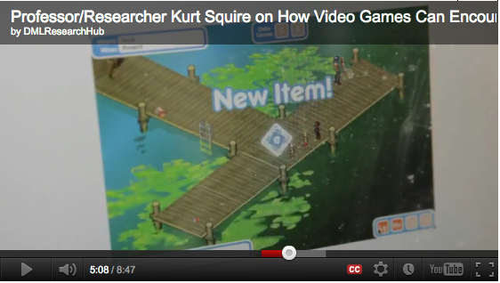
Critiquing the games
http://www.downes.ca/post/57523
Notes:
if your game is a ‘serious game’ or an ‘educational game’ it is probably missing its purpose
example from Kurt Squire – http://www.downes.ca/post/57523
(we’ve taught you everything you need to do to change the lake – we’re hopeful there will be a mass of students that actually do it)
better example – skills that you have to develop, eg. ‘writing a team charter’, ‘customize interface’

Slide 56

The Paucity of Badges
Notes:
What is a badge – a set accomplishment But was is accomplishment? Placement near a centre cluster. But there are thousands, millions, of clusters, and they are always shifting. Badges are hopelessly unable to keep up with that.
8j2b3mhx8
vyw4nt8x

Slide 57
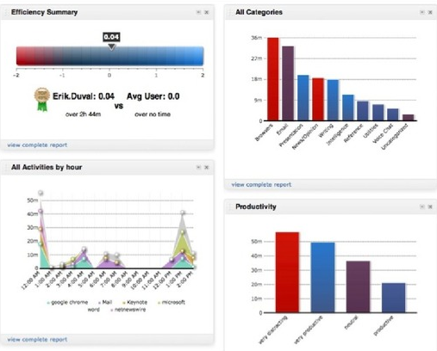
The Emptiness of Analytics
Notes:
What are you measuring?
‘That which is measured is managed’ -- vs – ‘That which is measured is distorted’

Slide 58
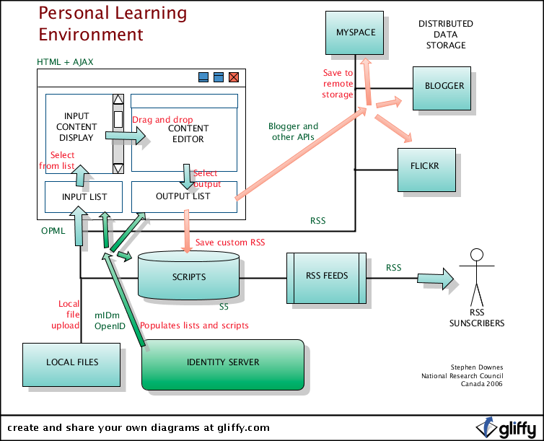
Personal Learning Environment
Notes:
Similar to your gaming client – customize your input stream, communications, etc

Slide 59
The Connectors
Things – events, games, arenas, etc., to ‘connect’ individuals with each other
  either as plug-ins on individual PLEs, or
  as third-party services, like scrabble.net
Conversation?
Chess game?
Simulation?

Slide 60
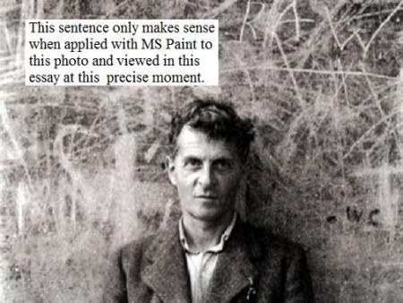
Language Games
http://www.popmatters.com/pm/post/65550-games-as-language-systems
Notes:
What is the language game of a domain or a discipline?
How do we begin to ‘think like a chess player’?
Elements of language = elements of games – syntax, semantics, pragmatics, context, inference, change

Slide 61
Ladders, Vectors, Networks
Chess and other person-to-person games rank people in ‘ladders’ (people want to ran schools this way too)
One way to think of a network is as a multidimensional ladder
Ranking is therefore ‘position’ in a network

Slide 62

http://www.downes.ca

