Slide 1
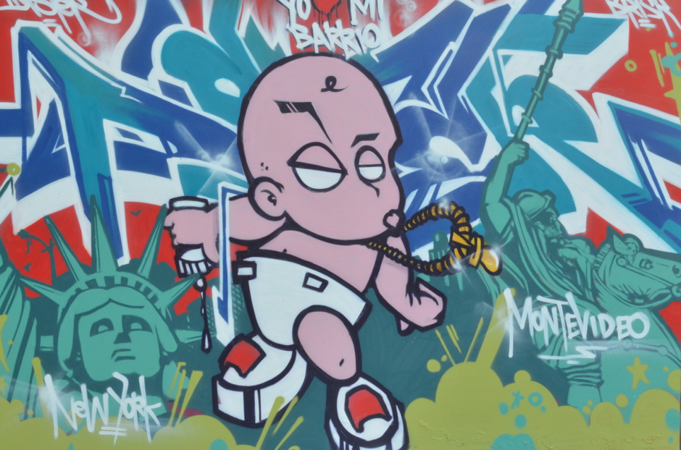
OER MiniCourse
Stephen Downes
Montevideo, Uruguay
November 21, 2012

Slide 2
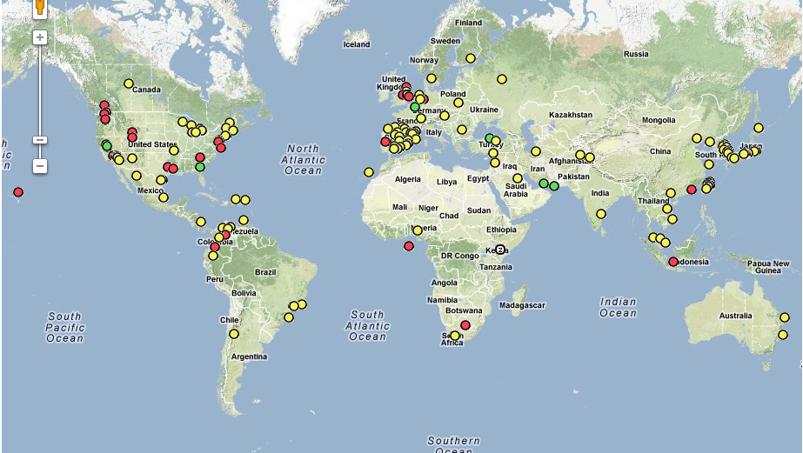

OER World Map
http://oerworldmap.oerknowledgecloud.org/

Slide 3
Setting Up
Wiki - http://oerminicourse.wikidot.com/
Backchannel - http://www.downes.ca/cgi-bin/cchat.cgi

Slide 4
What makes an OER
Definition of an OER: “any type of educational materials that are in the public domain or introduced with an open license.” http://www.unesco.org/new/en/communication-and-information/access-to-knowledge/open-educational-resources/
  Eg. OpenCourseWare (MIT) – link
  Eg. African Health OER Network – link
  Eg. Clean Water OER – link
OER Toolkit: http://wikieducator.org/UNESCO_OER_Toolkit_Draft

Slide 5
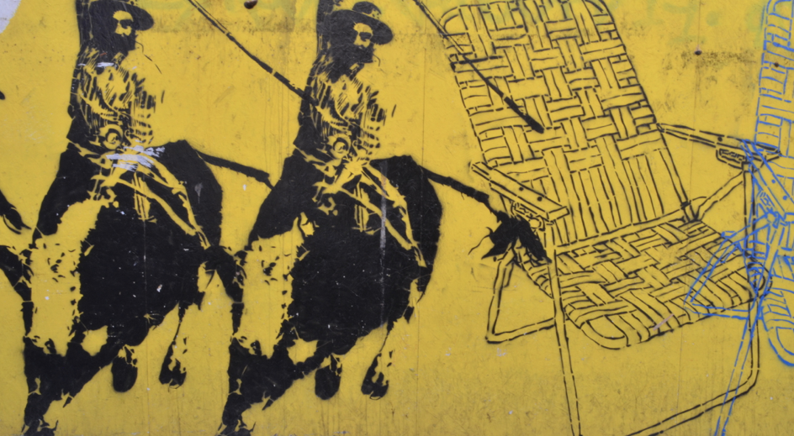
OER Content?

Slide 6
What Content?
open courseware and content;
open software tools (e.g. learning management systems);
open material for e-learning capacity building of faculty staff;
repositories of learning objects; and
free educational courses
Jan Hylén http://www.oecd.org/edu/ceri/37351085.pdf

Slide 7
More Content
Visiting lecturers and experts
Twinning arrangements - international exchanges of students and academic staff
Imported courseware in a variety of media
Externally developed sponsored programmes
Inter-institutional programmes developed collaboratively
Publications
Information resources on the Internet.

Slide 8
Creating OERs
Find
  Flickr CC Search, Google CC Search
  Wikimedia Commons - http://commons.wikimedia.org/wiki/Main_Page
  OER Commons - http://www.oercommons.org/
Creating
  Connexions - http://cnx.org/
  free-form: Google Docs – http://docs.google.com
Quality - http://www.oer-quality.org/
http://www.slideshare.net/epuckettrodgers/create-oer

Slide 9
The ‘Classic’ Model
Objectives / Competences
(Pre-test or warmup)
Presentation of content
Learning Activity
Discussion / Reflection
Evaluation or Assessment
Reflection

Slide 10
Learning Activities
ds106 – Submit Project Ideas
  http://assignments.ds106.us/
OER Commons – Games
  http://www.oercommons.org/courses/material_types/games
Collaborative activities
  http://www.oerafrica.org/supportinglearners/Unit5/Collaborativelearningactivitiesforfacetofac/tabid/1064/Default.aspx

Slide 11
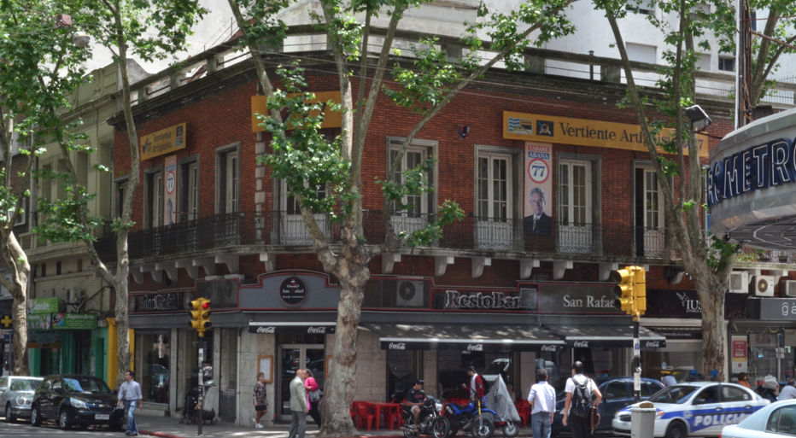
Your Metadata

Slide 12
OER Metadata (old)
IMS / IEEE - LOM http://www.imsproject.org/metadata/
Learning Design
Common Cartridge http://www.imsglobal.org/commoncartridge.html
Learning Tools Interoperability
Interactive WhiteBoard/ Common File Format
Learning Information Services
  http://www.imsglobal.org/cc/statuschart.cfm

Slide 13
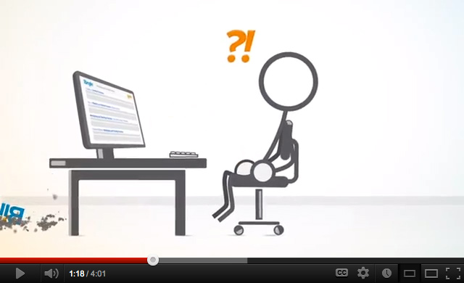
OER Metadata (new)
LRMI - http://www.lrmi.net/ (videos)
Also: http://creativecommons.org/tag/learning-resource-metadata-initiative

Slide 14
OER repositories
need: method to find OERs in different subject areas
  Britain - Joint Academic Coding System (JACS) http://www.hesa.ac.uk/index.php?option=com_content&task=view&id=158&Itemid=233
  UNESCO – ISCED - http://www.uis.unesco.org/Education/Pages/international-standard-classification-of-education.aspx
Harvesting
  OAI, Dlink
OpenAire - The EPrints software and DSpace IR software) both have OpenAIRE-compliant plugins.

Slide 15
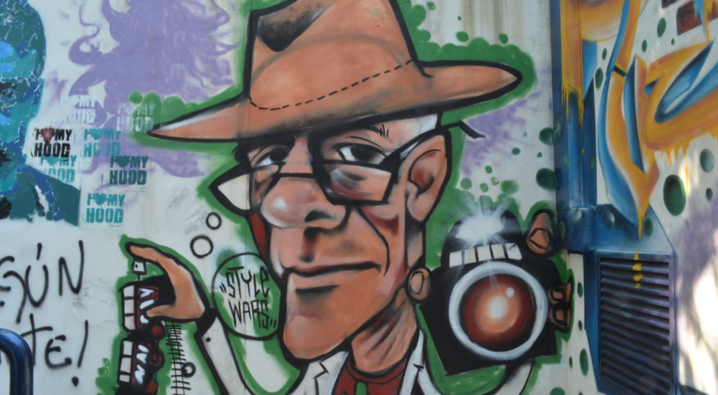
Sustainability

Slide 16
Sustainability Models for OERs
Endowment – eg. Stanford Encyclopedia of Philosophy
Membership – eg. Sakai
Donations – eg. Wikipedia
Conversion – eg. Suse, RedHat, Ubuntu
Contributor Pay – eg. PLoS
Sponsorship – eg. MIT iCampus Outreach Initiative (Microsoft)
Institution / Government
Partnerships and Exchanges
http://www.downes.ca/post/33401

Slide 17
How to use an OER
Stand-alone
Course model
MOOC model

Slide 18
Content sharing from live events
Recording – Audacity
Broadcasting – Hangout, Livestream

Slide 19
Other topics as I think of them :)

