Slide 1
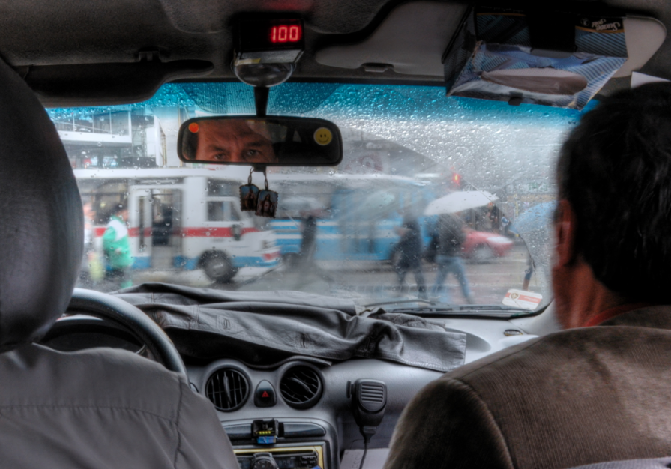
Sustainability and MOOCs in Historical Perspective
Stephen Downes, Bogota, November 15, 2012

Slide 2

This Presentation
http://www.downes.ca/presentation/304
- slides
- audio
- video

Slide 3
Online Learning: Two Origins
A basis in distance learning – managed learning, course packs, independent study
A basis in traditional classrooms – classes and cohorts, synchronous interaction, activities and projects

Slide 4
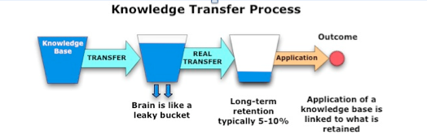
Pedagogies
Transmission model – Moore’s ‘transactional distance’ - based in communications theory
Constructivism – based on social interaction and negotiation of meaning; learners ‘construct’ their own knowledge

Slide 5
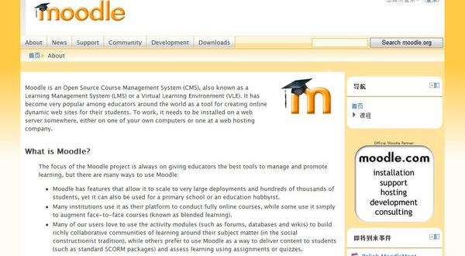
Learning Management Systems
Blackboard, WebCT, Desire2Learn
Moodle, Sakai
Two models: hosted, installed

Slide 6
Conferencing
Mailing lists and early massive email classes (listserv, majordomo)
Conferencing systems and discussion boards (First Class)
Instant messaging and SMS (ICQ, sms)

Slide 7

Learning Objects
IMS LOM
Content Packaging
Learning Design
Interoperability
SCORM

Slide 8

Repository Networks
National projects – EdNA, Edusource, Globe
Open Content – OAI, DSpace
GLOBEhttp://globe-info.org/

Slide 9


Learning Communities
Wenger – Communities of Practice
Portal sites
Online Communities – Net.Gain
OLDaily
PEGGAsus

Slide 10
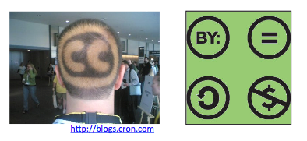
Open Educational Resources
Open Content – David Wiley
Open Licensing – Creative Commons

Slide 11

Models of Sustainability
Author-pay models
Foundation models
Public service models
Community models

Slide 12

E-Learning 2.0
Blogging and RSS
Social networks
Personal learning networks (= personal communities)
The web as platform
web of data
websites as applications

Slide 13
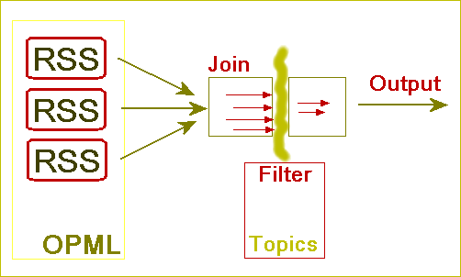
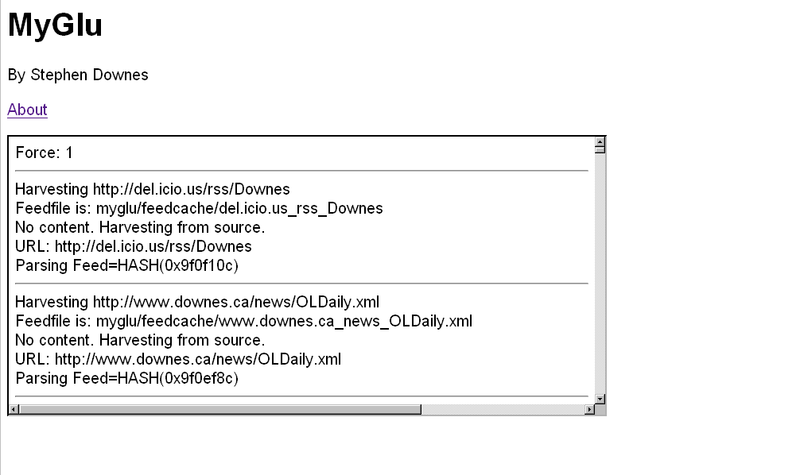
Aggregation and Remixing
http://www.downes.ca/mygluframe.htm

Slide 14
Connectivism
The idea of learning in a network
Siemens – Connectivism as a pedadogy - “I store my knowledge in my friends” – learning is knowing how to create and traverse networks
Downes – knowledge is a network state; learning is to create a network

Slide 15
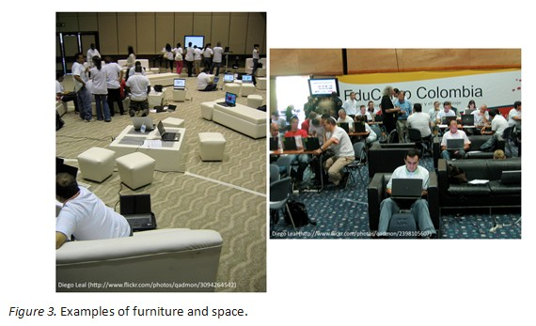
Informal Learning
Learning as Self-Directed
Learning ‘Camps’ – eg Educamp Colombia

Slide 16
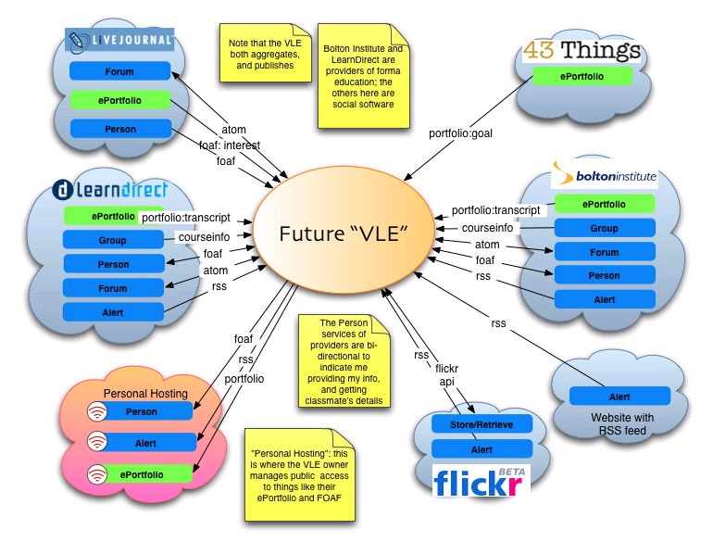
Personal Learning Environment

Slide 17

Open Courses
OpenCourseware
MIT OCW, Rice Connexions, OpenLearn
WikiEducator, Curricki, Wikiversity
Wiley Wiki
Open Courses – Alec Couros

Slide 18
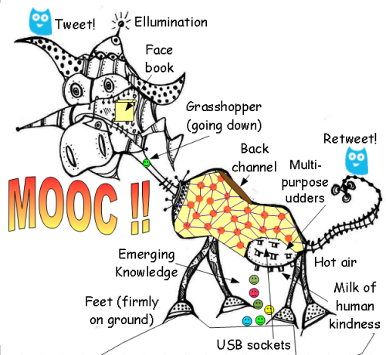
Massive Open Online Course
Combines the idea of open courses and e-learning 2.0
First MOOC:
CCK08, 2008

Slide 19
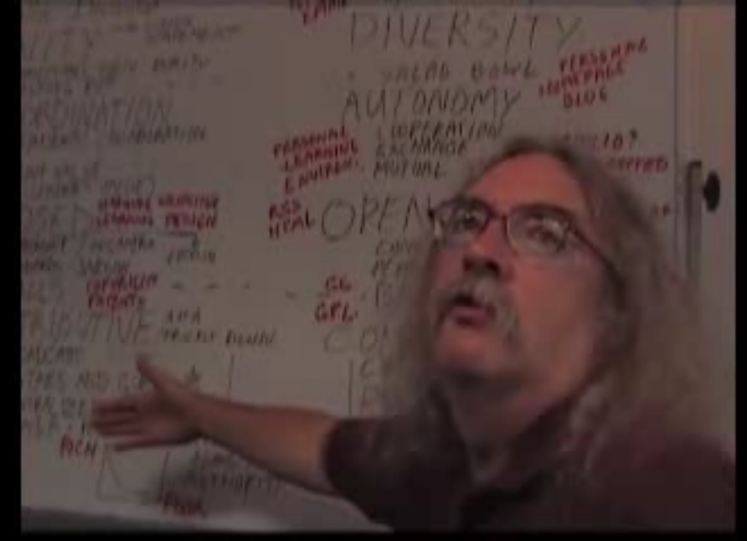
Semantic Principle
Autonomy
Diversity
Openness
Interactivity

Slide 20
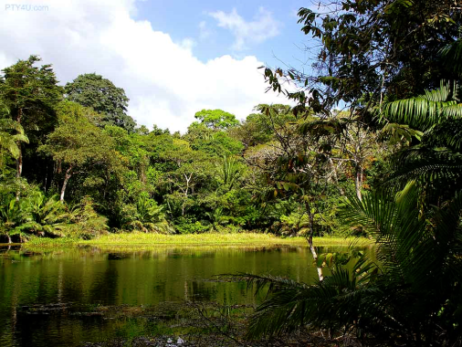
Diversity
You need a mixture of materials – you cannot grow organically from carbon alone, or water alone

Slide 21

Openness
Closed systems become stagnant
Raw materials are depleted
The system becomes clogged with the ‘creative product’ of its members

Slide 22
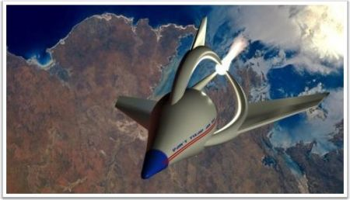
Autonomy
The simple cloning of entities does not allow for progress or development
Each individual entity must manage its own grown in its own way

Slide 23
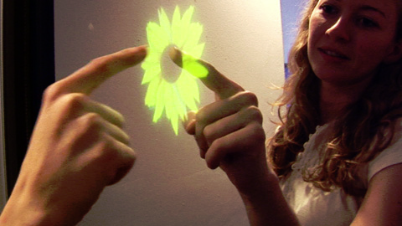
Interactivity
A system cannot grow unless its parts interact – flowers need bees, cows need grain, beavers need trees
Growth is created not by accumulation but by flow, by constant activation and interaction

Slide 24
MOOC Pedagogy
Self-directed / informal learning
Process more important than content
Emphasis on finding resources, selecting resources
Communication based on many points of view

Slide 25
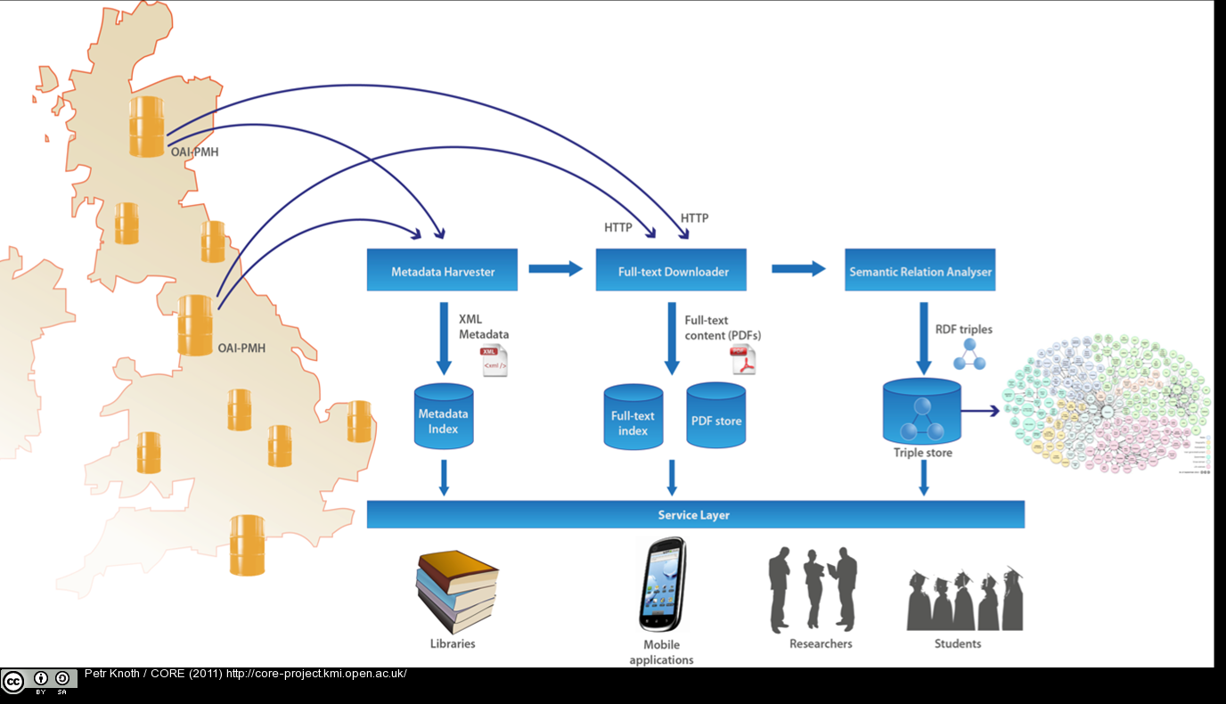
MOOC Technology
Formal and Informal Repositories
Khan Academy
SWORD (UK) deposit protocol, CORE (connecting)
Social networks and syndication
https://www.conftool.net/or2012/index.php/Kelly-Open_Metrics_for_Open_Repositories-138_b.pptx

Slide 26
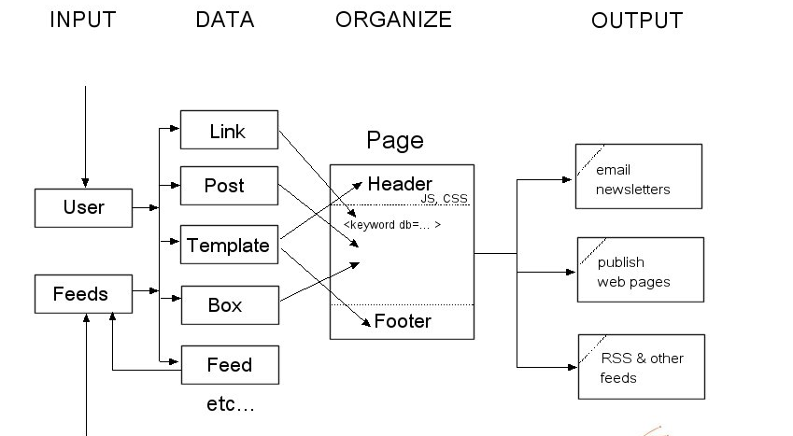
gRSShopper

Slide 27
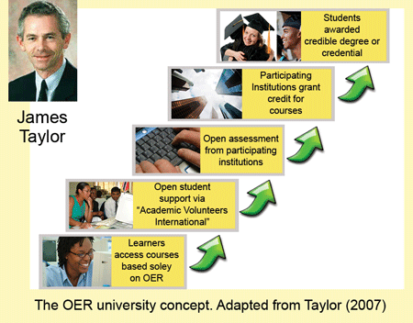
Dimensions of Openness
Open Content / Resources
Open Teaching / Open Classes
Open Assessment
http://www.col.org/blog/Lists/Posts/Post.aspx?ID=134

Slide 28
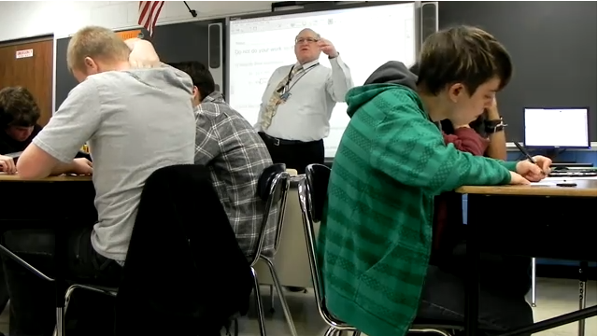
Follow-up MOOCs
CCK09 – students return, become teachers
ds106 – emphasis on projects and creativity
Critical Literacies – emphasis on basic skills needed

Slide 29

Commercial MOOCs
Stanford AI course – 160,000 registrations
Commercial Spin-offs: Coursera, Udacity
Based on Khan Academy, Traditional LMS Model
Companies are essentially commercial course repositories, Will be fee-based

Slide 30
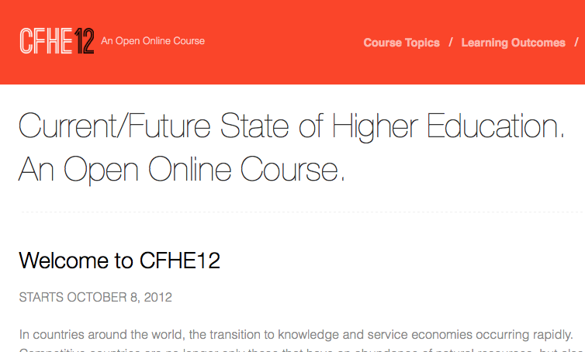
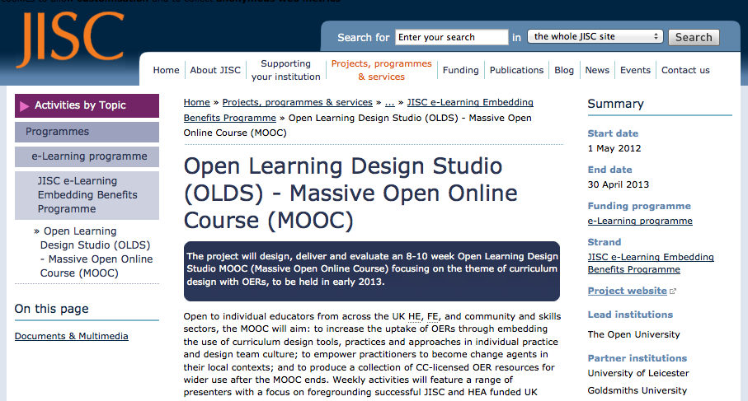
A World of MOOCs
www.mooc.ca

Slide 31
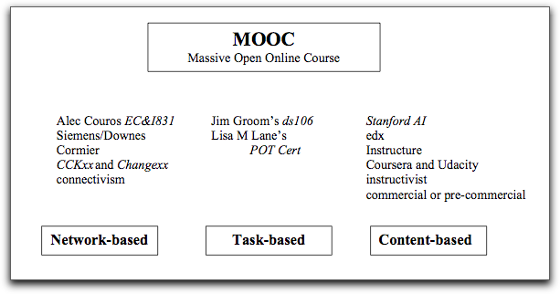
Types of MOOCs
cMOOC vs xMOOC
http://advanceducation.blogspot.com/2012/11/when-is-mooc-not-mooc-what-mooc-means.html

Slide 32
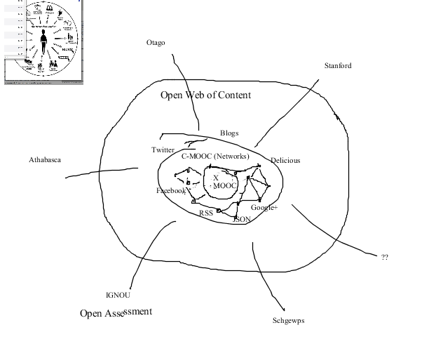
For xMOOC to be truly viable, it will inevitably have to move in the direction of cMOOC.

Slide 33
Soon: Open Educational Apps
Based on the ‘App Store’ model
Publishers will distribute commercial educational apps
Supported in MOOCs using IMS Learning Technology Interaction (LTI)
Open app market will emerge

Slide 34
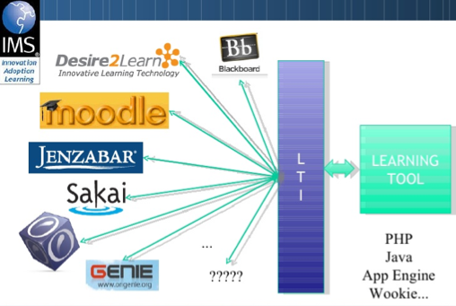
Open
Educational
App
MOOC

Slide 35
Course as Network
Near Future – consortia combining to form a single course
Far Future – no central ‘home’ for a course; course is a common resource accessed by institutions

Slide 36
Assessment Models
Near Future: open courses, commercialized assessment
testing centres – eg. Brainbench
badges, open and closed
Far future: community assessment, assessment as reputation
simplistic model: Klout, LinkedIn endorsements
long-term: data analysis (big data)

Slide 37
Sustainability
Public (government) support – basic infrastructure, ‘core’ or critical content
Community infrastructure – communities of practice, shared courses
Specialized commercial content (+ body of open educational resources)
Commercialized assessment (paid for by employers)

Slide 38

Stephen Downes
http://www.downes.ca

