Slide 1
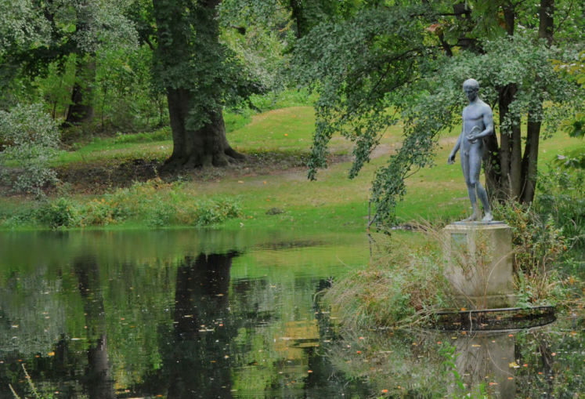
The Connective Learning Environment
Stephen Downes
Tele-Task Symposium
Potsdam, October 8, 2012

Slide 2
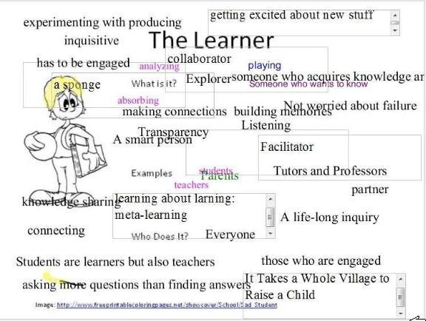
Rethinking the Learner

Slide 3
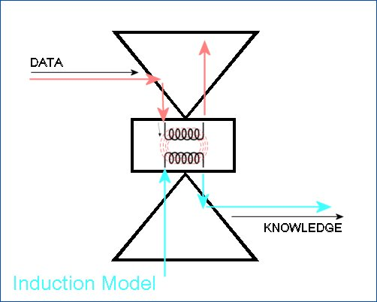
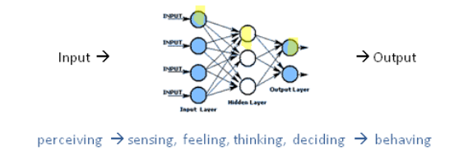
How People Learn

Slide 4
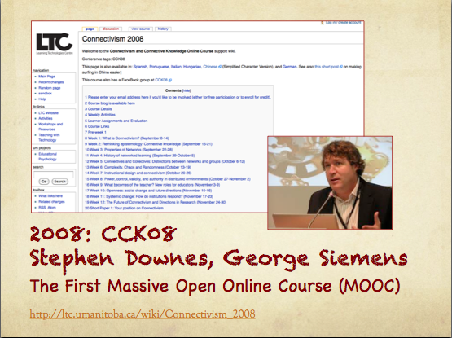
The First MOOC: CCK08

Slide 5
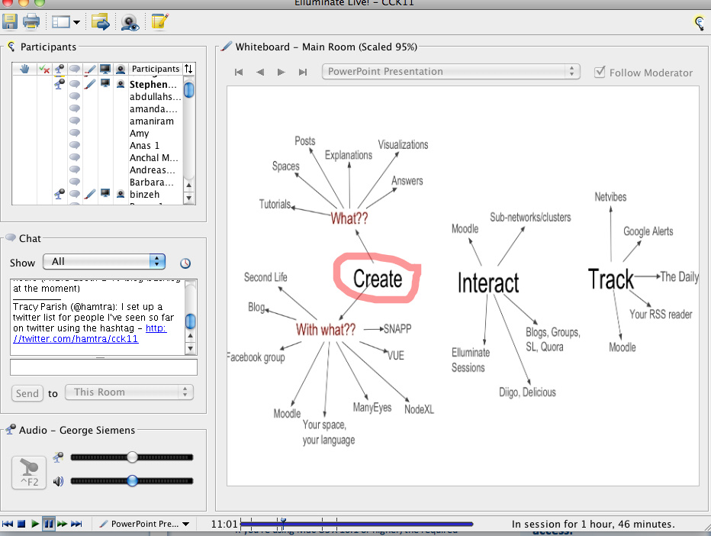
How to Participate in CCK08
Source: http://101friends.wordpress.com/2011/01/25/connectivism-new-ways-of-learning-through-connections-cck11/

Slide 6
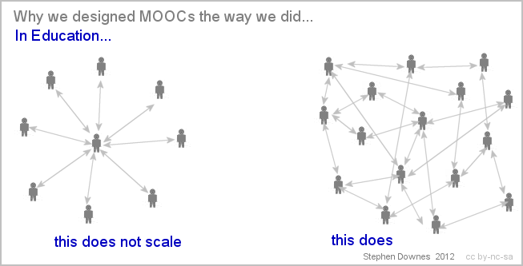
MOOC Design Logic

Slide 7
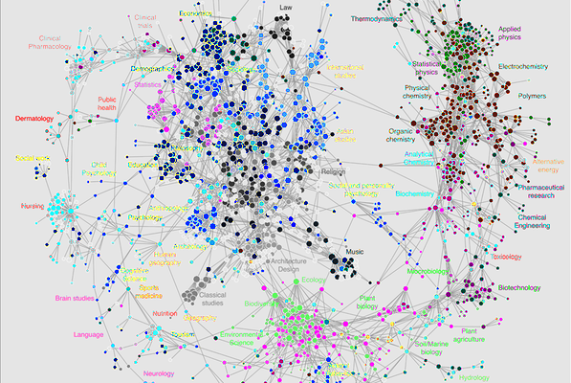
The Structure of Knowledge

Slide 8

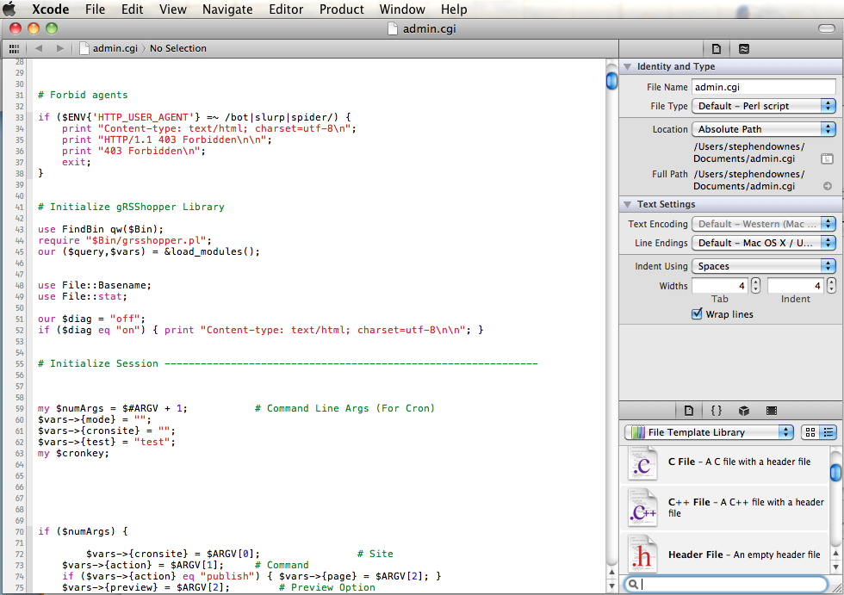
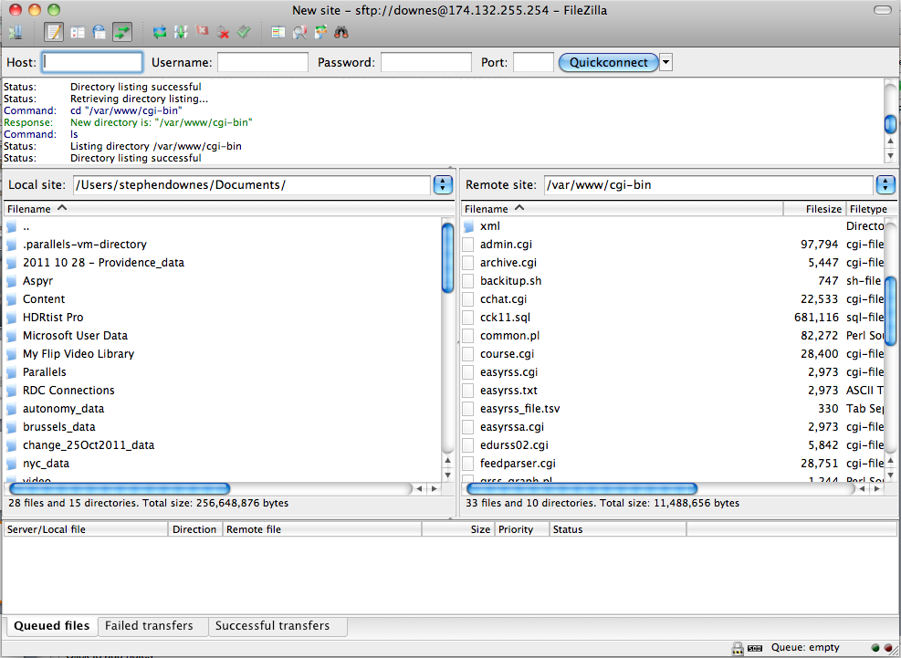
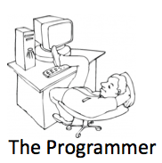
http://grsshopper.downes.ca/

Slide 9
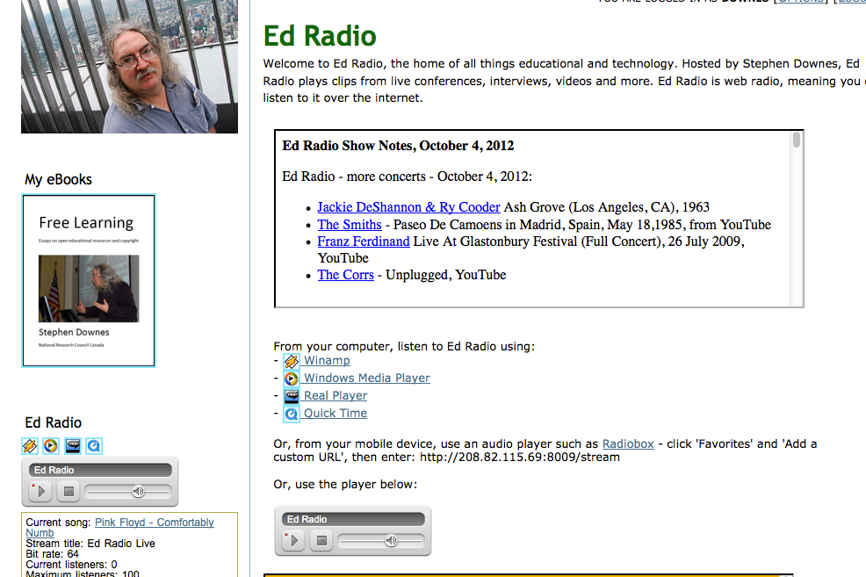
Ed Radio
Learning the lecture recording make for horrible radio

Slide 10
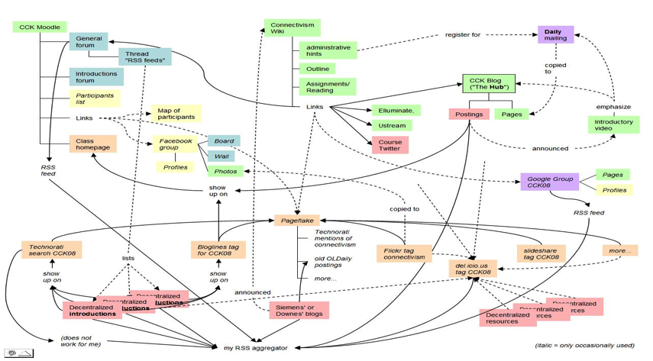
The Structure of a MOOC

Slide 11
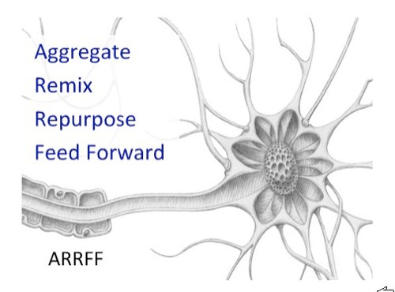
Course Design Principle

Slide 12
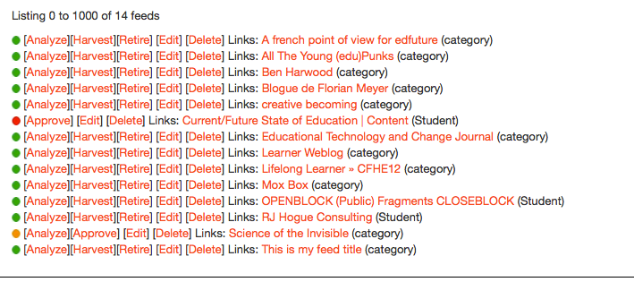
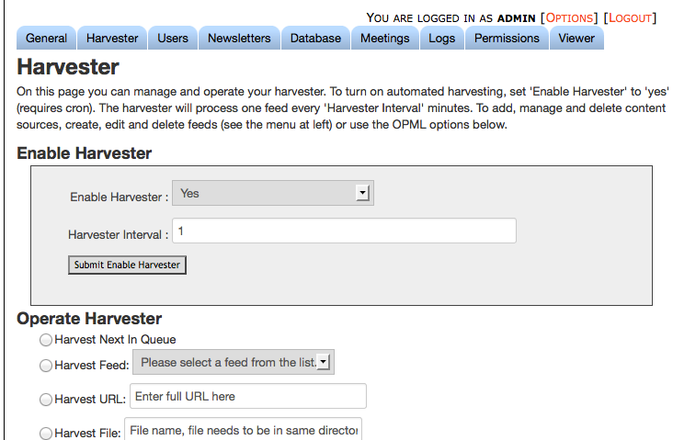
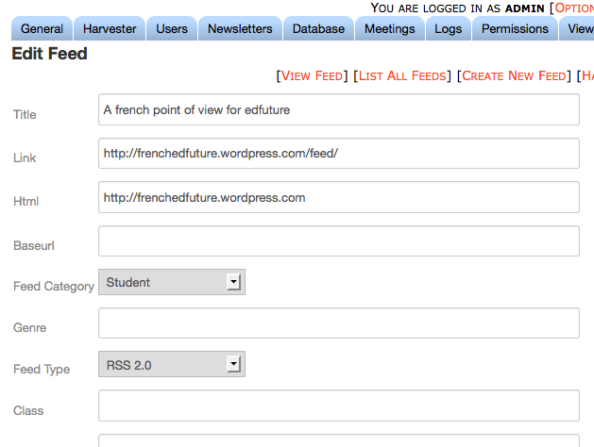
Feed Harvesting

Slide 13
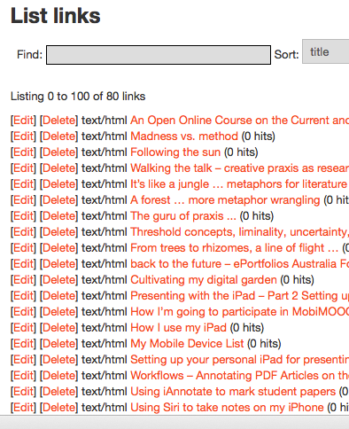
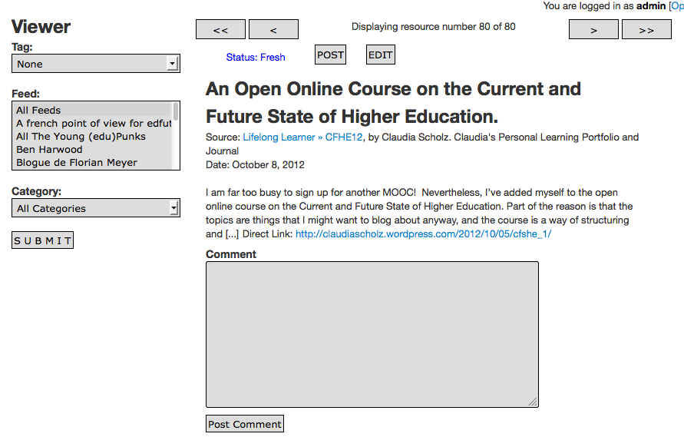
Viewing and Posting

Slide 14
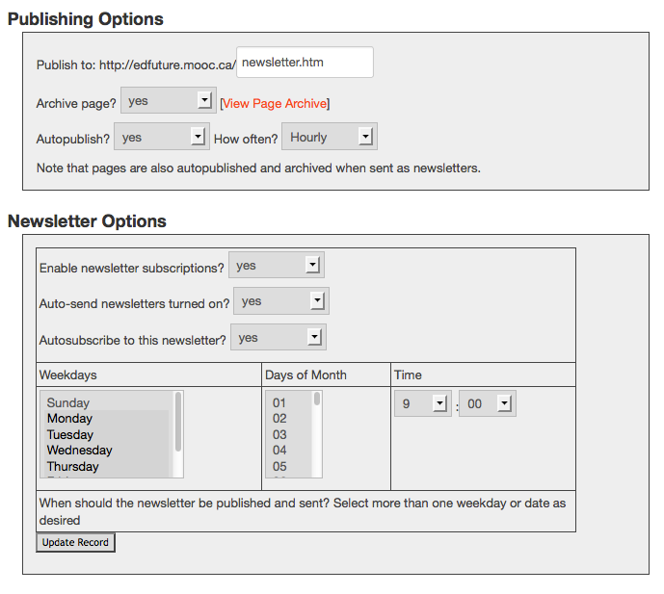
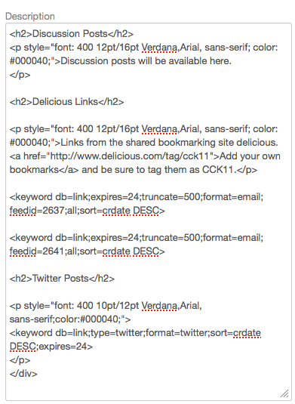
Mixing and Publishing

Slide 15
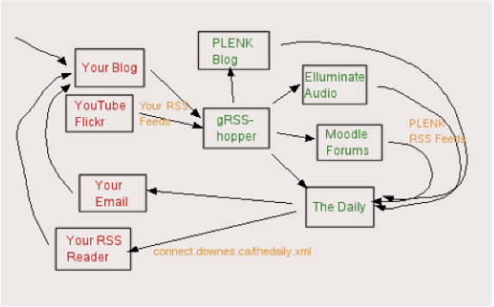
Course Content Network

Slide 16
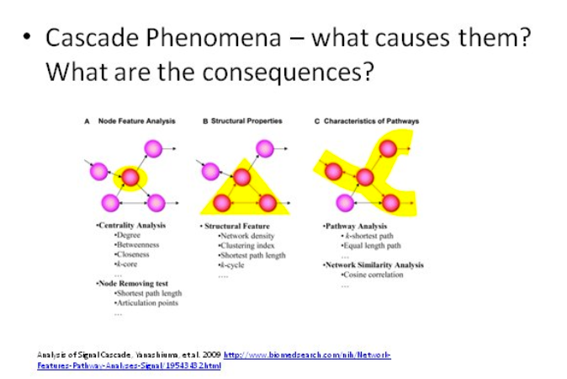
Unstable Networks

Slide 17
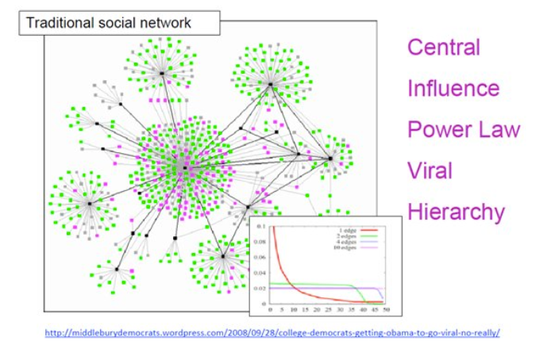
Unstable Networks

Slide 18
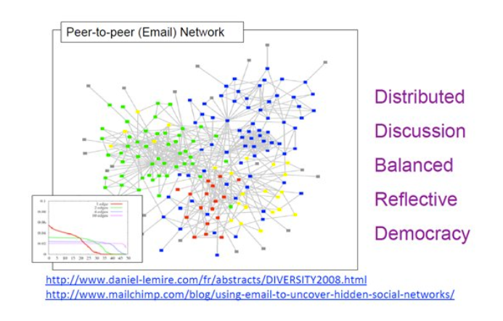
Stable Networks

Slide 19
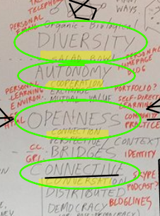
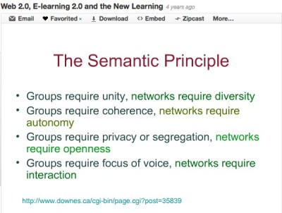
The Semantic Principle

Slide 20
4-factor Model of Autonomy
Experience
Scope and range of autonomous behaviour
Factors affecting epistemic states
Engagement
Empowerment
Capacity to act on epistemic states
Effects of autonomous behaviour
Effect
A Model of Autonomy
Stephen Downes
http://www.downes.ca/post/54222

Slide 21
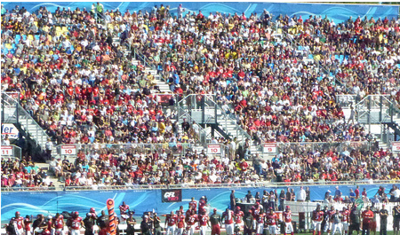
Connectivism and Effect (1)
While at the same time emphasizing the personal, maximize effect range and impact
  Connectivist courses support massive participation and growing impactful engagement in community

Slide 22
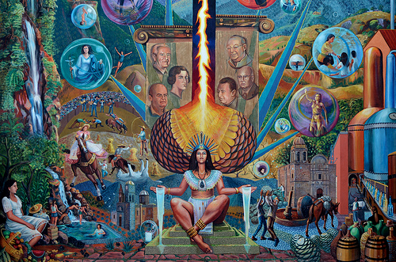
Connectivism and Effect (2)
Recognize and support the potential for improvements both social and personal
  The impact of connectivist courses is measured by one’s engagement and improvement in the wider knowledge community

Slide 23
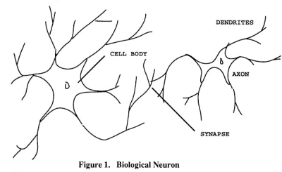
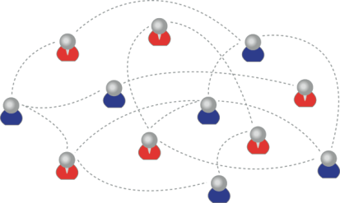
Learning Outcomes
We recognize this
By perfomance in this
There are not specific bits of knowledge or competencies, but rather, personal capacities
(more on this later)

Slide 24
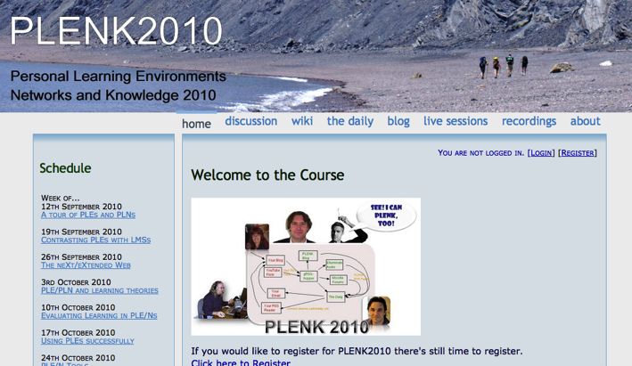
2010: Stephen Downes, Rita Kop
Critical Literacies & PLENK 2010
PLENK 2010 involved a significant research effort
http://connect.downes.ca/

Slide 25
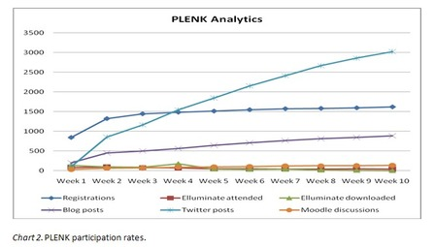
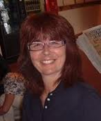
PLENK Analytics
Rita Kop
Supporting ongoing MOOC participation
http://www.irrodl.org/index.php/irrodl/article/view/882

Slide 26
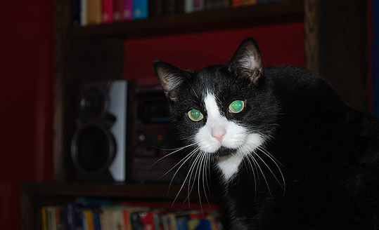
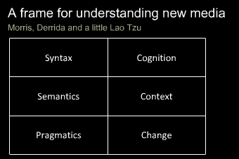
Critical Literacies
Understanding how we use artifacts to communicate in online and other learning networks
http://www.downes.ca/presentation/232

Slide 27
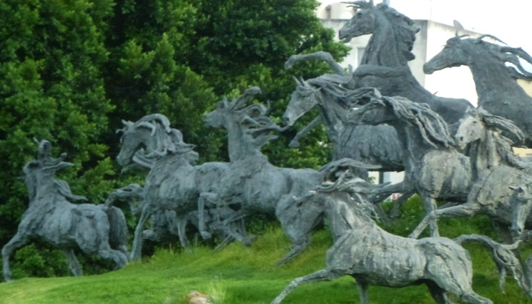
2011: Year of the MOOC

Slide 28
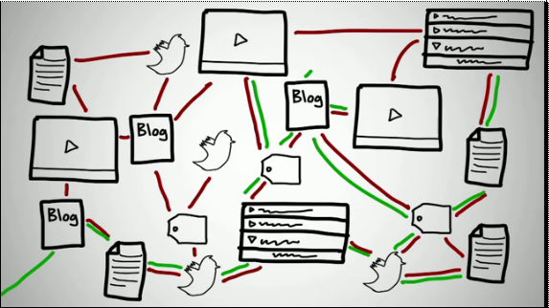
Connectivism & Connective Knowledge
CCK11: How to Learn in a MOOC
http://www.youtube.com/watch?v=eW3gMGqcZQc

Slide 29
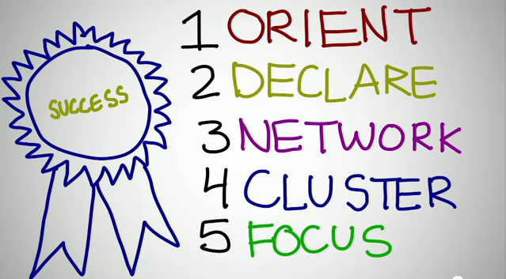
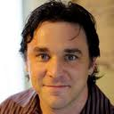
How to be Successful in a MOOC
Dave Cormier
http://www.youtube.com/watch?v=r8avYQ5ZqM0

Slide 30
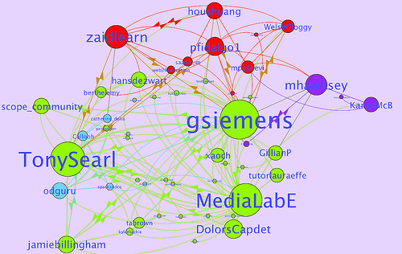
Learning Analytics
LAK11: How to measure success in a MOOC
http://scope.bccampus.ca/course/view.php?id=365

Slide 31
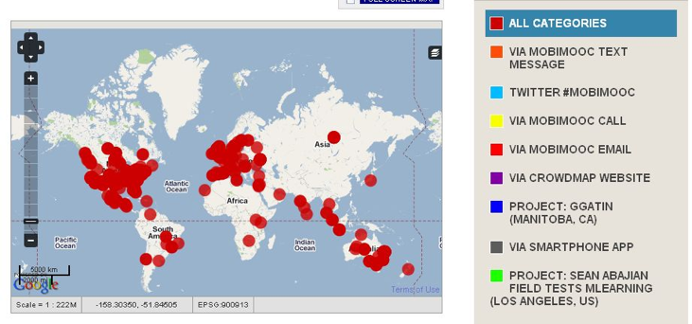
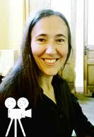
MobiMOOC
Inge de Waard
Supporting Mobile Learning Technology
http://mobimooc.wikispaces.com/

Slide 32
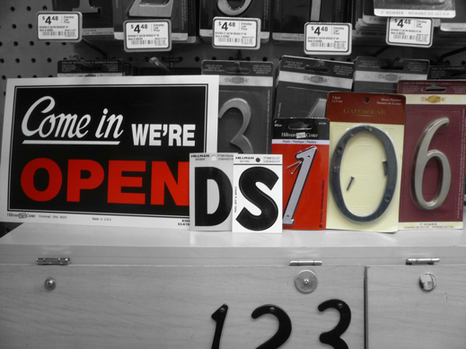
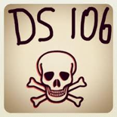
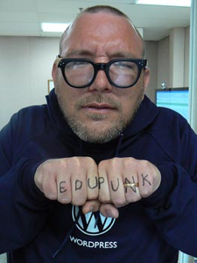
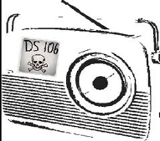
The madness and mayhem of DS106
Jim Groom
DS = Digital Storytelling
DS106 redefined activities and participation
http://ds106.us/

Slide 33
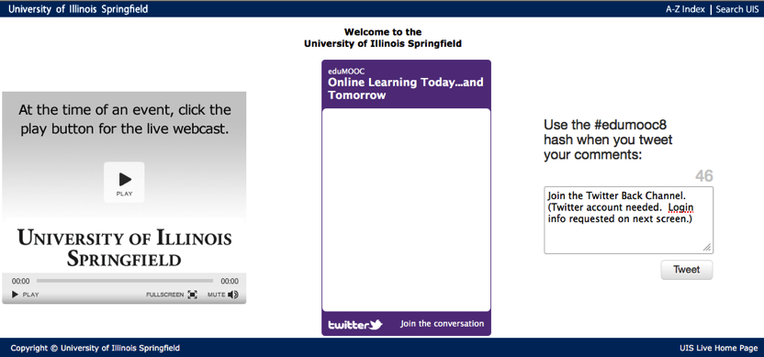
eduMOOC
Large, well publicized, but not very interactive
http://sites.google.com/site/edumooc/

Slide 34
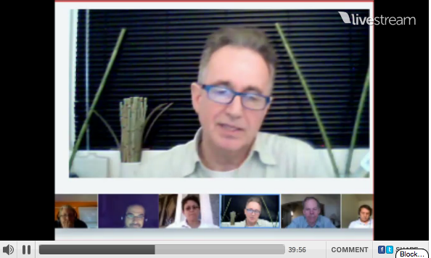
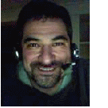
eduMOOC underground
Jeff Lebow
Jeff Lebow, Google+ hangout, and Livestream:
Taking something ordinary, and making it something special – YOU make the MOOC
http://www.livestream.com/jefflebow/

Slide 35

AI-Class: Redefining Massive
More than 100,000 people signed up for pre-registration
http://www.ai-class.com/

Slide 36


Change 2011
Downes, Cormier and Siemens try again
Image: http://steve-wheeler.blogspot.com/2011/04/running-mooc.html
http://change.mooc.ca

Slide 37

Stephen Downes http://www.downes.ca

