Slide 1
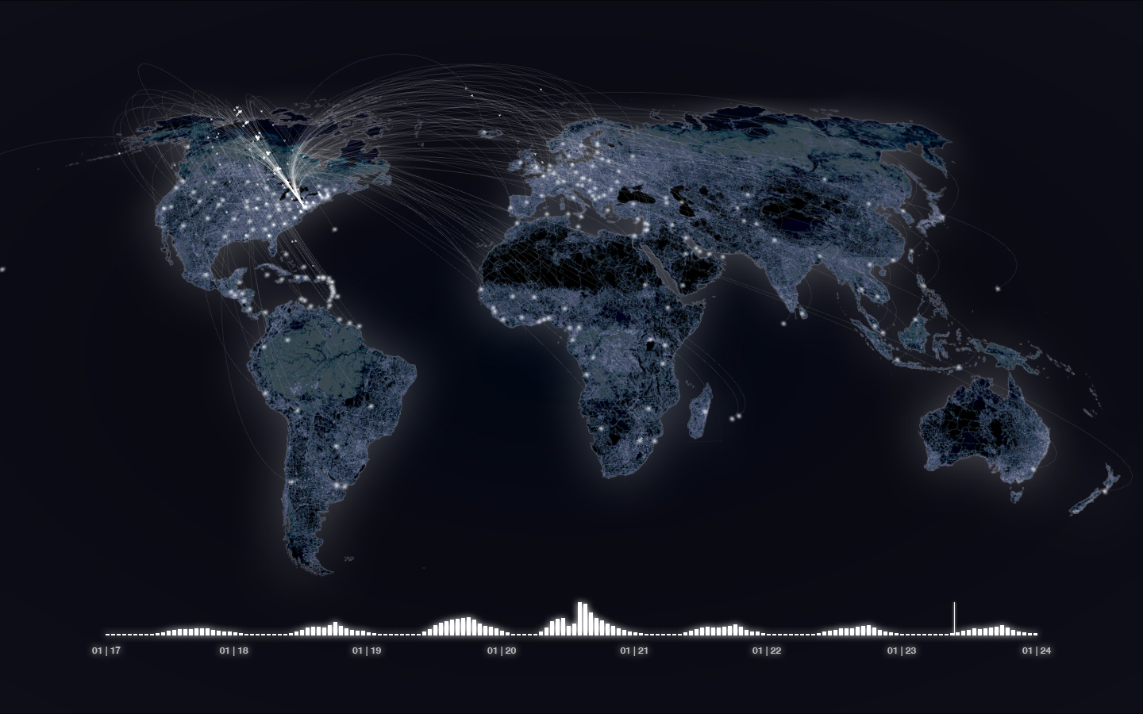
The World Beyond the Word
Stephen Downes
Destination: Innovation, Banff Centre, August 18, 2012

Slide 2
Presentation Page:
http://www.downes.ca/presentation/299
View slides, save to view video, listen to audio, etc. etc.

Slide 3
The Abstract
One of the primary tasks of an educational system is to foster creativity and innovation in its students - but what does that mean? We are inclined to tie innovation to phenomena that can be described in so many words - “if it can’t be measured it can’t be managed,” or so the saying goes. In the field of education, however, we deal every day with learning and discovery that goes beyond what we can describe. This is a form of ‘knowledge by recognition’ - and can be as simple (and difficult) as ‘how to recognize a cat’ or as difficult as advanced pattern recognition in complex systems such as weather patterns, ecosystems, and human society. In order to manage the deluge of data produced by modern technology, a rapidly changing society, and challenging environmental and economic systems, we need to relearn what we understand as social and scientific literacy. The students of today and the innovators of tomorrow will speak languages we barely recognize today. What are the fundamentals of these new literacies, how do we learn them and teach them, and how do they redefine innovation in the future? In this talk Stephen Downes describes a future in which learning is a creative act and the environments and technologies that will be needed to support this learning.

Slide 4
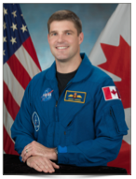
Tomorrow morning… Becoming an Astronaut
Join Major Jeremy R. Hansen as he discusses his journey to becoming an astronaut and the multidisciplinary training required for space flight.
August 20; 8:45 a.m. — 9:45 a.m.

Slide 5
One of the primary tasks of an educational system is to foster creativity and innovation in its students - but what does that mean?

Slide 6
Innovation*
is the creation of better or more effective [stuff] that are readily available to markets, governments, and society.
innovation refers to the use of a better and novel idea or method, whereas invention refers more directly to the creation of the idea or method itself.
(*) Wikipedia - http://en.wikipedia.org/wiki/Innovation
Cover Image: The World's (Phone) Reactions to Obama's Inauguration
http://radar.oreilly.com/2009/06/the-worlds-phone-reactions-to.html

Slide 7
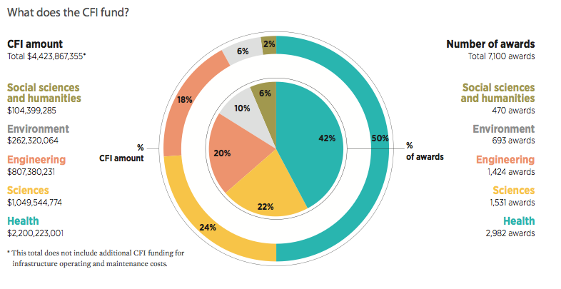
An overwhelming preference for engineering and health (with a nod to environment)
Reported from the Canada Foundation for Innovation, Annual Report 2010-11 p. 7, http://www.innovation.ca/en/AboutUs/PublicationsandReports/Annualreport

Slide 8
Some innovations: http://www.nytimes.com/interactive/2012/06/03/magazine/innovations-issue.html

Slide 9
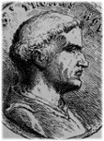
The five ways of Aquinas*
Argument from Motion - everything that moves is moved by another
Argument from Efficient Cause – there must be a First Cause
Argument to Necessary Being - existing things depend upon other things for their existence
Argument from Gradation - there must exist something that is an Absolutely Good Being
Argument from Design - a Great Designer exists.
(*) Lovingly listed for us at http://philosophy.lander.edu/intro/aquinas.shtml

Slide 10
metaphysical theory of innovation
innovations result from prime causes, first movers, or ‘drivers’
Drucker* – “purposeful search for innovation opportunities” such as:
unexpected occurrences, incongruities
process needs, industry & market changes
demographic changes, perception changes
new knowledge
(*) Liberated from the copy-protected source at HBR, ‘The Discipline of Innovation’, Peter Drucker, p. 4, http://www.omega-project.info/uploads/9/4/7/3/9473028/_the_discipline_of_innovation.pdf

Slide 11
character theory of innovation
being an innovator requires having the right ‘character’
typically this means having certain traits, for example, ‘willing to take chances’, ‘Driven and aggressive, yet sensitive’*, etc.
what’s missing is (a) a process for acquiring these characteristics, and (b) a link between these characteristics and innovative acts
(*) Shamelessly stolen from Lemke, slide 14,
http://ncliteracy.metiri.wikispaces.net/file/view/NC-Creativity%26Innovation2.pdf

Slide 12

Cheryl Lemke, Creativity and innovation in K-12
“How do we keep creativity and innovation alive in schools? And more basically, what is it? What does does creativity look like in a 3-year-old? In a grade 4, 7, or 10 student?”
Monday August 20; 2:30 p.m. — 3:30 p.m.

Slide 13
teleological theory of innovation
innovation works according to a design or plan
innovators are expected to be goal- or outcome-directed
a ‘prior art’ is typically required, eg. ‘innovation means asking good questons’

Slide 14
environmental theory of innovation
create the right environment, and creativity will follow
most famously: the Googleplex, MIT Media Lab, etc. (every engineer a foosball table)
can be expressed negatively, as descriptions of environments that stifle creativity* such as monitoring, testing, competition, etc
(*) Again, see Lemke, slide 24,
http://ncliteracy.metiri.wikispaces.net/file/view/NC-Creativity%26Innovation2.pdf

Slide 15
functional theory of innovation
“categorizing firms and individuals in terms of the functional relationship through which they derive benefit from a given product, process, or service innovation.”*
Eg, airline firms are users of aircraft because the benefit they derive from existing types of aircraft
So: find the function, find the innovation – eg. find user sources of innovation
(*) Eric von Hippel’s text ‘Sources of Innovation’ was found to be useful here. Ch. 1., p. 3, http://web.mit.edu/evhippel/www/sources.htm

Slide 16
economic theory of innovation
there is a financial return to be derived from innovation
von Hippel: “innovating firms could reasonably anticipate higher profits than noninnovating firms.”
therefore, profit is a motivating factor for innovation (and innovation can be found through maximizing profits)
(*) Eric von Hippel’s text ‘Sources of Innovation’ had the money quote. Ch. 1., p. 6, http://web.mit.edu/evhippel/www/sources.htm

Slide 17
We are inclined to tie innovation to phenomena that can be described in so many words - “if it can’t be measured it can’t be managed,” or so the saying goes.

Slide 18
A Frame to talk about Innovation
Consider the article on innovation in ecducation*
“...trying to find innovative ways to bring greater access, lower costs … to drive better learning efficacy.”
“several factors have changed the opportunity landscape for investors, including policy changes at the federal and local levels (etc.)”
“a major difference between the environment now and the one a decade ago seems to be the talent and experience of the people leading the innovation”
(*) Schooled by GigaOm, Investment in K-12 education innovation is soaring, but it’s not all rosy, http://gigaom.com/2012/08/02/investment-in-k-12-education-innovation-is-soaring-but-its-not-all-rosy/

Slide 19
Democratizing innovation*
“users of products and services—both firms and individual consumers—are increasingly able to innovate for themselves.”
“Users that innovate can develop exactly what they want, rather than relying on manufacturers to act as their (often very imperfect) agents.”
(*) Eric von Hippel’s text ‘Democratizing Innovation’ gets my vote, http://web.mit.edu/evhippel/www/democ1.htm

Slide 20
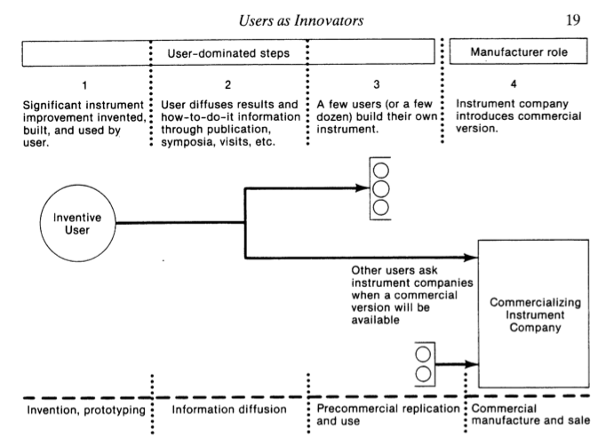

Slide 21
Democratizing innovation (2)
users often freely reveal what they have innovated (a practice that long predates open source)
von Hippel: “if the information needed to innovate in important ways is widely distributed, the traditional pattern of concentrating innovation-support resources on a few individuals is hugely inefficient.”

Slide 22

Mark Edwards, a framework for leadership in the digital world
“the use of digital resources and leveraging a distributed leadership team will be topics of review and discussion”
democratizing technology conversion?
elements of democracy: autonomy, diversity, etc…
Monday August 20; 1:00 p.m. — 3:30 p.m.
Tuesday August 21; 11:00 a.m. — 12:00 p.m.

Slide 23
What makes a society innovative?
Where does innovation come from? Not from measurement, management or market focus. No, it comes from literacy.

Slide 24
Traditional Literacy
Traditional literacy*: Literacy refers to the ability to read for knowledge and write coherently and think critically about the written word.
UNESCO: “Literacy is the ability to identify, understand, interpret, create, communicate and com- pute, using printed and written materials associated with varying contexts.”
(*) Wikipedia, where else? htp://en.wikipedia.org/wiki/Literacy
() UNESCO declafed this, The Plurality of literacy and its Implications for Policies and Programmes, 2004 http://unesdoc.unesco.org/images/0013/001362/136246e.pdf

Slide 25
In the field of education, however, we deal every day with learning and discovery that goes beyond what we can describe.
What is literacy? It isn't just language and numbers; literacy is the capacity to recognize what is relevant, useful, true

Slide 26
Functional Literacy
“Literacy as Freedom” - UNESCO
“the concept of “functional literacy” marked a turning point in the modern history of education. It allied education and especially literacy with social and economic development.”
Paulo Freire - political dimension of literacy -“conscientization”

Slide 27

Keith Krueger, Reimaging Learning
Or ‘reimagining learning’?
“society has moved to a more Participatory Culture where information and expertise is increasingly less hierarchical and society is more participatory.”
Speaking in LOLCats?
Monday August 20; 11:00 a.m. — 12:00 p.m.

Slide 28
Multiple Literacies
“Visual literacy includes in addition the ability to understand all forms of communication, be it body language, pictures, maps, or video.”*
Howard Gardner “proposes eight different intelligences to account for a broad range of human potential in children and adults.”w
They are:
(*) Wikipedia again
(w) Nicole Guevara gives us the list on her website, https://sites.google.com/site/multipleliteracies/howard-gardner/home/assessment/videos/literacies

Slide 29
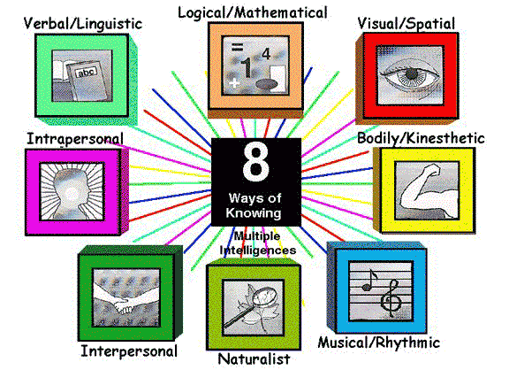
Ilustrated for us from Nicole Guevara, https://sites.google.com/site/multipleliteracies/howard-gardner/home/assessment/videos/literacies
Notes:
Also: computer literacy, media literacy, financial literacy, systems literacy (thanls David Hodgson from G+) etc etc etc

Slide 30
Jenkins – needed skills in a 21st century culture
play – experiment with one’s surroundings
performance – adopt alternative identities
simulation – build dynamic models
appropriation – sample and remix
multitasking – scan and shift focus
etc (several others)
Appropriated from Henry Jenkins, Confronting the Challenges of Participatory Culture, http://digitallearning.macfound.org/atf/cf/%7B7E45C7E0-A3E0-4B89-AC9C-E807E1B0AE4E%7D/JENKINS_WHITE_PAPER.PDF

Slide 31

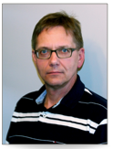
The flipped classroom
places the emphasis on the application of skills in the classroom
Patrick Bohnet and Ken Hakstol, Flipping Your Instruction
will model the process that you could use with your students.. will demonstrate a variety of ways to adapt your instruction to the flipped instruction model and you will experience the process for yourself.
Monday August 20; 1:00 p.m. — 3:30 p.m.

Slide 32

21st Century Skills Literacies
The ‘skills’ described by Jenkins and others performance, simulation, appropriation, etc - are actually languages and should be understood through a framework of literacy
Image swiped from http://spotlight.macfound.org/btr/entry/new_media_literacies/

Slide 33
There’s even an ‘innovation literacy’*:
“the ability to think creatively, evaluate, and apply problem-solving skills to diverse and intangible issues within industrial problems and multidisciplinary contexts.”
See also OECD ‘Skills for Innovation and Research’w
(*) Innovatively and literately created by George Brown College – http://applied-research.blogspot.ca/2009/01/innovation-literacy.html
(w) Blocked from the rest of us by OECD at http://www.oecdbookshop.org/oecd/display.asp?sf1=identifiers&st1=9789264097490

Slide 34
How do we understand and teach these multiple literacies without dividing knowledge into a series of ‘literacy silos’?
Andrew Flowerdew (today on Google+)*: “Whilst well meaning, often these lesson fail to move learning forward in a morass of unconnected, disjointed segments that may confuse as much as they do enlighten.”
(*) G+ed here: https://plus.google.com/u/0/109526159908242471749/posts/B2zz9HgUi8Z

Slide 35
This is a form of ‘knowledge by recognition’ - and can be as simple (and difficult) as ‘how to recognize a cat’ or as difficult as advanced pattern recognition in complex systems such as weather patterns, ecosystems, and human society.

Slide 36
Critical Literacies
Critical literacies are the elements in common across all literacies
They give us a mechanism for understanding what it means to be ‘visually literate’, ‘musically literate’, ‘computer literate’, etc.

Slide 37
Critical Literacies
Syntax | Cognition
Semantics | Context
Pragmatics | Change
We need this frame because if we aren‘t looking for these things, we just won’t see them.

Slide 38
21st Century Literacies
21st Century Languages
Literacies Elements | Verbal | Visual | Bodily (and so on)
Syntax
Semantics
Pragmatics
Cognition
Context
Change

Slide 39
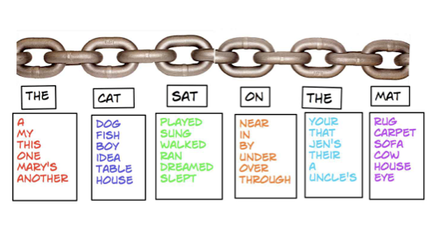
Syntax
For example, rules and grammar
What is it ‘to know’ syntax? What is ‘syntax literacy?’

Slide 40
The many forms of syntax (audio)
Forms: archetypes? Platonic ideals?
Rules: grammar = logical syntax, punctuation
Operations: procedures, motor skills
Patterns: regularities, substitutivity (eggcorns, tropes)
Similarities: Tversky - properties, etc
Ag. audio syntax
http://www.soundsnap.com/search/audio/inhale+woman/score (once you hear this in video, you can’t unhear it)
the Wilhelm Scream - http://www.youtube.com/watch?v=cdbYsoEasio

Slide 41
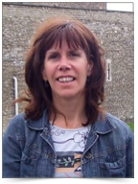
Universal design for learning – a syntax?
Kathy Howery - 21st Century Inclusive learning - Moving UDl from the promise to the practice
“three principles of UDL, providing multiple means of representation, expression and engagement can be practically achieved with today’s technologies.”
Tuesday august 21; 1:00 p.m. — 3:30 p.m.

Slide 42
Example: Performance - Syntax
Languages Elements | Performance (the ability to adopt alternative identities for the purpose of improvisation and discovery)(subcategories?)
Syntax: - Forms - Rules - Operations - Patterns - Similarities | - Presentation acting, method acting - “Know your lines” etc http://filmtvcareers.about.com/od/gettingthejob/a/GJ_Actor_Tips.htm - Stanislavski’s system (etc…) http://en.wikipedia.org/wiki/Stanislavski%27s_system - Ritual Performance (etc.) http://www.let.rug.nl/koster/papers/JHP.Koster2.Edit.pdf - Comparing Tales (etc.) http://artsedge.kennedy-center.org/content/2343/

Slide 43
Literacy Levels
The very idea of literacy levels* – eg.
Level 1 – basic word recognition, memorization
Level 2 – plain language reading only
Level 3 – words and concepts ‘in the marketplace’
Level 4,5 – technical reading, jargon, etc.
Problem: this is mostly a depiction of literacy as remembering – most ‘simple’ theories of literacy have this form – remembering word / sound / object association
(*) Leveling up from Windsor Public Library http://www.windsorpubliclibrary.com/literacy/levels.php

Slide 44
More on Literacy Levels
Logographic is defined as reading and writing that relies on context.
Alphabetic reading is defined as the attempt to use sound-letter correspondences in reading and writing.
Orthographic - highly sophisticated and complex understanding of written language
Written very well by Education Service Center, Region 2 in http://www.esc2.net/centers/instructional/ADTech/FACES-Language%20Arts/Literacy%20Levels.doc.pdf

Slide 45
Varying conceptions of knowledge:
‘knowledge’ as ‘remembering’
‘knowledge’ as ‘understanding’
etc.
Note how the definition of ‘innovation’ in this context is focused on:
‘knowledge’ as ‘using’
‘knowledge’ as ‘applying’
Bloom’s will take us further…

Slide 46
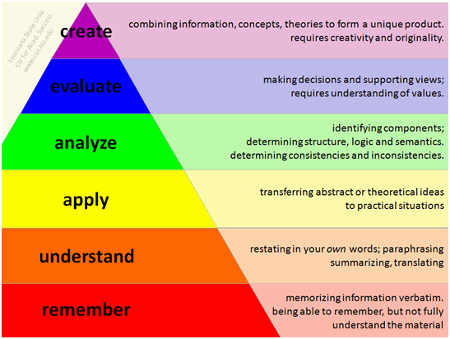
Bloom’s Taxonomy / Revised Bloom’s
Image applied at Concordia, http://teaching.concordia.ca/resources/teaching-with-new-technologies/using-clickers/pedagogical-faqs/

Slide 47
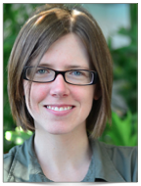
Karen Brennan
From unaware to everywhere: young people as designers of interactive media
Karen shares how work at the MIT Media Lab supports the transition to creating, rather than consuming, digital media.
Tuesday August 21; 8:45 a.m. — 9:45 a.m.

Slide 48
A taxonomy for syntax literacy:
Create (intuitively)
Choose
Discover
Recognize
Remember (rules, patterns, principles, etc)
Notes:
Create intuitively – see Dreyfus on expert knowledge

Slide 49
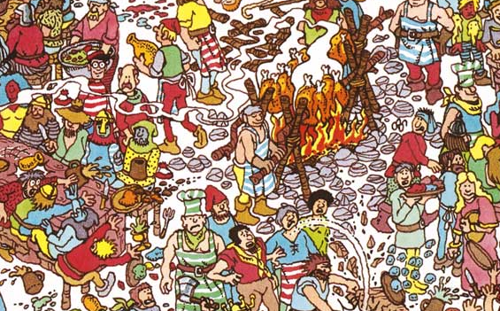
Why these? They are based on a theory of knowledge as recognition rather than remembering, understanding, applying, etc.

Slide 50
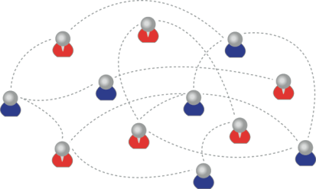
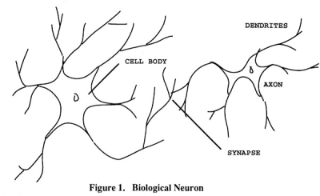
We are using one of these
To create one of these
Knowledge consists of neural connections, not facts and data

Slide 51
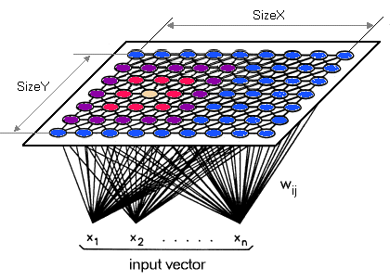
Simple vs complex – text vs network
“Paris is the capital of France”
vs

Slide 52
It is the difference between:
‘Knowing’ that ‘Paris is the capital of France’ or even some sort of ‘knowing how’ (these are external definitions of this knowledge) and
What it feels like to have geographical knowledge; what it feels like to be a speaker of a language
Learning a discipline is a total state and not a collection of specific states

Slide 53
Learning a discipline is a total state and not a collection of specific states
It is obtained through immersion in an environment rather than acquisition of particular entities
It is expressed functionally (can you perform ‘as a geographer’?) rather than cognitively (can you state ‘geography facts’ or do ‘geography tasks’?)

Slide 54
We recognize this
By perfomance in this
There are not specific bits of knowledge or competencies, but rather, personal capacities

Slide 55
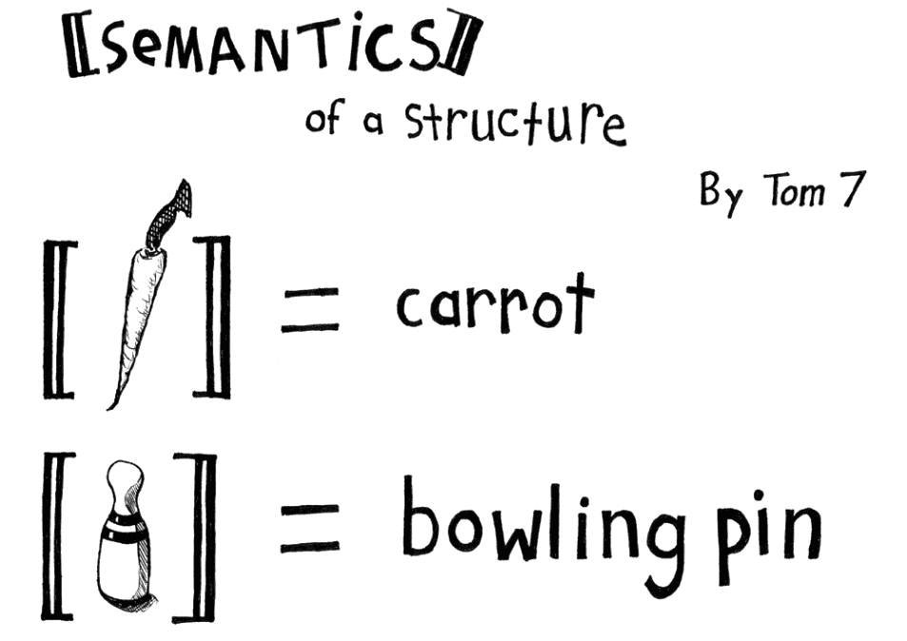
Semantics
Semantics
theories of truth / meaning / purpose / goal
http://www.cs.cmu.edu/~tom7/csnotes/fall02/semantics.gif

Slide 56
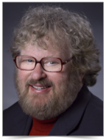

Curriculum as semantics?
makes me think of Elliott Soloway and Cathie Norris, Education in the Age of Mobilism
Schools have used computers – desktops to laptops, standalone to online – to “better” implement the existing curriculum – a curriculum that was initially design by the Committee of Ten to prepare students to enter Harvard -- in 1892.
Wednesday August 22; 8:45 a.m. — 9:45 a.m.

Slide 57
The Semantics of Pedagogy (Soloway and Norris, cont.)
“the transformation of the classroom from ‘I Teach’ a teacher-centric, didactic, direct instruction, 19th century, boring and ineffective pedagogy to ‘We Learn,’ a student-centric, project-based, inquiry-oriented, 21st-century pedagogy.”
Changing bases of truth, authority, object, goal

Slide 58
The many meanings of semantics
Sense and reference (connotation and denotation)
Interpretation (Eg. In probability, Carnap - logical space; Reichenbach - frequency; Ramsey - wagering / strength of belief)
Forms of association: Hebbian, contiguity, back-prop, Boltzmann
Decisions and decision theory: voting / consensus / emergence
Value, objective, goals, desires, meaning (as in ‘of life’)
Notes:
Note that ‘innocation’ privileges one semantics over another

Slide 59
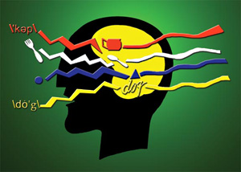
Pragmatics
use, actions, impact
Speech acts (J.L. Austin, Searle) assertives, directives, commissives, expressives, declarations (but also - harmful acts, harassment, etc)
Interrogation (Heidegger) and presupposition
Meaning (Wittgenstein - meaning is use)

Slide 60
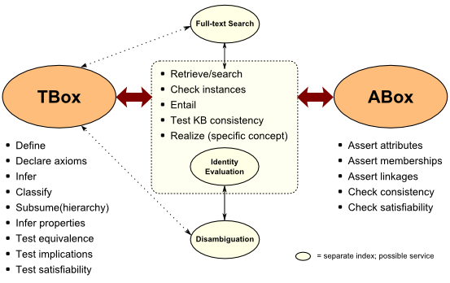
Cognition
reasoning, inference and explanation
http://www.mkbergman.com/category/description-logics/
description - X (definite description, allegory, metaphor)
definition - X is Y (ostensive, lexical, logical (necess. & suff conds), family resemblance - but also, identity, personal identity, etc
argument - X therefore Y - inductive, deductive, abductive (but also: modal, probability (Bayesian), deontic (obligations), doxastic (belief), etc.)
explanation - X because of Y (causal, statistical, chaotic/emergent)

Slide 61
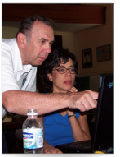
Critical thinking skills…
Howie Diblasi, Cultivating creativity and critical thinking in education
Ten web 2.0 projects…
I will be looking for the link between creativity and critical thinking
Monday August 20; 1:00 p.m. — 3:30 p.m.
Workshop Tuesday August 21; 1:00 p.m. — 3:30 p.m.

Slide 62
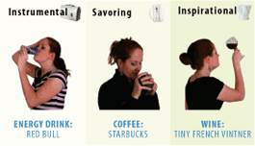
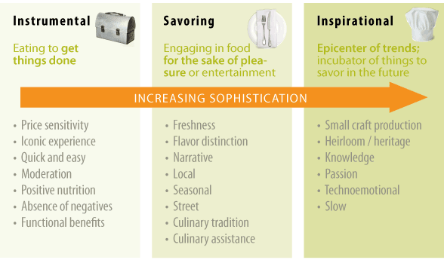
Context
placement, environment
http://www.occasionbasedmarketing.com/what-it-is
- explanation (Hanson, van Fraassen, Heidegger)
- meaning (Quine); tense - range of possibilities
- vocabulary (Derrida); ontologies, logical space
Frames (Lakoff) and worldviews

Slide 63
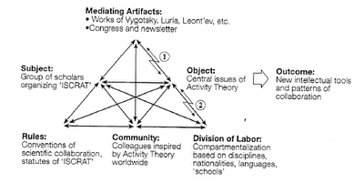
Change
relation and connection: I Ching, logical relation
flow: Hegel - historicity, directionality; McLuhan - 4 things
- progression / logic -- games, for example: quiz&points, branch-and-tree, database
- scheduling - timetabling - events; activity theory / LaaN

Slide 64
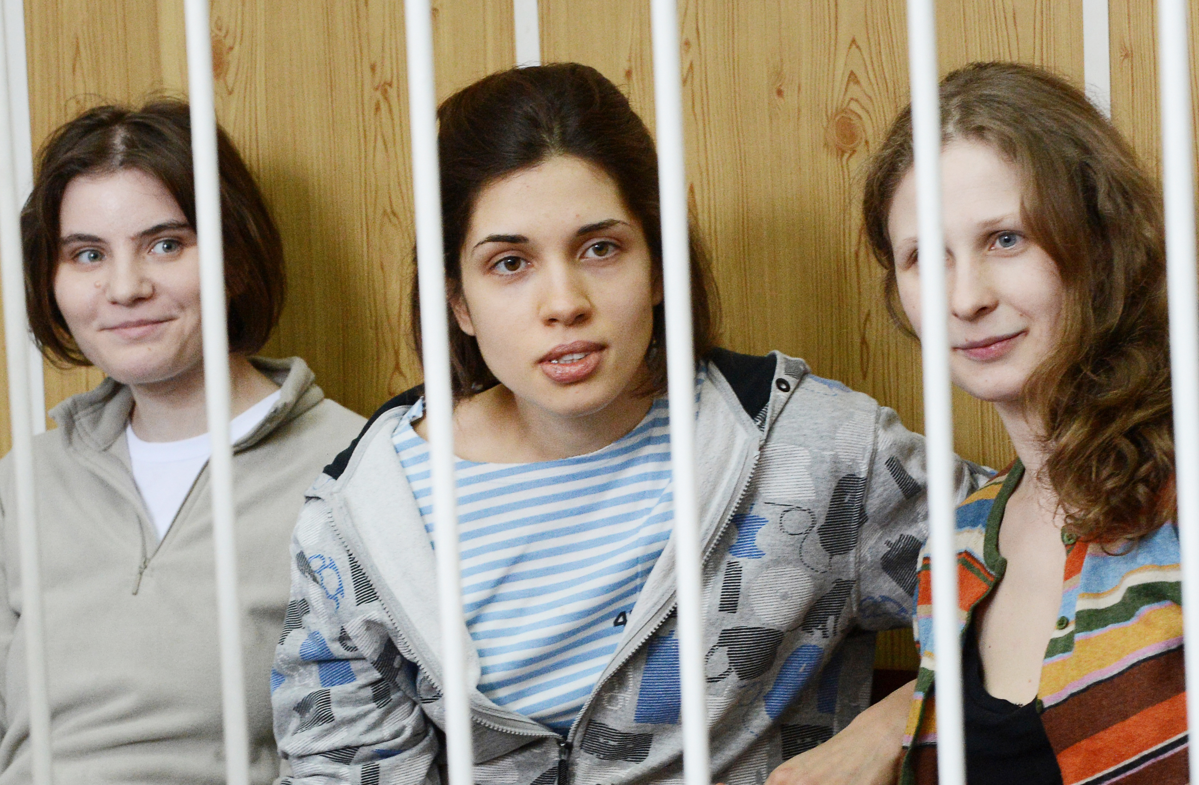
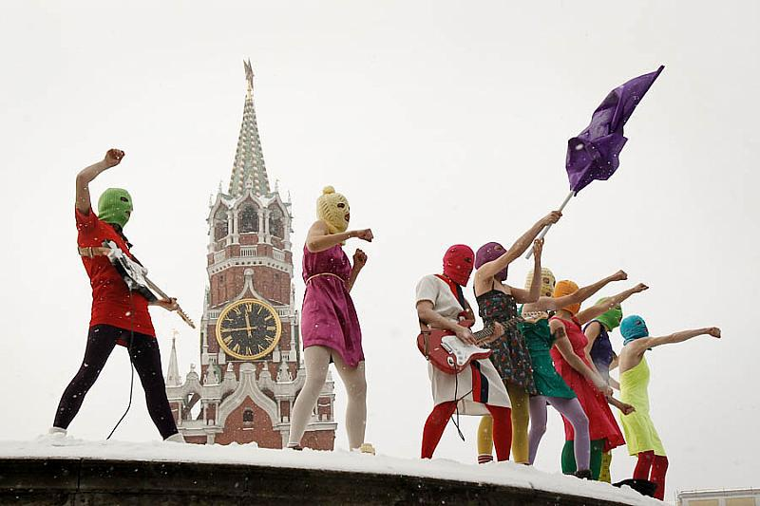
We used to speak in metaphors. Today, we can live our metaphors.
http://amnestyusa.org/pussyriot

Slide 65
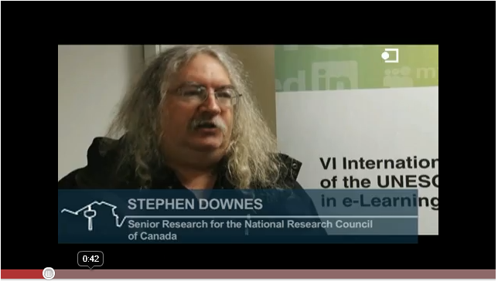
http://www.youtube.com/watch?v=X0iI0pgTUx0
http://www.downes.ca
Free Learning
Stephen Downes

