Slide 1
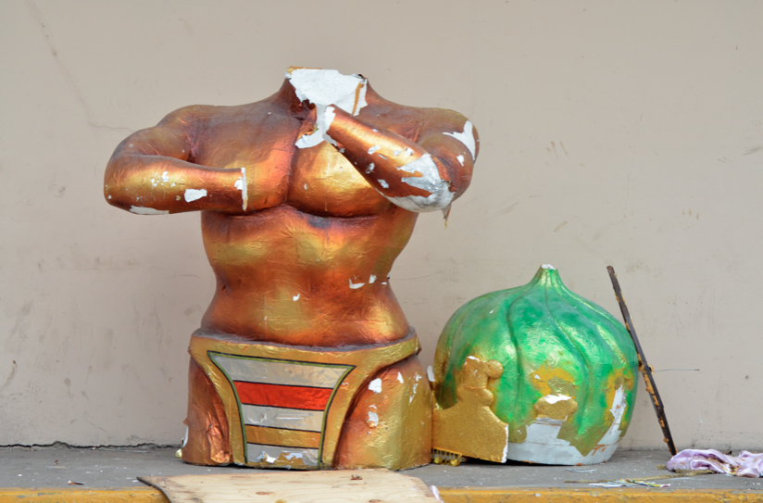
Models, Technological Resources and Knowledge Management
Stephen Downes
June 21, 2012

Slide 2
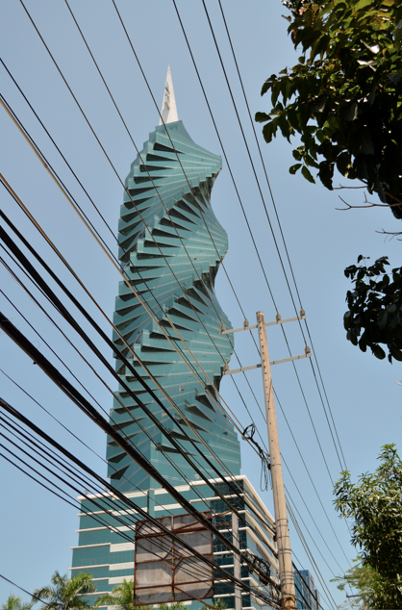
First, Some Context
We also believe that higher education is on the brink of a transformation now that online delivery has been legitimized by some of the elite institutions.
- Rector Helen Dragas on the forced resignation of UVa president
http://www.deltainitiative.com/bloggers/with-forced-resignation-of-uva-president-we-see-the-biggest-impact-of-moocs

Slide 3
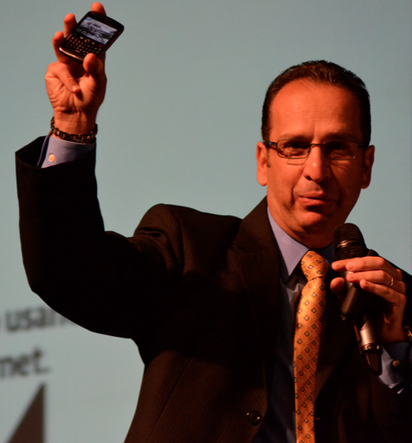
Mobile is Here
The use of mobile technologies is disrupting existing models.
For example: your mobile device is now your library. Vendors sell directly to iPad or Kinnect. In the same way, they sell music, and courses.
Juan Lucca, Blackboard
Notes:
Also – music – same thing – selling directly to iTunes, Spotify, Pandora.
Education – open, social, analysis, mobile

Slide 4
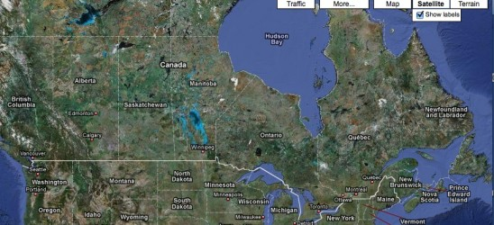
Online Learning is Here
Canada: just under one million online course registrations equivalent to about 100,000 FTEs
http://www.tonybates.ca/2012/06/12/the-status-of-online-learning-in-canada-in-2012/
Notes:
Tony Bates reviews this new report released by Contact North on the state of online learning in Canada. Major points:
Contact North estimates there are approximately just under one million online course registrations equivalent to about 100,000 FTEs
there is a good deal of innovation and development of online learning, but it is mainly at the grass roots level
quality still varies considerably (although not as much as in the USA)
a lack of strategic focus on online learning at national, provincial and above all institutional levels threatens its future development and may well result in Canada being left behind by international competitors.
Bates also compares this report to the 2001 report of the Federal Government’s Advisory Committee for Online Learning. The report (like all reports before and since, it seems) called for a national strategy, a program in 'learnware development', and a pan-Canadian initiative. None of these have been implemented, and it is not likely they will ben

Slide 5
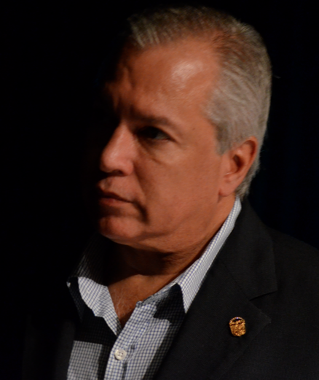
Programs Have Been Developed
“This isn’t something that just happened… it is the result of a plan started a number of years ago.”
Eduardo Jaen, AIG Panama
Notes:
The Balboa project & strategic plan for use of technologies within the classroom
Had to train 4,000 teachers – use of the devices to further collaborative work
were going to do co-pay, but computers were eventually provided free of charge – 90,000 computers per year – “this will allow that all teachers are transformed into content managers”
“a great leap forward, a quantum jump”

Slide 6
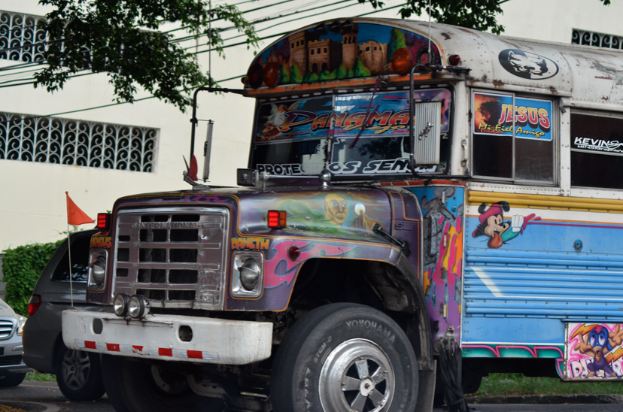
Getting on the Change Bus
Academics are not driving the change bus.
Leadership in traditional universities has been grossly negligent in preparing the academy for the economic and technological reality it now faces.
-- George Siemens
http://campustechnology.com/articles/2012/06/20/seeking-systemic-change-for-higher-ed-in-a-digital-networked-age.aspx

Slide 7
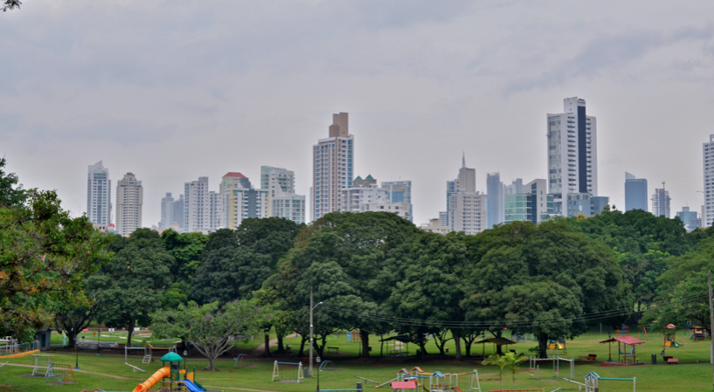
Models

Slide 8
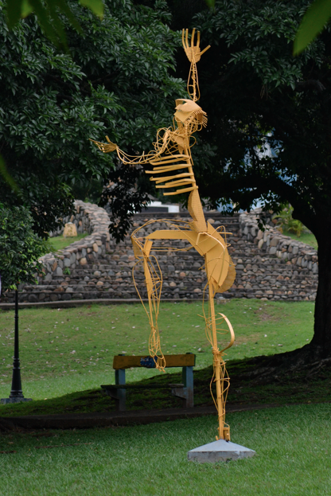
The Internet is a Model
If you take the idea literally, the whole internet is a model of the world. Or a model of what we think about the world (if there is any difference between the two).

Slide 9
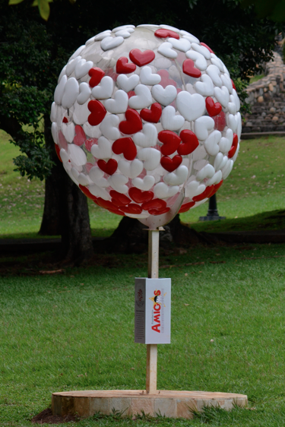
The Whole Internet
But you have to take it literally. It’s the whole internet that is the model, not some privileged subset of it, such as the erstwhile semantic web.

Slide 10

Models Are Hard
Just ask Google. It has tried again and again with the social web – first Orkut, then Google Wave, now Google+ -- None of them are stopping the slow erosion from search to social
http://rizzoma.com/
Notes:
Daniil Kravtsov writes to me to say that (a version of) Google Wave is still alive. He writes, "Our team loved the Wave. We've used it in our business and just for fun conversations. There was no way we could go back to email. When Google decided to shut the project down we had only one true way — to resurrect the great idea and continue its development. At the moment, our project is launched and works pretty good for more than 3000 active users. We would be happy to tell ex-wavers about it.”
Rizzoma: All existing communication and collaboration tools display messages chronologically and in a linear way making a context fragmented and difficult to comprehend.
Rizzoma allows communication within a certain context permitting a chat to instantly become a document where topics of a discussion organized into branches of mind-map diagram and minor details are collapsed to avoid distraction.

Slide 11
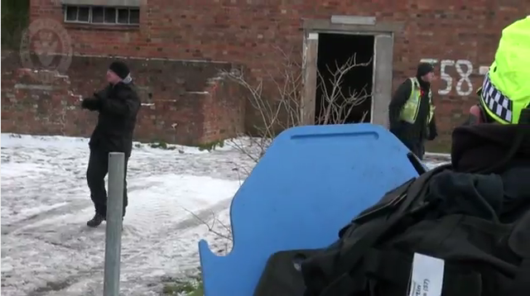
Real Life
Where's the e-learning? In the video, of course, and the intended audience is the wider community.
https://www.youtube.com/watch?v=cQZQ7RPQNeM
Notes:
It's not online learning - or is it? This video describes a firearms training session for the West Midlands Police. The whole thing is real-world simulation - the officers go out to a barn, use real firearms, and face real people acting out various scenarios. Even the planning sessions are analog - witness the hand drawings on flipboard charts. So where's the e-learning? In the video, of course, and the intended audience is the wider community. It's a short interesting look into a process people know little about. That's something e-learning does really well, I think.

Slide 12
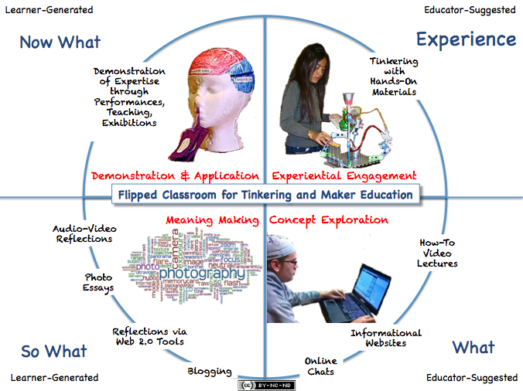
The Flipped Classroom
The school must represent present life—life as real and vital to the child as that which he carries on in the home, in the neighborhood, or on the playground.”
John Dewey
http://usergeneratededucation.wordpress.com/2012/06/16/the-flipped-classroom-the-full-picture-for-tinkering-and-maker-education/
Notes:
Jackie Gerstein shamelessly jumps on some current memes, such as the flipped classroom and the idea of 'Maker' education, and her model is a bit askew (to my perception) but there's definitely enough goodness here to pass along. Illustrated above is her "Flipped Classroom: The Full Picture" with four phases:
Experiential Engagement: The Activity
Concept Exploration: The What
Meaning Making: The So What
Demonstration: The Now What
To me this is an iteration of the Downes overly-simlistic (and unoriginal) theory of education: "to teach is to model and demonstrate; to learn is to practice and reflect." The demonstrating is the experiential engagement, the modeling is the concept exploration, the practice is the demonstration, the reflection is the 'meaning making'.

Slide 13
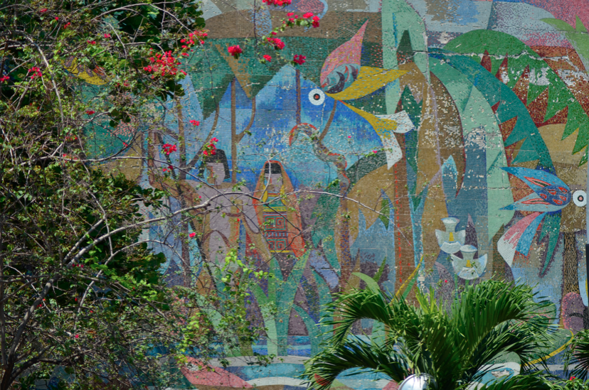
MOOC
Massive
Open
Online
Course

Slide 14
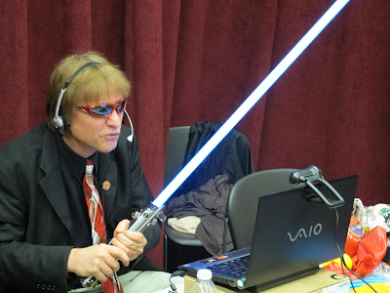
The Blackboard MOOC?
“I was thinking to myself that there are more people in this one class than I have likely taught 23 years of teaching in higher education…. If teaching is a calling, than a MOOC may be the ultimate such calling—at least today.”
Curt Bonk
http://travelinedman.blogspot.com/2012/06/unabridged-interview-on-mooc-for.html
Notes:
Bonk's experience - and his MOOC has endured its share of criticisms - shows just how hard it is to run a good MOOC. It's one thing to run a bunch of videos for an intro course, and quite another to offer what is more like "a summer workshop experience for college instructors."

Slide 15
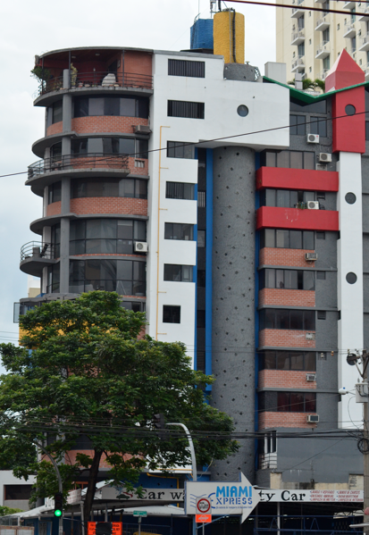
The MOOC ‘Model’
Massive for massive’s sake is a red flag. In ds106 we scale fractally not arithmetically – Alan Levine
http://worstprofessorever.com/2012/06/18/udacity-pearson-moocs-and-the-rest/#comment-4340
https://www.coursera.org/
Notes:
The Stanford AI model – the Courser model

Slide 16
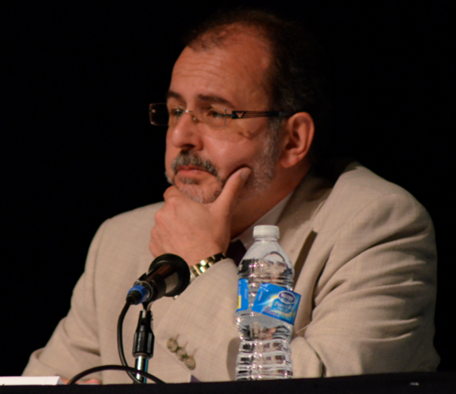
Learning Ecologies
A set of contexts made up of configurations of activities, materials, resources and relations generated in physical or virtual spaces, which provide opportunities for learning.
-- Barron, 2004
Albert Sangra, UO Catalunya
Notes:
Sangara UO Catalunya – creating and managing ecologies in learning
Tic? Tac?
- shift from conent to activities
resource are now equal to and the learning space is everywhere
results in learning *ecologies* rather than courses, objects, contents, etc
A set of contexts made up of configurations of activities, materials, resources and relations generated in physical or virtual spaces, which provide opportunities for learning. Barron 2004

Slide 17
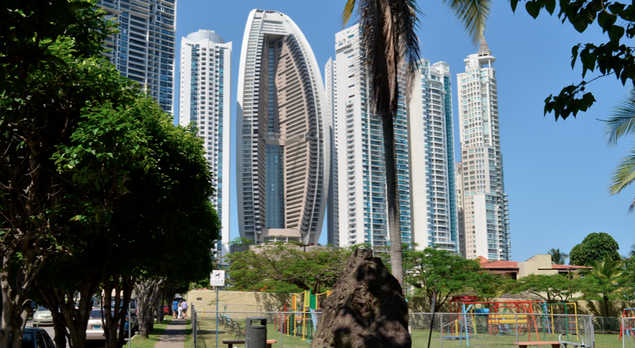
Technological Resources

Slide 18
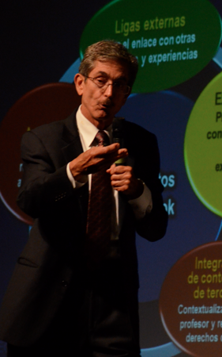
Why Digital Editions?
As we progress from printed texts to eBooks to online courses, the types of content will become indistinguishable
And they will be very affordable
Rafael Rangel Sostmann
Notes:
Rafael Rangel Sostmann - Monterrey
Why ebooks? Talent of more professors, accessible to more people, green, more innovative learning materials
elements of an ebook: extra languages, activities, glossary, explanations

Slide 19

As We Speak…
“Is the textbook dead? The model of selling learning materials for profit is quickly becoming obsolete in today’s online world.”
http://www.unesco.org/new/en/communication-and-information/resources/news-and-in-focus-articles/all-news/news/world_open_education_resources_congress/

Slide 20

Online Resources Will Be Open
Online contents – and this also includes software, to a large degree – will be open. Even our friends from Blackboard have acknowledged this, with their purchase of assets like MoodleRooms.

Slide 21
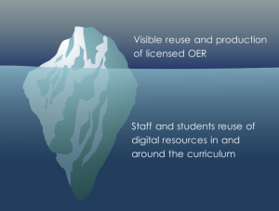
The OER Iceberg
those above the water-line, visible, above board, properly licensed
or those below the water line – where licensing is not so important.
http://jennymackness.wordpress.com/2012/06/14/open-educational-resources-and-pedagogy/
Notes:
Good iceberg graphic of the use and reuse of open educational resources. "We can take the iceberg metaphor and categorise them as
those above the water-line, visible, above board, properly licensed – the kind of resources produced by an institution to market itself
or those below the water line – where licensing is not so important.
These below the water line resources are easy access, free and easy to remix and repurpose, without much attribution. This happens a lot below the water line." That's where I live. Below the water line. The slides are from David ('visitors and residents') White - here's the recording on Elluminate.

Slide 22

The Open Protocol
“With open graph, your app becomes a part of the user’s identity and social graph. Through a single API, you can deeply integrate into the key points of distribution on Facebook: timeline, app views, news feed, and ticker.”
http://developers.facebook.com/docs/opengraph/#types
Notes:
Open graph allows apps to model user activities based on actions and objects. A running app may define the ability to “run” (action) a “route” (object). A reading app may define the ability to “read” (action) a “book” (object). A recipe app may define the ability to “cook” (action) to a “recipe” (object).
Twitter might be using the open graph protocol, as Bill Seitz suggested. I don't know about that yet. But open graph tags are well worth exploring, just in case they become widely used. I've covered this before. Facebook introduced the open graph last fall. This page describes the protocol in detail, describing a large number of OGP tags.

Slide 23
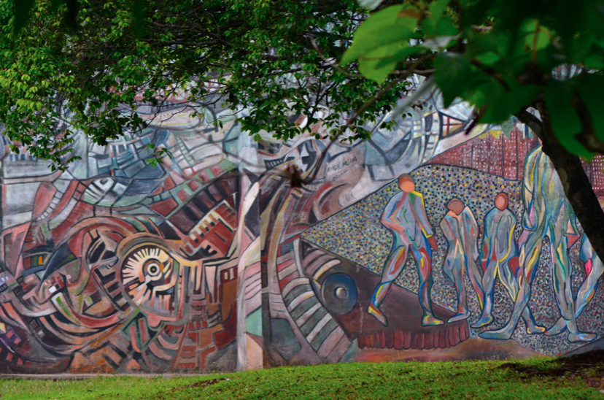
Capturing the Process
I've always felt, first, that whether or not to record one's work should remain a personal choice, but second, that everyone should do so.
http://www.downes.ca/post/58412/rd
Notes:
The University and College Union (UCU) in Britain has, as Adam Warren says, "passed a motion (HE43) at their recent HE sector conference that expresses some of the anxieties that surround lecture capture." The first item - to support professors who refuse to record lectures - has been "remitted" (in Canada, we would say that it has been tabled). The remaining three items, expressing doubts about the ubiquity and scale of lecture capture projects, were passed. I've always felt, first, that whether or not to record one's work should remain a personal choice, but second, that everyone should do so. In other words, I don't think edicts are appropriate, but support and encouragement should certainly be there.

Slide 24
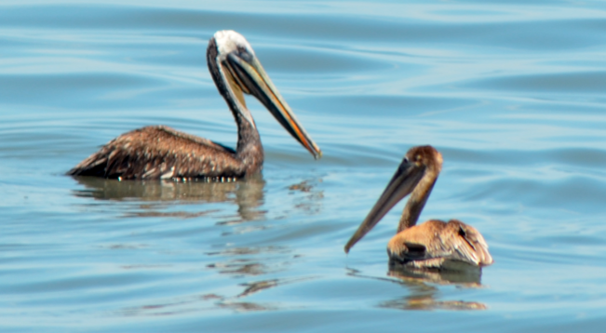
Knowledge Management

Slide 25
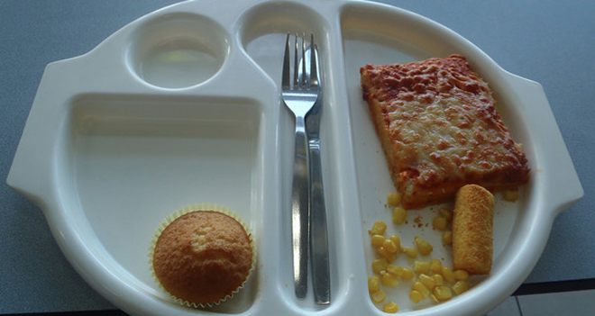
Real Life
Her school has decided that it will no longer allow its food to be photographed
http://www.wired.com/wiredscience/2012/06/neverseconds-shut-down/
Notes:
Take a few moments to look at the Never Seconds blog before it disappears. It was created by a nine-year old student to document the appalling food served at his school cafeteria. Martha Payne of western Scotland received wide publicity for he effort and after the blog went viral the food at her school began to improve. My favourite bit of the blog are the meal ratings and in particular the 'pieces of hair' count. Why mention it now? Her school has decided that it will no longer allow its food to be photographed, so Payne is being forced to shut the blog down. The school is sending exactly the wrong message, of course. "If you’d like to tell the Argyll and Bute Council, who made the decision, exactly how idiotic they’ve been, their webpage is here. (And they are @argyllandbute on Twitter.)"

Slide 26
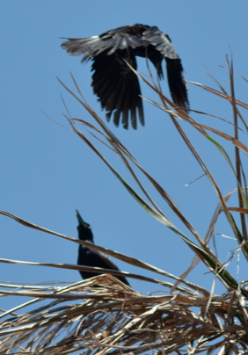
Why Knowledge Management Doesn’t Work
The same principle the transistor works on – a very small energy can leverage a very large energy
http://www.howtogeek.com/116890/grams-to-pounds-a-domino-chain-reaction-video/
Notes:
It’s not simply that the small domino will topple the big one, it’s that you don’t know which one is going to do it
The only way to stop the chaos is to block all the small ones – but then people figure out you’re up to something

Slide 27
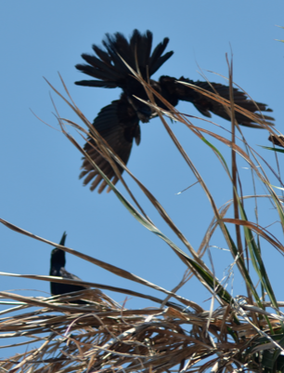
Murmuration
What this looks like when you have more than one domino. You can no more ‘manage’ knowledge than you can ‘lead’ a flock of birds
http://www.youtube.com/watch?v=V71hz9wNsgs&feature=related

Slide 28
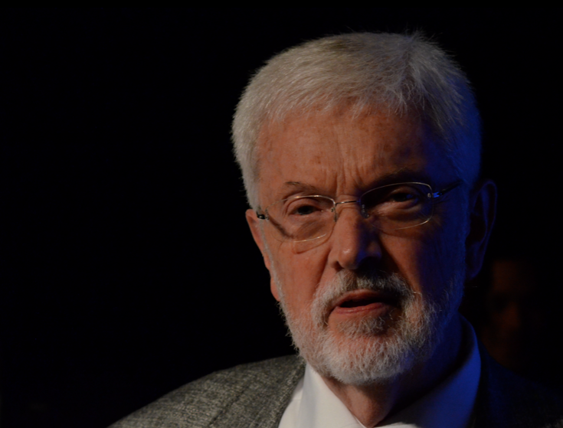
Education vs Catastrophe
A common objective – an educational system attainable to all to avoid catastrophe
But (cf Ostrom) we can’t manage our way forward
William H. Graves
Notes:
W need to understand that everything is connected – need to get the *model* right – environment, economy, etc
We need education as attainment – should be a common good, but is it?
Barriers – credentialed population has idled, need financial aid, “if we just leave it to our institutions of higher education…” – making sure the local results add up to the global goal
3-way conundrum:
education finds gov funding unreliable
gov finds education unaccountable
- needy students find edu inflexible, unaffordable and slow
Elinor Ostrom – economics of a commons
- Clearly defined boundaries (effective exclusion of external un-entitled parties);
- Rules regarding the appropriation and provision of common resources that are adapted to local conditions;
- Collective-choice arrangements that allow most resource appropriators to participate in the decision-making process;
- Effective monitoring by monitors who are part of or accountable to the appropriators;
- A scale of graduated sanctions for resource appropriators who violate community rules;
- Mechanisms of conflict resolution that are cheap and of easy access;
- Self-determination of the community recognized by higher-level authorities;
- In the case of larger common-pool resources,organization in the form of multiple layers of nested enterprises, with small local CPRs at the base level.

Slide 29
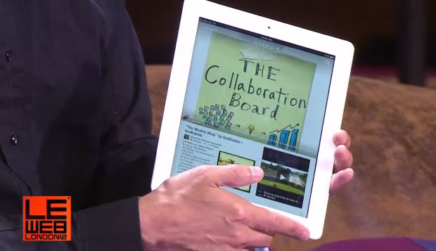
Collaboration: This is Old
A model based on a closed ecosystem and proprietary interface - no data in, no data out
http://news.cnet.com/8301-1023_3-57455826-93/flipboard-becomes-prominent-google-partner/

Slide 30
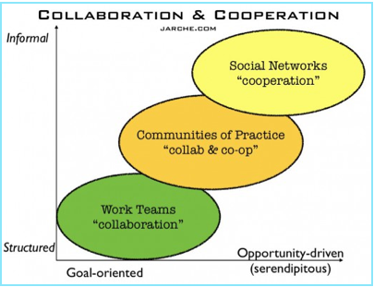
Cooperation: The New
Cooperation is also necessary, but it’s much less controllable than our institutions, hierarchies and HR practices would like to admit.
Harold Jarche
http://www.jarche.com/2012/06/in-networks-cooperation-trumps-collaboration/
Notes:
Harold Jarche offers a nice take on an argument I have often offered: that in a network world we organize ourselves by means of cooperation, not collabration. Jarche writes, "Shifting our emphasis from collaboration, which still is required to get some work done, to cooperation, in order to thrive in a networked enterprise, means reassessing some of our assumptions and work practices. For instance: The lessening importance of teamwork, versus exploring outside the organization may change our perceptions about being a “team player”. Detailed roles and job descriptions are inadequate for work at the edge. (And) You cannot train people to be social."

Slide 31
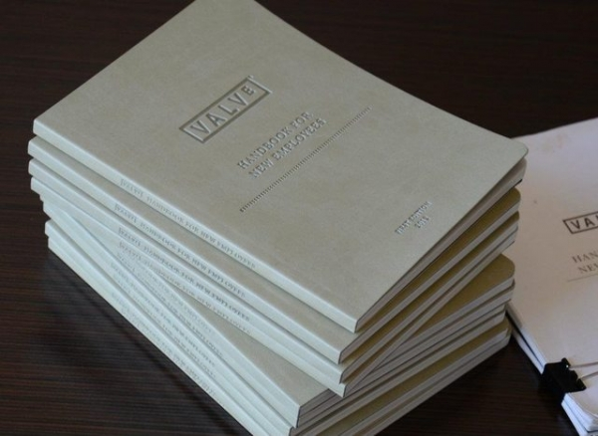
Valve
An organization with no managers, with self-organizing groups, and a workforce that decides for itself what it will do
http://www.techspot.com/news/48303-valves-new-employee-handbook-is-chock-full-of-awesome-read-it-now.html
Notes:
Civ V has grown a bit on me over time and yesterday I defeated it at Deity level for the first time ever (now I have a bunch of work to catch up on). But today, my affection for Valve, the company that makes Steam, grew by leaps and bounds with the discovery and reading of this handbook. It describes an organization with no managers, with self-organizing groups, and a workforce that decides for itself what it will do. This is the model of the future I have been describing and it's amazing to see that it not only actually exists but also that it has shipped product that I actually use. Here it is: read for yourself. See also coverage on Kotaku. Item via Flamehaus and Cooperative Catalyst.http://www.techspot.com/news/48303-valves-new-employee-handbook-is-chock-full-of-awesome-read-it-now.html

Slide 32

Analytics are not Local
Knowledge management has been replaced with ‘analytics’ – but what sort of analytics? “Twitter is the main way our posts are being shared. Linkedin comes in second with Delicious and Google+ (following).”
An Educational Positioning System? (Graves)
Notes:
I thought this was a good idea - using analytics to validate work on analytics. "We think this is a 'hot topic' but is it? Can our analytics help us to gauge interest?" For me, of course, the most interesting question is whether analytics can distinguish between a 'hot topic and something useful - but I digress. The result? Well though "it is apparent that Twitter is the main way our posts are being shared. Linkedin comes in second with delicious and Google+ also generating a few 'shares'." I can't tell from the text whether people are actually clicking and commenting on the analytics posts. And the images are totally unreadable - maybe we can get some more useful images! Related (and a much better example of how to share a graphic in a blog post) is Mohamed Amine Chatti's SWOT analysis oanalytics.

Slide 33
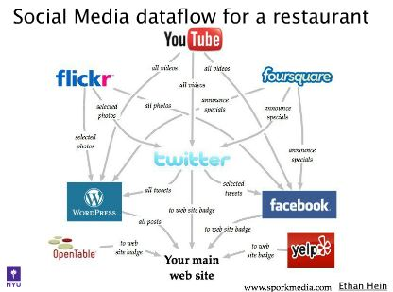
The Course Web
Downes's law of MOOCS: if it isn't a course web, it isn't a MOOC
http://www.pontydysgu.org/2012/06/social-learning-glue/
Notes:
This is still way too diffocult. Facebook is still a data sink, and Blackboard is a black box. But this slide show gets at some of the mechanics of creating a real course web (and for those of you who love definitions and laws, here's Downes's law of MOOCS: if it isn't a course web, it isn't a MOOC). RSS is of course central, and this presentation uses dlvr.it the way I use IFTTT. Matthew Leingang's presentation is on a post from Graham Attwell.

Slide 34

Our Next Course
What is role of the academy in increasing national economic competitiveness while preserving the “vital combat for lucidity” that defines an open democratic society?
http://edfuture.net/
Notes:
somewhat concerned – sponsorship from Gates, Educause, Chronicle

Slide 35
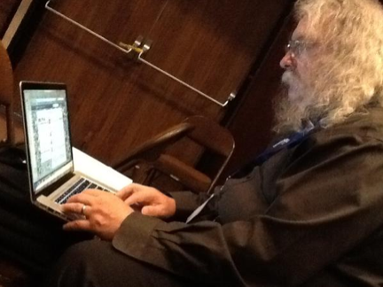
Thanks @verarex
http://t.co/MoSdTLgA
Stephen Downes
http://www.downes.ca

