Slide 1
The Open Advantage
What’s coming and why it’s coming
Stephen Downes
May 27, 2012

Slide 2
What’s Coming?
Open
Digital
Distributed

Slide 3
Trends

Slide 5
When you die..
http://www.downes.ca/post/58146

Slide 6
‘And so it begins’ -
Houghton Mifflin Harcourt is facing bankruptcy "as it faces a lagging textbook market due to drops in educational funding.”
  http://www.downes.ca/post/58190

Slide 7
CCK
http://www.downes.ca/post/58207
ebooks page - http://www.downes.ca/archive/me/mybooks.htm

Slide 9
Love Letter to Plywood
Tom Sachs, YouTube, May 16, 2012.
This short video, a tribute to plywood, is getting rave reviews. It's an educational video, but one that leaves one viewer "weeping in the building materials aisle at Home Depot." Me, I've spent a lot of time with plywood, and so I get that.
http://www.downes.ca/post/58164

Slide 10
The university system won’t last
http://www.downes.ca/post/58132
Notes:
Why the University System, as We Know It, Won’t Last …. and What’s Coming Next
Dan Colman, Open Culture, May 14, 2012.
Dan Colman points to two trends that, to him, signal the end of the university system as we know it:
First, Silicon Valley is finally focusing on e-learning. Udacity, Coursera, Kahn Academy, EdX — they’re all looking to lift e-learning out of a long period of stagnation.
Second, paying for a college education is getting unsustainable - as noted by the New York Times this weekend and Planet Money in audio.
"And then," he writes, "you consider this. Many universities seem indifferent to the difficulties students face, if they’re not intentionally exacerbating the problem."

Slide 12
Open

Slide 14
The push toward open

Slide 16
Costs
http://www.downes.ca/post/58136
Notes:
The ivory tower is showing cracks
Daniel Woolf, Ottawa Citizen, May 14, 2012.
With protests in the street in Montreal, rising student loan debts, and increasing government austerity, the university is under more pressure than ever to do the impossible: deliver a quality education to all at a price that will neither bankrupt students nor bankrupt nations. "Universities will inevitably adapt and modify, as they have for the past 800 years, because they will have to do so to survive. The trick will be to do so without destroying all the good things they have achieved for Canadians, and the world, over the last half century."

Slide 17
Mandating
arguments for (taken from http://thefinchandpea.com/2012/05/18/mandating-open-access-science-publishing/ )
  the public pays for research and thus deserves access. - response: “most of the technical articles published in scientific journals are of little utility to members of the general public, and generally those who can parse the technical articles can get access with the minor inconvenience of going to the local university library. (In the case of news organizations large enough to hire science journalists, they should be able to pay for subscriptions to the top tier journals.) “
  it’s better for science and the scientific community.
  its a very practical way to distribute manuscripts among scientists, making it easier to post manuscripts on lab web pages, to post links to papers on blogs that are read by scientists or science savvy readers.
  - increases citation impact – “Self-Selected or Mandated, Open Access Increases Citation Impact for Higher Quality Research” - http://www.plosone.org/article/info:doi/10.1371/journal.pone.0013636 - The OA advantage is greater for the more citable articles, not because of a quality bias from authors self-selecting what to make OA, but because of a quality advantage, from users self-selecting what to use and cite, freed by OA from the constraints of selective accessibility to subscribers only.
Mechanisms
  place immediately
  place 6 or 12 months after publication – eg NIH - http://grants.nih.gov/grants/guide/notice-files/NOT-OD-08-033.html

Slide 19
The counterarguments
“they add essential value to published research via their editorial and publication process, and thus they need subscription fees to stay in business.” http://thefinchandpea.com/2012/05/18/mandating-open-access-science-publishing/
It takes more than access - Intellectual Access — It Takes More Than Accessibility
Kent Anderson, The Scholarly Kitchen, May 23, 2012. http://www.downes.ca/post/58238
the ‘tyranny’ of openness - http://www.downes.ca/post/58191

Slide 21
Sustainability Models
author pay – eg. BioMed Central – “BioMed Central's standard article-processing charge for BMC subject journals is £1230(€1530 /US$1945). “ - http://www.biomedcentral.com/about/apcfaq/howmuch - also eg. “Open Access Option” from PNAS (Proceedings National Academy of Sciences USA) - http://www.pnas.org/site/subscriptions/open-access.shtml
Pays for:
  Immediate, worldwide open access to the full article text
  Developing and maintaining electronic tools for peer review and publication
  Preparation in various formats for online publication
  Securing inclusion in PubMed as soon as possible after publication
  Securing full text inclusion in a number of permanent archives such as INIST (France), Koninklijke Bibliotheek (The Netherlands) and arXiv.org (USA)
  Securing inclusion in CrossRef, enabling electronic citation in other journals that are available electronically
eg. – pubmed central http://www.ncbi.nlm.nih.gov/pmc/ - “PMC is a free full-text archive of biomedical and life sciences journal literature at the U.S. National Institutes of Health's National Library of Medicine (NIH/NLM).”
  1078 full participation journals – “the journal commits to depositing the complete contents of each issue or volume, starting with a particular volume/issue or publication date.”
  302 NIH portfolio journal – “the journal commits to depositing all NIH-funded articles”
  1726 selective deposit journals – “used by publishers who offer a hybrid publishing model, i.e., a traditional subcription-based journal in which only selected articles are made open access. These journals deposit just their open access articles in PMC.”

Slide 22
SHERPA
http://www.sherpa.ac.uk/index.html
  SHERPA Services
    RoMEO - Publisher's copyright & archiving policies
    JULIET - Research funders archiving mandates and guidelines
    OpenDOAR worldwide Directory of Open Access Repositories
    SHERPA Search - simple full-text search of UK repositories
  SHERPA Resources
    SHERPA speaking events - for future events see CRC
    Guidance on depositing material; copyright; and open access for authors
    Advocacy Materials for administrators, including past SHERPA presentations
    Links to other initiatives and related background information

Slide 23
Licensing
“Articles that are available through the PMC OAI and FTP services are still protected by copyright but are distributed under a Creative Commons or similar license that generally allows more liberal use than a traditional copyrighted work. Please refer to the license statement in each article for specific terms of use. The license terms are not identical for all the articles.”

Slide 24
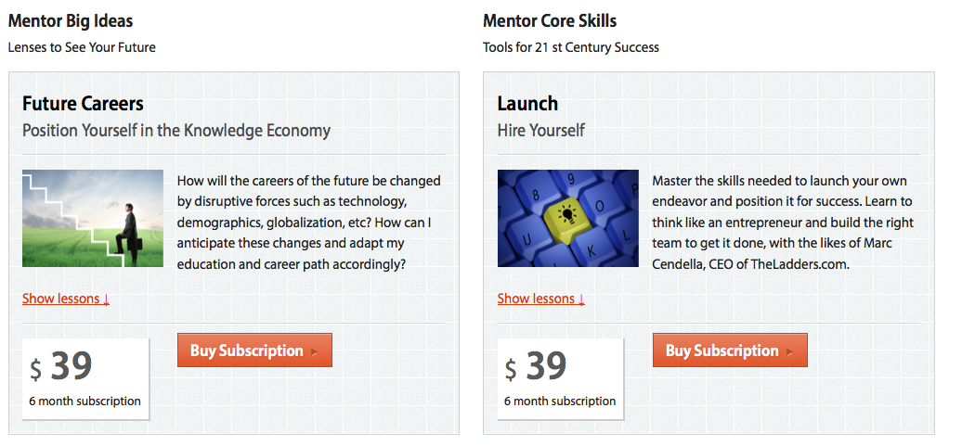
Blending Learning and Publishing
eg. Big Think Edge - http://edge.bigthink.com/
‘Mentor’ & ‘Pro’ – http://edge.bigthink.com/mentor
supported (marketed) with blog / magazine - http://bigthink.com/think-tank/me-all-the-time-the-epidemic-of-narcissism (similar to Nature eg. http://www.nature.com/news/finding-the-true-value-of-us-climate-science-1.9993 )
Notes:
career development toolkit delivering interactive multimedia courses to equip you with the real world skills you need to achieve your highest career goals. Mentor will give you guidance on topics ranging from how to spot and realize career opportunity at every level of your career to how to ace your next job interview.

Slide 26
Beyond academic resources
The open clipart directory http://www.downes.ca/post/58152

Slide 27
turnitin
http://www.downes.ca/post/58134

Slide 28
Authority vs open
the nature of digital influence
http://www.downes.ca/post/58135

Slide 30
Digital

Slide 31
Researchers develop 'smart' touch-responsive internet-enabled newspaper
http://www.downes.ca/post/58220
Notes:
http://www.downes.ca/post/58252

Slide 33
Why We Killed Our College Daily Paper for a More Digital Future
Ryan Frank, Mediashift, May 25, 2012.
http://www.downes.ca/post/58252

Slide 34
The adaptive image for multiple devices
http://www.downes.ca/post/58188

Slide 35
The Moog Doodle
http://www.downes.ca/post/58247

Slide 37
How the AP's Overview Turns Documents Into Pictures - http://www.downes.ca/post/58254
http://www.pbs.org/idealab/2012/05/how-the-aps-overview-turns-documents-into-pictures144.html

Slide 38
Virtual exercises help Army, Air Force work together
http://www.downes.ca/post/58219

Slide 40
Edshelf: An Educational App Directory for Teachers
http://www.downes.ca/post/58151

Slide 41
Distributed

Slide 44
Social Networks – so.cl
http://www.downes.ca/post/58203
The twitter signal channel
  http://www.downes.ca/post/58133

Slide 46
Beware of amazon
http://www.downes.ca/post/58249

Slide 48
Fear of a YouTube Planet
http://www.downes.ca/post/58245
Jim Groom, bavatuesdays, May 24, 2012.
It looks like we're in for another round of video deletions on YouTibe. As Jim Groom says, "I’ve probably had around 50 copyright complaints, and they have been coming fast and furious as of late. There must be some crackdown in the office of YouTube." What I don't understand is why the creators (or, more accurately, the copyright holders) of a film like The Wild Bunch don't understand that their property becomes more valuable when people use a clip of it as part of their everyday vocabulary. Oh well. I guess it's back to cat videos - they'll never become illegal (unless Disney decides it owns the rights to cat videos).

Slide 49
The danger of centralization - http://www.downes.ca/post/58187
Notes:
Here's The TED Presentation About Rich People That TED Doesn't Want You To See
Grace Wyler, Business Insider, May 18, 2012.
Normally people with these sorts of views would never be allowed near a TED stage. But a millionaire slipped through the cracks and as the National Journal reports, TED's Chris Anderson is refusing to publish a talk given on its stage by venture capitalist Nick Hanauer. As Time reports, Anderson's explanation is that the talk was “too political” to be posted during an election year, and that "a lot of business managers and entrepreneurs would feel insulted" by some of Hanauer’s arguments. Alas for Anderson, the video has surfaced at YouTube, so the rich will be insulted no matter what. Anyhow, you can read Hanauer's radical arguments on that beacon of socialism, Bloomberg. Or read the full text of the talk here. Meanwhile, you can read the discussion at TED where members are shocked - shocked! - to discover that TED wasn't the open marketplace of ideas they thought. People who read me know I have been critical of this aspect of TED for a long time. Maybe now, a few more eyes will be opened.

Slide 50
The case of wikipedia & reddit http://www.downes.ca/post/58159

Slide 51
Pan-Caadian network
An online opportunity for Canadian universities http://www.downes.ca/post/58218

Slide 52
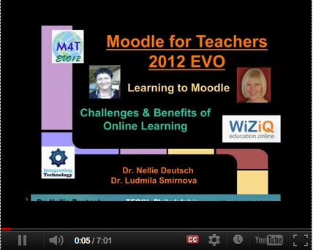

Slide 53
Learning Resource Metadata Initiative
http://www.downes.ca/post/58217

Slide 54
The research sidebar
http://www.downes.ca/post/58163

Slide 55
SPAWS
use case - http://www.downes.ca/post/58255
paradata recipes - http://www.downes.ca/post/58221

Slide 57
Cloud storage -
http://www.downes.ca/post/58189 - amazon for wp

Slide 58
Oauth is your future
  http://www.downes.ca/post/58186
Notes:
OK, this doesn't exist, but it is imaginable that we could read something like this in the near future: "Klout is trialling a beta program with the Department of Homeland Security and Customs and Border Protection to provide fast-track entrepreneur visa entry to individuals with high Klout scores in specific areas." Now - I know the first reaction is to say how bad this is. But is it unreasonable for government to have as much information on you as some company? Is it unreasonable for us to use it in some practical way, like crossing borders? And maybe - just maybe - if it becomes used in this way, maybe we'll have some rights to access it, use it ourselves, and ensure it is correct. Because right now none of that is the case.

Slide 61
the emergence of the Internet constituency (Geist) -
http://www.hyperorg.com/blogger/2012/05/24/11874/
people are forming their own media consortia. http://www.pbs.org/mediashift/2012/05/the-media-consortium-inside-our-may-day-collaboration145.html

Slide 62
Media Co-ops

Slide 64
The Open Learning Phenomenon

Slide 66
New model, same old story - http://www.downes.ca/post/58235
Coverage of some resistance being expressed by academics over MOOCs (and in particular, the Thomas Friedman version of MOOCs). Jonathan Rees, for example, writes, "don’t think that your exalted status as a college professor will cause anyone planning to make money off the corpse of your career to lose a wink of sleep." Mark Brown argues, "it’s disgusting to present MOOCs as a solution to the crisis in public funding for higher education." There's a lot more reaction covered in this article, and while I understand the concerns I don't think the academics interviewed have come to grips with the problems inherent in the existing system and how MOOCs (the real kind, not the Friedman kind) were designed to solve them.

Slide 67
The big schools
http://www.downes.ca/post/58206
Michael Geist writing about the revolution in education, citing examples like Stanford and MIT, and saying "there are serious doubts whether Canada is ready for these changes."

Slide 68
unbundling education
http://www.downes.ca/post/58176

Slide 69
DIY learning: Schoolers, Edupunks, and Makers challenge education as we know it
http://www.downes.ca/post/58205
Notes:
Schoolers are applying new tools to traditional goals to crack open the case on the traditional schoolhouse. With laptops, tablets, and cell phones, students no longer wait to be spoon-fed information, but reach out beyond the walls of the classroom for images, information, and insights at the moment the question arises for them.

Slide 70
Open Online learning – the MOOC
http://www.wiziq.com/course/4264-teaching-online
UMW Faculty academy - http://www.downes.ca/post/58248
- fslt12 - http://www.downes.ca/post/58175

Slide 71
The qualified self
http://www.downes.ca/post/58148

Slide 72
Perosnal learning
personal learning plan - http://www.downes.ca/post/58150

Slide 73
Life portfolio
http://www.downes.ca/post/58174

Slide 74
Experts on tap, not on top
http://www.downes.ca/post/58149

Slide 75
We’ll never turn back
http://www.downes.ca/post/58137

