Slide 1
Patterns of Progress
Stephen Downes
May 7, 2012

Slide 2
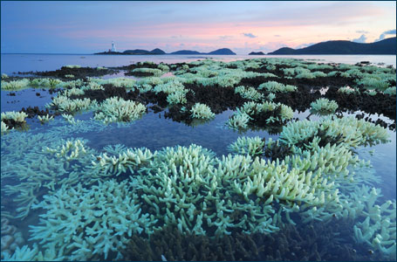
A. Patterns of Change
http://www.asrltd.com/expertise/climate-change-adaptation.php

Slide 3
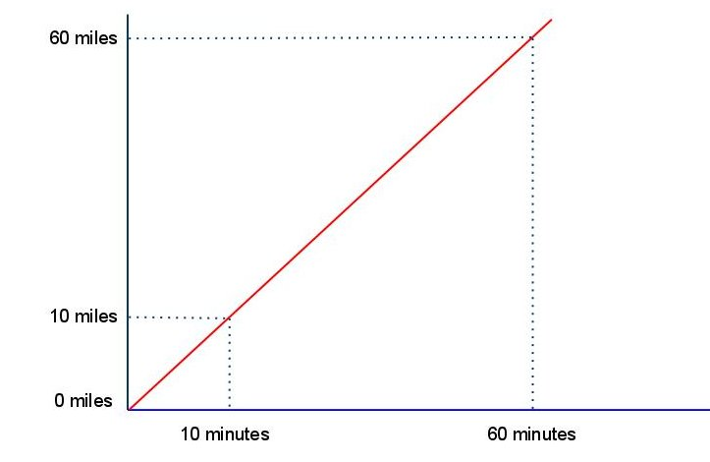
Linear Change

Slide 4
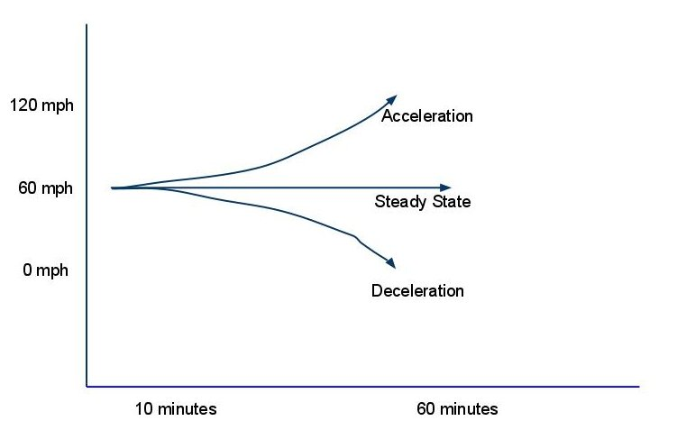
Changes to Linear Change

Slide 5
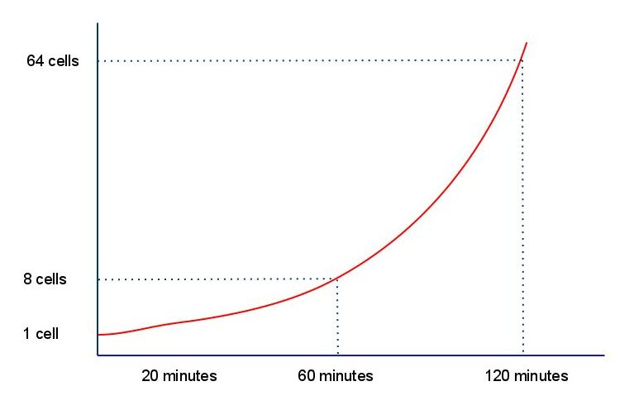
Exponential Change

Slide 6
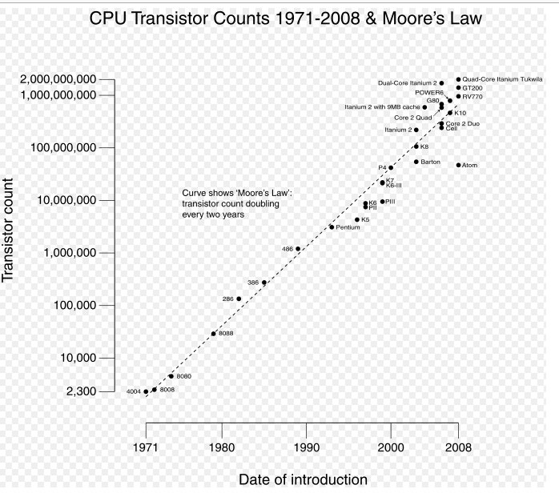
Logarithmic Representation

Slide 7
Models of progression typically invoke either linear change or exponential change.
The very concept of progress has, embedded in it, some notion of constant linear change, whether at a steady rate or an ever-increasing rate.

Slide 8
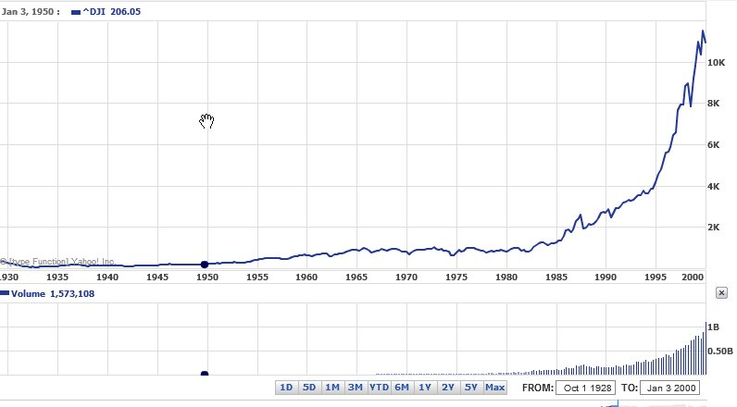
Progress

Slide 9
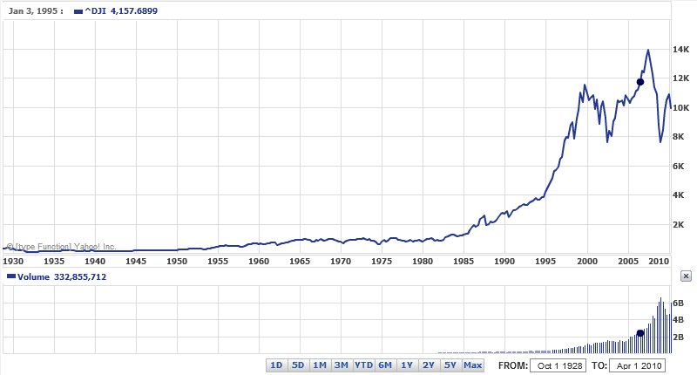
Progress Interrupted

Slide 10
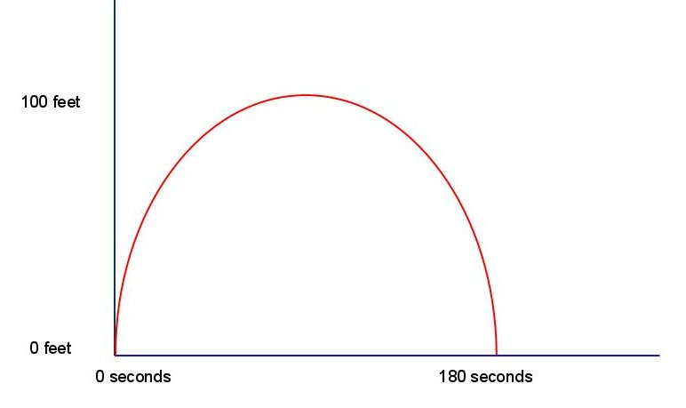
Parabolic Change

Slide 11
Arnold Toynbee describes the arc of civilization in this way. Civilizations rise and fall, he writes, in a constant and predictable way. They expand in (more or less) a circular fashion until they grow too large for their infrastructure to support.

Slide 12
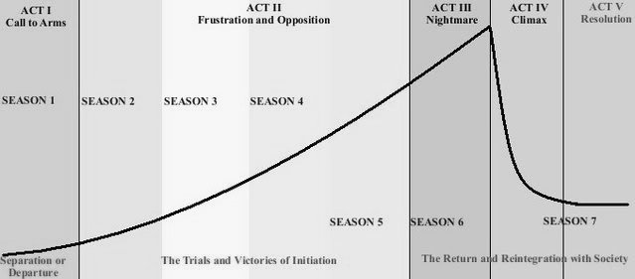
Story Arc

Slide 13
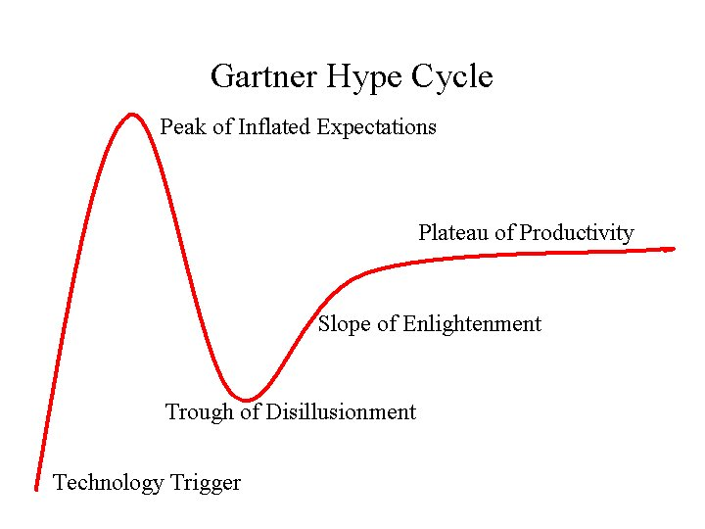
Hype Cycle

Slide 14
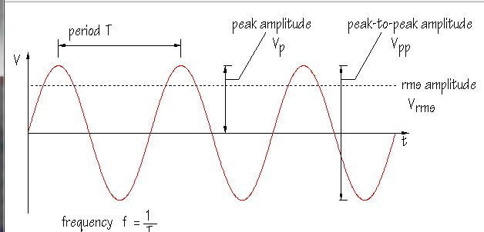
Cycles

Slide 15
We as humans are very sensitive to cycles. We create them, we repeat them, we have evolved an entire science of mathematics, electronics and music based on the manipulation of cycles. We are very prone to see them in the environment, and to expect to see the cycle repeat itself after a time.

Slide 16
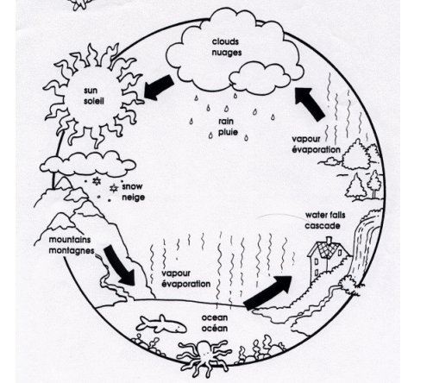
Water Cycle

Slide 17
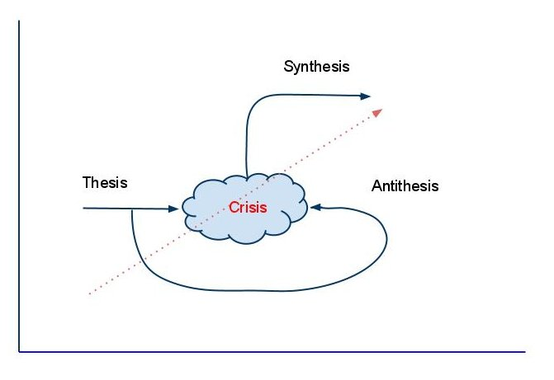
The Dialectic

Slide 18
The dialectic “contains elements of both cyclical and linear change, and thus change is spiral; significant change takes place as an attempt to resolve the accumulation of intolerable contradictions, the unravelling of stresses that are inherent in social life; short term repetitive change but with long term cumulative directional change; processes of change persist but the contents of the processes are changing.” - van der Veen

Slide 19
The concept of the paradigm shift. According to Thomas Kuhn, science does not progress in a linear fashion, but rather progresses through a series of jumps, called paradigms. Within a paradigm we have what is called ‘normal science’, but eventually, contradictions, unexplained experimental results, and other problems and questions force the science into a crisis point. Through this crisis, our view of the world is revised, and we adopt new scientific theories, terms and concepts.

Slide 20
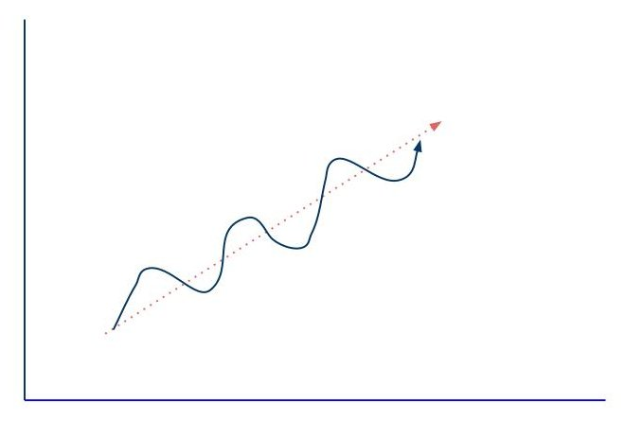
Dialectic Cycles

Slide 21
Viewed from a certain perspective, these aren’t cycles any more but spirals. The cycle may be progressing upward, or it may be progressing downward.
Stock market analysts have created mathematical models on forms of the dialectic to predict swings in share values.

Slide 22
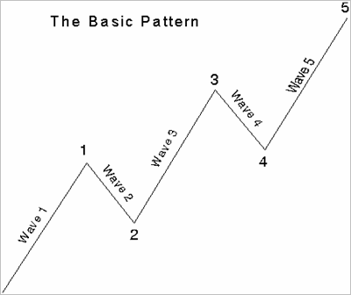
Here is an example called the Elliott Wave Principle:

Slide 23
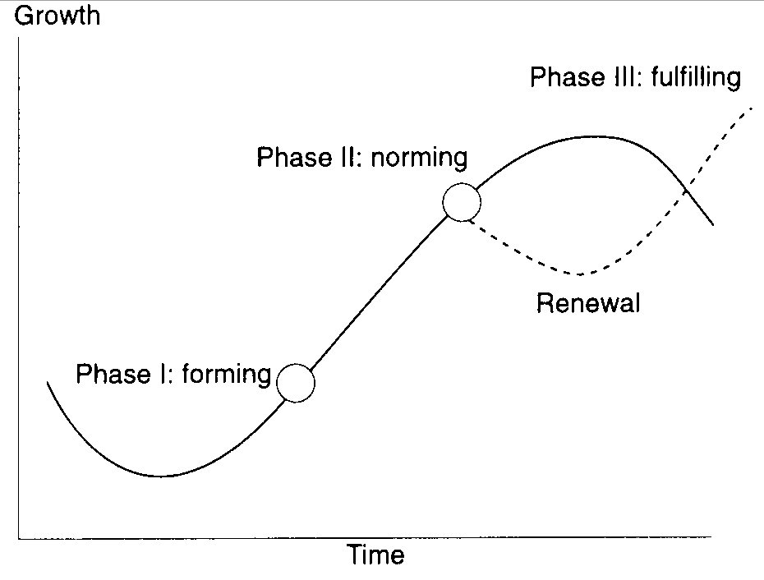
Forming, Storming and Norming
Forming Norming - Source: McNamee and McNamee

Slide 24
Virtuous circles, vicious cyrcles
Feedback loops - ne cycle feeds into the next cycle, accelerating its effects.
Network effect or the first mover advantage. Vicious and virtual cycles occur in interconnected networks, where we have not only a circle much a much more interconnected web of entities.

Slide 25
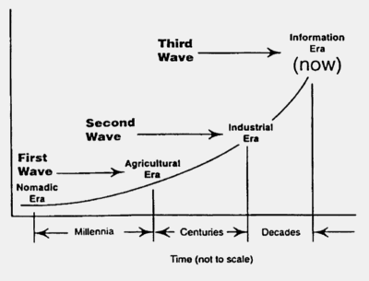
Waves
Third Wave - Exponential View - Source: Harbinger

Slide 26
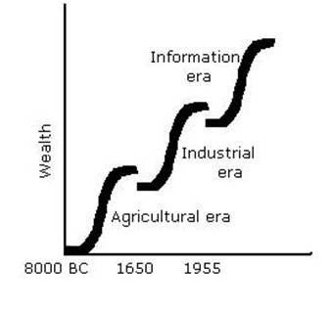
Waves and Eras
Toffler's Waves - Dialectic - Source: Maaw

Slide 27
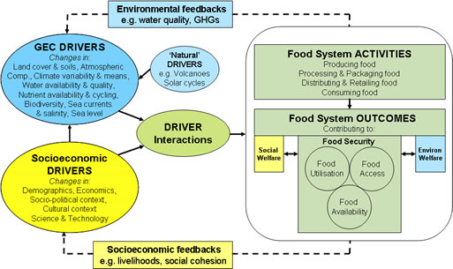
Drivers
Driver Flow Chart - Source: Gecafs

Slide 28
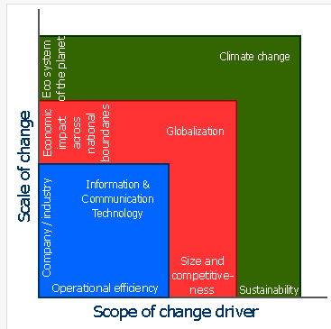
Drivers tend to be forces of nature – eg. three major drivers depicted: ICTs, globalization, and climate change. We see that these drivers are pushing us toward operational; efficiency, size and competitiveness, and sustainability.
Drivers of Change - Source: Alagse

Slide 29
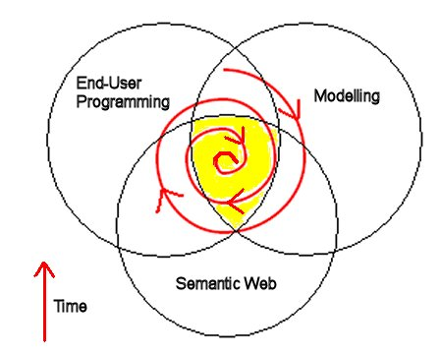
Attractors

Slide 30
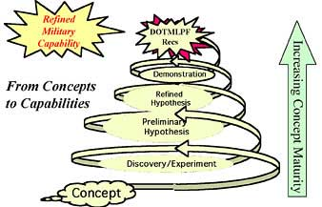
An attractor need not be physical, like gravity. It can also be an objective or goal. While such attractors can motivate change, they can’t really be said to cause change – they require human agency for that.

Slide 31
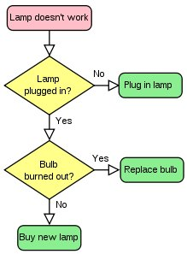
Design and Selection
This is reflective of the impact choice has on change.

Slide 32
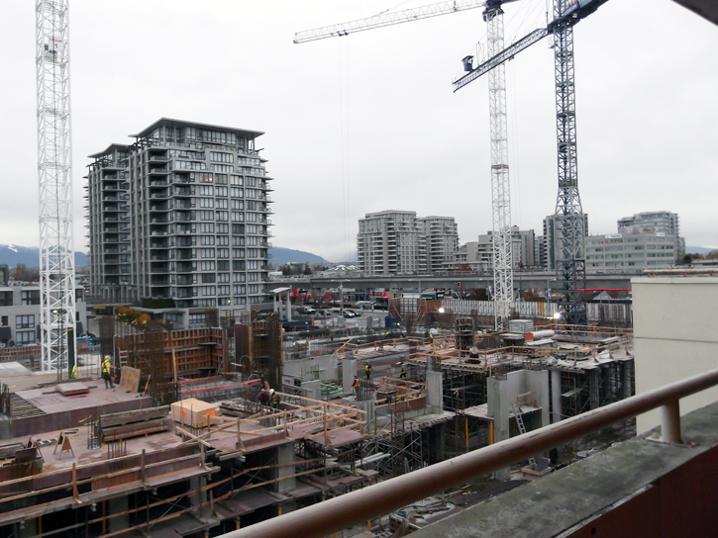
B. The Problem of Progress
http://www.citycentrerichmond.ca/progress-at-the-city-centre-community-centre-site

Slide 33
The book – ‘the progress trap’
Sumer, Rome, Maya, Easter island (also Egypt and China)
Tainter: Runaway train, dinosaur, house of cards

Slide 34
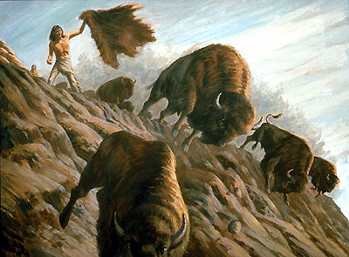
Is ’doing it better’ a trap? Is ‘getting hunting right’ or ‘getting agriculture right’ wrong?
http://www.thecanadianencyclopedia.com/media/buffalo-hunt-over-the-jump-767.jpg

Slide 35
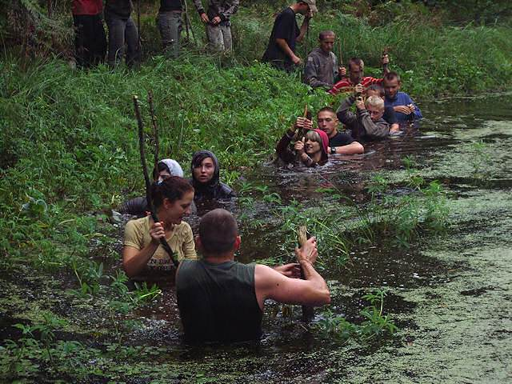
What is progress? – survival, material comfort? How does it change?
http://traderjoes.org/wilderness-survival

Slide 36
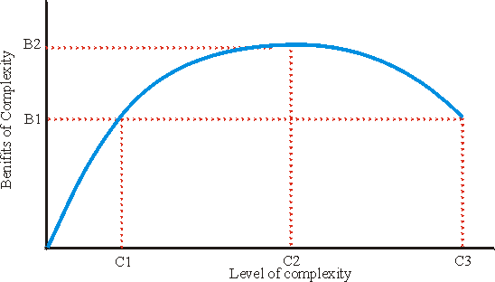
At a certain level of complexity, leadership breaks down, and becomes little better than shamanism – see Tainter 1996 - http://dieoff.org/page134.htm

Slide 37
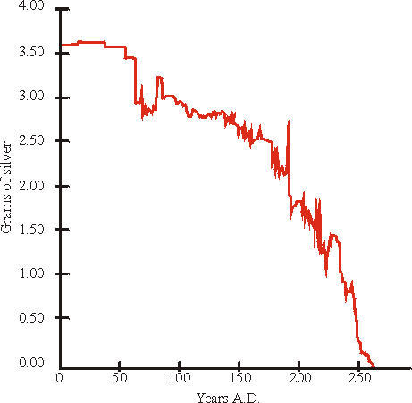
Debasement of the Roman silver currency, 0-269 A.D. (after Tainter 1994b with modifications). The chart shows grams of silver per denarius (the basic silver coin) from 0 to 237 A.D., and per 1/2 denarius from 238-269 A.D. (when the denarius was replaced by a larger coin tariffed at two denarii).

Slide 38
Tainter’s thesis is that when society’s elite members add one layer of bureaucracy or demand one tribute too many, they end up extracting all the value from their environment it is possible to extract and then some. The ‘and them some’ is what causes the trouble.
http://www.shirky.com/weblog/2010/04/the-collapse-of-complex-business-models/

Slide 39
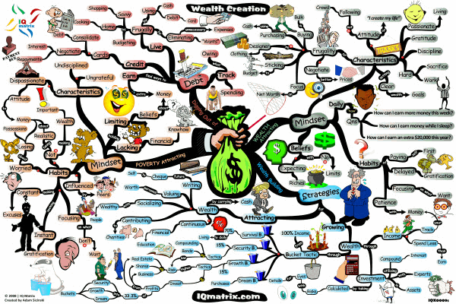
Progress as Material Conform, Economic Growth, Prosperity, Wealth
http://www.mindmapart.com/wealth-management-mind-map-adam-sicinski/

Slide 40
The Forbes article -0 web 1.0, web 2.0, mobile
with each new paradigm shift (first to social, now to mobile, and next to whatever else), the older generations get increasingly out of touch and likely closer to their significant decline.
http://www.forbes.com/sites/ericjackson/2012/04/30/heres-why-google-and-facebook-might-completely-disappear-in-the-next-5-years/2/

Slide 41
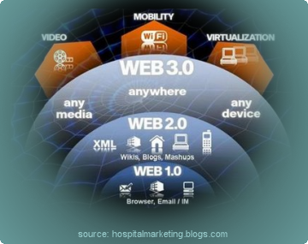
http://webredesignmiami.com/website_redesign_professionalism.php

Slide 42
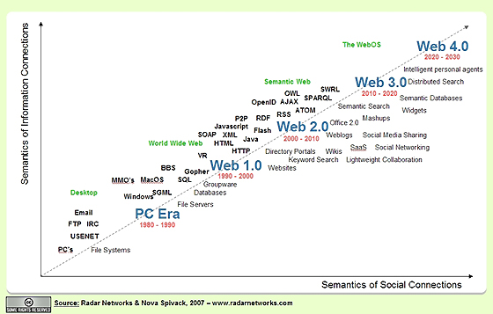
http://lifeboat.com/ex/web.3.0

Slide 43
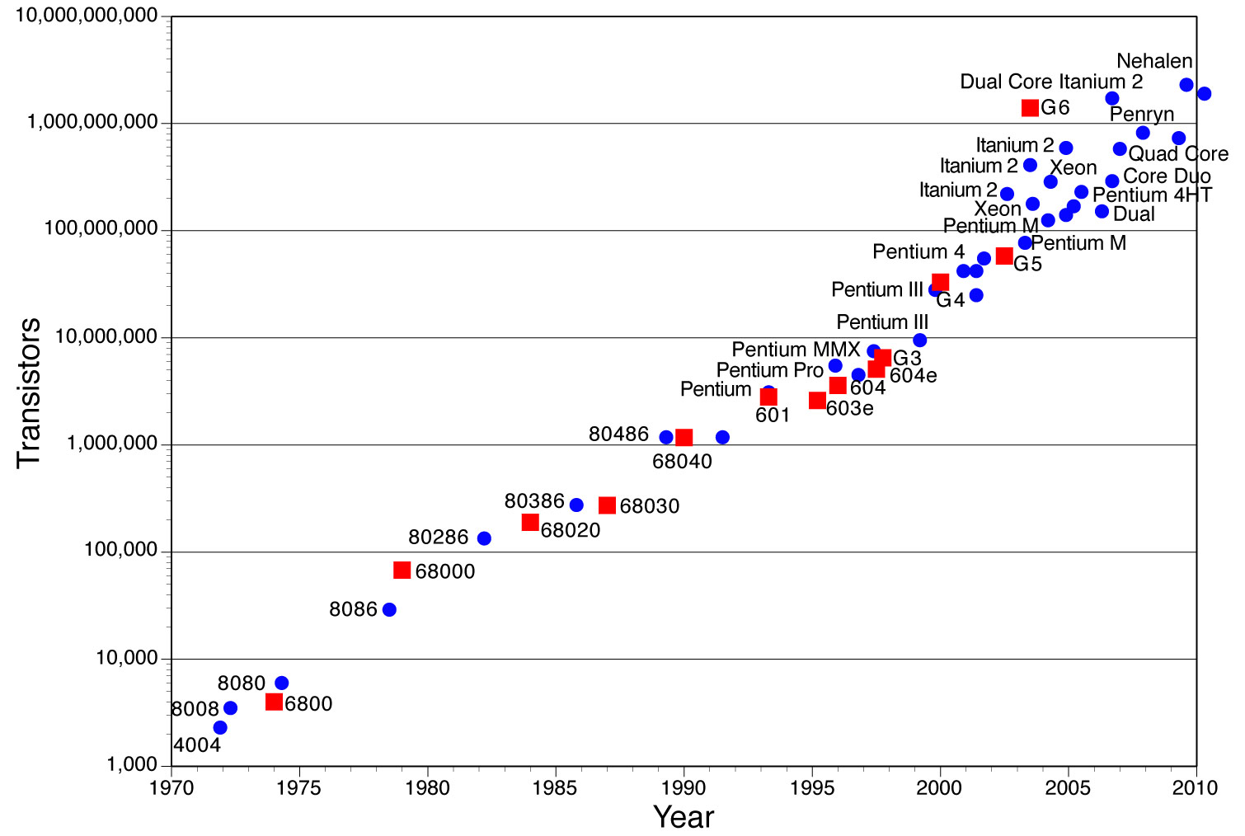
http://chemlinks.beloit.edu/edetc/SlideShow/

Slide 44
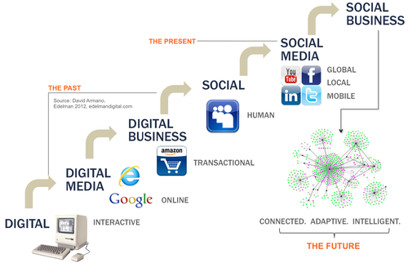
http://darmano.typepad.com/logic_emotion/2012/05/social_biz.html

Slide 45
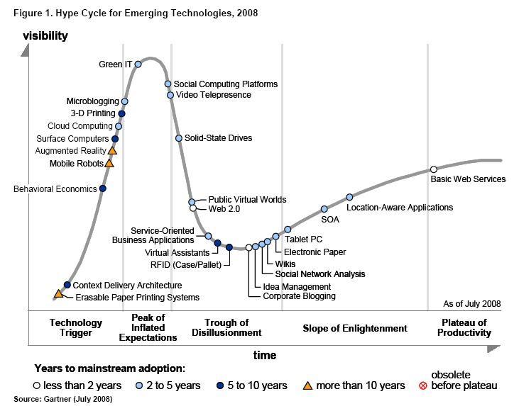
http://stephenslighthouse.com/2008/08/19/gartner-web-2-0-hype-cycle/

Slide 46
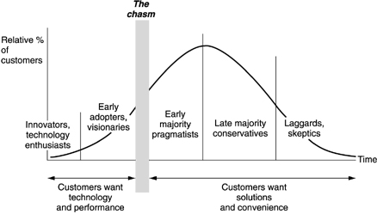
The life cycle of a technology: Why it is so difficult for large companies to innovate
http://www.nngroup.com/reports/life_cycle_of_tech.html
 |  | Donald A. Norman

Slide 47
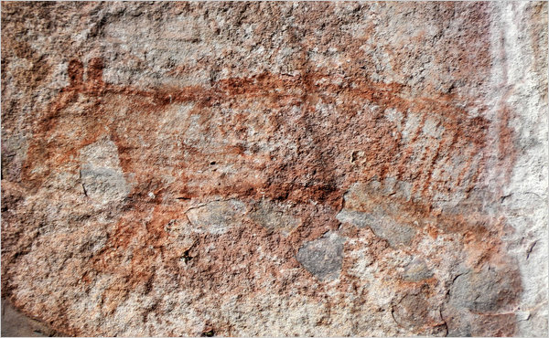
Kakadu slide

Slide 48
We are surrounded by a sea of possibility
Certainty
I must be
I must
I thought I was
I am becoming
I was
I am
I will be
I could have been
I might be
Time

Slide 49
Wenger – Community as self-definition
The transformation of the self from a consuming being to a knowing being

Slide 50
Self interest & self-government – different kinds of progress
– from life to property to liberty
- from self-interest as defined by nature to self-interest defined by value
From sovereign to self-government

Slide 51
The way out of the progress trap is to remove the imperative for survival
As long as there is wealth, people will desire wealth

