Slide 1

Education as Platform
The MOOC Experience and what we can do to make it better
Stephen Downes
EdgeX – New Delhi
March 12, 2012

Slide 2

1. A bit about MOOC Structure
2. Where MOOCs Fail
3. Reconceptualizing MOOCs
4. Chess Net
5. The Budget Game
6. The Education Platform
Notes:
Right now (that is, today!) I'd like to explore the idea of education as platform. We've had some good experience now with massive open online courses over the last three or four years. A pretty good set of design elements are falling into place, and I'd like to talk about these and how they relate to the pedadgogy used to design the course. We have also encountered some design challenges, especially with regard to offering an orchestrated view of a wide variety of distributed learning materials. How do we improve the concept of the open online course to support a proliferation of new media and environments? How do we sustain conversation and communication among dynamic, constantly changing, groups? How do we comprehend and represent the learning experience in such a way as to be able to demonstrate progress?

Slide 3

A bit about MOOC Structure
Notes:
George on disruption – not disrptive enough
Udacity, Khan Academy, Coursera – “I’ll tell you what you need to know”

Slide 4
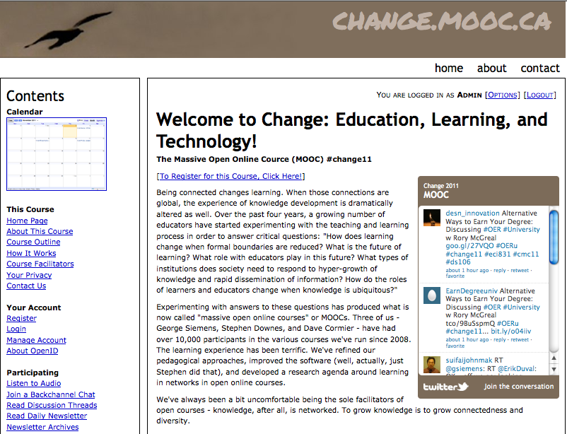
The MOOC Experience

Slide 5
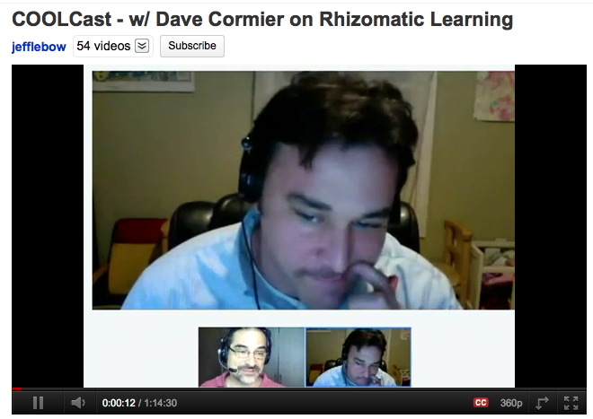
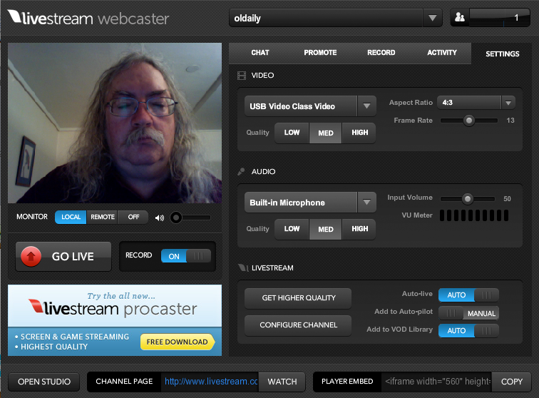
Open
Mix of levels – novice and experienced

Slide 6
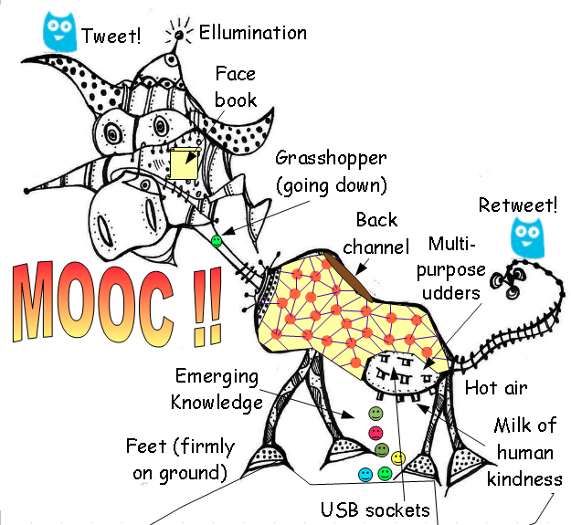
The network structure
http://cor-ar.blogspot.in/2012/03/two-distinct-course-formats-in-delivery.html
Notes:
distributed learning / distributed resources
Oswaldo – the central versus the aggregated
Format 1:
Many MOOCs have utilized a daily newsletter named “The Daily” which basically aggregates contributions from all blogs (or other resources) from participants tagged in a certain way. Examples are CCK08, PLEN2010, Change11 and LAK12.
Format 2:
Some MOOCs employ a “centralizing “web page used by the facilitators for announcing all activities and a mailing list open to contributions from participants(mostly Google Groups).

Slide 7
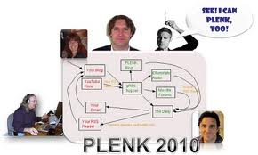

Aggregation – bringing together

Slide 8
The abundance of content
Some analogies:
  following football – there are more games in the world than you could possibly watch
  recipes – there is more food int eh world than you could possibly eat, more ways of eating food than you could experience in a lifetime
  places to visit – the world is vast, ou cannot possibly see everything

Slide 9


Social versus Solo
http://blog.learnlets.com/?p=2562
Notes:
Clark Quinn – contrasting Stanford AI with CCK: “The Stanford model, as I understand it (and I haven’t taken one), features a rigorous curriculum of content and assessments, in technical fields like AI and programming. The goal is to ensure a high quality learning experience to anyone with sufficient technical ability and access to the Internet. Currently, the experience does support a discussion board, but otherwise the experience is, effectively, solo.
The connectivist MOOCs, on the other hand, are highly social. The learning comes from content presented by a lecturer, and then dialog via social media, where the contributions of the participants are shared. Assessment comes from participation and reflection, without explicit contextualized practice.”

Slide 10
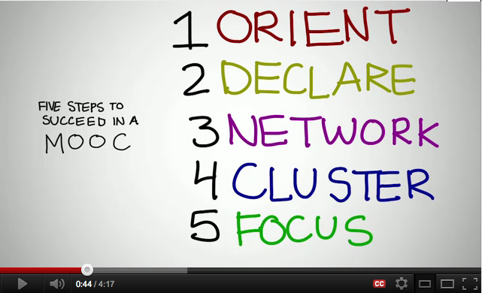
Success in a MOOC
http://www.youtube.com/watch?v=r8avYQ5ZqM0
Notes:
Cormier - http://www.youtube.com/watch?v=r8avYQ5ZqM0
Orient – finding stuff, figure out times
Declare – create a place for your thoughts+tags
Network – follow other people, make connections – reply and interact
Cluster – find a cluster to work with
Focus – find a purpose for the work you are doing

Slide 11
Self-Education
Bates: “They belong philosophically within the context of thinkers such as R. H. Tawney, Ivan Illich and Paulo Freire, who believed strongly in self-education, as part of their broader socialist views on equality, the need to open access to knowledge, and to educate the workers in order to break the existing hegemony, etc.”
http://www.tonybates.ca/2012/03/03/more-reflections-on-moocs-and-mitx/

Slide 12

Knowledge as Grown
There is a contrast between knowledge as something that is acquired, ingested, retained, remembered, and knowledge that is something that is grown as a response to experience rather than as a representation of it

Slide 13

2. Where MOOCs Fail

Slide 14
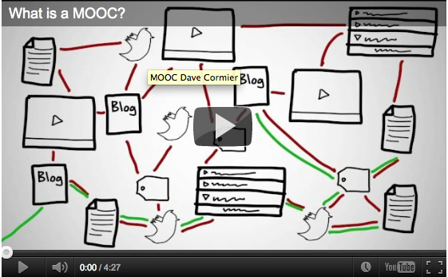
The Bootstrap Problem
http://www.tonybates.ca/2012/03/03/more-reflections-on-moocs-and-mitx/
Notes:
Bates: “MOOCs themselves are highly dependent, as Stephen acknowledges, on students already having a high level of understanding and an ability to learn independently, and to think critically.”
Formal education should be “developing and fostering such abilities so that learners can participate meaningfully in MOOCs and other forms of self-learning.”

Slide 15
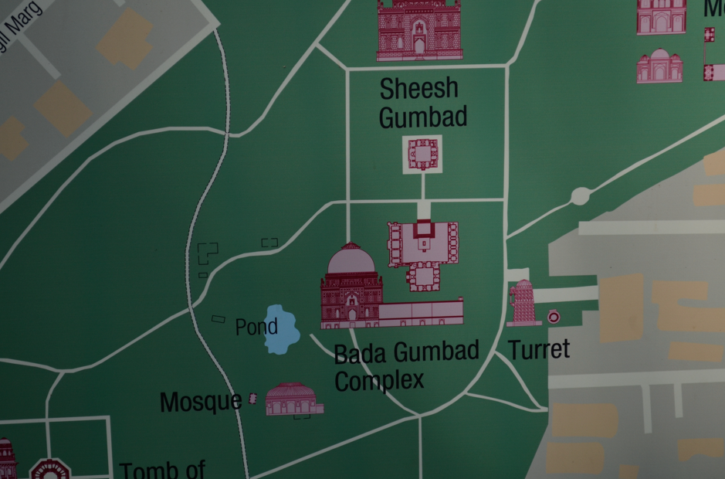
Navigation
Notes:
We often found navigating the MOOC waters frustrating. Once we got started it was not difficult to find the course material and a few other participants, but where was everything else? There didn't seem to be any discussion happening in one easily-accessible place. Why should content have to be so difficult to find? If you don't user Twitter, you can miss a vital discussion thread. Facebook groups or Google groups exist, but if you join the wrong one you could be one of 10 voices instead of one of 1700 participants. That's a lot of missed connections.
Synchronous forums—hosted during the run of the MOOC—are also prone to limited participation, while many blog posts lack comments. The problems with architecture and tools often subvert the promise of "connectedness" that MOOCs should provide.
Another concern lies with existing material. As fellow participants we question the value of simply retrieving old information from previous versions of a course. Since some participants are simply using the labor of previous learners to clarify difficult topics, are current learners getting as much out of the topic as they should?

Slide 16
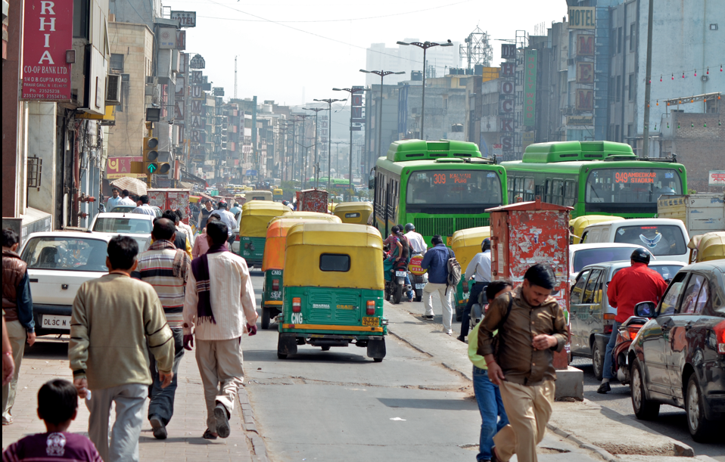
Size versus Connectedness
Lisa Chamberlin and Tracy Parish
http://elearnmag.acm.org/featured.cfm?aid=2016017
Notes:
“The number of people in a course can be overwhelming! How does someone connect with 2000-plus people? How does a learner even begin to make sense of all those voices adding commentary, questions, and posts? How does a learner get instructor feedback in this kind of a situation? It is impossible for an instructor to interact with even 1/10th of the class or even manage to address 1/10th of what is posted. The size of the MOOC size, while impressive, might work against the "connectedness" the facilitators and participants often seek.”

Slide 17

Elitism
Notes:
“Those who will not reach the academic level set by the organizers will remain lurkers who can only profit in discussing with the those in the crowd that can argue at the same level. But they cannot increase their skills. What’s that good for? The courses silently separate the elite from the mass. It looks like democracy but is quite the opposite of [real] teaching. Education normally tries to help people to enhance their understanding and make up their minds. MOOCs don’t take care of this. They are a non-educational approach. The new freedom and openness is a freedom for nothing.”

Slide 18

Effectiveness
What is learning if it isn’t learning content? How can we assess it, credentialize it?

Slide 19

3. Reconceptualizing MOOCs

Slide 20
Open
everybody can participate – but more importantly, there are many ways to participate
  ‘open’ means being able to watch
  ‘open’ means being able to participate at your own level
  ‘open’ means participating publicly, so others can watch

Slide 21
Online
means that it is connective, interactive
You can’t put a MOOC on a DVD
The MOOC is the process
It is a process that is greatly aided by being online
  many tasks are automated, scaffolded
  much greater communicative capacity
  more access to data, calculations

Slide 22
Connective
To the extent that a MOOC is about content, the MOOC fails
  it’s like confusing the learning of a game, or the playing of a game with memorizing the rules of a game
  it’s like confusing enjoying food and knowing how to cook with the memorization of recipes
  it’s like confusing the experience of travel with knowing where things are on a map

Slide 23
Restating the Problem
our MOOCs are insufficiently connective, and tend to slip toward an emphasis on content
  the form of connectivity – online conversation – is at once too simplistic and too complex
  looking for other ways to connect – eg., artwork (a la ds106) or activities/projects (but these have been very poorly defined in our courses)

Slide 24
Rediscovering Process
As we fail to provide process, the courses revert to their old ways
  people think the course is about the content
  they gravitate toward dependence on the leadership, and away from personal participation
It’s not that we don’t scaffold enough, it’s that there are not opportunities for participants to ‘play’

Slide 25
MOOC, Meet Game
The MOOCs we have offered have been very high level, involving professional presentations and conversations – but what would a MOOC look like for a 10-year old?
My answer: it would look like a game

Slide 26

4. Chess Net

Slide 27
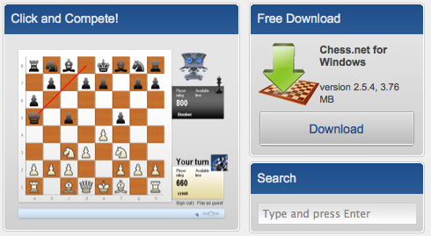
Searching for Chess Net - 1
Chess.net
http://www.chess.net
Notes:
Chess.net
Commercial service - For Chess.net enthusiasts - $8/quarter and $4/month options available!

Slide 28
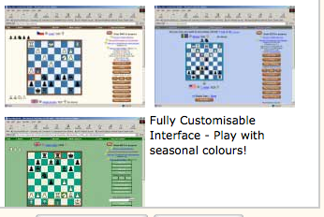
Searching for Chess Net - 2
Chess World
http://www.chessworld.net/
Notes:
ChessWorld is one of the very few dedicated correspondence style sites. We focus all our resources on quality correspondence style chess; we do not offer other styles of play or chess variants. Our membership model is simply Guest or Full Membership. Guest Membership gives access to a comprehensive sub-set of our features. Full Membership gives full access to all of our features.
Join thousands of active Members from hundreds of Countries around the Globe, celebrate playing chess Games with Chessworld Globe icons! We have Tournaments of all kinds - Thematic, Teams and Leagues , All-play-All, Knockout and Pyramids. We have a wealth of learning resources including Library Games , Annotated Games, Forums, Tips, Puzzles, Messages, Pictures and Free Videos

Slide 29
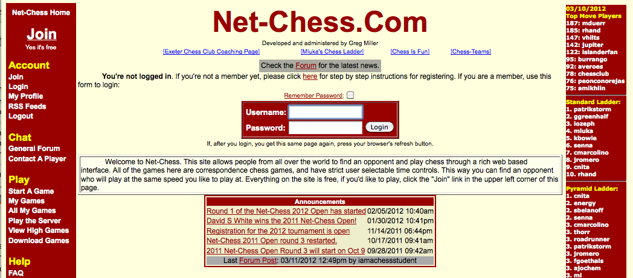
Searching for Chess Net - 3
Net-Chess.Com
http://net-chess.com
Notes:
This site allows people from all over the world to find an opponent and play chess through a rich web based interface. All of the games here are correspondence chess games, and have strict user selectable time controls. This way you can find an opponent who will play at the same speed you like to play at. Everything on the site is free, if you'd like to play, click the "Join" link in the upper left corner of this page.

Slide 30
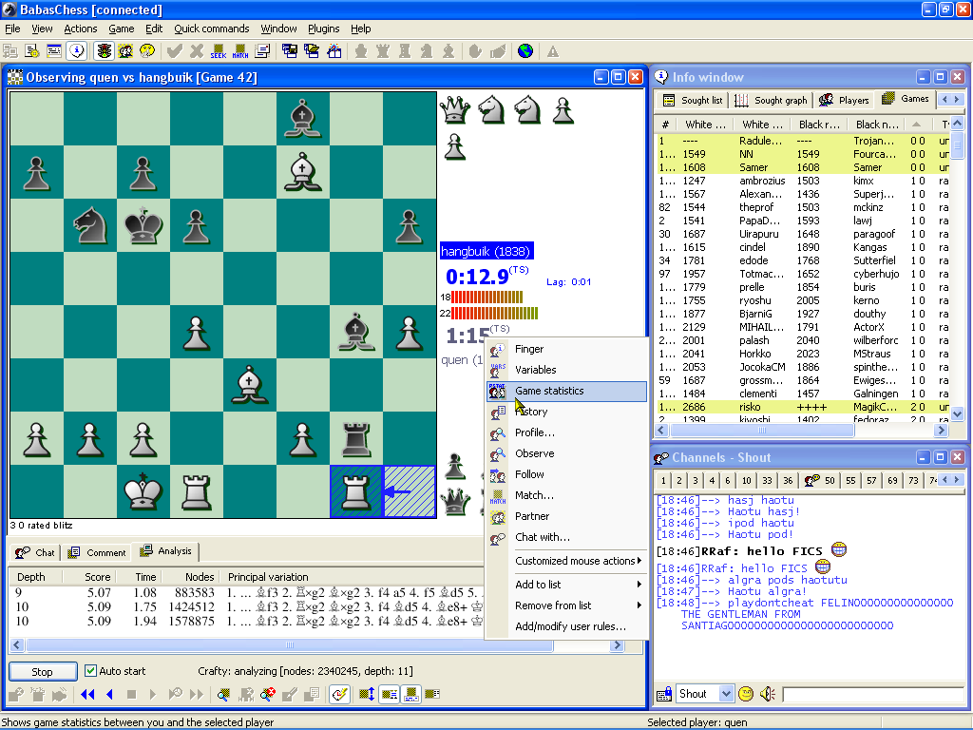
Searching for Chess Net - 4
BabasChess - The Free Internet Chess Client
http://www.babaschess.net/
Notes:
BabasChess is a new revolutionary Internet Chess Client for Windows. It combines ease of use with powerful features for advanced users; integrates a fast and customizable playing environment with a powerful PGN viewer/editor, chess engines support for analyzing positions and amusing chat features.

Slide 31
Searching for Chess Net - 5
European Chess Union
http://europechess.net/
“introduction of the programme ‘Chess in School’ in the educational systems of the European Union”

Slide 32

5. The Budget Game

Slide 33
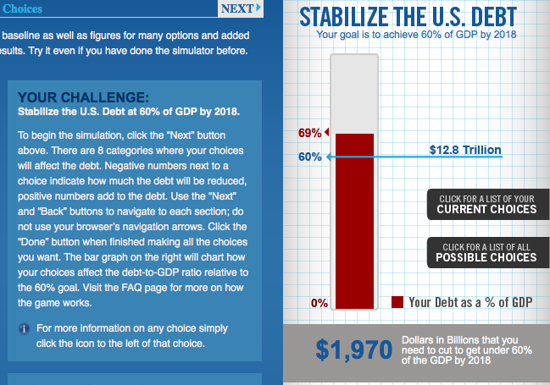
Budget Simulators
http://crfb.org/stabilizethedebt/
Notes:
Simulators – eg. http://crfb.org/stabilizethedebt/ from ‘The Committee for a Responsible Federal Budget’ –focus on cutting the debt

Slide 34
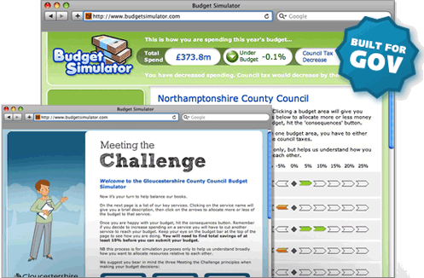
Meeting the Challenge
http://www.budgetsimulator.com/info/
Notes:
Budget simulator - http://www.budgetsimulator.com/info/ - “Engage people with budget-setting. Budget Simulator is a customisable web app, proven to consistently deliver high participation rates and meaningful results.”

Slide 35
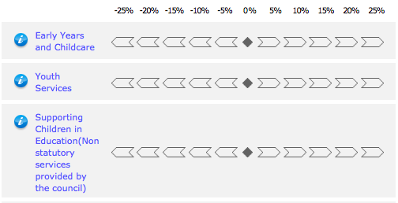
Fixed and Opaque
Budget Simulator
http://www.budgetsimulator.com/brightonandhove
Notes:
“gives you the chance to tell us how you’d like spending prioritised across six themes. You can increase, decrease or make no changes to each service. But can you get the budget to balance?”

Slide 36
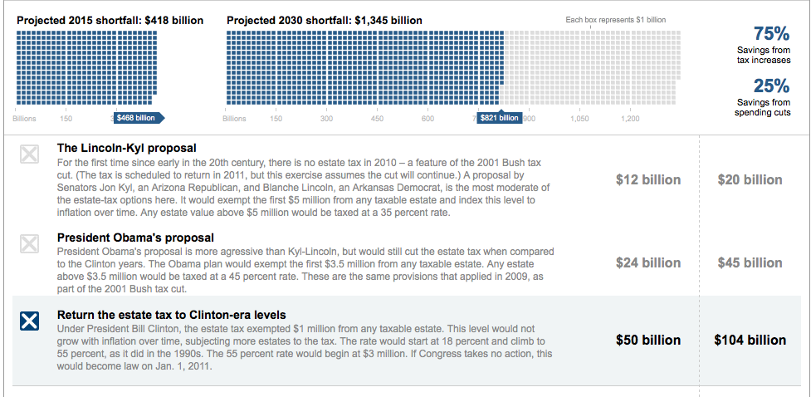
NY Times ‘Solve the Deficit’
http://www.nytimes.com/interactive/2010/11/13/weekinreview/deficits-graphic.html
Notes:
NY Times – You Fix the Budget - http://www.nytimes.com/interactive/2010/11/13/weekinreview/deficits-graphic.html
“Some of your options have more short-term savings and some have more long-term savings. When you have closed the budget gaps for both 2015 and 2030, you are done. Make your own plan, then share it online.”

Slide 37

What’s Wrong With The Simulators
they try to ‘teach’ – but instead become propaganda
they reduce complex problems to simple fixes

Slide 38

6. The Education Platform

Slide 39
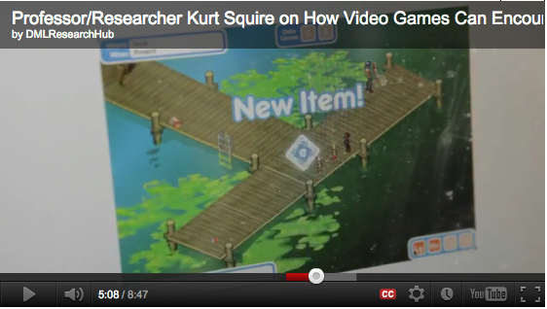
Critiquing the games
http://www.downes.ca/post/57523
Notes:
if your game is a ‘serious game’ or an ‘educational game’ it is probably missing its purpose
example from Kurt Squire – http://www.downes.ca/post/57523
(we’ve taught you everything you need to do to change the lake – we’re hopeful there will be a mass of students that actually do it)
better example – skills that you have to develop, eg. ‘writing a team charter’, ‘customize interface’

Slide 40
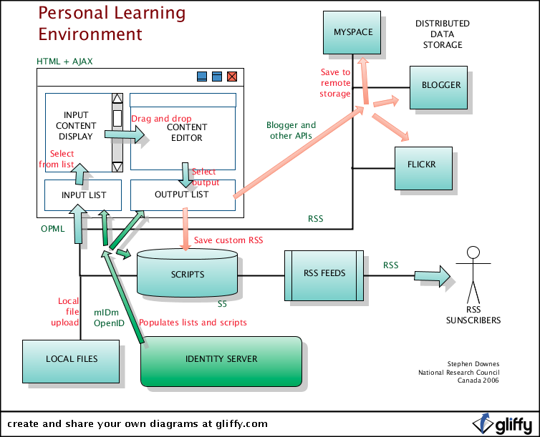
Revisiting the PLE
Notes:
Similar to your gaming client – customize your input stream, communications, etc

Slide 41
The Connectors
Things – events, games, arenas, etc., to ‘connect’ individuals with each other
  either as plug-ins on individual PLEs, or
  as third-party services, like scrabble.net
Conversation?
Chess game?
Simulation?

Slide 42
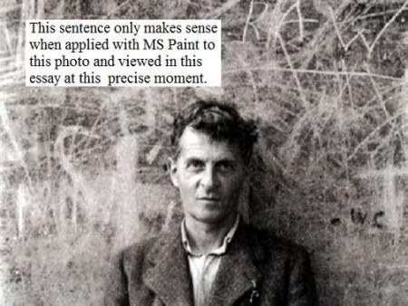
Language Games
http://www.popmatters.com/pm/post/65550-games-as-language-systems
Notes:
What is the language game of a domain or a discipline?
How do we begin to ‘think like a chess player’?
Elements of language = elements of games – syntax, semantics, pragmatics, context, inference, change

Slide 43
Ladders, Vectors, Networks
Chess and other person-to-person games rank people in ‘ladders’ (people want to ran schools this way too)
One way to think of a network is as a multidimensional ladder
Ranking is therefore ‘position’ in a network

Slide 44

The Paucity of Badges
Notes:
What is a badge – a set accomplishment But was is accomplishment? Placement near a centre cluster. But there are thousands, millions, of clusters, and they are always shifting. Badges are hopelessly unable to keep up with that.
8j2b3mhx8
vyw4nt8x

Slide 45
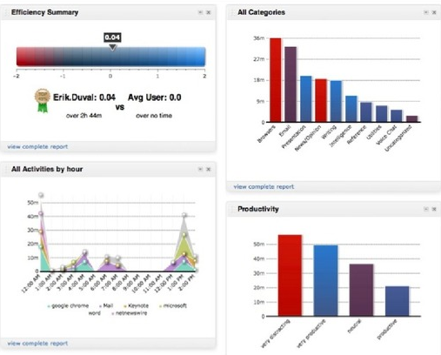
The Emptiness of Analytics
Notes:
What are you measuring?
‘That which is measured is managed’ -- vs – ‘That which is measured is distorted’

Slide 46
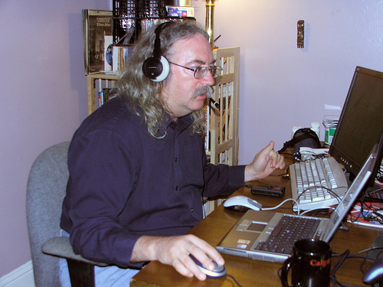
http://www.downes.ca

