Slide 1
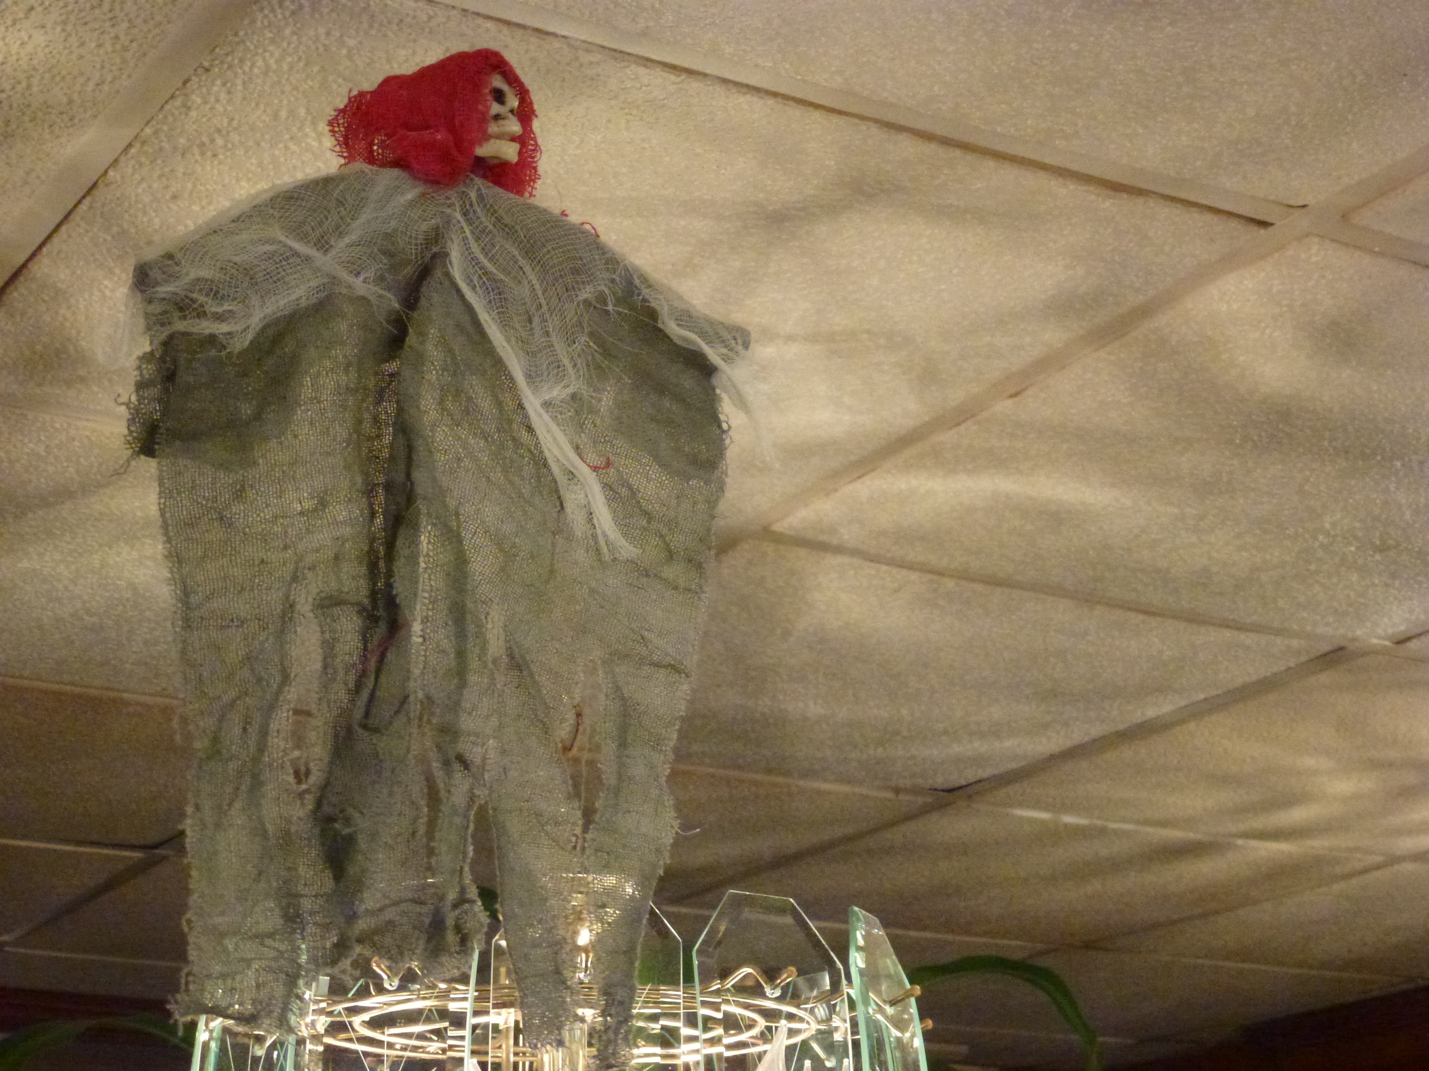
Social Network Technologies for Learning
Stephen Downes
New York City
October 29, 2011

Slide 2
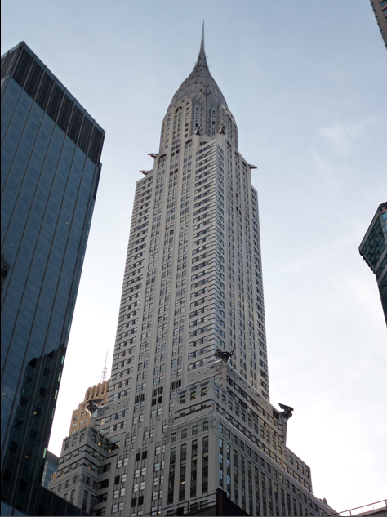
Overview:
The Major Social Networks
Anatomy of a Social Network
Social Networks in Learning
Platforms and Programs
Learning Network Applications

Slide 3
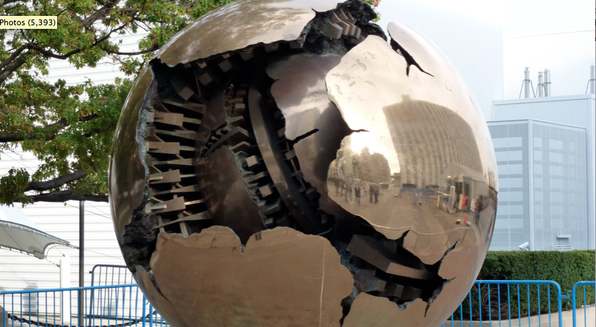
1. The Major Social Networks

Slide 4
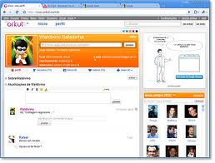
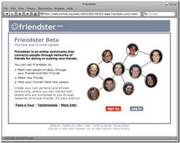
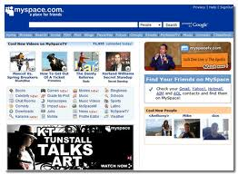
The Progenitors
Friendster – http://www.friendster.com
MySpace – http://www.livespace.com
Orkut – http://www.orkut.com

Slide 5
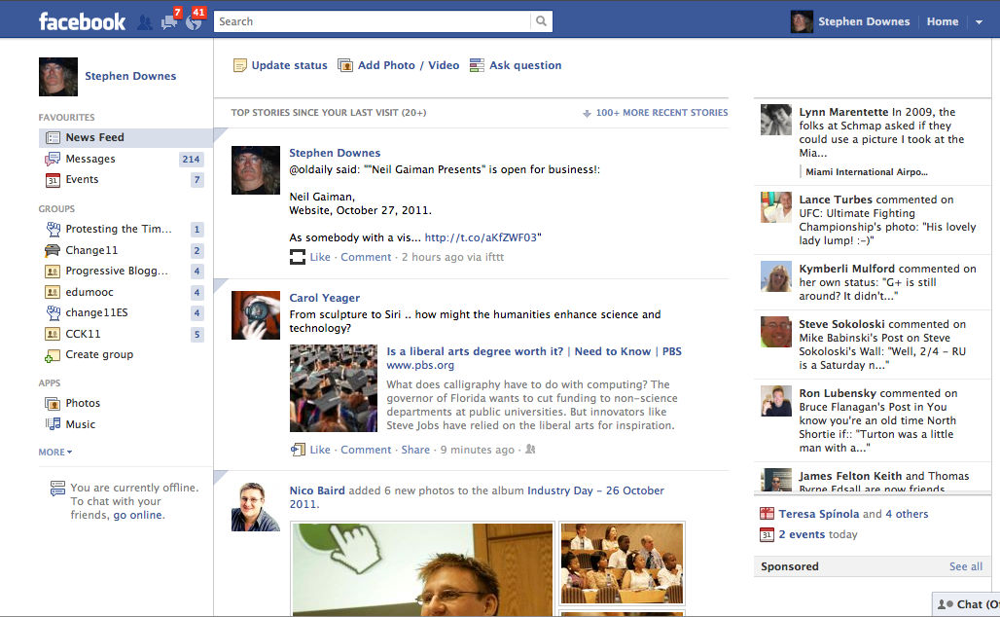
Facebook

Slide 6
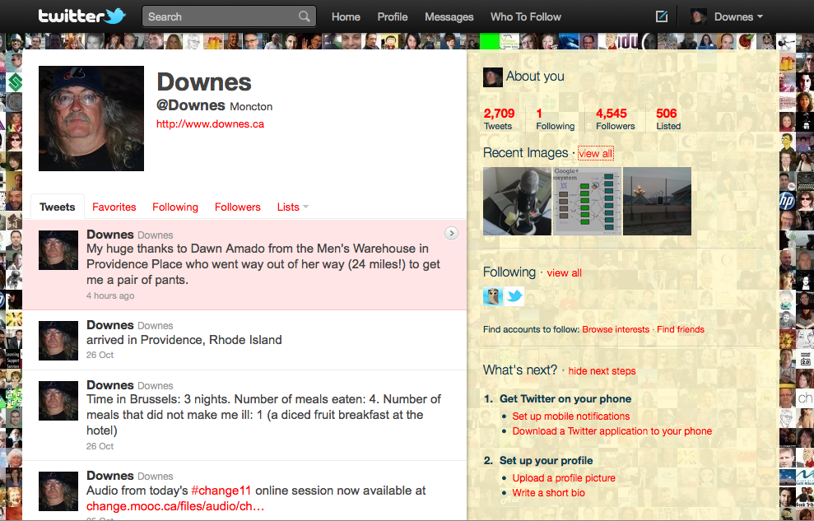
Twitter
http://twitter.com/Downes

Slide 7
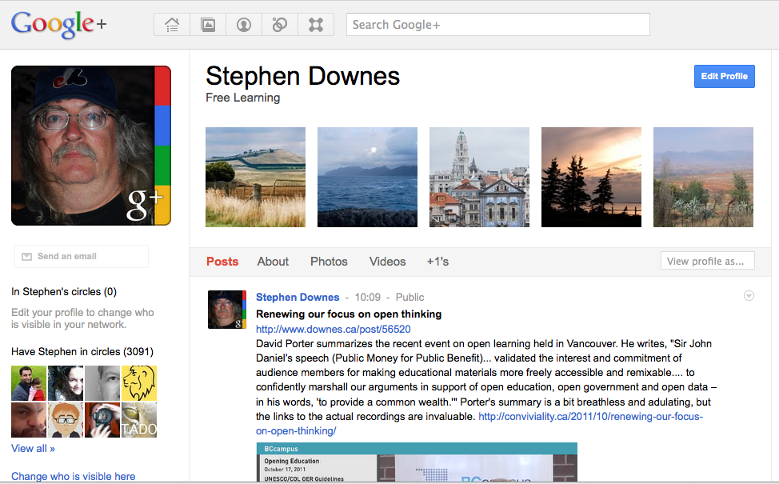
Google+
https://plus.google.com/109526159908242471749/posts

Slide 8
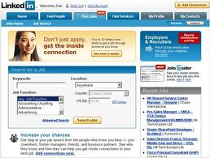
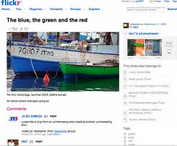
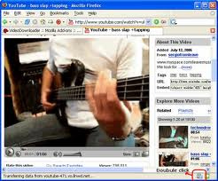
Some of the Others:
Flickr – http://www.flickr.com
LinkedIn – http://www.linkedin.com
YouTube – http://www.youtube.com

Slide 9
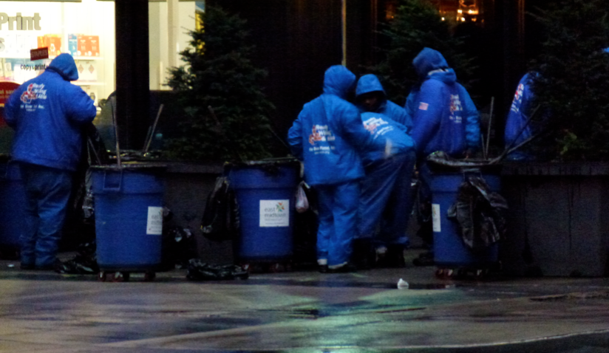
2. Anatomy of a Social Network

Slide 10
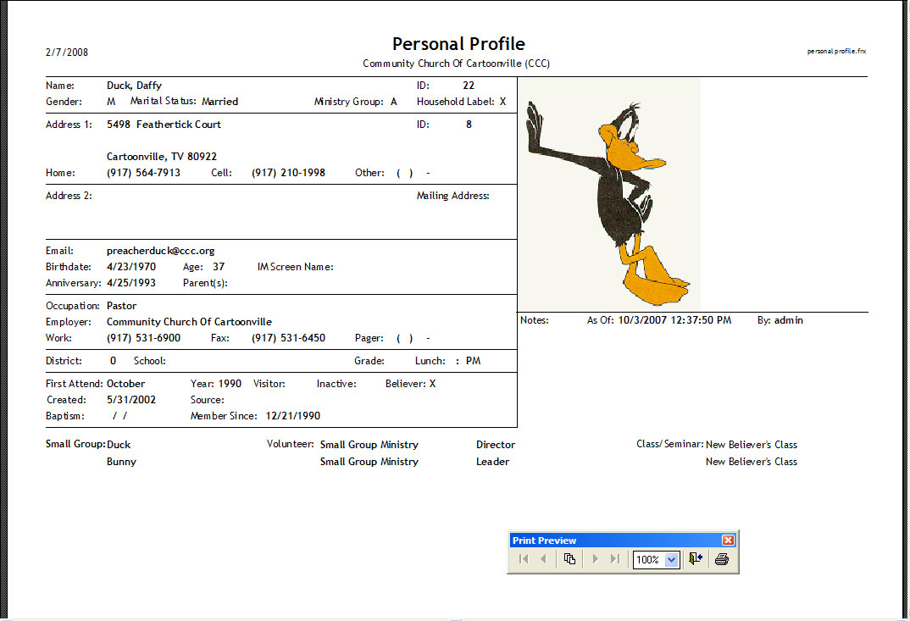
Personal Profile

Slide 11
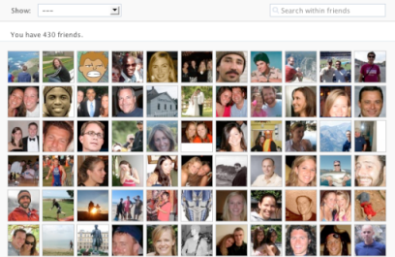
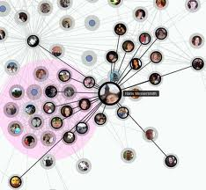
The Graph
Facebook ‘friending’ vs Twitter ‘following’ vs Google+ ‘circling’
Recommending – friend suggestions or maybe just ‘return the favour’

Slide 12
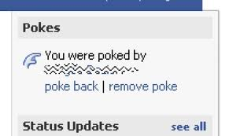

Actions
Things to Do…
  The Facebook ‘poke’
  Messaging
  Checking In - https://foursquare.com/
  Listening to - http://www.last.fm/
The activity stream

Slide 13

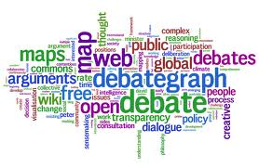
Likes and Dislikes
The ‘Like’ button / ‘Fan’
  Inside the Graph – Facebook
  Outside the Graph – Google’s +1
  Extended graph – would you ‘recommend’ this person, write them an endorsement?
Tagging – http://www.delicious.com
  Twitter hashtags
  word clouds
http://www.wordle.net/

Slide 14
Groups
Explicit group formation:
  Google Groups, Yahoo Groups
Object-based group formation
  Facebook ‘causes’, ‘like’, etc.
  Events

Slide 15

Sharing
Media – photo, video and audio uploads
Artwork – DeviantArt - http://www.deviantart.com/
Experiences
  the Twitter hashtag again
Places – 4Square
fake batman by *berkozturk, DeviantArt
http://browse.deviantart.com/?order=24&offset=24#/d4e3qt5

Slide 16
Reputation
Klout – http://www.klout.com
HootSuite - http://hootsuite.com/social-analytics
Social media key elements: PageRank, eBay Reputation, Amazon Reviews
Achievement: ‘become mayor’, ‘unlock badge’

Slide 17
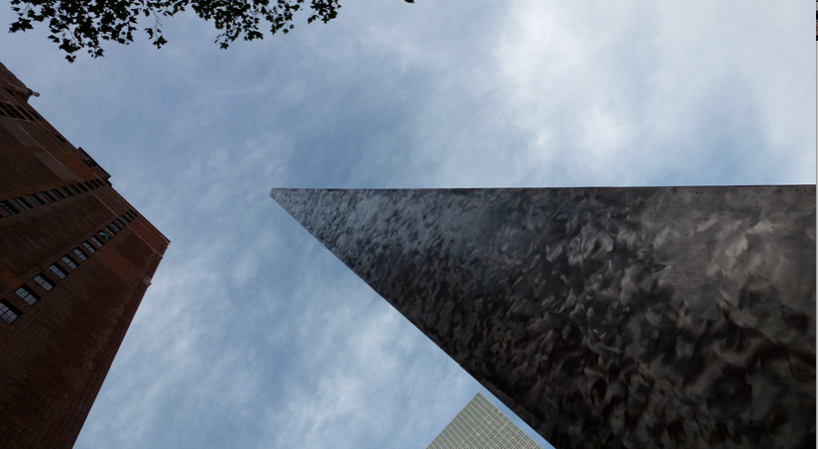
3. Social Networks in Learning

Slide 18
Some Benefits
It’s free
It cuts down on isolation
It builds tolerance and understanding of diversity
It amplifies passions
It’s more open, and education needs to be more open
George Couros, Connected Principals, Why Social Media Can and Is Changing Education
http://www.connectedprincipals.com/archives/3024

Slide 19
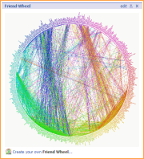
Positives
Connection and access
Increased awareness
Publicity and advertising
It’s who you know
Wikia, Social Networking in Education Wiki
http://socialnetworkingeducation.wikia.com/wiki/Social_Networking_in_Education_Wiki

Slide 20
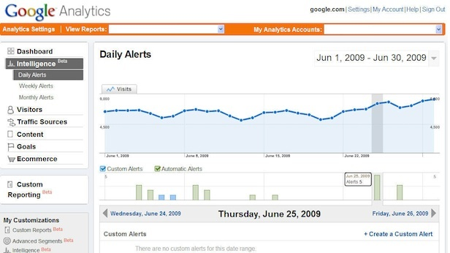
Risks
Privacy and security
  putting your data out there
  once online, always online
  “you are not a customer, you are a product”
Douglas Rushkoff, You Are Not Facebook's Customer
http://www.rushkoff.com/blog/2011/9/26/you-are-not-facebooks-customer.html

Slide 21
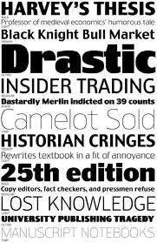
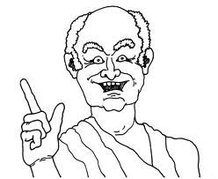
Rumours and Innuendo
Cyberbullying
Quality control
  Twitter rumours

Slide 22
Practical Applications
Online Discussions
  announcements and updates
  conversations
Group formation and planning
  support networks
  small group work & project teams
Online e-portfolios
  as an extension of the personal profile

Slide 23
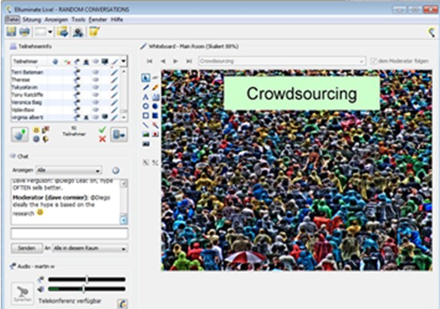
Crowdsourcing
Wikipedia and such
The Wisdom of Crowds

Slide 24
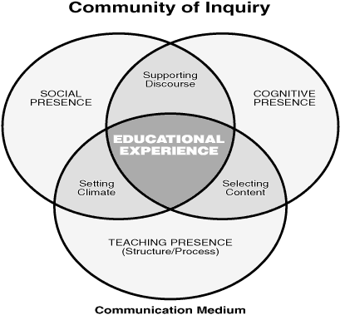
Social Presence
Twitter – “What
are you Doing?”
Anderson, Archer, Garrison
Community of Inquiry Model
http://edutechwiki.unige.ch/en/Community_of_inquiry_model

Slide 25
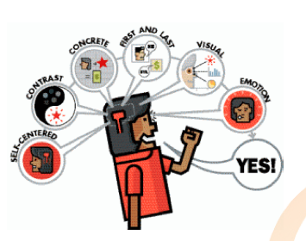
The Five intangibles
Attention
Attraction
Affinity
Audience
Action
The Five Elements of Social Media
Jay Deragon & David Bullock with Irene Williams
http://www.relationship-economy.com/Five Elements of Social Media.pdf

Slide 26
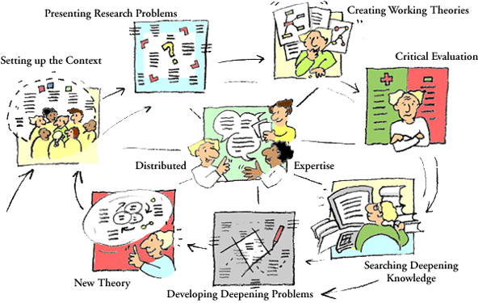
Mapping SNs and Learning Theory
Centre for Research on Networked Learning and Knowledge Building, Development f Learning Theories
http://www.helsinki.fi/science/networkedlearning/eng/delete.html

Slide 27
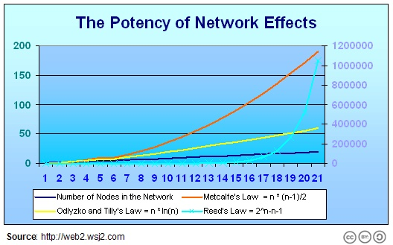
Network Effects
“A virtual learning environment consisting solely of students and instructor, in contrast, cannot partake of these network effects.”
Bryan Alexander, EDUCAUSE, Social Networking in Higher Education
http://net.educause.edu/ir/library/pdf/PUB7202s.pdf

Slide 28
Social Network Policies
Schools banning Facebook?
“Discussions of privacy and copyright, and questions about creativity and appropriation, citizenship, and governance can become grounded in years of social media experience.” – Alexander
Digizen, Case Study: Example Acceptable Use Policy
http://old.digizen.org/cyberbullying/fullguidance/resources/caseexample.aspx

Slide 29
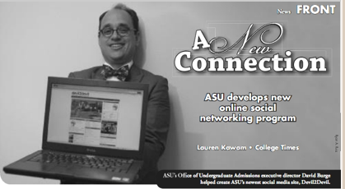
Some SN Education Platforms
Ning – http://www.ning.com
Elgg - http://elgg.org/
… and communities:
  Classroom 2.0 - http://www.classroom20.com/
  -Association for Social Media in Higher Education - http://www.socialmediahighered.com/

Slide 30
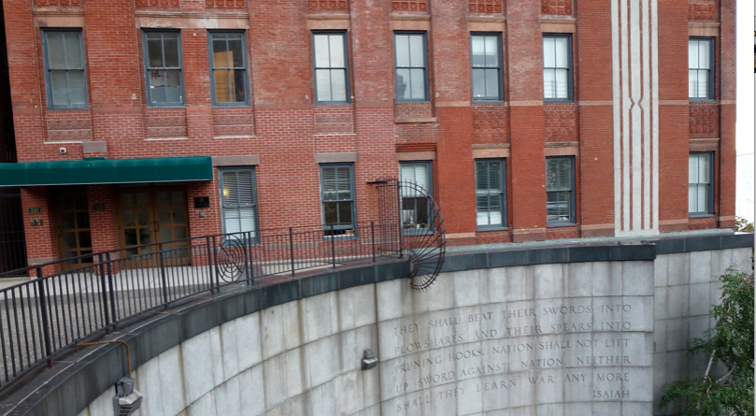
4. Platforms and Programs

Slide 31
To Understand Platforms…
Think of Mobile computing:
  iPod, iPhone, iPad
  Android, Windows Mobile, Blackberry
Next, think of ‘the App store’
  eg., the Apple app store
Apply the concept to a social network
  inside the social network is an ‘app store’
  these apps access SN data and functionality

Slide 32
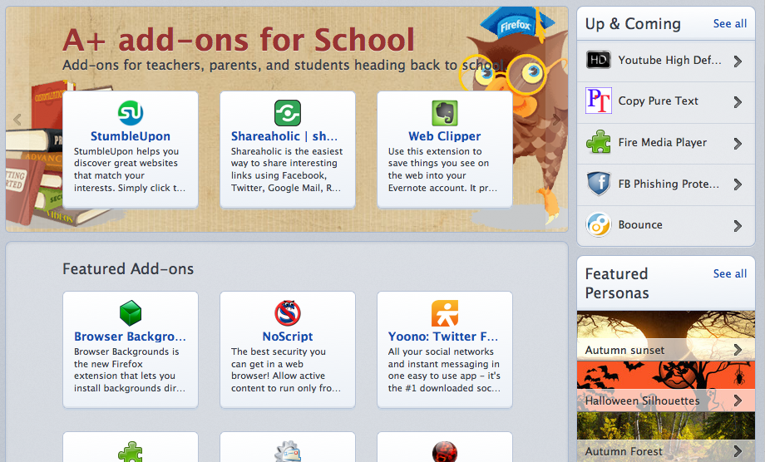
Some Analogies
Extensions in Firefox or Thunderbird
Modules in Drupal or WordPress
Google Apps in Chrome

Slide 33
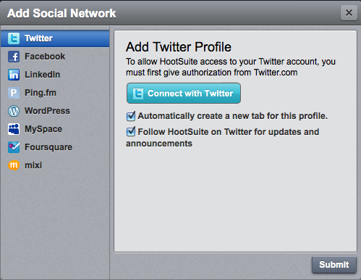
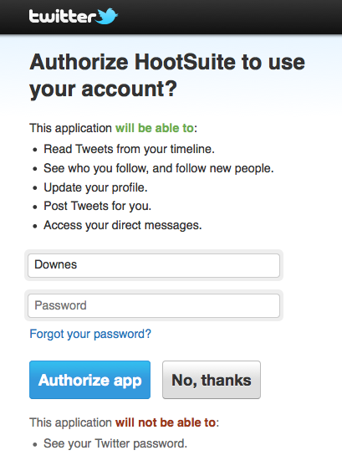
Connecting
OAuth 2.0
http://oauth.net/2/

Slide 34
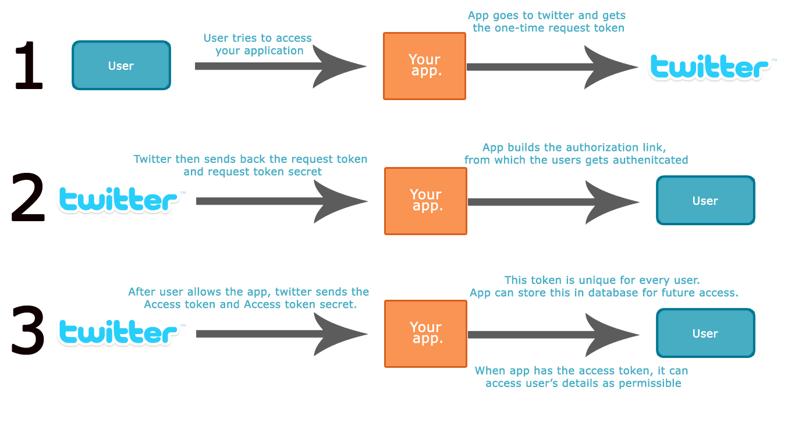
OAuth Permissions
Sachin Khosla , Internet.com,
Upgrading Basic Twitter Authentication to OAuth with PHP
http://www.phpbuilder.com/columns/sachin_khosla062510.php3

Slide 35
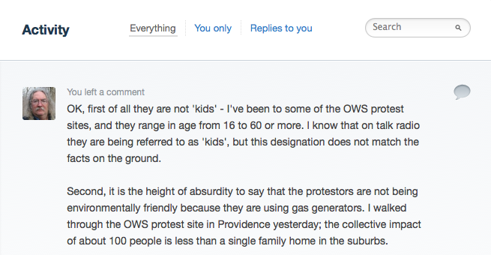
Identity and Login
Facebook Connect, Google SignOn, Twitter, OpenID
Disqus Comments
Mark Aaron Murnahan, Why Disqus May Be The Best Social Network of 2011
http://www.awebguy.com/2011/01/why-disqus-may-be-the-best-social-network-of-2011/

Slide 36
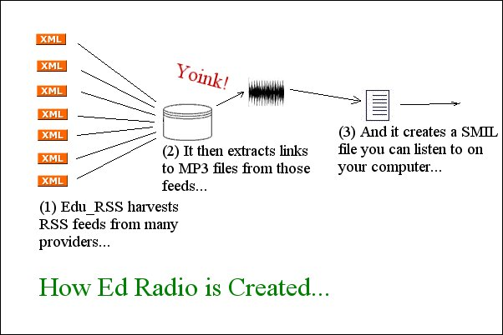
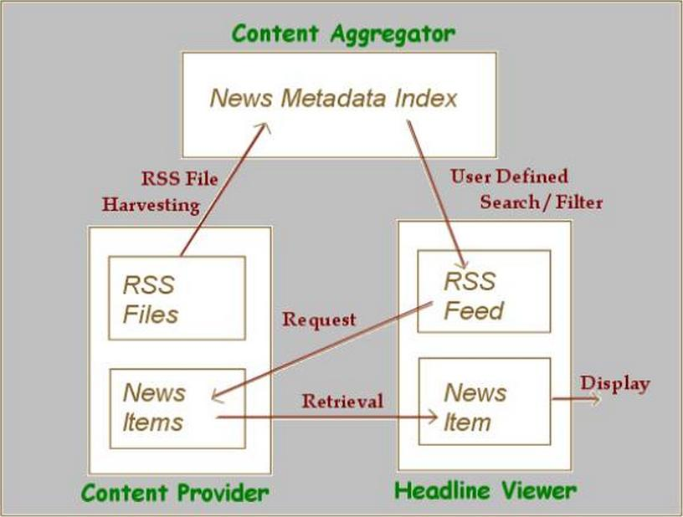
RSS and Atom
Stephen Downes, An Introduction to RSS for Educational Designers
http://www.downes.ca/files/RSS_Educ.htm

Slide 37
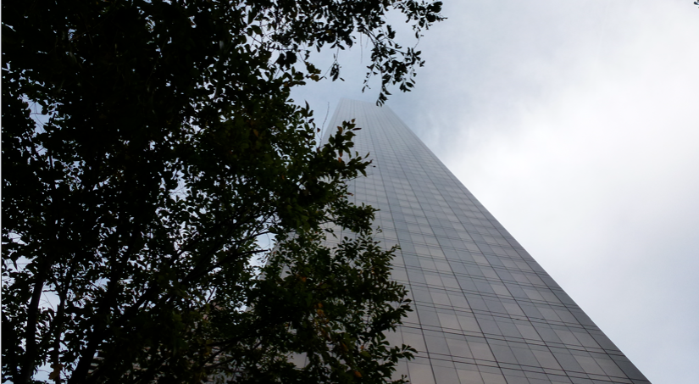
5. Learning Network Applications

Slide 38

Distributed SN Architectures
Napster, Gnutella, BitTorrent
OpenID Again
Diaspora - https://joindiaspora.com/
  Distributed Social Networking Protocol - http://www.complang.org/dsnp/

Slide 39
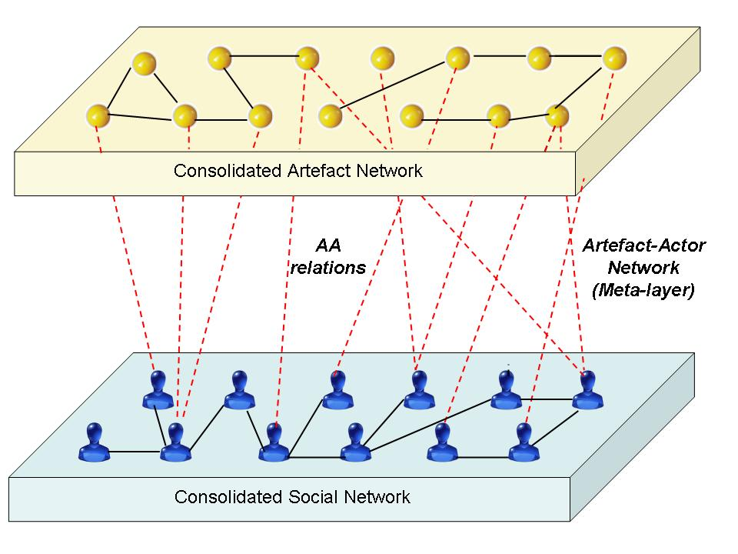
The Semantic Social Network
Recommender systems
Metadata and metatags
Types of indices:
  subject index
  keyword index
  citations and link indices
Stephen Downes, Semantic Networks and Social Networks
http://www.downes.ca/post/31624
Mahara, PLEs for Contemplation and Awareness: An Architectural Approach
http://mahara.org/view/view.php?id=38342

Slide 40
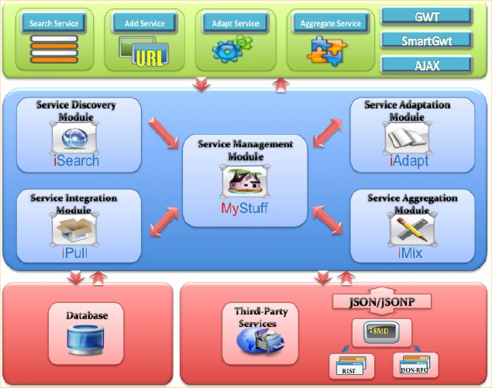
The Personal Learning Environment
Mohamed Amine Chatti, Model-Driven Mashup Personal Learning Environments
http://mohamedaminechatti.blogspot.com/2009/10/model-driven-mashup-personal-learning.html

Slide 41
Network Functionality
Pattern Recognition
  eg. from partial data – eg. face recognition
  Regression (prediction)
Similarity Functions
  network-based recommendation
Clustering
Self-Organizing Feature Map (SOFP)
Statsoft, Neural Networks
http://www.statsoft.com/textbook/neural-networks/

Slide 42

Emergent Properties
The whole is not the sum of the parts
Jarche: “Culture is an emergent property of people working together. Leadership is also an emergent property.”
Harold Jarche, Leadership emerges from network culture
http://www.jarche.com/2011/10/leadership-emerges-from-network-culture/

Slide 43
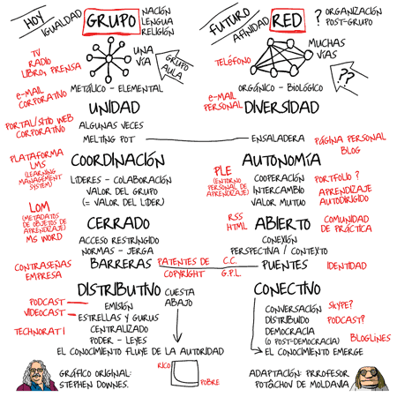
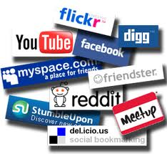
Groups and Networks

Slide 44
Some other References
Thomas Vander Wal
Personal InfoCloud, The Elements in the Social Software Stack
http://www.personalinfocloud.com/2008/01/the-elements-in.html
Martin Bryant, TheNextWeb, Anatomy of a Twitter rumor: When a story’s too juicy not to retweet http://thenextweb.com/socialmedia/2011/07/28/anatomy-of-a-twitter-rumor-when-a-storys-too-juicy-not-to-retweet/

Slide 45
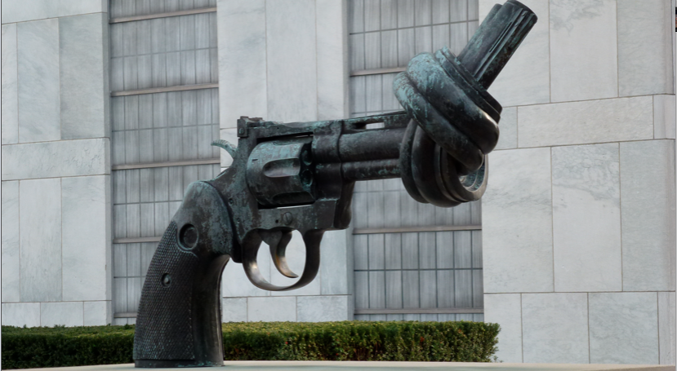
http://www.downes.ca

