Slide 1
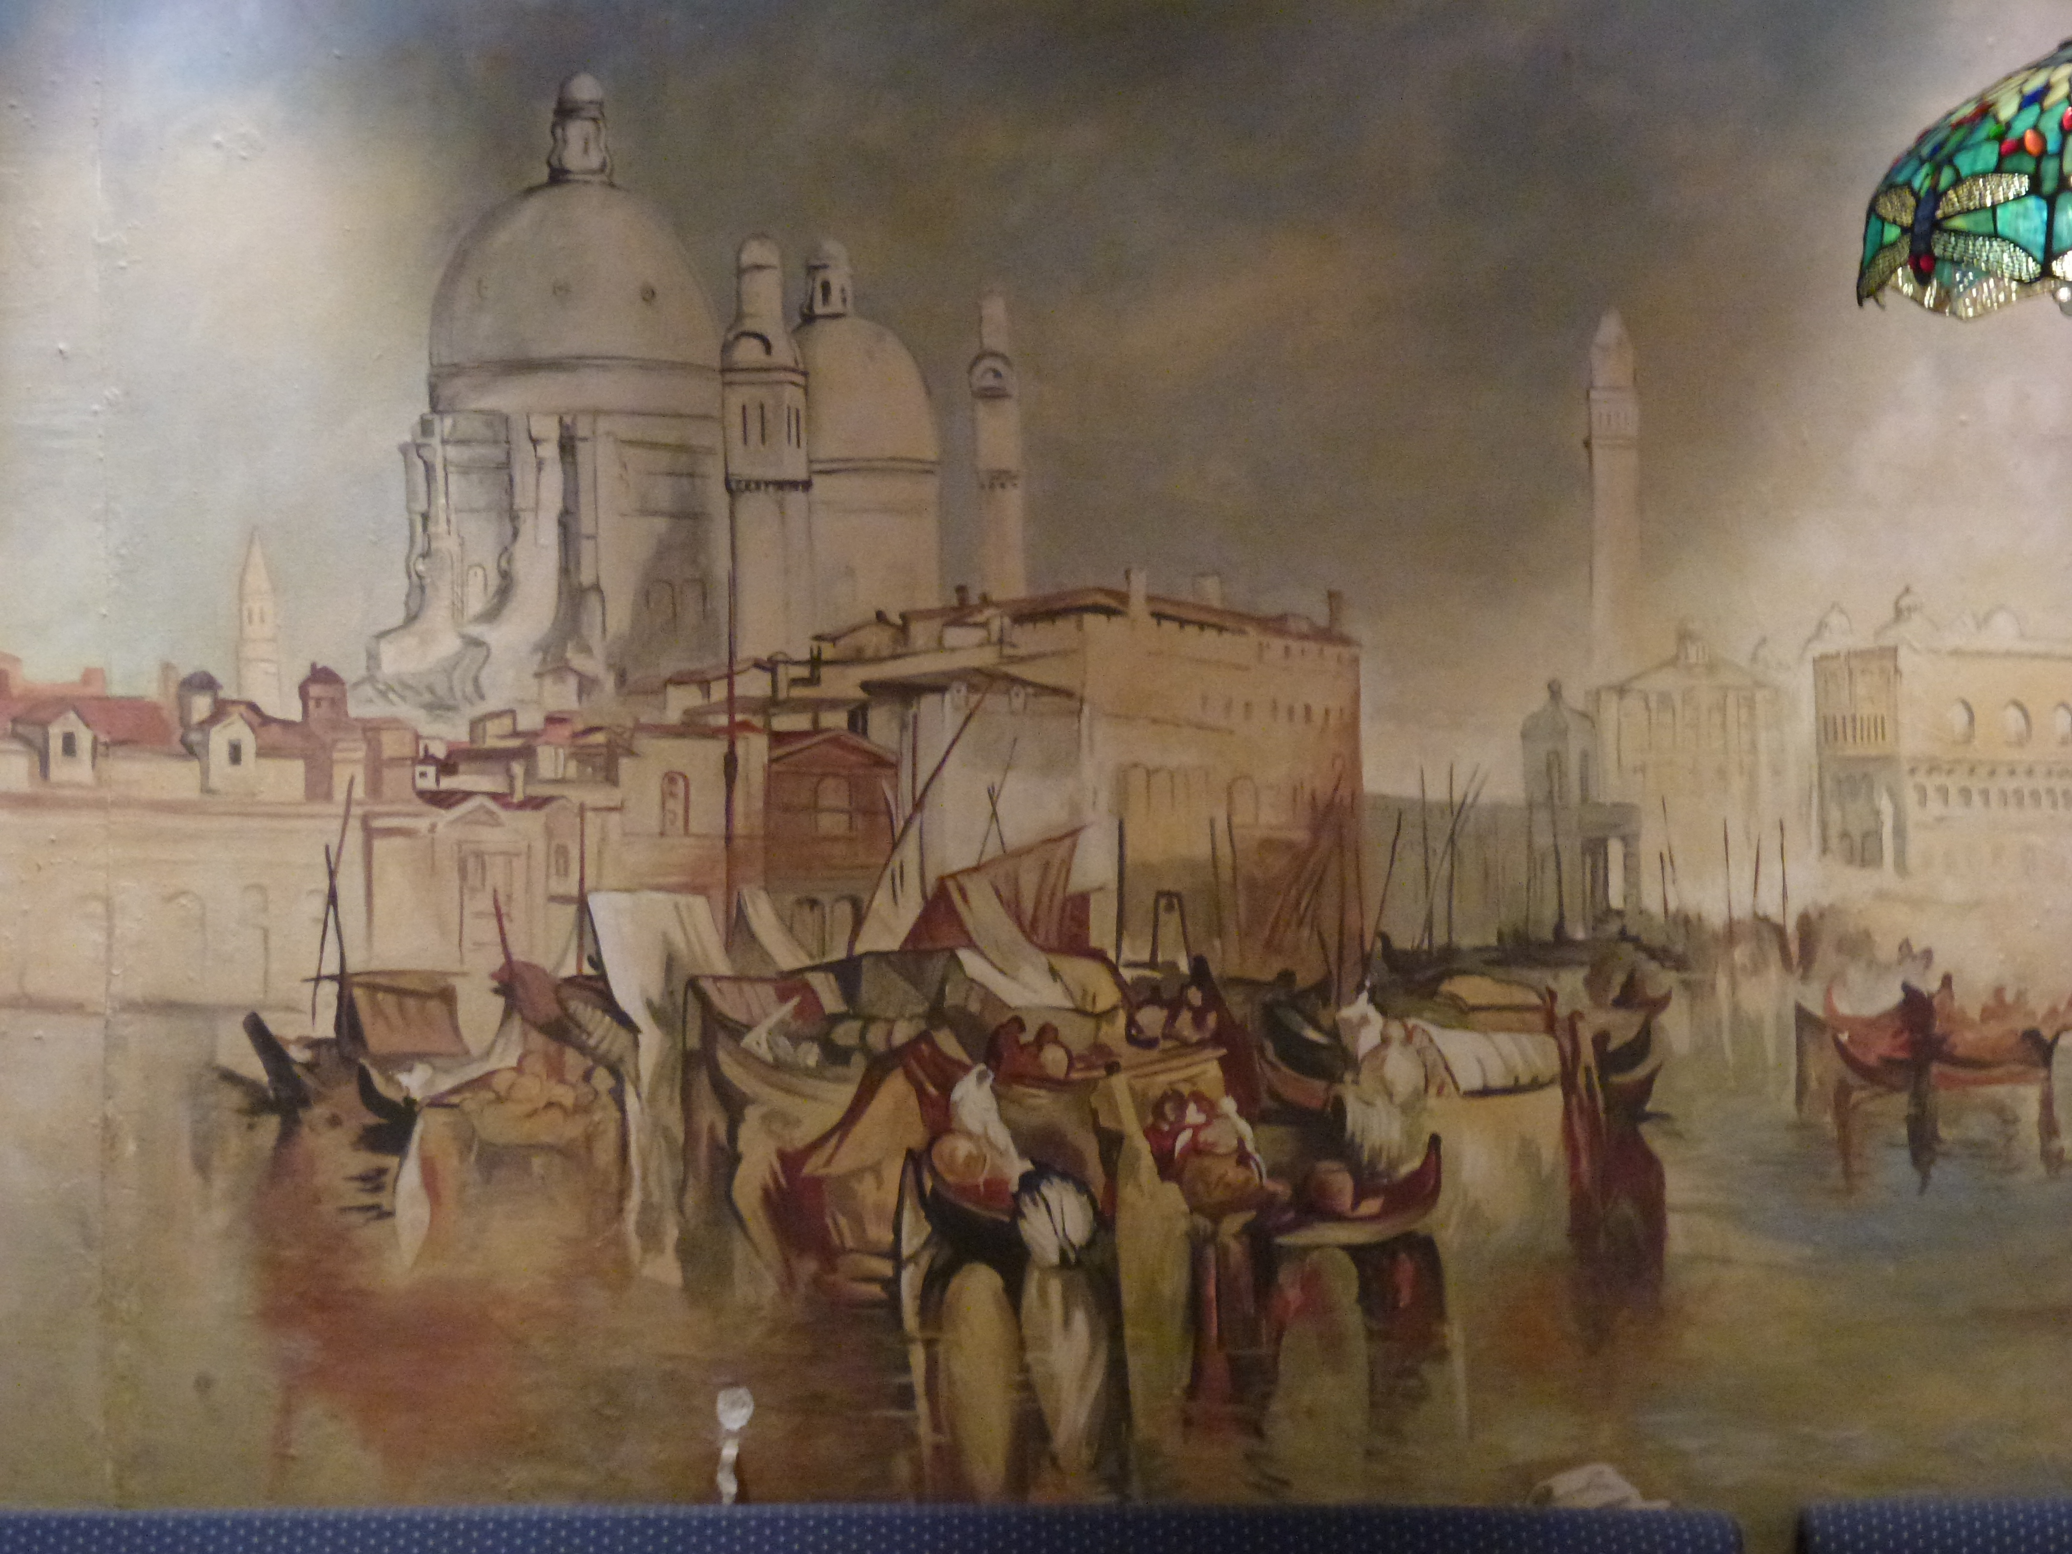
Public Support for Free Learning: A Policy Framework
Stephen Downes
October 25, 2011

Slide 2
Open Learning
Long associated with distance learning
  correspondence schools – 1880sff
  1915, creation of the National University Extension Association(NUEA)
  U.S. radio broadcasting licenses to 202 colleges, universities, and school boards – 1920s, 30s
  1926, historian J C Stobart wrote a memo advocating a 'wireless university’ while at BBC
Bizhan Nasseh, A brief History of Distance Education, http://www.downes.ca/files/nasseh_history.html
History of the OU, http://www8.open.ac.uk/about/main/the-ou-explained/history-the-ou

Slide 3
Open Institutions
Open University opens in 1971
  did not insist on prior educational qualifications
  required students to take two foundation courses
New York State’s Empire State College
  commenced operation in 1971
Athabasca University (1970/72), Indira Gandhi National Open University (1985)
Empire State College, College History http://alumni.esc.edu/inauguration/collegehistory.php
IGNOU http://www.ignou.ac.in/ignou/aboutignou/profile/2

Slide 4
Open Learning (2)
Over time – enhanced accessibility
  distance learning
  reduction of financial barriers
    tuition reductions
    subsidies
  progressive pedagogies
    Creation of distance learning pedagogies – Moore, Merrill, Gagne

Slide 5
Open Resources
Project Gutenberg
Open Archives Initiative
  BOAI
  DSpace
Wikipedia
  Curricki
  Wikiversity
  WikiEducator – Commonwealth of Learning

Slide 6
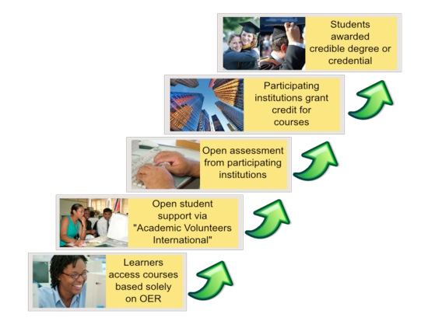
The OERu Logic Model
Taylor, J.C. 2007. Open courseware futures: Creating a parallel universe. e-Journal of Instructional Science and Technology (e-JIST), Vol 10, No. 1. Online: http://www.ascilite.org.au/ajet/e-jist/docs/vol10_no1/papers/full_papers/taylorj.htm

Slide 7
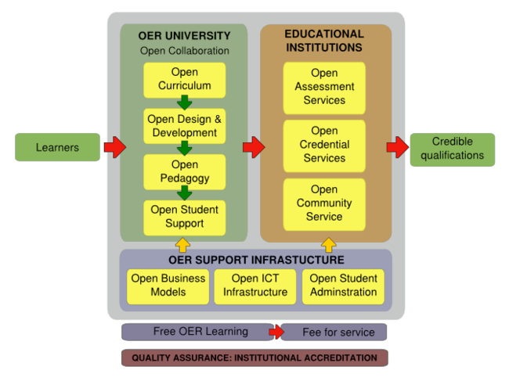

Slide 8
Criticism of the Logic Model
Traditional Curricular based approach
  a focus on articulation & credit transfer
  closed federation of traditional institutes
Tight link to traditional credentials
The Black Box problem – ‘open’ this or that (eg. ‘open business model’) unstudied and undeveloped

Slide 9
Contrasts in Design
Learning objectives
  concrete and stated Learning Objectives vs. unstated and multiple objectives
Organization of subject matter
  knowledge of vs knowledge about
  linear organization vs knowledge community

Slide 10
Contrast in Assessment
Subject and content-focused assessment, vs. performance-based and networked-based
Assessment against external criteria vs. self-assessment
Assessment by-instructor vs. 3rd-party assessment

Slide 11
Free Learning
Based on the principles of connectivist, or network, learning
Network design principles: distributed, disintermediated, dynamic
Design based on the ‘semantic principle’:
  autonomy
  diversity
  openness
  interactivity

Slide 12
Connectivist Learning Design
A non-curricular based approach
  course content is the ‘McGuffin’ vs (Freire) the ‘banking system’
  learning takes places through interaction and creativity
    Seymour Papert – constructionism
    Aggregate, remix, repurpose, feed forward
Learning a matter of growth, not accumulation

Slide 13
But… why
It’s a formal recognition that people have different destinations, different tastes
Based on an understanding that knowledge varies according to these
Expresses the principle that networks – communities – are stronger with multiple diverse perspectives
Knowledge learned is better – indeed, known

Slide 14
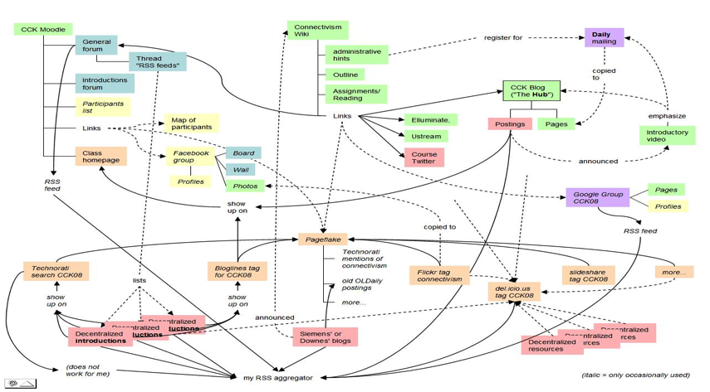
A Map of the Community
Connectivism: A Theory of Personal Learning
Stephen Downes, December 3, 2008, Educational Development Centre, Ottawa
http://www.downes.ca/presentation/208

Slide 15
The MOOC Model
MOOC: Massive Open Online Course
There is no central core feature – no core content, group, etc
Course design is a network, or a map, or a community
Resources are distributed, and aggregated
Participants are encouraged to create their own resources, communities, groups

Slide 16
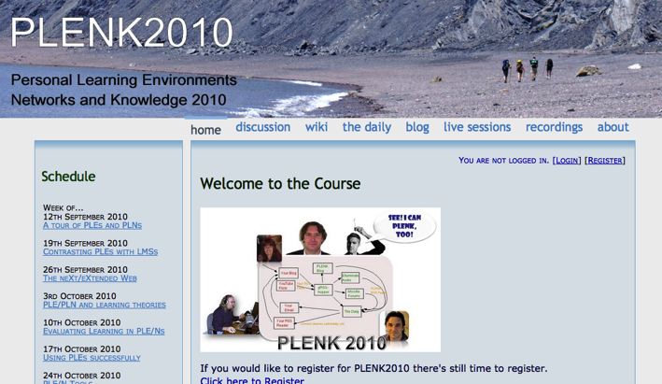
2010: Stephen Downes, Rita Kop
Critical Literacies & PLENK 2010
PLENK 2010 involved a significant research effort
http://connect.downes.ca/

Slide 17
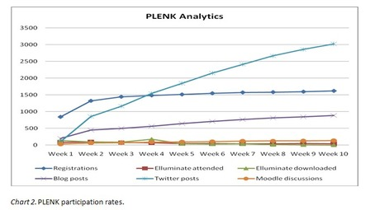
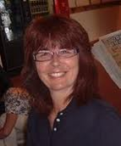
PLENK Analytics
Rita Kop
Supporting ongoing MOOC participation
http://www.irrodl.org/index.php/irrodl/article/view/882

Slide 18
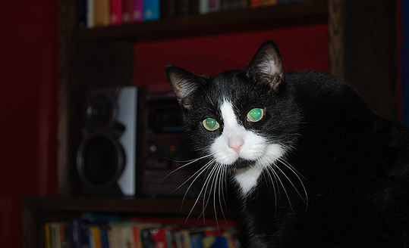
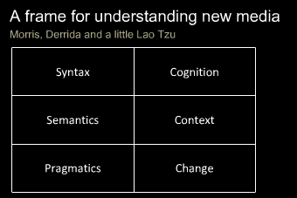
Critical Literacies
Understanding how we use artifacts to communicate in online and other learning networks
http://www.downes.ca/presentation/232

Slide 19
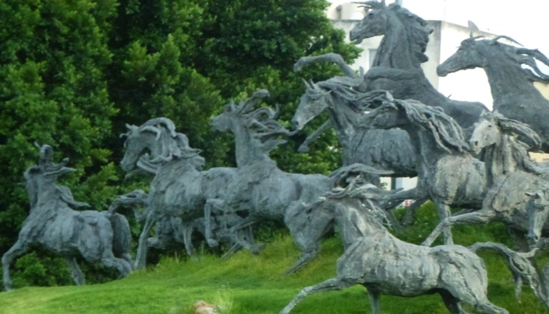
2011: Year of the MOOC

Slide 20
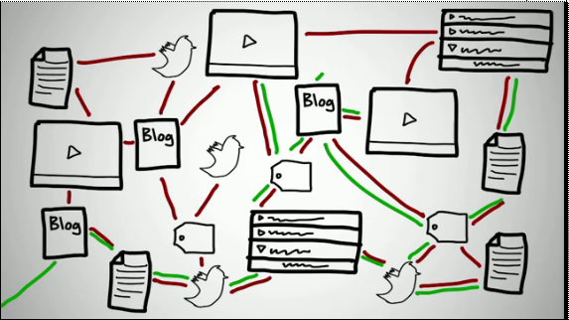
Connectivism & Connective Knowledge
CCK11: How to Learn in a MOOC
http://www.youtube.com/watch?v=eW3gMGqcZQc

Slide 21
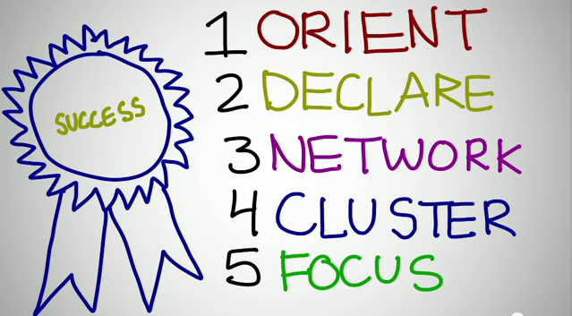
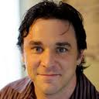
How to be Successful in a MOOC
Dave Cormier
http://www.youtube.com/watch?v=r8avYQ5ZqM0

Slide 22
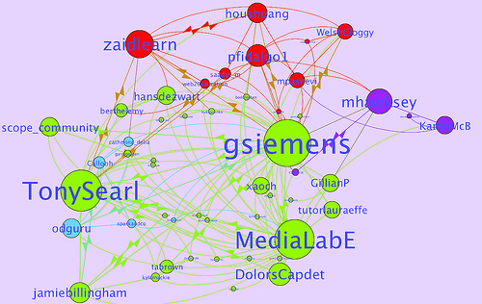
Learning Analytics
LAK11: How to measure success in a MOOC
http://scope.bccampus.ca/course/view.php?id=365

Slide 23
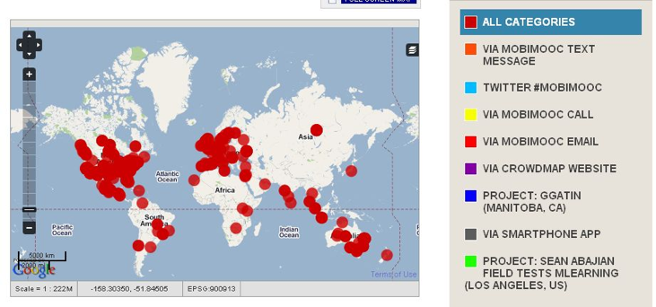
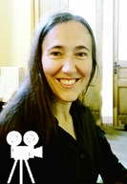
MobiMOOC
Inge de Waard
Supporting Mobile Learning Technology
http://mobimooc.wikispaces.com/

Slide 24
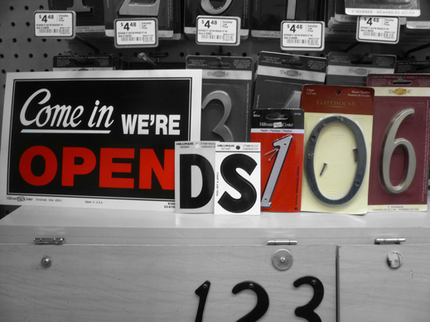
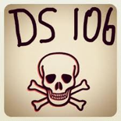
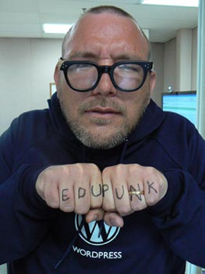
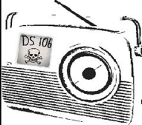
The madness and mayhem of DS106
Jim Groom
DS = Digital Storytelling
DS106 redefined activities and participation
http://ds106.us/

Slide 25
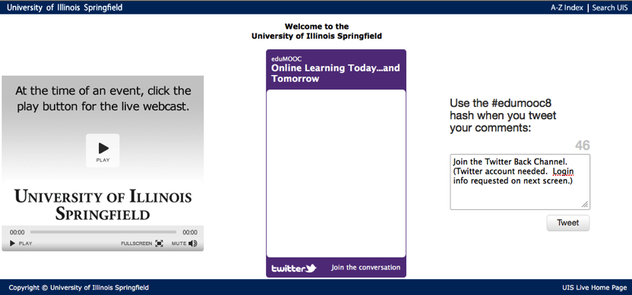
eduMOOC
Large, well publicized, but not very interactive
http://sites.google.com/site/edumooc/

Slide 26
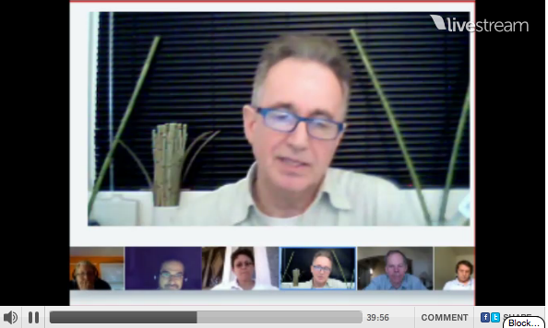
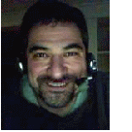
eduMOOC underground
Jeff Lebow
Jeff Lebow, Google+ hangout, and Livestream:
Taking something ordinary, and making it something special – YOU make the MOOC
http://www.livestream.com/jefflebow/

Slide 27

AI-Class: Redefining Massive
More than 100,000 people signed up for pre-registration
http://www.ai-class.com/

Slide 28

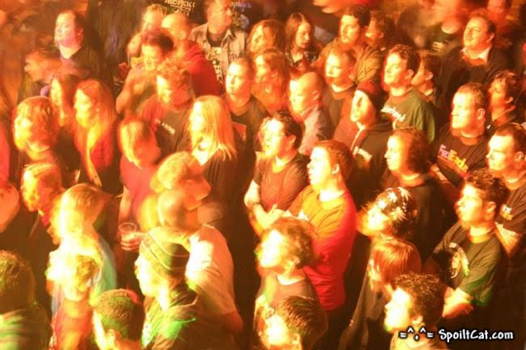
Change 2011
Downes, Cormier and Siemens try again
Image: http://steve-wheeler.blogspot.com/2011/04/running-mooc.html
http://change.mooc.ca

Slide 29
New Roles for Government
Communications and Education Infrastructure
Support for Open Educational Resources
Support for Free Learning
Management of assessments and credentialing

Slide 30
The Digital Infrastructure
Public high-speed backbone networks
  used not only for education but for other public services: police, fire and emergency, hospital, municipalities, etc.
Local Access
  eg. CAP Centres
Legal Framework
  policy on digital rights and copyright
  net neutrality and similar regulations

Slide 31
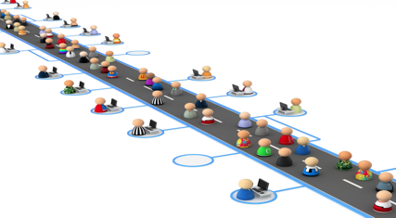
A Note on Sustainability
Whatever we really want is sustainable
Like, say, highways

Slide 32
Sustaining Infrastructure
Support for existing programs and services
  cost reductions in communications overhead
  improved efficiency of public service delivery
Overhead on entertainment and commercial infrastructure
  similar to broadcast ‘CanCon’ requirements

Slide 33
Open Educational Resources
Traditional Resources
  Already developed and paid for by government
  Open access initiatives
Public Policy Resources
  design to serve a public end or objective
  focus on basic literacies & community empowerment

Slide 34
Sustaining OERs
Redirection of existing resource allocations
  eg. OA mandates for grants and programs
  community outreach for existing agencies
    eg, NASA
Support for community-based OER process
  integration of OER development and use within publicly supported curricula
  use of OERs in public services and programs
- Stephen Downes, Models for sustainable Open Educational Rsources, ijklo.org/Volume3/IJKLOv3p029-044Downes.pdf http://www.downes.ca/presentation/76
- OER Help with Keynote Slides, OER-Forum http://lists.esn.org.za/pipermail/oer-forum/2011-October/thread.html

Slide 35
Software and Service Support
Software and environment support
  eg. Public Knowledge Project,
  Open Journal Systems, Moodle, et
Service networks and support
  JISC / CETIS, EdNA, etc.
  Common Services - eFramework

Slide 36
Sustaining Support Systems
Development and systems research support
Public adoption of open licensing
  FLOSS
    GNU/GPL, BSD, etc
    Creative Commons
  directs resources toward multi-sector development
Community service requirement for commercially sourced software

Slide 37
Assessment and Credentialing
Major policy initiatives
  separation of delivery and assessment
    an end to Digital Diploma Mills
  management of credentialing by professional associations under a regulatory framework
  development of community-based assessment metrics and infrastructure
    move away from simple testing, toward authentic community engagement and referrals

Slide 38
Assessment and Credentialing (2)
Support for Personal Learning
  provision of personal learning environments and frameworks
    promote lifelong learning
    link to skills database, corporate training registries
    direct support for employment and funding
  personal portfolios and credential banks
    voluntary, self-managed
    optional identity frameworks

Slide 39
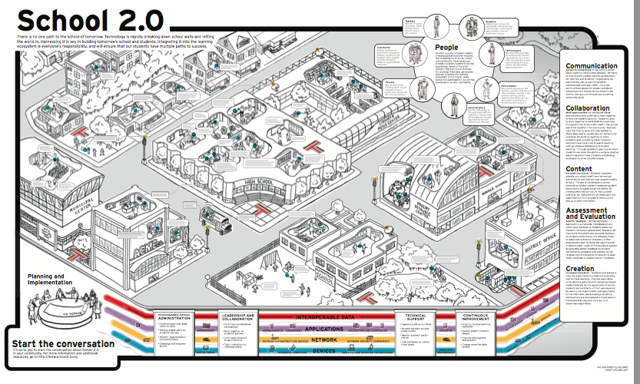
The Old School 2.0
School 2.0 etoolkit http://etoolkit.org/etoolkit/

Slide 40
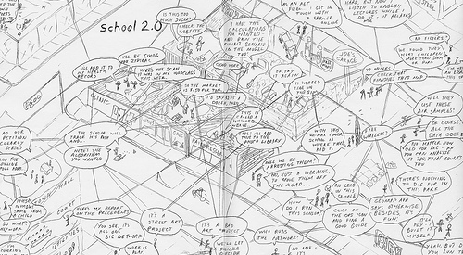
New Models for Schools

Slide 41
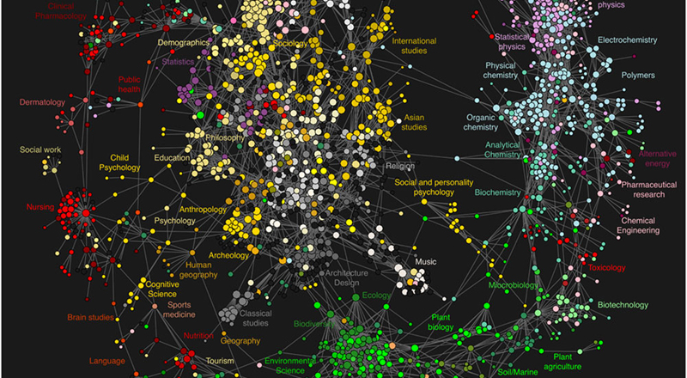
New Roles for Research

Slide 42
Community = Interactions
Not ‘spreading the word’
Not ‘amplification’
But rather, the creation of our own society, together
  emergent from the free actions of each of us
  not based on the ideas of one (or a small number) of individuals

Slide 43
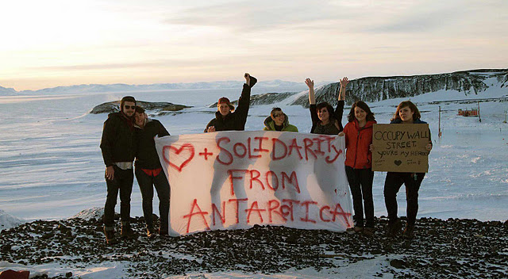
Open Communities are Free
Dave Pollard, the Metamovement http://howtosavetheworld.ca/2011/10/20/the-metamovement-moving-beyond-marches-and-people-in-the-street/

Slide 44
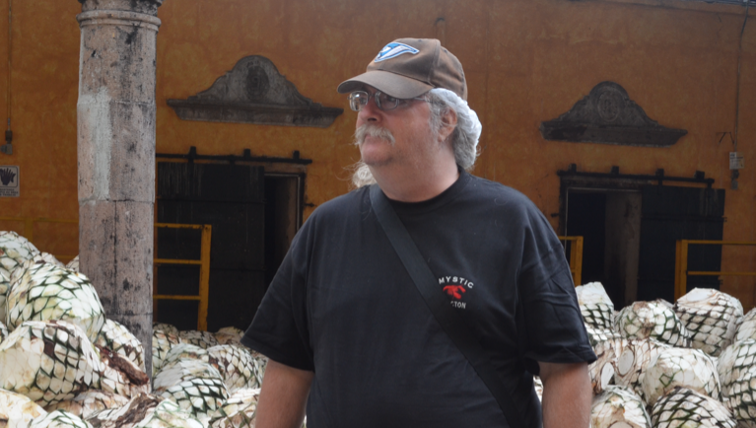
Stephen Downes http://www.downes.ca

