Slide 1

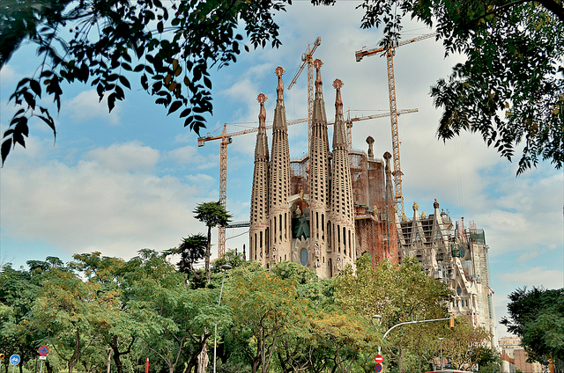
Connectivist Learning:
How new technologies are promoting autonomy and responsibility in education
Stephen Downes
Barcelona, Spain, October 22, 2011

Slide 2
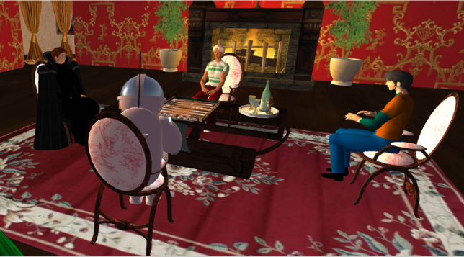
Visitors and Residents:
A Better Metaphor
Visitors and Residents: A new typology for online engagement
by David S. White and Alison Le Cornu.
First Monday, Volume 16, Number 9 - 5 September 2011
http://www.uic.edu/htbin/cgiwrap/bin/ojs/index.php/fm/article/viewArticle/3171/3049
Notes:
our goal is not to disprove Prensky’s thesis per se, but instead to challenge the underlying metaphor of language– and second–language–learning which he builds his case on, and then to offer an alternative. We want to ask questions such as: Can learning technological skills be likened to that of language learning? Is the analogy appropriate?

Slide 3
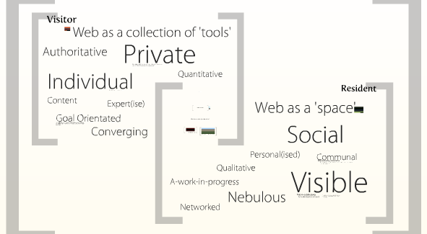
Dimensions of Engagement
Visitors & Residents: The Video
David S. White, TALL blog
http://tallblog.conted.ox.ac.uk/index.php/2009/10/14/visitors-residents-the-video/
Notes:
Visitors understand the Web as akin to an untidy garden tool shed. They have defined a goal or task and go into the shed to select an appropriate tool which they use to attain their goal.
Residents, on the other hand, see the Web as a place, perhaps like a park or a building in which there are clusters of friends and colleagues whom they can approach and with whom they can share information about their life and work.

Slide 4
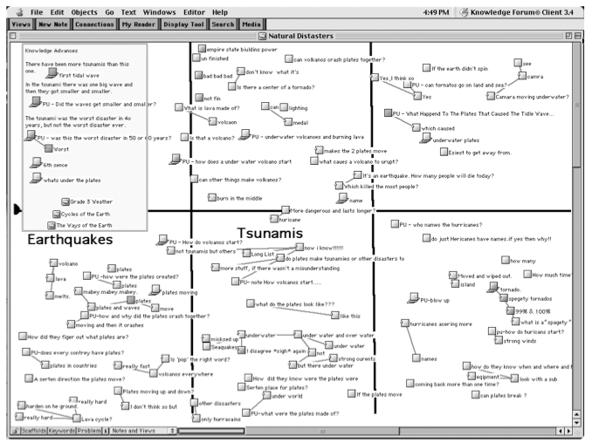

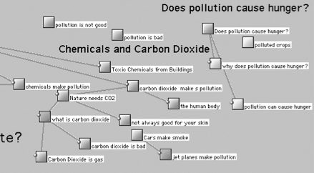
Knowledge as Community
Knowledge Building: Theory, Pedagogy, and Technology
Marlene Scardamalia and Carl Bereiter, Cambridge Handbook of the Learning Sciences
http://ikit.org/fulltext/2006_KBTheory.pdf
Notes:
Ours is a knowledge-creating civilization. A growing number of “knowledge societies” (Stehr, 1994), are joined in a deliberate effort to advance all the frontiers ofknowledge. Sustained knowledge advancement is seen as essential for social progress of all kinds and for the solution of societal problems.
Knowledge building, as elaborated in this chapter, represents an attempt to refashion education in a fundamental way, so that it becomes a coherent effort to initiate students into a knowledge creating culture.
In this context, the Internet becomes more than a desktop library and a rapid mail-delivery system. It becomes the first realistic means for students to connect with civilization-wide knowledge building and to make their classroom work a part of it.
From a pragmatic standpoint, a more useful distinction is between knowledge about and knowledge of something. Knowledge about sky-diving, for instance, would consist of all the declarative knowledge you can retrieve when prompted to state what you know about sky-diving. Such knowledge could be conveniently and adequately represented in a concept net. Knowledge of sky-diving, however, implies an ability to do or to participate in the activity of sky-diving.

Slide 5

The Learner as Visitor
Guide to Thomas Kuhn’s The Structure of Scientific Revolutions
Malcolm R. Forster
http://philosophy.wisc.edu/forster/220/kuhn.htm
Notes:
the concrete problem-solutions that student encounter from the start of their scientific education, whether in laboratories, in examinations, or at the ends of chapters in science texts. ... All physicists, for example, begin by learning the same exemplars: problems such as the inclined plane, the conical pendulum, and Keplerian orbits; instruments such as the vernier, the calorimeter, and the Wheatstone bridge."

Slide 6
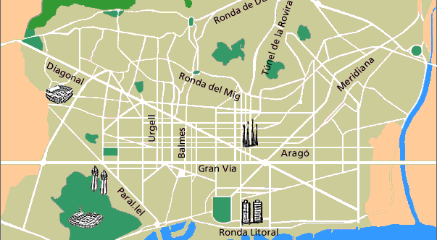
A Map of the City
Notes:
How does one explore a new city?
a map
a guided tour
bus lines and metro
etc.
vs. being driven exactly to your destination by a driver = ‘knowledge about’

Slide 7
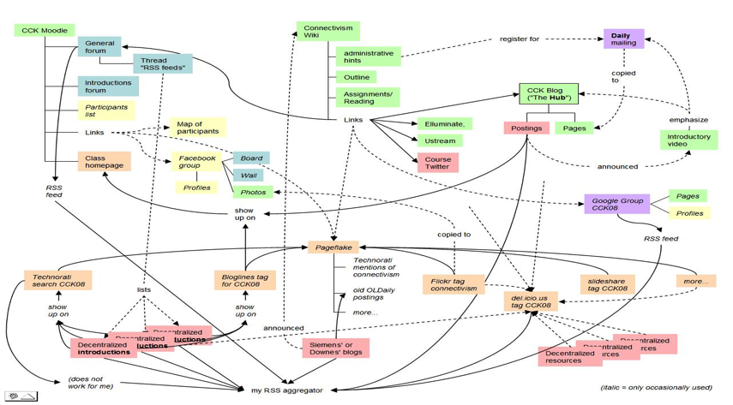
A Map of the Community
Connectivism: A Theory of Personal Learning
Stephen Downes, December 3, 2008, Educational Development Centre, Ottawa
http://www.downes.ca/presentation/208

Slide 8
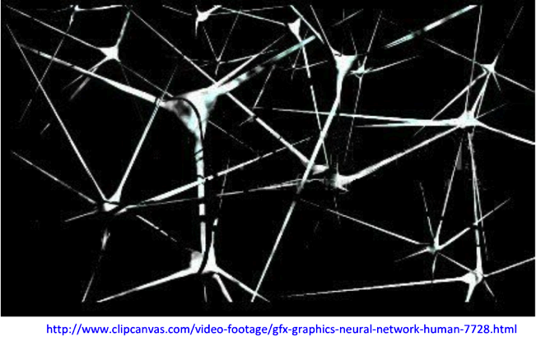
Connectivism: The Theory
Connectivism: A Learning Theory for the Digital Age
George Siemens, elearnspace
http://www.elearnspace.org/Articles/connectivism.htm
What Connectivism Is,
Stephen Downes, Half an Hour
http://halfanhour.blogspot.com/2007/02/what-connectivism-is.html
Notes:
At its heart, connectivism is the thesis that knowledge is distributed across a network of connections, and therefore that learning consists of the ability to construct and traverse those networks.
It shares with some other theories a core proposition, that knowledge is not acquired, as though it were a thing. Hence people see a relation between connectivism and constructivism or active learning (to name a couple).
Where connectivism differs from those theories, I would argue, is that connectivism denies that knowledge is propositional. That is to say, these other theories are 'cognitivist', in the sense that they depict knowledge and learning as being grounded in language and logic.
Connectivism is, by contrast, 'connectionist'. Knowledge is, on this theory, literally the set of connections formed by actions and experience. It may consist in part of linguistic structures, but it is not essentially based in linguistic structures, and the properties and constraints of linguistic structures are not the properties and constraints of connectivism.

Slide 9
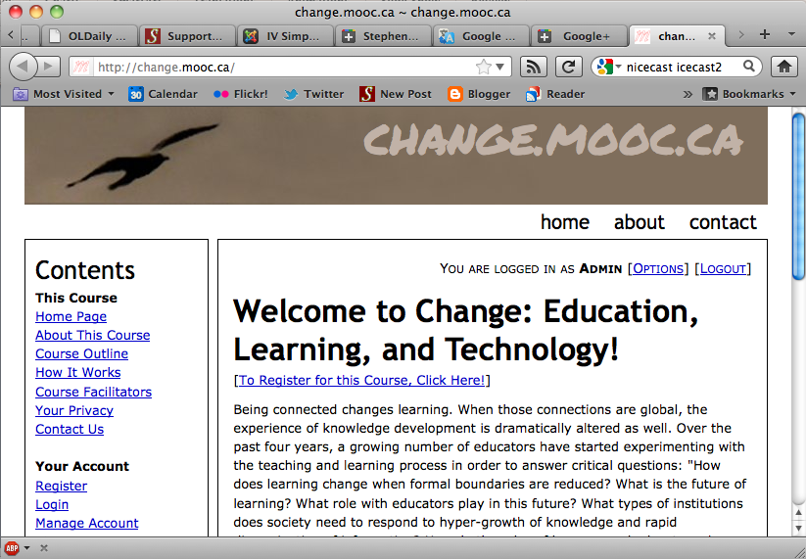
Connectivism: The Practice
The Massive Open Online Course
Change 2011, George Siemens, Dave Cormier, Stephen Downes
http://change.mooc.ca

Slide 10
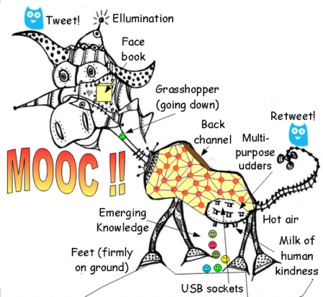
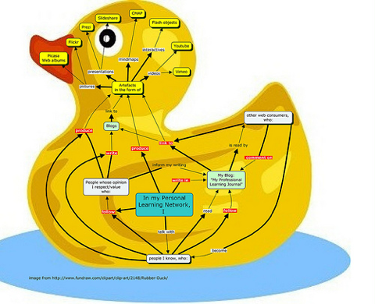
The Anatomy of a MOOC

Slide 11
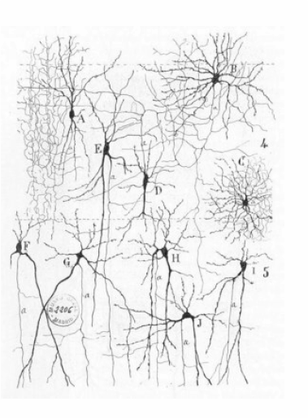
Learning as a Network
Teachers are nodes, students are nodes
Both teaching and learning consists of sending and receiving communications to other nodes

Slide 12
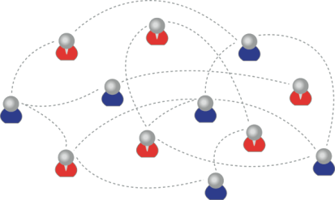
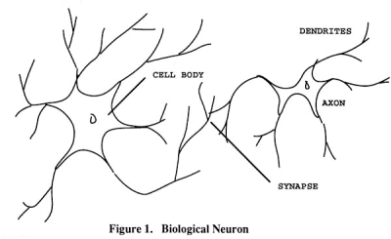
Personal Knowledge
We are using one of these
To create one of these
Personal knowledge consists of neural connections, not social connections

Slide 13
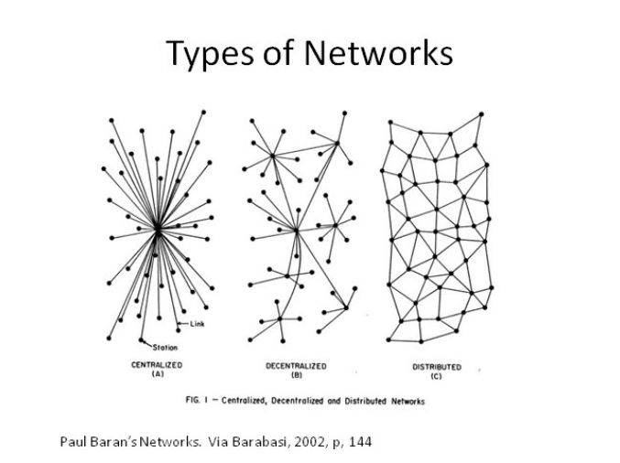
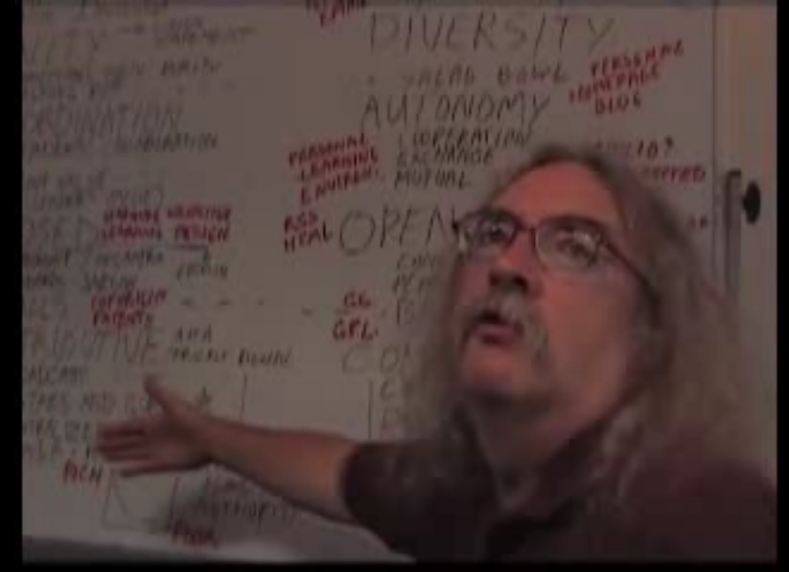
Network Learning: Success Factors
Autonomy – each node is self-governing
Diversity – nodes encouraged to have varying states
Openness – unhindered movement of signals, nodes
Interactivity – knowledge and learning are emergent
http://video.google.com/videoplay?docid=-4126240905912531540#
Notes:
Autonomy – each node is self-governing
Diversity – nodes encouraged to have varying states
Openness – unhindered movement of signals, nodes
Interactivity – knowledge and learning are emergent

Slide 14
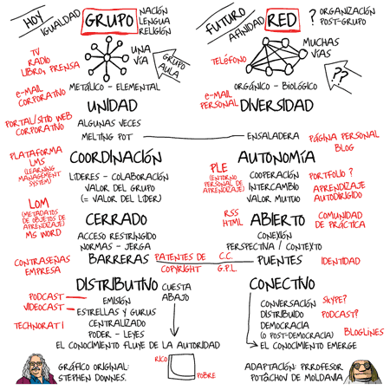
Mapa conceptual de Stephen Downes traducido por Potâchov,
e-learning, conocimiento en red
http://e-learning-teleformacion.blogspot.com/2008/07/la-va-ivan-illich-i-mapa-conceptual-de.html

Slide 15
Autonomy and Connectivism
Wikipedia: Autonomy means freedom from external authority.
Autonomy is what distinguishes between 'personal learning', which we do for ourselves, and 'personalized learning', which is done for us.
Autonomy
Stephen Downes
http://www.downes.ca/post/38545
Notes:
Wikipedia theory is a naïve theory (the way ‘freedom’ as ‘absence of restraint’ is a naïve theory – autonomy is not simply an absence of (‘freedom from’ but a positive attribute (‘capacity to’)
What does that mean in practice? It means that we ascribe to ourselves the possibility of choice (in fact, Gestalt alternatives, oscillating ways of seeing the world, the decision to perceive a duck rather than a rabbit), that this choice will be ascribed as the cause of our external actions, … and that these choices may have some effect
Autonomy as related to capacity, empowerment

Slide 16
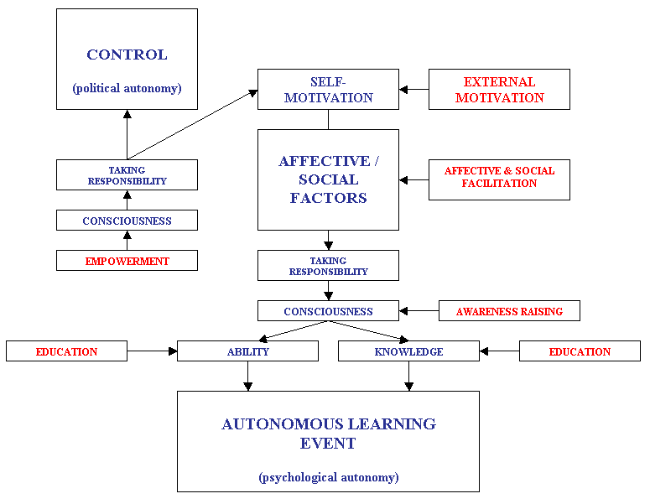
Autonomy as Capacity to Act
Do it yourself? A Learners' Perspective on Learner Autonomy and Self-Access Language Learning
Hayo Reinders
http://www.innovationinteaching.org/thesis_request.php

Slide 17
Four-Factor Model of Autonomy
Experience
Scope and range of autonomous behaviour
Factors affecting epistemic states
Engagement
Empowerment
Capacity to act on epistemic states
Effects of autonomous behaviour
Effect
A Model of Autonomy
Stephen Downes
http://www.downes.ca/post/54222

Slide 18
Factors Effecting Experience
Frames Metaphors
Cause Spirit
Ethics and morality
Memory
Traumas Phobias
Needs
Perceptions
Empirical
World View
Inference
Cognitive
Emotional state
Pain Suffering Fear
Literacy Numeracy
Certainty
Punishments
External
Vision
Rewards
Expectations
Money Recognition
Satisfaction
Standards
Less Autonomy
More Autonomy
Notes:
left – minimize
middle – encourage a variety
right – maximize

Slide 19
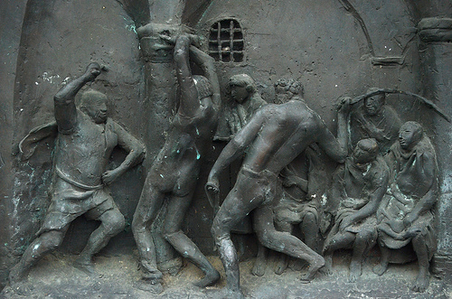
Connectivism and Experience (1)
Minimize the factors limiting autonomy, such as pain, fear, punishment, rewards
  A connectivist course does not have tests and grades, competition, passing, failure…

Slide 20
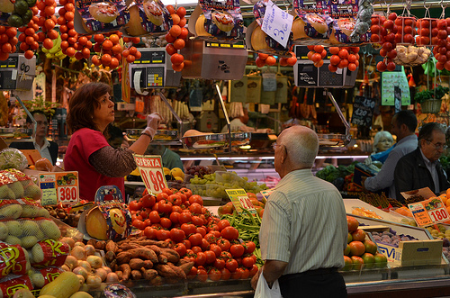
Connectivism and Experience (2)
Encourage a diversity of non-debilitating factors, such as memories, perceptions, visions, expectations
  A connectivist course provides many resources, varied exercises, new technology and media
Notes:
Instead of the ‘required text’, which linits diversity to one or a few

Slide 21
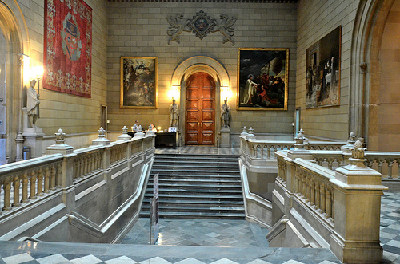
Connectivism and Experience (2)
Maximize the factors strengthening autonomy, such as perspective, point of view, literacy, numeracy
  A connectivist course models and provides scaffolds encouraging development of personal capacities
Notes:
Guides, maps, instructions, helpful hints, videos showing how, demonstrations, etc etc

Slide 22
Factors Effecting Empowerment
Mobility
Perceptual
Support
Static
Physical
More Autonomy
Laws, rules, regulations
Peer pressure
Social
Effective
Threats and Sanctions
Structural
Accessibility
Complexity
Design
Predictability
Resources
Barriers Locks Detours
Traps Loops
Range and Depth
Language, Presentation
Less Autonomy

Slide 23

Connectivism & Empowerment (1)
Maximize the factors providing greater physical flexibility and control
  A connectivist course supports the learner’s own physical environment, including mobile

Slide 24

Connectivism & Empowerment (2)
Minimize social pressures and encourage people to participate in their own way
  By supporting multiple environments, and not (say) a central forum, negative social impacts are minimized

Slide 25
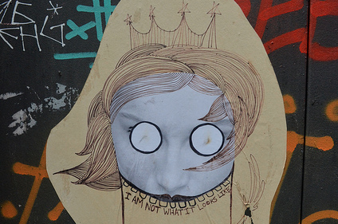
Connectivism & Empowerment (3)
Minimize structural constraints and reduce forced detours, loops, and requirements
  Connectivist courses as a whole are not ‘designed’ and do not attempt to engage a particular structure

Slide 26
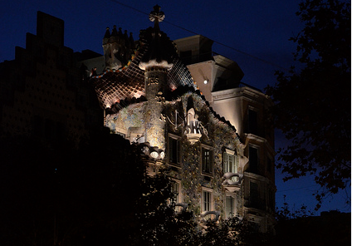
Connectivism & Empowerment (4)
Maximize the range, depth, openness and accessibility of resources
  Connectivist courses use open resources; all participants may create or submit resources

Slide 27
Factors Effecting Engagement
Languages
More Autonomy
Scope
Media
many
Word Use
Expression
Directionality
Association
Pedagogies
Method
Groups
Operating
Principles
Broadcast
Less Autonomy
Choices
Selection
one
Channels
Range
Noise
Results and Effects
Allocation
Background
Colours
Tools
Lighting and Clarity

Slide 28

Connectivism & Engagement (1)
Maximize the range and flexibility of association and groupings
  Connectivist courses do not create a single group or community, but encourage the creation of many

Slide 29
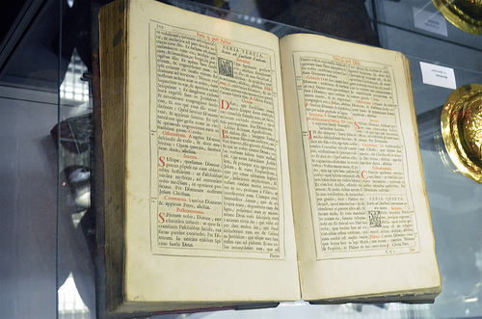
Connectivism & Engagement (2)
Encourage multiple languages and diverse communications environments
  Connectivist courses are run in multiple languages and varying modalities: images, audio, simulation…

Slide 30
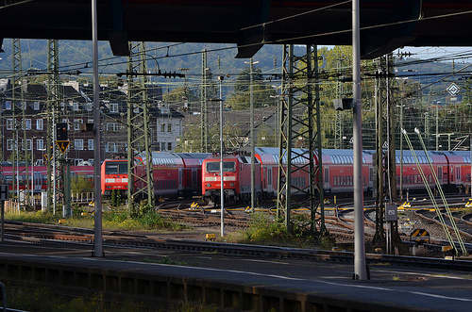
Connectivism & Engagement (3)
Expect different reasons for engagement, multiple outcomes, and varying mechanisms
  Connectivist support cooperation over collaboration, with varying pedagogies to support multiple aims

Slide 31
Factors Effecting Effect
Audience (How Many)
Impact
Efficacy
(How Much)
More Autonomy
(Requires Both)
Community
Social
Improvement
Public Good
Internal
Associative
External
Charity
Knowing More
Rights
Feeling Better
Employment
Social Justice
Wealth

Slide 32
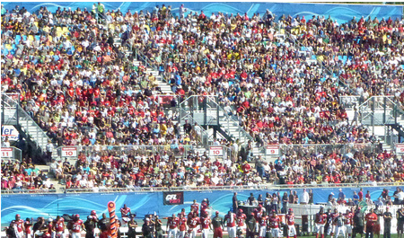
Connectivism & Effect (1)
While at the same time emphasizing the personal, maximize effect range and impact
  Connectivist courses support massive participation and growing impactful engagement in community

Slide 33

Connectivism & Effect (2)
Recognize and support the potential for improvements both social and personal
  The impact of connectivist courses is measured by one’s engagement and improvement in the wider knowledge community

Slide 34
Learning Outcomes
We recognize this
By perfomance in this
There are not specific bits of knowledge or competencies, but rather, personal capacities
(more on this later)

Slide 35
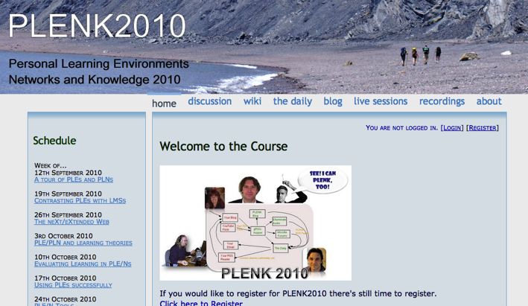
2010: Stephen Downes, Rita Kop
Critical Literacies & PLENK 2010
PLENK 2010 involved a significant research effort
http://connect.downes.ca/

Slide 36
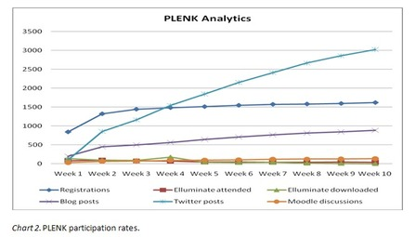

PLENK Analytics
Rita Kop
Supporting ongoing MOOC participation
http://www.irrodl.org/index.php/irrodl/article/view/882

Slide 37

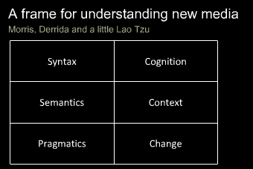
Critical Literacies
Understanding how we use artifacts to communicate in online and other learning networks
http://www.downes.ca/presentation/232

Slide 38
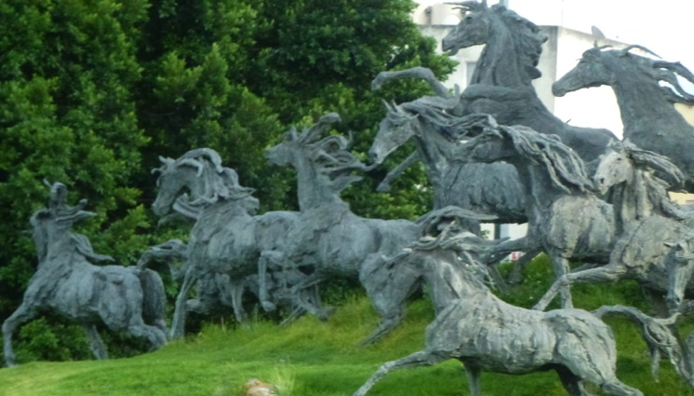
2011: Year of the MOOC

Slide 39
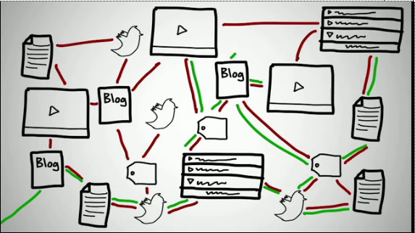
Connectivism & Connective Knowledge
CCK11: How to Learn in a MOOC
http://www.youtube.com/watch?v=eW3gMGqcZQc

Slide 40
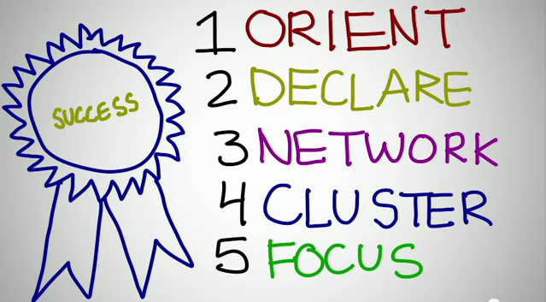

How to be Successful in a MOOC
Dave Cormier
http://www.youtube.com/watch?v=r8avYQ5ZqM0

Slide 41
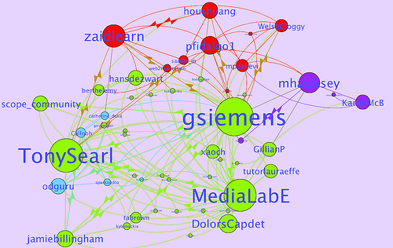
Learning Analytics
LAK11: How to measure success in a MOOC
http://scope.bccampus.ca/course/view.php?id=365

Slide 42
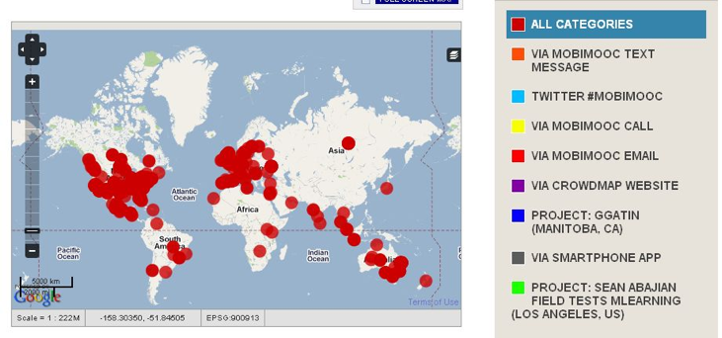
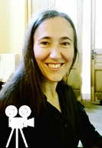
MobiMOOC
Inge de Waard
Supporting Mobile Learning Technology
http://mobimooc.wikispaces.com/

Slide 43


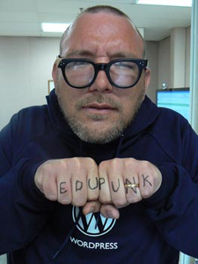

The madness and mayhem of DS106
Jim Groom
DS = Digital Storytelling
DS106 redefined activities and participation
http://ds106.us/

Slide 44
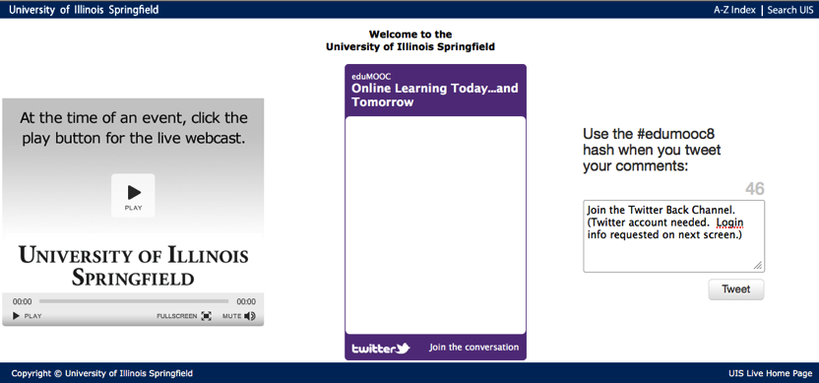
eduMOOC
Large, well publicized, but not very interactive
http://sites.google.com/site/edumooc/

Slide 45
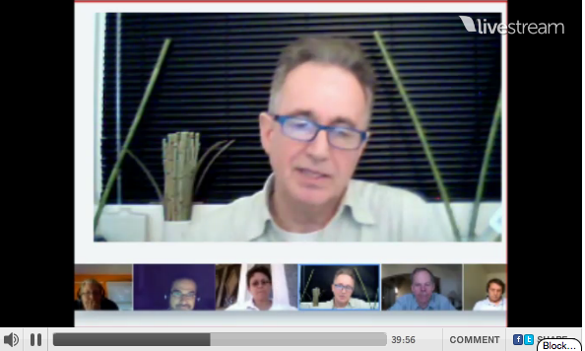

eduMOOC underground
Jeff Lebow
Jeff Lebow, Google+ hangout, and Livestream:
Taking something ordinary, and making it something special – YOU make the MOOC
http://www.livestream.com/jefflebow/

Slide 46

AI-Class: Redefining Massive
More than 100,000 people signed up for pre-registration
http://www.ai-class.com/

Slide 47

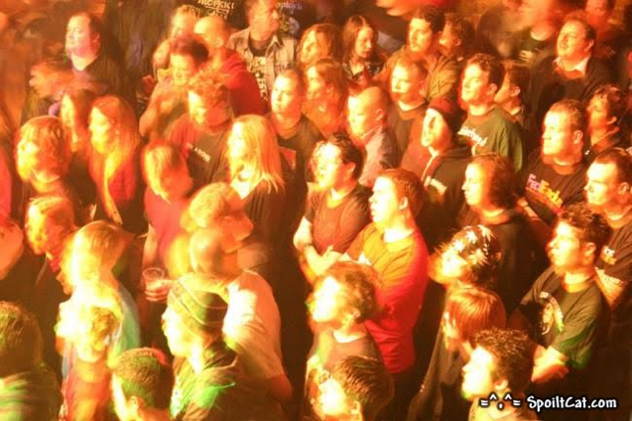
Change 2011
Downes, Cormier and Siemens try again
Image: http://steve-wheeler.blogspot.com/2011/04/running-mooc.html
http://change.mooc.ca

Slide 48
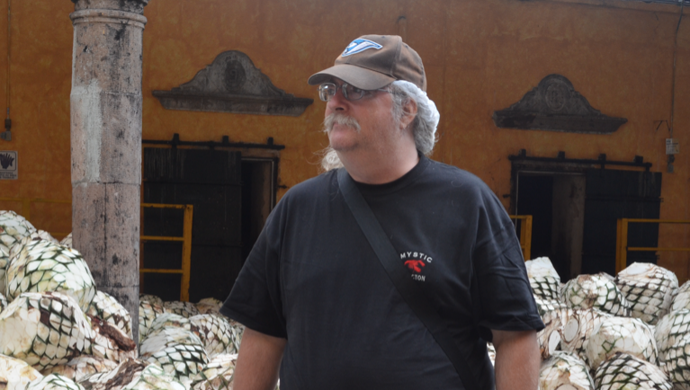
Stephen Downes http://www.downes.ca

