Slide 1

MOOC 2011
The Massive Open Online Course in Theory and in Practice
Stephen Downes, Guadalajara, 05 September 2011

Slide 2

Innovate to Transcend
El IV Simposio
de la Comisión Nacional para la Innovación Curricular
Transcend what? How? Why?

Slide 3

Objectives of this Symposium

Slide 4

1. Establish a forum for dialogue and reflection on topics and experiences

Slide 5
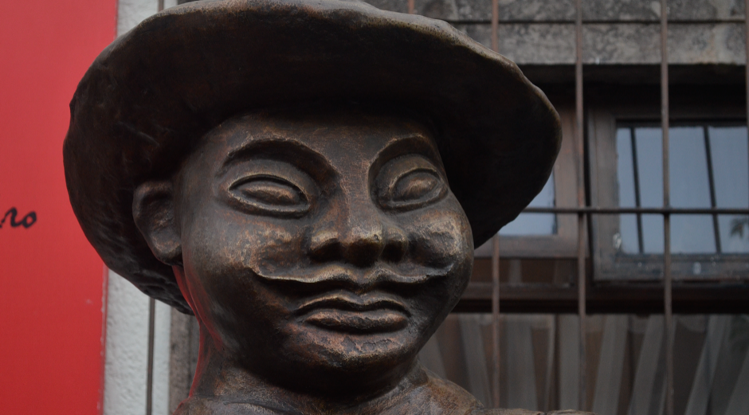
2. Discuss, with international experts, innovative proposals in the field

Slide 6

3. Promote training and updating of the participants in trends worldwide

Slide 7

4. Encourage the development of reflective working groups and research

Slide 8
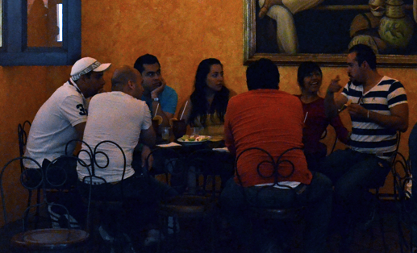
5. Promote inter-agency work to develop proposals and projects

Slide 9

6. Promote the strengthening and development of the organization

Slide 10

These are good objectives
Where are they in the schools or in the traditional curriculum?
To ‘transcend’ is to embody these objectives in new curricula.

Slide 11
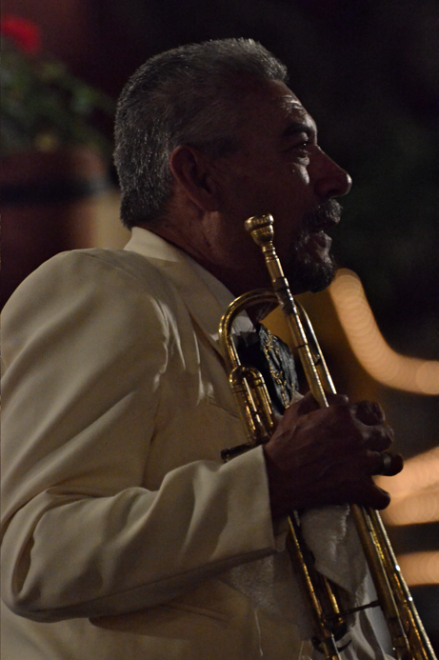
To teach, in other words, our students in the same way we would teach ourselves

Slide 12
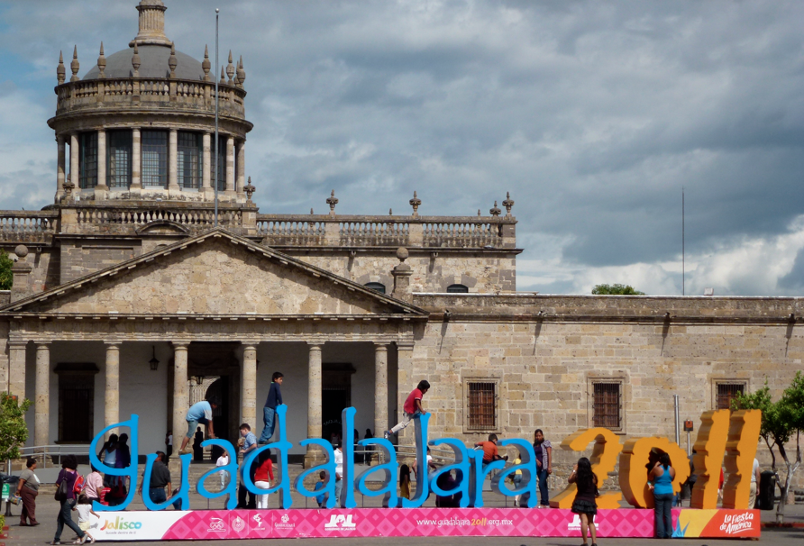
So here we are…
How could we meet these symposium objectives in the days and weeks ahead?

Slide 13
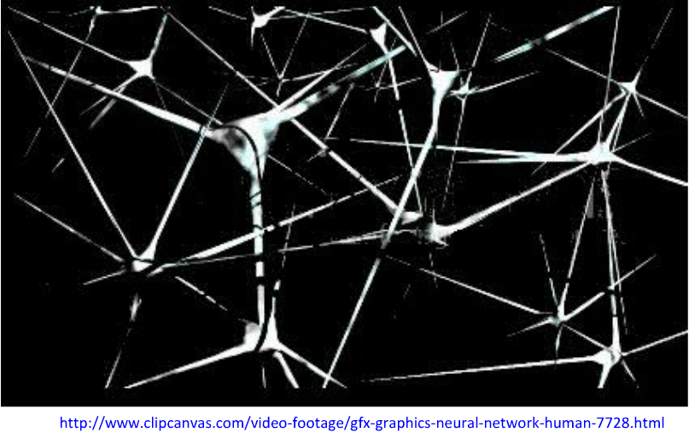
The Theory…
Learning and cognition happen in a network

Slide 14
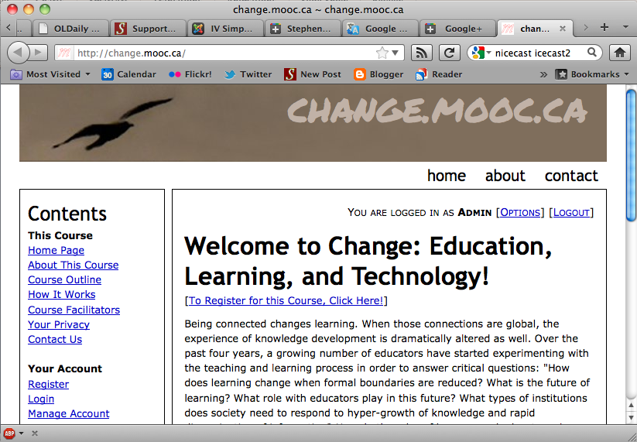
The Practice…
The Massive Open Online Course

Slide 15
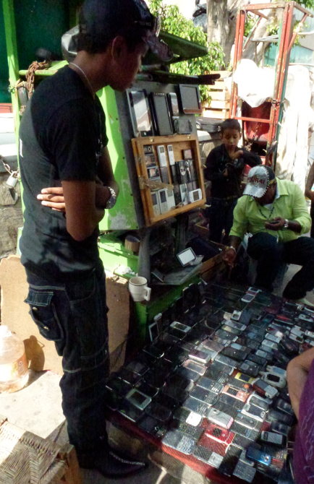
As we watch, the world is changing
Education is changing, learning is changing, curriculum is changing
We don’t just post traditional courses online any more
Here’s a short history…

Slide 16
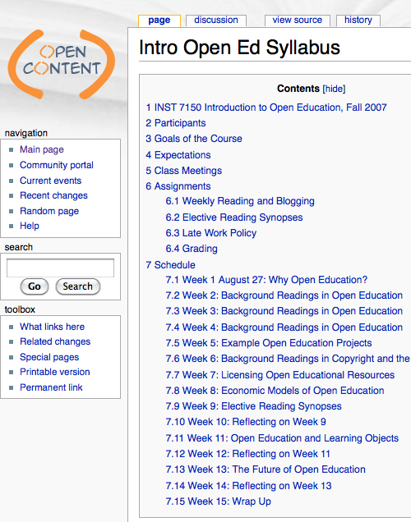
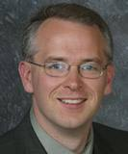
2007:
The Wiley Wiki
An Open Course based in a wiki
Participants from around the world contributed to the creation of the course
http://www.opencontent.org/wiki/index.php?title=Intro_Open_Ed_Syllabus

Slide 17
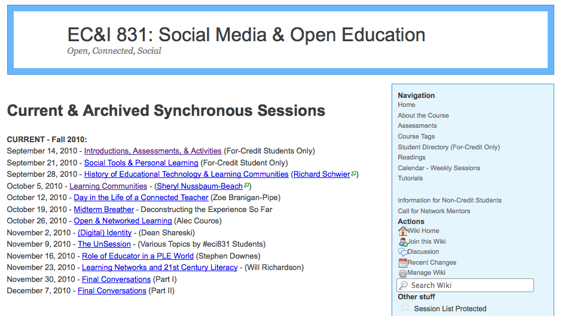
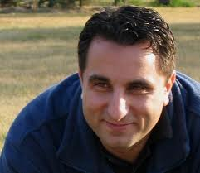
2007: Alec Couros
Social Media and Open Education
Open online course sessions with guest experts from around the world
http://eci831.wikispaces.com/Session+List

Slide 18
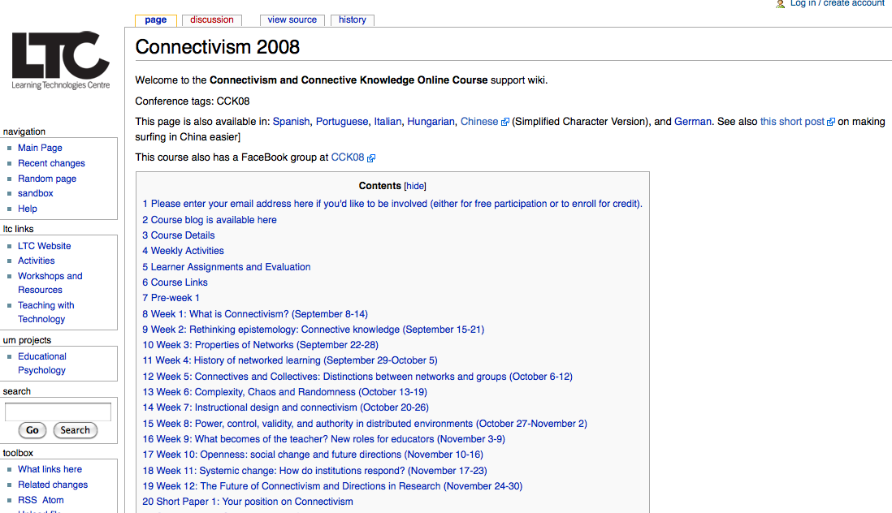
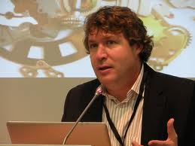
2008: CCK08
Stephen Downes, George Siemens
The First Massive Open Online Course (MOOC)
http://ltc.umanitoba.ca/wiki/Connectivism_2008

Slide 19
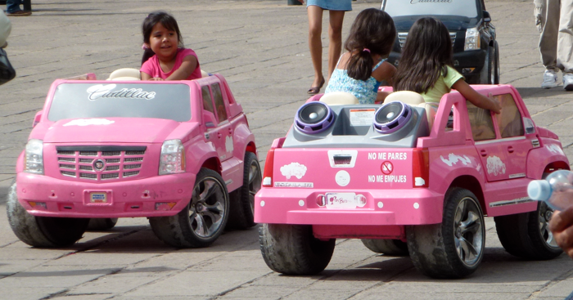
Why is CCK08 the First MOOC?
It combines open content (Wiley) and open teaching (Couros)
But also…

Slide 20

It supports Massive Participation
It does this by adopting a Connectivist pedagogy and structure

Slide 21
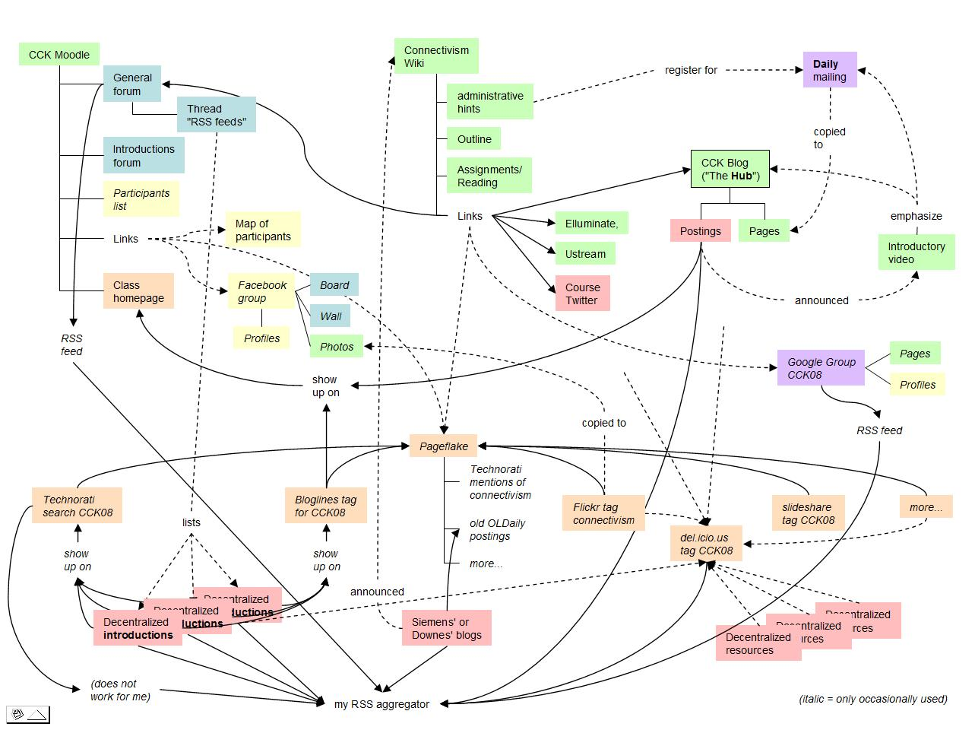
It is a Learning Network

Slide 22
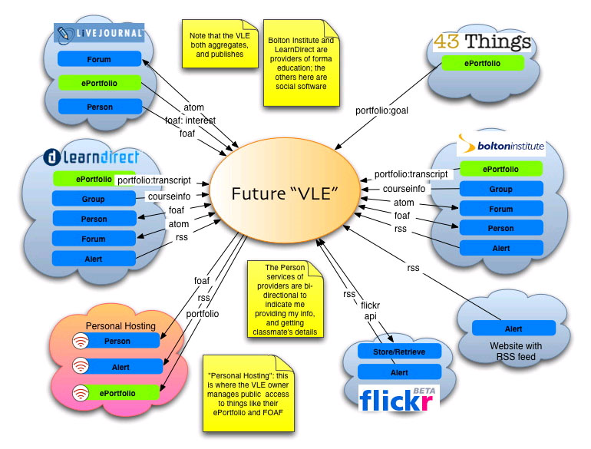
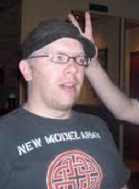
2006: The Personal Learning Environment
The Scott Wilson Diagram displaying a distributed learning architecture

Slide 23
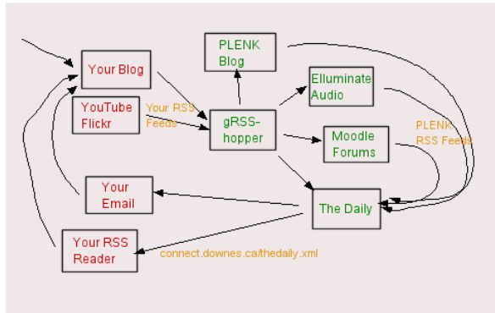
The Connectivist Architecture

Slide 24
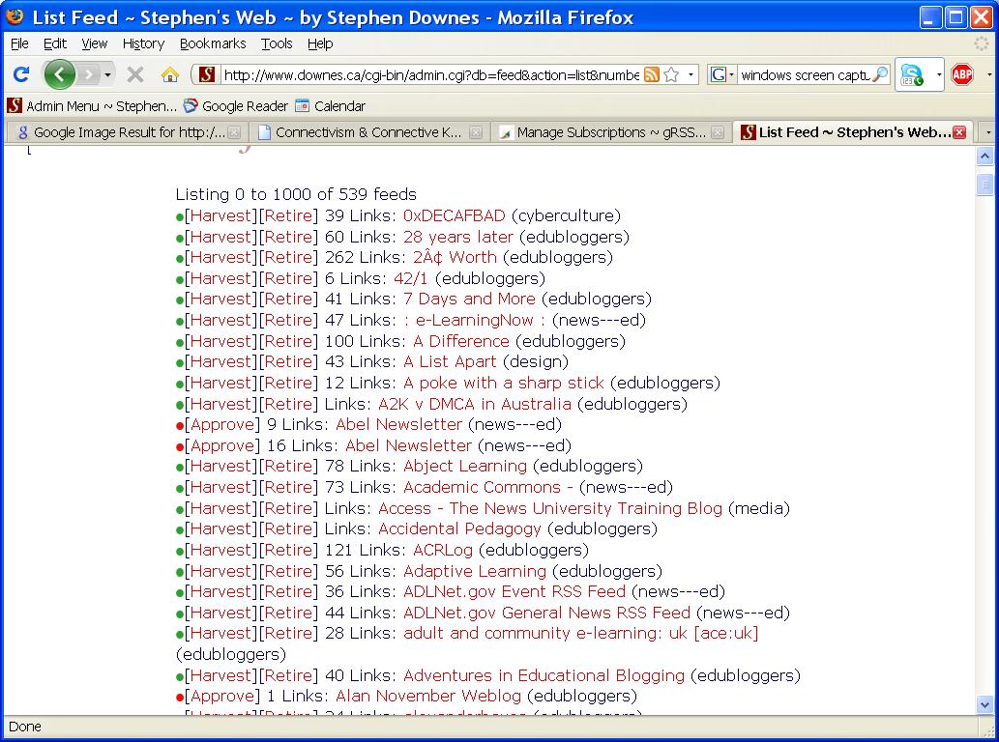

gRSShopper RSS Feed Harvesting
http://grsshopper.downes.ca/

Slide 25
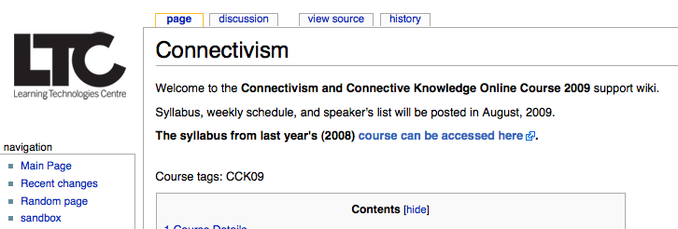
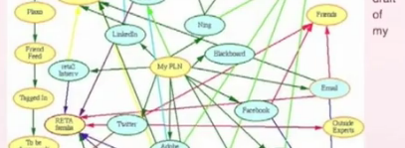
2009: CCK09, Connect Your PLN
http://ltc.umanitoba.ca/wiki/Connectivism
http://plnlab.pbworks.com/w/page/17277257/FrontPage

Slide 26
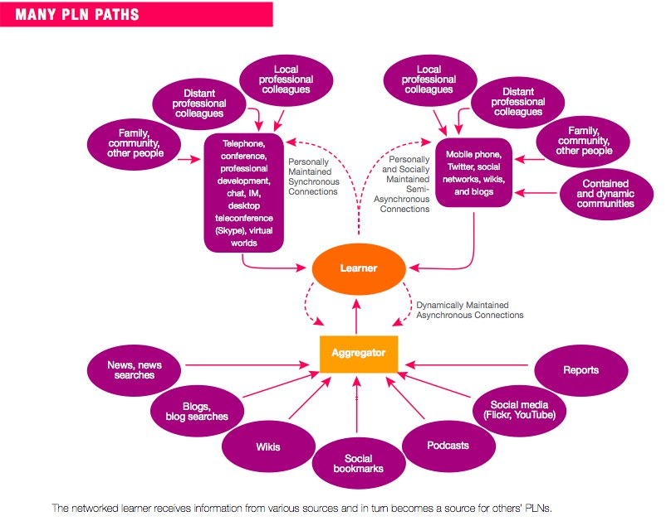
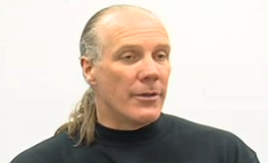

Personal Learning Networks
Will Richardson
Dave Warlick
http://www.youtube.com/watch?v=mghGV37TeK8
http://davidwarlick.com/wiki/pmwiki.php

Slide 27
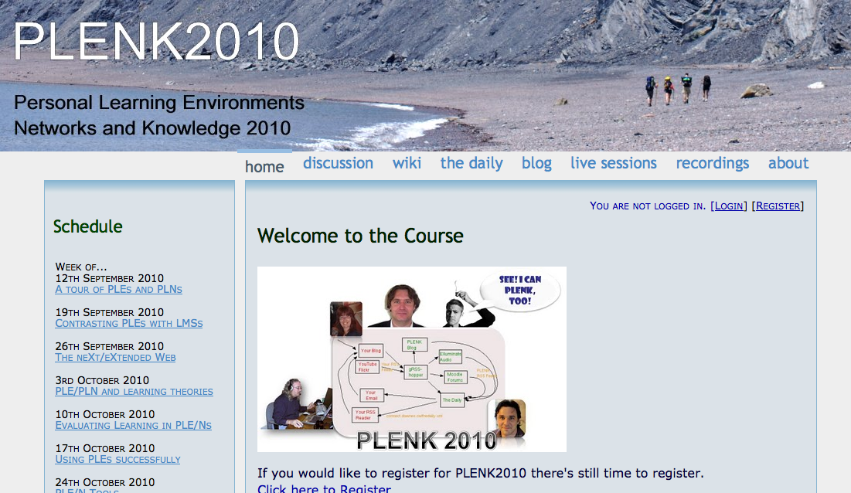
2010: Stephen Downes, Rita Kop
Critical Literacies & PLENK 2010
PLENK 2010 involved a significant research effort
http://connect.downes.ca/

Slide 28
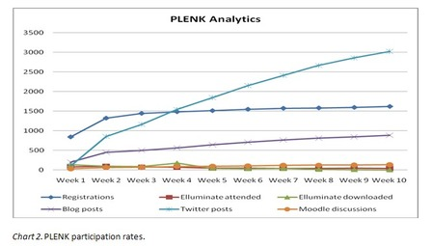
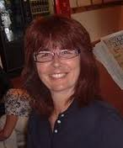
PLENK Analytics
Rita Kop
Supporting ongoing MOOC participation
http://www.irrodl.org/index.php/irrodl/article/view/882

Slide 29
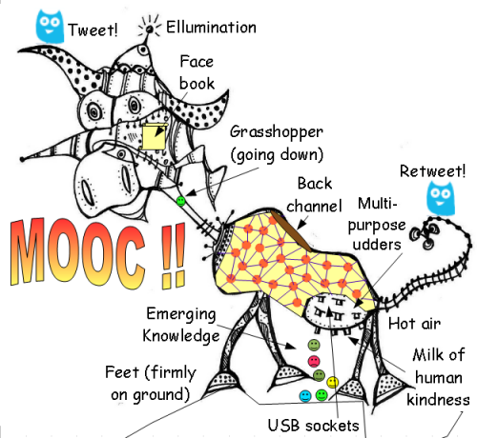
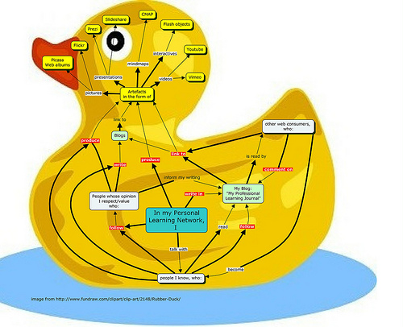
The Anatomy of a MOOC

Slide 30
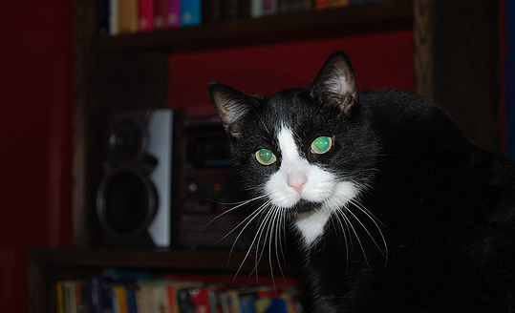
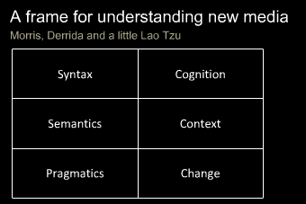
Critical Literacies
Understanding how we use artifacts to communicate in online and other learning networks
http://www.downes.ca/presentation/232

Slide 31
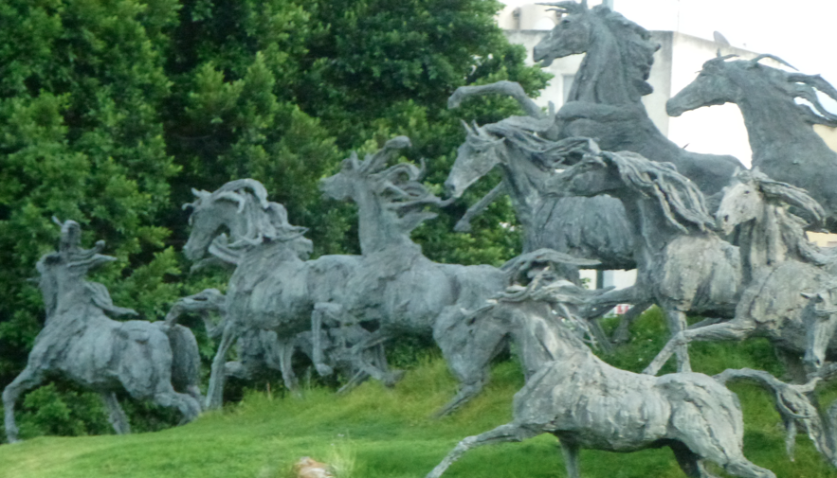
2011: Year of the MOOC

Slide 32
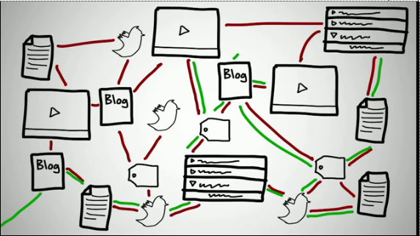
Connectivism & Connective Knowledge
CCK11: How to Learn in a MOOC
http://www.youtube.com/watch?v=eW3gMGqcZQc

Slide 33
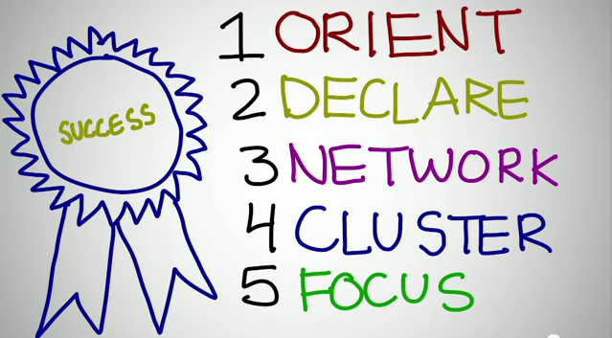
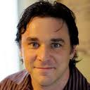
How to be Successful in a MOOC
Dave Cormier
http://www.youtube.com/watch?v=r8avYQ5ZqM0

Slide 34
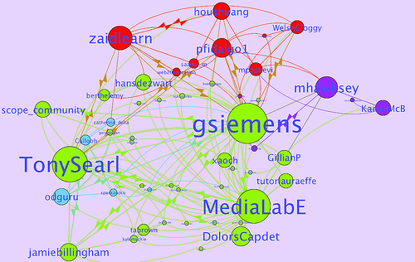
Learning Analytics
LAK11: How to measure success in a MOOC
http://scope.bccampus.ca/course/view.php?id=365

Slide 35
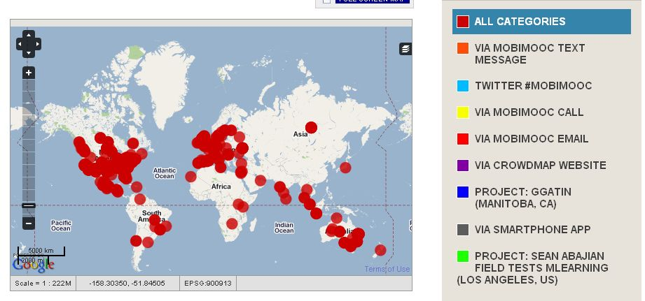
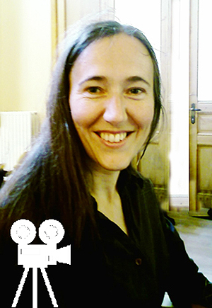
MobiMOOC
Inge de Waard
Supporting Mobile Learning Technology
http://mobimooc.wikispaces.com/

Slide 36
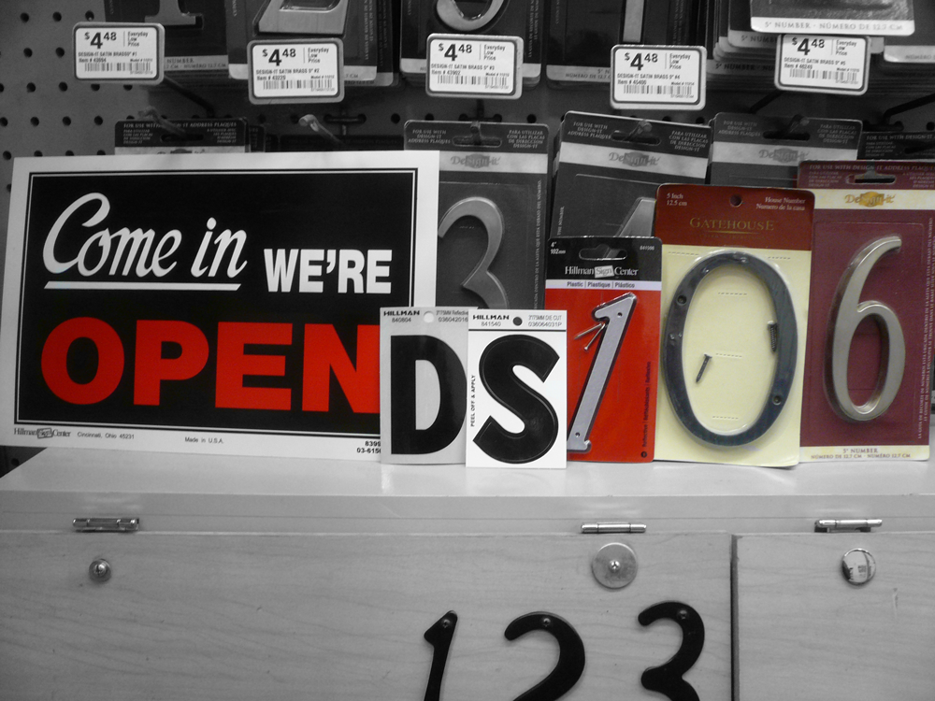

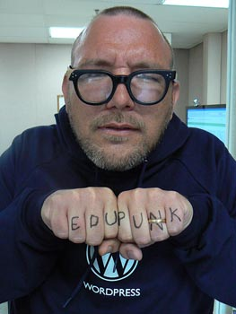

The madness and mayhem of DS106
Jim Groom
DS = Digital Storytelling
DS106 redefined activities and participation
http://ds106.us/

Slide 37
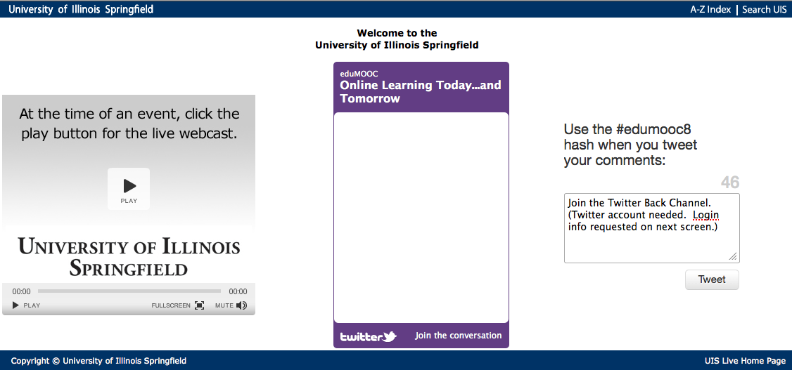
eduMOOC
Large, well publicized, but not very interactive
http://sites.google.com/site/edumooc/

Slide 38
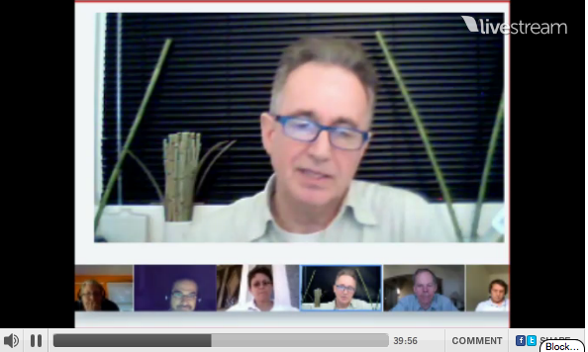
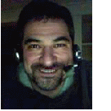
eduMOOC underground
Jeff Lebow
Jeff Lebow, Google+ hangout, and Livestream:
Taking something ordinary, and making it something special – YOU make the MOOC
http://www.livestream.com/jefflebow/

Slide 39

AI-Class: Redefining Massive
More than 100,000 people signed up for pre-registration
http://www.ai-class.com/

Slide 40

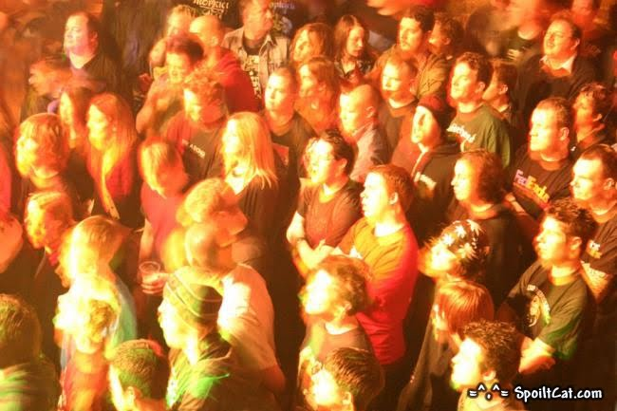
Change 2011
Downes, Cormier and Siemens try again
Image: http://steve-wheeler.blogspot.com/2011/04/running-mooc.html
http://change.mooc.ca

Slide 41

So what is a MOOC? What does a MOOC do?

Slide 42
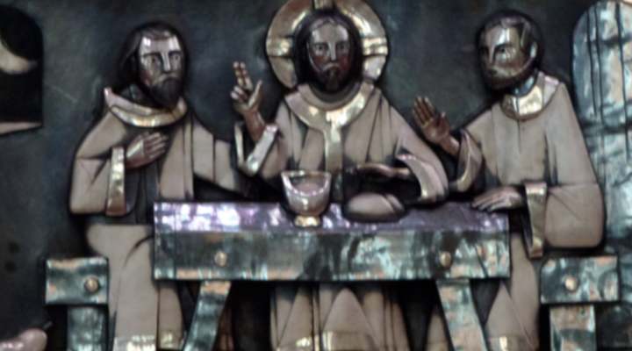
It is a forum for dialogue and reflection on topics and experiences…

Slide 43

… where we can discuss with international experts in the field…

Slide 44
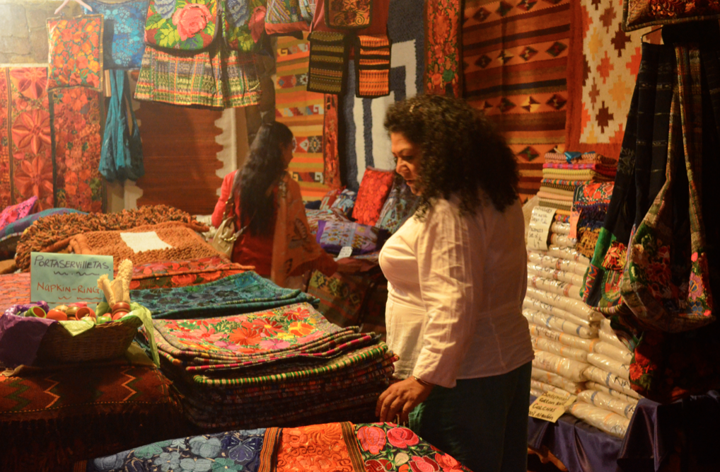
… and train and update ourselves in trends worldwide…

Slide 45

… and develop of reflective and research working groups…

Slide 46
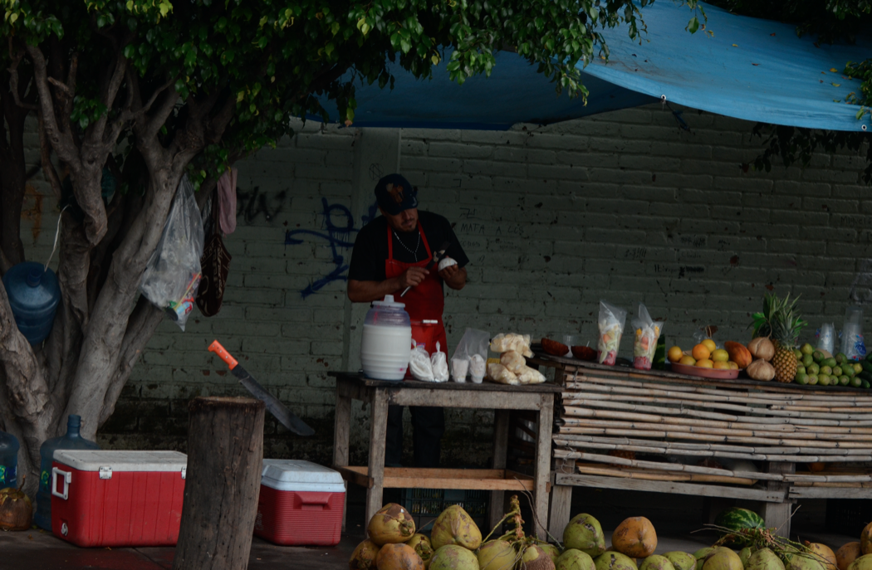
… promoting inter-agency cooperation…

Slide 47

and strengthening and developing the organization

Slide 48
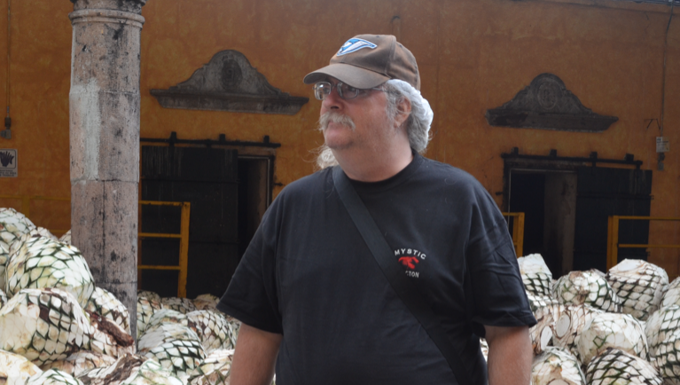
Stephen Downes http://www.downes.ca

