Slide 1
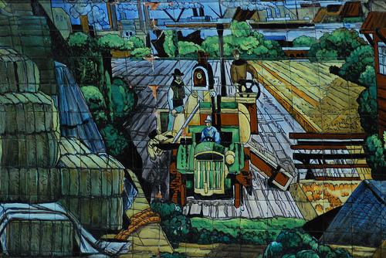
The Role of Educator in a PLE World
Stephen Downes
November 16, 2010
for EC&I 831: Social Media & Open Education
Alec Couros

Slide 2
Recent Work
  - the development of online learning software, such as gRSShopper, Synergic3, and Plearn
  - offering a series of open online courses, such as CCK08 and 09, Critical Literacies, and PLENK
  - theorizing around the idea of connective knowledge and learning communities
  - writing OLDaily, giving talks, attending conferences (input input input)

Slide 3
This Approach:
  - emphasizes open learning and learner autonomy
  - argues that course content is merely a tool employed to support learning, rather than the object of learning- - promotes a pedagogy of learning by engagement and activity within an authentic learning community
  - fosters a wider and often undefined set of competencies associated with a
  - exercises in activities requiring those competencies
  - grows knowledge rather than to transfer or construct knowledge through cognitive processes

Slide 4
Major Underlying Theme:
  - the role of the educator will change dramatically
  - not a ‘sage on the stage’
  - neither merely that of the ‘guide by the side’
  - students need to be able to look to prototypes on which to model their own work
  the instructor, therefore, is required to take an active role in the disciplinary or professional community, demonstrating tactics and techniques, and modeling the approach, language and world view of a successful practitioner.

Slide 5
Some Examples
Free Video Lectures http://freevideolectures.com/
Roots and Shoots http://www.rootsandshoots.org/campaigns
Challenge Based Learning http://ali.apple.com/cbl/
Serialized Courses http://course.downes.ca

Slide 6
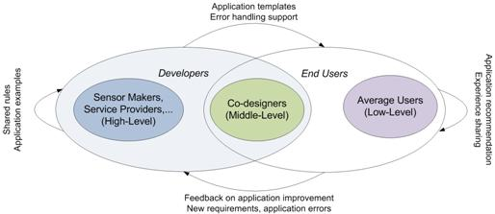
The Educator as Practitioner
Danielle - http://daniteachtech.wordpress.com/2010/11/14/being-a-techie-role-model/
“They are just children that copy what adults do.
http://www.downes.ca/post/54167/rd

Slide 7
The Roles:

Slide 8
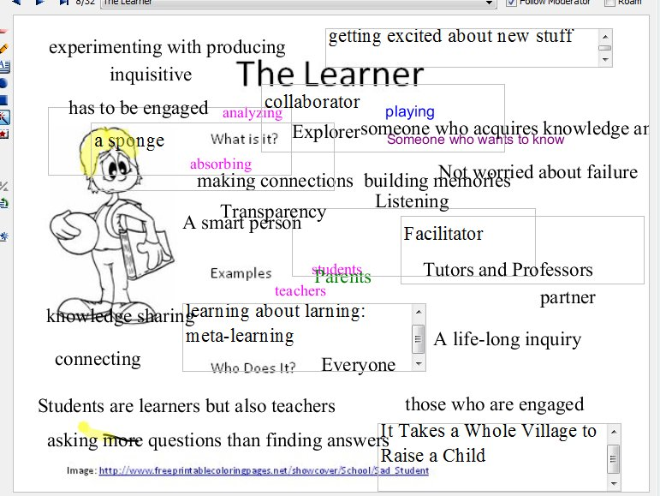
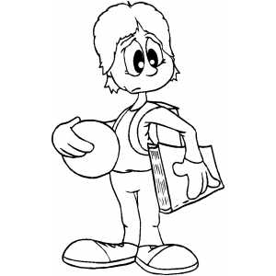
The Learner
What is it?
Examples
Who Does It?
Image: http://www.freeprintablecoloringpages.net/showcover/School/Sad_Student

Slide 9
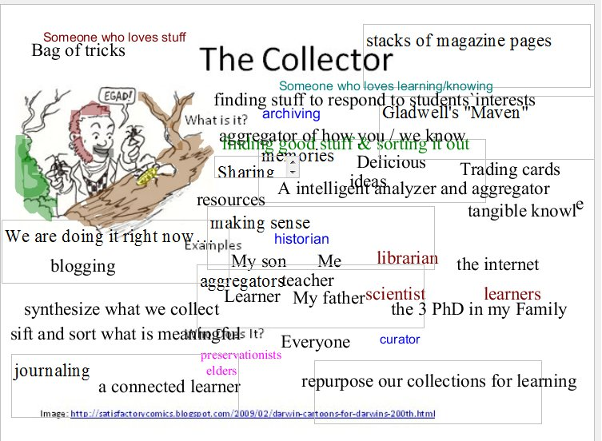
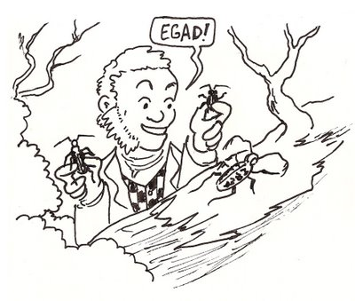
The Collector
What is it?
Examples
Who Does It?
Image: http://satisfactorycomics.blogspot.com/2009/02/darwin-cartoons-for-darwins-200th.html

Slide 10
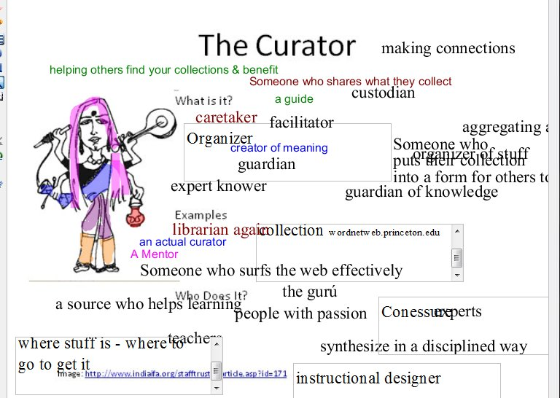
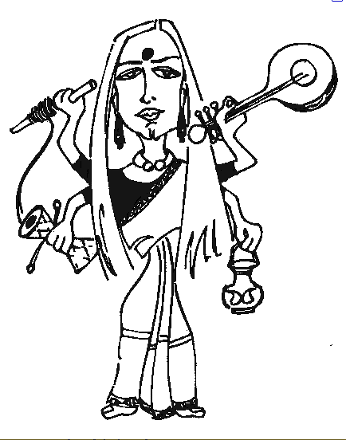
The Curator
What is it?
Examples
Who Does It?
Image: http://www.indiaifa.org/stafftrusteearticle.asp?id=171

Slide 11
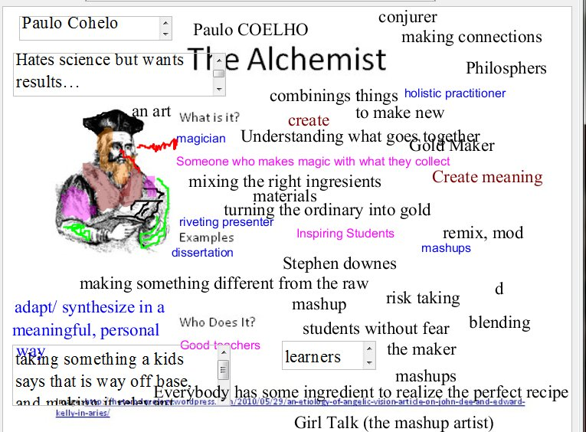
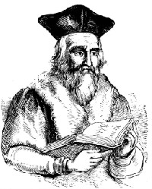
The Alchemist
What is it?
Examples
Who Does It?
Image: http://heterodoxology.wordpress.com/2010/05/29/an-etiology-of-angelic-vision-article-on-john-dee-and-edward-kelly-in-aries/

Slide 12
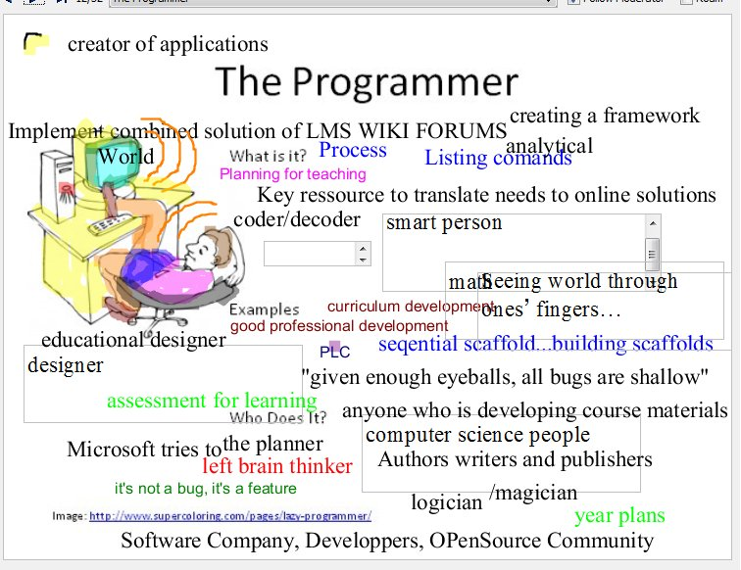
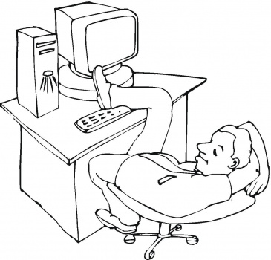
The Programmer
What is it?
Examples
Who Does It?
Image: http://www.supercoloring.com/pages/lazy-programmer/

Slide 13
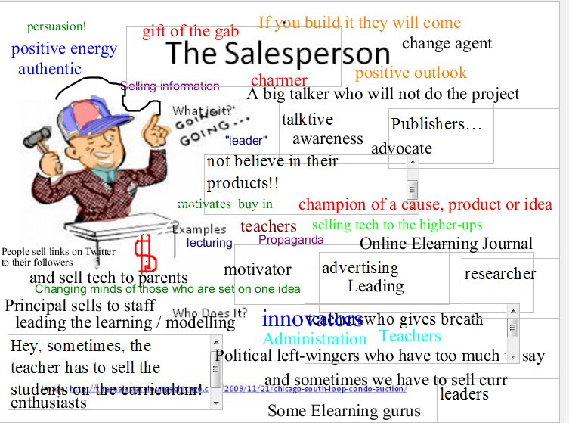

The Salesperson
What is it?
Examples
Who Does It?
Image: http://therealestateloungechicago.com/2009/11/21/chicago-south-loop-condo-auction/

Slide 14
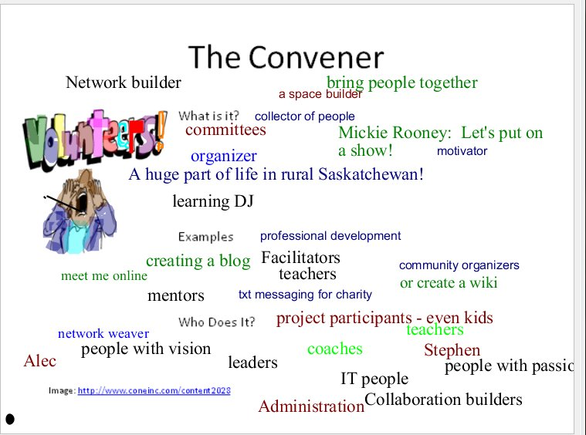

The Convener
What is it?
Examples
Who Does It?
Image: http://www.coneinc.com/content2028

Slide 15
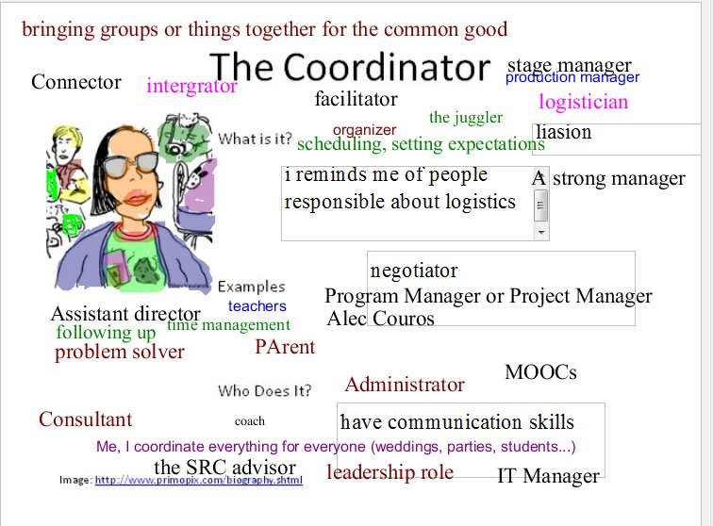
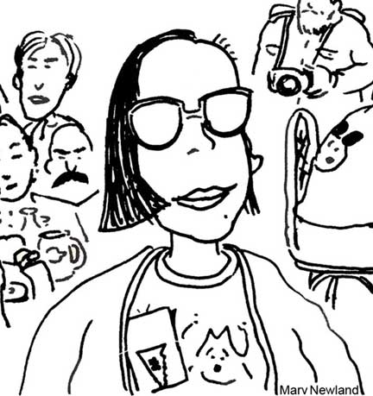
The Coordinator
What is it?
Examples
Who Does It?
Image: http://www.primopix.com/biography.shtml

Slide 16
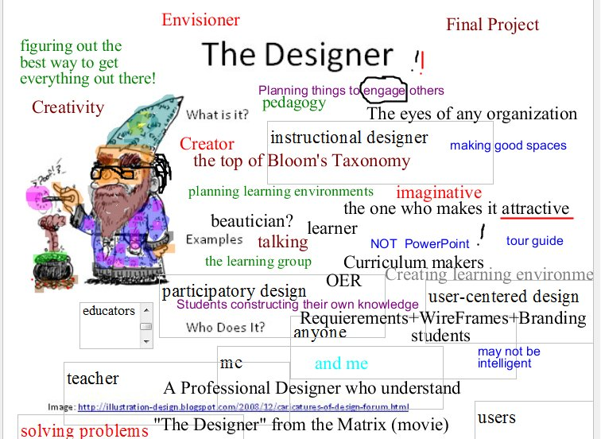
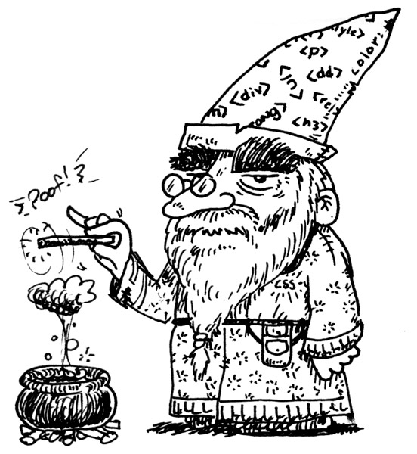
The Designer
What is it?
Examples
Who Does It?
Image: http://illustration-design.blogspot.com/2008/12/caricatures-of-design-forum.html

Slide 17
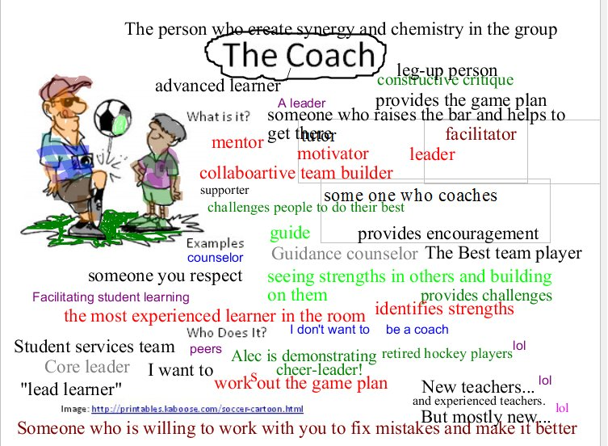
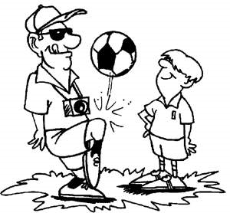
The Coach
What is it?
Examples
Who Does It?
Image: http://printables.kaboose.com/soccer-cartoon.html

Slide 18
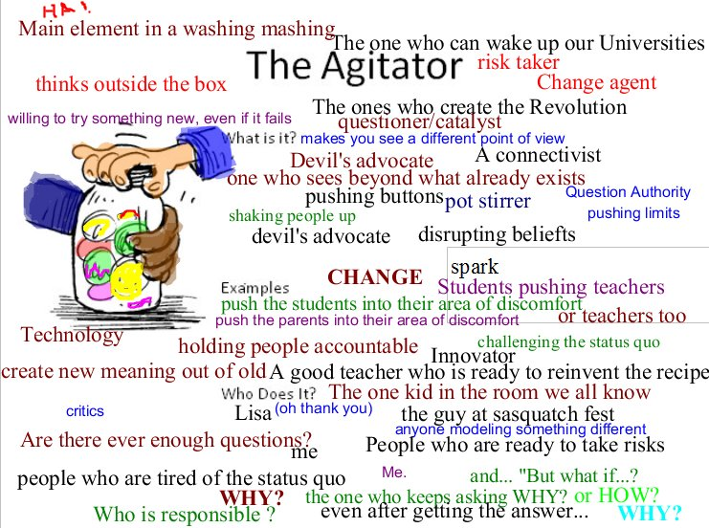
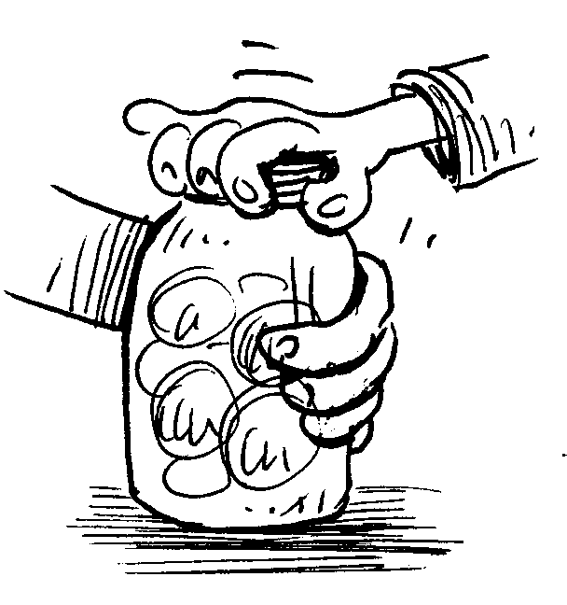
The Agitator
What is it?
Examples
Who Does It?

Slide 19
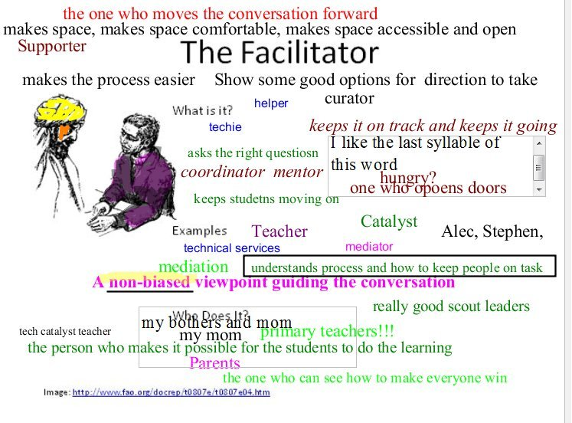
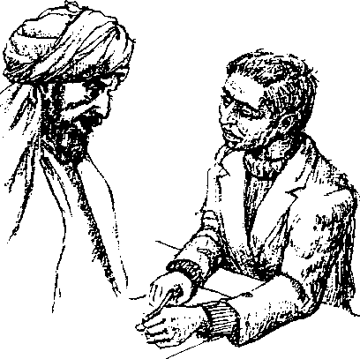
The Facilitator
What is it?
Examples
Who Does It?
Image: http://www.fao.org/docrep/t0807e/t0807e04.htm

Slide 20
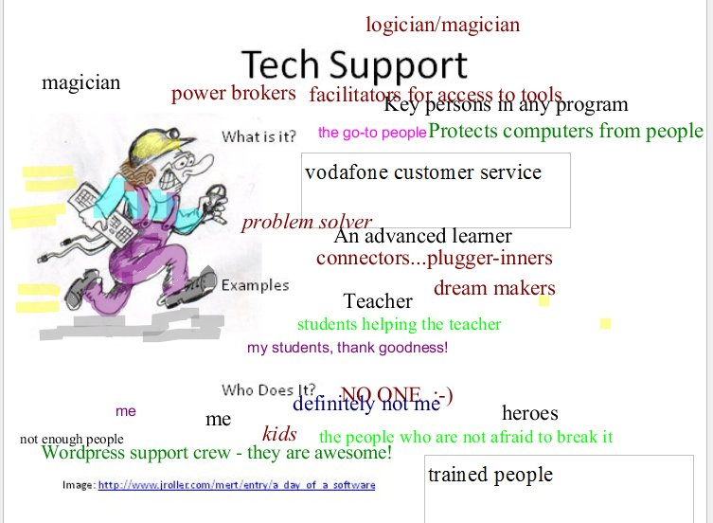
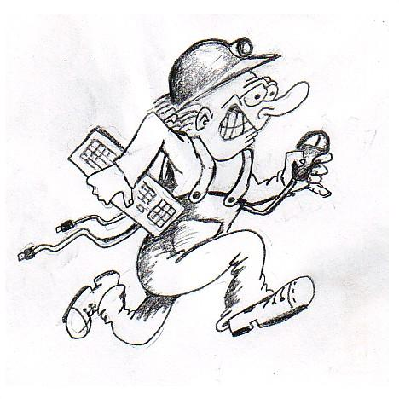
Tech Support
What is it?
Examples
Who Does It?
Image: http://www.jroller.com/mert/entry/a_day_of_a_software

Slide 21
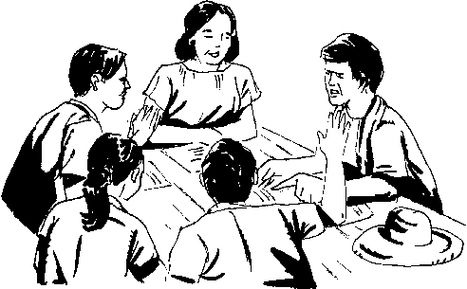
The Moderator
What is it?
Examples
Who Does It?
Image: http://scintillatingly-astute.blogspot.com/

Slide 22
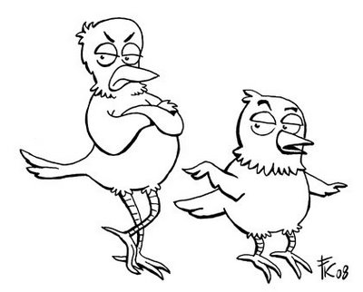
The Critic
What is it?
Examples
Who Does It?
Image: http://frankkennedysillustrations.blogspot.com/2008_10_01_archive.html

Slide 23
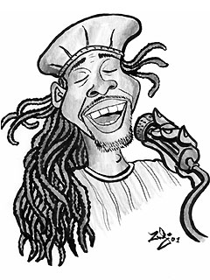
The Lecturer
What is it?
Examples
Who Does It?
Image: http://kajsaha.com/2009/05/kojo-antwi-and-accomodation-in-ghana/

Slide 24

The Demonstrator
What is it?
Examples
Who Does It?
Image: http://www.aryadevi.co.cc/2010/10/bagaimana-gaya-guru-idealnya.html

Slide 25
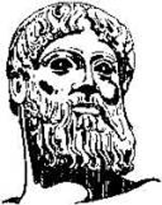
The Mentor
What is it?
Examples
Who Does It?
Image: http://www.sinigaglia.com/drstest5/page38/page38.html

Slide 26

The Connector
What is it?
Examples
Who Does It?
Image: http://blogs.rediff.com/balanmangudi/

Slide 27
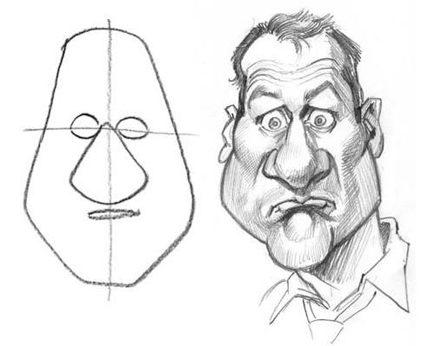
The Theorizer
What is it?
Examples
Who Does It?
Image: http://www.smashingmagazine.com/2009/09/08/50-clever-tutorials-and-techniques-on-traditional-drawing/

Slide 28

The Sharer
What is it?
Examples
Who Does It?
Image: http://www.kookerkids.com/Coloring/color_3_sharing.htm

Slide 29
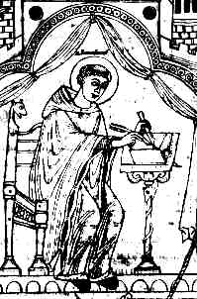
The Evaluator
What is it?
Examples
Who Does It?
Image: http://www.powayusd.com/teachers/dsykes/viking_age_archaeology_on_the_is.htm

Slide 30
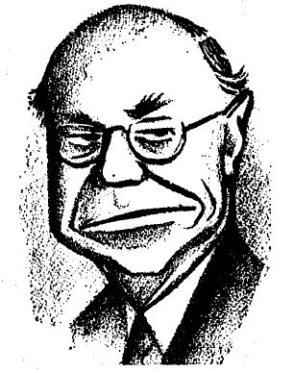
The Bureaucrat
What is it?
Examples
Who Does It?
Image: http://www.marxists.org/history/etol/writers/kerry/1955/xx/aflciomerger.htm

