Slide 1
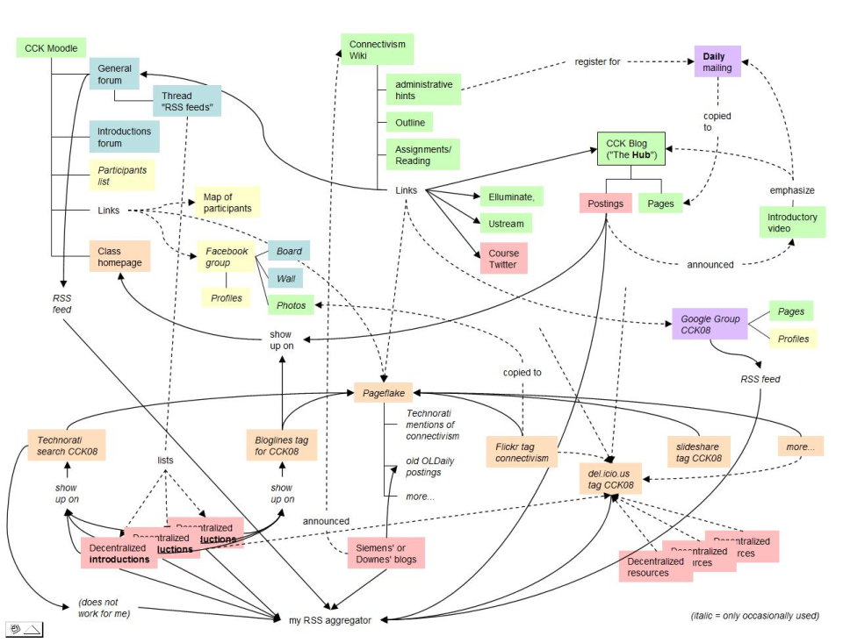
Decentralized Learning
Stephen Downes
National Research Council
March 17, 2010
APOP (Association for the Educational Application of Computer Technology at the Post-Secondary Level-Montréal)

Slide 2
Decentralized Learning
The model, pioneered in such events as the Connectivism and Connective Knowledge course, revolves around the idea that there is no 'core' content which much be learned, but rather, a body of loosely related materials that different people explore in different ways in order to satisfy their own personal learning needs.

Slide 3
Decentralized Learning
Physical Organization
Epistemology
Pedagogy
Success Factors

Slide 4
Physical Organization
The idea that a learning environment is distributed across a number of different sources
The role of the student is to connect these sources and draw from them learning resources as needed

Slide 5
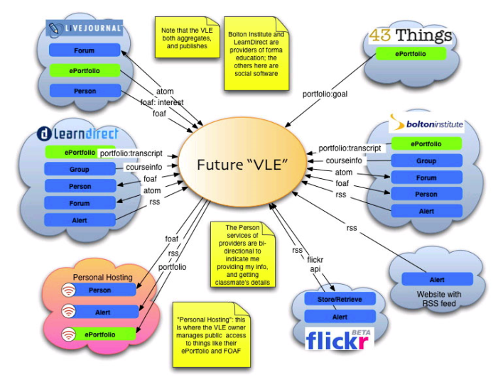
Physical Model

Slide 6
Personal Learning Environment
Best thought of as an ecology in which learning takes place
Is represented with the student thought of as being at the centre
But is in fact a mesh or a web of interconnected students

Slide 7
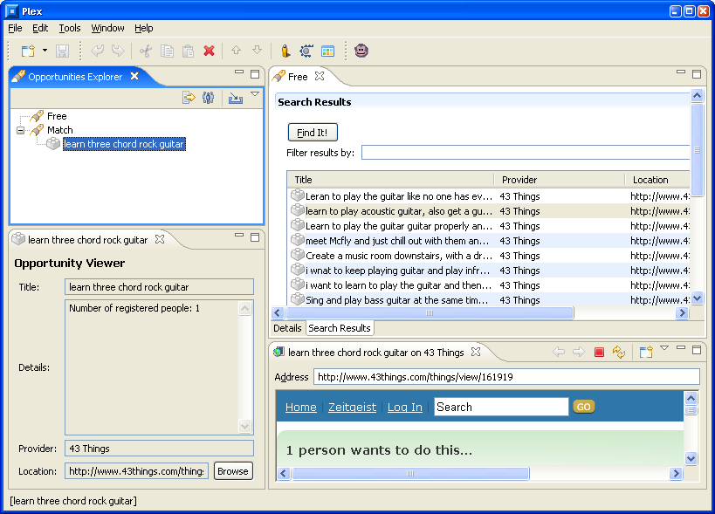
PLEX – Example of an Early PLE

Slide 8
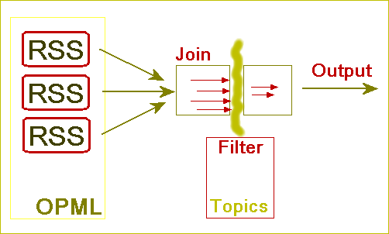
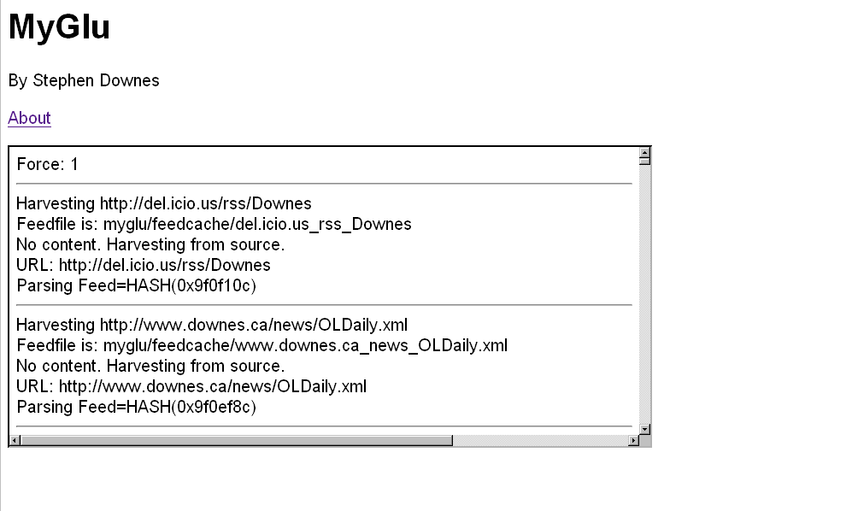
Aggregation and Remixing
http://www.downes.ca/mygluframe.htm

Slide 9
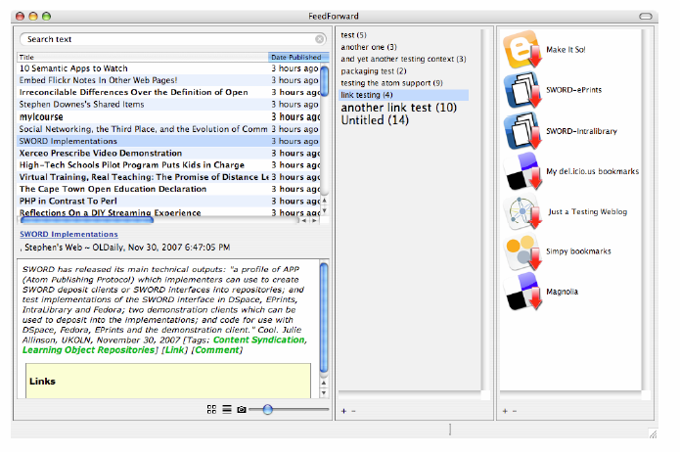
Feed Forward

Slide 10
Connective Knowledge
The knowledge created and shared by an interconnecting community of learners
Knowledge is distributed
Knowledge is created by conversation and interaction

Slide 11
Role of the Learner
Participates and engages in a community
Participation is guided by personal interest and motivation
(Not staged, akin to Lave & Wenger, no hierarchy of interaction, akin to Salmon, Carr)

Slide 12
The Connectivism Course
A good example of such a learning network
There was no ‘right’ way to interact
  No set of processes to master or undertake
  No specific body of knowledge to assimilate
The connectivist course is an example of open sharing

Slide 13
Connectivism
“At its heart, connectivism is the thesis that knowledge is distributed across a network of connections, and therefore that learning consists of the ability to construct and traverse those networks.”
  What Connectivism Is
  http://halfanhour.blogspot.com/2007/02/what-connectivism-is.html

Slide 14
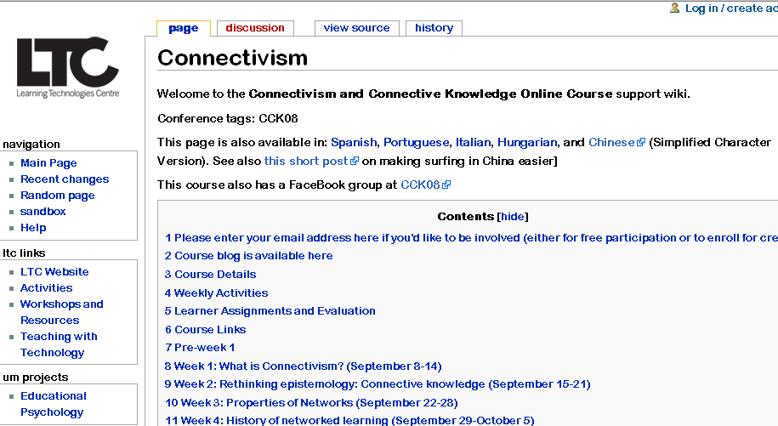
Course Components
http://ltc.umanitoba.ca/wiki/Connectivism
The Wiki…

Slide 15
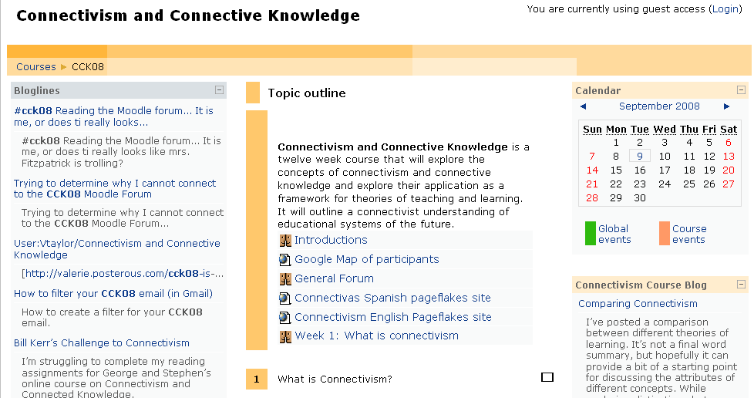
Course Components
http://ltc.umanitoba.ca/moodle/course/view.php?id=20
Course Moodle Forum

Slide 16
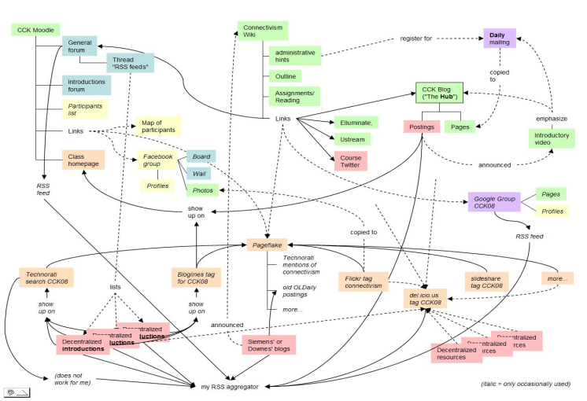
Connectivism as Mesh

Slide 17
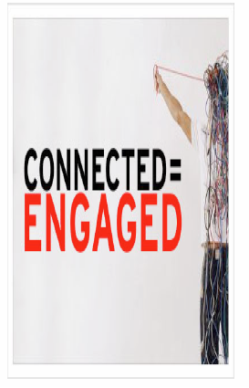
Connectivism as Engagement
There is no curriculum, no theory, no body of knowledge
  (or, more accurately, the curriculum is the McGuffin)
The product is not the knowledge, it is the learner
It’s not that there’s nothing to learn, it’s that it’s complex and needs to be navigated…

Slide 18
active engagement, not passive observation…
  a bit like ANT, but no presumption of commonality, translation…
  a bit like action research, but no presumption of a community of practice
http://carbon.cudenver.edu/~mryder/itc_data/ant_dff.html
http://www.emtech.net/actionresearch.htm

Slide 19
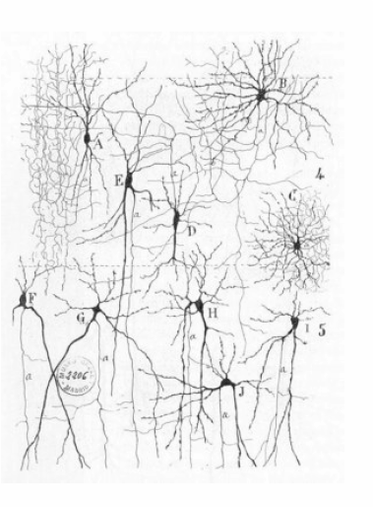
Teachers are nodes, students are nodes
Both teaching and learning consists of sending and receiving communications to other nodes

Slide 20
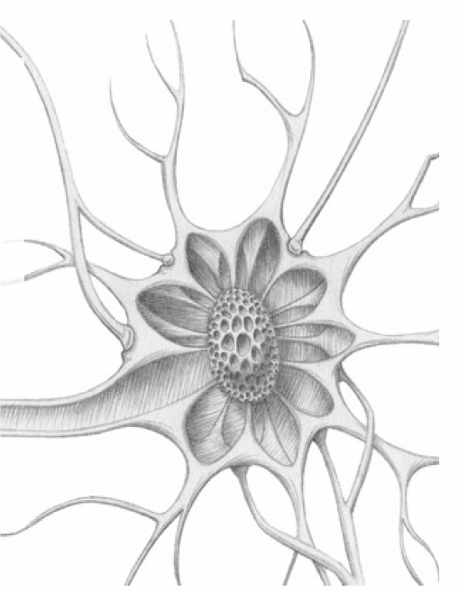
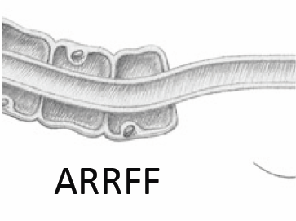
Aggregate
Remix
Repurpose
Feed Forward

Slide 21
Epistemology
Contrast between knowledge transmission and knowledge production
The distributed model draws on learner-centered and constructivists models

Slide 22
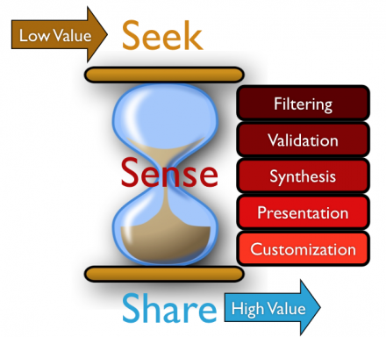
Knowledge Production
http://www.jarche.com/2010/03/sense-making/

Slide 23
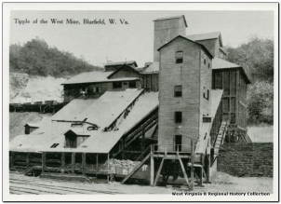
Knowledge Production As...
Mining
  data is like a raw material that is searched for and retrieved. It can be filtered, assessed and remixed
  You add value by creating more and more refined metals, alloys, compounds and materials out of what was there

Slide 24
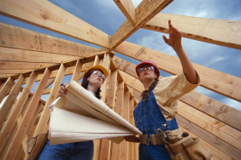
Knowledge Production As...
Construction
  data is like a raw material, but you work with it with your hands, and create something new
  add value to it by giving it form and function. Knowledge construction gives you the ability to create abstractions, to treat raw materials as signs and symbols

Slide 25
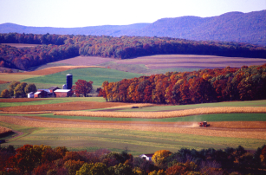
Knowledge Production As...
Growing
  data is like a raw material that serves as a nutrient or growth medium
  The raw material nourishes and contributes to the growth of the organism, which in turn creates something new and unexpected

Slide 26
Different Emphases
Mining – accuracy and purity
Construction – sameness and identity
Growth – creation and creativity
Each depends in some way on the other
  Filtering requires a sense of purpose
  Constructing depends on being able to create
  Growth requires filtering and selection

Slide 27
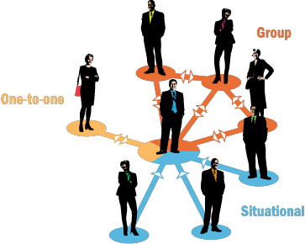
Pedagogy
The next step in such a discussion is usually to describe a theory of social learning, depicting learning as an external process (or set of processes)

Slide 28

Some Forms of Social Learning
Behaviourism / Instructivism
Interaction & Interaction Theory (Moore)
Social Constructivism (Vygotsky)
Problem-Based Learning (Johnasson)
Image: http://ibis.tau.ac.il/twiki/bin/view/Zoology/Lotem/MyResearch

Slide 29
Aspects of Social Learning
Externally-Based Definitions
  Learning objectives, Body of Knowledge
Externally-Based Processes
  Learning activities, Processes and conversations
  Interaction and communication
External Systems
  Classes, networks, groups, collaboration
External Evaluation

Slide 30
If Knowledge is Growth, Then...
Social knowledge is not personal knowledge
Personal Knowledge management = Learning
Social Knowledge Management = Research
The product of the educational system is not a social outcome (knowledge, skill, problem, community) but a personal outcome

Slide 31
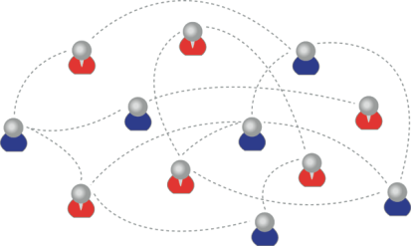
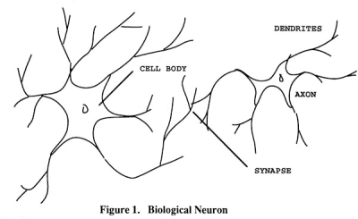
Personal Knowledge
We are using one of these
To create one of these
Personal knowledge consists of neural connections, not social connections

Slide 32
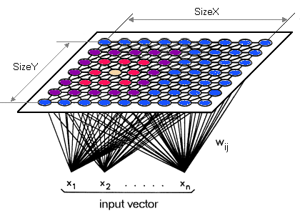
Learning Outcomes
Simple vs complex – text vs network
“Paris is the capital of France”
vs

Slide 33
Learning Outcomes (2)
It’s the difference between:
‘Knowing’ that ‘Paris is the capital of France’ or even some sort of ‘knowing how’ (these are external definitions of this knowledge) and
What it feels like to have geographical knowledge; what it feels like to be a speaker of a language
Learning a discipline is a total state and not a collection of specific states

Slide 34
Learning Outcomes (3)
Learning a discipline is a total state and not a collection of specific states
It is obtained through immersion in an environment rather than acquisition of particular entities
It is expressed functionally (can you perform ‘as a geographer’?) rather than cognitively (can you state ‘geography facts’ or do ‘geography tasks’?)

Slide 35
Learning Outcomes (4)
We recognize this
By perfomance in this
There are not specific bits of knowledge or competencies, but rather, personal capacities
(more on this later)

Slide 36

Success Factors
What sort of decentralized network will best support learning-as-growth?

Slide 37
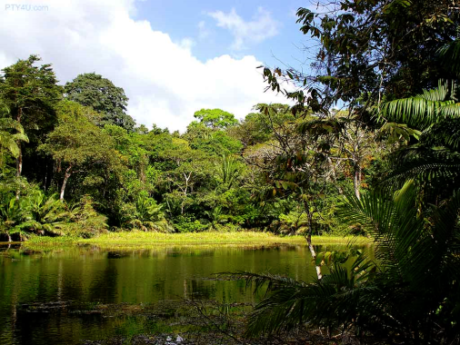
Diversity
You need a mixture of materials – you cannot grow organically from carbon alone, or water alone

Slide 38

Openness
Closed systems become stagnant
Raw materials are depleted
The system becomes clogged with the ‘creative product’ of its members

Slide 39
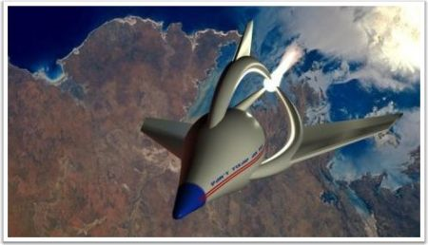
Autonomy
The simple cloning of entities does not allow for progress or development
Each individual entity must manage its own grown in its own way

Slide 40
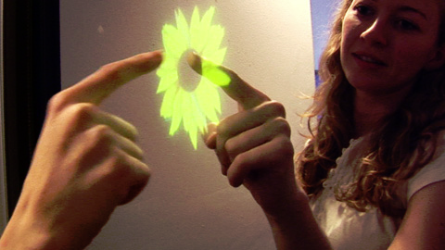
Interactivity
A system cannot grow unless its parts interact – flowers need bees, cows need grain, beavers need trees
Growth is created not by accumulation but by flow, by constant activation and interaction

Slide 41
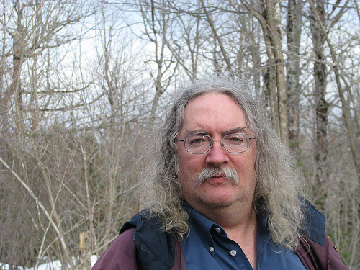
Stephen Downes
http://www.downes.ca

