Slide 1
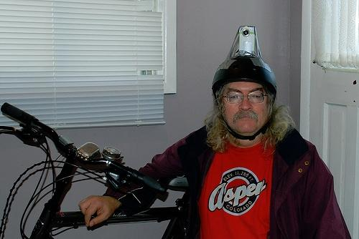
Trends in Personal Learning
Stephen Downes
February 2, 2010

Slide 2
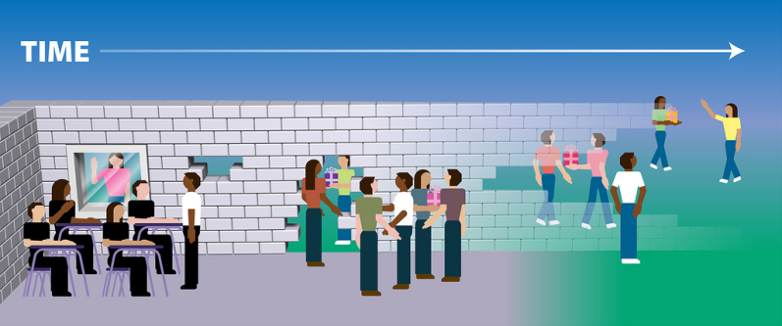
Personal Learning
http://www.flickr.com/photos/courosa/3292377555/
http://www.flickr.com/photos/courosa/3292377555/
Notes:
Individual – Network – Group
Self-study – Cooperation – Collaboration

Slide 3
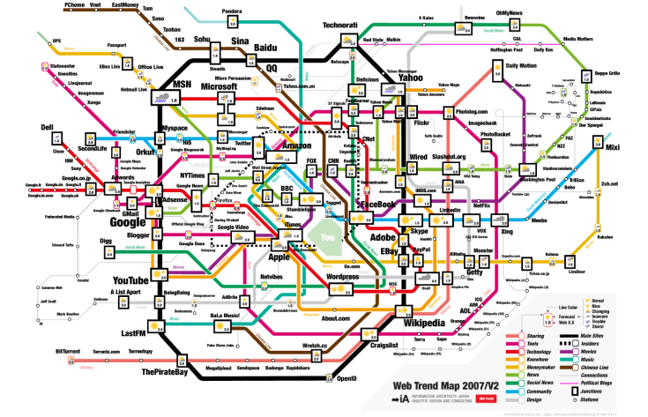
Overall Trends
http://strangemaps.wordpress.com/2007/07/21/153-a-subway-map-of-web-trends-20/
Notes:
Simplicity - easier
Invisibility - embedded
Ubiquity - ambient
Personalization - yours

Slide 4

Education
http://www.impactlab.com/2008/07/14/cancer-reduced-in-population-with-higher-education/
Notes:
Education is fundamentally a process of communication (learning is fundamentally a process of growth)
As such, educators have over the years attempted to keep the tools invisible, and to focus on the teaching
This focus is not simply content, but includes, as Terry Anderson says, presence
To learn a discipline is immersion in community

Slide 5
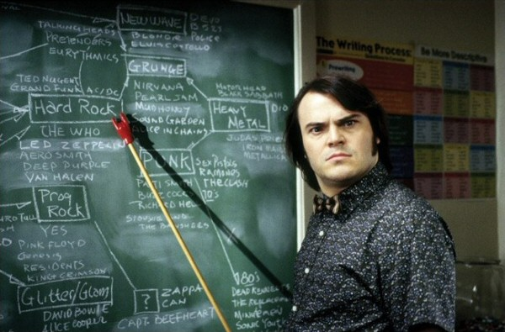
Basic Tools
http://elearning.unbc.ca/doku.php?id=blackboard_student_faq
Notes:
These tools remain staples:
Books and other reading implements
Notepads and other writing implements
Blackboards and other demonstration tools
Communication environments such as the classroom
A facilitator or teacher

Slide 6
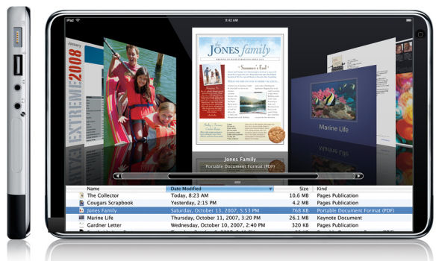
Personal Access
http://www.4winmobile.com/forums/news/18917-apple-ipad-tablet-device-rumoured-2009-a.html
Notes:
Need to mention in light of the whole computer lab phenomenon, 1-to-1 initiatives, etc.
In 1998, I called it the PAD - personal access device - and we’ve come close…
We’ve had the Tablet, we’ve had the OLPC, we’ve had the Blackberry, and more
We also have the wall-area display (WAD)
Don’t forget, also, the personal space online – blog, e-portfolio, etc.

Slide 7
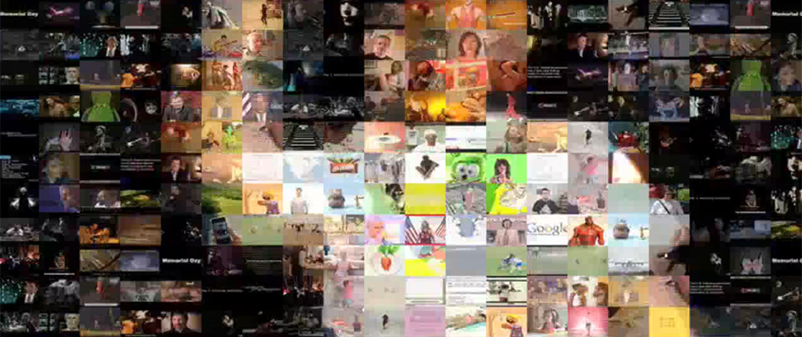
Creativity
http://www.googlelabs.com/
http://www.idsgn.org/posts/google-experiments-in-digital-creativity/
http://www.googlelabs.com/
Notes:
Input tools – cameras, video recorders, cameraphones, screencams, etc
But also editing tools – offline (eg. Audacity, Premiere Elements, Camtasia) but also online (eg. Piknik, Gliffy & many others)
Some single purpose – eg. Lolcats
Some API mashups, like pipes , or as pictured here, Google labs
Haptics, geolocation, etc

Slide 8
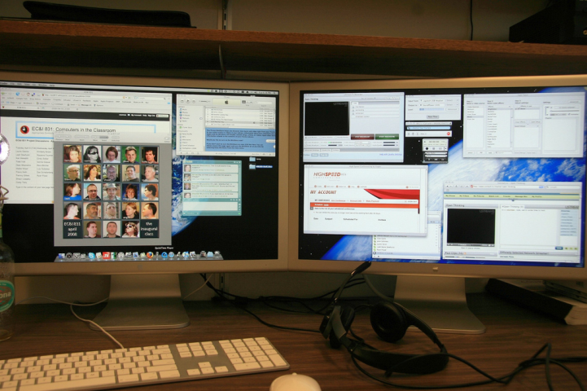
Presence / Presentation
http://www.flickr.com/photos/courosa/2399470001/
Notes:
First, increasingly sophisticated DIY tools for video, simulation, multimedia, more
Second, even more sophisticated tools for specialists (that allow them to make increasingly sophisticated DIY tools)
Interestingly - DIY HTML didn’t become too difficult - it became unnecessary
Events like this becoming commonplace
Internet TV, radio, podcasts
Streaming – Ustream, Skype
Video Obama on Youtube
Cisco MCU
Presence – very important

Slide 9
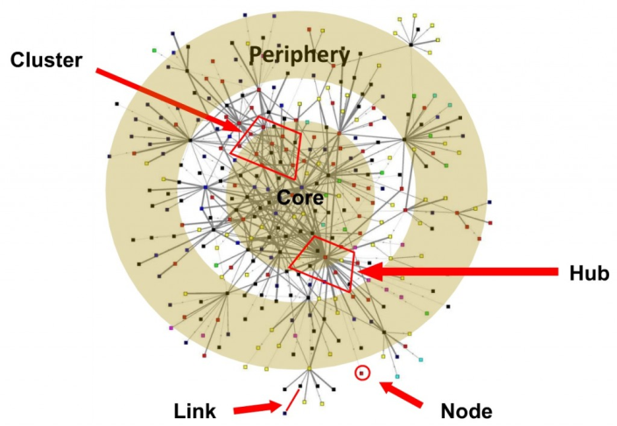
Community and Network
http://blog.wiserearth.org/using-the-network-lense-mapping-your-community/
Notes:
Mentioned groups vs networks – we are seeing m,uch more network formation
Facebook, social networks, Flickr, Twitter, etc.
Note the structure – it’s not a single entity – varying levels of participation
The connectivist MOOC format has taken off
Characteristic of less formal learning communities in general
Still site-based – but this may change, hard to say
Don’t forget to blend this idea with the preceding – personal device, personal space, presentation, etc

Slide 10
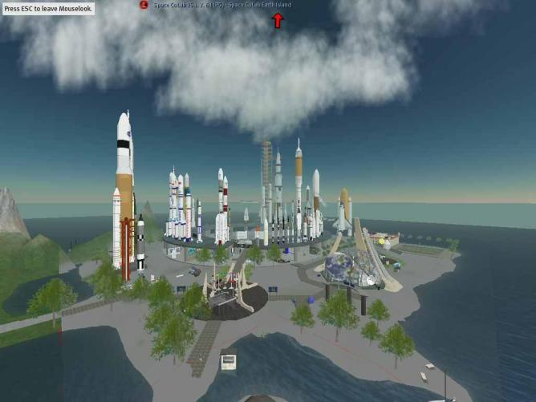
Immersion and Virtual Reality
http://mindpractice.blogspot.com/2008/02/virtual-reality-is-reality-says-famed.html
Notes:
Includes simulations, games, applications and dashboards, etc.
Moving from predefined (decision tree) to open-ended environments
Again – mix with preceding – the idea is to have a personal space, to create, to hjave a presence, to connect and communicate
There is a growing wave of immersive simulations being developed
Still in the second (specialist) world - but will be huge when it becomes DIY
Also – whoever develops the 3D immersive simulation (use the glasses you got from Avatar) will have a huge hit on their hands

Slide 11
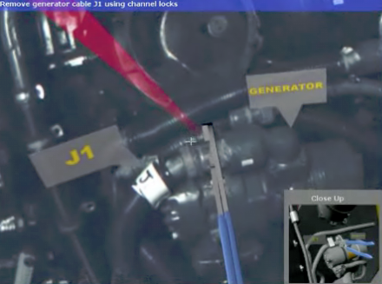
Augmented Reality
http://www.psfk.com/2009/10/marine-mechanics-work-50-faster-using-augmented-reality-goggles.html
Notes:
First iteration (besides military HUD) is the GPS
Real estate, tourism, etc
Supported via goggles or on a mobile – eventually contact lens or implant
Again – don’t just think passive consumer – people will create their own augmented realities (there are already alternate reality games)

Slide 12
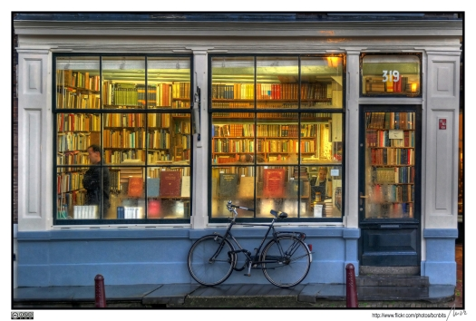
Toward Personal Learning
http://www.psfk.com/2008/08/personal-learning-environments.html
Notes:
Where does ‘the class’ fit in all this?
The concept of the class
Is still basic to education
Still is determined (at lower levels) by age rather than inclination or achievement
Is sometimes disguised (as, eg., the cohort)
I think there are emotional factors holding us to the idea of the class
The feeling is, without the group, we will atomize - nobody is willing to risk that

Slide 13
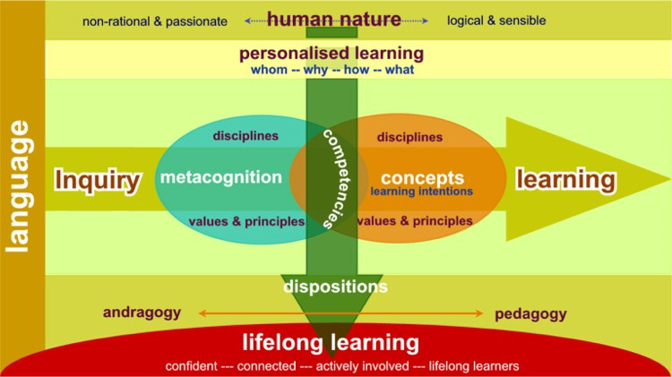
Organizing Learning
Notes:
In 1998 I predicted a shift in the fundamental unit of education:
From the class
To the topic
This is being realized today in the development of competences and competency-based systems (eg. TenCompetence, HR-XML, Europass)
To the task
Learning is becoming more project focused, while accreditation is being based more on credentials and competences
Not so much common core, but personalized
http://www.i-learnt.com/Paradigm_Competencies.html
The selection of learning resources will not be a stand-alone activity, but will be embedded in other activities (think, again, of how we learn in the context of a game)

Slide 14
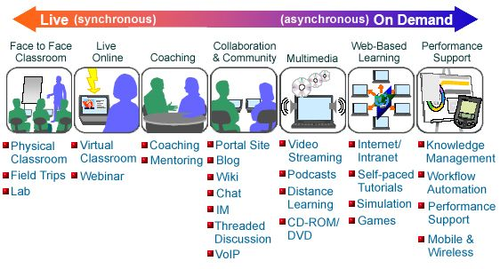
Learning Activities
http://www.cognitivedesignsolutions.com/ELearning/BlendedLearning.htm
Notes:
delivery systems today Are essentially content delivery systems
Are based on a publication model of storage and distribution
Are institutionally based
Tend to focus on delivery to classes
Topic delivery systems…
Are like game module (or level) delivery systems, or are like (content) resource delivery system
The original intent was that such systems would delivery learning objects
These will deliver into other environments – creations, presentations, networks, simulations, environments

Slide 15
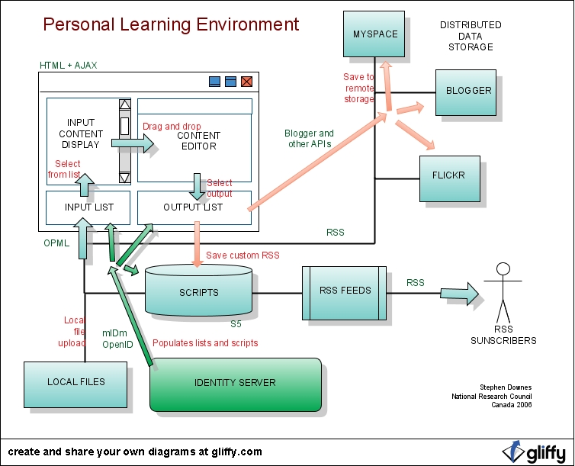
Personal Learning Environments
http://edtechpost.wikispaces.com/PLE+Diagrams
Notes:
PLE: Is based on the idea of personal access to resources from multiple sources
Like conferencing, is based on a personal we presence
Focuses on creation and communication rather than on content completion
Educational institutions need to think of their offerings as entities that will be a part of, and interact with, the larger environment

Slide 16
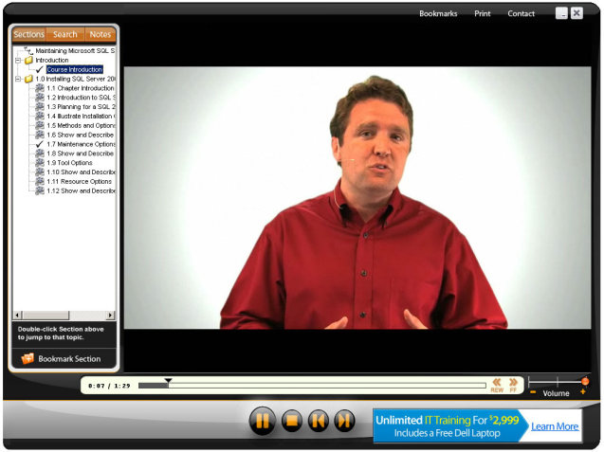
Learning Management
http://www.cbtplanet.com/librarysuite-corporate-it-cbt.htm
Notes:
Resources will be offered:
Student-selected, from a ‘library’ (which you share with other ‘publishers’)
Event-driven, by the system, which will offer a resource at an appropriate time
Time-driven (think of Tony Hirst’s RSS-driven course)
Instructor (or mentor, or coach) driven - as in a blog offering or RSS feed
These resources need to:
Be able to learn about the environment they are being offered in
Be able to learn about the student
And to get this information, not just locally, but from anywhere on the internet
Communicate state and other information to other (authorized) systems and services

Slide 17
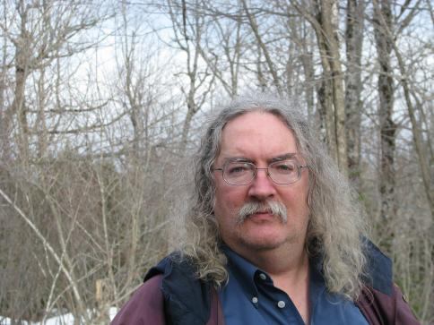
Stephen Downes
http://www.downes.ca

