Slide 1
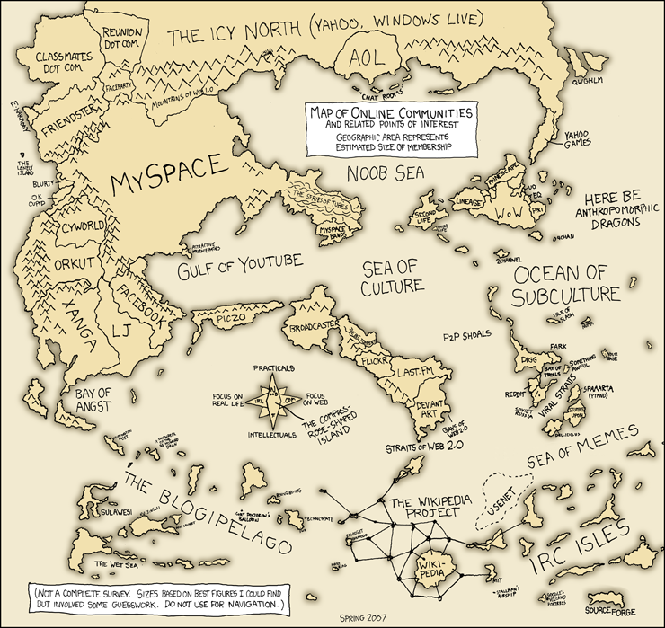
Virtual Worlds in Context
Stephen Downes
May 10, 2007
Background: http://xkcd.com/c256.html

Slide 2
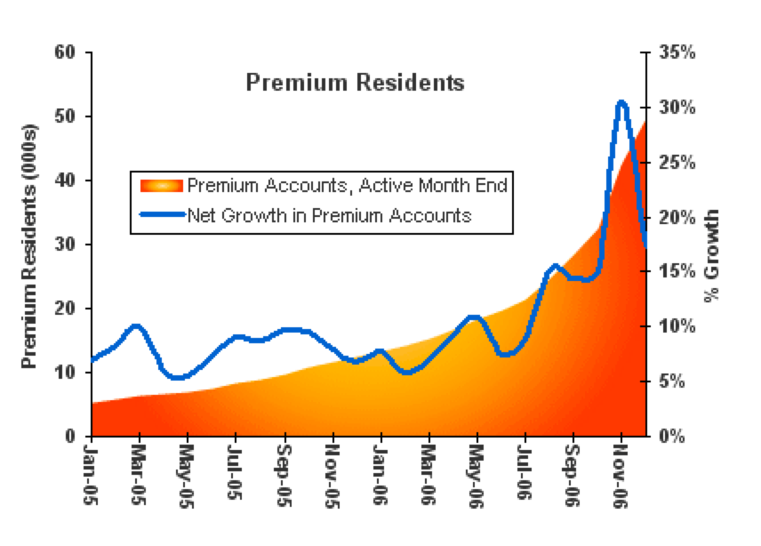
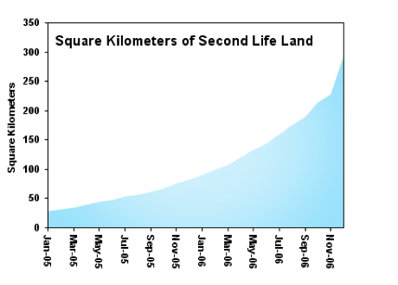
The Second Life Phenomenon
http://secondlife.com/whatis/economy-graphs.php

Slide 3
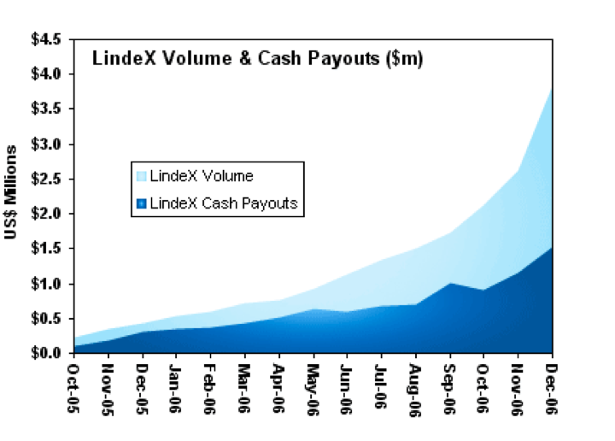
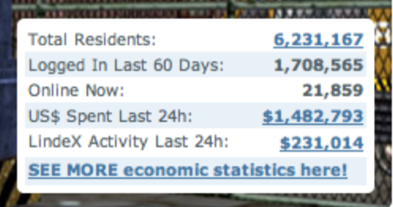
A (mostly) economic phenomenon
http://secondlife.com/whatis/economy-graphs.php

Slide 4

80 percent of active internet users will have a ‘second life’ by 2011???
That’s what Gartner says…
Of course they are sponsoring a symposium on this…
http://home.businesswire.com/portal/site/google/index.jsp?ndmViewId=news_view&newsId=20070424006287&newsLang=en

Slide 5
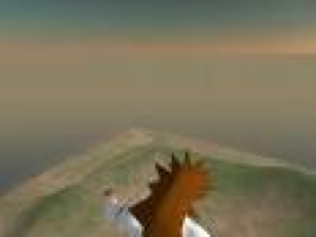
Some Edu Initiatives…
“Schome will NOT be another ‘virtual learning space’, it will involve physical spaces for learners”
Schome
(Not school, not home…)
http://www.schome.ac.uk/

Slide 6
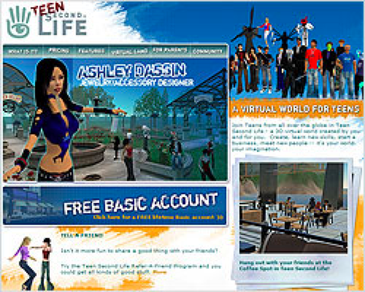
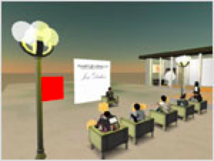
Teen Library in Second Life
Through special permission from Linden Lab, the creators of Second Life, a select group of librarians and other adult educators have been given access…
It’s all so familiar…
http://plcmc.org/teens/secondlife.asp

Slide 7
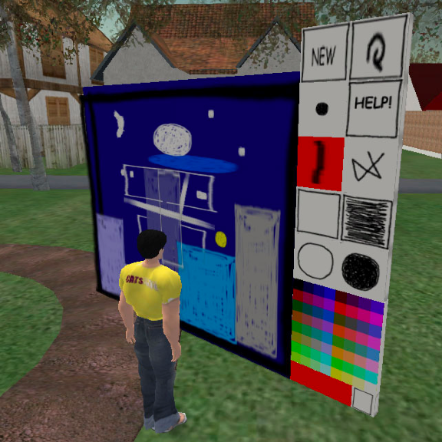
Research
grad students
accessibility
LMS-2L mash-ups
cool tools
2L in healthcare
Etc…
[SLED] Second Life Educators
http://www.simteach.com/forum/index.php

Slide 8

http://www.storyofmysecondlife.com/?p=116
CAVE
Center for Advanced Virtual Education
But…
But…
It’s all so derivative, isn’t it?
Now! The ridiculousness of this does not escape me. I’m in my presentation, pointing my audience to the online wiki handouts, via a presentation slide. It points to a web URL that will link SL users to teleport to my office. There you can click the drawer for the current presentation, which links you back out to your browser. Dave Warlick
http://davidwarlick.com/2cents/2007/05/09/what-im-doing-in-the-cave

Slide 9

Discovery Educator Network…
If you have a brand, you’re in Second Life…
http://discoveryeducatornetwork.com

Slide 10
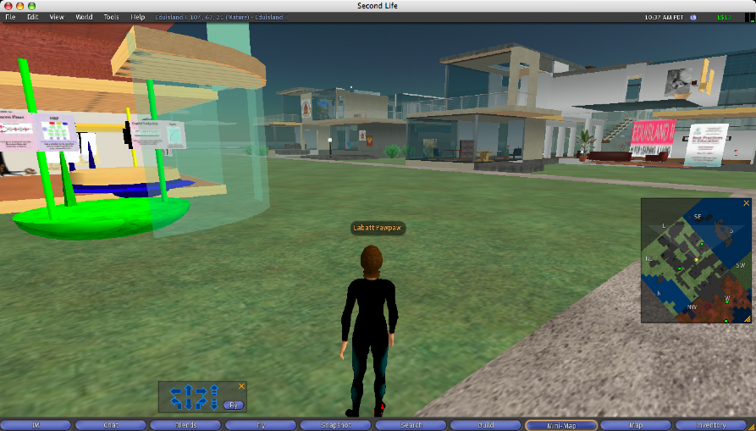
Encountering Second Life…
It’s like a scene from Star Trek
until you hit the casinos
(You know, where the flying heechees have eliminated all life…)

Slide 11
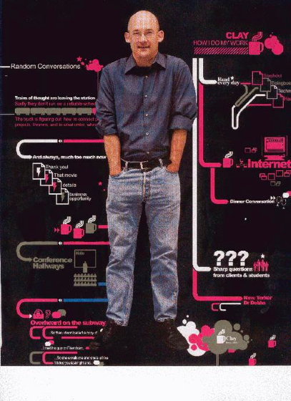
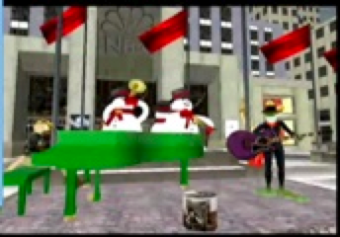
Questioning the numbers…
‘A story too good to check…’
‘Second Life is largely a
"Try Me" virus…’
‘a service that appeals
to tens of thousands of people, but in a billion-person internet, that population is also a rounding error.’
Clay Shirky
http://valleywag.com/tech/second-life/a-story-too-good-to-check-221252.php

Slide 12
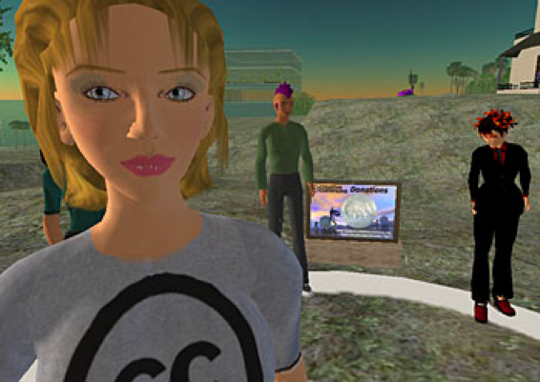
Why the big story?
Shirky:
people don’t remember the history of VR
a 3D reality is conceptually simple
the media loves the ‘content is king’ story
the current mania is largely push-driven
I ask….
Where are the bottom-up user-driven initiatives?
Where is 2L wikipedia? 2L OSS? Why was copybot killed?

Slide 13
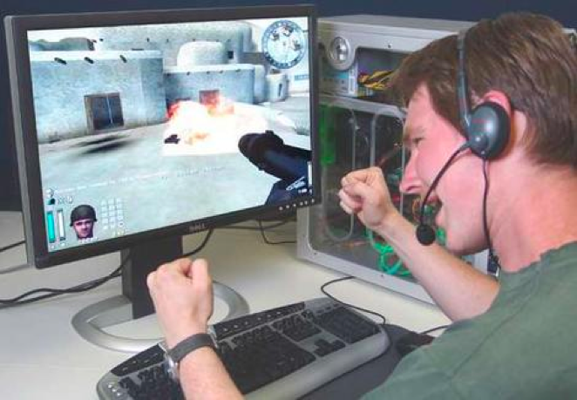
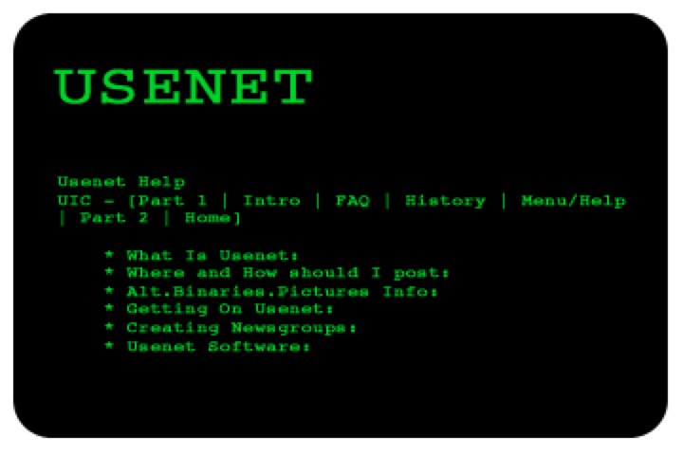
Some history…
Two sides of cyberspace:
The ‘gamer’ side
The ‘text’ side

Slide 14
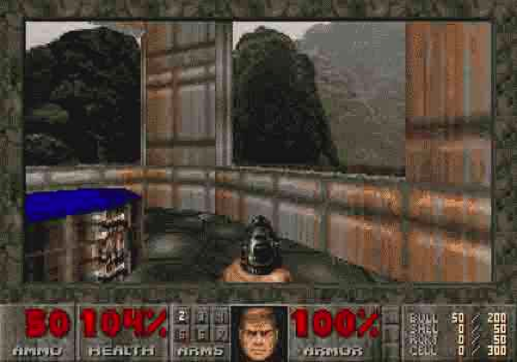
What is Second Life, really…?
Despite being ‘not a game’ (which appeals a lot to the text people) it is the latest inheritor of a long line of online games.
the 'hero' in the gaming environment is the same as the 'student' in the learning environment and the 'individual' in the real environment.
http://www.downes.ca/post/40010

Slide 15
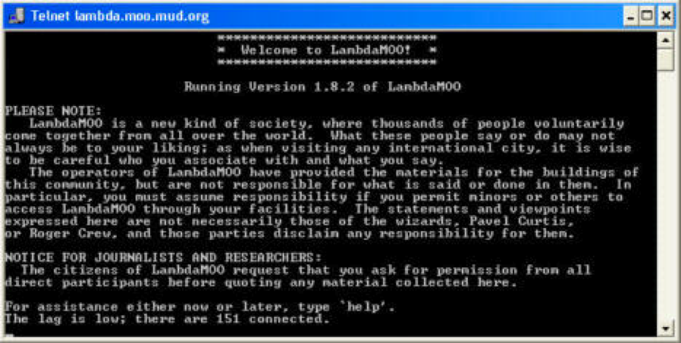
Virtual Worlds Online…
MUDs, MOOs, MUSEs, DIKUs

Slide 16
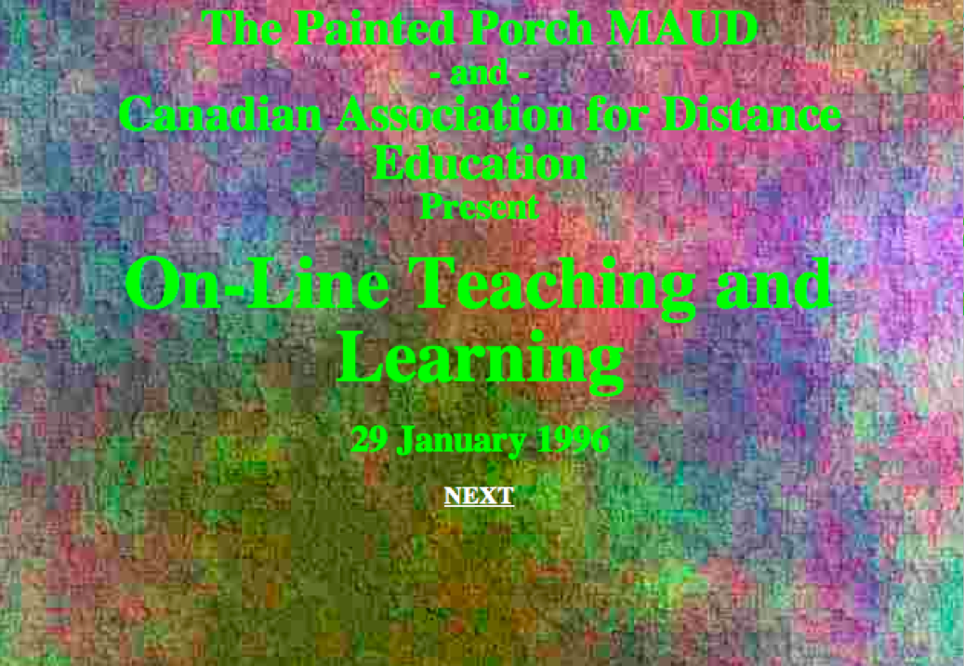
The Multi-Academic User Domain (MAUD)
The inheritors…
Diversity University…. Walden University
Terry Anderson at Athabasca University

Slide 17
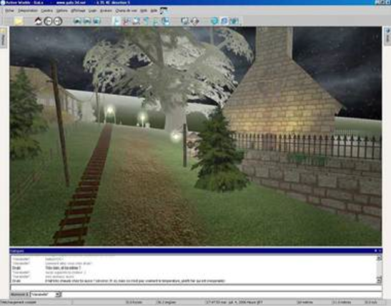
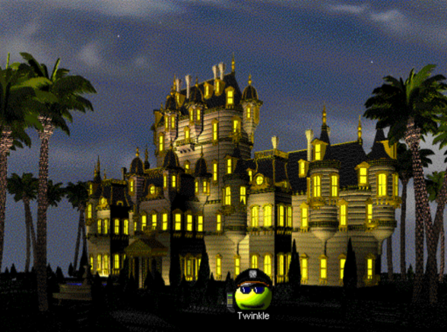
More VR….
The Palace
Active Worlds

Slide 18
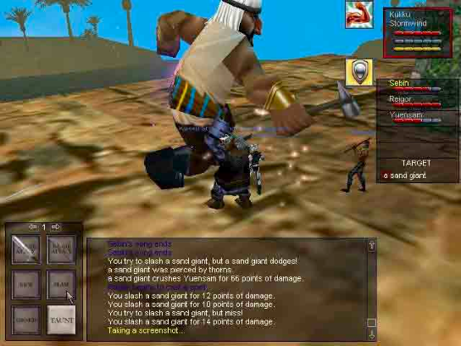
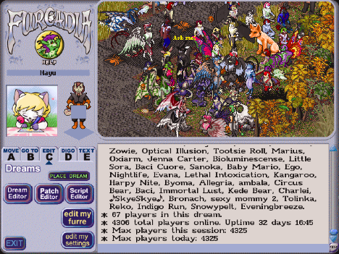
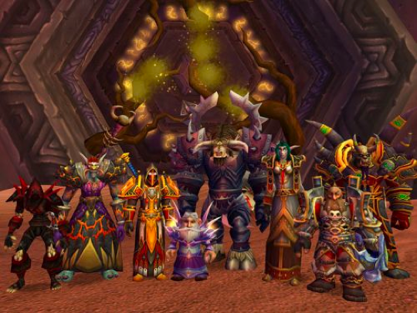
And more VR….
Everquest
Furcadia
World of Warcraft

Slide 19
Five ‘laws’ of virtual reality…?
Gartner
* First Law: Virtual worlds are not games
* Second Law: Every avatar is a real person.
* Third Law: Be relevant and add value.
* Fourth Law: Contain the downside.
* Fifth Law: This is a long haul.
Fashion!
Bots
Casinos
Porn
Crash

Slide 20
It’s helpful to recall a guy named David Noble…
Yes, that David Noble…
Let’s look at the real issues of Second Life
"universities are not only undergoing a technological transformation. Beneath that change, and camouflaged by it, lies another: the commercialization of higher education".
Digital Diploma Mills
www.firstmonday.org/issues/issue3_1/noble/

Slide 21

Who owns Second Life?
‘Babbage Linden’ tells us people “own” their content…
… as long as you keep paying your rent
… and paying for your identity

Slide 22
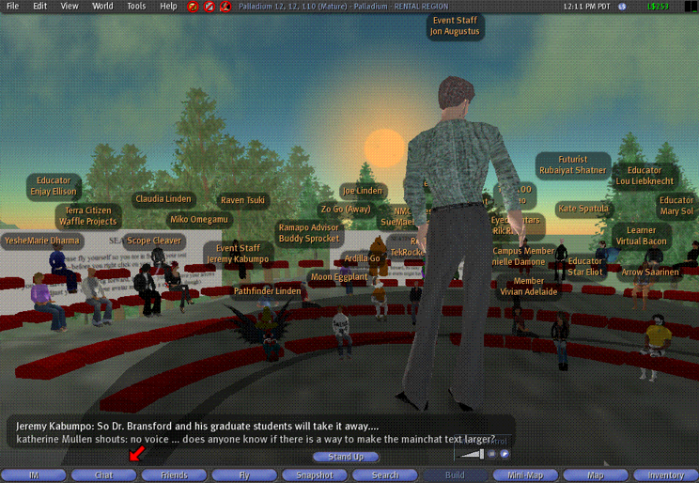
Can Second Life Scale…?
Project Open Letter
http://www.projectopenletter.com/
http://www.dmwmedia.com/news/2007/05/04/analysis-reality-is-hitting-second-life-hard

Slide 23
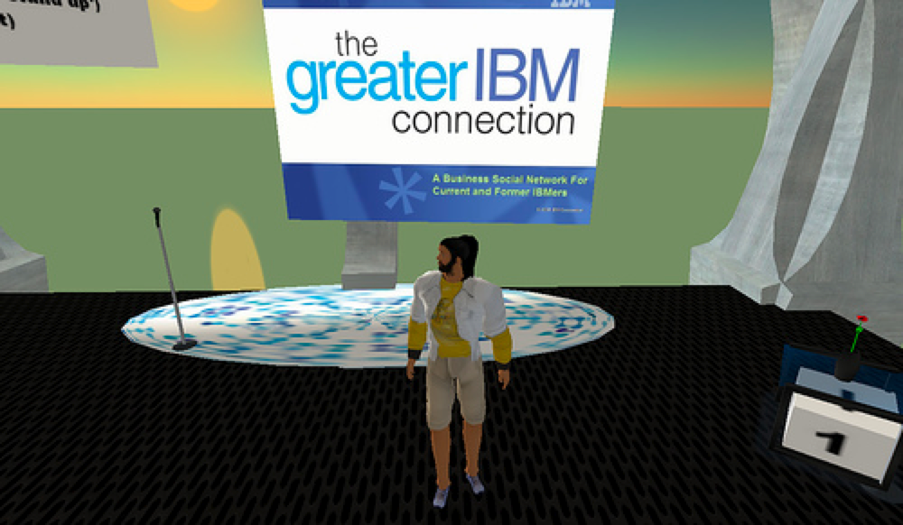
What About Interoperability…?
Open Source Server?
IBM call for a ‘Virtual Planet’
http://www.pcworld.com/article/id,131511-pg,1/article.html
http://www.intermud.org/

Slide 24
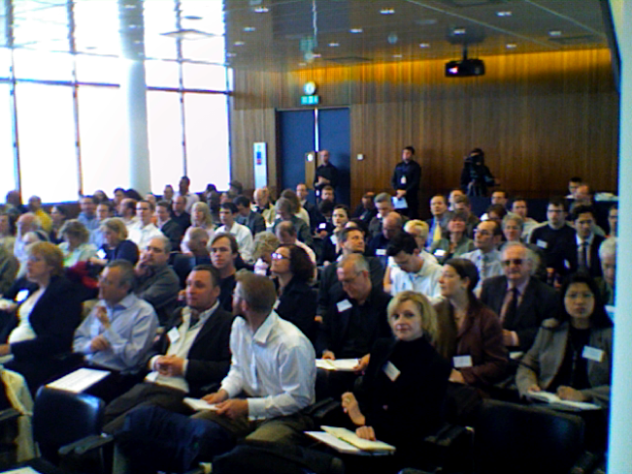
What’s really happening?
This…
Looks like this

Slide 25
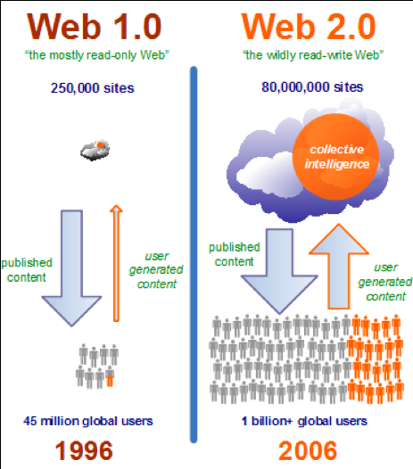
Second Life taps into a latent conservatism that serves their interests and helps people feel comfortable in familiar surroundings…
It’s so not Web 2.0
Contra Ian Davis
pedagogy doesn’t change
power structures don’t change
the elite remains the elite
Where is data portability? Where are open standards?
http://www.rojo.com/mojo/4110

Slide 26
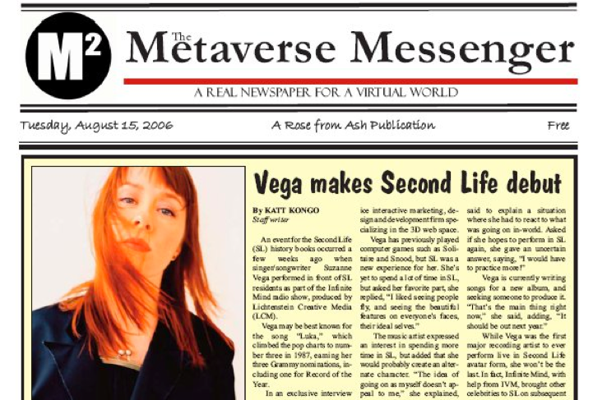
Where’s the ‘there’ there?
Streaming of videos?
Standing in front of a class?
Avatars?
Rehearsal?
Virtual Worlds vs Simulations

Slide 27
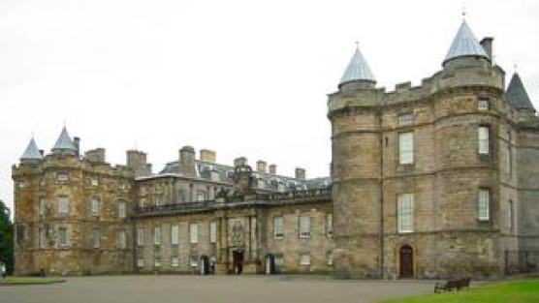
Hamish MacLeod
Why Second Life?
‘Cross-Platform’
‘Openness and Neutrality’
‘Manifest involvement with education’
Are these unique to Second Life?
To virtual reality?

Slide 28
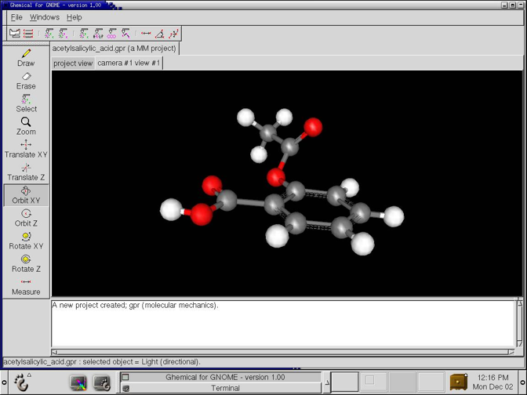
Enhanced visualization
Rapid development potential
International communication
Sense of presence
Why
Second
Life?
Joanna Scott
Nature Publishing Group

Slide 29
None of these is unique to Second Life
2L isn’t even particularly good at some of them…
Compare, for example, with phenomena like Instant Messaging, MySpace, YouTube, Skype, Wii…
“We would never consider placing our articles in Second Life… it’s just pointless.” - Joanna Scott

Slide 30
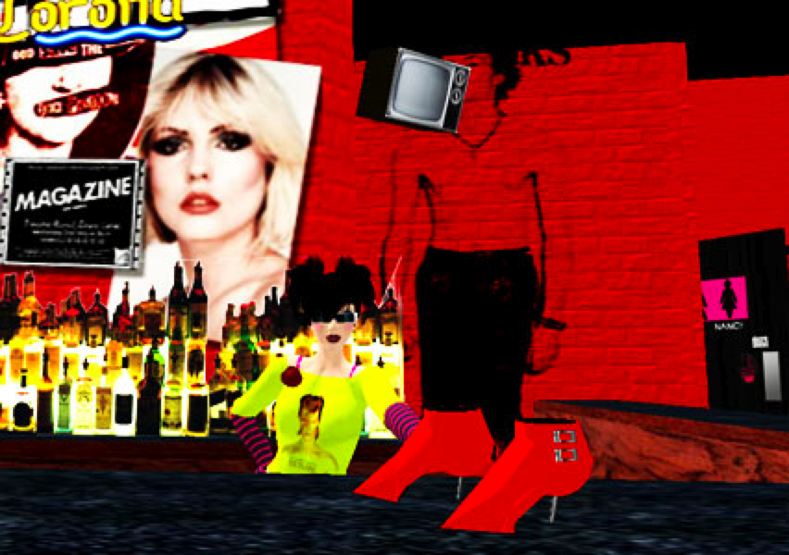
So what’s the real point of 2L?

Slide 31

Onder Skall
* 1. Real money must move in and out of the “virtual” economy freely.
* 2. Users must be able to create unique content and retain ownership over it.
* 3. The world must be persistent, and the users able to change it.
http://slgames.wordpress.com/2007/04/12/alternatives-to-second-life-uber-edition/#more-340

Slide 32
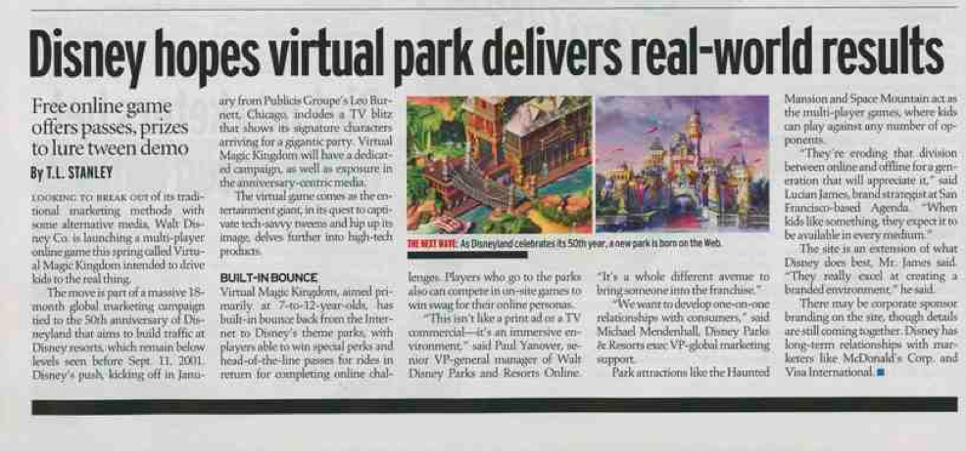
Is this what online learning has been waiting for?
Commercial transactions?

Slide 33

Private ownership?

Slide 34
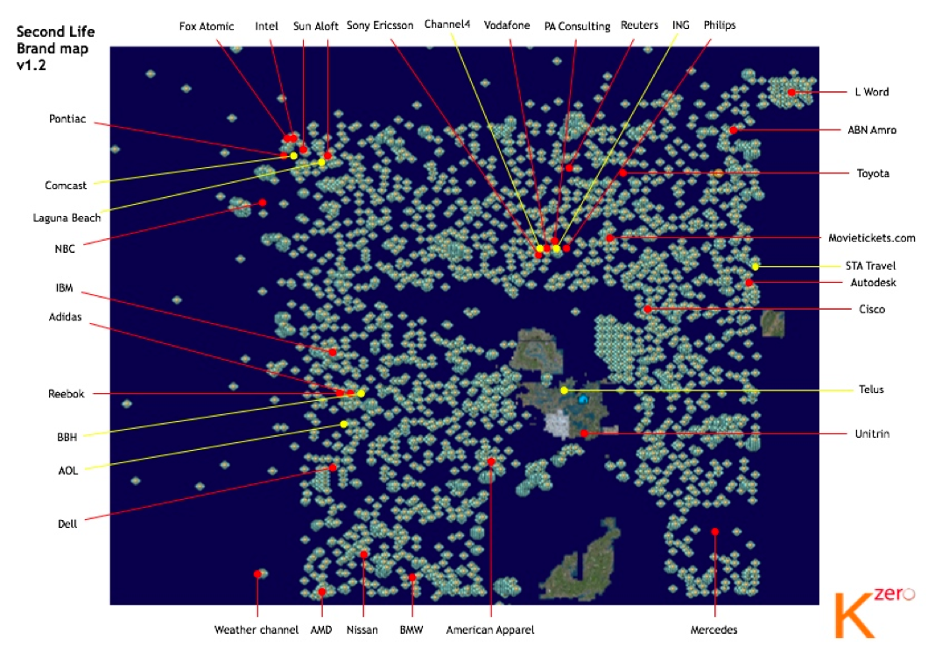
Silos and walled gardens?
Built by companies and institutes that can afford ‘islands’
http://www.kzero.co.uk/blog/?p=430

Slide 35
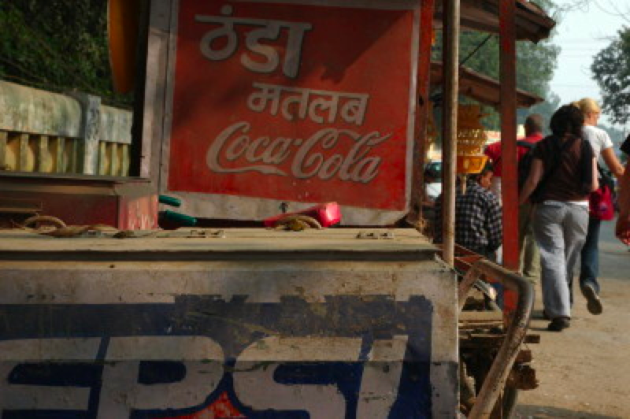
Branding?

Slide 36
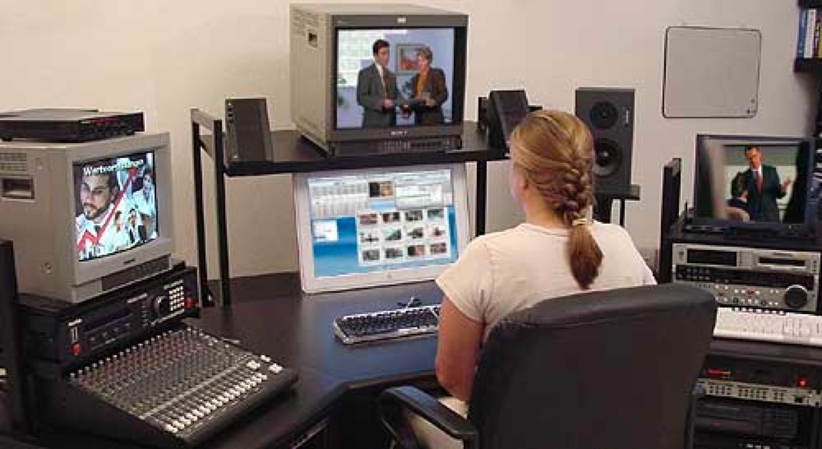
Proprietary technology?

Slide 37

An identity fee?
http://blog.secondlife.com/2007/05/04/age-and-indentity-verification-in-second-life/

Slide 38
I submit….
That the future for virtual reality is (must be?) exactly what Second Life isn’t…
distributed hardware, distributed ownership
open source - not proprietary technology
noncommercial (or at least, for public education, a noncommercial alternative)
diverse and democratic

Slide 39
A virtual world more like the web…
where we create out own worlds
where we can visit from place to place
anonymously
or as an avatar
where we can create a learning commons

Slide 40

http://www.downes.ca

