Slide 1

Distributed Digital Rights Management
Stephen Downes, National Research Council
ODRL Workshop, April 23, 2004

Slide 2
What is DRM?
Digital – specific to digital resources, such as electronic documents and media
Rights – concerned with ownership and the terms and conditions of use
Management – concerned with creating mechanisms to enable or prevent use

Slide 3
Aspects of DRM
Expression – the description of the resource, ownership of the resource, and the terms and conditions of use
Authentication – verification that the person using the resource has the right to use the resource
Protection – means, such as encryption, to ensure only authorized users have access

Slide 4
Where DRM is Applied
Resource – a particular document or digital resource – for example, a document may be locked or encrypted
Access Point – a content server, such as a website – for example, a website may require a login
Network – the connections between servers – for example, ATM network

Slide 5
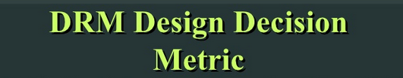
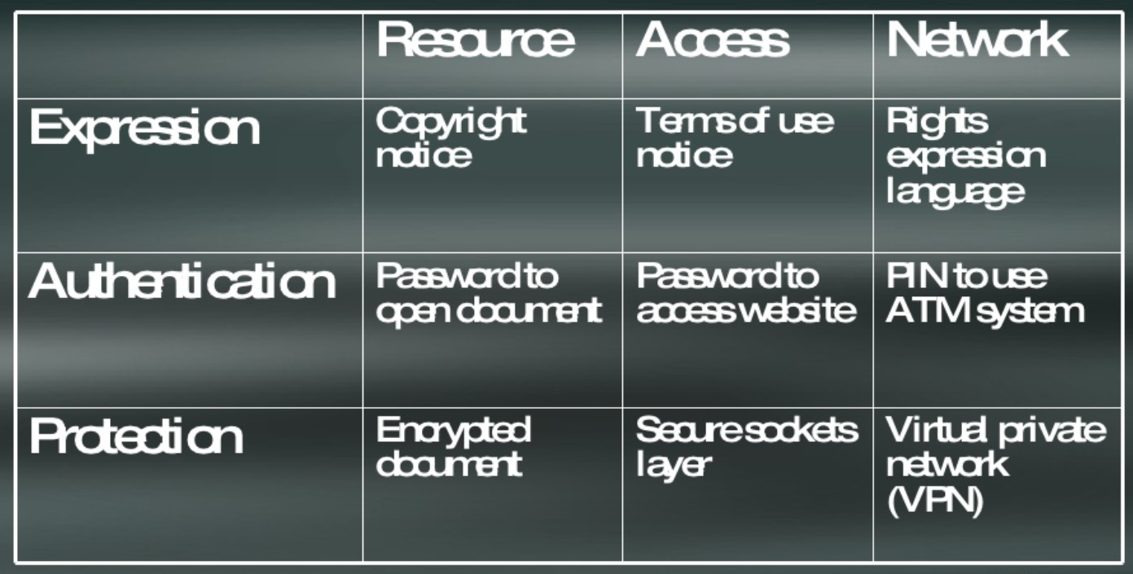

Slide 6
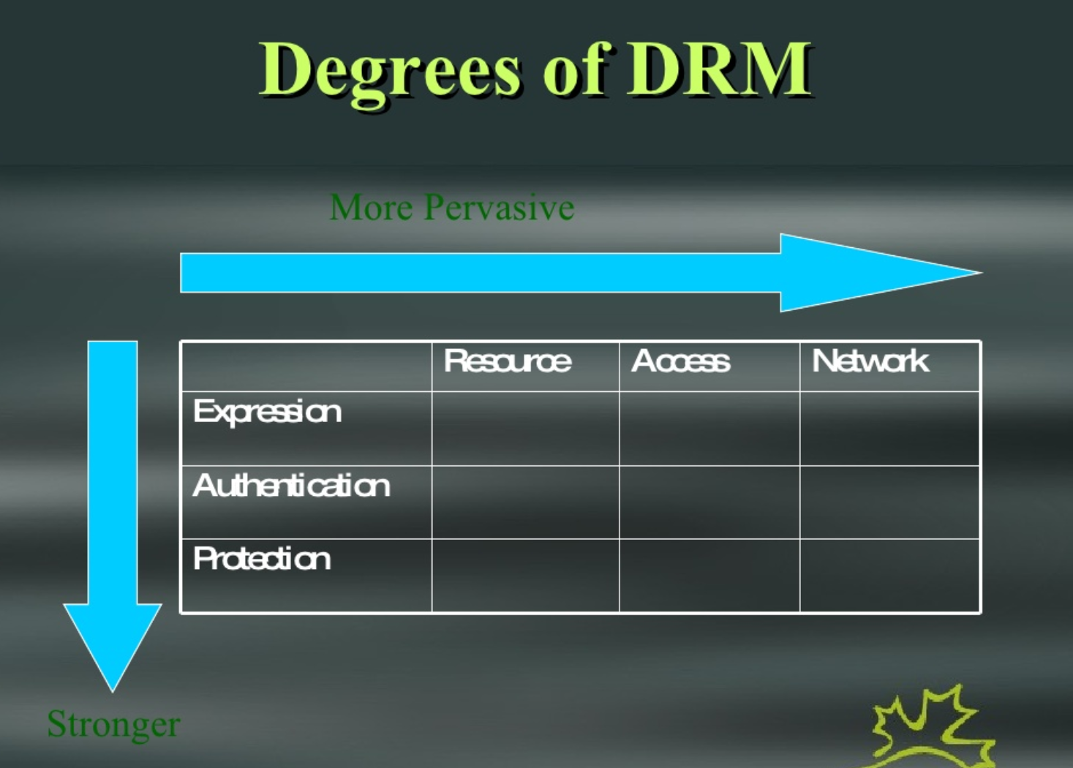

Slide 7
Weak DRM
Expression: in the resource only
Authentication: none
Protection: none
Examples: web page with a copyright notice, book with a copyright page, property with a ‘keep out’ sign

Slide 8
Strong DRM
Expression: in the resource, access point, or network
Authentication: network – single login
Protection: network wide
Example – the ATM system requires that you provide credentials to use the system, and encrypts all data and communication

Slide 9
Issues in DRM
DRM is too weak – in networks like the web and Napster, expression alone is insufficient to ensure that rights are respected
DRM is too strong – proposed DRM systems require a unique userid (eg., MS Passport) and fully secured network (eg., Rights management server, ‘trusted’ applications), violate privacy, fair use

Slide 10
The Middle Way
Expression – supported at the network level through the use of a rights expression langauge
Authentication – supported at the access level through the use of keys
Protection – supported at the document level with locks or encryption

Slide 11
Critics from Both Sides…
It’s too strong – advocates of open content fear any DRM system will prevent people from freely sharing content
It’s too weak – commercial providers want stronger protection, such as authentication at the network level, to prevent file sharing

Slide 12
Responses
It’s weak enough – to use free resources, rights must be declared, and any further level of authentication and protection is at the discretion of the resource owner
It’s strong enough – a key system makes it difficult to obtain unauthorized access to content, but leaves it easier to buy content than to steal it

Slide 13
What Causes File Sharing?
When DRM is too weak – there is no incentive to go through the extra work and cost to pay for content; commercial content is not viable
When DRM is too strong – free content is not viable, and the transaction cost is too high, so it is easier to look elsewhere for the same content

Slide 14
DRM Principles
Open Standards – the mechanisms for expression, authentication and protection can be used by anyone
Open Network – any agency or entity may provide any of the services provided by the network
Open Marketplace – and agency or entity may buy or sell on the network

Slide 15
Rights Expression
Defined at the Network Level
  A rights expression language (REL) is used
  Current support for ODRL because it does not create a cost – XrML, DRML are options if they are royalty free
  A mechanism for expressing digital rights expression is supported such that these are available anywhere in the network

Slide 16
Rights Models (1)
HTML
LOM
A resource (e.g., HTML) is described by Learning Object Metadata, with points to a rights model
ODRL

Slide 17
Rights Models (2)
A single ODRL rights model may describe numerous resources
HTML
ODRL

Slide 18
Rights Models (3)
<lom>
<rights>
…
<description>
http://…:model42
</description>
LOM
ODRL
LOM metadata points to the location of the rights metadata

Slide 19
Two Types of Right Expression
Offer - this is the proposal that a vendor puts in front of potential customers. An offer is provided by a vendor who wants to sell (or give) you something
Agreement – this is the offer that was accepted by the customer, and is like a contract. Agreements may be held by a third party, who acts as a registrar or notary

Slide 20
Pointers to Offers and Agreements
Pointers to Offers – are contained in the learning object metadata for resources that are not being used yet
Pointers to Agreements – may be contained if the resource is used in a package or otherwise redistributed, showing that the resource has been paid for
Agreements are not used for free resources or one-time uses, such as viewing

Slide 21
Vendor Brokers
A vendor broker is a service that helps vendors create rights metadata and which stores and serves the rights model on request
A vendor broker also conducts transactions on behalf of the vendor, accepting payment and providing keys for access

Slide 22
Vendor Broker Services
Create rights metadata model
Send rights models on request
Agree with a purchaser who is willing to accept the terms
Provide key to a purchaser who has satisfied the terms of the agreement

Slide 23
Vendor Repositories
Consumer asks for rights model and makes agreements
3
2
Vendor sends metadata to the world
LOM
searcher
Resources
Consumer sends key to vendor and receives resource
1
Vendor creates rights model
5
Broker
Broker sends rights model and key
4

Slide 24
About Vendor Brokers
There may be many vendor brokers
Large providers may be their own vendor brokers, while small provider may access a vendor broker service
Vendor brokers receive payments and forward money in lump sums to vendors

Slide 25
Example
Creative Commons is like a vendor broker
  It has a set of rights models that resource providers can pick from
  Reference to the rights models may be carried in metadata (eg., RSS CC field)
  Customers may request to see the rights model, and know they have permission to use the resource

Slide 26
Example (2)
Amazon is like a vendor broker
  Vendors can use Amazon to set terms of purchase
  Potential purchasers can obtain these terms of purchase from Amazon
  Customers make payment to Amazon directly, which then later pays the vendor

Slide 27
Purchasers
A purchaser is any person who wishes to access or use a resource
Purchasers do the following:
  They locate the resource
  They retrieve rights expression
  They accept the terms of conditions
  They make payment if necessary
  They access the resource

Slide 28
Locating Resources
Resources are located via searches on metadata search service (such as eduSource)
The searcher may use rights information as a parameter, depending on the search service – for example – a searcher may request ‘only free resources’ or ‘only resources that cost less than five dollars’

Slide 29
Purchaser Brokers
This is a new feature unique to DDRM
A purchaser broker acts as a representative for the purchaser
  It makes requests for rights metadata
  It pays the vendor broker for the purchaser
  It transports the key from the vendor to the purchaser
  It accepts bulk payments from the purchaser

Slide 30
Why a Purchaser Broker?
A purchaser broker can handle many accounts on behalf of a purchaser
A purchaser broker acts as a steward of personal information, protecting the purchaser’s identity and credit information
A purchaser may exercise transactions automatically based on rules set by the purchaser

Slide 31
Payment Models
Vendor
Purchaser
Payments made using eg. Paypal, credit account, cheque, other service
Broker
Broker

Slide 32
Why Two Brokers?
A vendor broker may accept transactions from many purchaser brokers, and a purchaser broker may make transactions with many vendor brokers
But a vendor can deal with a single vendor broker, and a purchaser can deal with a single purchaser broker

Slide 33
It’s a Lot Like Your Store
Pickle Maker
You
Wholesaler
Retail Store

