Slide 1

MOOC – Diversity and Community in Online Learning
Stephen Downes
26 November 2013
Lyon, France
Image: http://www.erbgood.com/Trees_for_Learning_328548.html
Notes:
My objective in this talk is to address how the massive open online course (MOOC) will impact the future of distance education, and in particular, strategies and examples of the use of MOOCs to promote cultural and linguistic diversity.

Slide 2


…how the massive open online course (MOOC) will impact the future of distance education. .
Images: http://afaucher2001.blogspot.ca/ and http://moreorlessbunk.wordpress.com/2012/03/10/a-wondrous-new-machine/
Notes:
The proposition I will offer is that MOOCs give us a new way to understand learning, and hence, a new way to understand certain types of learning, such as for example learning that supports diversity in language and culture.
To be clear, my expertise is in the field of open online learning, and not in the field of cultural and linguistic diversity. So my talk can only carry the discussion a certain distance. My hope is to offer a starting point for this discussion.
And I want to be clear that when I talk about a MOOC, I am talking about a different kind of learning. Most of you will be familiar with the traditional online course, which is based on the presentation of content and information, and based on a clear curriculum which is to be learned.
And the MOOCs you may have read about in the newspaper, the online courses offered though American universities such as Harvard and Stanford and MIT, these MOOCs are also examples of traditional online learning, with content and curriculum.
My understanding of the term ‘MOOC’ is a bit different; it is derived from a theory of learning based on engagement and interaction within a community of practitioners, without predetermined outcomes, and without a body of knowledge that we can simply ‘transfer’ to the learner.
And my understanding of the term ‘MOOC’ is based on five years of experience developing and offering MOOCs, from the very first MOOC, “CCK08”, created by George Siemens and myself in 2008, and run a total of four time in the years following, to MOOCs in personal learning environments, critical literacies, and more.
So, first I will talk about what I mean by a MOOC and expand a bit on MOOC pedagogy. Then I will talk about the outcomes of a MOOC and the purpose of offering or taking a MOOC. Then I will address the relation between MOOC and community, and finally I will make some observations and offer some examples showing how MOOCs can promote cultural and linguistic diversity.

Slide 3

…my understanding of the term ‘MOOC’ is based on five years of experience developing and offering MOOCs
Image: http://www.michaelbransonsmith.net/blog/2012/12/19/day-of-the-mooc-now-animated/
Notes:
To begin, then, with the definition: The term MOOC as is commonly known stands for ‘Massive Open Online Course’. That gives us four terms: ‘massive’, ‘open’, ‘online’, and ‘course’.
There have been numerous efforts recently to define each of these four terms, sometimes in such a way as to result in an interpretation opposite to the common understanding of the term. To some people, a MOOC may be thought of as a small, closed, and offline.
In my opinion, we should be relatively rigid in our definition of a MOOC, if for no other reason than to distinguish a MOOC from the other forms of online learning that have existed before and since, and hence to identify those aspects of quality that are unique to MOOCs. Hence, a MOOC is to my mind, defined along the following four dimensions:

Slide 4

To educate is to do more than merely deliver content, and more than to merely support interaction.
Massive
Image: http://theextinctionprotocol.wordpress.com/2011/01/29/rage-hard-sun-unleashes-twin-massive-explosions/
Notes:
Massive (ou massif) -Massive - here I mean not necessarily the success of the MOOC in attracting many people, but in the design elements that make educating many people possible. And here we need to keep in mind that to educate is to do more than merely deliver content, and more than to merely support interaction, for otherwise the movie theatre and the telephone system are, respectively, MOOCs.
My own theory of education is minimal. It is so minimal it hardly qualifies as a theory, and is almost certainly not my own: “to teach is to model and to demonstrate; to learn is to practice and reflect.”
Thus, minimally, we need an environment that supports all four of these on a massive scale. In practice, what this means is a system designed so that bottlenecks are not created in any of the four attributes: modeling, demonstration, practice, and reflection.
To offer a simple example: an important part of reflection is the capacity to perform and then discuss performance with others. If each person must perform and discuss the performance with a specific person, such as the teacher, then a bottleneck is created, because there is not enough time to allow a large number of people to perform.
Similarly, if each performance and discussion involves the entire class, the same sort of bottleneck is created. Hence, in order for a course to be massive, performance and reflection must be designed in such a way that does not require that certain people view all performances.
You may ask, why would it be necessary for a course to be massive? Indeed, this seems to run against what we know of teaching and learning, where we want smaller class sizes and personal attention from an instructor. And this is quite true, if we think of ‘massive’ in the sense of ‘mass media’ or ‘mass lectures’. These become ineffective precisely because they become impersonal.
What we are attempting to repeat on a massive scale in a MOOC is not the delivery of instruction or the management of learning resources. We are trying to emulate, on a massive scale, these small-scale and personal one-to-one interactions. It is this interaction that is the most significant in learning, but also often the most important, and for a course to be truly massive, it must enable, and even encourage, hundreds or even thousands of these small interpersonal interactions.

Slide 5


Think of a course as like a language. If a language is closed, it dies. If people are not allowed to speak it, it dies.
Ouvert
Images: http://www.rdvemploi-orlyparis.com/jeunes-diplomes-salaries and http://ageheureux.centerblog.net
Notes:
Open (ouvert) –Open – I have had many arguments with people over the years regarding the meaning of ‘open’, and in my opinion these arguments have most always involved the other people attempting to define ‘open’ in such a way as to make ‘open’ mean the same as ‘closed’.
There are different senses of the word ‘open’ in education. The word ‘open’ is a single word in English that corresponds to three separate words in French:
First, there is the sense of ‘open’ as in ouvert. This is the sense of ‘open admissions’ in education, where there are no academic barriers to admission to a course.
Second, there is the sense of ‘open’ as in gratis. This is the sense of ‘open access’, where there is no fee or tuition or subscription charge required in order to access a resource.
Third, there is the sense of ‘open’ as in libre. This is the sense of ‘open educational resource’, where a resource that one has accessed to may be reused in any way desired, without limitations.
For my own part, the meaning of ‘open’ has more to do with access to a resource, as opposed to having to do with what one can do with a resource. The definition of ‘open source software’, or ‘free software’, for example, assumes that the software is already in your possession, and defines ways you can inspect it, run it, and distribute it, without limitations.
But this definition is meaningless to a person who, for whatever reason, cannot access the software in the first place. The more common and widely understood meanings of ‘free’ and ‘open’ are broader in nature, more permissive with regard to access, and more restrictive with regard to the imposition of barriers.
In particular, something (a resource, a course, an education) is free and open if and only if:
- the resource may be read, run, consumed or played without cost or obligation. This addresses not only direct fee-for-subscription, but also enclosure, for example, the bundling of ‘free’ resources in such a way that only those who pay tuition may access them
- there are reasonable ways to share the resource or to reuse the resource, and especially to translate or format-shift the resource (but not necessarily to be able to sell or modify the resource)
Having said that, as George Siemens and I discussed the development of MOOCs in 2008, we were conscious of and communicated the fact that we were engaged in a progression of increasingly open access to aspects of education:
• first, open access to educational resources, such as texts, guides, exercises, and the like
• next, open access to curriculum, including course content and learning design
• third, open access to criteria for success, or rubrics (which could then be used by ourselves or by others to conduct assessments)
• fourth, open assessments (this was something we were not able to provide in our early courses)
• fifth open credentials
And by the term ‘open’ we very clearly intended both the aspects of access and sharing to be included; what this meant in practice was that we expected course participants not only to use course resources, curriculum, etc., but also to be involved in the design of these.
Hence, for example, before we offered CCK08, we placed the course schedule and curriculum on a wiki, where it could be edited by those who were interested in taking the course (this was a strategy adapted from the ‘Bar Camp’ school of conference organization and the EduCamp model as employed by Nancy White and Diego Leal).
It is interesting to contrast our approach to ‘open’ with the “logic model” devised by James C. Taylor and eventually adopted by OERu which preserved the openness of resources and courses, but kept closed access to assessments and credentials.
Such courses are not to my mind ‘open courses’ as a critical part of the course is held back behind a tuition barrier. Exactly the same comment could be made of ‘free’ courses that entail the purchase of a required textbook. Just because some part of a course is free or open does not entail that the course as a whole is free or open, and it is a misrepresentation to assert such.
Why make our courses open? Think of a course as like a language. If a language is closed, it dies. If people are not allowed to speak it, it dies. To enable people to genuinely participate in the culture of a discipline, whether it be physics or chemistry or political science, the content and the materials of the discipline must be open.
There is the danger that a cultural or linguistic group will retreat into itself in the face of this risk. I look, for example, at the state of publishing in communities like Finland or Sweden, and find that open access is very limited, as the publishers imagine that there is no other place for Finnish or Swedish speakers to turn. But they do turn, as we know, to open online content in English.

Slide 6
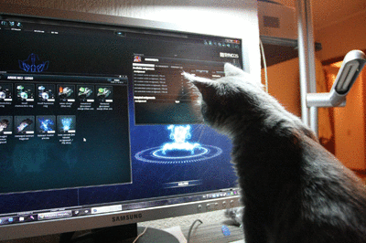
Being online is what makes it possible for these courses to be both massive and open
En ligne
Image: http://chickgeekgames.com/2011/12/gamer-cat-playing-with-perpetuum-online.html
Notes:
Online (en ligne) – Online – I have noticed recently the phenomenon of ‘wrapped’ MOOCs, which postulate the use of a MOOC within the context of a traditional location-based course; the material offered by the MOOC is hence ‘wrapped’ with the trappings of a more traditional education. This is the sort of approach to MOOCs which treats them more as modern-day textbooks, rather than as courses in and of themselves.
But insofar as these wrapped MOOCs are courses, they are no longer online, and insofar as they are online, they are no longer courses. So whatever a ‘wrapped MOOC’ is, it is not a MOOC. It is (at best) a set of resources misleadingly identified as a ‘MOOC’ and then offered (or more typically, sold) as a means to supplement traditional courses.
For a MOOC to be ‘online’ entails that (and I’ll be careful with my wording here) no required element of the course is required to take place at any particular physical location.
The ‘wrapped MOOCs’ are not MOOCs because you cannot attend a wrapped MOOC without attending the in-person course; there will be aspects of the MOOC that are reserved specifically for the people who have (typically) paid tuition and are resident at some college or university, and are physically located at the appropriate campus at the appropriate time.
Just as being online is what makes it possible for these courses to be both massive and open, being located at a specific place makes the course small and closed.
But this does not mean MOOCs cannot include or allow elements of real-world interaction or activity. Indeed, the best use of a MOOC does entail some offline real-world activity.
For example, our original CCK08 MOOC recommended, but did not require, in-person meet-ups, for example, and these were held at various locations around the world. MOOCs such as ds106 require that a person go out into the world and take photographs (for example).
In any online course there will be a real-world dimension; what makes it an ‘online’ course is that it does not specify a particular real-world dimension. I will talk much more about this in a few minutes.

Slide 7

The creation of temporary and bounded events allows for engagement between communities that would not normally associate with each other
Cours
Image: http://svc249.bne152v.server-web.com/surveys/survey_div_css.asp
Notes:
Course (cours) – before we launched our first MOOC both George Siemens and I were involved in various activities related to free and open online learning.
George, for example, had staged a very successful online conference on Connectivism the year before. I had, meanwhile, been running my newsletter service for the educational technology community since 2001. Each of these was in its own way massive, open and online, but they were not courses.
There is obviously some overlap between ‘course’ and ‘conference’ and ‘community’, and people have since suggested that there could be (or should be) massive open online communities of practice and of course there could – but they are not MOOCs.
There is also some overlap between the concept of the ‘course’ and the ‘course package’, as in, for example, the self-paced self-study online learning packages first distributed on paper (and with audio tapes) by distance education institutions. Here, the overlap is so great, they are often misleadingly called ‘courses’ instead of ‘course packages’.
To be clear: I am very supportive of the idea of massive open online communities, and I am also supportive of the use of course packages, but the MOOC is a different entity, with its own properties and role in the environment. But a course is an event. A community is not and event. A course package is not an event.
And specifically:
• a course is bounded by a start date and an end date
• a course is cohered by some common theme or domain of discourse
• a course is a progression of ordered events related to that domain
Why insist on these? Aside, that is, from the pedantic observation that if you call something a ‘course’ then it ought to have the properties of a course?
My own observation is that the creation of temporary and bounded events allows for engagement between communities that would not normally associate with each other. Courses are a way of, if you will, stirring the pot. By creating a limited and self-contained event we lower the barriers to participation – you’re not signing up for a lifetime commitment – and hence increasing accessibility.
In a sense, the same reason we organize learning into courses is the reason we organize text into books. Yes, simply ‘reading’ is useful and engaging, and widely recommended, but ‘reading a book’ is defined and contained. A person can commit to ‘reading a book’ more easily than to ‘reading’, especially if by ‘reading’ we mean something that never ends.
Hence, massive open online learning that is not bounded, does not cohere around a subject, and is not a progression of ordered events, is not a course, and outside the domain of discourse.

Slide 8
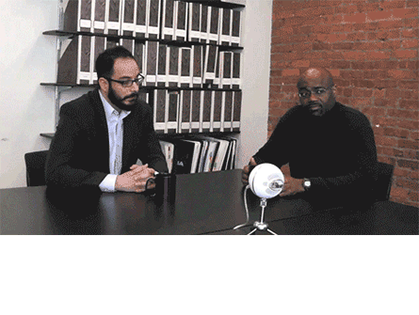
What is important about a connectivist course is not the course content.
Image: http://jitp.commons.gc.cuny.edu/
Notes:
The way we set up a MOOC is to define a six or twelve (or even thirty) week course of readings, each on a different topic, progressing through a domain of enquiry. We also hosted online seminars, many of which featured guest experts from outside the course.
But there the similarity with a traditional course ends. We do not require that people study the readings; these are optional. Rather, what we are saying through this structure is that we, the course authors, will be studying these materials. And people are welcome to come along for the ride.
What is important about a connectivist course is not the course content. Yes, there is some content -- you can't have a conversation without it -- but the content isn't the important thing. It serves merely as a catalyst, a mechanism for getting our projects, discussions and interactions off the ground. It may be useful to some people, but it isn't the end product, and we certainly do not want people to memorize it.
Let me explain why we take this approach.

Slide 9

The things we learn and the things we know are literally the connections we form between neurons.
Image: http://gifsoup.com/view/2304989/neurons.html
Notes:
Our thesis that knowledge is distributed across a network of connections, and therefore that learning consists of the ability to construct and traverse those networks. Knowledge, therefore, is not acquired, as though it were a thing. It is not transmitted, as though it were some type of communication. You can’t ‘promote’ something simply by assembling course packages and sending them out into the world.
The things we learn and the things we know are literally the connections we form between neurons as a result of experience. The brain is composed of 100 billion neurons, and these form some 100 trillion connections and it is these connections that constitute everything we know, everything we believe, everything we imagine.
And while it is convenient to talk as though knowledge and beliefs are composed of sentences and concepts that we somehow acquire and store, it is more accurate -- and pedagogically more useful -- to treat learning as the formation of connections.
From the perspective of the course, what it means is that the process of taking the course is itself much more important than the content participants may happen to learn in the course. The idea of a connectivist course is that a learner is immersed within a community of practitioners and introduced to ways of doing the sorts of things practitioners do, and through that practice, becomes more similar in act, thought and values to members of that community. To learn physics, in other words, you join a community of physicists, practice physics, and thereby become like a physicist.

Slide 10

It is essential to immerse oneself in the day-to-day activities and culture of the people who speak it.
Image: http://www.tumblr.com/tagged/tumblr%20language
Notes:
It is, indeed, like the learning of a language. It is possible to learn a language in theory, by studying books, as though one would study Latin. But to learn a language fully it is essential to immerse oneself in the day-to-day activities and culture of the people who speak it.
Again, it is tempting to say that there are certain things that people learn when they learn a language, that there is some content that is essential to being a speaker of that language. The meaning of words, for example, or the conjugation of verbs. But this is misleading and wrong.
Dictionary meanings and verb conjugations are, at the very best, an abstraction of the much more complex set of practices, attitudes and beliefs common among physicists. Because it is an abstraction, such a description cannot be accurate, and may actually mislead people about what being a physicist actually entails.
A person who merely knew the content supposedly taught and tested for at a language academy would feel grossly out of place in a gathering of physicists. It's like knowing the words but not knowing the tune.
So what a connectivist course becomes is a community of educators attempting to learn how it is that they learn, with the objective of allowing them to be able to help other people learn. We are all educators, or at least, learning to be educators, creating and promoting the (connective) practice of education by actually practicing it.
In practice connectivist teaching and learning consists of four major sorts of activities (and remember, this is just an abstraction, not a definition; just a starting point, and not 'content' to be remembered):

Slide 11
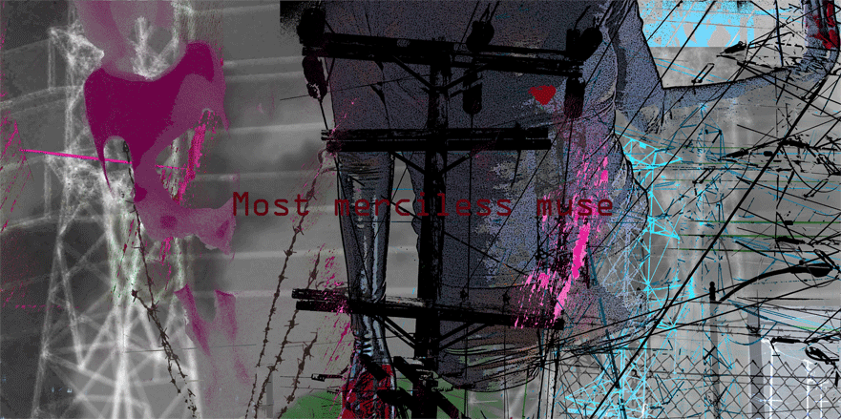
Each person creates their own perspective on the material by selecting what seems important to them.
Agrégation
Image: http://melindarsmith.com/most-merciless-muse
Notes:
Aggregation - the point of offering a course at all is to provide a starting point, to provide a variety of things to read, watch or play with. There is a lot of content associated with the course, everything from relatively basic instruction to arguments and discussions to high-level interviews with experts in the field.
The course is composed not only of recommended readings but also articles, videos and recordings made by course facilitators, blog posts, images, videos and other recordings made by course participants, collected tweets from Twitter, bookmarks from Delicious, discussion posts, and whatever else we can think of.
What we have experienced after delivering a half-dozen MOOCs is that we have to tell people at the start of the course to pick and choose what they will read, watch or participate in. Again and again, we have to stress that there is no central content to the course, that each person creates their own perspective on the material by selecting what seems important to them.
Again, if we draw the comparison to learning a language, it is like telling a person to pick and choose from real books, real newspaper articles, and real conversations.
From the perspective of the course provider, what is important at this point is that there actually be a rich range of resources, open and freely accessible, that can be used by course participants. In any course, in any discipline, I am looking for a wide range of resources, and encouraging course participants to do the same.
The key here is diversity. This includes diversity of format: we want texts, videos, animations, games, seminars, and anything else, because people prefer to use different media. But it also includes different languages and perspectives. In any MOOC – and not simply MOOCs designated as French-language, it would be relevant to include French-language resources.
One of the things I have learned in learning more than one language is that each language views the world differently, represents the world differently.

Slide 12

What we are encouraging here especially is a mixing of diverse cultures.
Restructuration
Image: http://alodj.com/viet-remix-hay-khoc-di-em-remix-2013-s195.html
Notes:
Remixing - the next step is to draw connections. The idea is to associate the materials (or parts of the materials) with each other, and with materials from elsewhere.
There are different ways to associate materials -- typically we look for some sort of commonality, such as a term, reference, topic or category. Sometimes we look for a fit, as though one thing follows from another. There are no rules to association, and part of learning is to get a feel for what goes with what.
The main point here is to encourage people to keep track of this. We suggest that they keep records on their computers of all the documents they've accessed, perhaps with summaries or evaluations of the material. Or, better yet, they can keep a record online somewhere. That way they will be able to share their content with other people.
In the course we make some specific suggestions:
- Create a blog with Blogger. Go to http://www.blogger.com and create a new blog. Or, if you already have a blog, you can use your existing blog. You can also use Wordpress (http://www.wordpress.com) or any other blogging service. Each time you access some content, create a blog post.
- Create an account with del.icio.us and create a new entry for each piece of content you access.
- Take part in an online discussion. You can, for example, join a Google group and exchange thoughts with other course participants, or use the discussion forum provided in the course's online environment.
- Tweet about the item in Twitter. If you have a Twitter account, post something about the content you've accessed.
- Anything else: you can use any other service on the internet -- Flickr, Second Life, Yahoo Groups, Facebook, YouTube, anything! Use your existing accounts if you want or create a new one especially for this course. The choice is completely yours.
What we are encouraging here especially is a mixing of diverse cultures. We are not trying to create a blend, but to highlight the distinctive perspective offered by each. You can see here that an ideal MOOC requires participation from different societies and different linguistic groups.
People often ask whether there are any French-language MOOCs and French-language learning resources, and this is a fair question. For me, though, the deeper question is whether there is any French-language culture attached to existing courses.
We saw this in our connectivist MOOCs through the activities of the Spanish-speaking community, the ‘connectvistas’, who would organize their own events, in their own language, online and offline, around our open online course. And their perspective became an important part of our online course, and Spanish ideas and culture became a part of the subject matter itself.

Slide 13

Learning is not simply a process of reception and filtering.
Adaptation
Image: http://lifeinauthoring.tumblr.com/post/50495928196/why-does-my-editor-joke-about-on-twitter-with-his-other
Notes:
Repurposing - we don't want participants to simply repeat what other people have said. Learning is not simply a process of reception and filtering. It is important to create something, to actively participate in the discipline.
This is probably the hardest part of the process, and not everybody will participate at this level (we remind participants, you get out of the course what you put into it; there's no magic here).
But it is important to remember that creativity does not start from scratch. There is this myth that we stare at a blank sheet of paper, and that ideas then spring out of our heads. But it's just a myth. Nobody ever creates something from nothing. That's why we call this section 'repurpose' instead of 'create.'
The materials were aggregated and remixed online are the bricks and mortar that can be used to compose new thoughts and new understandings of the material. What thoughts? What understanding? That is what we are creating in the course.
Repurposing is often a process of translating – taking an idea from one culture and representing it in the forms and idioms of another culture. This may be as simple as translating a block of text into a picture, or as difficult as representing a complex idea in another language.
Part of the reason why I am presenting this talk in French is to learn French, and this process (this is now my fourth French-language presentation) has taught me more than years of classes. But the other part of the reason I am presenting this talk in French is to learn more about the subject of the presentation.
If you're thinking that this isn't really very new educational theory, you're right. It is old. It forms the core of the concept we now call 'apprenticeship', and has been formally described most recently as 'constructionism' by the people like Seymour Papert.
What this isn't is a short cut. People learn through practice, and so this practice forms the core of connectivist pedagogy.

Slide 14

Sharing in public is harder. But it's better.
Circulation de l'information
Circulation de l'information
Image: http://im9.eu/animation/publish-how-the-net-works
Notes:
Feeding Forward - We want participants to share their work with other people in the course, and with the world at large. Now to be clear: participants don't have to share. They can work completely in private, not showing anything to anybody. Sharing is and will always be their choice.
And we know, sharing in public is harder. People can see your mistakes. People can see you try things you're not comfortable with. It's hard, and it's sometimes embarrassing.
But it's better. You'll try harder. You'll think more about what you're doing. And you'll get a greater reward -- people will see what you've created and comment on it. Sometimes they will be critical, but more often they will offer support, help and praise.
But even more importantly, it helps others see the learning process, and not just the polished final result. My ambition to speak in public in French, for example, was prompted by a talk given by Doug McLeod to a national conference on learning networks. I could see that something like this can be an important step in mastering a new skill.
You know this, I don’t need to tell you this, but I’ll say it anyway: when you speak or write in your own language, in a public domain, about some topic or discipline, what you are saying is “my language encompasses that discipline.”
It’s not simply that there is a French culture, full stop. It is that French culture encompasses physics, and chemistry, and economy, and even (I’m sorry to say) political science. But more, it is to say that a part of the domains of physics and chemistry and political science are formed from, and informed by, French culture.
The philosophers know this well. Can you imagine philosophy without the contributions of Descartes and Pascal and Camus and Sartre and Derrida? Can you imagine philosophy without the influence of the language on their contributions?

Slide 15

…the idea of using massive open online learning to promote diversity in language and culture.
Image: http://bavatuesdays.com/classic-twilight-zone-animated-vintage-clipart/
Notes:
Let me return to the idea of using massive open online learning to promote diversity in language and culture.
There is a challenge inherent in the idea of saying the purpose of a MOOC is to promote culture or that the purpose of a MOOC is to promote some idea or concept. It ties into the idea that the purpose of a MOOC is to help someone learn. It is, after all, a course. But purposes are never so easily transparent.
Organizations have multiple motives when they offer MOOCs. Thus Coursera, for example, may want to support learning, but it is also a company that wants to make money at the same time. A cultural organization may want to promote an idea, but it will also have financial needs, and will soon search for business models to sustain its online course.
Organizations offer MOOCs in order to serve other objectives. Cole Camplese at Penn State talks of “providing education and experimentation.” Keith Devlin refers to “the true democratizing of higher education on a global scale.”
But people do not take a MOOC in order to satisfy the purposes of the MOOC provider. A person does not enroll in a Coursera course because he wants Coursera to make money. Nor does a student enroll at Penn State in order to give professors a way to experiment on them.

Slide 16
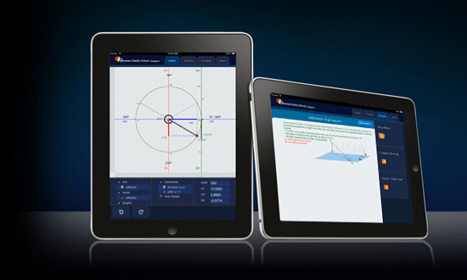
It is tempting to say a person takes a course to learn something
Image: http://www.ofs.edu.sg/learning-apps/
Notes:
It is tempting to say a person takes a course to learn something. But even this can be misleading. Consider what the founders of Coursera say about most students who sign up: “Their intent is to explore, find out something about the content, and move on to something else.” So says Daphne Koller.
Adding tuition fees changes the dynamic, as does adding credentials at the end of the course. Coursera has learned it can earn money charging for authentication services, which satisfies both its need to make money, and a student’s need for a certificate (though at the expense of no longer being free and open).
Many students would skip the course entirely, and proceed straight to obtaining credentials, as they do when they buy a degree from a degree mill.
It becomes clear through reflection that MOOCs serve numerous purposes, both to those who offer MOOCs, those who provide services, and those who register for or in some way ‘take’ a MOOC.

Slide 17

The course design gradually began to look less and less like a traditional course, and more like a network
Image: https://lh5.googleusercontent.com/-8XSBdS099jU/T5QbrWhLvsI/AAAAAAAAMFc/YhQZyQfrqrA/w500/IBWqm.gif
Notes:
The original MOOC offered by George Siemens and myself had a very simple purpose at first: to explain ourselves. The topic of ‘connectivism’ had achieved wide currency, and was the subject of the online conference mentioned earlier, and yet remained the subject of considerable debate. What was it? Was it even a theory? Did it even apply to education? Was it founded on real research, or was it simply made up? We believed we had good answers to those questions, and the curriculum was designed to lead participants (and ourselves!) through a clear and articulate answering of them.
As we began to design the course (and in particular, as I began to use the gRSShopper application I had designed to support my website and newsletter) it became clearer to both of us that the purpose of the course was also to serve as an example of connectivism in practice.
After several years of describing the theory we began to feel some obligation to demonstrate it in practice. So the course design gradually began to look less and less like a traditional course, and more like a network, with a wide range of resources connected to each other and to participants. And the course became much less about acquiring content or skills, and much more about making these connections, and learning from what emerged as a result of them.

Slide 18

The participants in our MOOCs also demonstrated a similarly wide range of motivations.
Image: http://aforgrave.ca/detritus/tag/ds106/
Notes:
The participants in our MOOCs also demonstrated a similarly wide range of motivations.
We had several participants who were in the course for the research opportunities it offered (and people like Jenny Mackness, Frances Bell and Sui Fai John Mak have become voices in their own right in the field).
Others came with the intent to learn about connectivism, to supplement their existing studies in a masters or PhD program.
Others joined in to participate in what they saw as an event, others to make connections and extend their social network (or as it came later to be called, their ‘personal learning network’).
At least one (and maybe others) came with the specific intent of discrediting connectivism (and in passing, to call George and myself “techno-communists”).
Even if we limit our focus to what is putatively the primary function of a course, to teach, it becomes difficult to identify the purpose of a MOOC.
Much has been made of MOOC completion rates, with the suggestion that completion is in some respects tantamount to learning. However, it could be argued that enabling a person to sample a course and withdraw without having lost thousands of dollars of tuition is a success.
Moreover, different people want to learn different things: some about what connectivism is, some, how best to criticize it, some, whether it even makes sense to their own experience.

Slide 19
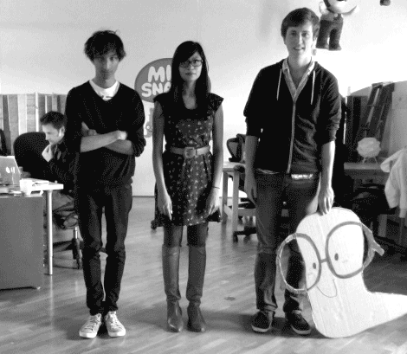
There are different senses of learning.
Image: http://ihogeek.com/2012/01/24/want-to-learn-another-language-mindsnacks-to-the-rescue/
Notes:
And there are different senses of learning.
In one sense, to ‘learn’ is to acquire some knowledge or skill, and it is this sense of learning that is most often associated with education, and especially formal education.
But there is an equally valid sense of learning, where the objective is to achieve some outcome or complete some task, what Rogers (2006) calls “task-conscious learning”. This sort of task-focused outcome is much more common in informal learning; it is the sort of learning I do, for example, when I dip into Stack Overflow to learn how to set the value of a field before submitting an Ajax form.

Slide 20


We do not create a MOOC to send a message; the MOOC is the message.
Image: http://en.wikipedia.org/wiki/Nilgiri_Mountain_Railway and http://lv.wikipedia.org/wiki/In%C5%BEenierija
Notes:
It becomes clear that we cannot assess the purpose of a MOOC qua MOOC by assessing the reasons and motivations of the people taking them, nor even by assessing the reasons and motivations of those offering them.
All that can be said is that the purpose is that it is based on the idea of creating a MOOC. It is based on the idea of creating an open online course designed in such a way as to support a large (or even massive) learning community.
That is, it is the properties of a MOOC, and not the content per se, that make it worth creating.
We do not create a MOOC to send a message; the MOOC is the message. So we would not, for example, create a MOOC in order to support a culture or a community; a MOOC is the culture or community.
A MOOC may be a very good or very poor PR device, may transmit content very well or very poorly, may advance research a lot or not at all, all depending on who is using it, how they are using it, and why.

Slide 21

…is to learn the habits, patterns, ways of thinking and ways of thinking characteristic of that discipline.
Image: http://www.ixiqi.com/archives/24493
Notes:
Just as a language is more than the words and sentences, and a culture is more than clothing and dances, education is not merely the acquisition of new information and skills.
To become educated in a discipline is to learn the habits, patterns, ways of thinking and ways of thinking characteristic of that discipline.
Although we learn what we learn from personal experience, we usually learn what we learn from other people.
Consequently, learning is a social activity, whether we immerse ourselves into what Etienne Wenger called a community of practice (Wenger, Communities of Practice: Learning, meaning and identity, 1999), learn what Michael Polanyi called tacit knowledge (Polanyi, 1962), and be able to complete, as Thomas Kuhn famously summarized, the problems at the end of the chapter. (Kuhn, 1962)

Slide 22

It is the creation of this community that constitutes the core activity of a MOOC.
Image: http://socialmediaweek.org/blog/2013/02/going-social-meet-nokias-brad-spike/
Notes:
]Learning is a social activity, and that is why the picture of distance learning wherein each person studies from their own home, supported by a personal computer and desk videophone, is wrong.
To be sure, there is room for home study, but people, and especially children, need community as well. It is because of this that MOOCs in the future will emphasize community much more than is perhaps imagined today.
It is the creation of this community, rather than the curation or transmission of any sort of content, that constitutes the core activity of a MOOC. The content is what we call the ‘McGuffin’ – it is an object of interest, that attracts our attention, but which could be anything.
For our discussion it is relevant to focus on two major types of community of significant importance to MOOCs. Both are relevant to MOOCs, but in very different ways. One is the ‘online community’, while the other is the ‘peer community’.

Slide 23
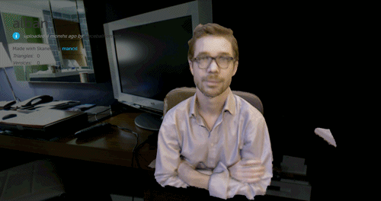
They are formed around a topic of interest, a profession, or a domain.
Communauté en ligne
Image: http://rhizome.org/editorial/2013/mar/18/prosthetic-knowledge-picks-webgl/
Notes:
The online community is what we might call an interest-based communities. They are formed around a topic of interest, a profession, or a domain. They are similar to Etienne Wenger’s ‘communities of practice’, though I think that my own sense of the concept may be wider than Wenger’s.
Interest based communities are collections of people who, although they may be geographically dispersed, share a common location on the internet. This location is created and defined by the shared interest people have with each other.
Now, to be clear: this shared interest may have to do with an offline interest. Indeed, most of them are. So online communities form around offline activities such as hockey or baseball, real-world pursuits such as business or biology, around hobbies and crafts, and even around a town, village or high school.
We see these everywhere. Gardeners hang out at gardenweb. Computer geeks hang out at Wired. Educational technologists have found a home in the Google+ Ed Tech group. Across the internet, thousands of topic-specific communities have been formed, some around websites, some in social networking services, some using tools like WordPress or Skype.
With today’s focus on MOOCs and social networking sites (such as Facebook and Google+) the discussion of community per se has faded to the background. This perhaps resembles the way corresponding community networks have been swallowed and anonymized by these branded commercial services.
Online educators will find themselves building interest based communities whether they intend to do this or not, because the mechanics necessary for the creation of an online topic based community are present in the structure of almost any online course.
In order to create a online based community, one only needs a topic, a group of geographically dispersed people interested in that topic, and a means of shared communication, such as a discussion list or online chat.
What will change in the future is that online educators will better learn how to foster and nourish online communities. They will want to do this because, the greater the dedication to the community, the greater the dedication to learning, since learning is the shared experience which defines this community.
This is what connectivism brings to the table. This is what MOOCs bring to the table.

Slide 24
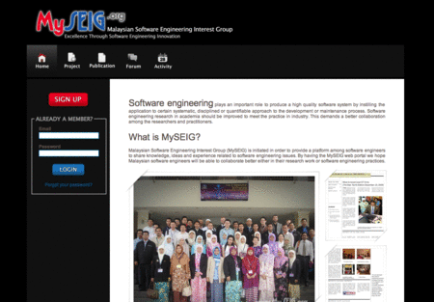
. Communities form around a topic of interest … and they share a practice
Image: http://www.kliquey.com/
Notes:
The factors which contribute to a successful online community are to some degree known, though that said much more empirical data needs to be collected. But in general, one of the keys is ownership. By that, what I mean is that the members of the community play a key role in shaping the community. For a community is not a broadcast medium.
It is not a place where the organizer provides material and the members consume it. It is a shared and constructed environment, where the members along with the organizers play roughly equal roles in content creation.
Wenger’s characterization is informative. Communities form around a topic of interest – the ‘domain’. They engage in community activities – as he says, “members engage in joint activities and discussions, help each other, and share information.” And they share a practice – a repertoire of resources, a vocabulary, common stories, common methodologies, common ways of approaching a problem. (Wenger, Communities of practice: a brief introduction, 2004)
Learning in the community of practice takes the form of what might be called ‘peer-to-peer professional development activities’. Rather than formalized learning, members help each other directly. We discovered this in Alberta when we studies how professional town managers learn: we discovered they call each other up on the telephone. (Stefanick & Lesage Jr., 2005)
In an educational context, what this means is that a lot of the learning - and learning materials - will be those constructed by the students themselves. We begin to see this with the use of discussion lists in online courses, but also in the creation of topic-based web pages (and other resources).
MOOCs – at least the way we create MOOCs – build on this. The MOOC is for us a device created in order to connect these distributed voices together, not to create community, not to create culture, but to create a place where community and culture can flourish,

Slide 25

They are just people who meet by happenstance, and find an affinity for each other.
Communauté de pairs
Image: http://favim.com/image/371402/
Notes:
The peer community by contrast almost by definition cannot be formed over the internet. These are the communities that form in our neighborhoods, at church or schools, or in the community centre, the tavern or the grocery store.
They will exist because people need a pat on the back, a (physical) shoulder to lean on, a drinking buddy, an opponent to play squash, somebody whose physical presence, for one reason or another, matters.
And they need a physical environment, which may include sports facilities, an industrial arts shop, a gym, a golf course, or even just a field with four bases and a baseball or flat sheet of ice and a puck.
They are first created through proximity, being composed of people who live in the same neighborhood or who go to the same school. Over the longer term, we may say, they are just people who meet by happenstance, and find an affinity for each other.
While online communities depend on a topic or area of interest to exist, peer communities can be topic neutral; even if members share an interest in sports or science, it is physical proximity which causes the community to exist.

Slide 26

Peer communities are activity based
Image: http://15991471.wwww.fanpop.com/clubs/marlon-brando/images/32437165/title/marlon-playing-bongos-fanart
Notes:
While online communities are topic-based, peer communities are activity based. An online community may convene to talk hockey, while a peer community will convene to play hockey. Online community may consist of your friends. Peer community consists of your neighbours.
This creates great variety in membership. One person may be a scientist while another may be an artist. While online communities consist of geographically dispersed members, peer based learning communities exist in some particular geographical location.
A peer learning community will be that group of people attending a particular school or learning centre. People become members of the community because of a shared location, workplace, cultural background, religion, or language, and because of shared experiences in online learning.
While people in a topic based community, for example, will discuss this or that monograph or expert in the topic, people in a peer based learning community will discuss this or that institution, interface software, or community events.
Peer learning communities are vital to learning because they provide a safe environment in which to learn. A person does not feel adrift on the internet when working in a community of people facing similar needs and challenges. Though each may be pursuing a different educational goal, their overall objective and means of travel is the same, and thus they offer mutual support, encouragement, and reassurance.

Slide 27

People talk of ‘learning communities’ but strictly speaking there is no such thing as a ‘learning community’
Image: http://en.root-top.com/toplist/beauxbatons/elementy,2421.html
Notes:
At university I may have studied philosophy, but like so many other university students I obtained my real education through social interaction. In my case, it was at the offices of the Gauntlet, the student newspaper, where I spent more time than I ever did in the classroom.
My most direct interaction with peer learning communities as an educator came when I was working in the Canadian north - the learning centre in Fort St. John, in northern British Columbia, or the fishers' retraining centre, a block away from the urban aboriginal training centre, fostered by the New Westminster School Division. The Sunrise Project, based in Slave Lake, Alberta. Or the South West Indian Training centres in Sioux Valley and Waywayseecappo, in rural Manitoba.
It is the sort of success that was replicated across the country with the Community Access Points. This was a project that did more than merely provide internet access, it created a common location for people interesting in technology and computers (and blogs and Facebook).
People talk of ‘learning communities’ but strictly speaking there is no such thing as a ‘learning community’ – save, perhaps, the strained and artificial creations of educational institutions that try to cram classes into collectives, creating personal relationships where none naturally exist.
Rather, people learn in communities, and what would make any given community a ‘learning’ community or otherwise is whether people in the community learn more or less well.

Slide 28

It should be a truism today that communities are grown rather than constructed.
Image: http://www.powerfulintentions.org/profile/Jkada
Notes:
It should be a truism today that communities are grown rather than constructed. Sharing and learning cannot be “legislated into existence.” (Dube, Bourhis, & Jacob, 2006) The desire for autonomy comes part and parcel with some of the perceived benefits of learning and growing in a community: safely, security, and privacy.
In the field of learning especially, there is a great deal of attention paid to what it is members have in common that facilitates the creation of a community – whether it be common educational needs, common age or locale, common sets of values, or even more theoretical entities, such as common objects, domains of discourse, or understandings.
The value of a community, however, and especially of a learning community, comes from the diversity in the community. Students gather around an instructor precisely because the instructor has knowledge, beliefs and opinions that the students don’t share.
They gather around each other because they each have unique experiences. Fostering a learning community is as much a matter of drawing on the differences as it is a matter of underlining the similarities.

Slide 29

Le risque est ce que la culture la plus grande finira par dominer les institutions sociales et politiques
Image: http://www.powerfulintentions.org/profile/Jkada
Notes:
There is both risk and opportunity in this model for specific cultural and linguistic groups.
Provider institutions may be located anywhere. MOOCs serve a global audience. We are seeing this trend develop already. Even today, I see course announcements posted almost daily, on new MOOCs rather from individual universities or via EdX or Coursera. It is now possible to take a course on almost anything from almost anywhere in the world.
The risk is of course the same as is created by any mass media, that the largest culture will come to dominate social and political institutions by weight of number and prevalence on mass media. And this is in fact what we have seen in the area of MOOCs. The language of instruction has been until recent years almost exclusively English.

Slide 30


Diverse languages and culture belongs in all courses and communities
Image: http://kentoster.deviantart.com/art/Walking-Animation-165680217 and http://www.papeldeparede.imagensdahora.com.br/papeisdeparede/2578/torre_eiffel/
Notes:
The typical response to promote diversity is to promote coyrses originating in a specific language or culture. This, for example, has been the response of the French-language community in the face of an almost overwhelming anglosphere presence.
For example, one of the best-known francophone MOOCs was the MooC ITyPA (Internet : Tout Y est Pour Apprendre) offered predominately through l’École Centrale de Nantes (http://www.itypa.mooc.fr/node/29) and Thot Cursus (www.cursus.edu), a french-speaking website dedicated to education and digital culture.
With my colleagues at the University of Moncton, I will be participating in the creation of a french-language MOOC on Open Educational Resources, to be offered in cooperation with the OIF, next fall.
Culturally diverse peer communities active in global MOOCs ensure that even in Anglophone MOOCs, a wide range of community and contribution is present.
It is not enough to offer courses and programs online in, say, French, in my opinion. Diverse languages and culture belongs in all courses and communities, even those that are predominately English.

Slide 31
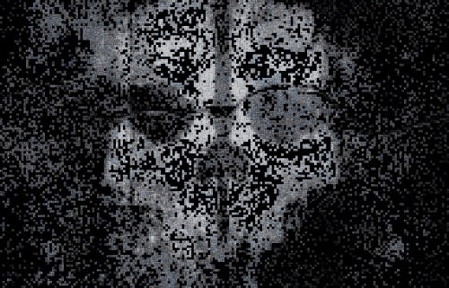
The MOOCs we designed and developed were explicitly designed to support participation from a mosaic of cultures.
Image: http://www.joblo.com/forums/showthread.php?p=3675040
Notes:
The MOOCs George Siemens and I have designed and developed were explicitly designed to support participation from a mosaic of cultures. Other, more traditional, MOOCs make it more difficult, but the key to participation in these is to convert a static one-language presentation-mode course into a thriving multilingual and multicultural community.
We see this more widely in other online courses through the ‘meet-up’. A good example of this is the Denver Francophone Group. http://www.meetup.com/The-Denver-Francophone-Group/ Or the Austin French meetup club. http://www.meetup.com/austinfrenchlanguageclub/
It seems so little. What is being done to support these groups? What resources are available, what online courses in the French language?
Why is this important, particularly in the context of fostering language and culture?
It is worth noting that theorists of both professional and social networks speak of one’s interactions within the community as a process of building, or creating, one’s own identity.

Slide 32

The process of learning is a process of becoming, a process of developing one’s own self.
Image: http://ladyannarielle.tumblr.com/post/39494188698
Notes:
Wenger, for example, writes, “Having a sense of identity is a crucial aspect of learning in organizations... The corporate world is full of these displays of identity, which manifest themselves in the jargon people use, the clothes they wear, and the remarks they make.” (Wenger, 1998)
[slide 31 – identity] And danah boyd writes, “Profiles are digital bodies, public displays of identity where people can explore impression management…. Explicit reaction to their online presence offers valuable feedback. The goal is to look cool and receive peer validation.” (boyd, 2006)
In both of these we are seeing aspects of the same phenomenon. To learn is not to acquire or to accumulate, but rather, to develop or to grow. The process of learning is a process of becoming, a process of developing one’s own self.
We have defined three domains of learning: the individual learner, the online community, and the peer community.
Recent discussions of MOOCs have focused almost exclusively on the online community, with almost no discussion of the individual learner, and no discussion peer community. But to my mind over time all three elements will be seen to be equally important.
At university, I became not so much a philosopher, though that was my formal education, but rather, a journalist, which is the community I became a part of.

Slide 33
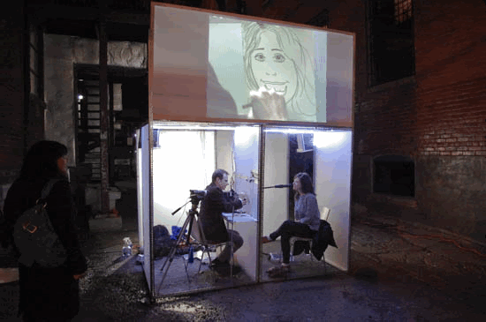
MOOCs are communities in which learners can immerse themselves and grow into something new.
Image: http://www.thegridto.com/culture/arts/nuit-blanche-animated/3/
Notes:
MOOCs are communities in which learners can immerse themselves and grow into something new. Previous experience suggests that these will be places where they can create and where they can project – not “serious games” but “modding communities”, not “reading groups” but “fan fiction”, not “educational simulations” but “LAN parties”.
We might also define three key roles in online learning: the student, the instructor, and the facilitator. The ‘instructor’ is the person responsible for the online community, while the ‘facilitator’ is the person responsible for the peer community.
Of course, the ‘instructor’ and the ‘facilitator’ are abstracts. We think of them as one person, but in fact these roles are fulfilled by teams of people working together to orchestrate the experience of community.
The talk of ‘star instructors’ without reference to the wider facilitation is as nonsensical as talking about ‘movie stars’ as being the entire film industry, without regard to directors, camera operators, distributors and movie theatre managers.
The ‘star’ is yet another McGuffin – of no great importance, but some candy designed to attract us to the event.
In traditional education, the two communities exist as a single entity. The same institution which produces the online instruction is also the institution attended by the student. For example, if I say I am taking a course from the University of Calgary, what I mean is that the course instruction is being delivered by the University of Calgary, and also that the University of Calgary provides the facilities where I receive that course instruction.

Slide 34
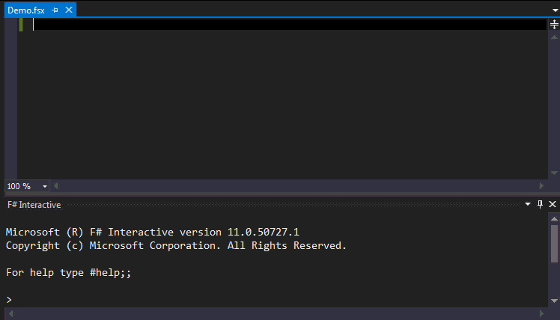
Local support offered for participation in online courses offered in a variety of languages at a variety of locations around the world.
Image: http://open.bekk.no/utforskende-programmering-med-fsharp-type-providers/
Notes:
In the future, host and provider institutions will increasingly be different institutions. One example of this is course brokering, wherein the course I am taking may have been developed by, and even instructed by, a University of Calgary instructor, but is being delivered at Red Deer College. Thus, when I take the course, I use Red Deer's classrooms, computers, and facilities even though the course is a University of Calgary course.
The recent MOOCs offered by companies like Coursera and Udacity have commercialized course brokering. They take a course offered by one university and make it available to other institutions to host in on-campus peer communities.
Of course, this is a model that the K-12 community has employed for any number of years. It is common to see a single course taught from one location and delivered to other locations by means such as video conferencing and interactive environments.
And, one would expect the same phenomenon to extend into diverse social, political and cultural communities, to see local support offered for participation in online courses offered in a variety of languages at a variety of locations around the world.

Slide 35
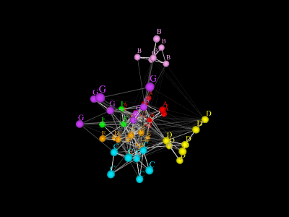
Il ne sera pas suffisant de simplement rédiger du contenu et d'offrir des cours.
Image: http://members.ozemail.com.au/~dekker/orgnets.html
Notes:
It will not be enough simply to author content and offer courses. The place for diverse community is in the middle of these domains, in discourse and discussion on a global stage.
Yes, content and courses are necessary. But what is needed more than anything is diverse participation in the discourse itself, that idea that, for any online course, any online community, distinct cultures and languages have a place there, belong there, and are necessarily a part of that course and that community.

Slide 36

www.downes.ca

