Slide 1

Supporting a Distributed Online Course
Stephen Downes
Antalya, Turkey, October 10, 2013

Slide 2
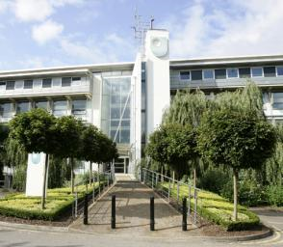
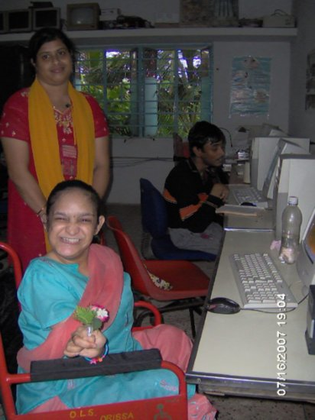
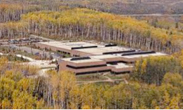
The Idea of Open Learning...
http://www.open.ac.uk/
http://www.open.edu.au/
इंदिरा गाँधी राष्ट्रीय मुक्त विश्वविद्यालय
http://www.ignou.ac.in/
http://www.athabascau.ca/

Slide 3

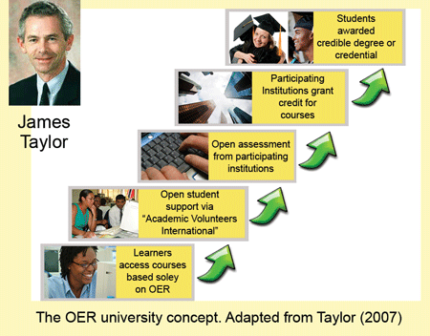
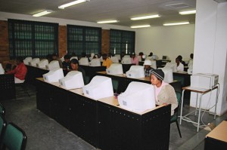
Phases of Openness?
http://www.col.org/blog/Lists/Posts/Post.aspx?ID=134
http://www.col.org/blog/Lists/Posts/Post.aspx?ID=130

Slide 4
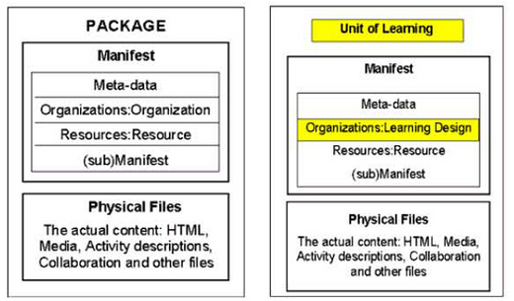
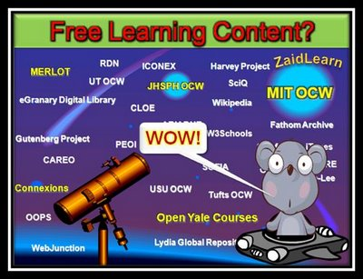
Open Educational Resources
Phase 1
http://zaidlearn.blogspot.com/2008/06/university-learning-ocw-oer-free.html
http://www.imsglobal.org/metadata/
http://ltsc.ieee.org/wg12/files/LOM_1484_12_1_v1_Final_Draft.pdf
http://creativecommons.org/

Slide 5
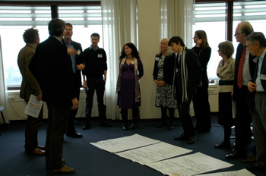
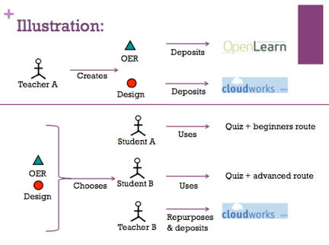
Learning Design & Open Practices
Phase 2
http://www.educause.edu/Resources/BeyondOERShiftingFocustoOpenEd/224619
http://opal.innovationpros.net/news/launch-of-tools-to-enable-open-educational-practices/
...the Open Educational Practices movement, developed by Germany's Ulf-Daniel Ehlers and the UK's Gráinne Conole...
http://e4innovation.com/?p=373

Slide 6
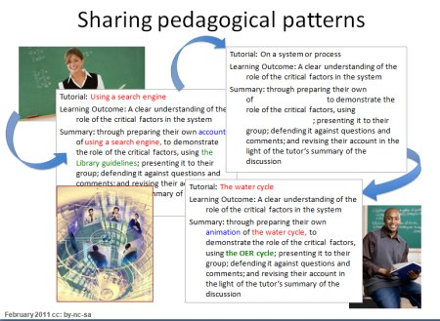
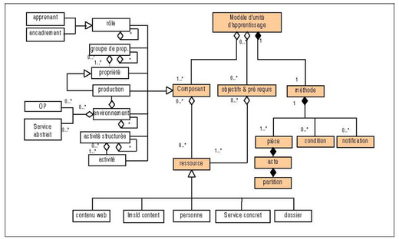
Learning Design & Patterns
http://repository.alt.ac.uk/883/
http://www.imsglobal.org/learningdesign/

Slide 7
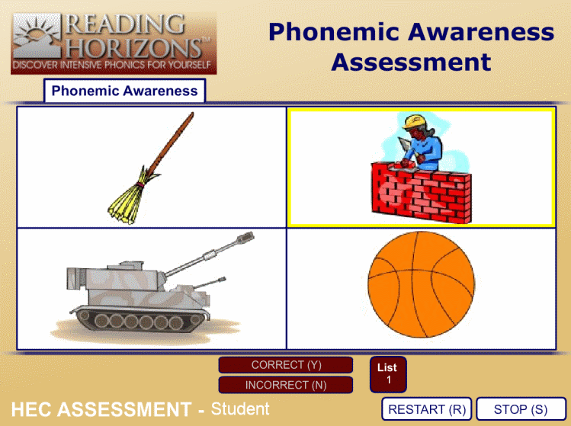
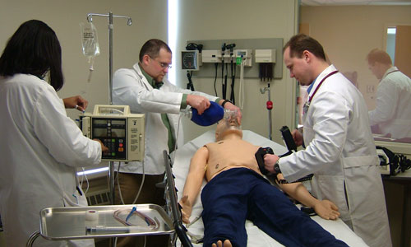
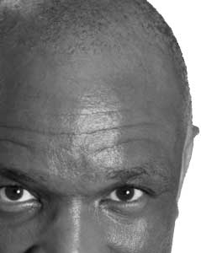
Open Assessment?
Phase 3
http://www.brainbench.com/
http://www.aspirationtech.org/events/p2pu/openassessment/2010

Slide 8
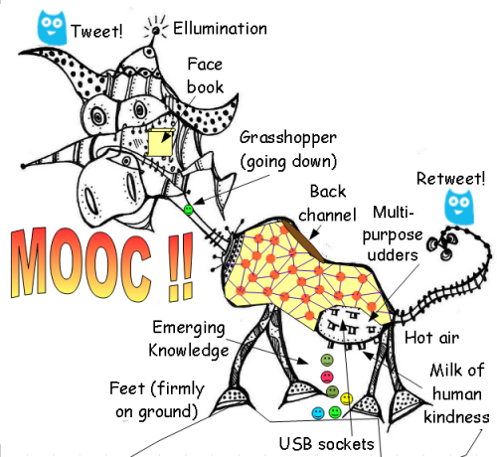
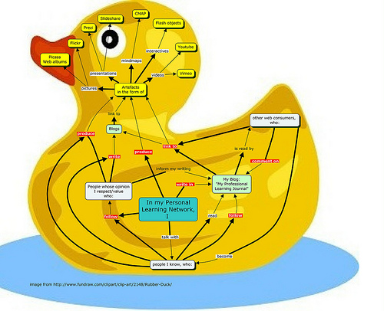
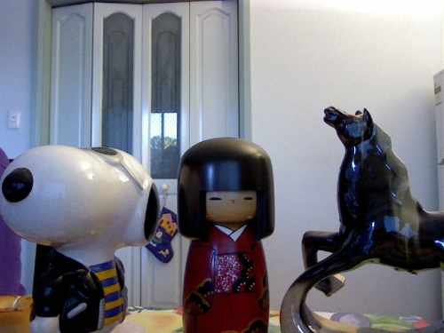
The MOOC...
http://www.mooc.ca
http://cck11.mooc.ca
http://suifaijohnmak.wordpress.com/2011/03/10/cck11-how-to-explain-connectivism-mooc-and-plepln/

Slide 9
What are MOOCs
Massive – by design
Open – gratis and libre
Online – vs. blended and wrapped
Courses – vs. communities, websites, video collections, etc
http://mooc.ca

Slide 10
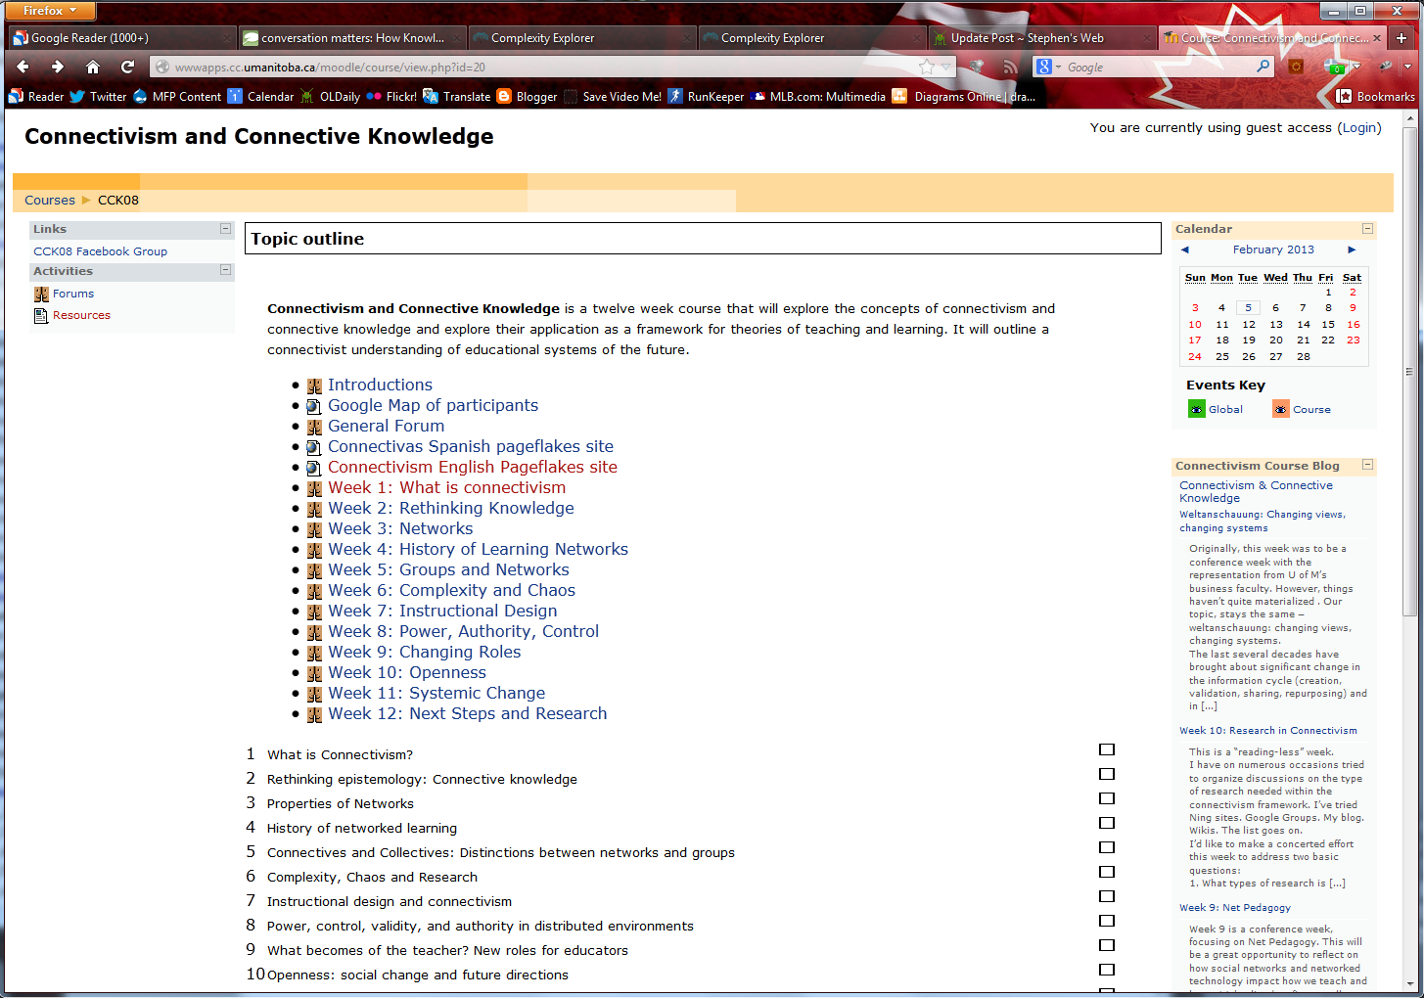
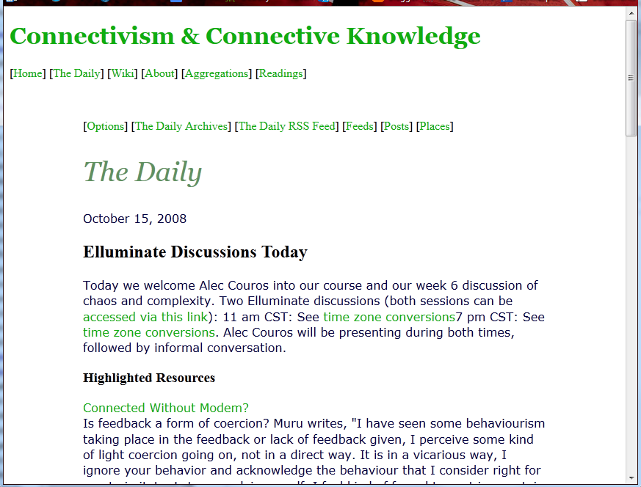
CCK08
2300 students
http://wwwapps.cc.umanitoba.ca/moodle/course/view.php?id=20
http://connect.downes.ca/cgi-bin/archive.cgi?page=thedaily.htm

Slide 11
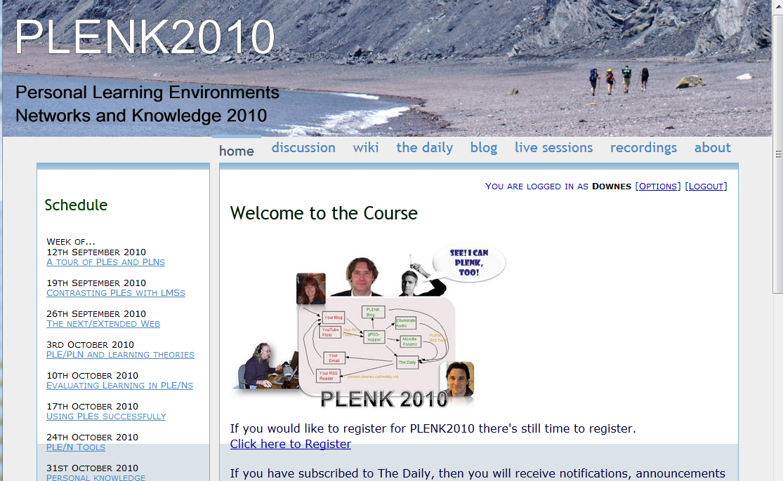
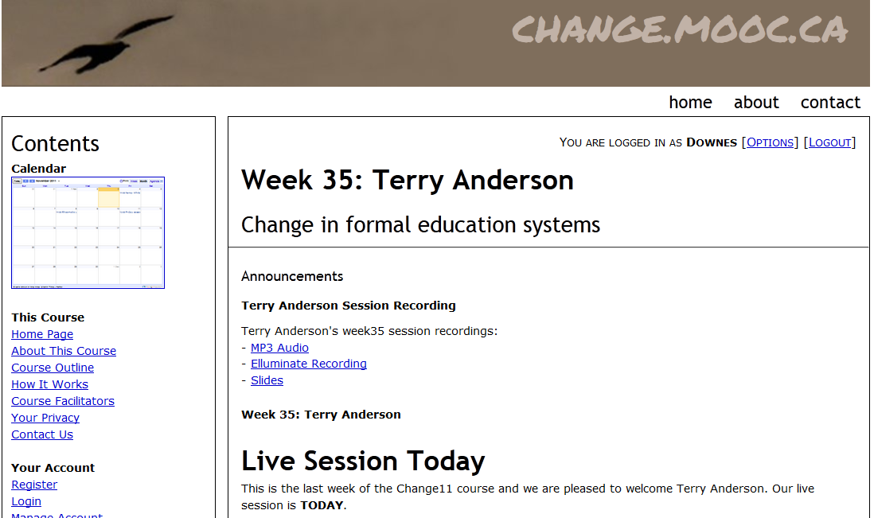

Other Courses
1800 students
http://connect.downes.ca/
2800 students
3000 students
http://change.mooc.ca/
http://edfuture.net/

Slide 12
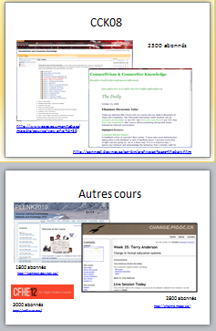

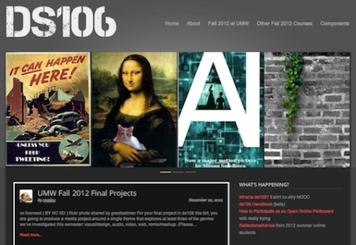
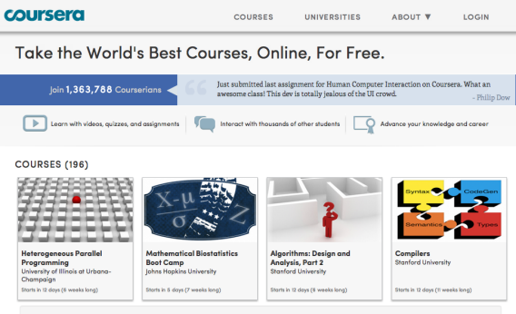
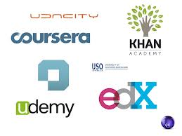
cMOOC vs xMOOC
networks
tasks
contents
https://www.ai-class.com/
http://ds106.us/history/
https://www.coursera.org/
http://lisahistory.net/wordpress/2012/08/three-kinds-of-moocs/

Slide 13
Traditional Course
Traditional
Course
Website
Most online courses are based on websites (even Coursera, Klan and Udemy)

Slide 14
Massive Open Online Course
Site
A MOOC is a Web, not a Website

Slide 15
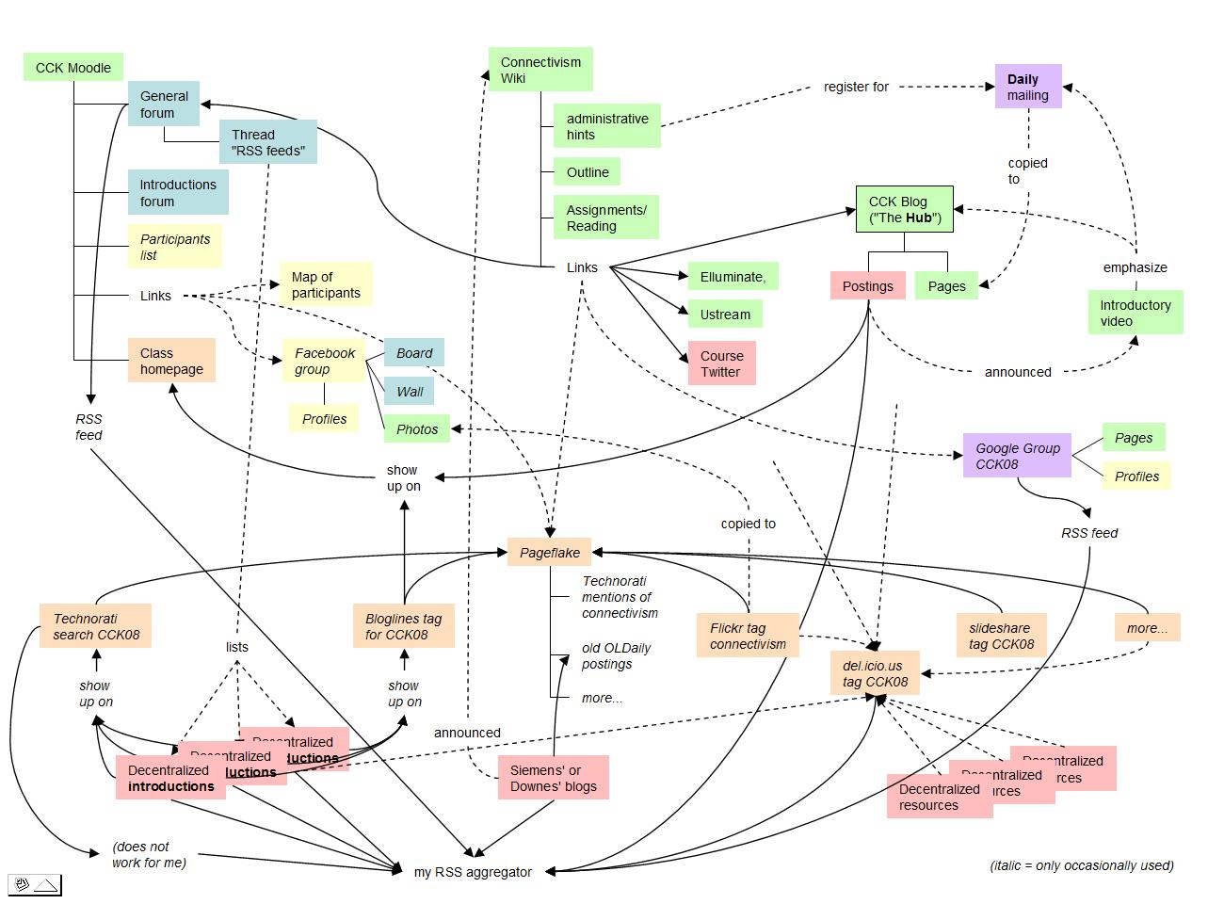
Connectivist MOOCs
http://x28newblog.blog.uni-heidelberg.de/2008/09/06/cck08-first-impressions/

Slide 16
Underlying MOOC Support
1. First student creates resource and sends info to course
Site
2. Second student sees resource info in newsletter and RSS feed
3. Second student accesses the resource directly
4. Second student finds link to third student’s resource

Slide 17

















Course Provider Perspective
Subscribed
students
Student
content
Site
Course
content
Live online events
Event recordings

Slide 18
The Student’s Perspective
Site
A range of different resources and services

Slide 19

gRSShopper Functionality
Harvester
- atom, RSS, JSON
- blogs, discussions, pages
- Twitter, Facebook, etc
User management
- Login and authentication
- Newsletter subscription
- Social network information
Feed Manager
Distribution
- Email newsletter
- RSS / Atom / JSON feeds
- API to Twitter, Facebook, etc
Site Manager
- Course pages
- Events, etc.
- Newsletter pages

Slide 20
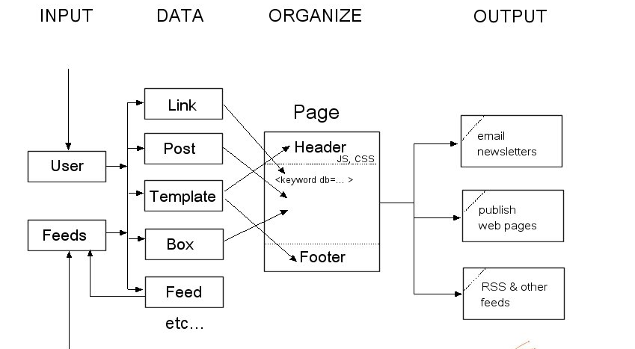
gRSShopper Flow
http://grsshopper.downes.ca

Slide 21
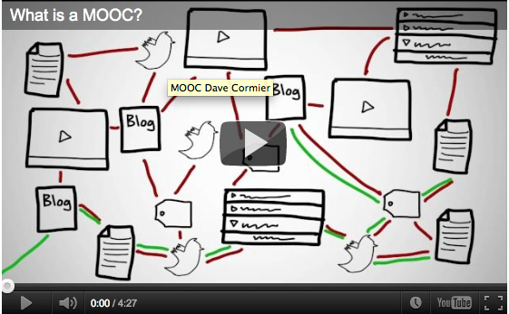
How to Learn in a cMOOC
A process of immersion into a knowing community
http://www.tonybates.ca/2012/03/03/more-reflections-on-moocs-and-mitx/

Slide 22
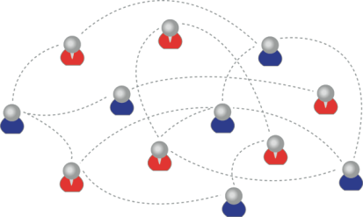
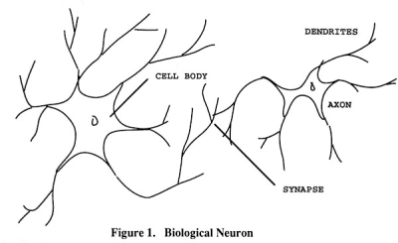
How to Create a cMOOC
It’s like creating a network
Don’t centralize
Concentrate on the creation of links
We use social networks...
… to create personal knowledge

Slide 23

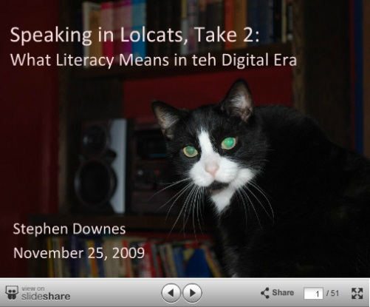
Why Open Educational Resources?
Learning activities are essentially conversations
OERs are the words used in those conversations
http://www.downes.ca/presentation/233

Slide 24
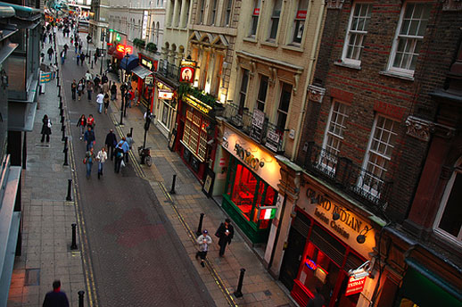
Success Factors
What sort of decentralized network will best support learning-as-growth?

Slide 25
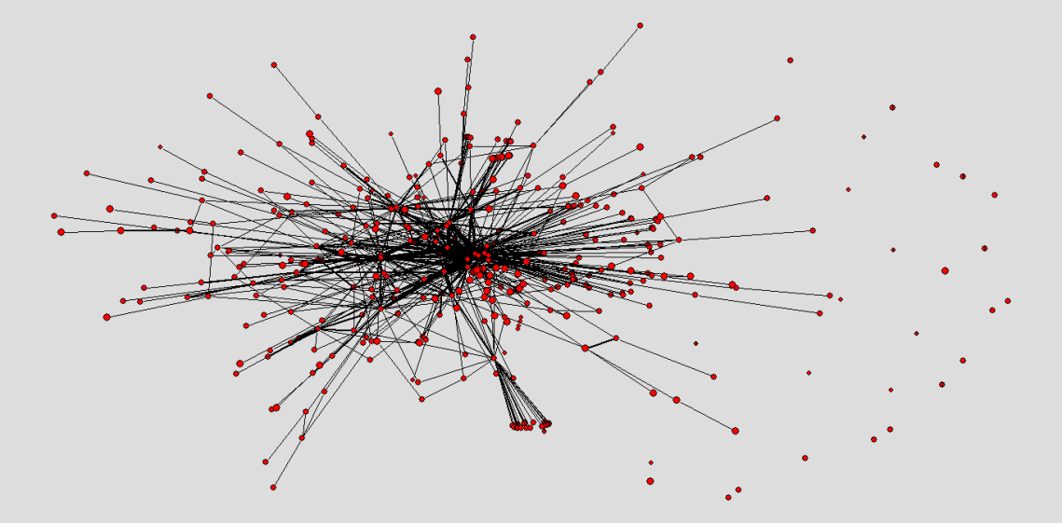
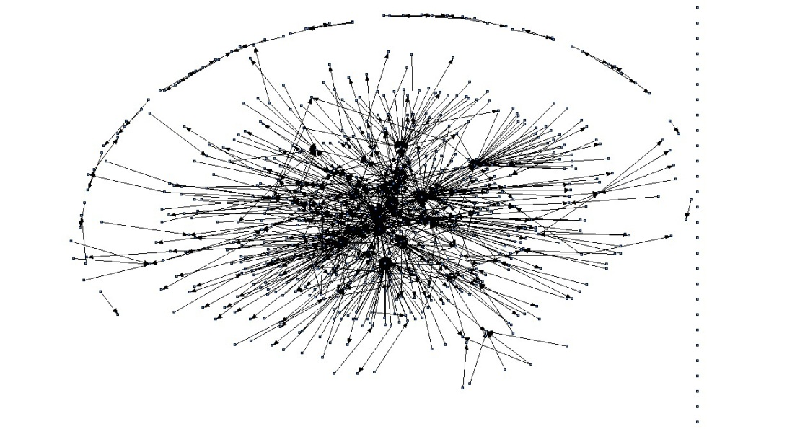
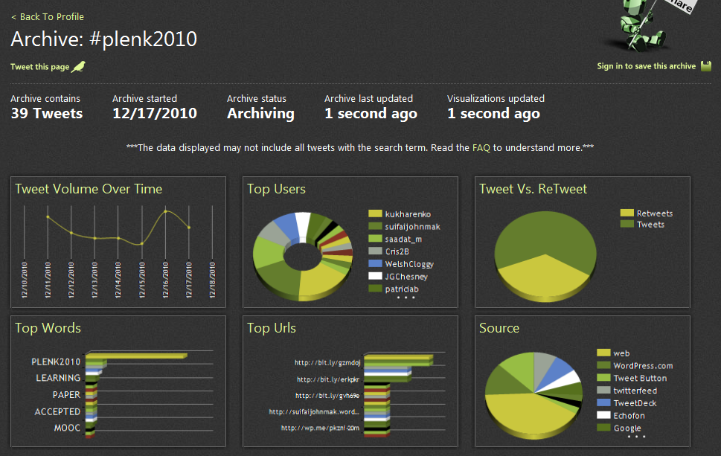
The Semantic Condition
Autonomy, diversity, openness, interactivity
These conditions are the conditions for a constructive dialogue…
And are thus the design principles for a MOOC
http://itforum.coe.uga.edu/paper92/paper92.html

Slide 26

Design Principles
Autonomy
- Choice of contents
- Personal learning
- No curriculum
Openness
- Open access
- Open content
- Open activities
- Open assessment
Diversity
- Multiple tools
- Individual perspective
- Varied content
Interactivity
- Encourage communication
- Cooperative learning
- Emergent knowledge

Slide 27
How to Evaluate Learning
Learning is not possession of a collection of facts, it’s the expression of a capacity
Learning is recognized by a community of experts in a network
Learning analytics
We recognize our understandings…
…by the way we use them in our social network

Slide 28
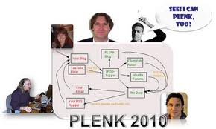

Aggregated Conversations

Slide 29
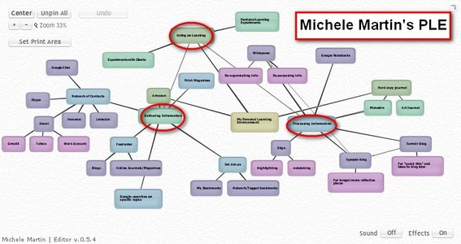
Personal Learning
http://dmlcentral.net/blog/howard-rheingold/diy-u-interview-anya-kamenetz
http://www.downes.ca/post/58150
Notes:
Howard Rheingold searches for the new in Anya Kamenetz's Edupunk's Guide, suggesting that what has been added is the idea of the personal learning plan to the personal learning network. "Making a public commitment to something is going to increase your accountability," says Kamenetz. Rheingold writes, "Her work serves as a bridge between blended learning and peeragogy. I previously wrote about Shelly Terrell and personal learning networks" and asks here what it takes for a group to self-organize. Kamanetz responds that there needs to be a common understanding of the goal - of course, this would be the outcome of self-organization, not what makes it possible.

Slide 30
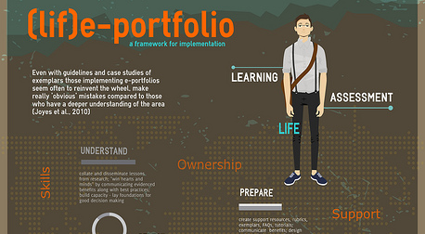
Life portfolio
http://leelearning.wordpress.com/2012/05/17/life-portfolio/
http://www.downes.ca/post/58174
Notes:
"I finally finished my research study," writes Lee D. Ballantyne. "This is a summary of the outcomes: a framework for e-portfolio implementation. Full pdf paper here. The result is a good 52-page study of the subject. "Fundamental to these ideas of digital identity and a personal learning environment is the ability to create a personalised space. The benefits of personalisation are twofold. Firstly, a guiding principle behind reflective e-portfolio development – learner control – should apply to the tools learners use as well as to the content. The ability to customise the e-portfolio (process), to integrate the learner' own choice of tools (tools or systems), and, ultimately, create a digital identity (product) is incredibly important to learners. Secondly, personalisation allows learners to take responsibility for their own learning: developing metacognitive skills and promoting autonomy."

Slide 31
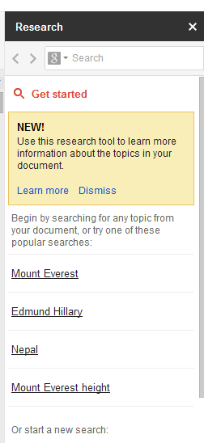
The Research Sidebar
http://www.downes.ca/post/58163
http://googlesystem.blogspot.ca/2012/05/research-sidebar-in-google-docs.html
Notes:
Microsoft recently introduced online research support in its office suite and Google has announced a similar service in its 'Research Sidebar'. This post from Google Operating System (not an official Google weblog) covers the basics. "The sidebar includes the top Google search results, image search results, facts, maps, reviews and famous quotes. Click the icon from the search box to restrict the results to images and quotes." My question is, do we really want pages and pages of 'hotel deals' listings in the sidebar of our Google documents?

Slide 32
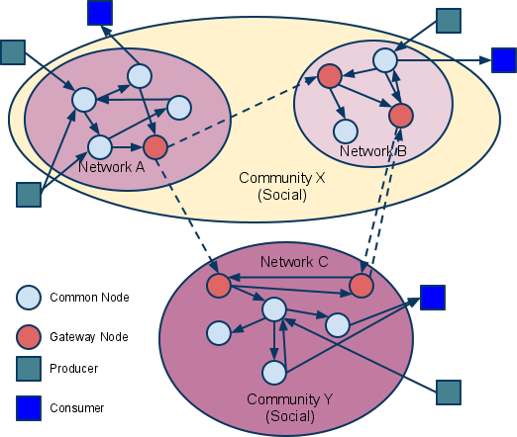
SPAWS
paradata recipes -
http://www.downes.ca/post/58221
use case - http://www.downes.ca/post/58255
Notes:
Scott Wilson helps us all understand SPAWS (Sharing Paradata Across Widget Stores) with a new use case. "Paradata – reviews by users, ratings and ‘likes’, and aggregate download statistics – is collected separately by each store. Sharing this paradata between stores will add value for users of all the stores." Basically, then, it's like sharing metadata created by users (or as I called it, second party metadata) - except that the metadata is shared (as I could see from the paradata cookbook) in JSON rather than XML. meanwhile, related to another educational metadata initiative (LRMI), Phil Barker asksthe all-importnat question: Will using schema.org metadata improve my Google rank?

Slide 33
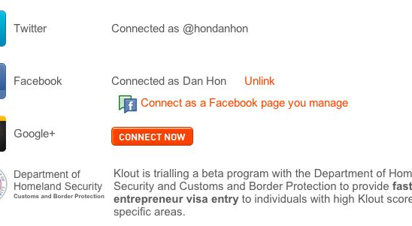
Oauth is Your Future
http://www.downes.ca/post/58186
Notes:
OK, this doesn't exist, but it is imaginable that we could read something like this in the near future: "Klout is trialling a beta program with the Department of Homeland Security and Customs and Border Protection to provide fast-track entrepreneur visa entry to individuals with high Klout scores in specific areas." Now - I know the first reaction is to say how bad this is. But is it unreasonable for government to have as much information on you as some company? Is it unreasonable for us to use it in some practical way, like crossing borders? And maybe - just maybe - if it becomes used in this way, maybe we'll have some rights to access it, use it ourselves, and ensure it is correct. Because right now none of that is the case.

Slide 34
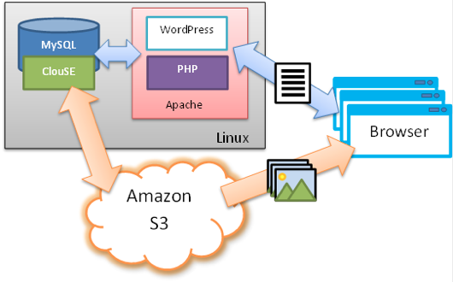
Cloud Storage for the People
http://www.readwriteweb.com/cloud/2012/05/s3-storage-for-wordpress-blogs.php
http://www.downes.ca/post/58189

Slide 35
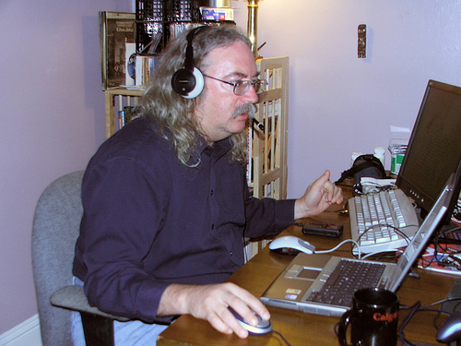
http://www.downes.ca

