Slide 1
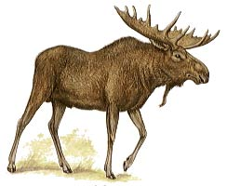
Massive Open Online Support for Education
Stephen Downes
May 6, 2013

Slide 2
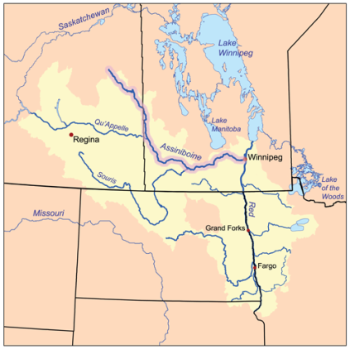
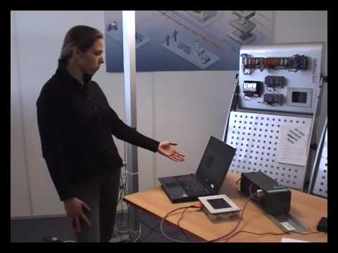
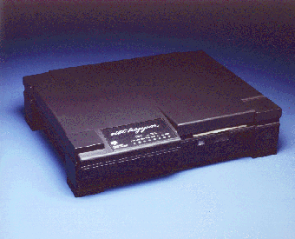
Have Network, Will Travel
http://www.support.psi.net/support/common/routers/nethopper/index.html
1996

Slide 3
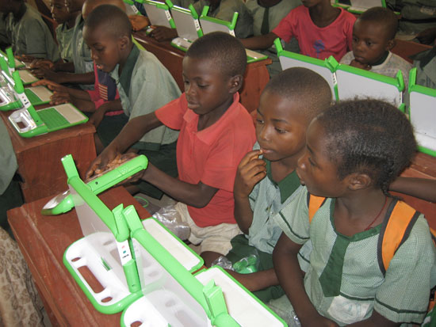
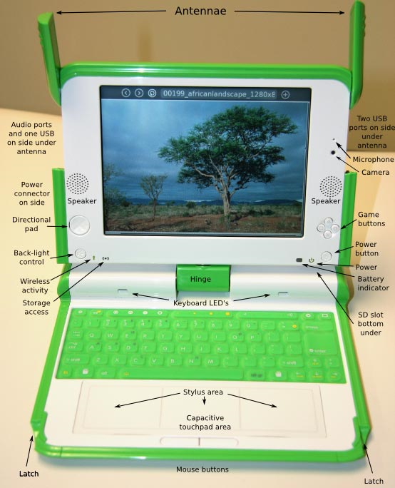
One Laptop Per Child
2006
http://one.laptop.org/

Slide 4
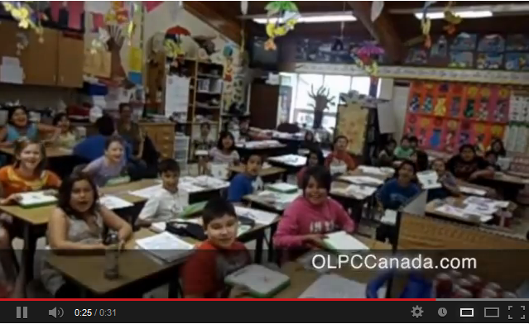
OLPC Canada Promo
http://www.olpccanada.com/

Slide 5

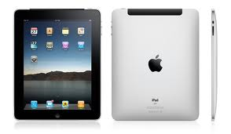
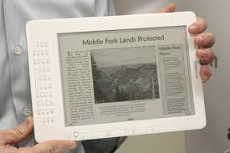
“That's 40,000 books already delivered...”
2016?
http://www.downes.ca/post/55228

Slide 6
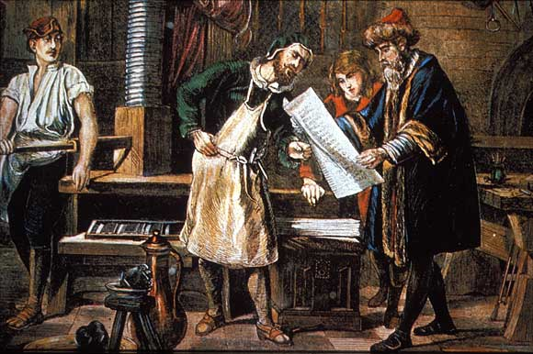
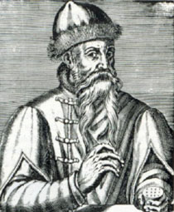
“A spring of truth shall flow from it”
"It is a press, certainly, but a press from which shall flow in inexhaustible streams...Through it, God will spread His Word. A spring of truth shall flow from it: like a new star it shall scatter the darkness of ignorance, and cause a light heretofore unknown to shine amongst men"
http://www.gutenberg.org/

Slide 7
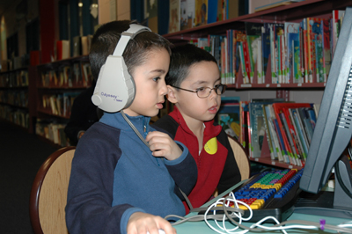

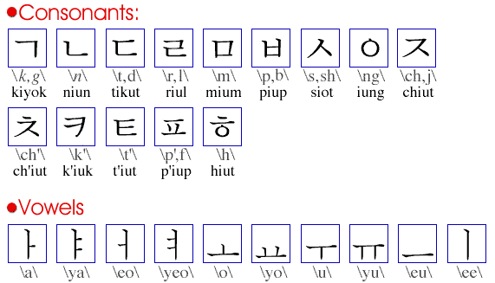
Language, literacy, libraries
Revai Meeks, 6, and Easton Meeks, 3, read with their mother Erika Lee at the Belleville Public Library Jan. 20, 2011
Brampton Library tested an Early Literacy Workstation at its South Fletcher's Branch for a two-week period earlier this month. 2007
http://www.thebramptonnews.com/articles/1524/1/Early-Literacy-Workstation-Fun-for-Kids/Page1.html
http://www.qnetnews.ca/?p=5159

Slide 8
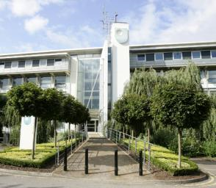
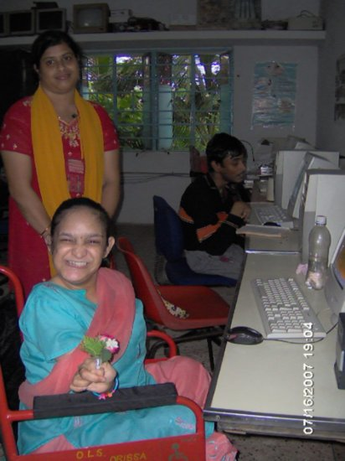
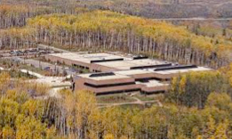
The Idea of Open Learning...
http://www.open.ac.uk/
http://www.open.edu.au/
इंदिरा गाँधी राष्ट्रीय मुक्त विश्वविद्यालय
http://www.ignou.ac.in/
http://www.athabascau.ca/

Slide 9

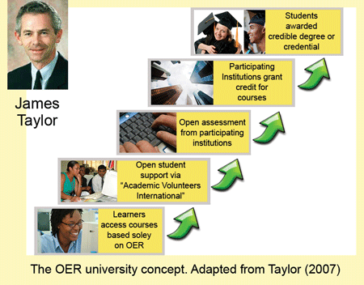
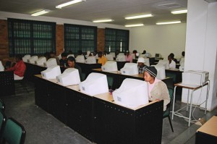
Phases of Openness?
http://www.col.org/blog/Lists/Posts/Post.aspx?ID=134
http://www.col.org/blog/Lists/Posts/Post.aspx?ID=130

Slide 10
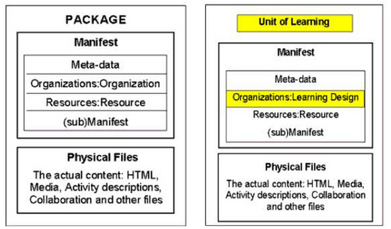
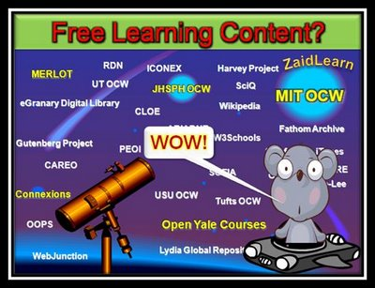
Open Educational Resources
Phase 1
http://zaidlearn.blogspot.com/2008/06/university-learning-ocw-oer-free.html
http://www.imsglobal.org/metadata/
http://ltsc.ieee.org/wg12/files/LOM_1484_12_1_v1_Final_Draft.pdf
http://creativecommons.org/

Slide 11
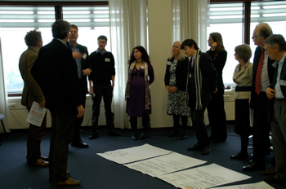
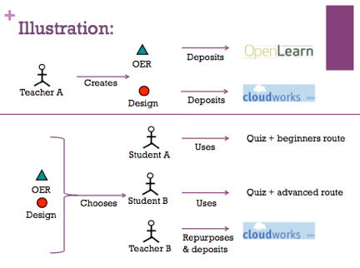
Learning Design & Open Practices
Phase 2
http://www.educause.edu/Resources/BeyondOERShiftingFocustoOpenEd/224619
http://opal.innovationpros.net/news/launch-of-tools-to-enable-open-educational-practices/
...the Open Educational Practices movement, developed by Germany's Ulf-Daniel Ehlers and the UK's Gráinne Conole...
http://e4innovation.com/?p=373

Slide 12
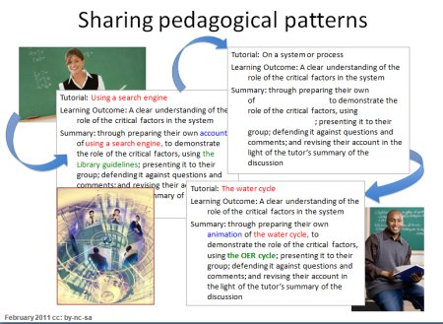
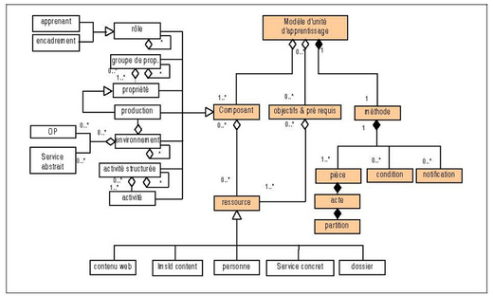
Learning Design & Patterns
http://repository.alt.ac.uk/883/
http://www.imsglobal.org/learningdesign/

Slide 13
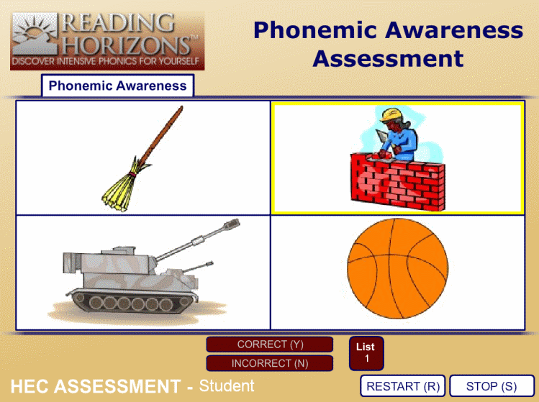
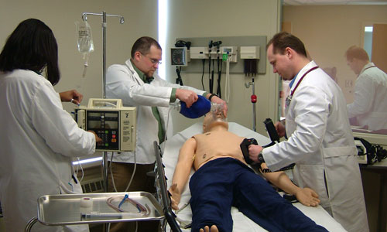
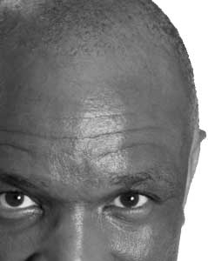
Open Assessment?
Phase 3
http://www.brainbench.com/
http://www.aspirationtech.org/events/p2pu/openassessment/2010

Slide 14
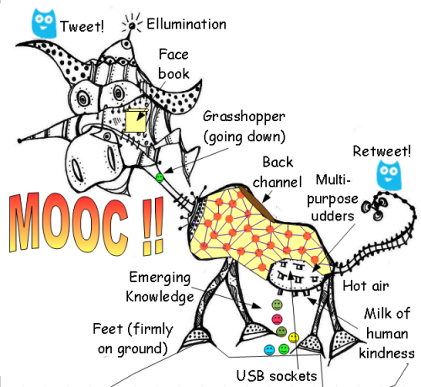
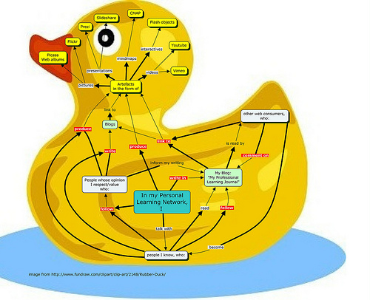
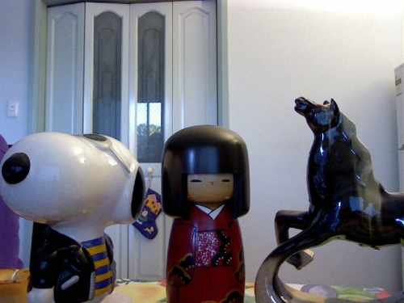
The MOOC...
http://www.mooc.ca
http://cck11.mooc.ca
http://suifaijohnmak.wordpress.com/2011/03/10/cck11-how-to-explain-connectivism-mooc-and-plepln/

Slide 15
What are MOOCs
Massive – by design
Open – gratis and libre
Online – vs. blended and wrapped
Courses – vs. communities, websites, video collections, etc
http://mooc.ca

Slide 16
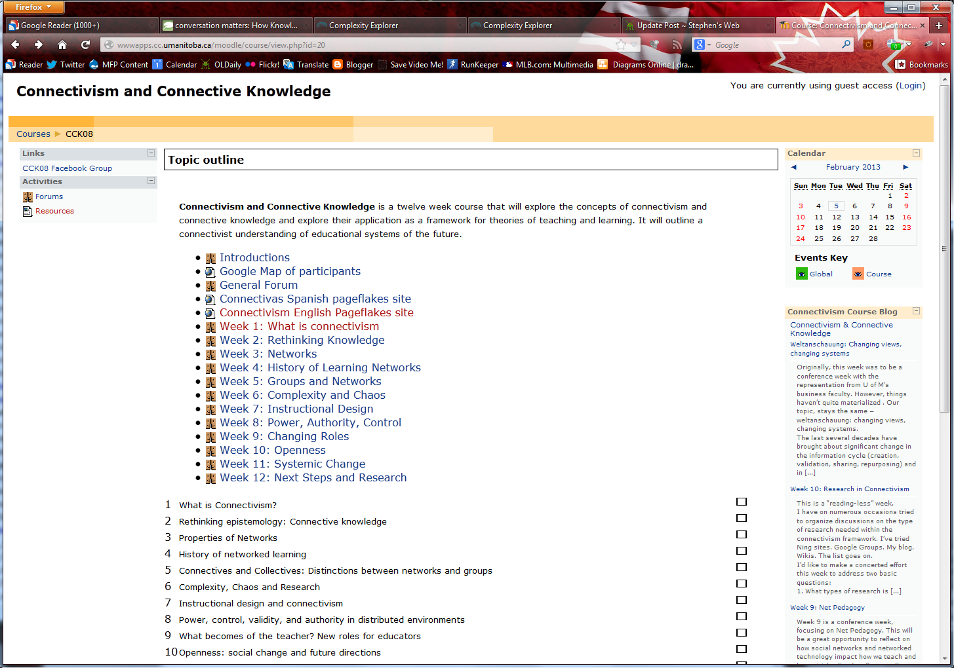
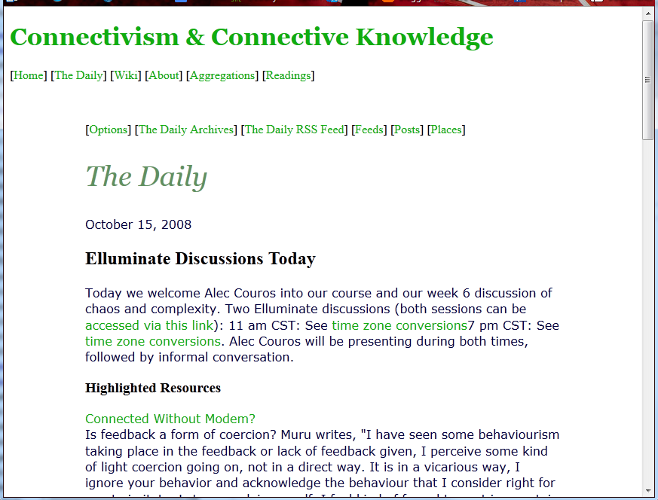
CCK08
2300 students
http://wwwapps.cc.umanitoba.ca/moodle/course/view.php?id=20
http://connect.downes.ca/cgi-bin/archive.cgi?page=thedaily.htm

Slide 17
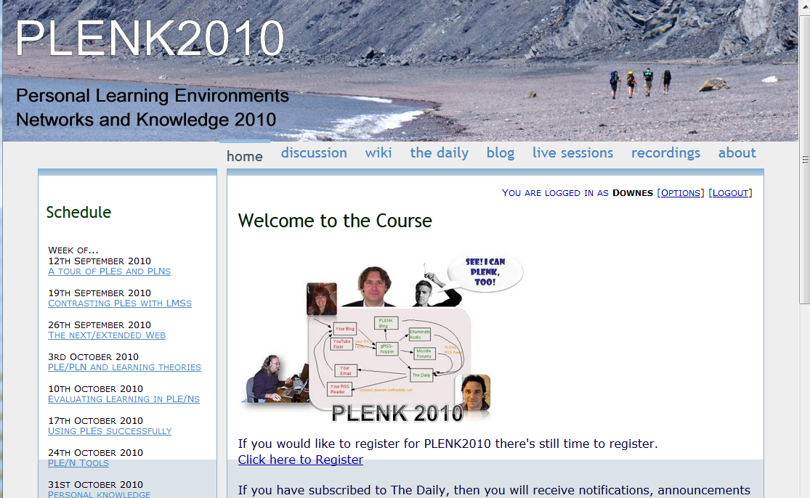
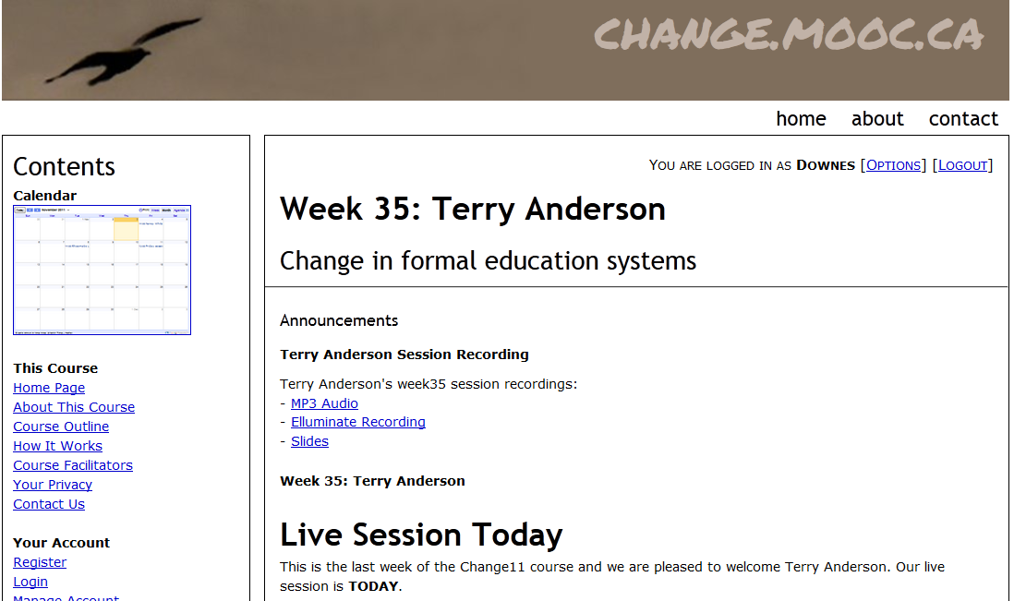

Other Courses
1800 students
http://connect.downes.ca/
2800 students
3000 students
http://change.mooc.ca/
http://edfuture.net/

Slide 18
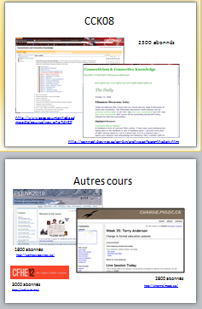

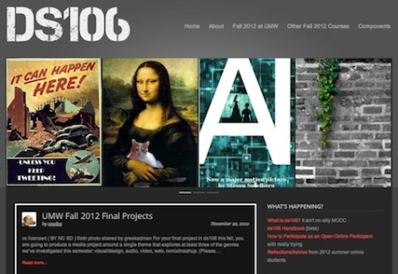
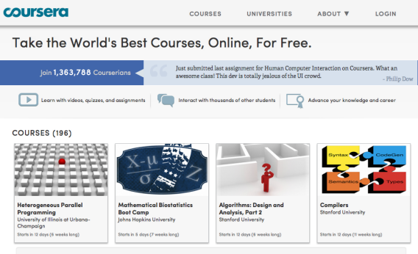

cMOOC vs xMOOC
networks
tasks
contents
https://www.ai-class.com/
http://ds106.us/history/
https://www.coursera.org/
http://lisahistory.net/wordpress/2012/08/three-kinds-of-moocs/

Slide 19
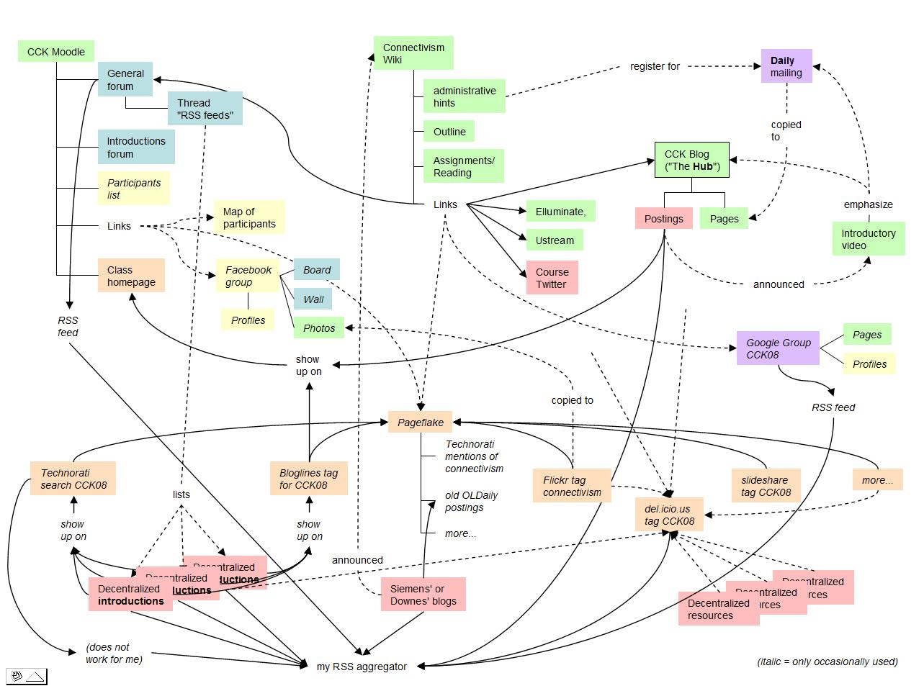
Connectivist MOOCs
http://x28newblog.blog.uni-heidelberg.de/2008/09/06/cck08-first-impressions/

Slide 20
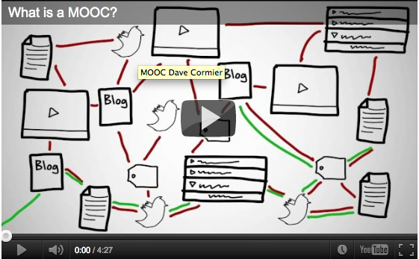
How to Learn in a cMOOC
A process of immersion into a knowing community
http://www.tonybates.ca/2012/03/03/more-reflections-on-moocs-and-mitx/

Slide 21
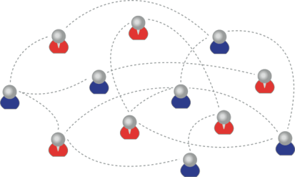
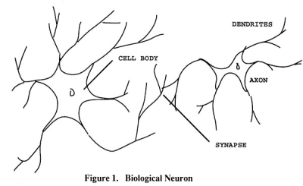
How to Create a cMOOC
It’s like creating a network
Don’t centralize
Concentrate on the creation of links
We use social networks...
… to create personal knowledge

Slide 22

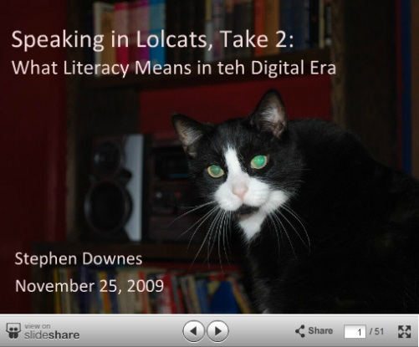
Why Open Educational Resources?
Learning activities are essentially conversations
OERs are the words used in those conversations
http://www.downes.ca/presentation/233

Slide 23
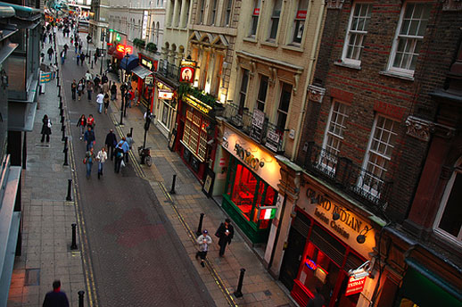
Success Factors
What sort of decentralized network will best support learning-as-growth?

Slide 24
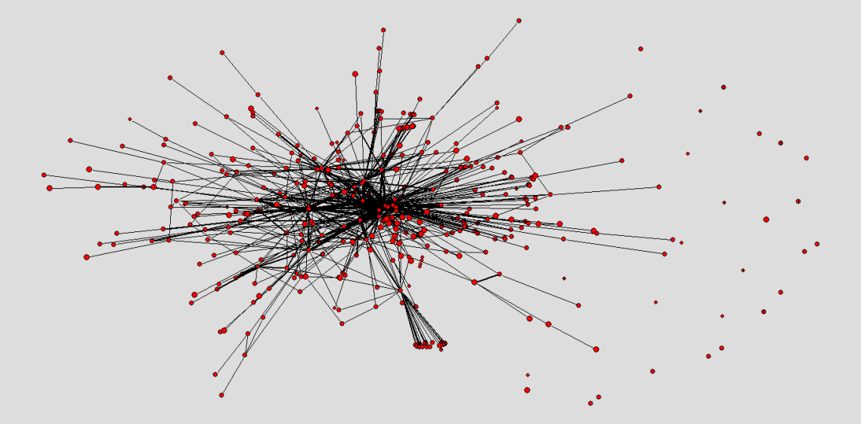
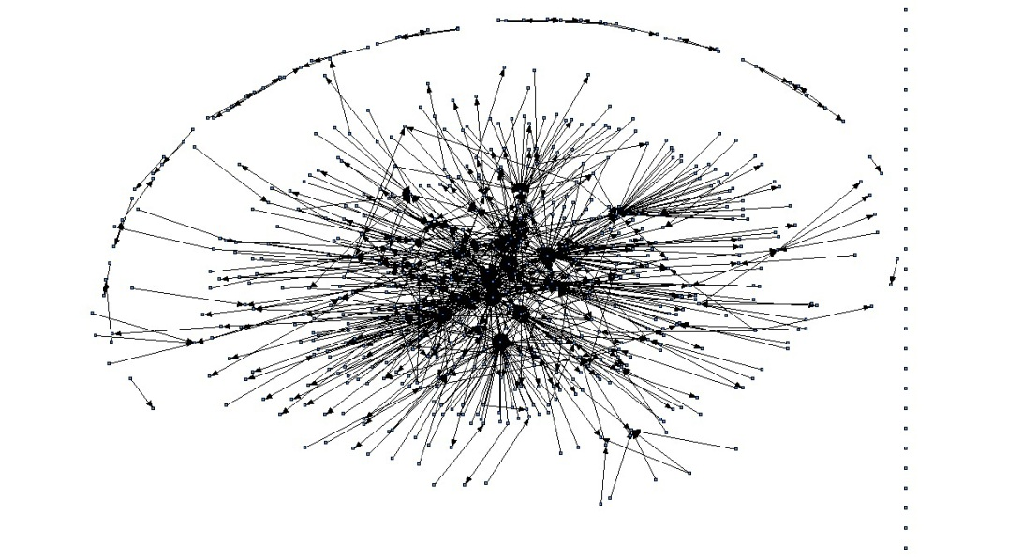
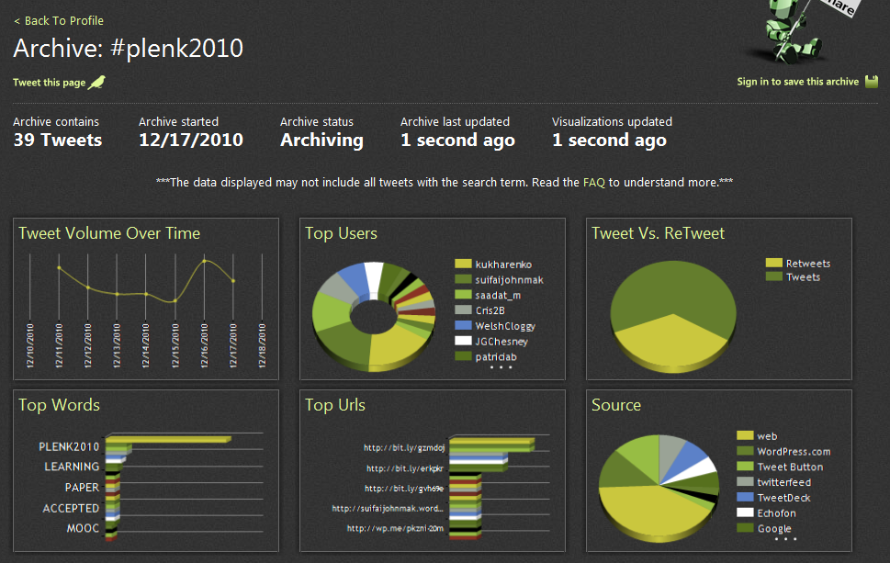
The Semantic Condition
Autonomy, diversity, openness, interactivity
These conditions are the conditions for a constructive dialogue…
And are thus the design principles for a MOOC
http://itforum.coe.uga.edu/paper92/paper92.html

Slide 25
How to Evaluate Learning
Learning is not possession of a collection of facts, it’s the expression of a capacity
Learning is recognized by a community of experts in a network
Learning analytics
We recognize our understandings…
…by the way we use them in our social network

Slide 26
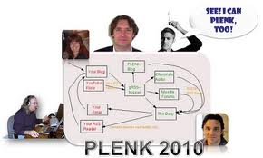

Aggregated Conversations

Slide 27
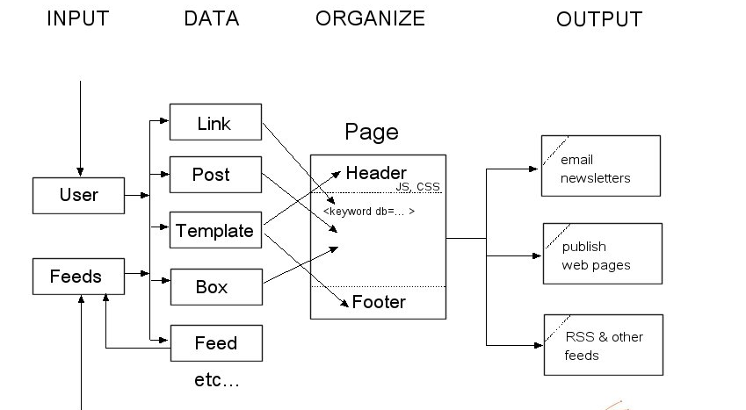
gRSShopper
http://grsshopper.downes.ca

Slide 28
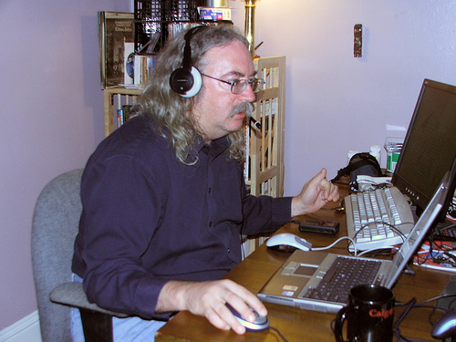
http://www.downes.ca

